Slide 1

Exploring teachers’ adaptive expertise in education: A scoping review methodology
Lihua Xu, Kennedy Chan, Amanda Berry, Joe Ferguson, Gahyoung Kim, Jan van Driel, Colleen Vale, and Wanty Widjaja

Slide 2
ARC DP Project: Primary teachers’ adaptive expertise in interdisciplinary mathematics and science
Project team:
Chief Investigators:
Prof. Amanda Berry
Prof. Colleen Vale
Prof. Jan van Driel
A/Prof. Wanty Widjaja
Dr. Lihua Xu
Research Fellows:
Dr. Joe Ferguson
Dr. Gahyoung Kim
International Advisory Board:
Dr. Kennedy Chan
Prof. Russell Tytler
Emeritus Prof. Peter Sullivan
Prof. Tamara Moore
A/Prof. Karen Könings
Project aims: To improve theoretical and practical understanding of the nature and development of teachers’ adaptive expertise in interdisciplinary mathematics and science in primary education.
Key research questions:
1. How can primary teachers’ adaptive expertise in interdisciplinary mathematics and science be characterised in terms of components (i.e., flexibility, deeper level of understanding, and deliberate practice) and levels?
2. To what extent, and how, does primary teachers’ adaptive expertise change and develop during a trajectory across three school years aimed at interdisciplinary mathematics and science in a co-plan, co-teach and co-reflect approach?

Slide 3
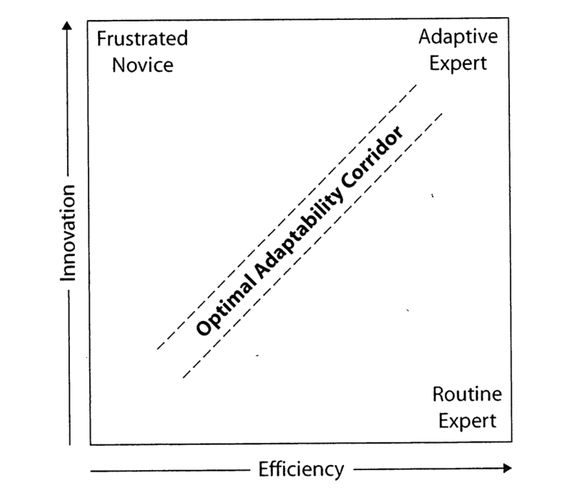
Defining adaptive expertise
Adaptive experts are “those who not only perform procedural skills efficiently but also understand the meaning of the skills and nature of their object.” (Hatano & Inagaki, 1984, p. 28)
Bereiter and Scardamalia (1993) distinguished between crystallized and ﬂuid expertise:
  Crystallized (routine) expertise consists of intact procedures that have been thoroughly learned through experience, brought forth and used in relatively familiar tasks.
  Fluid (adaptive) experts appear to learn throughout their careers, bringing the expertise they possess to bear on new problems, and ﬁnding ways to tie the new situations they encounter to the knowledge base they have.
The trajectory towards adaptive expertise balances efficiency and innovation via the optimal adaptability corridor (Schwartz, D. L., Bransford, J. D., & Sears, D. , 2005).
Notes:
Schwartz, D. L., Bransford, J. D., & Sears, D. (2005). Efficiency and innovation in transfer. Transfer of learning from a modern multidisciplinary perspective, 3, 1-51.

Slide 4
Research synthesis methods and methodologies
The purpose of research synthesis is to ‘produce new knowledge by making explicit connections and tensions between individual study reports that were not visible before’ (Suri, 2011, p.63).
Statistical research syntheses: emphasize statistical integration of primary research reports, such as meta-analysis and best-evidence synthesis (Suri and Clarke, 2009).
Systematic reviews: emphasize a priori protocols, comprehensive searches, transparency to reduce biases, and the involvement of stakeholders in the review process (Suri and Clarke, 2009).
Scoping reviews: map the literature on a particular topic or research area and provide an opportunity to identify key concepts; gaps in the research; and types and sources of evidence to inform practice, policymaking, and research (Daudt et al., 2013).
Rapid reviews: more streamlined systematic approach to synthesise high quality secondary evidence in a shorter timeframe than full systematic reviews. Essentially, it is a review of reviews (Garrity et al., 2020).
Notes:
Rapid: More often used in reviews of health and medical research
Garritty, C., et al., 2020. Cochrane Rapid Reviews. Interim Guidance from the Cochrane Rapid Reviews Methods Group. Available from: https://methods.cochrane.org/rapidreviews/sites/methods.cochrane.org.rapidreviews/ files/public/uploads/cochrane_rr_-_guidance-23mar2020-final.pdf [16 February 2021].
Daudt HM, van Mossel C, Scott SJ. 2013. Enhancing the scoping study methodology: a large, inter-professional team’s experience with Arksey and O’Malley’s framework. BMC Medical Research Methodology 13: 48. DOI: 10.1186/1471-2288-13-48.

Slide 5
Systematic reviews
Scoping Reviews
Seek to find, critique and synthesise all available evidence for a focused question to determine the effectiveness of interventions or to prepare for a meta-analysis.
Support decision-making and development of best practice, and may make recommendations for further research.
Are exhaustive, transparent, and must be reproducible to enable updating and verification.
Purposes of a systematic reviews(Munn, et al., 2018):
      Uncover the international evidence
      Confirm current practice/address any variation/identify new practices
      Evaluate quality of the literature
      Identify and inform areas for future research
      Identify and investigate conflicting results
      Produce statements to guide decision-making
Tend to be broader in scope than systematic reviews, and seek to explore and map overall themes and gaps in the available research literature on a broad topic.
May be used to scope further research and determine the possible usefulness of a future systematic review.
Searching is systematic and transparent, with criteria modified as review proceeds.
Purposes of a scoping review (Munn et al., 2018):
      To identify the types of available evidence in a given field
      To clarify key concepts/definitions in the literature
      To examine how research is conducted on a certain topic or field
      To identify key characteristics or factors related to a concept
      As a precursor to a systematic review
      To identify and analyse knowledge gaps
Notes:
Similar in both scale and rigor; both of these literature review methodologies are comprehensive approaches to reviewing the literature on a topic (Hanneke et al., 2017).
Rating of quality (evidence …) in systematic reviews

Slide 6
Scoping Reviews
The stages involved in a scoping review (Arksey & O’Malley, 2005):
Identifying the research question
Identifying relevant studies
Study selection
Charting the data (=data extraction in systematic review)
Collating, summarizing and reporting the results
Consultation exercise (optional)
Notes:
Aksey and O’Malley, comparing the two reviewing methodologies

Slide 7
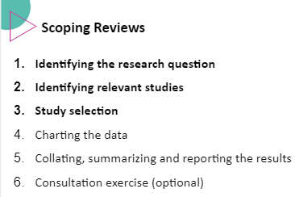
Methodological decision making
STEP1. Identifying research questions and purposes
STEP2. Organising the reviewing process
STEP3. Identifying key search terms and search strategies
STEP4. Deciding on the inclusion and exclusion criteria
STEP5. Screening titles and abstracts for study inclusion
STEP6. Reviewing full texts
STEP7. Charting the data (Extracting)
STEP8. Summarizing and reporting the results

Slide 8
STEP1. Identifying research questions and purposes
Purpose of the scoping review:
Initial research questions:
Examine the types of available evidence
Clarify key concepts and characteristics associated with the construct of adaptive expertise
Identify research gaps in the existing literature
How is AE conceptualised, developed, and measured in the context of education?
Which aspect of AE is domain specific and which aspect is domain general?
What implications can we draw from this review to inform our understanding of teacher AE in interdisciplinary science and mathematics?

Slide 9
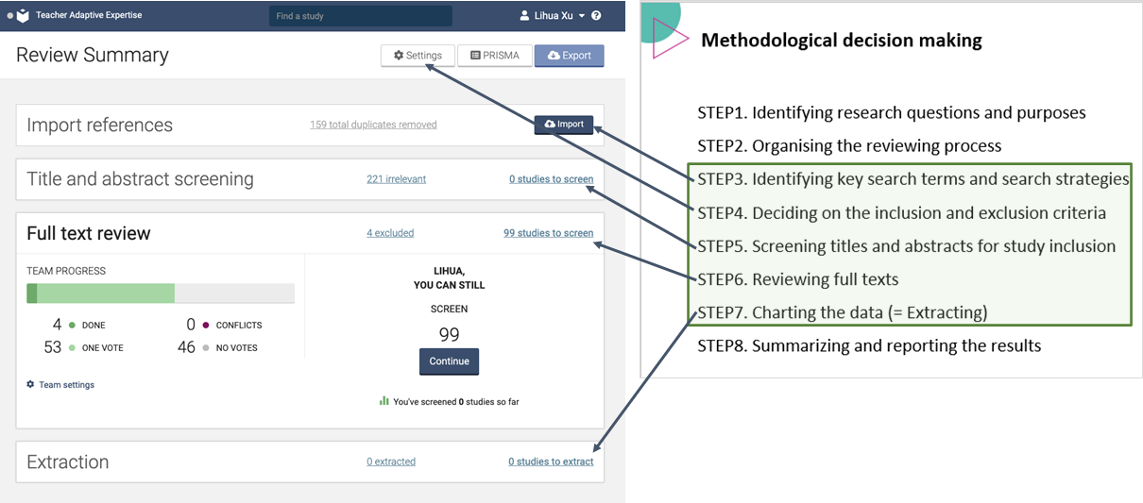
STEP2. Organising the reviewing process (Covidence: app.covidence.org)

Slide 10
STEP3. Identifying key search terms and search strategies
Key search terms
  ‘adaptive expertise’
  ‘adaptive teaching’
  ‘adaptability’
  ‘adaptive performance’
  ‘reflective expertise’
Systemic database searches
  Scopus
  Web of Science
  ERIC
485 studies imported for screening
159 duplicates removed
324 studies screened
PRISMA diagram - STEP2. Identifying

Slide 11
STEP4. Deciding on the inclusion and exclusion criteria
Criterion | Inclusion | Exclusion
1. Source | Peer-reviewed journals | Conference papers/proceedings, book chapters, non-peer-reviewed journals
2. Language | English | Non-English
3. Type of publication | Empirical research | Literature reviews, editorials, position papers or commentaries
4. Research focus | Adaptive expertise is a substantial focus Adaptive teaching is clearly conceptualised and operationalised | Adaptive expertise is only mentioned in passing Adaptive systems Adaptive teaching is mentioned but without clear conceptualisation
5. Subject domain | All | All
6. Participants | Pre-service and in-service teachers Teachers of all levels (e.g schools, university) and fields (e.g. medical, engineering) | School and university students

Slide 12
STEP5. Screening titles and abstracts for study inclusion
Reviewer A | Reviewer B | Agreement | Dis- agreement | Proportionate Agreement
Reviewer 1 | Reviewer 2 | 19 | 5 | 79.2%
Reviewer 3 | Reviewer 4 | 98 | 29 | 77.2%
Reviewer 4 | Reviewer 2 | 66 | 11 | 85.7%
Reviewer 4 | Reviewer 1 | 15 | 2 | 88.2%
Reviewer 3 | Reviewer 1 | 29 | 11 | 72.5%
Reviewer 3 | Reviewer 2 | 26 | 12 | 68.4%
485 studies imported for screening
159 duplicates removed
324 studies screened
221 studies irrelevant
103 studies screened
PRISMA diagram - STEP5. Screening

Slide 13
Discussion points
Purposeful sampling rather than comprehensive synthesis of evidence
  How is the construct ‘adaptive expertise’ used, in what literature, by whom and for what purpose?
Balance between breadth and comprehensiveness
  Ongoing refinement of research questions and clarification of purposes.
Iterative rather than linear processes
  Study selection: literature search, refining search strategies, reviewing articles, and revising criteria.
Division of labour amongst reviewers
  independent reviewing, team discussion, and resolving conflict

