Slide 1
Stakeholder Influences on the Relationships
Between ESG Governance, Reporting and
Profitability in the Global Automotive
Industry Supply Chain
Dr. Shirley J Daniel, University of Hawaii at Manoa, USA
Dr. Ting-Tsen Yeh, Louisiana State University in Shreveport, USA
Dr. Yuanzhang Xiao, University of Hawaii at Manoa, USA

Slide 2
Agenda
Introduction
Motivation
Prior Literature
Theoretical Framework
Research Questions
Variables
Auto industry Data
Models
Results
Conclusion

Slide 3
Introduction
Increasing public/political pressure on social justice, income inequality, diversity, labor rights
Increasing focus on climate change causing to natural disasters and sea level rise in critical coastal areas
Increased regulatory focus on ESG
    European Green Deal, EFRAG
    SASB industry ESG reporting guidelines
    SEC increased focus in climate and human capital disclosures in 10Ks.
Investor and creditor focus on risks and opportunities from ESG
    Tesla market cap higher than other auto firms while volumes less than 5% of market
    Janet Yellen mentioned need for capital providers to consider climate change in their portfolio decisions

Slide 4
Motivation
Good governance requires comprehensive risk assessment by the Board
  Supplier chain integration necessary for systemic improvements
  Customer demands for better ESG, and need for meaningful measures to drive process improvements along the value chain
  Reputational risk exposure from suppliers
Much skepticism and lack of consistency about ESG metrics
  Greenwashing
  Proliferation of private rating firm scores
  Need for rigorous interdisciplinary research to address these issues
Investors and Stakeholders demanding responsible corporate behavior and transparency.

Slide 5
Prior Literature
Research on sustainable practice adoption in global supply chains (Kano, Tsang, & Yeung, 2020).
Stakeholder theory (Freeman & Dmytriyev, 2017; Freudenreich, Lüdeke-Freund, & Schaltegger, 2020)
Open Strategy (Hautz, Seidl, & Whittington, 2017; Stadler, Hautz, & von den Eichen, 2020).

Slide 6
Prior Literature
Effect of disclosure regulation on supply chain (She, 2021)
Effect of stakeholders on managerial decisions:
  Reputation building (Chakravarthy, deHaan, & Rajgopal, 2014)
  Early adoption of corporate responsibility reporting (Bhimani, Silvola, & Sivabalan, 2016)
  Development of sustainability reporting control system (Herremans and Nazari, 2016)
Sustainability performance and financial performance (Lu and Taylor, 2016)

Slide 7
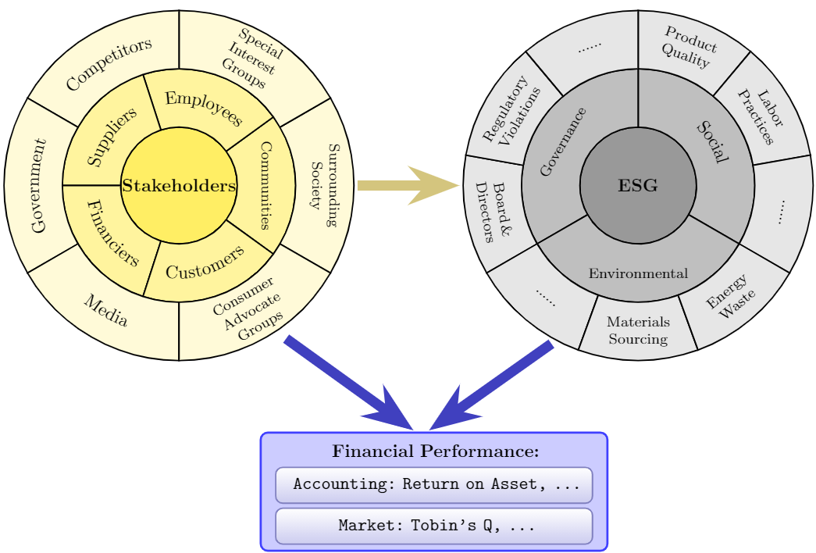
Theoretical Framework

Slide 8
Research Questions
Question 1: How do stakeholder related policies of OEMs and their suppliers influence ESG practices and outcomes along the automotive supply chain?
Question 2: How do stakeholder related policies of OEMs and their suppliers influence firm financial performance along the automotive supply chain?

Slide 9
Auto Industry Data
Eleven OEMs that account for 80% of the world auto market: Ford, GM, BMW, Daimler, Volkswagen, Renault, Stellantis, Honda, Nissan, Toyota and Hyundai.
Using the Bloomberg Supply Chain function, we identify the top 12 to 15 tier one suppliers for each OEM, and in turn the top 15 tier two suppliers for each of the tier one suppliers
Linked data set of 751 firms, consisting of the 11 OEMs, 83 tier one suppliers and 657 tier two suppliers
ESG scores from Refinitiv
Financial data from DataStream/Worldscope

Slide 10
Performance variables
ESG Performance | Measure | Source
OVERALL_SCORE | ESG overall scores reported by Refinitiv | Refinitiv
ENV_SCORE | Environmental scores reported by Refinitiv | Refinitiv
SOC_SCORE | Social scores reported by Refinitiv | Refinitiv
GOV_SCORE | Corporate governance score reported by Refinitiv | Refinitiv
Financial Performance | Measure | Source
ROA | Return on assets calculated by net income (item 7220) divided by total assets (item 7230) | Datastream/Worldscope
EBIT/sale | Earnings before income taxes to sales ratio calculated by earnings before income taxes (item 18191) divided by sales (item 1001) | Datastream/Worldscope
Q | Tobin’s q calculated by total assets (item7230) plus market capitalization (item 7210) minus book value of equity (item 7220) divided by total assets (item 7230) | Datastream/Worldscope
Economy Variable | Measure | Source
Emerging | 1 if firms’ origins are the emerging economies; 0 otherwise. | United Nations Conference on Trade and Development (UNCTAD)

Slide 11
Stakeholder variables
Variable | Measure | Source
InCO2emission | Natural logarithm of CO2 equivalents emissions (EN_EN_ER_DP023) | Refinitiv
renewableenergyuse | Does the company make use of renewable energy? (EN_EN_RR_DP046) | Refinitiv
productrecall | Has the company announced a mass recall of products or has completely withdrawn a product due to defects or safety reasons? (SO_CU_PR_DP060) | Refinitiv
policycustomerhealth | Does the company have a policy to protect customer health & safety? (SO_CU_PR_DP012_1) | Refinitiv
avoidchildlabor | Does the company have a policy to avoid the use of child labor? (SO_SO_HR_DP010_2) | Refinitiv
corporaterespaward | Has the company received an award for its social, ethical, community, or environmental activities or performance? (SO_SO_CO_DP074) | Refinitiv
endhumanrightsupplier | Does the company report or show to be ready to end a partnership with a sourcing partner if human rights criteria are not met? (SO_SO_HR_DP029) | Refinitiv
flexibleworkingscheme | Does the company provide flexible working schemes? (SO_WO_DO_DP026) | Refinitiv
partnerwithNGO | Does the company report on partnerships or initiatives with specialized NGOs, industry organizations, governmental or supra-governmental organizations, which are focused on improving environmental issues? (EN_EN_ER_DP070) | Refinitiv
strike | Has there has been a strike or an industrial dispute that led to lost working days? (SO_WO_EQ_DP037) | Refinitiv
Greenfund | 1 if firms are included in one of the top 10 ESG funds; 0 otherwise. | Refinitiv
AIAG | 1 if firms are the members of Automotive Industry Action Group (AIAG); 0 otherwise. | Automotive Industry Action Group

Slide 12



EU OEMs and Tier 1 suppliers
BMW
Daimler
VW
Renault
Stellantis
node size: proportional to sales
node shape: circles are OEMs, squares are Tier 1 suppliers
node color: blue for European, red for North American, yellow for Asian
node color intensity: darker for higher ESG scores, lighter for lower ESG scores
distance between OEM and Tier 1: shorter for high percentage of revenue from OEM

Slide 13



Asian OEMs and tier 1 suppliers
Honda
Nissan
Toyota
Hyundai
node size: proportional to sales
node shape: circles are OEMs, squares are Tier 1 suppliers
node color: blue for European, red for North American, yellow for Asian
node color intensity: darker for higher ESG scores, lighter for lower ESG scores
distance between OEM and Tier 1: shorter for high percentage of revenue from OEM

Slide 14


North American OEMs and tier 1 suppliers
Ford
GM
node size: proportional to sales
node shape: circles are OEMs, squares are Tier 1 suppliers
node color: blue for European, red for North American, yellow for Asian
node color intensity: darker for higher ESG scores, lighter for lower ESG scores
distance between OEM and Tier 1: shorter for high percentage of revenue from OEM

Slide 15
Sample Characteristics
Panel A. Europe (N is the number of firm-year data samples from 2010 to 2020)
 | OEM (n= 55) |  |  | Tier 1 (n = 279) |  |  | Tier 2 (n = 1, 666)
Variable | Mean | Median |  | Mean | Median |  | Mean | Median
Total Assets (in millions) | 222,640 | 184,831 |  | 24,507 | 14,558 |  | 24,015 | 10,354
EBIT/Sale | 0.07 | 0.07 |  | 0.08 | 0.07 |  | 0.12 | 0.08
ESG Score | 0.90 | 0.93 |  | 0.79 | 0.84 |  | 0.76 | 0.84
ENV Score | 0.94 | 0.94 |  | 0.84 | 0.93 |  | 0.77 | 0.90
SOC Score | 0.90 | 0.92 |  | 0.79 | 0.87 |  | 0.74 | 0.84
GOV Score | 0.66 | 0.73 |  | 0.52 | 0.55 |  | 0.58 | 0.68
Panel B. Asia (N is the number of firm-year data samples from 2010 to 2020)
 | OEM (n = 44) |  |  | Tier 1 (n = 315) |  |  | Tier 2 (n = 1, 485)
Variable | Mean | Median |  | Mean | Median |  | Mean | Median
Total Assets (in millions) | 212,870 | 160,331 |  | 28,441 | 16,717 |  | 27,067 | 11,959
EBIT/Sale | 0.06 | 0.06 |  | 0.07 | 0.06 |  | 0.10 | 0.07
ESG Score | 0.76 | 0.79 |  | 0.65 | 0.72 |  | 0.74 | 0.81
ENV Score | 0.93 | 0.94 |  | 0.82 | 0.93 |  | 0.81 | 0.91
SOC Score | 0.84 | 0.85 |  | 0.71 | 0.81 |  | 0.76 | 0.86
GOV Score | 0.22 | 0.17 |  | 0.21 | 0.11 |  | 0.43 | 0.30
Panel C. U.S. (N is the number of firm-year data samples from 2010 to 2020)
 | OEM (n = 22) |  |  | Tier 1 (n = 179) |  |  | Tier 2 (n = 953)
Variable | Mean | Median |  | Mean | Median |  | Mean | Median
Total Assets (in millions) | 190,382 | 189,612 |  | 14,506 | 11,221 |  | 19,622 | 8,882
EBIT/Sale | 0.06 | 0.07 |  | 0.09 | 0.07 |  | 0.14 | 0.09
ESG Score | 0.86 | 0.91 |  | 0.75 | 0.81 |  | 0.74 | 0.81
ENV Score | 0.92 | 0.93 |  | 0.80 | 0.92 |  | 0.75 | 0.90
SOC Score | 0.74 | 0.79 |  | 0.70 | 0.80 |  | 0.72 | 0.82
GOV Score | 0.82 | 0.83 |  | 0.55 | 0.63 |  | 0.58 | 0.68

Slide 16
Regression models – Research Question 1
Variables | OVERALL_SCORE | ENV_SCORE | SOC_SCORE | GOV_SCOE
 | Coefficient
Intercept | 0.204 | 0.409*** | 0.140 | 0.338
Emerging | -0.053*** | -0.010 | 0.007 | -0.213***
InCO2emission | 0.003 | -0.001 | 0.001 | -0.003
renewableenergyuse | 0.067*** | 0.075*** | 0.070*** | 0.013
productrecall | -0.042** | -0.008 | -0.060*** | -0.054
policycustomerhealth | 0.023 | 0.038*** | 0.061*** | -0.081***
avoidchildlabor | 0.068*** | 0.017* | 0.063*** | 0.073***
corporaterespaward | 0.052*** | 0.050*** | 0.051*** | 0.044*
endhumanrightsupplier | 0.056*** | 0.005 | 0.036*** | 0.175***
flexibleworkingscheme | 0.008 | 0.039*** | 0.058*** | -0.132***
partnerwithNGO | 0.052*** | 0.034*** | 0.060*** | 0.074***
strike | 0.003 | -0.035*** | -0.049*** | 0.117***
Greenfund | 0.053*** | -0.007 | -0.003 | 0.245***
AIAG | -0.006 | 0.022* | -0.010 | -0.045
Controls | Yes | Yes | Yes | Yes
Adjusted R² | 0.354 | 0.299 | 0.351 | 0.422
n | 1991 | 1991 | 1991 | 1991

Slide 17
How do stakeholder policies impact ESG scores?
Our results indicate that firms from emerging markets have lower overall ESG scores, driven primarily by their lower governance scores.
Significant impacts on ESG overall scores are from
  positive renewable energy use
  avoiding child labor
  policies to end supplier relationships if they have human rights violations and
  the firm having corporate responsibility awards.
All elements of the ESG scores are positively impacted by partnering with an NGO.
The positive impact of being listed in a green fund comes mainly from the governance score.

Slide 18
How do stakeholder policies impact ESG scores?
Looking at the components of the ESG score it is interesting to note that often the environmental and social scores have a different sign than the governance scores.
For example, there is a negative impact on governance scores for having policies relating to customer health, while there is a positive impact on the environmental score and social score. Similarly, a flexible working scheme results in a negative impact on governance scores, but a positive impact on environmental and social scores. It seems these offsetting impacts result in the overall ESG score being not significant.

Slide 19
Regression models – Research Question 2
Variables | ROA | EBIT/Sale | Q
 | Coefficient
Intercept | 0.025 | -0.269 | 2.778***
Emerging | 0.011** | 0.014 | -0.162
InCO2emission | -0.001 | -0.012 | -0.109***
renewableenergyuse | -0.004 | 0.005 | 0.090
productrecall | 0.010 | -0.029* | -0.166**
policycustomerhealth | 0.007 | -0.026** | 0.025
avoidchildlabor | 0.003 | -0.009 | 0.077
corporaterespaward | 0.003 | -0.011 | 0.053
endhumanrightsupplier | 0.002 | -0.005 | 0.062
flexibleworkingscheme | -0.006 | 0.012 | -0.047
partnerwithNGO | -0.008* | 0.008 | 0.000
strike | -0.003 | 0.006 | -0.017
Greenfund | 0.014* | 0.032* | 0.656***
AIAG | -0.002 | -0.024*** | -0.121*
Controls | Yes | Yes | Yes
Adjusted R² | 0.245 | 0.188 | 0.339
n | 1991 | 1991 | 1991

Slide 20
How do stakeholder policies impact financial performance?
Firms from emerging markets have slightly higher return on assets
Firms that partner with NGO's have slightly lower returns on assets
EBIT is negatively impacted by product recalls, policies on customer health, and membership in the AIAG
EBIT is positively related to being in a green fund
Similarly, Tobin's Q is positively impacted by being in a green fund, and negatively impacted by CO2 emissions, being in AIAG, and having product recalls.

Slide 21
Conclusions, implications for governance, and future research
Contrary to some conventional wisdom, while OEM firms are larger than their suppliers, they are not necessarily more profitable. In fact, in some supply chains the Tier 2 suppliers are the most profitable.
There are significant relationships between Stakeholder variables and ESG practices and their suppliers OEM practices and profits. However, the economic magnitude of these relationships is not great.
There are significant relationships between Stakeholder variables and firm financial performance
ESG reporting and measurement along the supply chain is still evolving and would benefit from serious input by academics and the accounting profession
We are planning interviews with OEM and suppliers, as well as ESG consultants to expand our understanding of supply chain ESG management practices to supplement empirical analysis.

Slide 22
Questions and suggestions
Mahalo!

