Slide 1

In Search of a New Chicago School:
Revising the Theory Behind
Corporate Governance and Management Control
Douglas E. Stevens, Ph.D.
Professor and Copeland/Deloitte Chair School of Accountancy
Robinson College of Business
Georgia State University
2022 ICVG Conference: Governance in its Institutional Context and MAR Special Issue: Corporate Governance and Management Control
December 15, 2022
Summary of Presentation:
1. Introduction: Background and Methodology
2. Description and tombstone of the Chicago School
3. The Chicago School at the height of its influence
4. Early doubts after the dot-com crash in 2000
5. Michael Jensen’s change of heart in 2008
6. The current state of the search
7. Conclusion: How we failed Sam Bankman-Fried

Slide 2
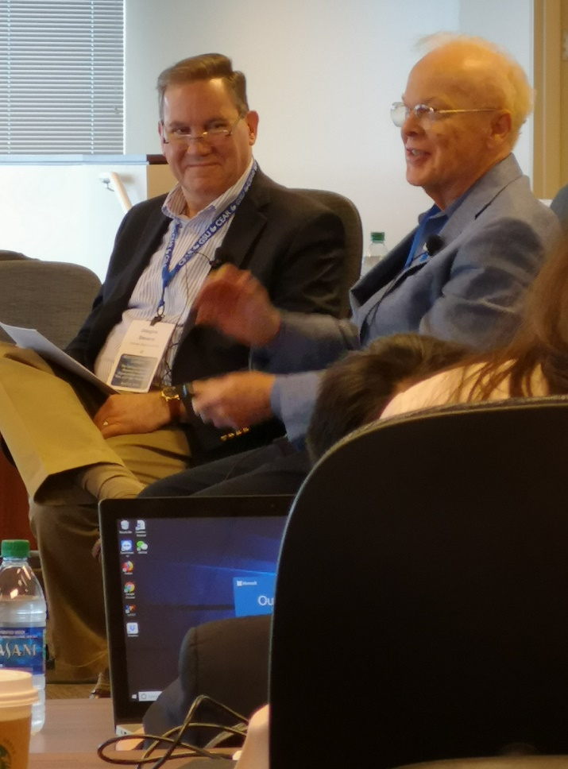
1. Introduction: Background and Methodology
In 2019, the Center for the Economic Analysis of Risk (CEAR) and the School of Accountancy (SOA) at GSU sponsored a conference to celebrate the 50-year anniversary of Ray Ball and Phil Brown’s 1968 seminal study in JAR.
Joint CEAR and SOA Conferences at GSU have brought together top researchers in accounting and economics to discuss extending the theory of the firm out of Chicago: Keynote speakers have included Shyam Sunder (2015), Paul Fischer (2017), and Greg Waymire (2019).
Ray Ball
CEAR/SOA Conference
April 5-6, 2019

Slide 3
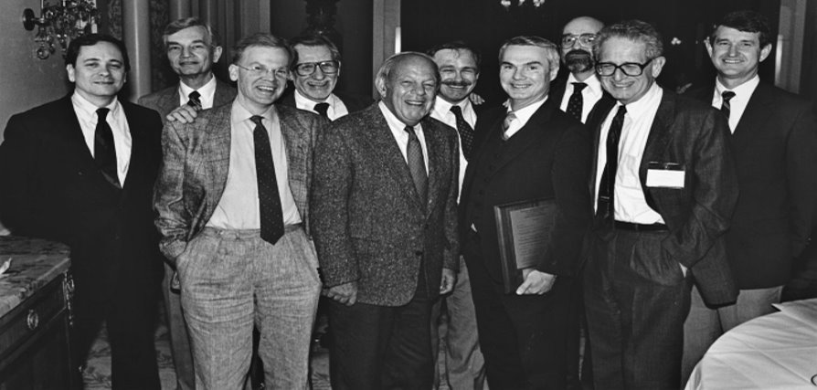
1. Introduction: Background and Methodology
Left to Right: Chicago GSB Dean Jack Gould, Chuck Horngren, Ray Ball, Nick Dopuch, Sidney Davidson, Ross Watts, Bill Beaver, Joel Demski, George Sorter, and Phil Brown. Picture taken at the JAR Conference Celebrating the 20th Anniversary of the publication of Ball and Brown (1968) and Beaver (1968). [Special thanks to Greg Waymire for providing this picture.]

Slide 4
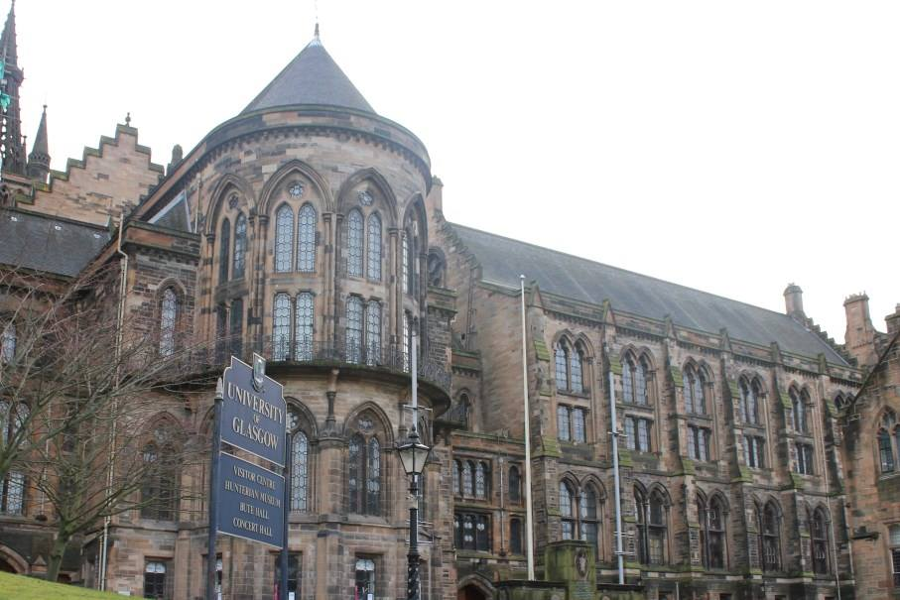


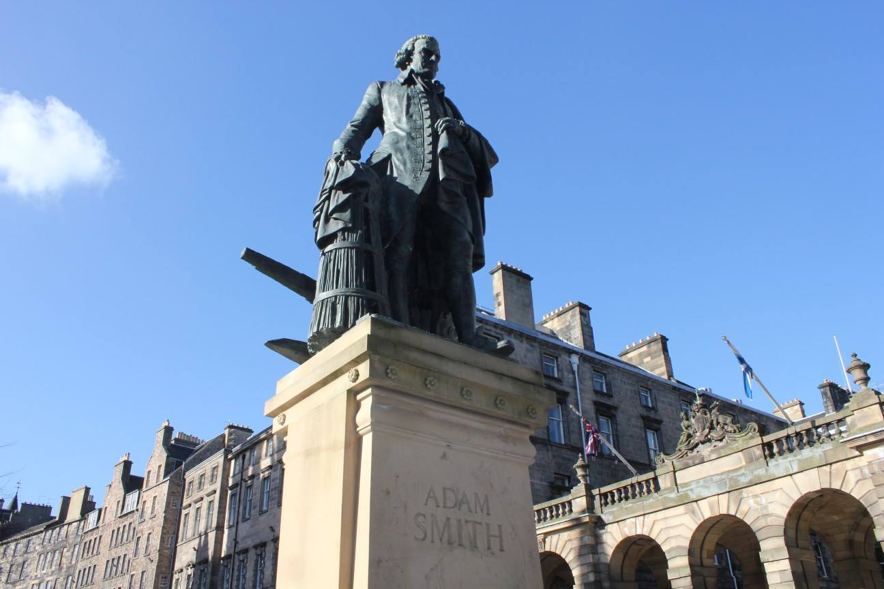
1. Introduction: Background and Methodology
My introduction to Adam Smith, Spring 2011

Slide 5
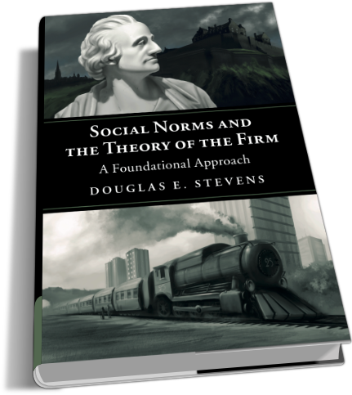
1. Introduction: Background and Methodology
My search to expand the theory of the firm out of Chicago led me to write my first book (Stevens 2019):

Slide 6
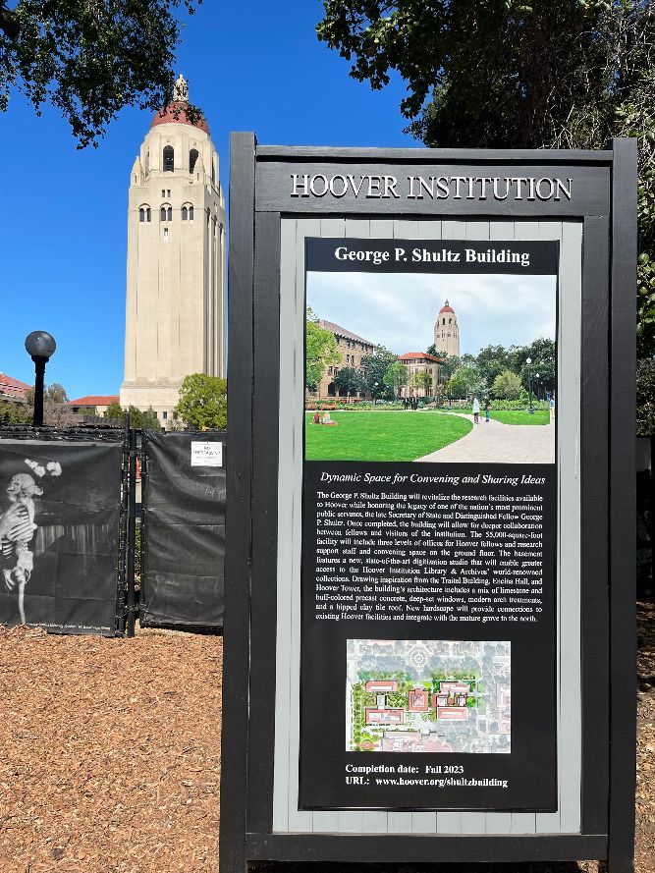
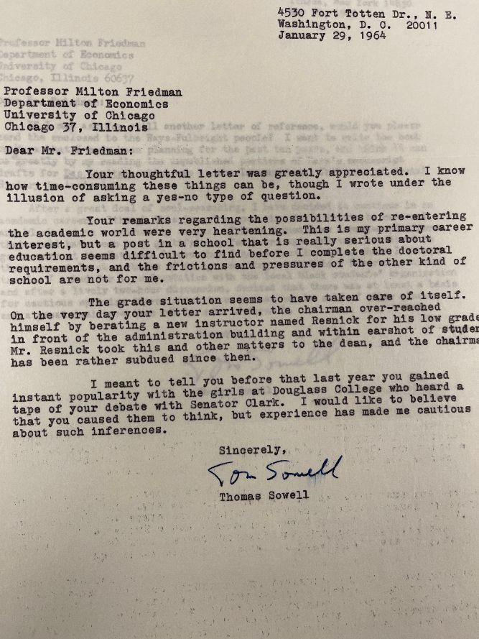
1. Introduction: Background and Methodology
My search to expand the theory of the firm has led me to directly study the development and influence of the Chicago School at Stanford’s Hoover Institution

Slide 7
1. Introduction: Background and Methodology
Thus, I use the following research methods to expand the theory of the firm out of Chicago:
• Experimental Economics Research
• Historical Research in Classical and Neoclassical Economics
• Memoirs of Neoclassical Economists (e.g., Milton Friedman, George Stigler, Vernon Smith, and Amartya Sen)
• Original Documents Related to Adam Smith (Glasgow) and the Chicago School (Hoover)

Slide 8
1. Introduction: Background and Methodology
In this paper, I call on economists to join the search for a New Chicago School by arguing the following:
• The Chicago School lasted from the founding of the Mont Pélerin Society in 1947 to 2007-2008 (≈ 60 yrs).
• The main architect of the theory of the firm, Michael Jensen, has recently recanted many of his views.
• The economic theory behind corporate governance and management control is incomplete and in need of revision.
• The search for a New Chicago School has already begun and is yielding fruitful results.

Slide 9
2. Description and Tombstone of the Chicago School
In his memoirs published in 1988, George Stigler described the essential three approaches of the Chicago School as follows:
• The shift to studies of market efficiency.
• The pervasiveness of competitive pressures.
• The application of economics to the causes and effects of public regulation.

Slide 10
2. Description and Tombstone of the Chicago School
Stigler (1988) argued that the neoclassical theory out of Chicago had “conquered the field” of economic theory that existed in the postwar period including:
• The historical and institutional economic theory that originated in Germany
• Joan Robinson’s (1933) theory of imperfect competition
• Edward Chamberlin’s (1933) theory of monopolistic competition
• All other forms of neo-Kaynesian economic theory
• The Austrian School (which lasted from 1870-1930)

Slide 11
2. Description and Tombstone of the Chicago School
Stigler’s (1988) description and apparent criteria for writing the tombstone of other research paradigms suggests that the Chicago School died in 2008 because:
• The essential three main approaches of the Chicago School (efficient markets, perfect competition, and lack of a justification for public regulation) are no longer compelling.
• The traditional theory of the firm does not support common management controls such as participative budgeting and the balanced scorecard.
• The traditional theory of the firm does not support new management controls such as DEI and ESG.

Slide 12
3. The Chicago School at the Height of its Influence
Friedman’s (1953) methodological essay blocked other paradigms by, 1) discounting the importance of the underlying assumptions of a theory, and 2) arguing that any criticism of the current paradigm was beside the point unless combined with a theory of equal generality.
• Oliver Williamson’s (2009) review of Friedman’s (1953) methodological essay was very critical.
• Williamson complained that Friedman reveled in controversy and was given to overreaching.
• The strong views of Friedman and Stigler pushed out their mentor Frank Knight, their visionary Friedrich Hayek, and the theorists at the Cowles Commission.

Slide 13
3. The Chicago School at the Height of its Influence
Friedman’s (1953) methodological essay was heavily influenced by Karl Popper’s (1934) philosophy of science based primarily on natural science and the formation of falsifiable hypotheses. However, his hostility toward extensions of his neoclassical economic was more characteristic of Thomas Kuhn’s (1962) philosophy of science that argued:
• Normal science functions within a scientific community’s commitment to a theoretical paradigm.
• Normal science involves the laborious process of accumulating detail in accord with the established theory without questioning its assumptions.

Slide 14
3. The Chicago School at the Height of its Influence
One of the strongest advocates for the theory of the firm out of Chicago was its main architect Michael Jensen. He continued to defend the traditional theory of the firm by:
• Providing a strong defense of Friedman’s (1970) investor primacy view of the corporation over a broader stakeholder view (Jensen 2000)
• Arguing against the use of participative budgeting because it only encouraged managers to lie and cheat (Jensen 2001).
• Arguing against the use of the balanced scorecard because of its focus on other objectives besides maximizing shareholder returns (Jensen 2002).

Slide 15
4. Early doubts after the dot-com crash in 2000
In his review of capital markets research in accounting in 2001, S.P. Kothari (2001, 113) concluded that the evidence against market efficiency was so great that “capital markets research in accounting today appears to be in a similar state as accounting theory was prior to 1968.”
Recent capital markets research has documented a dramatic increase in price and volume reactions to earnings announcements since 2001 (Beaver, McNichols, and Wang 2018, 2020; Barron, Schneible, and Stevens 2018). Surprisingly, this increase in market reactions to earnings is greatest in large firms.

Slide 16
5. Michael Jensen’s Change of Heart in 2008
In 2008, Michael Jensen (2008, ix-x) wrote a forward to the book, “Moral Markets: The Critical Role of Values in the Economy,” edited by Paul Zak:
Economics, having traditionally focused on the positive analysis of alternative institutional structures, has far too long ignored the normative world. By the term “positive analysis,” I mean, of course, the analysis of the way the world is, however it behaves, independent of any normative value judgments about its desirability or undesirability…By “normative,” I mean establishing, relating to, or deriving from a standard or norm that specifies desirable or undesirable conduct or behavior, that is, what ought to be…

Slide 17
5. Michael Jensen’s Change of Heart in 2008
In 2008, Michael Jensen (2008, ix-x) wrote a forward to the book, “Moral Markets: The Critical Role of Values in the Economy,” edited by Paul Zak:
…I look forward to seeing the creation of an entirely new field of inquiry in economics, and in its sister social sciences, focused deeply on the positive analysis of the role of values in elevating the possible outcomes of human interaction.

Slide 18
6. The Current State of the Search
Other neoclassical economists have extended the traditional theory of the firm out of Chicago by:
• Relaxing the assumption of narrow self-interest to include commitments to social and moral norms (Stevens 2019).
• Incorporating insights from stakeholder theory to extend the responsibilities of the firm beyond shareholders to employees, suppliers, communities, the environment, etc… (Mayer 2013).
• Returning economics to a social science dealing with individual and societal diversity (Sen 2022).

Slide 19
6. The Current State of the Search
I conclude that this effort has been hampered by some remaining baggage from the old Chicago School:
• A flawed view of the father of modern economic theory: Adam Smith.
• A flawed view of economic science that emphasizes the rigor of the physical sciences at the expense of individual and social concerns.
• The continued commitment to “positive theory” to the detriment of Adam Smith’s commitment to social and moral norms.

Slide 20
7. Conclusion: How We failed Sam Bankman-Fried
I have used business cases such as Enron and Lehman Brothers in my graduate courses to emphasize the need for strong corporate governance, managerial control, and business ethics.
This past semester, however, our class discussions of these important issues centered around the sudden collapse of FTX and the investor fraud perpetuated by its founder and CEO, Sam Bankman-Fried (SBF).

Slide 21
7. Conclusion: How We failed Sam Bankman-Fried
SBF had become a media darling for promoting business ethics and a unique moral theory called “effective altruism” that encouraged amassing great wealth to promote progressive moral causes.
In a text interview with Vox, however, SBF admitted that his preaching of business ethics was merely “a shibboleth” or virtue signaling meant to impress people and win over investors. In the same interview, he disparaged government regulation. Thus, it appears that SBF used his emphasis on business ethics to mislead the media, regulators, and investors.

Slide 22
7. Conclusion: How We failed Sam Bankman-Fried
SBF’s political influence peddling and investor fraud is exactly what Milton Friedman warned about in his famous article regarding the purpose of the corporation in 1970.
The FTX case led to a discussion of the refutation of the shareholder primacy view of the corporation by the Business Roundtable in August of 2019. Their new statement of the purpose of the corporation encouraged business leaders to embrace a stakeholder view of the firm. Is the main lesson from FTX that we need to return to the shareholder primacy view of the corporation?

Slide 23
7. Conclusion: How We failed Sam Bankman-Fried
As with Enron and Lehman, the FTX case emphasizes the continuing need for responsibility, transparency, and accountability in government and business. Whenever these three pillars are missing, it puts both capitalism and individual liberty at risk.
I continue to teach the traditional economic theory of the firm based on narrow self-interest and preferences only for wealth and leisure, but I emphasize that it does not sufficiently motivate responsibility, transparency, and accountability. This gives me an opportunity to introduce Adam Smith’s moral theory and its role as the moral foundation for capitalism and the firm.

Slide 24
7. Conclusion: How We failed Sam Bankman-Fried
This past fall, my final exams included a new multiple-choice question in my MBA and graduate managerial accounting courses:
25.___The ability of the Chicago School to ignore evidence inconsistent with narrow self-interest for so long is likely:
A) because such evidence is severely lacking.
B) because such evidence is only appearing in experimental research.
C) because such evidence cannot be incorporated in mathematical models.
D) because of their strong research paradigm.

Slide 25
7. Conclusion: How We failed Sam Bankman-Fried
My final exams also included a new essay question:
29. …On November 11, 2022, FTX, Alameda and dozens of affiliated companies filed for bankruptcy. In bankruptcy court, a lawyer for the failed crypto exchange said that a substantial amount of FTX’s assets are either missing or stolen. Individual and institutional customers number in the millions, and the 50 largest creditors alone are owed more than $3 billion, court papers show.
Questions:
Describe how the “theory of the firm” out of Chicago fails to promote responsibility, transparency, and accountability.
b. How could the theory of the firm be altered to better support effective corporate controls and avoid investor frauds like FTX from happening?

