Slide 1
Appropriate use of antidepressant medications for changed behaviours in people living with dementia
Education Activity
Centre for Medicine Use and Safety (CMUS)

Slide 2





Introduction
Background
Dementia is associated with a deterioration in:^{1,2}
  Memory
  Thinking
  Behaviour
  Communication
  Ability to perform daily activities

Slide 3




Introduction
Dementia and changed behaviours
People living with dementia often experience changed behaviours. Changed behaviours are diverse and may include:
  Wandering e.g. walking aimlessly and/or excessively, attempting to exit a safe location³
  Anxiety e.g. thoughts of worry, fearfulness and behaviours such requests for reassurance^{2,3}
  Depressive symptoms e.g. hopelessness, tearfulness, loss of interest, withdrawal, changes in appetite, sleep disturbances and suicide ideation (e.g. a person is thinking or planning to take their own life)^{2,3}
  Sleep disturbances e.g. difficulty falling or staying asleep³

Slide 4
Introduction
Care for people living with dementia and changed behaviours
Care for people living with dementia and changed behaviours can be split into two broad strategies:
Non-pharmacological strategies
Definition: non-medication strategies
Examples: pet therapy, exercise therapy, art therapy^{2,3}
Pharmacological strategies
Definition: medication strategies
Example: psychotropic medications
Royal Commission into Aged Care Quality and Safety⁴ defines a psychotropic medication as:
“Any drug capable of affecting the mind, emotions, and behaviour”

Slide 5

Introduction
Use of Psychotropic Medications in People Living with Dementia and in Residential Aged Care
The Royal Commission into Aged Care Quality and Safety Interim Report: Neglect highlighted an overreliance on psychotropic medications⁵
Psychotropic medications such as antidepressants are associated with adverse outcomes for people living with dementia:
  Sedation e.g. drowsiness, sleepiness
  Falls
  Agitation

Slide 6
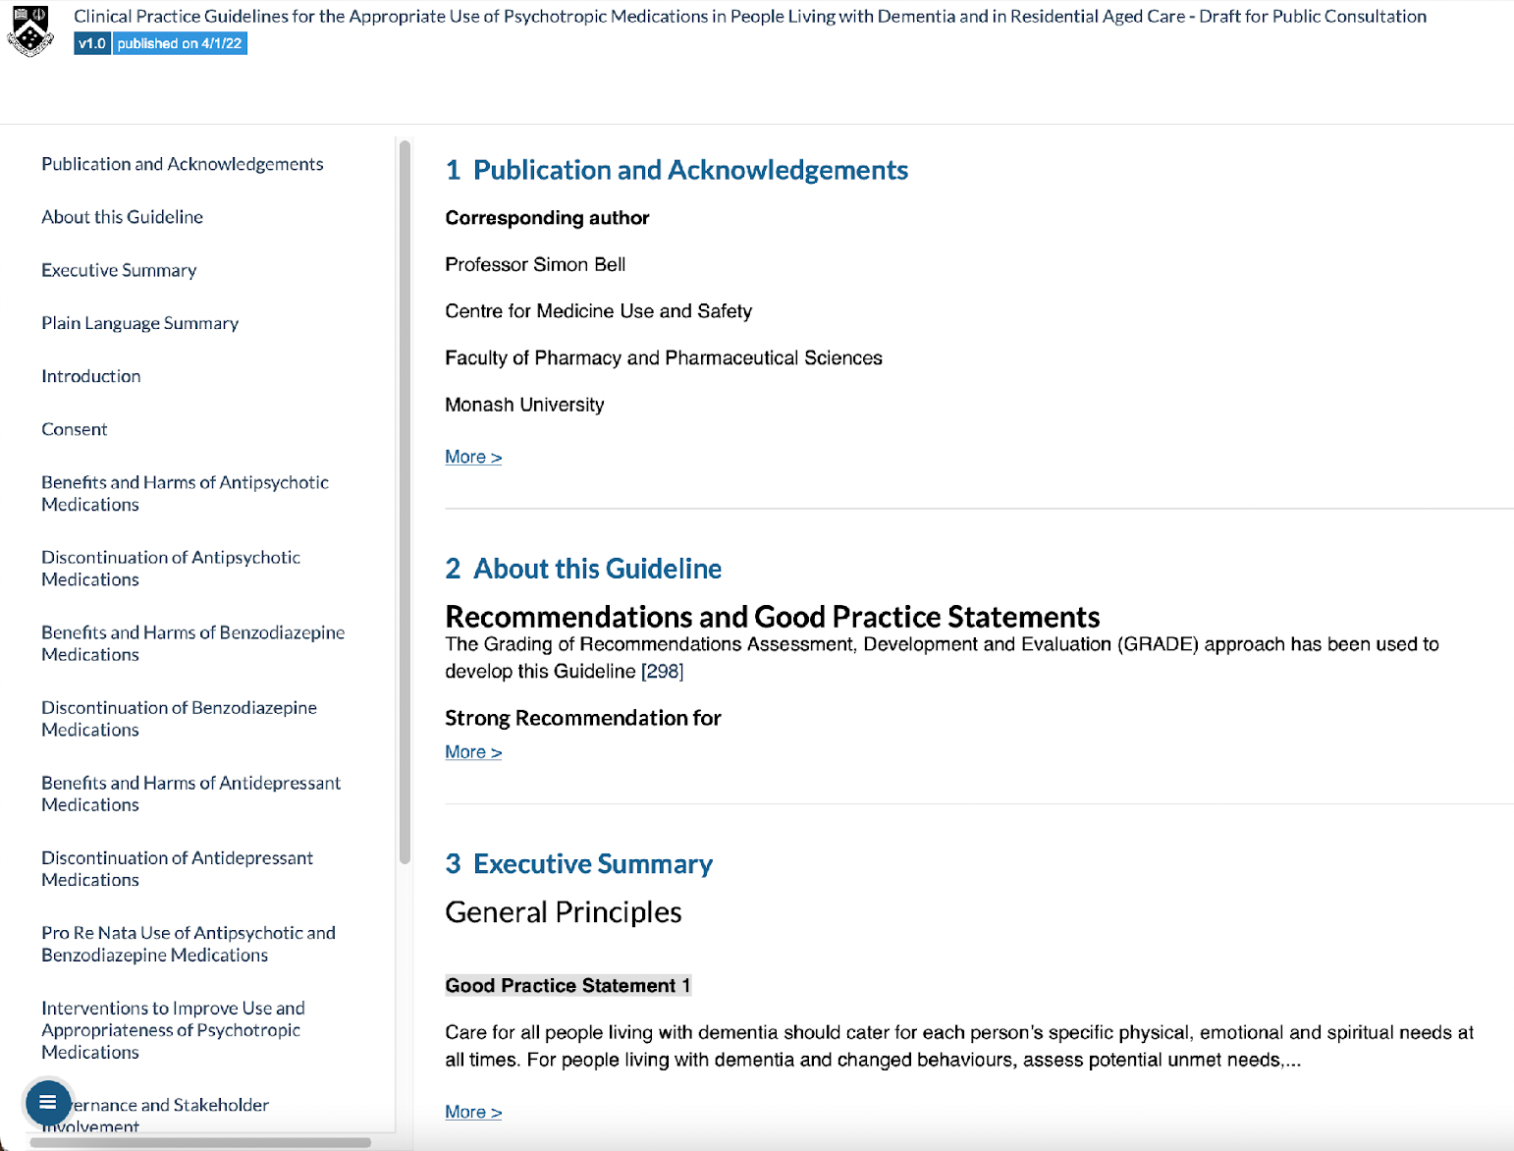
Introduction
Clinical Practice Guideline for Appropriate Use of Psychotropic Medications in People Living with Dementia and in Residential Aged Care
Three most common psychotropic medications implicated in restrictive practice in residential aged care are:
  Antipsychotics
  Benzodiazepines
  Antidepressants⁴
The new clinical practice guideline focuses on the appropriate medication use of antipsychotics, benzodiazepines and antidepressants

Slide 7
Learning Objectives
By the end of this session, you should be able to:
Explain the criteria that should be met before using an antidepressant for people living with dementia and changed behaviours
Specify the criteria for escalating care surrounding initiation of an antidepressant
Explain what should be documented surrounding initiation of an antidepressant
Be aware of supporting resources accompanying the Guideline to use in everyday practice

Slide 8


Initiation of antidepressants
Image from freepik

Slide 9
Group discussion - what is an antidepressant?

Slide 10

What is an antidepressant?
An antidepressant is a class of medication that can be used for:^{4,6}
  symptoms of depression
  anxiety disorders
  obsessive compulsive disorder
Some examples of antidepressants include citalopram, escitalopram, mirtazapine and sertraline
Sometimes antidepressants are prescribed to people living with dementia and changed behaviours
One Australian study⁷ reported 37% of residents are dispensed an antidepressant within three months of admission to residential aged care, with higher rates of antidepressant use among residents living with dementia

Slide 11
Multiple choice question
When should antidepressants be considered for sleep disturbances in people living with dementia? Select the most correct answer:
  When a person becomes a resident in residential aged care
  When a person is experiencing sleep disturbances
  When a person is experiencing new depressive symptoms and is NOT experiencing suicidal ideation (e.g. a person is thinking or planning to take their own life) and/or at risk of self-harm (e.g. a person who is deliberately causing pain or damage to their own body)
  All of the above
  None of the above
Answer: E

Slide 12



Multiple choice question - answer
Why is option E correct?
Antidepressants could be considered for people living with dementia who develop:
  Moderate major depressive disorder AND who have previously taken an antidepressant that worked, or
  Severe major depressive disorder, or
  Depressive disorder with suicidal ideation and/or risk of self-harm
    Self-harm describes a person who is deliberately causing pain or damage to their own body
Antidepressants should NOT be considered for people living with dementia who:
  Are not experiencing depressive symptoms
  Experience sleep disturbances because;
    there is a lack of evidence they work, AND
    there is evidence they can cause harm
  Experience newly developed depressive symptoms or mild-to-moderate major depressive disorder

Slide 13
Harms vs benefits of antidepressants
Antidepressant use results in little to no difference in depressive symptoms⁸
Antidepressant use reduces agitation slightly⁹
Increase the risk of adverse events⁸
  e.g. an unintended and sometimes harmful effect
  also known as a side effect
Some adverse of antidepressants are;
  falls
  insomnia
  agitation
  nausea
BENEFITS
HARMS

Slide 14
Steps before initiating an antidepressant
Clinical Steps
When a person living with dementia is displaying a changed behaviour for the first time, contact the prescriber to rule out other possible factors (e.g. delirium)³
After these have been excluded, all staff should trial the following measures for an adequate and agreed period of time:
  Identify potential unmet needs such as;
    loneliness
    need for social contact
    need for meaningful activity and discomfort
  Non-pharmacological strategies
    Staff may be able to refer to a dementia specialist within the residential aged care facility or the Dementia Support Australia¹⁰
Communication and documentation
steps
Document clinical steps trialled and the person’s changed behaviours in the (where applicable);
  medical record
  nursing progress notes
  behaviour support plan
Document conversations and the plan going forward
Recommend an assessment by a psychiatrist, geriatrician and/or older person’s mental health team
  This assessment should be organised as early as possible for people living with dementia who develop clinically significant depressive symptoms
Get the entire care team involved!

Slide 15

Case study
Jack Jones is a person living with Alzheimer’s dementia
Jack’s friends describe him has an extroverted person
Jack worked as a mailman for 45 years
Jack’s workmates first noticed a change in his memory when Jack was reporting back to the post office late without delivering all his allocated mail
Jack has now become a resident at Sunnyside residential aged care facility
Image from freepik

Slide 16
Case study
Small groups
Read the Case Study
Discuss questions 1 and 2 over the next 15 minutes
Prepare answers to share in group discussion

Slide 17
Review of case study questions
Group Discussion
Question 1. Should an antidepressant be prescribed for Jack’s depressive symptoms? What would you communicate and document?

Slide 18
Review of case study questions
Group Discussion
Question 1. Should an antidepressant be prescribed for Jack’s depressive symptoms? What would you communicate and document?
Clinical steps
No
Prescribing, dispensing or administering an antidepressant in this case should not be considered
Non-pharmacological strategies should be trialled for an adequate period of time first
Communication and documentation steps
Document Jack’s changed behaviour in the medical record, nursing progress notes and behaviour support plan, where applicable
  e.g. Jack was experiencing xxxxxx
Discuss Jack’s changed behaviours with the entire care team
Recommend an assessment by a psychiatrist, geriatrician and/or older person’s mental health team
An antidepressant should only be considered for Jack’s depressive symptoms if he develops:
  Severe major depressive disorder, or
  Depressive disorder with suicidal ideation and/or risk of self-harm

Slide 19
Review of case study questions
Group Discussion
Question 2. List some management strategies you should try first before considering an antidepressant for Jack. How would you communicate and document this?

Slide 20
Review of case study questions
Group Discussion
Question 2. List some management strategies you should try first before considering an antidepressant for Jack. How would you communicate and document this?
Clinical Steps
All staff should trial the following measures and for an adequate and agreed period of time:
  Identify potential unmet needs;
    is Jack experiencing hearing loss?
    is Jack feeling lonely? Could in person or virtual visits with his friends be organised?
    could Jack assist staff to ‘deliver’ the newspaper to residents in the morning?
    could staff encourage Jack to play cards with other residents who enjoy card games?
  Non-pharmacological strategies;
    would Jack benefit from pet therapy?
    would Jack benefit from exercise therapy?

Slide 21
Review of case study questions
Group Discussion
Question 2. List some management strategies you should try first before considering an antidepressant for Jack. How would you communicate and document this?
Communication and documentation steps
Document clinical steps trialled and the changed behaviours Jack is experiencing in the (where applicable);
  medical record
  nursing progress notes
  behaviour support plan
Contact the prescriber
Notify the care team
Document conversations and plan going forward about Jack’s depressive symptoms
  Jack gave consent to speak with his friend, David. David reports he did not realise he could visit Jack in person. Explained the process of organising a visit at Sunnyside aged care facility. David booked in to see Jack next Thursday at 2pm

Slide 22

Update on Jack
Nurses and care staff organised for Jack to deliver newspapers to some residents each morning.
Jack has great conversations with the other residents where they are often observed sharing stories about “the good old days”. Jack’s friend, David comments,
“Jack loved his job as a mailman- it was his life. Here at Sunnyside residential aged care facility, delivering the newspapers to other residents each morning has given Jack something meaningful to do. And he loves playing cards with the other residents. It’s great to see the impact all this has had on Jack!”
Image from freepik

Slide 23
Prescribers’ responsibilities surrounding antidepressant initiation
What steps should prescribers complete and document before initiating an antidepressant?
Clinical Steps
Identify the specific changed behaviour they want to improve (target symptom)
  does Jack have severe major depressive disorder or a depressive disorder with suicide ideation and/or risk of self-harm?
  in general, all other measures been trialled for an adequate and agreed period of time?
Identify the anticipated treatment outcome
  what benefit does Dr. Mary want to see as a result of Jack taking the antidepressant?
Complete an individual harm-benefit analysis
  what are Jack’s individual risks and benefits of taking the antidepressant?
  what other medications is Jack taking?
Communication and documentation steps
Have a comprehensive discussion with the person living with dementia, support person and/or their substitute decision maker
Obtain informed consent
Document antidepressant review date
  Dr. Mary should discuss the antidepressant review date with Jack, the nurse and aged care staff

Slide 24



Take home messages
Antidepressants have little benefit in improving depressive symptoms in people living with dementia
In general, before considering initiation of an antidepressant, all staff should trial for an adequate and agreed period of time:
  Identify potential unmet needs
  Non-pharmacological strategies
Recommend an assessment by a psychiatrist, geriatrician and/or older person’s mental health team for all people living with dementia who develop clinically significant depressive symptoms

Slide 25
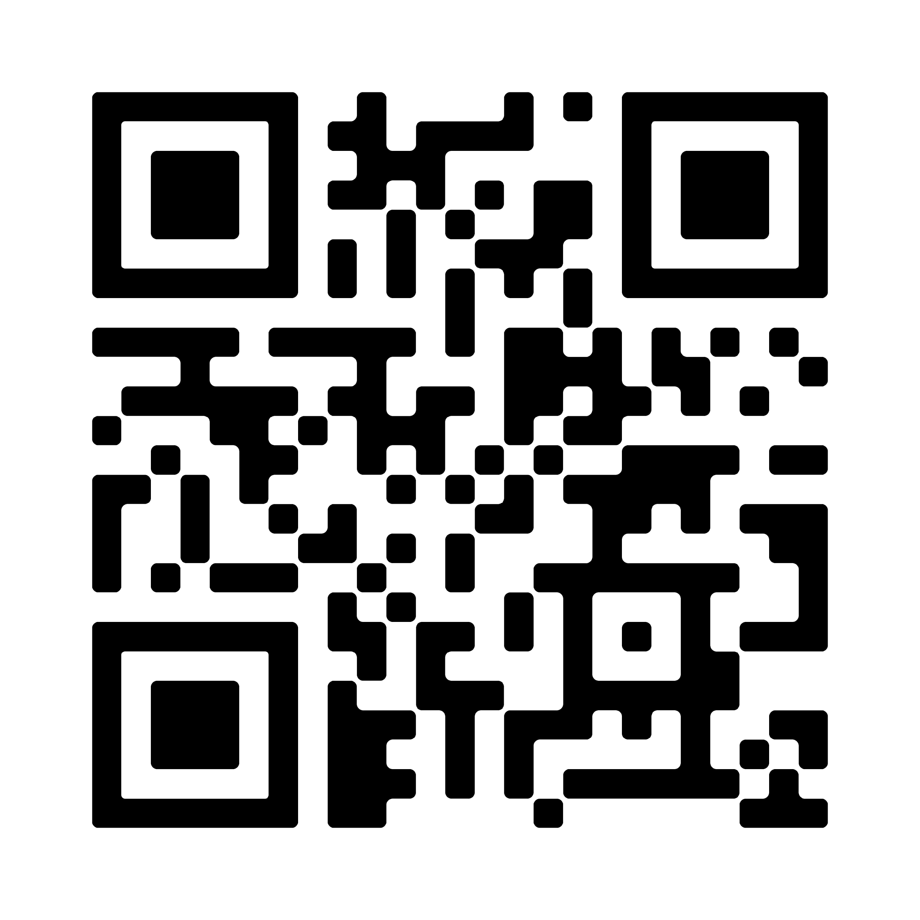
Supporting resources
Access to the Guideline

Slide 26
References
The Royal Commission into Aged Care Quality and Safety. Background Paper 3: Dementia in Australia: Nature, Prevalence and Care. Commonwealth of Australia; 2019. Accessed December 9, 2022. https://agedcare.royalcommission.gov.au/sites/default/files/2019-12/background-paper-3.pdf
New South Wales Ministry of Health. Assessment and Management of Behaviours and Psychological Symptoms associated with Dementia (BPSD). 2022. Accessed January 25, 2023. https://www.health.nsw.gov.au/mentalhealth/resources/Publications/assessment-mgmt-people-bpsd-2022.pdf.
Burns K, Jayasinha R, Tsang R, Brodaty H. Behaviour Management A Guide to Good Practice: Managing Behavioural and Psychological Symptoms of Dementia. Dementia Support Australia; 2012. Accessed September 19, 2022. https://www.dementia.com.au/resource-hub/behaviour-management-a-guide-to-good-practice
Aged Care Quality and Safety Commission. Psychotropic medications used in Australia: information for aged care. Australian Government; 2021. Accessed September 2, 2022. https://www.agedcarequality.gov.au/resources/psychotropic-medications-used-australia-information-aged-care
The Royal Commission into Aged Care Quality and Safety. Interim Report: Neglect. Commonwealth of Australia; 2019. Accessed September 19, 2022. https://agedcare.royalcommission.gov.au/publications/interim-report
National Health Service. Overview – Antidepressants. National Health Service; 2021. Accessed November 30, 2022. https://www.nhs.uk/mental-health/talking-therapies-medicine-treatments/medicines-and-psychiatry/antidepressants/overview/
Harrison, SL, Sluggett, JK, Lang, C, et al. The dispensing of psychotropic medicines to older people before and after they enter residential aged care. Med J Aust. 2020;212(7):309-313. doi: 10.5694/mja2.50501
Dudas R, Malouf R, McCleery J, Dening T. Antidepressants for treating depression in dementia. Cochrane Database Syst Rev. 2018;8(8):CD003944. doi: 10.1002/14651858.CD003944
Hsu TW, Stubbs B, Liang CS et al. Efficacy of serotonergic antidepressant treatment for the neuropsychiatric symptoms and agitation in dementia: A systematic review and meta-analysis. Ageing Res Rev. 2021;69:101362. doi: 10.1016/j.arr.2021.101362.
Dementia Support Australia. Helping you care for people with dementia. Dementia Support Australia. Accessed February 2, 2023. https://www.dementia.com.au/who-we-help/dementia-healthcare-professionals?hsCtaTracking=c0d1774a-0ac3-4c51-ade3-7370dee3ce26%7C5fd0cceb-a3e2-40d7-a516-d4845624ccef
Unless specified, all icons included in this presentation are from Flaticon.com

