Slide 1
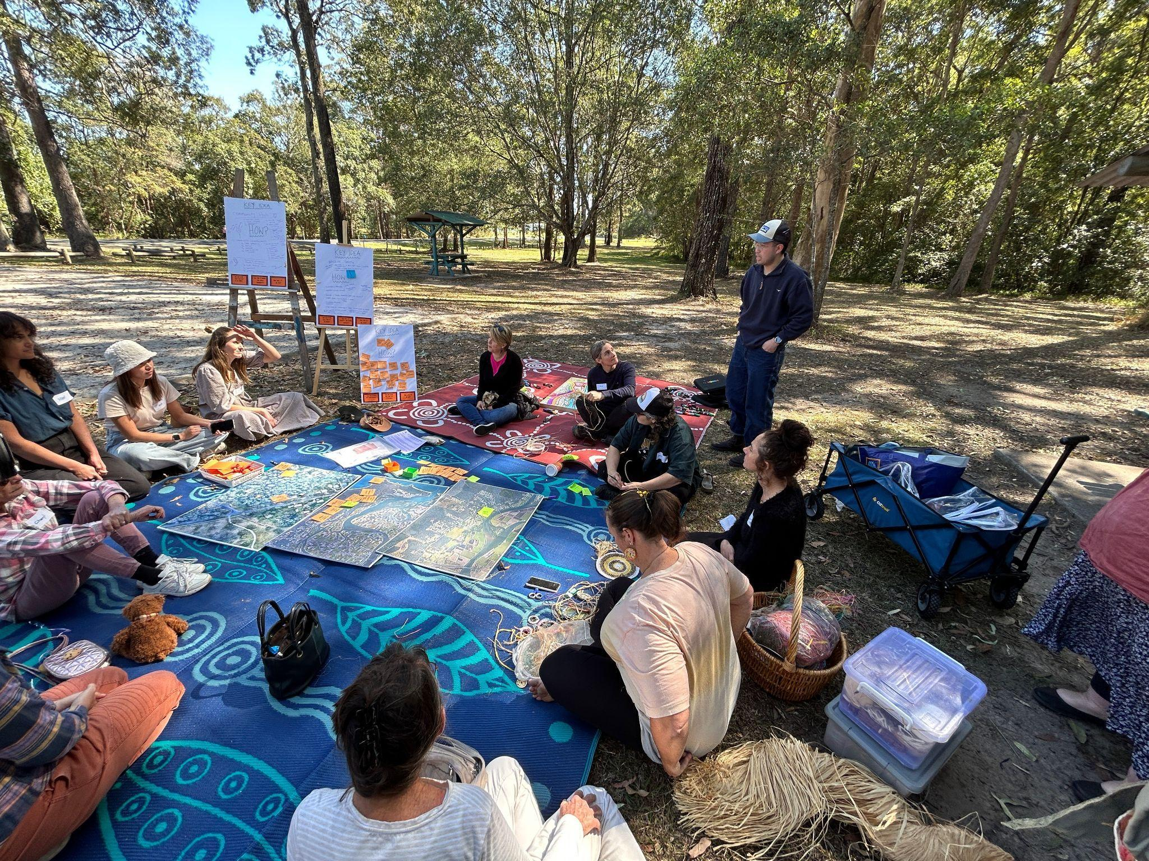
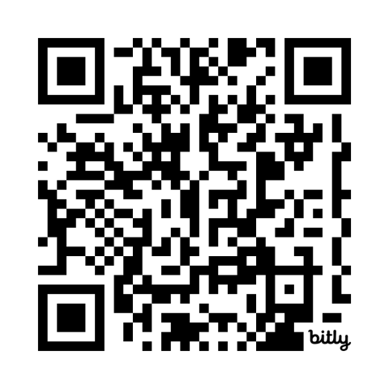
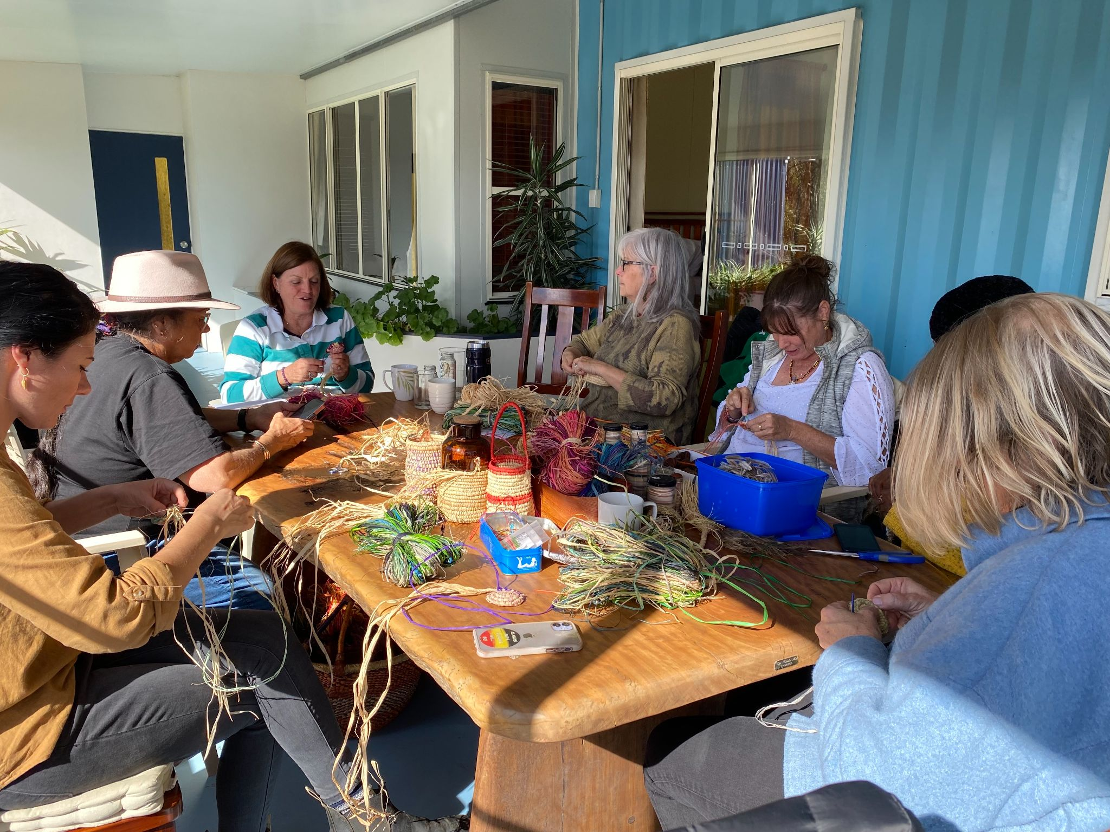
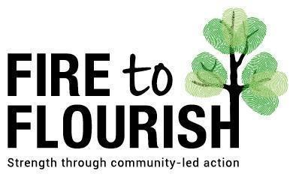
The Royal Geographical Society (with IBG) Annual Conference,
Imperial College London, 27-30 August 2024.
The Role of Relational Agency in Transformative Outcomes for Disaster Recovery
Belinda Davis, PhD Researcher, Monash University, Australia.

Slide 2
Structure of Presentation
Introduce the concept of relation agency as a resource to transform social practice.
Describe a methodological application of Cultural Historical Activity Theory (CHAT) to show how relational agency can be analysed in a way to optimise transformative outcomes.
Exemplify how relational agency can work to transform social practices for disaster recovery using examples from peer reviewed literature and an Australian community led programme called Fire to Flourish.

Slide 3
Research Questions
How can we apply the concept of relational agency to better understand…
the social dimensions associated with disaster recovery in communities?
the interrelational spaces and mediated objects for which these dimensions can enact transformation?

Slide 4
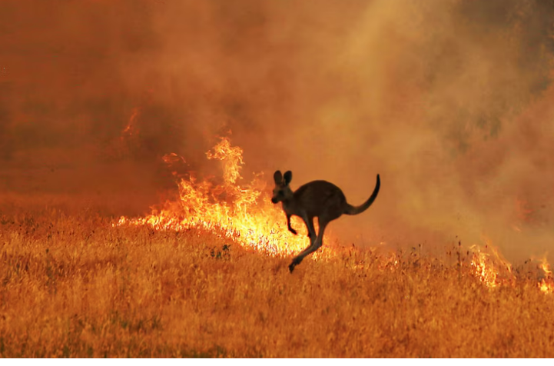
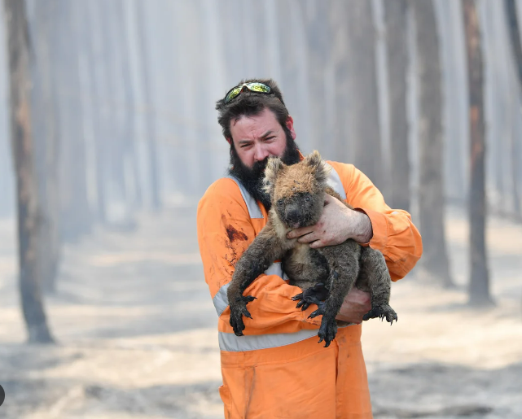
Why Relational Agency?
Relational agency places a focus on the quality of a relation and can implicate a moral imperative of the Self-in-relation to the Other by working towards the common good.
Relational agency, like other relational ontologies, supports the interconnectedness of humans and non-human others that aligns with indigenous and First Nations worldviews.
Relational agency can be understood as a resource that can expand our capacity to solve common problems by bringing together different expertise and tools in a social practice.
Surprisingly, relational agency as a resource is not well understood in disaster recovery.
Notes:
The notion that we are (the Self) are inextricably connected to land, place and other people and animals. This aligns to indigenous worldviews and philosophies. Not just human centric.

Slide 5
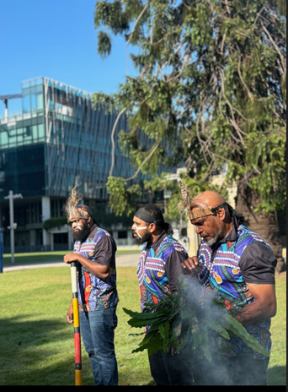
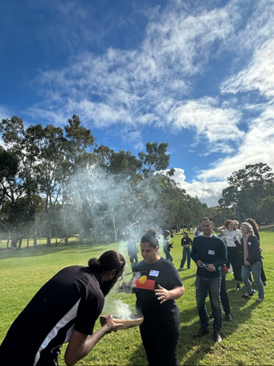
Aboriginal Knowledge is Relational, Involving a Deep
(Self) Identification with Country (Other) Dating Back Around 65,000 Years (or possibly longer)
…I’ve watched in anguish and horror as fire lays waste to precious Yuin land, taking everything with it – lives, homes, animals, trees – but for First Nations people it is also burning up our memories, our sacred places, all the things which make us who we are. It’s a particular grief, to lose forever what connects you to a place in the landscape. Our ancestors felt it, our elders felt it, and now we are feeling it all over again …(Allam, 2020a).
Williamson B., Markham F., & Weir J.K. (2020). Aboriginal Peoples and the Response to the 2019-2020 Bushfires.
Notes:
In Australia Aboriginal people are deeply connected to County (the land) and its cultural artefacts and this is exemplified through cultural practices, such as the ceremonial welcome and acknowledgement of country - a symbolic ceremony involving native vegetation burning to pay respect which now takes place as all major events. Aboriginals lived in harmony with Country for around 65,000 years. Deep trauma is felt when the land is destroyed in a disaster.

Slide 6
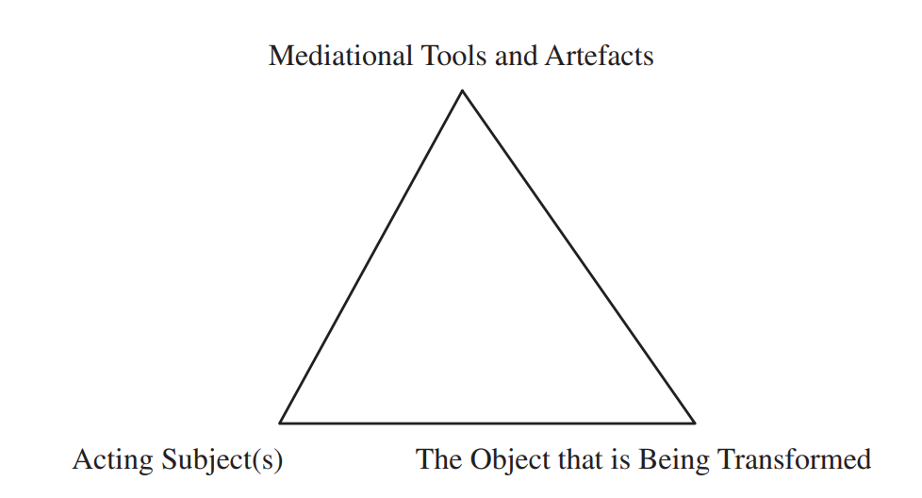
Applying CHAT to Understand how Relational Agency is Mediated Within Social Systems: Object Focussed
Cultural Historical Activity Theory (CHAT) derives from:
1. Lev Vygotsky's sociocultural psychology: the mind (Self)
cannot be separated from its surrounding historical and cultural social context (Other).
2. Activity Theory derives from ideas of collective consciousness
and Marxist socialist ideas.
We transform the world first by interpreting it. We then act on the basis of our interpretations in a social setting. We can apply a CHAT mediation triangle to explore and analyse how social practices are shaped by relational agency.
Relational agency implies a capacity to work with others to expand the (object) that one is working to transform by accessing the resources (tools) that other (acting subjects) bring to the table.
Basic CHAT Mediation Triangle,
Anne Edwards (2005)
Notes:
Here I draw upon Anne Edwards conceptualization of relational agency. The expansion of relational agency is linked to the idea of expansive learning and shifts the focus from the individual to joint action and the impact on those who engage in it between and across systems. Anne has applied this method to understand how to make professional training of teachers more effective. Anne used this approach to explore how to the professional training of teachers more effective.

Slide 7
An Activity System: Analysing relational agency through the structure of social practice
We can use an activity system as a collective unit of analysis to identify how social structures within a social practice interrelate to expand (or contract) relational agency.
Exploring these interrelational spaces can show us how objects are mediated within a certain social practice at both micro and macro levels simultaneously.
This can be helpful in multi-agency settings, such as disaster recovery.
Notes:
Mention first generation CHAT, now up to third generation CHAT. We can use this structure to analyse how different social practices interrelate to shape relational agency. We can also analysis how different social systems interrelate.

Slide 8
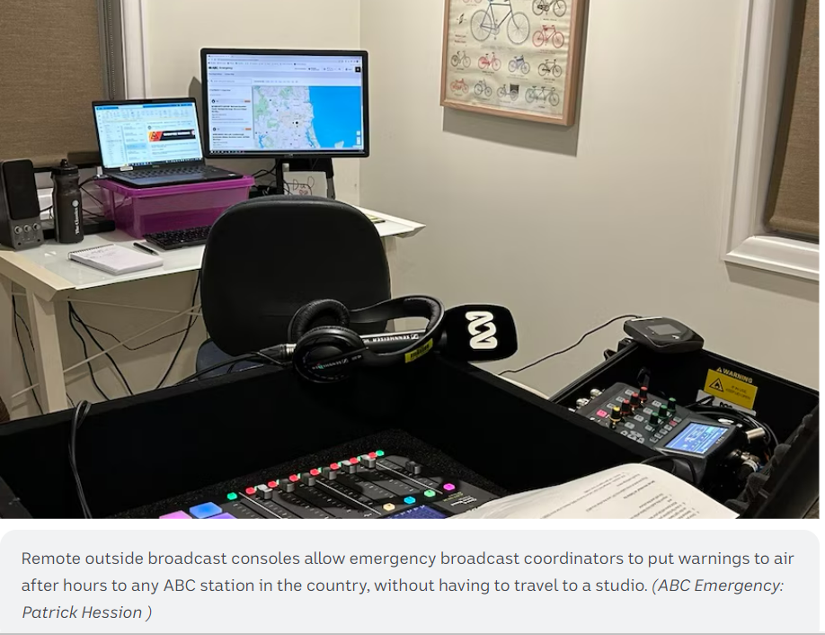
A Case in Point: Relational Agency Saves Lives During the 2009 Australian Black Saturday Bushfire
Two young boys broadcasting a youth program on Saturday evening began to receive calls from distressed residents. Not many people knew the fires had destroyed all transmitters on Mount Tassie. People were effectively cut-off from any local news and information. The young boys' radio transmitters, however, had survived because they were located on a different hilltop and the two boys were still able to broadcast their program.
The local ABC radio acted quickly and contacted the two boys at
3GCR and set up a live-to-air studio as though it was a live phone
interview and were able to transmit the local ABC through the
3GCR transmitter for 48 hours.
The ABC had access to local emergency information about the
latest fire conditions. The young boys had the radio equipment to
transmit the vital information to the local community. This pooling
of resources expanded relational agency to save lives.

Slide 9
Key Findings from a Literature Review:
(Re)connecting the Self with Other is Vital for Recovery
Societal
Civic participation
Collective
Sense of community & belonging
Ethic of care for Other
Individual
Meaningful / purposeful Identity & Sense of Self
Social networks & social media
Relational agency is a social process that influences how transformation is shaped through social practices of disaster recovery.
At an individual level a sense of Self needs to be restored or recreated due to it being shattered by the altered social and physical landscape of (Other).
Individual processes relating to a sense of (Self) identity are vital for moving to positive collective and societal level transformative outcomes.
.
Notes:
The analysis of key literature showed that all levels are important and starts with individual relational processes within the Self. Following a disaster the individual needs to reorient with the altered social and physical landscape in a way that generates a sense of self purpose and meaningful identity. Collective practices involving communities of practices can assist by offering a sense of belonging and generation of an ethic of care for other. This can take time and disaster recovery practitioners need to allow for this.

Slide 10
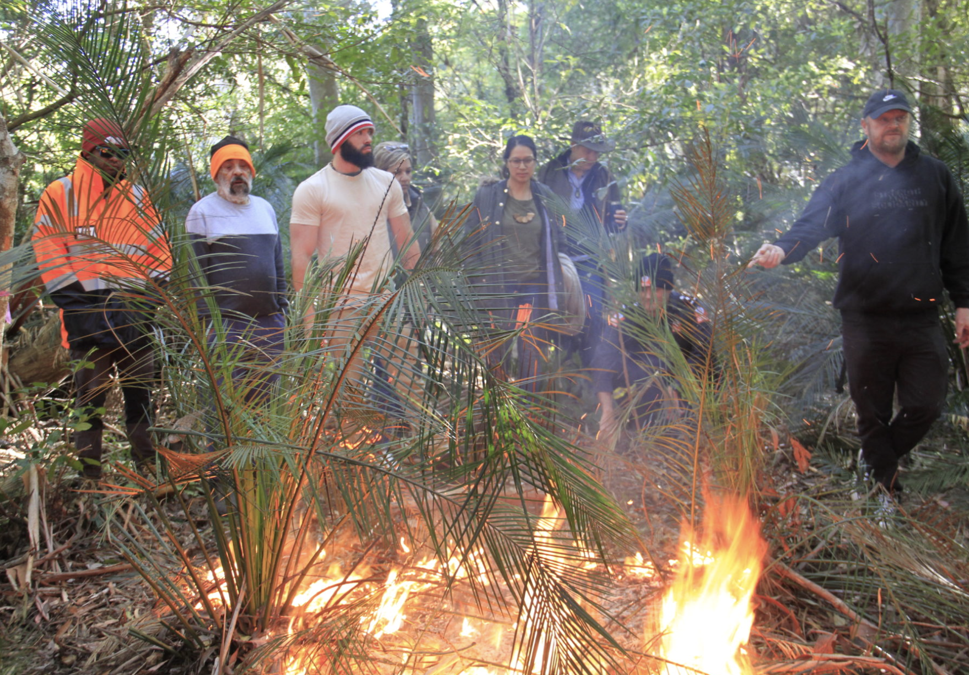
Achieving Transformative Outcomes in Disaster Affected Communities: (Re)connecting the Self with Other Expands Relational Agency
The Fire to Flourish programme is oriented to object-focused durable outcomes rather than short term goals.
Prioritises Aboriginal knowledge as a mediated tool for bushfire knowledge co-creation, recovery and practice.
Community led collaboration works to develop a collective vision of a sense of place developed through interpretations of what a meaningful relationship with Country (as the object of focus) looks like.
Makes collective decisions (e.g. about funding and investment priorities) for disaster recovery through an expansion of relational agency.
This has been transformative for decision-making.
Monash University's Fire to Flourish Program
Notes:
We see here how Relational agency is a capacity to work with others to expand the object (seen here as indigenous fire practices) that one is working on and trying to transform by recognising and accessing the resources that others bring to bear as they interpret and respond to the object. Relational agency is an enhanced version of personal agency and as a capacity it can be learnt.
For discussion time.
In Monash University's Fire to Flourish program, our processes are based on bringing community members together to make sense of their local place through relationality with Country, deep discussions with each other to understand shared and different perspectives, develop a shared vision, identify disaster recovery & resilience priorities and make collective decisions about how to invest available grant funding. Participation by Aboriginal community members are prioritised in these processes and they are grounded in Aboriginal knowledge - community members have reflected that these approaches have been transformative for their resilience (in terms of strengthened relationships, capabilities and connection with Aboriginal wisdom).

Slide 11
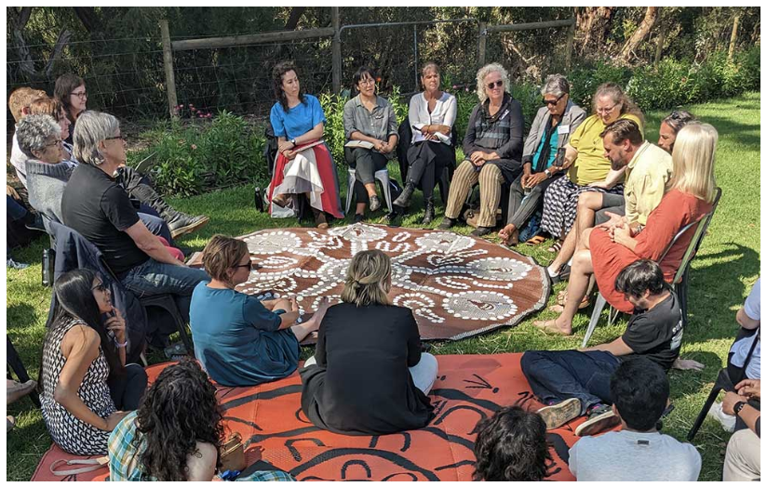
Relational Agency is a Resource and We Can Design it into Disaster Recovery Practices
First: Recognise that relational agency is a resource that can mobilise knowledge and expertise to shape transformative outcomes within social practices.
Second: Identify ways to design a social practice to optimise relational agency by more effectively tapping into the unique intelligence located within people and the associated tools and artefacts they bring to the table.
Third: Apply this knowledge to the design of policy and practice to optimise positive transformative outcomes within multi-agency disaster recovery practices.
Monash University's Fire to Flourish Program
Notes:
Exploring the social organisation of disaster recovery work could uncover more effective ways of working across agencies and areas of expertise.

Slide 12
Key References
Daniels, H. (2016). Application of the Theory of Activity in the Conditions of Interdepartmental Interaction. Cultural-Historical Psychology, 12, 15-26. doi:10.17759/chp.2016120302
Edwards, A. (2005). Relational agency: Learning to be a resourceful practitioner. International Journal of Educational Research, 43(3), 168-182. doi:10.1016/j.ijer.2006.06.010
Engestrom, Y. (2000). Activity theory as a framework for analyzing and redesigning work. Ergonomics, 43(7), 960-974. doi:10.1080/001401300409143
Williamson, B., Markham, F., & Weir, J. (2020). Aboriginal peoples and the response to the 2019–2020 bushfires. In: POLIS: Centre for Indigenous Policy Research. doi: 10.25911/5e7882623186c

Slide 13
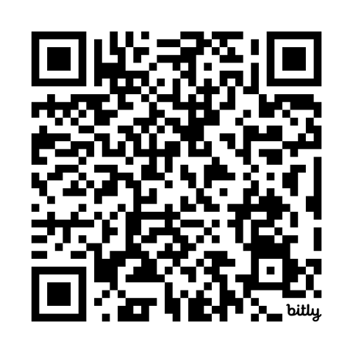


Thank You
Belinda Davis
Belinda.davis1@monash.edu
Supervisors:
Prof Alan Reid, Faculty of Education, Monash University
Prof Briony Rogers, Monash Sustainable Development Institute & CEO Fire to Flourish
Prof Ilan Kelman, UCL, Department of Risk and Disaster Reduction
Recent publication
Davis, B.J. Reid. A. & Rogers. B. (2024).' The Butterfly Effect': Identifying pathways for sustainability transformation through social processes of disaster resilience, Global Sustainability. 7. DOI: https://doi.org/10.1017/sus.2024.44

