Slide 1

10 Things you should know about the new Optional Protocol to CROC
Dr Paula Gerber
Associate Professor
Monash Law School
Deputy Director, Castan Centre for Human Rights Law

Slide 2

Background to the new OP
On 19 December 2011, the UN General Assembly adopted a 3rd Optional Protocol to the Convention on the Rights of the Child (CROC).
This OP establishes a system whereby children can bring a complaint alleging violation of a human right to the UN Committee on the Rights of the Child (CRC).
Prior to the adoption of this OP, the CRC was the only UN treaty committee that had not been empowered to receive communications alleging violations of a human rights treaty.

Slide 3

Background cont.
This OP recognises that states have primary responsibility for respecting and fulfilling human rights. But, when domestic systems do not provide adequate redress for human rights violations their needs to be a ‘back-stop’.
This OP creates a child specific back-stop by allowing children to bring complaints relating to breaches of CROC as well as the two prior OPs which relate to:
  the sale of children, child prostitution and child pornography; and
  the involvement of children in armed conflict.
Drafting of this OP was very quick because many of the provisions replicate the recently drafted OP to ICESCR.

Slide 4

1. Application of the Bests interests of the child principle
Article 2:
“In fulfilling the functions conferred on it by the present Protocol, the Committee shall be guided by the principle of the best interests of the child.”
The best interests principle is to act as an additional test, e.g., in determining the admissibility of a complaint, the CRC must apply the best interests test so as to avoid possible manipulation of child victims where the communication is made for inappropriate purposes, such as advancing the representative’s interests, rather than defending the individual child’s rights.

Slide 5

Application of the Bests interests of the child principle cont.
Only other mention of best interest principle is in Article 3 which requires the CRC to develop child-sensitive procedures that are based on the best interest of the child.
CROC provides that the best interests of the child shall be “a primary consideration”, while the OP provides that the CRC shall be “guided by” the best interests principle. Significance of this different language?

Slide 6

2. Application of the Child’s right to be heard principle
Article 2 provides that the CRC shall:
“have regard for the rights and views of the child, the views of the child being given due weight in accordance with the age and maturity of the child”.
Contrast this with Article 12 of CROC which provides:
“States Parties shall assure to the child who is capable of forming his or her own views the right to express those views freely in all matters affecting the child, the views of the child being given due weight in accordance with the age and maturity of the child.”

Slide 7

Child’s right to be heard cont.
We will have to wait and see whether the CRC will recognise or have regard to forms of communication other than the standard written submission.
Will CRC establish procedures that allow for “non-verbal form of communication including play, body language, facial expressions, and drawing and painting”, as recommended in General Comment 12 in the context of Article 12 of CROC.

Slide 8

3. Protection Measures
Article 4 is designed to ensure that an individual is not subjected to recriminations for bringing a complaint to the CRC pursuant to the OP. It provides that:
1. A State party shall take all appropriate steps to ensure that individuals under its jurisdiction are not subjected to any human rights violation, ill-treatment or intimidation as a consequence of communications or cooperation with the Committee pursuant to the present Protocol.
The identity of any individual or group of individuals concerned shall not be revealed publicly without their express consent.
Paragraph 2 is unique to this OP.

Slide 9

Protection Measures cont.
This provisions indicators that the drafters of the OP were attentive to the vulnerability of children as complainants.
Article 4 seeks to ensure that child complainants will not be harmed for communicating with the CRC.
The threshold for protection measures is “any human rights violation, ill-treatment or intimidation”. This sets the provision apart from protection measures under the OPs to ICESCR and CEDAW both of which use only ill-treatment or intimidation as the threshold.

Slide 10

Protection Measures cont.
The joint NGO working group that campaigned for this OP and was involved in the drafting process behind the scenes argued that the threshold in the OPs to ICESCR and CEDAW were inadequate for child complainants, as they might not encompass the full range of negative measures that children could be subjected to in retaliation for submitting a communication to the CRC.

Slide 11

4. Interim Measures
Article 6 empowers the CRC, in exceptional circumstances, to request a State Party to take steps to avoid possible irreparable damage to a victim of the alleged violation before having made a determination on the merits of the complaint.
Article 6 is identical to the interim measures provisions under the OPs to CEDAW and ICESCR, and in the rules of procedure for the ICCPR, CAT and CERD.

Slide 12
Interim Measures cont.
Failure to comply with interim measures requested by the CRC would appear to breach a State Party’s obligation to respect in good faith the communication procedure established under the OP.
However, Article 6 does not expressly mention an obligation to comply with a request for interim measures.
Too early to know how frequently the CRC will use the interim measures provision or how states will respond to such requests.

Slide 13

5. Complaints concerning economic, social or cultural rights
Article 10(4):
“When examining communications alleging violations of economic, social or cultural rights, the Committee shall consider the reasonableness of the steps taken by the State party in accordance with article 4 of the Convention. In doing so, the Committee shall bear in mind that the State party may adopt a range of possible policy measures for the implementation of the economic, social and cultural rights in the Convention.”

Slide 14
Complaints concerning ESC rights cont.
Article 10(4) uses a reasonableness standard, and recognises that a range of possible measures could meet this standard.
This mirrors the approach developed by the South African Constitutional Court. That Court has preferred using reasonableness to contextually assess compliance with ESC rights obligations and rejected the alternative ‘minimum core’ approach.

Slide 15

Complaints concerning ESC rights cont.
The ‘minimum core’ approach would involves the CRC determining the minimum essential levels of a human right. ie a categorical statement of the contents of each right.
The South African Court has viewed its role in adjudicating ESC rights as limited to determining WHAT government should be doing, not working out the details of HOW it should do it.
Thus, the CRC will be determining whether a State Party’s action is reasonable, as opposed to whether it meets minimum standards.
The reasonableness approach leaves open a wide margin for interpretation by State Parties, with associated vagaries and uncertainty.

Slide 16

6. Following-up CRC Recommendations
Article 11 sets out a mechanism for a State Party to report back to the CRC about action it has taken to give effect to views and recommendations of the Committee.
Such report is to be submitted to the CRC as soon as possible, but in any event within six months.
This provision reflects best practice in the system of individual communications to UN human rights treaty committees.

Slide 17

Follow-up cont.
In 1990, the HRC adopted rules of procedure allowing it to follow up with a State regarding action taken to give effect to its views. It created a Special Rapporteur for Follow-up on Views. This Rapporteur is a member of the HRC, and has a mandate to analyse and report on individual communications.
Commentators have observed that despite the existence of this process, the HRC has not been diligent in following-up with states and it has been accused of exerting minimum effort in this regard.

Slide 18

Follow-up cont.
The system of UN treaty committees reviewing individual complaints has been criticised as being a toothless tiger because states can ignore recommendations with impunity.
The inclusion of a follow-up provision in the new OP to CROC goes some way to addressing this criticism.

Slide 19
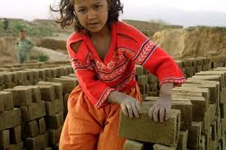
7. Inquiry procedure for grave or systemic violations
Article 13(1) provides that:
“If the Committee receives reliable information indicating grave or systematic violations by a State party … the Committee shall invite the State party to cooperate in the examination of the information and, to this end, to submit observations without delay with regard to the information concerned.”

Slide 20

Inquiry Procedure cont.
This is an important procedure for situations where individuals may be reluctant to bring a complaint to the UN for fear of reprisals.
But … Article 13(7) allows a State Party, at the time of ratification, to declare that it does not recognise the competence of the Committee to conduct such inquiries, in which case the CRC will not have the jurisdiction to inquire into grave or systemic violations absent an individual communication.

Slide 21



Inquiry Procedure cont.
Thus, it is an ‘opt-out’ option.
Contrast this with OP to ICESCR which provides that the committee does not have the jurisdiction to inquire into allegations of grave or systemic violations unless a state has declared that it recognises the competence of the Committee to undertake such inquires, i.e. an ‘opt-in’ provision.
An ‘opt-out’ provision, as in the OP to CROC, is clearly preferable to the ‘opt-in’ provision in the OP to ICESCR, since the default position is that State Parties are subject to the inquiry jurisdiction.

Slide 22
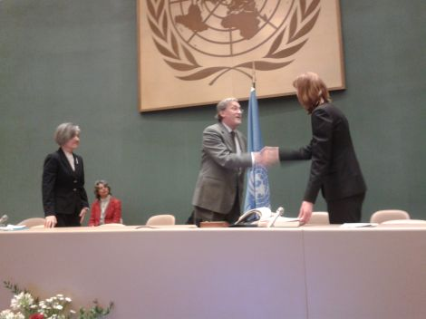
8. Entry into force
OP was opened for signature at a ceremony in Geneva on 28 February 2012.
To date there are 21 states that have signed the OP.
BUT none have yet ratified it.
Article 19: OP only enters into force 3 months after the 10th ratification.

Slide 23

Entry into force cont.
CROC has 193 State Parties, so shouldn’t take too long to achieve 10 ratifications…
OP on sale of children opened for signature on 6 September 2000 and entered into force on 18 January 2002 (16 months).
OP on children in armed conflict, same story (17 months).
BUT… Is the entry into force of the OP to ICESCR a better indicator of when this OP might enter into force?

Slide 24

OP to ICESCR
Adopted by General Assembly in December 2008.
Only eight states have thus far ratified it:
  Argentina,
  Bolivia,
  Bosnia and Herzegovina,
  Ecuador;
  El Salvador;
  Mongolia;
  Slovakia; and
  Spain.
States seem to be in no hurry to submit to a treaty committee's jurisdiction to receive complaints.

Slide 25

Entry into force cont.
Complaints can only be brought in relation to violations that took place after the entry into force of the OP for a particular state. Thus, this instrument will not provide relief for any human rights violations currently being committed.

Slide 26
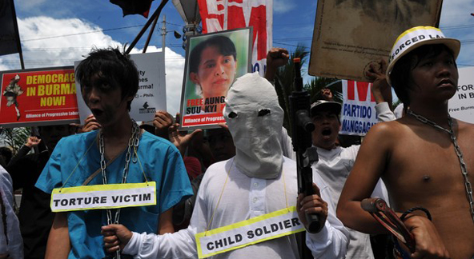
9. Collective Complaints
Previous 8 points all related to what is IN the OP; just as important is what was left OUT.
NGOs lobbied for the inclusion of a provision allowing for collective complaints, but Article 5 simply provides that “communications may be submitted by or on behalf of an individual or group of individuals”.
There are times when it is not possible, or appropriate, for complaints to be brought by named individuals, and it is preferable that a human rights institution or NGO brings a complaint on behalf of unnamed individuals.

Slide 27

Collective Complaints cont.
“Collective complaints are a very effective way to ensure that all children have access to the communications procedure, including those who are not in position to bring complaints and those who cannot be identified, for instance victims of forced marriage or victims of child pornography.”
Ellen Stie, Advocacy Manager at Save the Children

Slide 28

Collective Complaints cont.
The African Charter on the Rights and Welfare of the Child provides that:
“The Committee may receive communication, from any person, group or nongovernmental organization recognized by the Organization of African Unity, by a Member State, or the United Nations relating to any matter covered by this Charter.” [Emphasis added] (Article 44)

Slide 29
10. Normative development of children’s rights
Primary function of the OP is to provide redress for violations of children’s rights.
But, there is a secondary function, namely providing an opportunity for the normative development of children’s rights.
Juridical analysis of the rights in CROC and the two preceding OPs has the potential to significantly increase understanding of the normative content of the rights contained in these instruments.

Slide 30
Normative development cont.
The absence of any case law has been a significant obstacle to the normative development of children’s rights. The CRC’s jurisdiction to adjudicate complaints presents a long overdue opportunity for it to provide clarity and precision to the language of CROC which can be vague and imprecise.
Thus, this OP has the potential to not only remedy individual violations but to overcome a “key barrier to normative development” of children’s rights.
Marcus, David ‘The normative development of socioeconomic rights through supranational adjudication’ (2006) 42 Stanford Journal of International Law 53, 55.

Slide 31
Conclusion
The communications procedures established under other optional protocols are open to all individuals, including children.
However, none of these procedures were developed with the special status of children in mind, none cover the full gamut of children’s rights set out in CROC and the two preceding OPs, and none allow for a complaint by a child to be considered by a committee made up of experts in children’s rights.
For all these reasons, this latest OP is a very welcome addition to the body of international human rights law.

Slide 32

Conclusion
“This must be considered as the greatest legal victory for the children of the world in 22 years”.
Michael French, Save the Children UN representative in Geneva.

