Slide 1
Periodic Reporting under UN Human Rights Treaties
The Government’s report to the Committee on the Rights of the Child
4 – 5 June 2012
Notes:
1

Slide 2
Overview
Introduction to the treaty reporting cycle
Preparation of treaty reports
Key steps
Appearance before a Committee
Key Steps
Concluding Observations and follow-up

Slide 3
Australia’s reports & appearances
ICCPR
5th Report: 2007
Appearance March 2009
ICESCR
4th Report: 2007
Appearance: May 2009
CEDAW
CAT
4th Report: 2005
Appearance: April 2008
6th and 7th Report: 2008
Appearance: July 2010
CRC and OPs
4th Report (& initial reports for OPS):
2009
Appearance: June 2012
CRPD
1st Report: 2010*
Appearance: ? 2012?
CERD
15th-17th Report: 2009
Appearance: August 2010

Slide 4
Treaty reporting cycle
Submission of Periodic Report
Consideration by Treaty Committee
‘List of Issues’ given to State Party
‘Written Response’ to List of Issues submitted [and NGO Shadow Report]
‘Constructive dialogue’/ appearance before Committee
‘Concluding Observations ‘ Issued
Follow Up work and
Preparation of Periodic Report

Slide 5
Key steps for Government
Preparation of Periodic Report
Written response to List of Issues
Preparation for Committee Appearance
Committee appearance
Follow-up to Concluding Observations

Slide 6
1. Preparation of Treaty Reports

Slide 7
Preparation of periodic report
In Australia, typically there are 6 main stages in preparing a periodic report
Stage 1: Prepare skeleton draft of report
  Check Rules of Procedure
  Identify key issues
  Prepare structure and headings
  Draft ‘skeleton’ response

Slide 8
Periodic report continued …
Stage 2: Circulate draft to relevant Federal Government departments for input
  Identify relevant areas of Federal Government and the articles of the treaty they are responsible for
  Provide advance notice to departments of reporting process and timeframes
  May need to consult further and amend draft report
Notes:
8

Slide 9
Periodic report continued ...
Stage 3: Consult on draft with States and Territories (SCOT)
  Identify relevant areas of State and Territory Governments and the articles of the treaty they are responsible for
  Provide advance notice to departments of reporting process and timeframes
  May need to consult further and amend draft report

Slide 10
Periodic report continued …
Stage 4: Seek the views of the general public
  e.g. NGO input

Slide 11
Periodic report continued ...
Stage 5: Inform responsible Government agencies (Federal + State and Territory) about comments
  May need to consult further and amend information
  Also constitutes final update to and clearance of report

Slide 12
Periodic report continued ...
Stage 6: Ministerial clearance and lodgement with UN

Slide 13
2. Written response to List of Issues

Slide 14
List of Issues
Questions on general issues and specific cases, and requests for statistics/data
Consult with relevant departments and States and Territories
Draft response
Ministerial clearance
Lodge with the UN within stated time frame (allow sufficient time for translation)

Slide 15
3. Preparation for Committee
Appearance

Slide 16
Preparing delegation briefing
Key steps:
  Identify issues (‘briefing matrix’) and prepare briefings
  Prepare delegation briefing material
  Draft Opening Statement
  Draft Summary Statement (if required)

Slide 17
4. Committee Appearance

Slide 18
Appearances
One or two days; only a few hours in total
Geneva or New York
Purposes:
  To answer questions relating to the periodic report, the Written Response and any other issues relating to the implementation of treaty obligations
  To provide the Committee updates on progress
  To identify and acknowledge areas that need improvement/more work – especially priority issues

Slide 19
Committee Appearance
Opening Statement [& Summary Statement (if required)]
Gathering questions
Responding to questions – techniques
Coordinating with Government
  Key contacts in New York/ Geneva, at your department and other relevant Federal and State+ Territory departments
  Advise key contacts of procedure relating to Committee appearances and timeframes
  Processes for gathering further information if requested by the Committee

Slide 20
Committee appearance continued ...
Reviewing UN press release at end of day
Managing media reporting
The role of non-government organisations (NGOs) and national human rights institutions

Slide 21
5. Follow-up to Concluding Observations

Slide 22
Concluding Observations and Follow-up
Anticipate Concluding Observations
Prepare press release
Review Concluding Observations
Identify priority areas for follow-up
Circulate to all stakeholders (AG publicises on website)
Develop plan for follow-up
Use as the basis for next periodic report

Slide 23
Further follow-up
Several Committees request information on follow-up action on particular Concluding Observations/recommendations within one year
Sometimes there are additional requests for further information – eg CAT Committee

Slide 24
The role of civil society/NGOs
Increasingly NGOs are playing an important role in the treaty reporting process, e.g.
  Shaping the list of issues
  Providing a detailed and co-ordinated Shadow report
  Meeting with the Committee and attending the appearance
NGOs comment on concluding observations and monitor Government’s follow up.

Slide 25
Third Optional Protocol to CRC
The Government is currently considering its position in relation to this instrument
Submissions from public were invited on website
Consultations within government are continuing

Slide 26
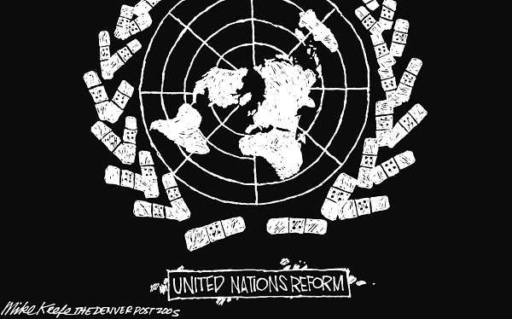

Slide 27
Any questions?
Further information published on website
http://www.ag.gov.au/Humanrightsandantidiscrimination/Pages/Humanrights.aspx#reports

