Slide 1






SCALING UP DELIVERY OF MINDFULNESS BASED COGNITIVE THERAPY - A CONTRIBUTION TO STRATEGIC HEALTH SERVICES PLANNING THROUGH APPLICATION OF AGENT-BASED MODELLING.
.
`

Slide 2
Contributors
G. Meadows ¹
J. Enticott ¹
M Ozmen¹
S. Patten ²
F. Shawyer ¹
A. Prodan ³
J Atkinson ³
¹Monash University, Psychiatry, Melbourne, Australia
²University of Calgary, Departments of Community Health Sciences and Psychiatry, Calgary, Canada
⁴ Sax Institute, Sydney
Notes:
contributors

Slide 3
Background and aims:
As an intervention to reduce recurrence of Major Depressive Episodes (MDEs), Mindfulness Based Cognitive Therapy (MBCT) is firmly evidence-based including positive health economic evaluations. However, MBCT is typically available to very few of those it could benefit.
Scaling up MBCT delivery to have substantial population health impact invites questions including of MBCT’s overall funding priority, then about training and credentialing strategies.
Exploring possible scenarios for wide-scale MBCT implementation is difficult to do through real-world experiments, and here we explore how application of contemporary simulation modelling techniques may add information on how best to scale-up MBCT delivery and possible resulting population-health impact.
Notes:
From the Abstract

Slide 4
MBI RESEARCH – FAILNG TO BRIDGE THE IMPLEMENTATION GAP
Dimidjian S, Segal ZV. Prospects for a clinical science of mindfulness-based intervention. Am Psychol. 2015;70:593-620.
Notes:
Research heavily weighted to stage 1 with insufficient attention paid to other stages, especially III-V

Slide 5
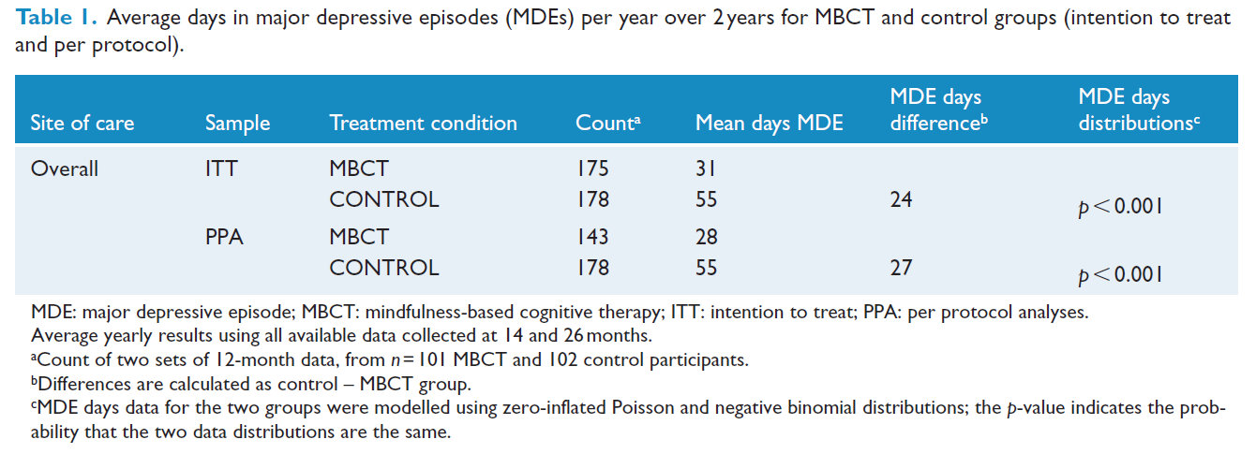
Notes:
One of our contributions so far – an effectiveness study with health economics outcomes that gave us indications for modelling for instance in regards to the distribution

Slide 6
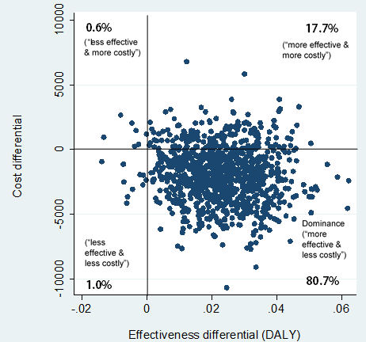
Cost-effectiveness
Notes:
CE Plane for MBCT

Slide 7


ARC Linkage project team
Prof Graham Meadows
Peter Gibbs
Prof Brett Inder
Prof Scott Patten
Dr Lee Gordon-Brown,
Dr Mehmet Ozmen
Dr Joarder Kamruzzaman,
Dr Gour Karmakar
A/Prof Fiona McDermott
Dr Simon Albrecht

Slide 8
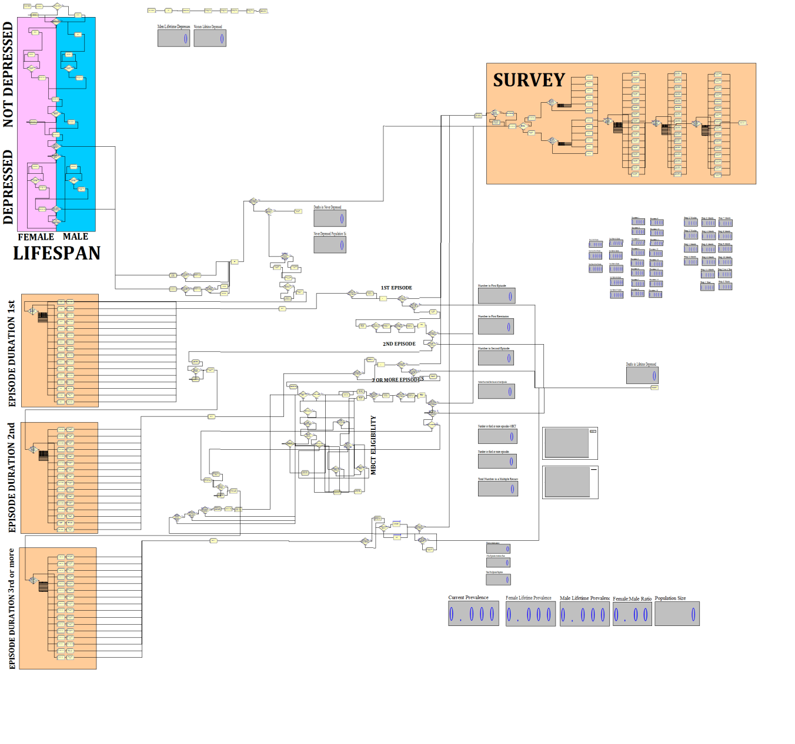
MDD Population Epidemiology and MBCT Treatment Simulation Process Layout
Notes:
Please find attached new slides:
A) Composite of current model
B) Uptake scenario
C) Current (1yr) and LTime Prev by Gender
(1) Raw with st.devs.
(2) Percentage
(3) In terms of population (using Aus. data - just as bonus I also did Germany, since you're presenting there)
(4) Population with relevant Deltas
D) Overlapping distributions across simulation runs (baseline vs MBCT results histograms with 150 sim each (300 total)) (purple = overlap ->means baseline and MBCT scenarios yielded same results) -> I think this a slide to spend some time on (effect marginal for men, distribution shifting for women). Any boffin worth their salt will consider dispersion of results, can even mention that using a small simulation population so expanding simulation pop may tightened dispersion.
E) Number of episodes (sorry, didn't get resolution we were after, hence not much to say here (consider not using, all within margin or error)... would have needed to bump sim population and significantly re-engineer... gave up after spending three days on it... would have had to recalibrate sim from scratch to change population)
Tommorrow: Model diagram + other minor things.
Not this time: Durations -> broke durations when implementing scenario-builder. They are fine in the model, but data doesn't extract... attempted fixing, decided easier to rebuild internal survey from scratch (but not within two days).

Slide 9
Notes:
Please find attached new slides:
A) Composite of current model
B) Uptake scenario
C) Current (1yr) and LTime Prev by Gender
(1) Raw with st.devs.
(2) Percentage
(3) In terms of population (using Aus. data - just as bonus I also did Germany, since you're presenting there)
(4) Population with relevant Deltas
D) Overlapping distributions across simulation runs (baseline vs MBCT results histograms with 150 sim each (300 total)) (purple = overlap ->means baseline and MBCT scenarios yielded same results) -> I think this a slide to spend some time on (effect marginal for men, distribution shifting for women). Any boffin worth their salt will consider dispersion of results, can even mention that using a small simulation population so expanding simulation pop may tightened dispersion.
E) Number of episodes (sorry, didn't get resolution we were after, hence not much to say here (consider not using, all within margin or error)... would have needed to bump sim population and significantly re-engineer... gave up after spending three days on it... would have had to recalibrate sim from scratch to change population)
Tommorrow: Model diagram + other minor things.
Not this time: Durations -> broke durations when implementing scenario-builder. They are fine in the model, but data doesn't extract... attempted fixing, decided easier to rebuild internal survey from scratch (but not within two days).

Slide 10
MBCT Uptake Scenario (after MDE>3)
Uptake | Male | Female
Immediate | 10% | 30%
Never | 50% | 30%
With 10% probability at each additional episode | 40% | 40%

Slide 11
Current and Reported Lifetime Prevalence
Simulated (150 Iterations)
 | Population |  | Female |  | Male
 | Baseline | MBCT | Baseline | MBCT | Baseline | MBCT
1 Year Period Prevalence | 2.62% | 2.38% | 3.22% | 2.81% | 2.03% | 1.96%

Slide 12
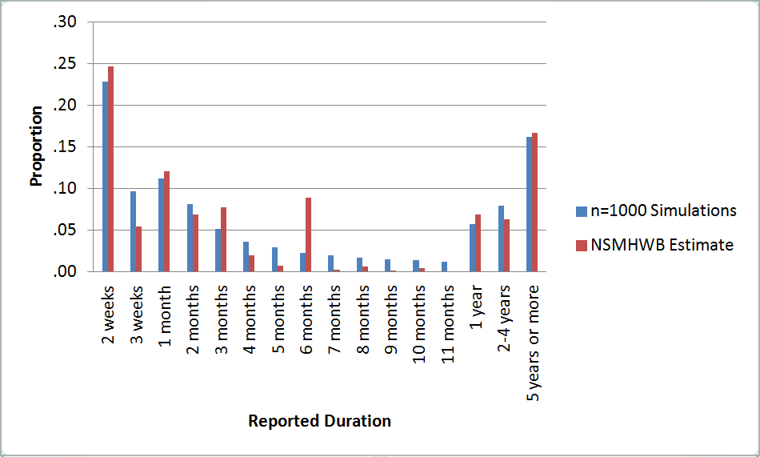
Survey and Simulation Durations
Survey bias towards six months
Model spreads these
across other time periods

Slide 13
Materials and methods:
Individual agents in an Agent Based Model (ABM) are born into a software simulation ‘world’ with rules governing occurrence and persistence of MDEs through time until death.
On models typically including agents representing several thousand MBCT-eligible people, with animated representations, population depression prevalence and time-in MDE are calibrated against known survey results.
The model then introduces MBCT provision including probability of referral, numbers of instructors, gender-varying acceptability of MBCT, waiting behaviour and MBCT group delivery with associated costs.
Following MBCT completion, agents are assigned different time-courses for MDEs based on locally generated effectiveness data.
The model simulates impact through time of various implementation scenarios on levels of instructor experience, on one-year prevalence, days-depressed and Disability Adjusted Life Years as capturing health utility.
Notes:
From the Abstract

Slide 14
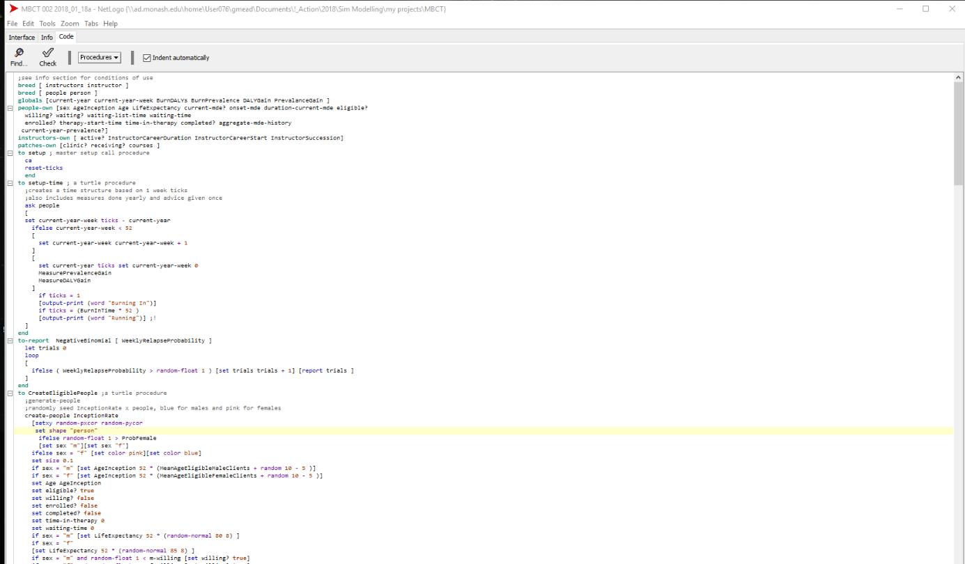
Netlogo code
Notes:
So this is a task that requires writing some code

Slide 15
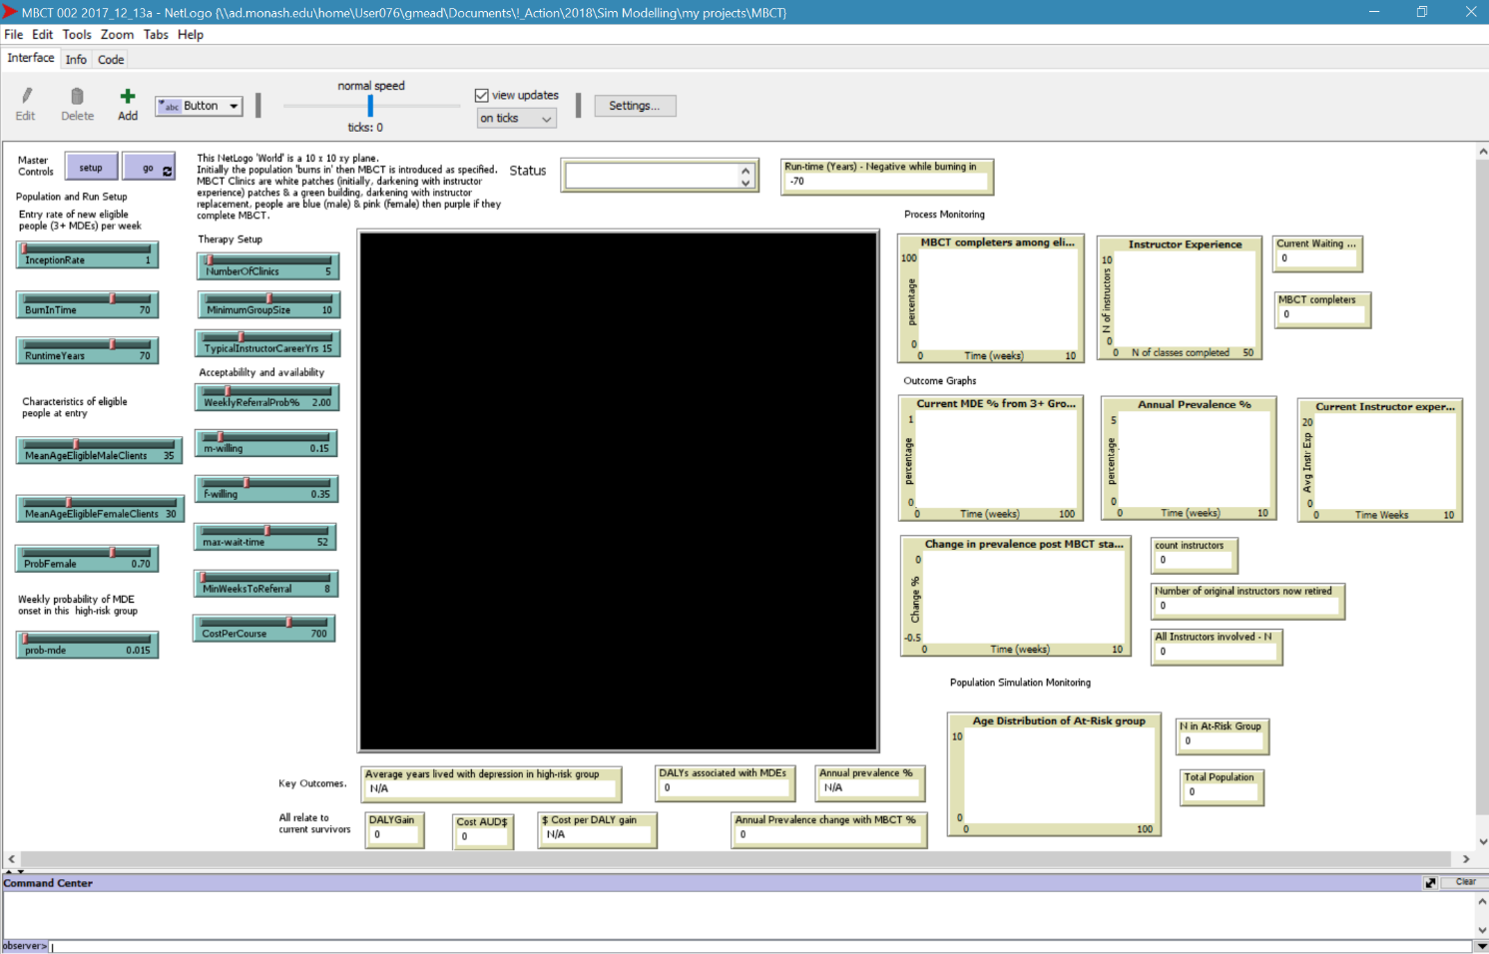
Notes:
This is what the interface typically looks like for this model, with minor task-specific variations

Slide 16
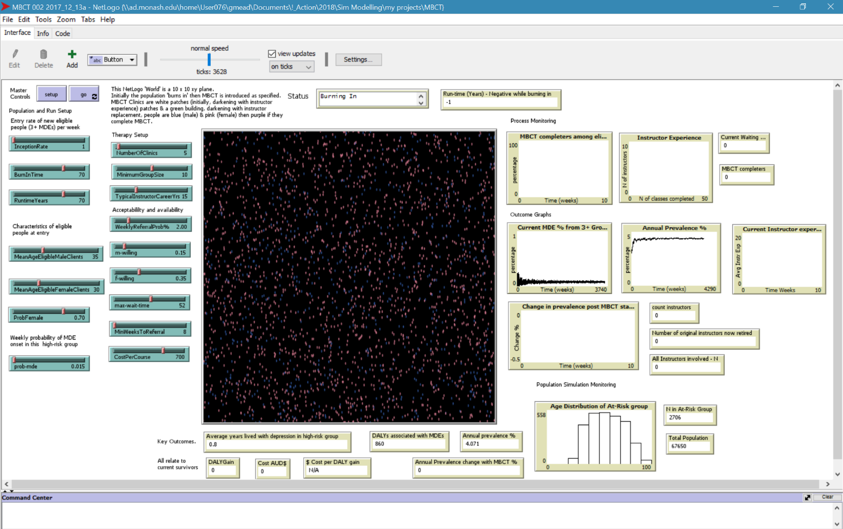
Notes:
Here’s it burning in

Slide 17
Implementing a negative binomial distribution in the software
to-report NegativeBinomial [ WeeklyRelapseProbability ]
let trials 0
loop
[
ifelse ( WeeklyRelapseProbability > random-float 1 )
[set trials trials + 1]
[report trials ]
]
end
Notes:
Here’s how we model the earlier noted distribution

Slide 18
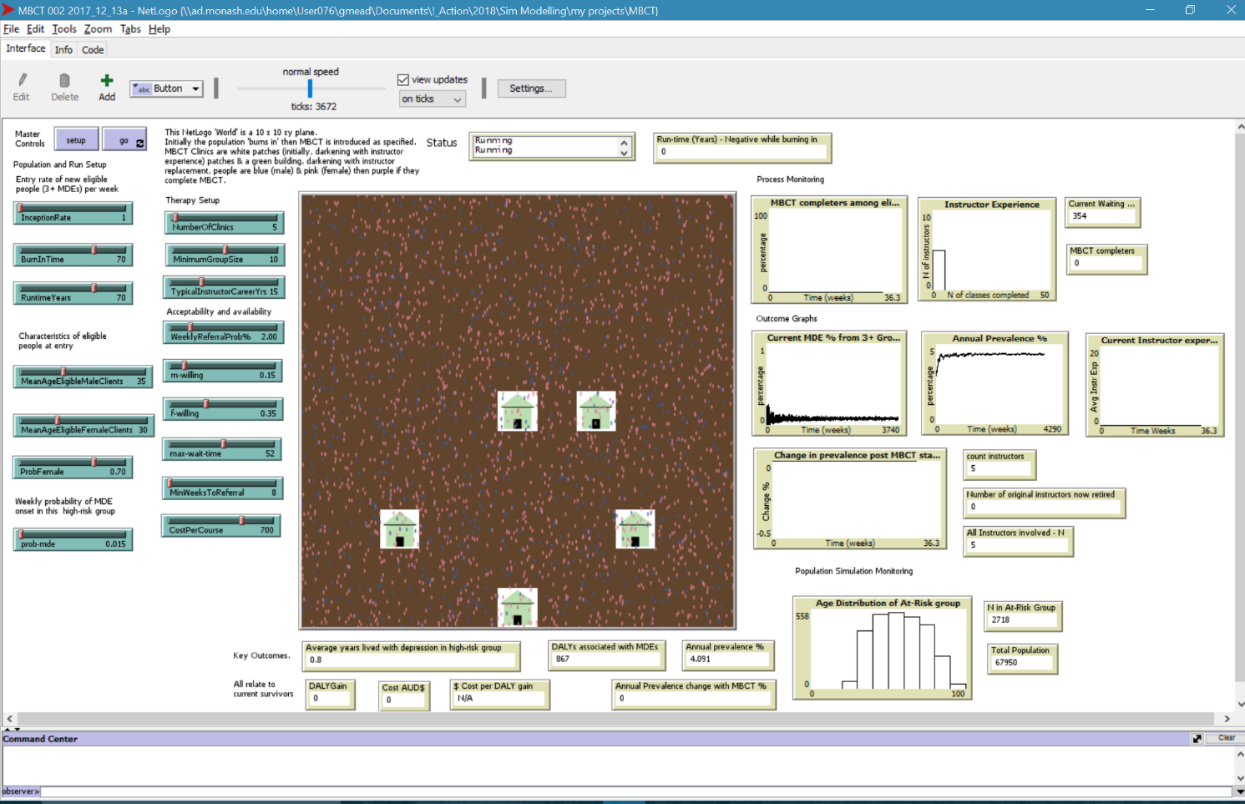
Notes:
Here’s introduction of the clinics into the burned in population

Slide 19
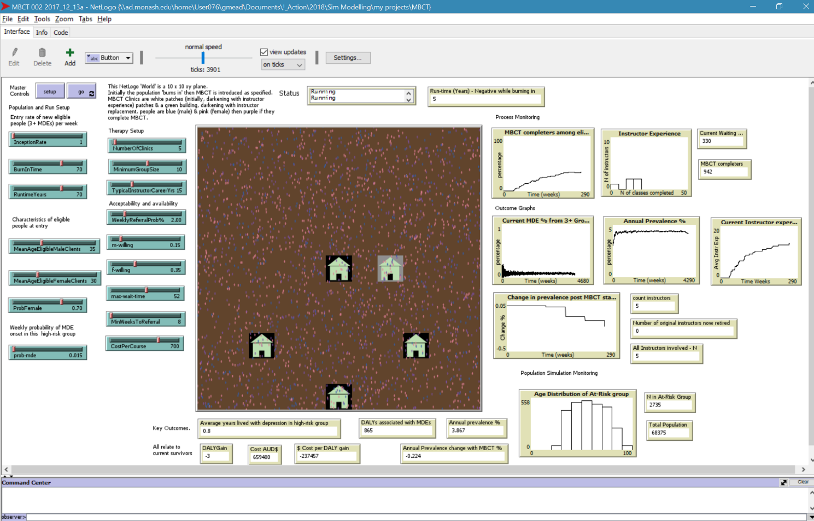
Notes:
5 years in

Slide 20

Notes:
20 years in

Slide 21
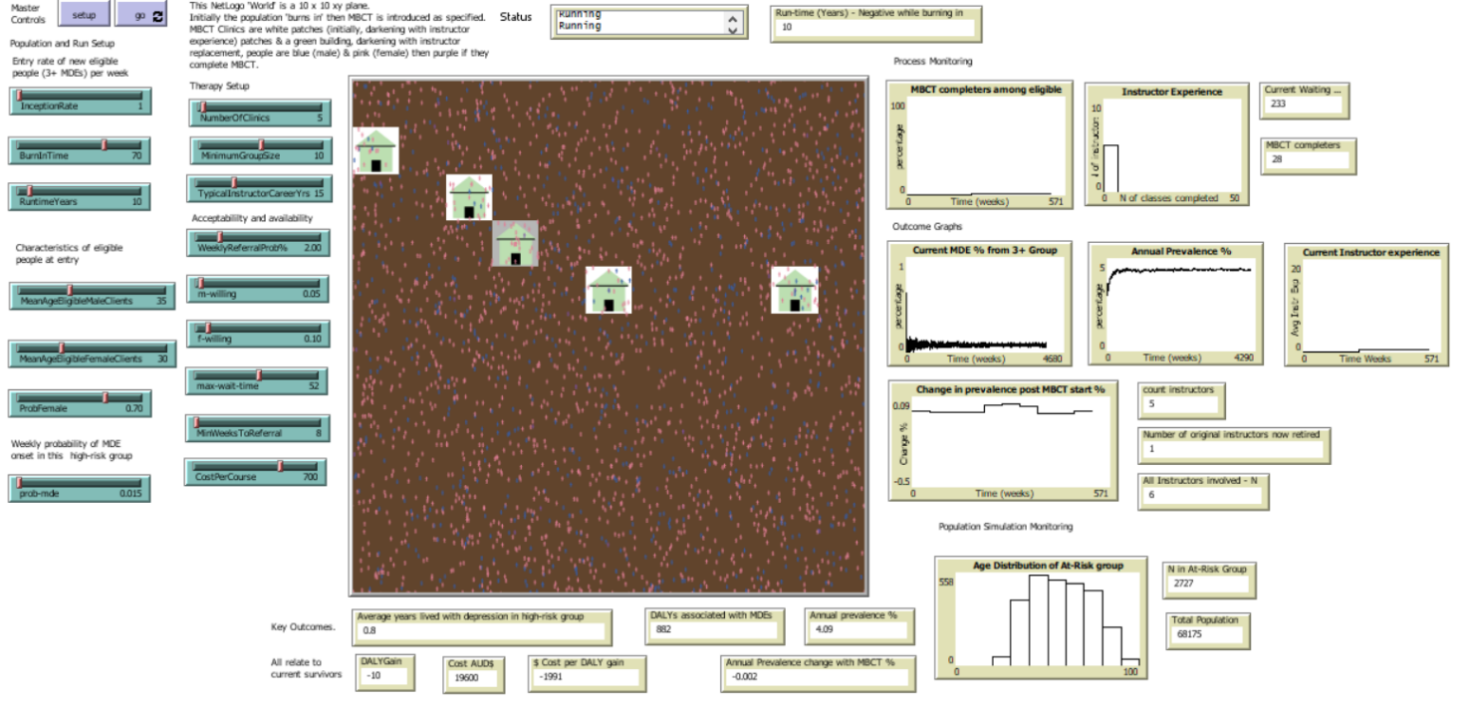
Sensitivity to treatment acceptability
-0.002%
Notes:
Low treatment acceptability, minimal impact

Slide 22
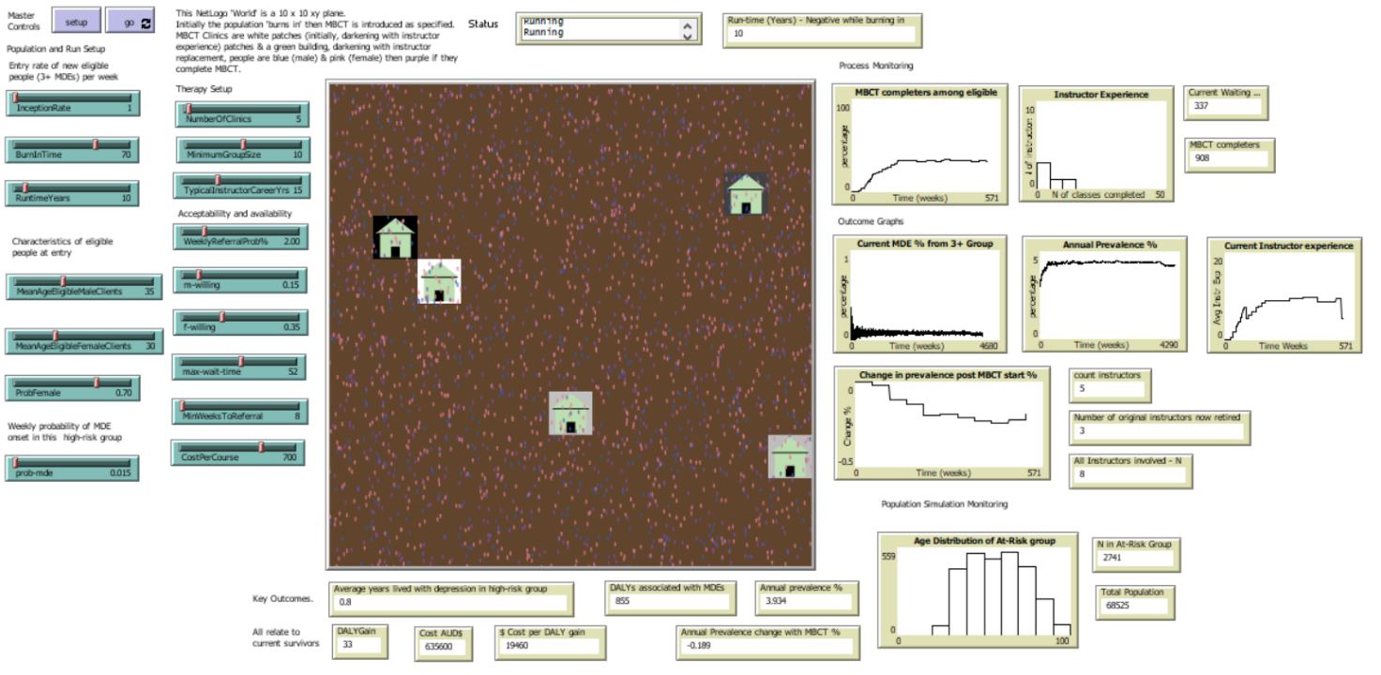
Sensitivity to treatment acceptability
-0.189%
Notes:
Medium treatment acceptability, medium impact

Slide 23
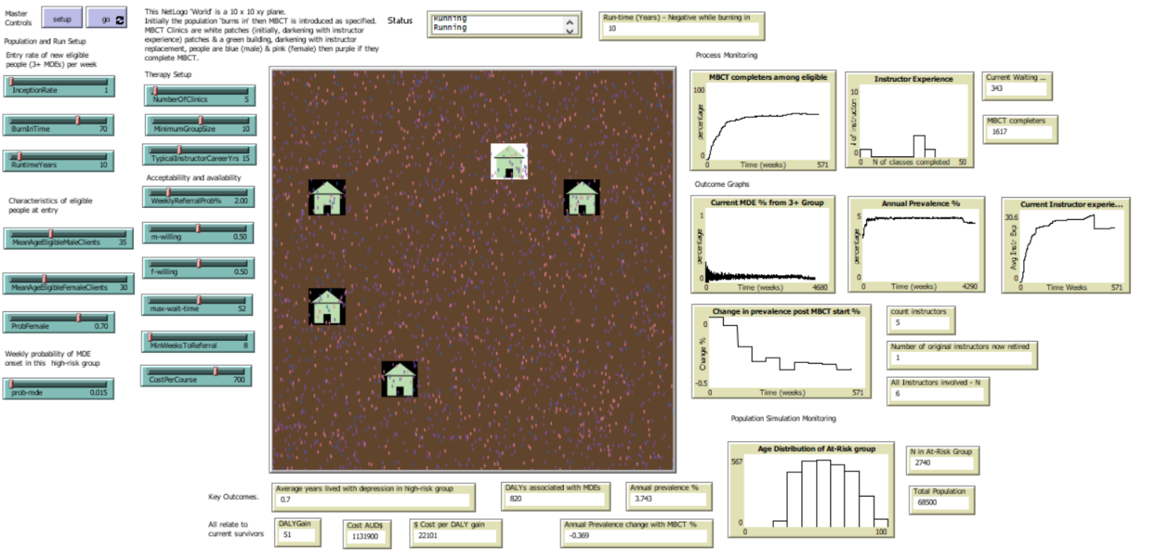
Sensitivity to treatment acceptability
-0.369%
Notes:
High treatment acceptability, high impact

Slide 24
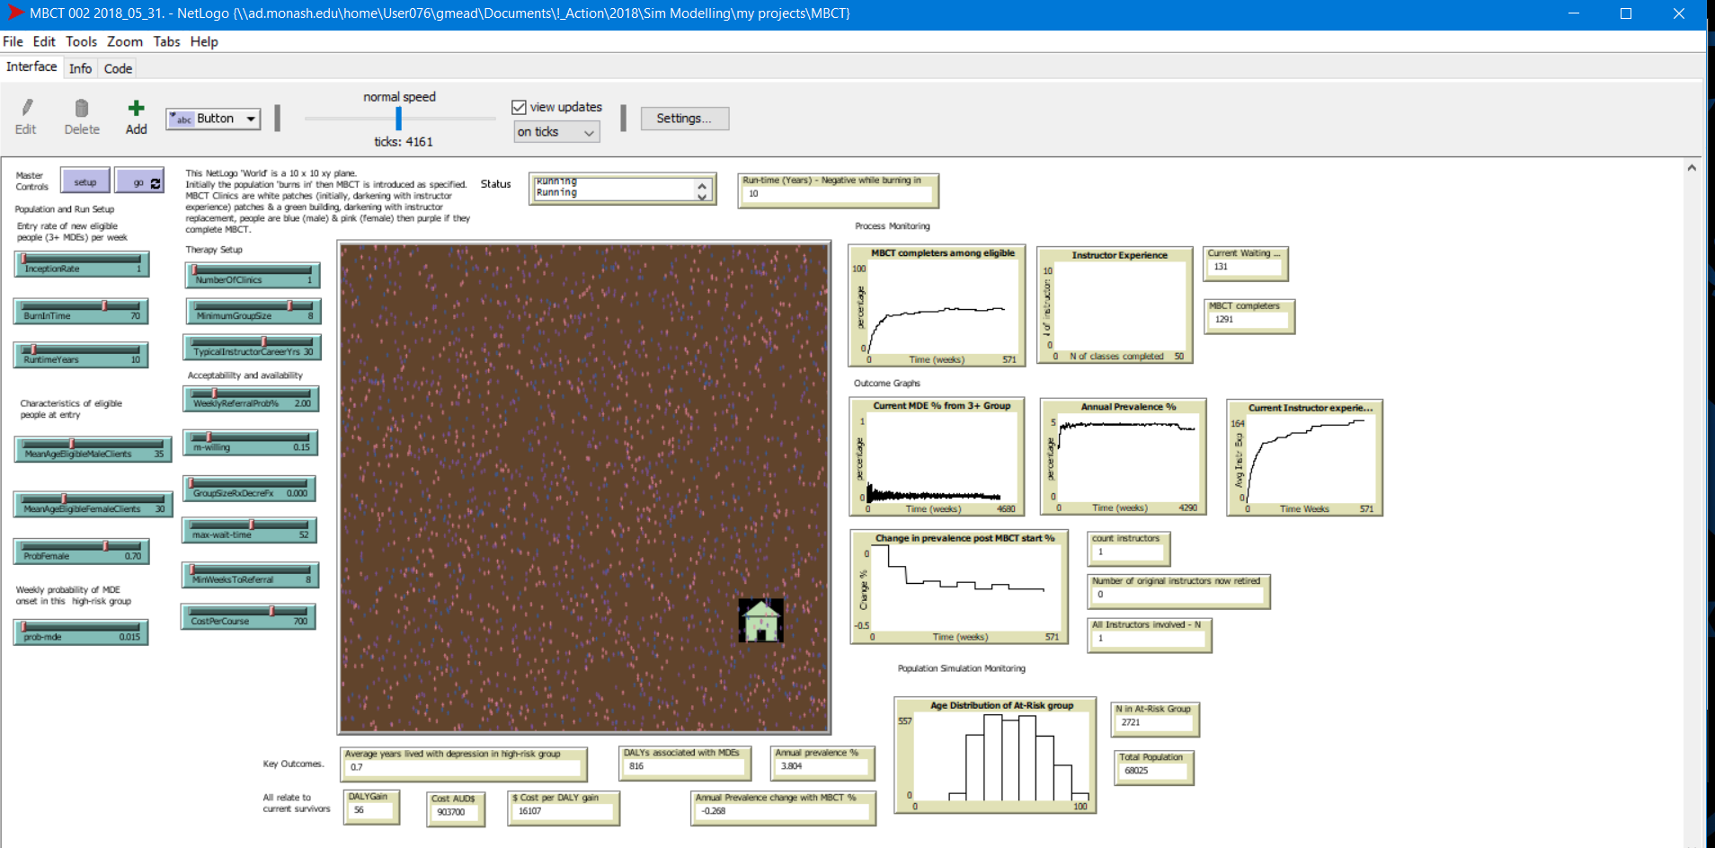
Trading off access with instructor experience
-0.268%
Notes:
Only one instructor who then gets lots of experience but has not so much population health impact and a long waiting list

Slide 25
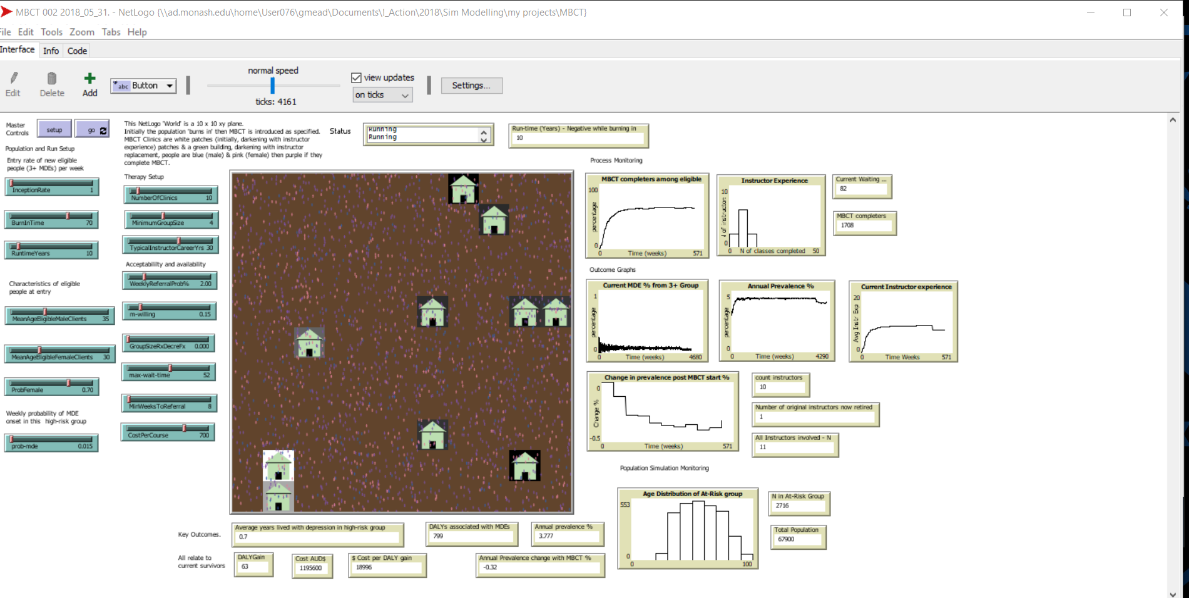
Trading off access with instructor experience
-0.320%
Notes:
10 instructors, not much experience but greater population health impact

Slide 26
Group size and population impact 1 – no change in treatment effect
Notes:
Assuming treatment effect is constant across all group sizes, then the smaller the group, the greater the population health impact

Slide 27
Group size and population impact 2 –effect reduces with smaller groups
Notes:
But if we decrement clinical effectiveness as group size decreases then the trend reverses

Slide 28
Group size and acceptability interaction
Notes:
Here we see the different patterns of influence of group size on population health impact against different willingness settings

Slide 29
Results:
Modelling suggests the possibility of an overall 0.2% reduction in population one-year prevalence of MDEs with health-gain accumulating over decades.
A trade-off emerges between the priorities of maximising access and of developing a sustainable pool of expert providers who can train others.
Health economic properties for MBCT at large scale are positive.
Notes:
From the Abstract

Slide 30
Conclusions:
This work provides estimates for likely impact of MBCT at implementation scales and over timelines that would be impossible to design as real-world experiments.
ABM as a technique is valued not only for answering questions for also for generating them; arising from this modelling we can see research questions related to what may constitute an ideally balanced strategy for defining competencies for delivery and for training others.
Notes:
From the Abstract

