Slide 1
2022 ICVG Conference: Governance in its institutional context
Monash Business School
Government in Business: Empirical evidence from an emerging market
Authors: Giang Hoang, Daisy Chou, Darren Henry and KB Oh
Presenter: Giang Hoang
‹#›

Slide 2
Agenda
Motivation
Introduction
Prior Literature
Research Design
  Findings
  Q&A
‹#›

Slide 3

Motivation
Before the Doi Moi reform in 1986, Vietnam was one of the poorest counties in the world.
After three decades: A middle-income country, described as “a success story” by the World Bank.
Moving forward in the next 2-3 decades: Top 20 advanced countries in the world, The Next Eleven, known as N-11 (Jim O’Neil, 2018)
Phoenix rising from the ashes

Slide 4
Motivation
  History of Vietnamese enterprises with
  unique agency problems
  Until early 1990s
SOEs with full state control
Complex corporate landscape
A mixture of government linked & family-based firms
  Strong need for privatisation
Young and small private enterprises
  Strong need for expansion
‹#›

Slide 5
Motivation
  History of Vietnamese enterprises with
  unique agency problem
  Until late 1990s
SOEs with state ownership
Unique agency problems
Shareholders vs Managers
Controlling shareholders vs Minority shareholders
State shareholders vs others
Foreigners vs local shareholders
  Different state representatives
  Institutional investors
  Foreign investors
  Private shareholders
Young and small private enterprises
  Dominant founding shareholders
  Other shareholders
‹#›

Slide 6
Who represents state ownership in equitised SOEs?
Agencies | 2000 | 2011
Central government ministry | 31.29 | 31.79
Local authority | 63.44 | 57.79
State corporation and economic group | 5.27 | 10.42
Total | 100 | 100
(Source: OECD, 2013)
‹#›

Slide 7
Motivation
In 2005, the Government of Vietnam established a state fund (SCIC- State Capital Investment Corporation) to act as a professional investor in the equitised companies with state ownership.
The SCIC is also different from other Government-linked firms such as Temasek of Singapore, Khazanah Nasional and Permodalan Nasional Berhad of Malaysia and State Asset Management Bureaus of China.
Role of SCIC in the context of Vietnam’s listed companies???
‹#›

Slide 8
Prior Literature
Government stakes are generally argued to be less efficient than private stakes because of lower managerial objectives although the empirical findings are inconsistent (Megginson and Netter, 2001)
State shareholders: bureaucratic and corporate shareholders
  Bureaucratic state shareholder: Political and managerial perspectives => Poor performance
  Corporate state shareholder: mixed evidence
‹#›

Slide 9
Some empirical studies
Certain types of state ownership can be superior to private ownership when the institutional environment is relatively underdeveloped and law enforcements is capricious and weak.
Certain types of state ownership help increase firm performance
(Chen, Firth and Xu, 2009)
‹#›

Slide 10
Some empirical studies
There was no evidence that the GLCs were less profitable than non-GLCs. (Feng et al, 2004)
Singaporean GLCs have higher valuations and better corporate governance than a control group of non-GLCs. (Ang and Ding, 2006)
‹#›

Slide 11
Vietnamese setting
Vietnam stock market
  Establishment in 2000. Stock exchanges: HOSE, HNX (Now VNX)
  Total market cap: US$ 188, equivalent to 74% of the country’s GDP in 2022.
Stock Exchange | No. of companies (2015) | No. of companies (2022) | Market cap (Billion, US$, 2015) | Market cap (Billion, US$, 2022)
HOSE | 301 | 385 | 42 | 173.15
HNX | 359 | 342 | 5.5 | 14.09
UpCOM | 176 | 860 | 1.5 | 40.05
Total | 856 | 1,587 | 49 | 187.24
SCIC-linked | 82 listed companies (2015)
‹#›

Slide 12
Vietnamese setting
SCIC – established in 2005
Portfolio as of 12/2015: 361 firms with book value of USD 700 mil, 82 firms are listed on stock exchange.
Portfolio category | Description | Weight (%)
Group A (17 firms) | Large-scale firms in key industries | 70%
Group B (80 firms) | Mid-sized firms with its charter capital of USD 5 million or more | 19%
Group C (264 firms) | Small and poor performing | 11%
 |  | 100%
‹#›
(Source: SCIC, 2015)

Slide 13
Research design
Research questions:
      Is there any difference that the SCIC is able to make as a professional investor?
Sub-research questions:
  How does a certain announcement made by SCIC (buy, sell, appointment) affect the reaction of stock price?
  Is there any difference of this impact between high state ownership and low state ownership firms?
  How does SCIC’s ownership influence on stock returns of its linked companies?
‹#›

Slide 14
Research design
Hypotheses:
  Hypotheses 1,2,3: There is a positive stock price reaction to buy, sell and board member appointment announcements by the SCIC to linked firms.
  Hypothesis 4: There is a significant difference in price reactions around SCIC announcements between the group of firms with high SCIC ownership and the group of firms with low SCIC ownership. (50% as a cut-off level)
  Hypothesis 5: SCIC ownership is positively related to CAR of its linked companies.
‹#›

Slide 15
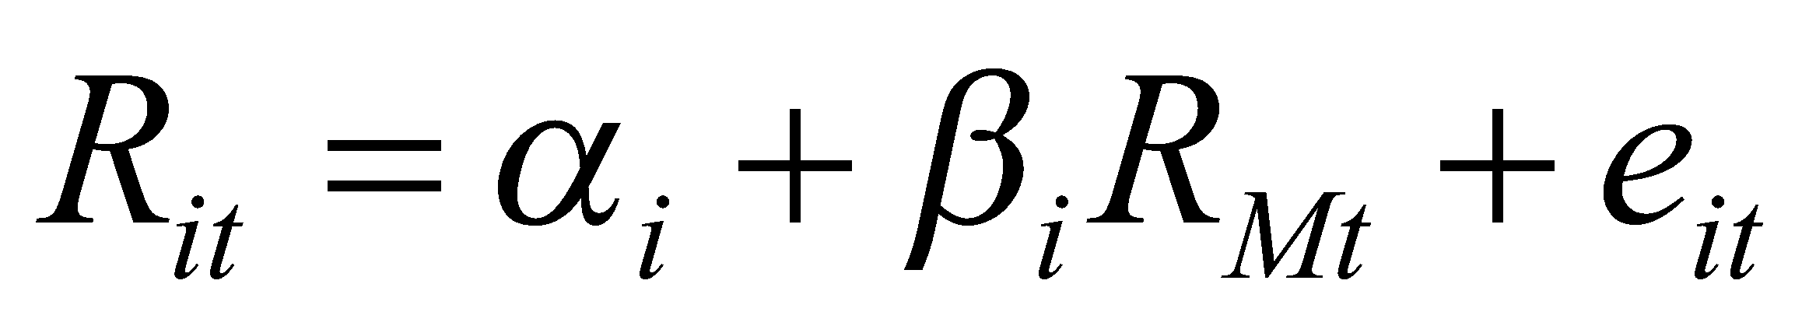
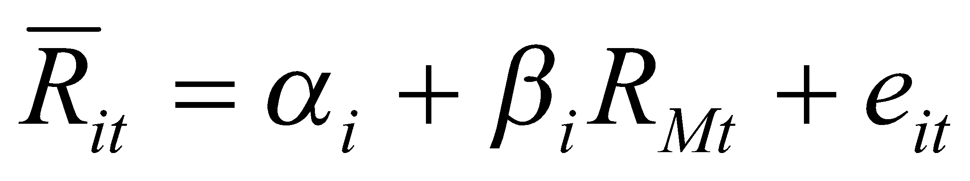
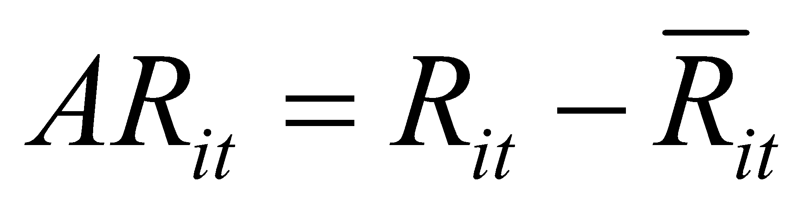
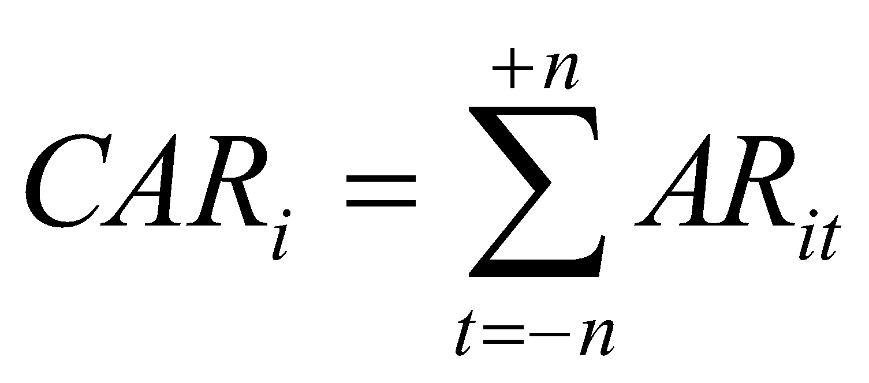
Research Design
Method: Event study
Use the method of calculating AR based on the market model.
  In the estimation period: (1)
  In the event time window: (2)
  In the event time window: (3)
  In the event time window of (-n; +n) (4)
SCIC’s announcements
CAR
SCIC’s announcements
‹#›

Slide 16
Research Design
Sample size: 82 firms with 160 observations collected from early 2006 until mid-2015.
Data source:
  HOSE and HNX, Vietnam: Event dates and other firm-specific data
  Datastream: Returns, prices
Announcement type:
  Sell
  Buy
  Appoint
Measurement windows
- 252th day - 44th day -nth day +nth day
Estimation period Event time window
Announcement date (0)
‹#›

Slide 17
Findings: Cumulative abnormal returns to SCIC-linked firms’ shareholders
This table reports mean and median cumulative abnormal return(in percentage) employing the market model for SCIC’s announcements for the period starting from n days before to n days after the announcement. Significance levels of mean and median abnormal returns are reported in parentheses using the t-test statistic and Wilcoxon signed rank test statistic respectively. ***, ** and * indicate statistical significance levels at the 1%, 5% and 10% respectively.
 | Buy |  | Sell |  | Appointments
 | Mean | Median | Mean | Median | Mean | Median
AR(0) | 0.0131*** (5.4351) | 0.0081*** (3.9200) | 0.01403*** (7.1708) | 0.01006*** (3.6937) | 0.0255*** (8.7177) | 0.0158*** (4.2978)
CAR(-1,1) | -0.00101 (-0.2422) | -0.3194 (0.3661) | 0.0116* (1.6901) | 0.0034* (1.706) | 0.0113 (1.1672) | 0.0004 (0.9590)
CAR(-2,2) | -0.00596 (-0.875) | -0.0064 (0.913) | 0.1263 (1.2078) | 0.0082 (0.6080) | 0.0134 (1.4700) | 1.094 (1.309)
CAR(-3,3) | -0.0026 (-0.2700) | -0.0021 (-0.4850) | -0.0038 (-0.5800) | 0.0066 (-0.421) | 0.0252** (2.3200) | 0.0127** (2.495)
CAR(-4,4) | -0.0183 (-1.3300) | -0.0319 (-1.1950) | -0.0057 (-0.300) | -0.1040 (-0.280) | 0.0252** (2.1900) | 0.0025* (1.9050)
CAR(0,1) | -0.0015 (-1.1618) | -0.0023 (-0.5600) | 0.0194** (2.5300) | 0.0082** (2.296) | 0.0189** (2.8900) | 0.0002** (2.391)
CAR(0,2) | -0.0083 (-0.329) | -0.0406 (0.968) | 0.0023 (0.500) | 0.0026 (0.561) | 0.0186*** (2.8000) | 0.0082*** (3.3500)
CAR(0,3) | -0.852 (-0.154) | -0.0231 (-0.1824) | 0.0225* (1.924) | 0.0087 (1.460) | 0.0149** (1.8800) | 0.0052** (2.5570)
CAR(0,4) | -0.0015 (-0.1600) | -0.0023 (-0.560) | 0.0082 (0.6900) | -0.0067 (-0.280) | 0.0244** (2.5200) | 0.0172*** (2.797)
‹#›

Slide 18
Findings: Appointment announcements
This table reports mean and standard deviation of cumulative abnormal return (in percentage) employing the market model for SCIC’s appointment announcements for the period starting from n days before to n days after the announcement. This table also provides t-test statistics for the difference in mean abnormal returns across the different groups.
 | Low ownership group (0) |  | High ownership group (1) |  | Difference (0) – (1)
 | Mean | STDEV | Mean | STDEV | Mean Dif.
AR(0) | 0.01306 | .01633 | 0.00581 | 0.00333 | 0.00725 (0.9692)
CAR(-1,+1) | -0.0019 | 0.0050 | 0.0035 | 0.0102 | -0.0055 (-0.5249)
CAR(-2,+2) | 0.0030 | 0.0072 | -0.0329 | 0.0152 | 0.03597 (2.3865)**
CAR(-3,+3) | 0.0060 | 0.0465 | -0.0242 | 0.0486 | 0.0302 (1.2466)
CAR(-4,+4) | -0.0165 | 0.0637 | -0.0219 | 0.0641 | 0.00549 (0.1668)
CAR(0,+1) | 0.0058 | 0.01269 | 0.00739 | 0.0176 | -0.0015 (-0.1861)
CAR(0,+2) | 0.0080 | 0.0270 | -0.0108 | 0.0123 | 0.0188 (1.488)
CAR(0,+3) | 0.0114 | 0.0394 | -0.0048 | 0.0178 | 0.0162 (0.8807)
CAR(0,+4) | 0.0013 | 0.0491 | -0.0082 | 0.0428 | 0.0095 (0.4209)
‹#›

Slide 19
Findings: Sell announcements
This table reports mean and standard deviation of cumulative abnormal return (in percentage) employing the market model for SCIC’s sell announcements for the period starting from n days before to n days after the announcement. This table also provides t-test statistics for the difference in mean abnormal returns across the different groups.
 | Low ownership group (0) |  | High ownership group (1) |  | Difference (0) – (1)
 | Mean | STDEV | Mean | STDEV | Mean Dif.
AR(0) | 0.01964 | 0.02605 | 0.03440 | 0.03390 | -0.01476 (-1.9921)**
CAR(-1,+1) | 0.0085 | 0.0075 | 0.0218 | 0.0245 | -0.1333 (-0.6934)
CAR(-2,+2) | 0.0077 | 0.0097 | 0.0340 | 0.0230 | -0.0263 (-1.119)
CAR(-3,+3) | 0.0221 | 0.0958 | 0.0363 | 0.1125 | -0.0142 (-0.5356)
CAR(-4,+4) | 0.0225 | 0.1028 | 0.0348 | 0.1146 | -0.0123 (-0.4381)
CAR(0,+1) | 0.0076 | 0.0784 | 0.034 | 0.0978 | -0.0263 (-1.195)
CAR(0,+2) | 0.0123 | 0.0645 | 0.0096 | 0.0619 | 0.0027 (0.1594)
CAR(0,+3) | 0.0170 | 0.0753 | -0.0015 | 0.0744 | 0.0185 (0.9358)
CAR(0,+4) | 0.0185 | 0.0846 | -0.0046 | 0.0837 | 0.023 (1.0379)
‹#›

Slide 20
Findings: Buy announcements
This table reports mean and standard deviation of cumulative abnormal return (in percentage) employing the market model for SCIC’s buy appointment announcements for the period starting from n days before to n days after the announcement. This table also provides t-test statistics for the difference in mean abnormal returns across the different groups.
 | Low ownership group (0) |  | High ownership group (1) |  | Difference (0) – (1)
 | Mean | STDEV | Mean | STDEV | Mean Dif.
AR(0) | 0.00950 | 0.01058 | .01884 | 0.00109 | -0.0093 (-1.2223)
CAR(-1,+1) | 0.0146 | 0.0701 | -0.0116 | 0.0270 | 0.0368 (1.527)
CAR(-2,+2) | 0.0255 | 0.0792 | -0.0472 | 0.0790 | 0.0727 (1.260)
CAR(-3,+3) | 0.0212 | 0.0925 | 0.0028 | 0.0062 | 0.0183 (0.2751)
CAR(-4,+4) | 0.4200 | 0.0510 | 0.0017 | 0.0038 | -0.250 (-0.899)
CAR(0,+1) | 0.0137 | 0.0383 | -0.0086 | 0.0342 | 0.0224 0.7939)
CAR(0,+2) | 0.0172 | 0.0567 | -0.0102 | 0.0174 | 0.0274 (0.6697)
CAR(0,+3) | 0.0185 | 0.0546 | 0.0002 | 0.0435 | 0.0182 (0.4546)
CAR(0,+4) | 0.0214 | 0.0606 | 0.0086 | 0.0217 | 0.0128 (0.2927)
‹#›

Slide 21
Findings: Impact of SCIC ownership on stock returns
CAR (-n,+n) = β₀ + β₁SCICOwnership_{it} + ∑ β_{i}Control variables_{it}+ Year and Industry dummies + ε_{it}(1)
 | AR(0) | CAR(-1,1) | CAR(-2,2) | CAR(-3,3)
SCIC ownership | -0.0037 (-0.21) | 0.0637* (1.79) | -0.011 (-0.31) | 0.067 (1.10)
Foreign ownership | 0.0076 (0.02) | 0.032 (0.72) | -0.058 (1.18) | -0.102 (1.30)
Trading volume/SCIC ownership | -0.195** (2.77) | -0.332** (2.39) | -0.018 (-0.12) | -0.127 (0.53)
Firm size | -0.004* (1.78) | -0.012** (2.72) | 0.006 (1.24) | 0.008 (1.08)
ROA | -0.108** (2.10) | -0.178** (2.03) | -0.087 (0.79) | -0.203 (1.16)
Investments in fixed assets | -0.019 (0.57) | -0.035 (0.51) | -0.024 (0.32) | -0.106 (0.88)
Investment opportunity | 0.0097* (1.68) | 0.025** (2.07) | 0.002 (0.15) | 0.012 (0.56)
Leverage | 0.002 (0.08) | 0.006* (1.94) | 0.002 (0.99) | 0.009 (0.09)
Intercept | 0.149*** (2.59) | 0.288*** (2.66) | -0.98 (0.33) | -0.176 (-0.94)
‹#›

Slide 22
Findings: Impact of SCIC ownership on stock returns
 | AR(0) | CAR(-1,1) | CAR(-2,2) | CAR(-3,3)
SCIC ownership*Sell_event | -0.007 (0.38) | 0.073* (1.86) | -0.003 (0.08) | 0.075 (1.10)
SCIC ownership*Buy_event | 0.0134 (0.52) | 0.052 (1.59) | -0.016 (0.28) | 0.078 (0.79)
SCIC ownership*Appoint_event | -0.007 (0.32) | 0.045 (0.55) | -0.031 (0.58) | 0.045 (0.55)
Foreign ownership | -0.008 (0.35) | -0.097 (1.21) | -0.053 (1.06) | -0.097 (1.21)
Trade volume/SCIC ownership | -0.195 (0.53) | -0.155 (0.61) | -0.044 (0.28) | -0.155 (0.61)
Firm size | -0.005* (1.87) | 0.008 (1.09) | 0.006 (1.28) | 0.008 (1.10)
ROA | -0.102* (1.95) | -0.196 (1.10) | -0.083 (0.74) | -0.196 (1.10)
Investments in fixed assets | -0.018 (0.78) | -0.102 (0.84) | -0.021 (0.28) | -0.102 (0.84)
Investment opportunity | 0.009 (1.49) | 0.009 (0.48) | 0.002 (0.13) | 0.009 (0.47)
Leverage | 0.002 (0.04) | 0.008 0.08 | -0.007 0.01 | 0.008 0.08
Intercept | 0.151*** (2.70) | 0.290*** (2.91) | -0.179 (0.93) | -0.172 (0.95)
‹#›

Slide 23
Summary of results
CAR over 3 event windows for buy, sell and appointment are positively significant on the day of announcement. The results remain unchanged for a few subsequent days.
There are differences in price reactions to SCIC announcement between two groups of firms (Negative reaction to SCIC staff appointment and positive reaction to SCIC sell announcements for the group of firms with at least 50% of SCIC ownership)
SCIC ownership is positively associated with stock returns (CAR(-1,1).
=> The findings do provide sufficient evidence to support Hypothesis 1,2,3,4,5.
‹#›

Slide 24
Endogeneity and further robustness check
 | Endogeneity of SCIC ownership |  | Alternative variable for SCIC ownership
 | Dependent variable: CAR(-1,+1) |  | Dependent variable: CAR(-1,+1)
 | First stage | Second Stage
SCIC ownership |  | 0.005* (1.86)
Foreign ownership | -0.110 (1.01) | -0.124 (0.99) | 0.020 (0.44)
Trade volume/SCIC ownership | -0.458 (1.36) | -0.329 (1.21) | -0.365*** (2.61)
Firm size | -0.006 (0.54) | -0.004* (1.89) | -0.013*** (2.78)
ROA | 0.833 (3.48) | -0.081 (1.42) | -0.111 (1.09)
Investments in fixed assets | 0.250 (1.49) | -0.004 (1.21) | -0.014 (0.21)
Investment opportunity | -0.032 (1.13) | 0.003 (1.19) | 0.029* (1.68)
Leverage | 0.003 (0.14) | 0.029 (0.74) | 0.054 (0.89)
Regulatory Quality Score | 3.215* (1.88)
SCIC ownership control |  |  | -0.009* (1.73)
Intercept | 2.44** (2.25) | 0.282** (2.23) | 0.322*** (2.99)
‹#›

Slide 25
Conclusion
The results from baseline models are checked to be robust and in support of our hypotheses, suggesting overall, the market perceived SCIC’s trading activities and initiatives to create value to shareholders of its linked firms.
There is a threshold whereby the impact of state ownership represented by SCIC is detrimental only if it exceeds a critical level (In our case, 50%).
‹#›

Slide 26
Contribution of the research
This study add to the extant literature the understanding of a government business-oriented fund in the emerging market.
It provides timely assistance to the authority who might seek to evaluate the performance of the SCIC. The SCIC’s direct reporting line to the Prime Minister of Vietnam might not be totally relevant and might require a certain degree of additional monitoring of the SCIC operations towards firms
‹#›

Slide 27
Current updates on the SCIC
Change in the reporting line:
  2015: SCIC no longer had its direct reporting line to Prime Minister.
  Its news supervisors: the Ministry of Finance of Vietnam in 2015, and the Commission for the Management of State Capital at Enterprises from 2018.
Change in its portfolio
  Sold its stake in most of its linked firms and keeps its ownership in only 145 enterprises as of the end of 2021, with total assets worth $2.4 billion, according to the Sovereign Wealth Fund Institute (SWFI, 2021)

