Slide 1
Audit Committee Expertise, Securities Class Action Lawsuits, and Risk-Taking
Gopal Krishnan (Bentley University)
Jiancheng Liu (University of Macau)
Wei Shi (Deakin University)

Slide 2
Research Objective and Motivation
The objective of this study is to empirically examine whether AC expertise mitigates securities class action lawsuits (and risk-taking in general).
Motivation
Securities class action lawsuits impose legal, reputational, and time costs on the firm, managers (Kim and Skinner 2012), AC members, and others (Srinivasan 2005).
  Total settlements from securities class action lawsuits since 1996: > $104 billion
However, prior research on litigation generally focuses on the consequences of litigation, and there is limited research on factors that mitigate litigation risk.
Mitigating securities class action lawsuits is a cleaner measure of AC’s effectiveness in monitoring the financial reporting process and risk oversight in general.
We believe our findings would be of interest to boards of directors, AC members, managers, and others in recruiting and retaining AC members that have the skill set in mitigating securities class action lawsuits.

Slide 3
Background: Audit Committee & Risk Oversight
“Risk management is no longer simply a business and operational responsibility of management. It has also become a governance issue that is squarely within the oversight responsibility of the board.” Lipton et al. (2018)
The Federal Reserve (2018) issued an enforcement action against Wells Fargo & Company (WFC) stating, “It is incumbent upon the board of directors of WFC to carefully evaluate the firm’s risk management capacity and to oversee senior management’s implementation of an adequate risk management framework for the entire firm.”
Audit committee members rate risk management as the top issue among those posing the greatest challenges to their companies (KPMG 2018)
“Review with the Corporation’s General Counsel legal matters that may materially affect the financial statements, the Corporation’s compliance policies and any material reports or inquiries received from regulators or governmental agencies ”-Skyworks Audit Committee Charter

Slide 4
Background: Audit Committee Recommendations/Regulations
BoD: Monitoring/Advising (recent survey, Adams 2017)
AC committee: Composition/Authority/Resources/Diligence (DeZoort et al. 2002)
Recommendation that listed companies appoint a financial expert to audit committee (Blue Ribbon Committee 1999)
Stock exchanges/association adopted the recommendation (NYSE, NASD, AMEX, PCX)
Disclosure of whether the firm has at least one audit committee financial expert (SEC 2003; SOX 406/407)

Slide 5
Background: Securities Class Action Lawsuits
Securities class action lawsuits involve alleged violation of Rule 10b-5 of the Securities Exchange Act of 1934.
These violations are triggered by a misstatement or omission of material information and are directly related to financial reporting and disclosure.
Kim and Skinner (2012): 10b-5 cases represent 89% of securities class action lawsuits.
Chalmers et al. (2012): accounting-related litigations constitute a large proportion of Rule 10b-5 lawsuits especially after the PSLR Act and find a significant association between Rule 10b-5 accounting-related lawsuits and accounting quality.
Lead plaintiffs in 2016: Union/public pension funds (61%) and other institutional investors (17%).
Defendants in 2016: CEO, CFO, director, and AC (16%).

Slide 6
Preview of the Results
Incremental to accounting quality and other factors, the audit committee’s combined accounting and industry expertise is negatively associated with firm’s incidence of accounting-related securities class action lawsuits. This finding also holds for allegations that are unrelated to restatement or GAAP violation.
A one standard deviation increase in the combined expertise lowers the litigation risk by 4.32 percent to 19 percent.
The amount of total case settlement is lower by about $10 million for firms with the combined industry and accounting expertise relative to firm-years where the audit committee lacks the combined expertise.
Further, using a broader measure of risk, we find that audit committee’s combined expertise is negatively associated with firm risk-taking.
Following a securities class action lawsuit, firms recruit directors with accounting and industry expertise to strengthen the AC’s expertise.

Slide 7
Securities Class Action Lawsuits and Audit Committee
PwC (2017): in 2016, accounting-related federal class action lawsuits were more than 20% of all class action suits.
The top-3 categories of accounting-related allegations for class action lawsuits in 2016 were, internal controls, revenue recognition, and others which includes related party transactions, earnings smoothing, and off-balance sheet financing.
In addition to accounting-related allegations, class action lawsuits involve issues with implications for the audit committee.
For example, in 2016, about 15.2% and 17.4% of the securities class action lawsuits relate to improper activities and disclosure, respectively.
Examples of improper activities include kickbacks, FCPA violations, and fraud.
Examples of disclosure issues include making insufficient or false and misleading statements.

Slide 8
Securities Class Action Lawsuits and Audit Committee
Maletta and Wright (1996): there are significant differences in error characteristics across industries, suggesting deep industry knowledge will enable an AC member to be effective in monitoring financial reporting quality (also Wang et al. 2015, Skyworks rationale, AICD).
Cohen et al. (2014): AC members who are both financial and industry experts are associated with a lower restatement likelihood and lower discretionary accruals, consistent with effective monitoring of the financial reporting process.
AC members are incentivized to remain diligent and independent to protect their reputation capital (Srinivasan 2005).
AC members who are both accounting experts and industry experts are likely to be effective in monitoring the financial reporting process and mitigate securities class action lawsuits.
There are additional channels through which AC members can mitigate securities class action lawsuits.

Slide 9
Hypothesis Development
However, it is not obvious whether AC’s expertise is informative about the risk of securities class action lawsuits beyond accounting quality, industry affiliation, market variables (e.g., stock price volatility), and other firm characteristics.
In other words, it is not clear whether AC expertise has a direct effect on securities class action lawsuits.
Further, it is an empirical issue which type of expertise matters in mitigating securities class action lawsuits – only accounting expertise, only industry expertise, combined accounting and industry expertise or other forms of expertise.
Thus, we present our hypothesis in null form as follows:
H1: Audit committee expertise is not associated with securities class action lawsuits.

Slide 10
Measures of Audit Committee Expertise
Supervisory expertise is defined as AC members previously having supervisory positions such as CEO, COO, chairman of board, or president of a company.
 | Accounting Expertise | Industry Expertise | Supervisory Expertise
INDAFE | Y | Y | Y/N
INDSFE | Y/N | Y | Y
ONLYIND | N | Y | N
ONLYAFE | Y | N | N
ONLYSFE | N | N | Y
Industry expertise is defined as AC members having work experience in another firm in the same industry with the focal firm.
Accounting financial expertise is defined as AC members holding a degree or professional certification related to accounting, auditing or taxation, or having accounting related working experience.

Slide 11
Empirical Model
SUED_{t} = ß₀ + ß₁ACEXP_{t} + ß₂OTHERAFE_{t} + ß₃OTHERSFE_{t} + ß₄OTHERIND_{t}
+ ß₅FPS_{t} + ß₆LNASSETS_{t-1} + ß₇SGROWTH_{t-1}
+ ß₈RET_{t-1} + ß₉SKEW_{t-1} + ß₁₀RETSTD_{t-1} + ß₁₁TURNOVER_{t-1}
+ ß₁₂MTB_{t-1} + ß₁₃INSIDER_{t-1} + ß₁₄AQ_{t-1} +Year FE + ɛ (1)
SUED = 1 if there is a securities class action lawsuit filed against the firm in year t, and 0 otherwise.
ACEXP represents the five measures of AC expertise;
OTHERAFE, OTHERSFE, and OTHERIND are measures of expertise of other (non-audit committee) directors.
FPS = 1 for firms operating in biotechnology, computers, electronics, and retail industries (Francis et al. 1994) and 0 for firms in other industries;
See Appendix for variable definitions.

Slide 12
Sample Selection
Number of observations available on BoardEx to calculate the audit committee expertise variables for years 2000 through 2017 | 84,689
Less: observations not available on Compustat | (23,379)
Remaining observations | 61,310
Less: observations with missing data on control variables | (35,152)
Less: observations with missing data to estimate Kim and Skinner model | (673)
Final number of observations | 25,485

Slide 13
Descriptive Statistics-Full Sample
Variable | N | Mean | S.D. | P25 | P50 | P75
SUED | 25,485 | 0.019 | 0.136 | 0 | 0 | 0
INDAFE | 25,485 | 0.092 | 0.164 | 0 | 0 | 0.200
INDSFE | 25,485 | 0.198 | 0.255 | 0 | 0 | 0.333
ONLYIND | 25,485 | 0.021 | 0.076 | 0 | 0 | 0
ONLYAFE | 25,485 | 0.086 | 0.143 | 0 | 0 | 0.200
ONLYSFE | 25,485 | 0.326 | 0.257 | 0 | 0.333 | 0.500
OTHERAFE | 25,485 | 0.756 | 0.429 | 1 | 1 | 1
OTHERSFE | 25,485 | 0.985 | 0.121 | 1 | 1 | 1
OTHERIND | 25,485 | 0.631 | 0.482 | 0 | 1 | 1
FPS | 25,485 | 0.400 | 0.490 | 0 | 0 | 1
SGROWTH_{t-1} | 25,485 | 0.084 | 0.239 | -0.014 | 0.054 | 0.162
LNASSETS_{t-1} | 25,485 | 6.445 | 2.079 | 4.941 | 6.488 | 7.873
MTB_{t-1} | 25,485 | 2.987 | 4.318 | 1.353 | 2.133 | 3.592
RET_{t-1} | 25,485 | 0.028 | 0.517 | -0.270 | -0.038 | 0.215
SKEW_{t-1} | 25,485 | 0.379 | 1.426 | -0.194 | 0.312 | 0.915
RETSTD_{t-1} | 25,485 | 0.028 | 0.016 | 0.017 | 0.024 | 0.035
TURNOVER_{t-1} | 25,485 | 8.582 | 7.522 | 3.425 | 6.496 | 11.247
AQ_{t-1} | 25,485 | 0.060 | 0.111 | 0.014 | 0.024 | 0.051
INSIDER_{t-1} | 25,485 | -0.003 | 0.015 | -0.002 | -0.001 | 0.003

Slide 14
Descriptive Statistics-Sub-Sample
Variable | Sued firm-years (n=480) |  |  | Non-sued firm-years (n=25,005) |  |  | Test of differences in means and medians
 | Mean | Median | S.D. | Mean | Median | S.D. | t-statistic | Wilcoxon z
INDAFE_{t} | 0.095 | 0.000 | 0.153 | 0.092 | 0.000 | 0.164 | 0.372 | 1.092
INDSFE | 0.242 | 0.200 | 0.272 | 0.198 | 0.000 | 0.255 | 3.751*** | 3.840***
ONLYIND | 0.027 | 0.000 | 0.084 | 0.021 | 0.000 | 0.076 | 1.959** | 2.183**
ONLYAFE | 0.079 | 0.000 | 0.137 | 0.086 | 0.000 | 0.143 | 1.027 | -0.921
ONLYSFE | 0.309 | 0.286 | 0.266 | 0.327 | 0.333 | 0.257 | 1.458 | -1.773*
OTHERAFE | 0.769 | 1 | 0.422 | 0.756 | 1 | 0.430 | -0.655 | -0.655
OTHERSFE | 0.996 | 1 | 0.064 | 0.985 | 1 | 0.122 | 1.965** | 1.965**
OTHERIND | 0.725 | 1 | 0.447 | 0.630 | 1 | 0.483 | 4.296*** | 4.294***
FPS_{t} | 0.517 | 1.000 | 0.500 | 0.398 | 0.000 | 0.489 | 5.269*** | 5.266***
LNASSETS_{t-1} | 7.351 | 7.375 | 2.142 | 6.428 | 6.473 | 2.074 | 9.646*** | 8.798***
SGROWTH_{t-1} | 0.108 | 0.068 | 0.243 | 0.083 | 0.053 | 0.239 | 2.281** | 2.036**
RET_{t-1} | -0.026 | -0.148 | 0.582 | 0.029 | -0.037 | 0.515 | -2.247** | -4.459***
SKEW_{t-1} | -0.042 | 0.085 | 1.789 | 0.388 | 0.318 | 1.417 | -6.536*** | -6.330***
RETSTD_{t-1} | 0.028 | 0.024 | 0.015 | 0.028 | 0.024 | 0.016 | 0.348 | 1.162
TURNOVER_{t-1} | 13.35 | 10.945 | 9.371 | 8.490 | 6.439 | 7.453 | 14.061*** | 13.390***
MTB_{t-1} | 3.916 | 2.689 | 5.658 | 2.970 | 2.125 | 4.286 | 4.759*** | 5.969***
INSIDER_{t-1} | -0.004 | -0.000 | 0.019 | -0.003 | -0.000 | 0.015 | -1.913* | 0.901
AQ_{t-1} | 0.067 | 0.026 | 0.113 | 0.060 | 0.024 | 0.111 | 1.288 | 1.144

Slide 15
Types of allegations in securities class action lawsuits
 | All Cases | Accounting Cases (ACCT_SUED) | Non-Accounting Cases (NACCT_SUED)
GAAP violation | 151 | 161
Restated earnings | 98
Section 10(b) | 445 |  | 319
Section 11 | 38
Transactional | 28
Insider trading | 68
IPO violation | 4
SPO violation | 20

Slide 16
Main Analyses-all lawsuits
 | (1) | (2) | (3) | (4)
 | SUED | SUED | SUED | SUED
 | Proportion | Proportion | Number | Binary
INDAFE | -0.021*** | -0.022*** | -0.005*** | -0.006**
 | (-4.00) | (-4.16) | (-3.11) | (-2.49)
INDSFE | 0.007 | 0.007 | 0.002 | 0.001
 | (1.52) | (1.57) | (1.64) | (0.64)
ONLYIND | 0.100 | 0.010 | 0.003 | 0.003
 | (0.83) | (0.88) | (0.80) | (0.72)
ONLYAFE | -0.000 | -0.001 | -0.001 | -0.001
 | (-0.07) | (-0.10) | (-0.44) | (-0.58)
ONLYSFE | 0.002 | 0.002 | 0.001 | -0.002
 | (0.37) | (0.43) | (0.75) | (-0.78)
OTHERAFE | 0.002 | 0.002 | 0.002 | 0.001
 | (1.11) | (1.06) | (0.98) | (0.73)
OTHERSFE | 0.002 | 0.001 | 0.001 | 0.003
 | (0.41) | (0.27) | (0.19) | (0.66)
OTHERIND | -0.000 | -0.000 | -0.001 | -0.000
 | (-0.11) | (-0.19) | (-0.31) | (-0.16)
Additional controls | No | Yes | Yes | Yes
Fixed Effects | Industry/Year | Industry/Year | Industry/Year | Industry/Year
Cluster | Firm/Year | Firm/Year | Firm/Year | Firm/Year
Adj-R² | 0.019 | 0.023 | 0.023 | 0.023
N | 25,485 | 25,485 | 25,485 | 25,485
One SD increase in the combined expertise lowers the litigation risk by 14% - 18%.

Slide 17
Main Analyses-accounting-related lawsuits
 | (1) | (2) | (3)
 | ACCT_SUED | ACCT_SUED | ACCT_SUED
 | Proportion | Number | Binary
INDAFE | -0.007** | -0.002** | -0.002**
 | (-2.39) | (-2.42) | (-2.46)
INDSFE | 0.001 | 0.001 | 0.001
 | (0.23) | (1.16) | (0.49)
ONLYIND | 0.002 | 0.000 | 0.000
 | (0.38) | (0.05) | (0.16)
ONLYAFE | -0.002 | -0.000 | -0.001
 | (-0.55) | (-0.35) | (-0.72)
ONLYSFE | 0.000 | 0.000 | 0.000
 | (0.02) | (0.96) | (0.07)
OTHERAFE | 0.001 | 0.001 | 0.001
 | (0.77) | (0.85) | (0.79)
OTHERSFE | -0.001 | -0.001 | -0.001
 | (-0.25) | (-0.42) | (-0.31)
OTHERIND | 0.001 | 0.000 | 0.001
 | (0.65) | (0.43) | (0.42)
Additional controls | Yes | Yes | Yes
Fixed Effects | Industry/Year | Industry/Year | Industry/Year
Cluster | Firm/Year | Firm/Year | Firm/Year
Adj-R² | 0.009 | 0.009 | 0.009
N | 25,166 | 25,166 | 25,166

Slide 18
Main Analyses-non-accounting-related lawsuits
 | (1) | (2) | (3)
 | NACCT_SUED | NACCT_SUED | NACCT_SUED
 | Proportion | Number | Binary
INDAFE | -0.015** | -0.003* | -0.004
 | (-2.59) | (-1.77) | (-1.61)
INDSFE | 0.006* | 0.001 | 0.001
 | (1.75) | (1.03) | (0.41)
ONLYIND | 0.009 | 0.003 | 0.002
 | (0.84) | (0.86) | (0.77)
ONLYAFE | 0.002 | -0.000 | -0.000
 | (0.31) | (-0.27) | (-0.21)
ONLYSFE | 0.002 | 0.000 | -0.002
 | (0.59) | (0.40) | (-1.34)
OTHERAFE | 0.001 | 0.001 | 0.000
 | (0.59) | (0.47) | (0.25)
OTHERSFE | 0.002 | 0.002 | 0.004
 | (0.54) | (0.58) | (0.99)
OTHERIND | -0.001 | -0.001 | -0.001
 | (-0.66) | (-0.75) | (-0.57)
Fixed Effects | Industry/Year | Industry/Year | Industry/Year
Cluster | Firm/Year | Firm/Year | Firm/Year
Adj-R² | 0.019 | 0.019 | 0.019
N | 25,324 | 25,324 | 25,324

Slide 19
Main Analyses-litigation outcome
Variable | Sample Mean | INDAFE Dummy=1 (152 Obs) | INDAFE Dummy=0 (323 Obs) | Difference
Total settlement | $20,600,000 | $13,200,000 | $23,900,000 | $10,700,000* (p-value=0.074)
Case length (days) | 949.91 | 888.22 | 978.94 | 90.72* (p-value=0.100)

Slide 20
Main Analyses-litigation outcome (settlement amount)
 | (1) | (2) | (3)
 | Total settlement | Total settlement | Total settlement
 | Proportion | Number | Binary
INDAFE | -46.861** | -11.423* | -10.352*
 | (-2.26) | (-1.95) | (-1.76)
INDSFE | 4.574 | 6.546 | 0.067
 | (0.18) | (1.01) | (0.01)
ONLYIND | -21.053 | -3.242 | -6.032
 | (-0.85) | (-0.51) | (-0.96)
ONLYAFE | -37.374* | -6.372 | -7.803
 | (-1.88) | (-1.11) | (-1.31)
ONLYSFE | -18.095 | -0.213 | -3.063
 | (-1.02) | (-0.04) | (-0.57)
OTHERAFE | 2.030 | 3.438 | 2.871
 | (0.30) | (0.48) | (0.39)
OTHERSFE | 8.554 | 5.372 | 7.254
 | (0.57) | (0.36) | (0.63)
OTHERIND | 0.426 | -2.649 | 3.509
 | (0.05) | (-0.31) | (0.30)
Robust SE | Yes | Yes | Yes
Adj-R² | 0.078 | 0.078 | 0.073
N | 475 | 475 | 475

Slide 21
Main Analyses-litigation outcome (case length)
 | (1) | (2) | (3)
 | Case length | Case length | Case length
 | Proportion | Number | Binary
INDAFE | -410.215* | -99.617* | -58.999
 | (-1.83) | (-1.74) | (-0.85)
INDSFE | -92.835 | 16.088 | -96.313
 | (-0.48) | (0.34) | (-1.04)
ONLYIND | 110.250 | 25.774 | -14.339
 | (0.27) | (0.24) | (-0.13)
ONLYAFE | -252.884 | -65.243 | -69.539
 | (-1.02) | (-1.06) | (-1.00)
ONLYSFE | -136.884 | -3.057 | 65.701
 | (-0.94) | (-0.09) | (1.01)
OTHERAFE | 90.496 | 107.937 | 108.481
 | (1.15) | (1.34) | (1.36)
OTHERSFE | -92.463 | -120.500 | -166.542
 | (-0.19) | (-0.25) | (-0.35)
OTHERIND | 70.326 | 49.458 | 131.598
 | (0.78) | (0.54) | (1.26)
Robust SE | Yes | Yes | Yes
Adj-R² | 0.028 | 0.026 | 0.029
N | 475 | 475 | 475

Slide 22
Robustness Tests
Propensity score matched sample (also Entropy balancing, Tables 6 & 7)
To address any concern about reverse causality, we employ alternate measures of our AC expertise variables by using average expertise measured over 3-years (year t-2 to t) or over 5-years (year t-4 to t) instead of using current year information. We find results that are consistent with the results reported in Table 5.

Slide 23
Cross-sectional Tests
Value of Audit Committee Industry and Accounting Expertise Depends on Board Characteristics
The value of combined AC expertise is compromised among firms with CEO duality
The value of combined AC expertise is enhanced if the presence of other board members’ legal expertise

Slide 24
Additional Analyses
AC expertise and firm risk-taking
  AC members with accounting and industry expertise can play an advisory role in evaluating risky projects, including appraising NPV projections, valuing risky assets, and guide the firm on dealings with foreign entities (FCPA compliance) and thus, mitigate firm risk-taking.
  We find that AC’s combined accounting and industry expertise also plays a role in constraining firm risk-taking (SD of ROA).
Changes to the AC following the lawsuits
  Following a securities class action lawsuit, firms recruit directors with accounting and industry expertise to strengthen AC’s expertise.

Slide 25
Additional Analyses
AC members with accounting and industry expertise, and risk-taking
 | (1) | (2) | (3) | (4)
 | RISKTKG (Y_{t-4}, Y_{t}) | RISKTKG (Y_{t-4}, Y_{t}) | RISKTKG (Y_{t}, Y_{t+4}) | RISKTKG (Y_{t}, Y_{t+4})
 | Avg_Proportion | Avg_Number | Avg_Proportion | Avg_Number
INDAFE | -0.079*** | -0.019*** | -0.052* | -0.012*
 | (-3.04) | (-3.11) | (-1.87) | (-1.81)
INDSFE | 0.008 | 0.002 | 0.025 | 0.005
 | (0.27) | (0.37) | (0.93) | (0.85)
ONLYIND | -0.015 | -0.001 | 0.166 | 0.039
 | (-0.31) | (-0.09) | (1.64) | (1.67)
ONLYAFE | -0.035 | -0.008 | -0.022 | -0.005
 | (-1.36) | (-1.37) | (-0.93) | (-0.93)
ONLYSFE | -0.001 | -0.000 | 0.004 | 0.002
 | (-0.11) | (-0.02) | (0.36) | (0.99)
OTHERAFE | 0.009 | 0.009 | 0.010 | 0.009
 | (1.09) | (1.03) | (1.72) | (1.60)
OTHERSFE | 0.011 | 0.011 | -0.003 | -0.004
 | (0.70) | (0.71) | (-0.08) | (-0.10)
OTHERIND | -0.004 | -0.005 | 0.004 | 0.006
 | (-0.36) | (-0.38) | (0.64) | (0.96)
Fixed Effects | Industry/Year | Industry/Year | Industry/Year | Industry/Year
Cluster | Firm/Year | Firm/Year | Firm/Year | Firm/Year
Adj-R² | 0.076 | 0.076 | 0.126 | 0.125
N | 22,313 | 22,313 | 22,252 | 22,252

Slide 26
Additional Analyses
Will firms recruit AC members with accounting and industry expertise?
 | (1) | (2) | (3)
 | INDAFE | INDAFE | INDAFE
 | Proportion | Number | Binary
SUED_POST | 0.016** | 0.052* | 0.035*
 | (2.14) | (1.76) | (1.68)
Constant | 0.091*** | 0.354*** | 0.288***
 | (153.29) | (151.41) | (174.81)
Fixed Effect | Firm/Year | Firm/Year | Firm/Year
Cluster | Firm | Firm | Firm
Adj-R² | 0.750 | 0.710 | 0.710
N | 25,485 | 25,485 | 25,485

Slide 27
Contributions
We make the following contributions.
First, we extend the literature on the role of BoD/AC in risk oversight by providing empirical evidence that AC expertise is also valuable in mitigating securities class action lawsuits (both accounting and non-accounting).
Second, we contribute to AC expertise and FRQ literature.
Third, we also contribute to the debate in the corporate governance literature on which committees of the board or the entire board oversee risk oversight (Ittner and Keusch 2015).
Finally, we extend the prior research on potential drivers of litigation risk (Kim and Skinner 2012) by identifying a new mitigating factor, i.e., audit committee’s combined industry and accounting expertise.

Slide 28
Implications for Practice
The results for audit committee expertise outplaying that of other (non-audit) committees in mitigating litigation risk lend empirical support to the prevailing practice of assigning firm risk oversight responsibility to audit committees.
Regarding recruiting and retaining audit committee members, our results underscore the importance of the composition of the audit committee.

Slide 29
Spare Slides

Slide 30
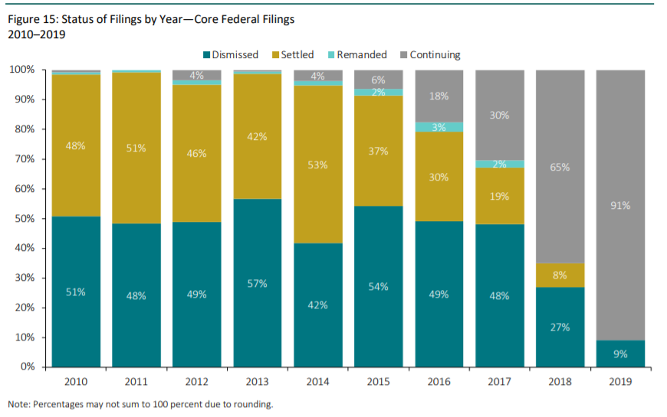
Status of Filings by Year

Slide 31
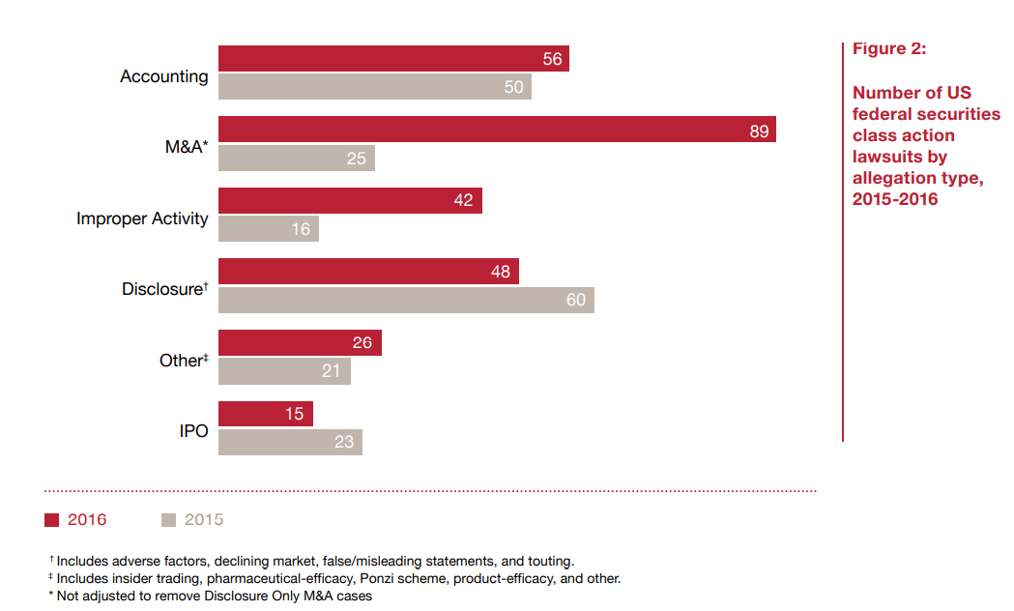
PwC Study

