Slide 1
The relationship between negative social media sentiments, environmental and social disclosure and firm revenue
Dr. Samuel Jebaraj Benjamin
Dr. Jayalakshmy Ramachandran
Associate Professor of Auditing and Accounting
Dr. Pallab Kumar Biswas
2022 ICVG Conference
Day 2, 16 December 2022
Monash University, Melbourne

Slide 2

Table of content
Background of the study
Research Problem
Literature review and theories
Hypothesis development
Findings
Discussion
Contributions to theory
Governance food for thought

Slide 3

Background of the study
Best avenue
For feedback
Experiences of stakeholders (gaining popularity in sentiment study)
SMS influences firm value, performance and revenue.
Negative social media sentiment impacts firm reputation (past studies)
Responding to negative SMS is imperative.
CSR are common method to address and increase corporate reputation

Slide 4
Research Problem
Negative SMS causes reputational damage, while environmental and social disclosures increase corporate reputation.
Firms experiencing negative SMS may respond by enhancing their environmental and social disclosures
The negative SMS and ESG relationship may be moderated/affected by variables such as firm size, number of employees, profitability, gearing and importantly firm advertising propensity.
Firms’ strategy in responding
to negative SMS
Not much attention has been paid in investigating how firms react to online issues stemming from sentiments expressed in social media

Slide 5

Literature review and theories
The theory asserts that the average prediction of the crowd is more accurate than that of experts (Surowiecki, 2004).
Sentiments expressed in social media (positive or negative sentiments) allows corporations to tap into the wisdom of the crowd in order to understand its implications, respond appropriately and gauge future performance prospects of a firm (Benjamin et al. 2021; Nguyen et al. 2020).
Typical negative SMS are identified through words like “angry” and “I hate it” (Nguyen et al. 2020).

Slide 6

Reputation Risk
McDonald’s humiliation in 2012 after receiving massive amount negative SMS from customers sharing negative experiences
United Airlines’ reputation damage in 2017 caused by negative online comments after the airline threw off a passenger violently off the place (Etter et al. 2019).
Corporations react to negative SMS in the form of voluntary disclosures to preserve their reputation (Luo et al. 2013; Luo 2007)
The strategy of disclosing voluntary information (CSR) has often been related to market benefits (Meng et al. 2019).
CSR information as a strategic investment promotes the reputation of the firm and one that will result in better future financial performance (Drempetic et al. 2020; Wang et al. 2016).

Slide 7
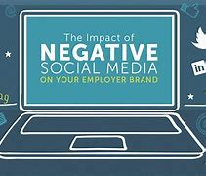
Hypothesis Development (H₁)
Firms encountering negative SMS will be motivated to safeguard their reputation through higher ENV and SOC disclosures.
H1a: Negative SMS increases environmental and social disclosure
The effects of negative SMS on environmental and social disclosures could vary between low and high subsamples of certain firm-specific factors.
H1b: The impact of negative SMS on environmental and social disclosure is conditional on firm specific factors such as size, advertising intensity, employees, leverage, and profitability

Slide 8


Hypothesis Development (H₂)
Prior literature also shows that negative SMS brings about decline in sales and causes damages to firms’ reputation (Chiosa and Anastasiei 2017; Sonnier et al. 2011; Bambauer-Sachse and Mangold 2011).
Firms’ strategy of responding to negative SMS by increasing environmental and social disclosures not only offsets their reputational decline, but also results in net gains that increase their future revenue.
H2: The effect of negative SMS on future revenue differs between firms with high and low environmental and social disclosure

Slide 9

Data collection methodology
Fortune 500 firms from the year 2010 to 2017.
Social media data was retrieved from Infegy Atlas social media database (Benjamin et al. 2021; Nguyen et al. 2020)
Firms’ environmental and social disclosure scores and board-level governance variables are retrieved from Bloomberg professional services database.
Firm-level financial data are sourced from the Compustat database

Slide 10

Sampling
Initial sample of this paper was 4,000 firm-year observations but after removing financial firms and observations with incomplete financial, environmental, social or corporate governance data, the final sample totaled 2,296 firm-year observations.

Slide 11

Control Variables
Following prior-related literature (Benjamin et al. 2021; Nguyen et al. 2020; Schmidt et al. 2020; Liao et al. 2015; Brammer and Pavelin 2006), we control for variables that can affect the individual firm’s environmental and social disclosure and sales
Female directors
Independent directors,
CEO duality on the board
Board size,
Employees
Firm size
Leverage,
Profitability
Advertising spending intensity

Slide 12
Findings and Discussions
Firms experiencing negative SMS intensify E&S disclosures.
Larger firms with more resources as opposed to relatively smaller sized firms are more concerned with the reputational impacts of negative SMS
The need to respond to negative SMS by increasing E&S disclosures is important in firms with low advertising spending intensity.
Firms strongly respond to negative SMS by increasing their E&S disclosure when they have high number of employees.
High levered firms increase social disclosure
When profits reduce, firms mask by increasing E&S disclosure.
Finally, firms can enjoy increased sale in the subsequent year following negative SMS, if they increase environmental disclosure.

Slide 13
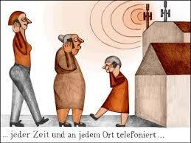
Contributions to body of knowledge
Wisdom of Crowds is fairly recent, and we emphasise the importance of the same for companies in managing their reputation
Reputation Risk Management is quite critical for organisation success and sustainability

Slide 14

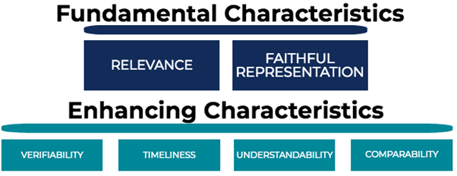
Governance food for thought
Important to go back to ground zero – purpose of ESG.
Consistent disclosures
Are voluntary disclosures marketing tools?
Are managers contributing to Stakeholders value maximisation?
Is CSR repackaged with a new technical word?

Slide 15


