Slide 1
Appropriate use of benzodiazepine medications for sleep disturbances in people living with dementia
Education Activity
Centre for Medicine Use and Safety (CMUS)

Slide 2





Introduction
Background
Dementia is associated with a deterioration in:^{1,2}
  Memory
  Thinking
  Behaviour
  Communication
  Ability to perform daily activities

Slide 3



Introduction
Dementia and changed behaviours
People living with dementia often experience changed behaviours. Changed behaviours are diverse and may include:
  Wandering e.g. walking aimlessly and/or excessively, attempting to exit a safe location³
  Sleep disturbances e.g. difficult falling or staying asleep³
  Agitation e.g. excessive fidgeting, pacing, irritability³
  Aggression e.g. verbal insults, swearing, punching, throwing objects^{2,3}

Slide 4
Introduction
Care for people living with dementia and changed behaviours
Care for people living with dementia and changed behaviours can be split into two broad strategies:
Non-pharmacological strategies
Definition: non-medication strategies
Examples: pet therapy, exercise therapy, art therapy^{2,3}
Pharmacological strategies
Definition: medication strategies
Example: psychotropic medications
Royal Commission into Aged Care Quality and Safety defines a psychotropic medication as:
“Any drug capable of affecting the mind, emotions, and behaviour”⁴

Slide 5
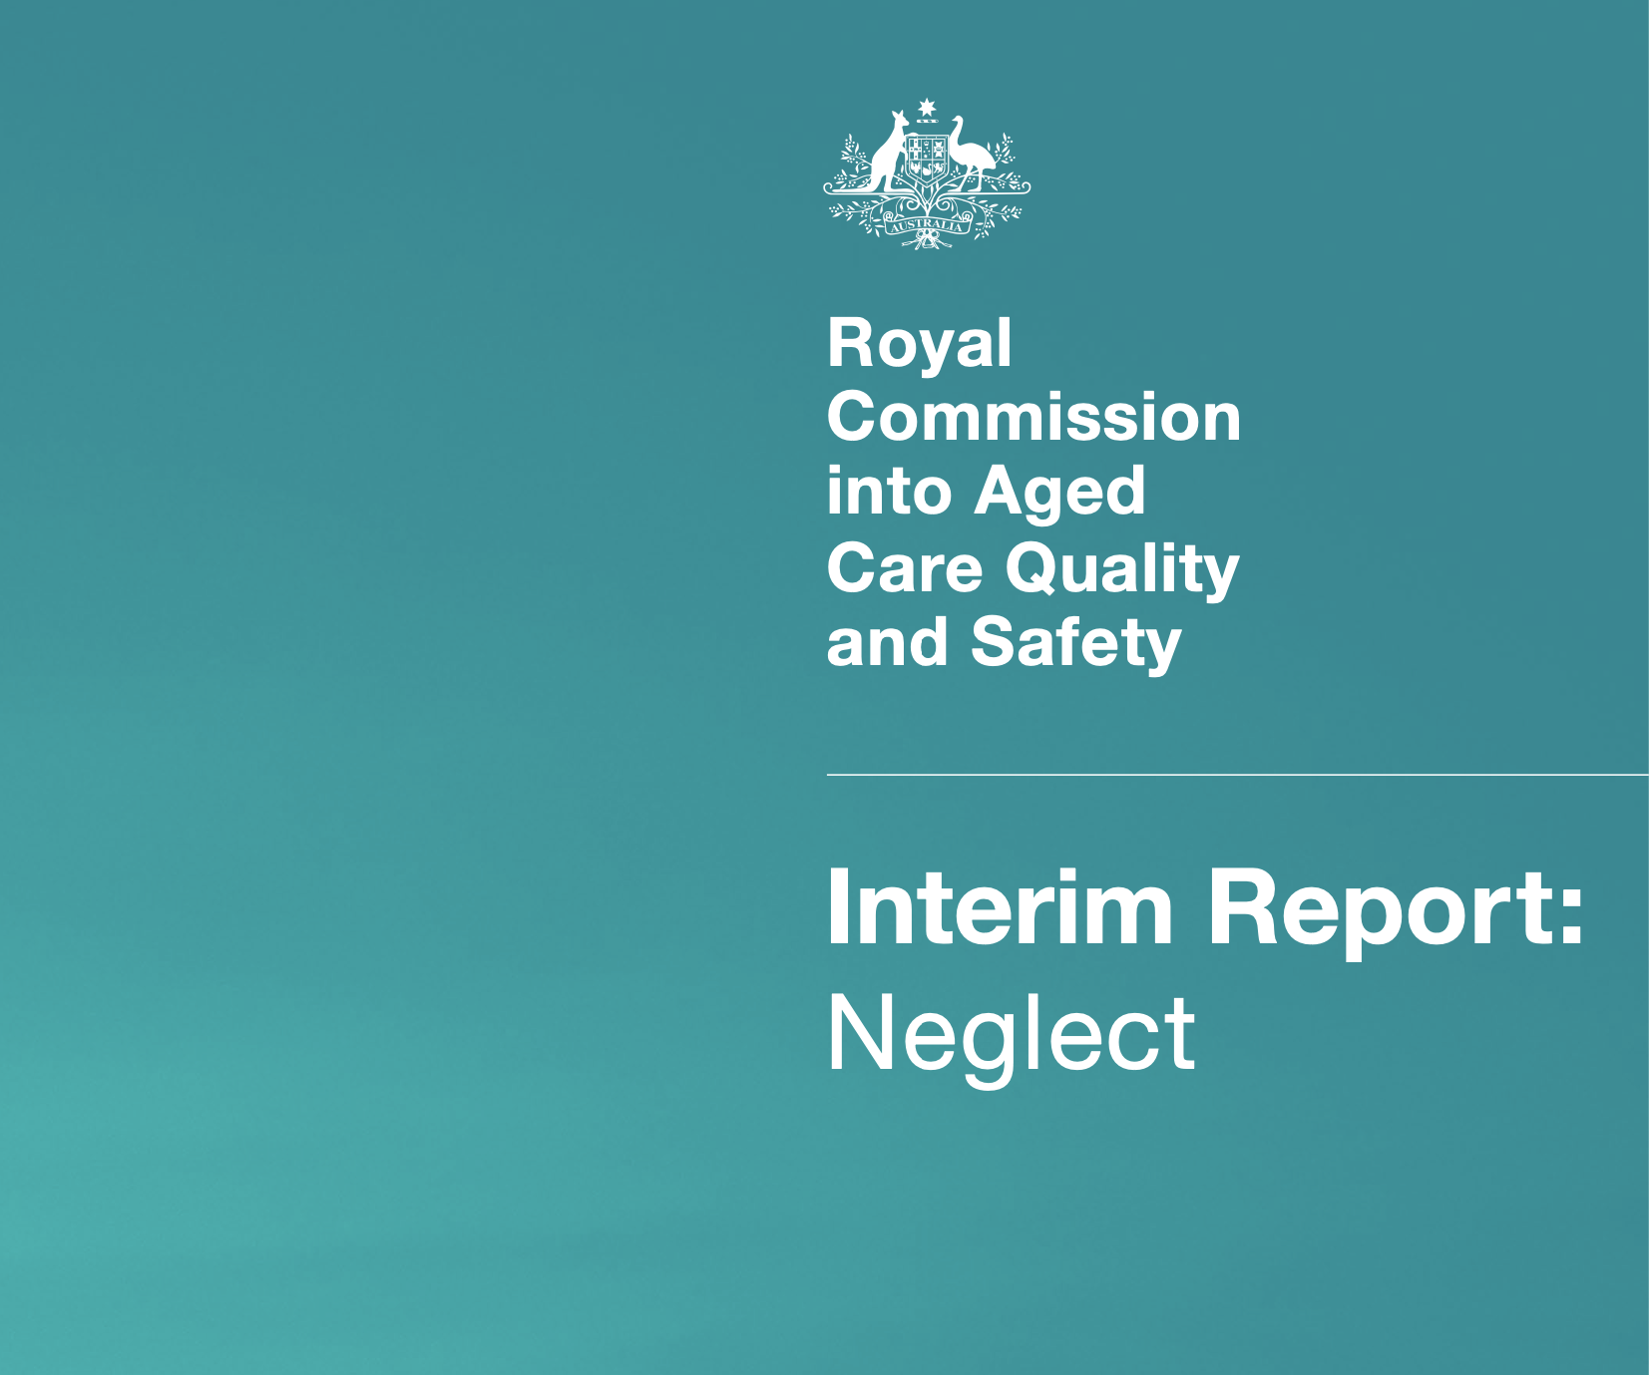
Introduction
Use of Psychotropic Medications in People Living with Dementia and in Residential Aged Care
The Royal Commission into Aged Care Quality and Safety Interim Report: Neglect⁵ highlighted an overreliance on psychotropic medications
Psychotropic medications such as benzodiazepines are associated with adverse outcomes for people living with dementia:
  Sedation e.g. drowsiness, sleepiness
  Falls
  Fractures

Slide 6
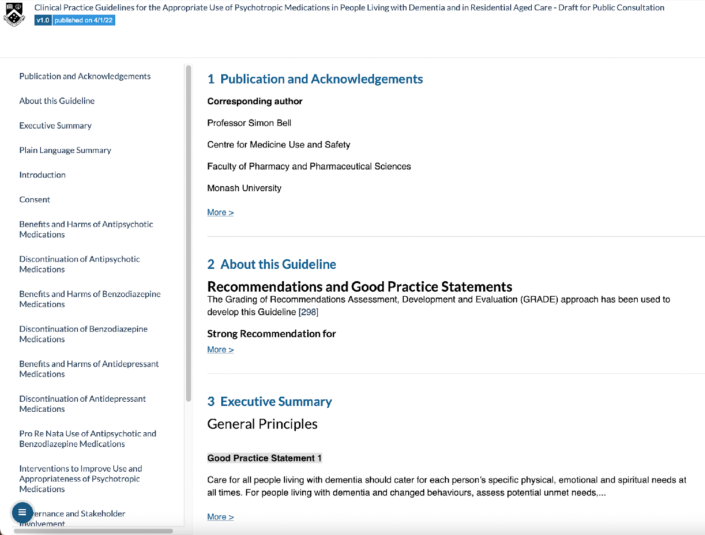
Introduction
Clinical Practice Guideline for Appropriate Use of Psychotropic Medications in People Living with Dementia and in Residential Aged Care
Three most common psychotropic medications implicated in restrictive practice in residential aged care are:
  Antipsychotics
  Benzodiazepines
  Antidepressants⁴
The new clinical practice guideline focuses on the appropriate medication use of antipsychotics, benzodiazepines and antidepressants

Slide 7
Group discussion – what is a benzodiazepine?

Slide 8

What is a benzodiazepine?
A benzodiazepine is a class of medication that slows down the workings of the brain⁶
Benzodiazepines can cause:
  Excess sedation e.g. drowsiness, sleepiness
  Physical dependence⁷
  Tolerance⁷
Sometimes benzodiazepines are prescribed to people living with dementia and changed behaviours
One Australian study⁸ reports that 30% of residents are dispensed benzodiazepines within three months of admission to residential aged care
Some examples of benzodiazepines are temazepam, oxazepam, lorazepam and diazepam^{4,9}

Slide 9


The place of benzodiazepines in the care of a person living with dementia
There is a limited role for benzodiazepines in sleep disturbances
If a benzodiazepine is initiated, the initial treatment duration for sleep disturbances should not exceed two weeks
Benzodiazepines should only be used as a last resort for people living with dementia who are experiencing sleep disturbances

Slide 10
Learning Objectives
For people living with dementia and changed behaviours:
  Identify the prompts for discontinuation of a benzodiazepine for people living with dementia and sleep disturbances
  Compare the potential harms and benefits associated with prescribing benzodiazepines regularly versus when required (or PRN)
  Specify the criteria for escalating care surrounding discontinuation of a benzodiazepine
  Explain what should be documented surrounding discontinuation of a benzodiazepine
  Be aware of supporting resources accompanying the Guideline to use in everyday practice

Slide 11


Discontinuation of benzodiazepines
Image from freepik

Slide 12

What is medication discontinuation?
Medication discontinuation is the planned and supervised process of stopping a medication
Medication discontinuation may also be known as:
  Deprescribing
  Medication cessation
  Medication withdrawal

Slide 13



When should we start thinking about discontinuation?
Benzodiazepines are associated with significant risk of unintended and sometimes harmful effects (adverse events)
  Is the person living with dementia experiencing an adverse event?
    e.g. the person is drowsy since starting a benzodiazepine
Using benzodiazepines for changed behaviours may be considered restrictive practice
  Restrictive practice must only be used as a last resort and for the shortest time necessary
  Benzodiazepines may provide little benefit in relieving sleep disturbances
    Has the specific changed behaviour you want to improve (target symptom) improved?
      e.g. the person has woken up once during the night over the last 7 days
    Has the target symptom remained unchanged?
      e.g. the person still wakes up twice each night
    Has the target symptom worsened?
      e.g. the person wakes up 5 times each night
  Benzodiazepines are associated with tolerance
    Tolerance occurs when the same dose is no longer as effective
    Benzodiazepines can lose their effectiveness to improve sleep disturbance within 7 to 28 days¹¹
Restrictive practice is “any practice or intervention that has the effect of restricting the rights or freedom of movement of the care recipient”¹⁰

Slide 14
Group discussion – what are some prompts for benzodiazepine discontinuation?

Slide 15
Prompts for benzodiazepine discontinuation
Clinical steps
Person living with dementia:
  Has experienced an adverse event
    e.g. the person had a fall
  Is at risk for experiencing an adverse event
    e.g. the person is taking multiple medications that could increase their risk of having a fall
  No longer consents to take the benzodiazepine
  Has requested a review
  Is having difficulty or refusing to swallow
  Has a change in goals of care
  Has been using a benzodiazepine for more than two weeks
Target symptoms:
  Have not improved
    e.g. a person’s sleep disturbance has NOT improved with the use of non-pharmacological strategies and a benzodiazepine
There is no known reason why the benzodiazepine is being used
  e.g. a person is new to your residential aged care and they are prescribed a benzodiazepine for an unknown reason
Benzodiazepine not used for an appropriate reason
  e.g. a person is prescribed a benzodiazepine for wandering
Please see the Guideline for additional prompts for benzodiazepine discontinuation

Slide 16
Prompts for benzodiazepine discontinuation
Communication and documentation steps
Contact the prescriber
Document the prompts for discontinuation you have identified
Notify entire care team
Document conversation with prescriber and plan going forward
  e.g. contacted prescriber and will discuss the option of benzodiazepine discontinuation with entire care team at next case conference
Recommend a comprehensive medication management review

Slide 17
Harms vs Benefits of Discontinuation of Benzodiazepines
Improved quality of life
Reduced medication errors
Reduced risk of adverse events
Simpler medication regimens
Symptoms coming back
  This is known as reoccurrence of symptoms
Unpleasant reaction that may happen during the process of stopping a medication
  This is known as discontinuation symptoms
  May also be known as adverse withdrawal events, discontinuation effects, withdrawal effects and withdrawal symptoms
BENEFITS
HARMS

Slide 18
Group discussion - what should you monitor for during the discontinuation process?

Slide 19
What should you monitor for during the discontinuation process?
While a benzodiazepine is being tapered, all staff should monitor for:
The effect on the person living with dementia’s target symptoms
  Has the sleep disturbances come back (recurrence of symptoms)?
  Has the sleep disturbances stayed the same?
  Has the sleep disturbances improved?
  Discontinuation symptoms
    Is the person more irritable?
  Benefits of discontinuation
    Has the person had less falls?
    Is the person more alert during the day?
All staff should notify the prescriber or clinical nurse as soon as possible once a symptom reoccurs or if there are discontinuation symptoms.
Non-pharmacological strategies should continue throughout the discontinuation process and after the benzodiazepine is stopped.

Slide 20
Is PRN use safer than regular use?
Pro re nata (PRN; when required/as needed) benzodiazepine use may be acceptable:
  As part of a step-down or staged discontinuation protocol
Adverse events
Risk of providing symptom relief without thoroughly investigating the underlying cause
Contribute to a complex medication regimen
Risk of exceeding the maximum recommended daily dose in people prescribed the same medication on both a PRN and regular basis
BENEFITS
HARMS
The Guideline recommends against the routine prescribing of PRN benzodiazepines for people living with dementia and changed behaviours

Slide 21
Monitoring PRN use
Clinical steps
A PRN benzodiazepine should only be prescribed for a specific target symptom
If a PRN benzodiazepine is used, it should be completed by trained staff who can:
  Comprehensively assess unmet needs
    is the person lonely?
    does the person need meaningful activity?
  Monitor for and recognise adverse events
    is the person experiencing an adverse event?
    is the person not experiencing an adverse event?
  Assess effectiveness of PRN administration
    has the target symptom improved?
    has the target symptom remained unchanged?
    has the target symptom worsened?
  Document outcome of PRN administration
    what happened?
PRN benzodiazepine use may still represent restrictive practice
PRN prescribing, dispensing and administration should be completed by trained staff

Slide 22
Monitoring PRN use
Communication and documentation steps
Document in the medication chart, medical record, nursing progress notes and behaviour support plan, where applicable:
  Comprehensive assessment of unmet needs
  Adverse event monitoring
  Effectiveness of PRN administration
  Outcome of PRN administration
Discuss the above points with the entire care team, including the prescriber. It is important to get the whole team involved
Document all conversations and the plan going forward.
PRN benzodiazepine use may still represent restrictive practice
PRN prescribing, dispensing and administration should be completed by trained staff

Slide 23

Case study
Mr. Dimitri Popov is an 84-year-old man living with vascular dementia living at Sunnyside residential aged care
The general practitioner (GP), Dr. Mary Song, initiates a benzodiazepine, temazepam, for Dimitri’s sleep disturbances
During handover, your colleague Jenny tells you, “ Dimitri’s sleep disturbances is not getting any better. He is still waking up at 3am every morning. When Dimitri got up last night, he felt light headed and he nearly had a fall in front of me!”
When you go to give Dimitri his afternoon medication, he asks you, “Is that sleeping tablet in there? I refuse to take that tablet anymore, it makes me feel funny. I hate it!”
Image from freepik

Slide 24
Case study
Small groups
Read the Case Study
Discuss questions 1 and 2 over the next 15 minutes
Prepare answers to share in group discussion

Slide 25
Review of case study questions
Group Discussion
Question 1. What are some prompts that would make you consider discussing discontinuation of Dimitri’s benzodiazepine with Dr. Mary Song? How would you communicate and document this?

Slide 26
Review of case study questions
Group Discussion
Question 1. What are some prompts that would make you consider discussing discontinuation of Dimitri’s benzodiazepine with Dr. Mary Song? How would you communicate and document this?
Clinical steps
Dimitri’s target symptom has not improved
Dimitri has been taking a benzodiazepine for up to two weeks
Dimitri is experiencing an adverse event
Dimitri is at risk of experiencing a second adverse event
Dimitri no longer consents to taking the benzodiazepine
Communication and documentation steps
Contact the prescriber
Document your observations
Document conversation with prescriber and plan going forward
  e.g. called Dr. Mary Song. She advised to withhold temazepam tonight and she will review Dimitri tomorrow morning
Notify entire care team
Recommend a medication review
Non-pharmacological strategies should continue throughout the discontinuation process and after the benzodiazepine is stopped

Slide 27

Case study continued
Seven days after initiating temazepam for Dimitri, Dr. Mary decides NOT to discontinue temazepam for Dimitri. Instead, Dr. Mary decides to continue temazepam treatment but reduce the frequency to temazepam PRN.
Dr. Mary has documented the reason for the change where she states,
“Reduce temazepam to PRN to reduce the risk of adverse events.
Plan: continue temazepam PRN ongoing in case Dimitri needs it to sleep”.

Slide 28
Review of case study questions
Group Discussion
Question 2. Do you think prescribing a benzodiazepine for Dimitri’s sleep disturbance is safer than prescribing it regularly? How would you communicate and document this?

Slide 29
Review of case study questions
Group Discussion
Question 2. Do you think prescribing a benzodiazepine for Dimitri’s sleep disturbance is safer than prescribing it regularly? How would you communicate and document this?
Clinical steps
Some risks of using a benzodiazepine PRN for Dimitri include:
  Dimitri is experiencing light-headedness and at risk of having a fall with regular temazepam
  Dimitri could be administrated a benzodiazepine without a thorough investigation of the possible underlying causes of his sleep disturbances
  Dimitri no longer consents to taking a benzodiazepine
  Treatment duration may exceed two weeks
Communication and documentation steps
Contact the prescriber
Document your observations
Document conversation with prescriber and plan going forward
  e.g. called Dr. Mary Song. She agreed benzodiazepine discontinuation should be considered. She advised to withhold temazepam PRN and she will review Dimitri on [date]
Notify entire care team
Recommend a medication review

Slide 30

Update on Dimitri
After Dr. Mary had a comprehensive discussion with Dimitri, a decision was made to trial discontinuing his benzodiazepine
Since Dimitri’s room is located close to the nurses’ station, the care team suspected that the noisy environment may be disrupting his sleep. Nurses and care staff trialled closing his door at night and providing a night-light in his room for orientation. Dimitri responded well to this strategy and he is now experiencing improved sleep without the use of a benzodiazepine. Dimitri’s wife, Irene states,
“Dimitri looks so much better. He enjoys his walks in the garden a lot more now. And he is alert during the day! It makes me so happy to see him spending time with the grandkids when they visit. Before, he was just too tired. I’m so glad the team here at Sunnyside residential aged care facility spoke to us about the option to stop the sleeping tablet.”
Image from freepik

Slide 31


Take home messages
The care team should try to stop benzodiazepine treatment no later than two weeks after it was started
While a benzodiazepine is slowly stopped, all staff should monitor for:
  The effect on the person’s specific changed behaviour (target symptom)
  Unpleasant reaction that may happen during the process of stopping a medication (discontinuation symptoms)
  Benefits of discontinuation
PRN benzodiazepine use is not necessarily safer than regular use. PRN benzodiazepine use may be acceptable as part of a plan to slowly reduce the benzodiazepine dose until it’s stopped
Non-pharmacological strategies should continue throughout the discontinuation process and after the benzodiazepine is stopped

Slide 32
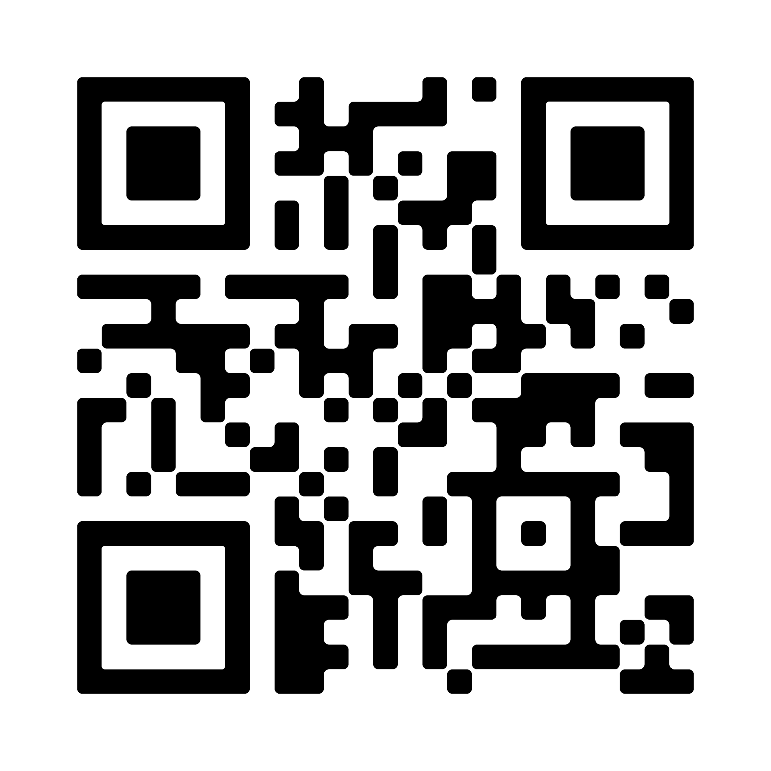
Supporting resources
Access to the Guideline

Slide 33
References
The Royal Commission into Aged Care Quality and Safety. Background Paper 3: Dementia in Australia: Nature, Prevalence and Care. Commonwealth of Australia; 2019. Accessed December 9, 2022. https://agedcare.royalcommission.gov.au/sites/default/files/2019-12/background-paper-3.pdf
New South Wales Ministry of Health. Assessment and Management of Behaviours and Psychological Symptoms associated with Dementia (BPSD). New South Wales Government; 2022. Accessed January 25, 2023. https://www.health.nsw.gov.au/mentalhealth/resources/Publications/assessment-mgmt-people-bpsd-2022.pdf.
Burns K, Jayasinha R, Tsang R, Brodaty H. Behaviour Management A Guide to Good Practice: Managing Behavioural and Psychological Symptoms of Dementia. Dementia Support Australia; 2012. Accessed September 19, 2022. https://www.dementia.com.au/resource-hub/behaviour-management-a-guide-to-good-practice
Aged Care Quality and Safety Commission. Psychotropic medications used in Australia: information for aged care. Australian Government; 2021. Accessed September 2, 2022. https://www.agedcarequality.gov.au/resources/psychotropic-medications-used-australia-information-aged-care
The Royal Commission into Aged Care Quality and Safety. Interim Report: Neglect. Commonwealth of Australia; 2019. Accessed September 19, 2022. https://agedcare.royalcommission.gov.au/publications/interim-report
Department of Health, State Government of Victoria. Benzodiazepines. Better Health Channel. Updated October 26, 2020. Accessed October 27, 2022. https://www.betterhealth.vic.gov.au/health/healthyliving/tranquillisers#what-are-benzodiazepines
Depressants. Alcohol and Drug Foundation; 2022. Accessed January 13, 2023. https://adf.org.au/drug-facts/depressants/
Harrison, SL, Sluggett, JK, Lang, C, et al. The dispensing of psychotropic medicines to older people before and after they enter residential aged care. Med J Aust. 2020;212(7):309-313. doi: 10.5694/mja2.50501
Australian Medicines Handbook. Australian Medicines Handbook Pty Ltd. Updated January 2023. Accessed February 10, 2023. https://amhonline.amh.net.au.acs.hcn.com.au
Aged Care Quality and Safety Commission. Overview of restrictive practices. Australian Government; 2021. Accessed September 2, 2022. https://www.agedcarequality.gov.au/resources/overview-restrictive-practices
Pottie K, Thompson W, Davies S, et al, et al. Deprescribing benzodiazepine receptor agonists: evidence-based clinical practice guideline: evidence-based clinical practice guideline. Can Fam Physician. 2018;64(5):339-351. Accessed September 2, 2022. https://pubmed.ncbi.nlm.nih.gov/29760253/
Unless specified, all icons included in this presentation are from Flaticon.com

