Slide 1
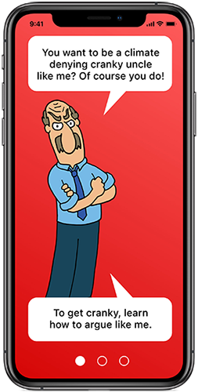
‘Cranky Uncle’
Persuasive techniques & the FLICC Framework

Slide 2

Truth or deceptive?
“Thermometer readings have uncertainty which means we don’t know whether global warming is happening.”
ENGAGE

Slide 3
Truth or deceptive?
“Thermometer readings have uncertainty which means we don’t know whether global warming is happening.”
Deception: Ambiguity
ENGAGE
Notes:
Ambiguity: Using ambiguous language in order to lead to a misleading conclusion.

Slide 4
Truth or deceptive?
“A retired physicist argues against the climate consensus, claiming the current weather change is just a natural occurrence.”
ENGAGE

Slide 5
Truth or deceptive?
“A retired physicist argues against the climate consensus, claiming the current weather change is just a natural occurrence.”
Deception: Fake Experts
ENGAGE
Notes:
Fake Experts: Presenting an unqualified person or institution as a source of credible information.

Slide 6
Truth or deceptive?
“In the 1970s, climate scientists were predicting an ice age.”
ENGAGE

Slide 7
Truth or deceptive?
“In the 1970s, climate scientists were predicting an ice age.”
Deception: Straw Man
ENGAGE
Notes:
Straw Man: Misrepresenting or exaggerating an opponent’s position to make it easier to attack.

Slide 8
Truth or deceptive?
“Our product is environmentally-friendly thus assures you that it is safe, sustainable and value for money.”
ENGAGE

Slide 9
Truth or deceptive?
“Our product is environmentally-friendly thus assures you that it is safe, sustainable and value for money.”
Deception: Bias/ Vague or Misleading Terminology
ENGAGE
Notes:
Bias/ Vague or Misleading Terminology: The use of unclear or deceptive language is a common greenwashing tactic. For instance, companies may market their product as "natural," "organic," or "eco-friendly" without defining these terms. Since there are no standard regulations, these labels may be misleading, and some companies may use them to falsely suggest that their product is environmentally friendly.

Slide 10
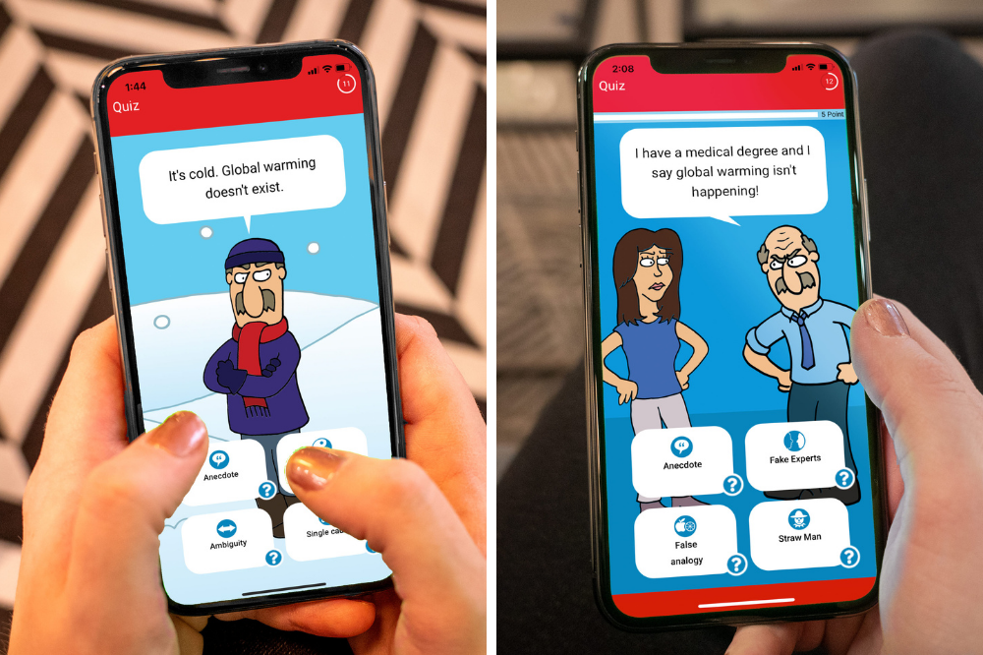
‘Cranky Uncle’
Online Game
https://crankyuncle.com/game/
EXPLORE

Slide 11






FLICC Framework
Fake Experts
Logical Fallacies
Impossible Expectations
Conspiracy Theories
Cherry Picking
EXPLAIN

Slide 12

EXPLAIN

Slide 13
Fake Experts
Presenting an unqualified person or institution as a source of credible information.
EXPLAIN

Slide 14
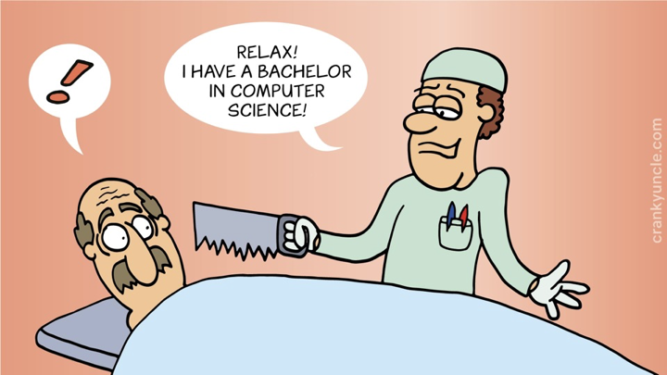
EXPLAIN

Slide 15
Logical Fallacies
Arguments where the conclusion doesn’t logically follow from the premises. Also known as a non sequitur.
EXPLAIN

Slide 16
Logical Fallacies example
“I have blue eyes therefore I know quantum physics.”
EXPLAIN

Slide 17
Impossible Expectations
Demanding unrealistic standards of certainty before acting on the science.
EXPLAIN

Slide 18
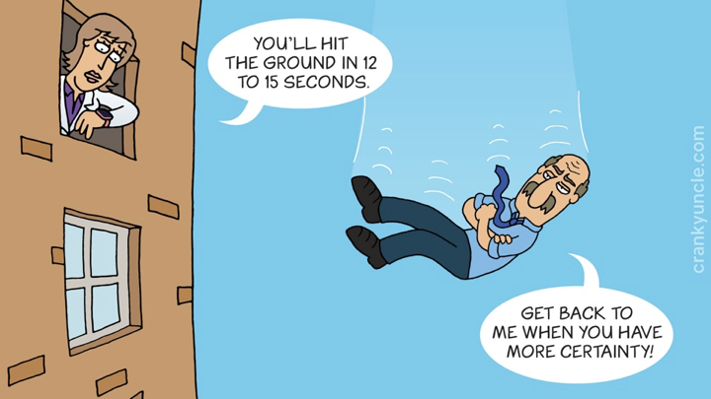
EXPLAIN

Slide 19
Conspiracy Theories
Proposing a secret plan to implement a nefarious scheme such as hiding a truth or perpetuating misinformation.
EXPLAIN

Slide 20
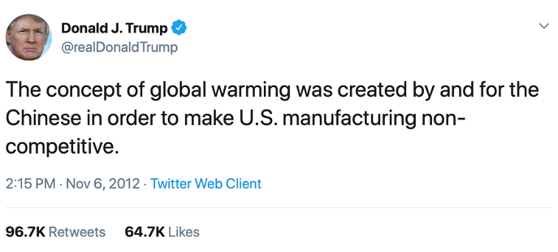
EXPLAIN

Slide 21
Cherry Picking
Carefully selecting data that appear to confirm one position while ignoring other data that contradicts that position.
EXPLAIN

Slide 22
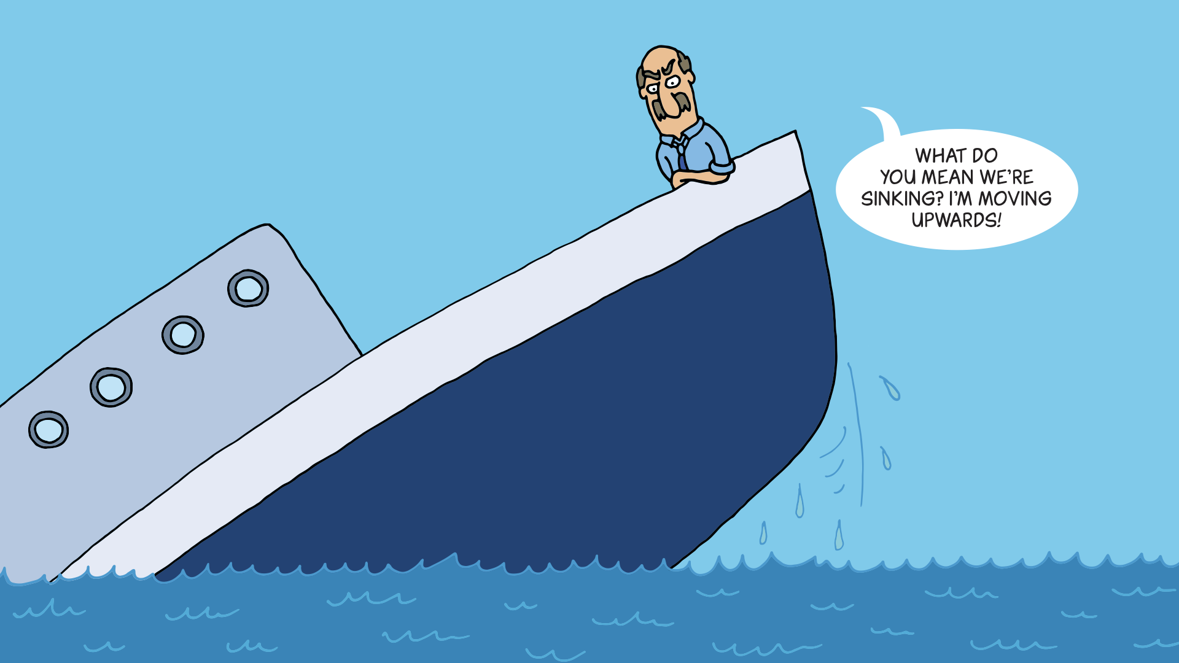
EXPLAIN

Slide 23
EXPLAIN

Slide 24

Ambiguity
Using ambiguous language in order to lead to a misleading conclusion.
EXPLAIN

Slide 25
Ambiguity example
“Thermometer readings have uncertainty so we don’t know whether global warming is happening.”
EXPLAIN

Slide 26
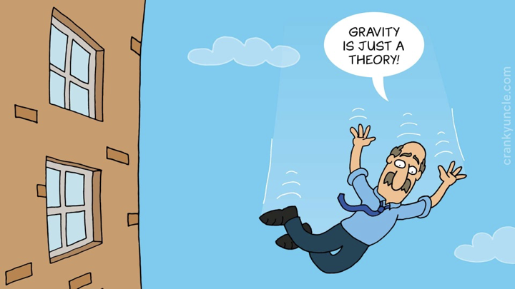
EXPLAIN

Slide 27

False Analogy
Assuming that because two things are
alike in some ways, they are alike in
some other respect.
EXPLAIN

Slide 28
False Analogy example
Todd asks Anne to pass him a spoon. Anne instead passes Todd a fork. When Todd complains Anne says: ‘What’s the problem? A fork is basically just a spoon with extra pointy bits’.
EXPLAIN

Slide 29

Misrepresentation
Misrepresenting a situation or an
opponent’s position in such a way as
to distort understanding.
EXPLAIN

Slide 30
Misrepresentation example
“They changed the name from ‘global warming’ to ‘climate change’ because global warming stopped happening.”
EXPLAIN

Slide 31

Oversimplification
Simplifying a situation in such a way as
to distort understanding, leading to erroneous conclusions.
EXPLAIN

Slide 32
Oversimplification example
“CO2 is plant food so emitting CO2 is
good for plants.”
EXPLAIN

Slide 33
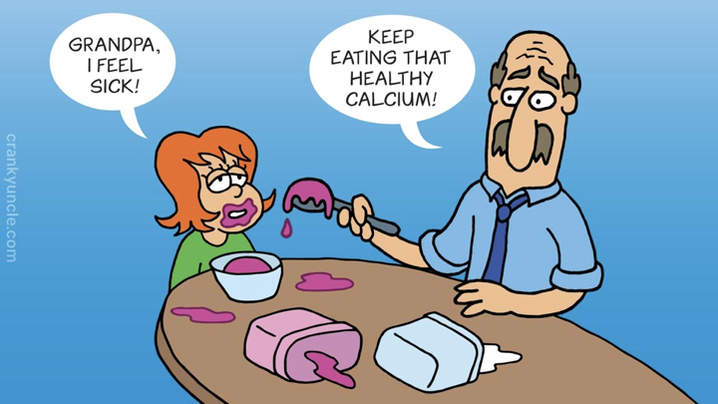
EXPLAIN

Slide 34
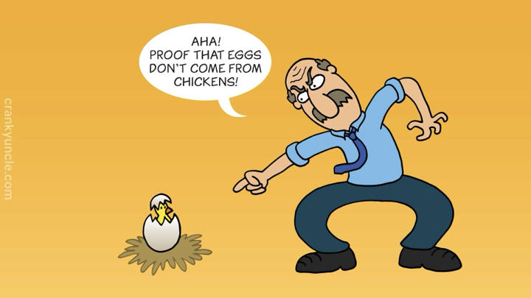
EXPLAIN

Slide 35

Red Herring
Deliberately diverting attention to an irrelevant point to distract from a more important point.
EXPLAIN

Slide 36
Red Herring example
“CO2 is only 0.04 percent of the atmosphere so can’t have a
significant effect.”
EXPLAIN

Slide 37
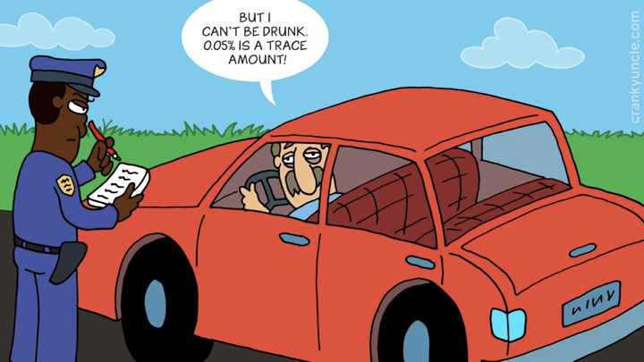
EXPLAIN

Slide 38

Anecdote
Using personal experience or isolated examples instead of sound arguments or compelling evidence.
EXPLAIN

Slide 39
Anecdote example
“My brother was in an unhappy marriage—getting married is a bad idea.”
EXPLAIN

Slide 40
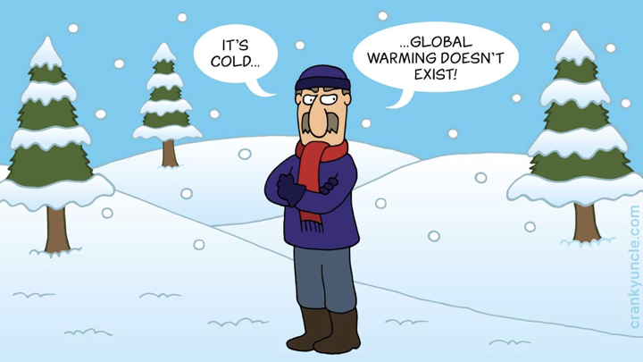
EXPLAIN

Slide 41
In groups, create your own examples for 3-4 FLICC techniques
ELABORATE

Slide 42

Write your name and one of your FLICC examples on a piece of paper and hand it to your teacher on the way out of class.
To leave…
Your name
1 x FLICC denial technique example
:)
EVALUATE

