Slide 1

The 5E Pedagogical Model Overview
Notes:
Teacher Only Slide - Brief overview of the 5E Pedagogical Model for Inquiry Learning

Slide 2
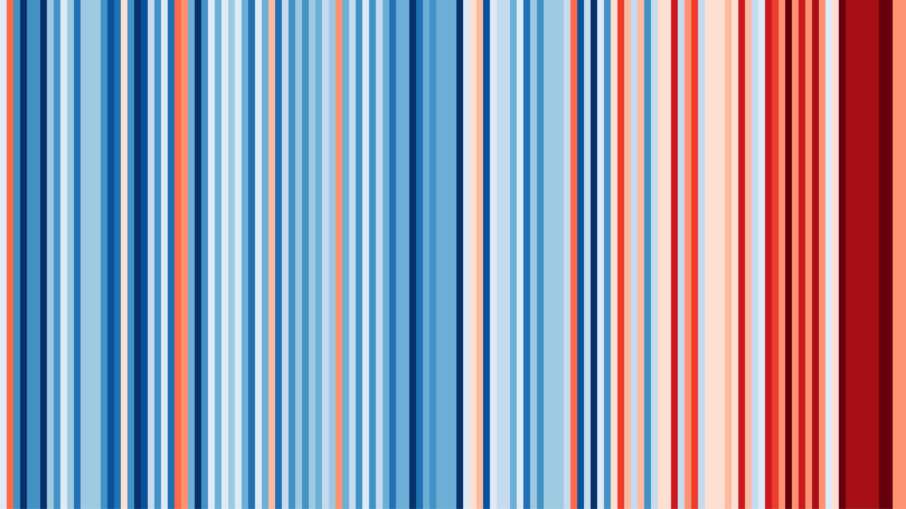
Utilising Visual Arts to Communicate Climate Data

Slide 3
Learning Intention
Students will be able to develop their own artwork to communicate climate data, inspired by Ed Hawkins and Jill Pelto.
Success Criteria/ Agenda
Investigate how artists develop and use their personal expression to represent and communicate similar ideas
Develop artwork to communicate climate data, inspired by climate artists
Analyse climate data trends and connect these trends to visual motifs

Slide 4
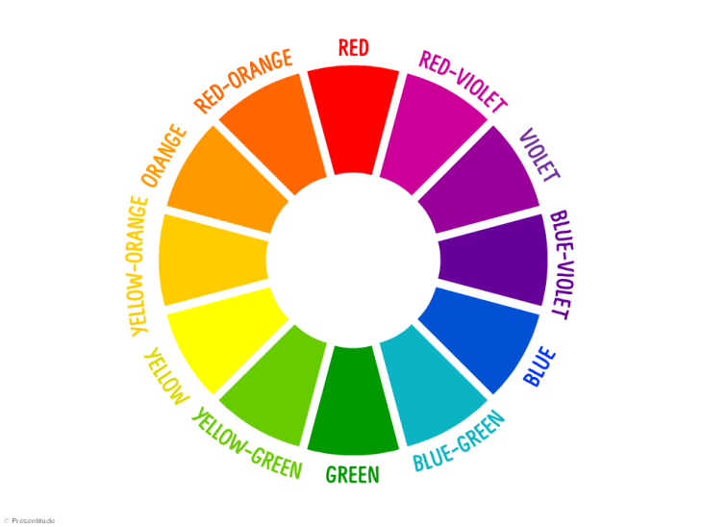
Do Now:
Identify one word you associate with each colour on the colour wheel?
Notes:
Non-persuasive messages provide evidenced-based information in easily understood formats, while avoiding advocacy. This style of messaging minimises ideological pushback, reduces the possibility of alienating people, and allows for delivery to large, diverse, public audiences. Our intention here is to increase literacy and get people thinking about things, which can in turn facilitate behaviour change.

Slide 5
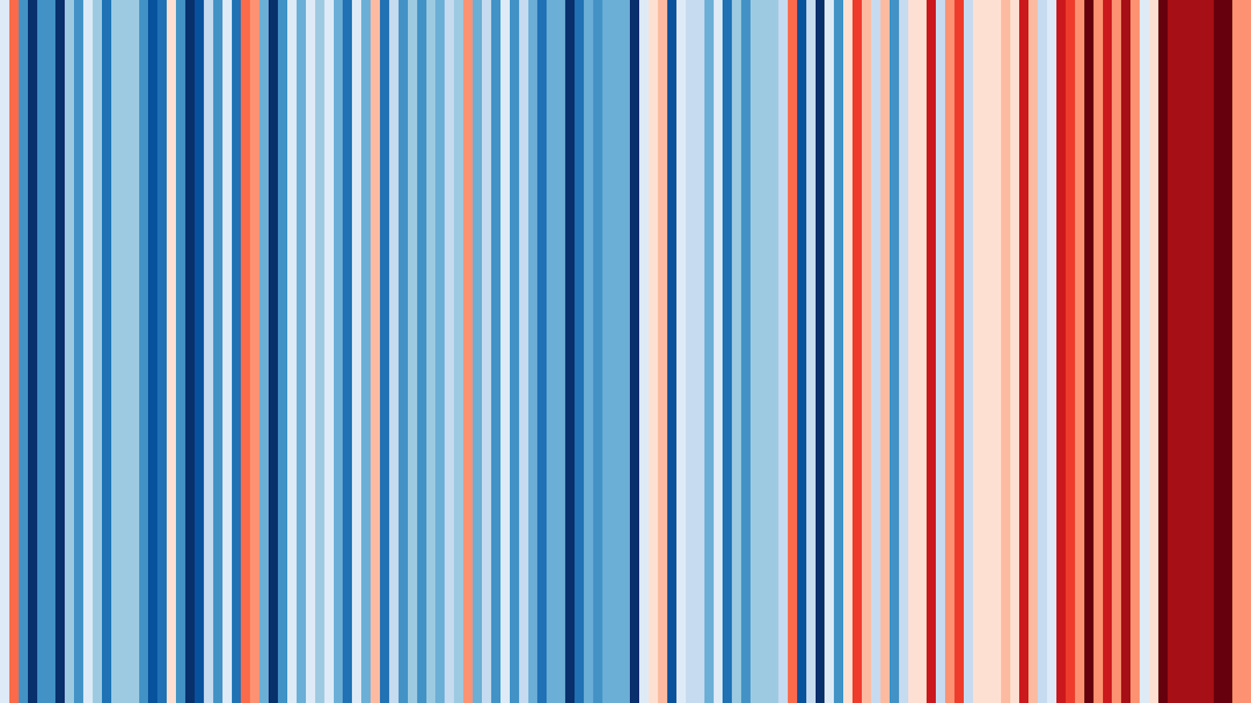
What do you see in this image?
What do you think this image means?
What does this image make you wonder?
ENGAGE

Slide 6
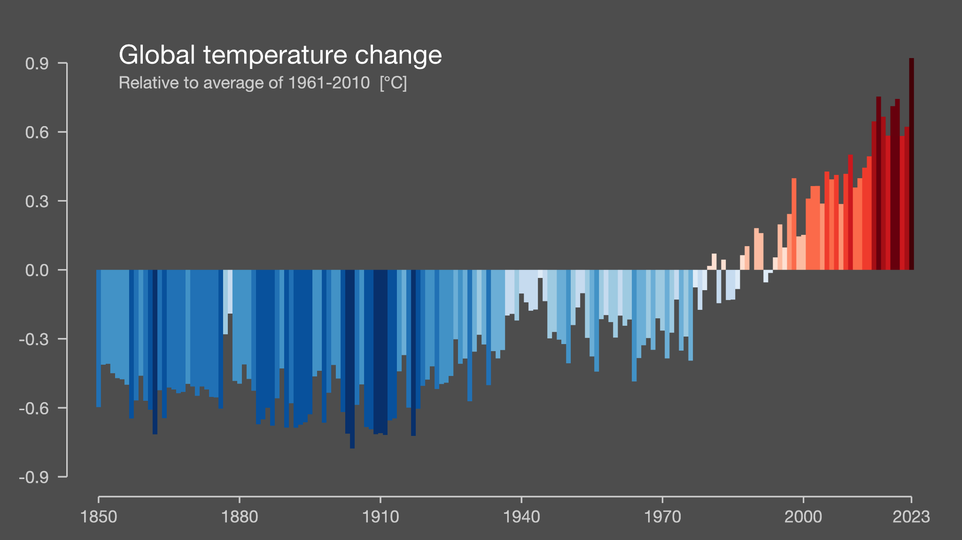
Climate stripes were designed by climate scientist Ed Hawkins to help visualise global temperature changes from 1850-present.
Climate Stripes
EXPLORE

Slide 7


Slide 8

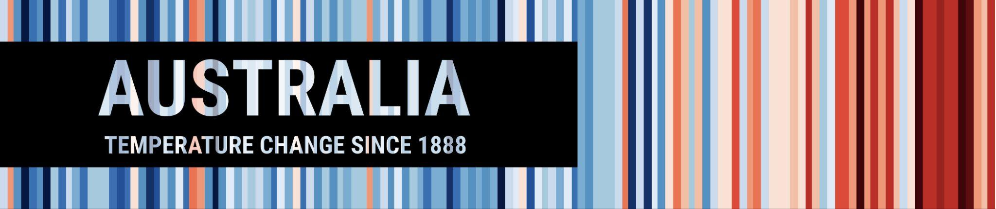

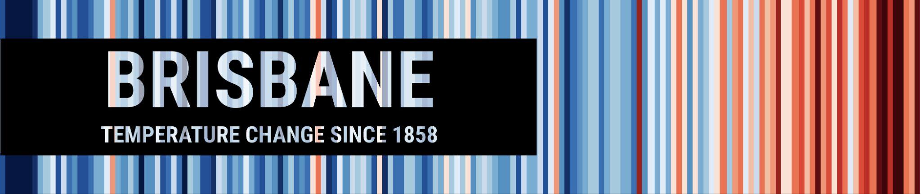
The original climate stripes image is global temperature data.
However, the stripes have also been created on a local scale.
How might local data be used to connect with the audience compared to global data?
EXPLORE

Slide 9
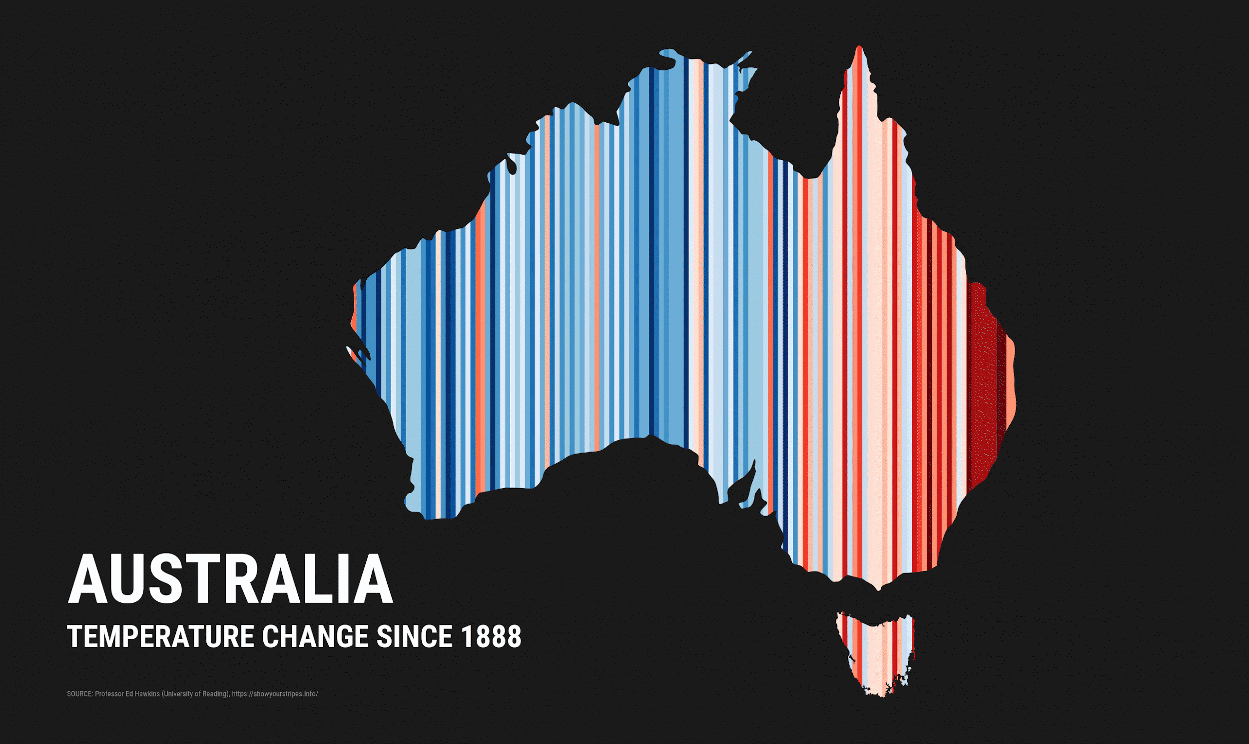
EXPLORE

Slide 10

Our key question
How do artists utilise their personal expression to represent and communicate similar ideas?
EXPLORE
Notes:
What's the one thing you want people to take away from what you say - think about this like a headline

Slide 11
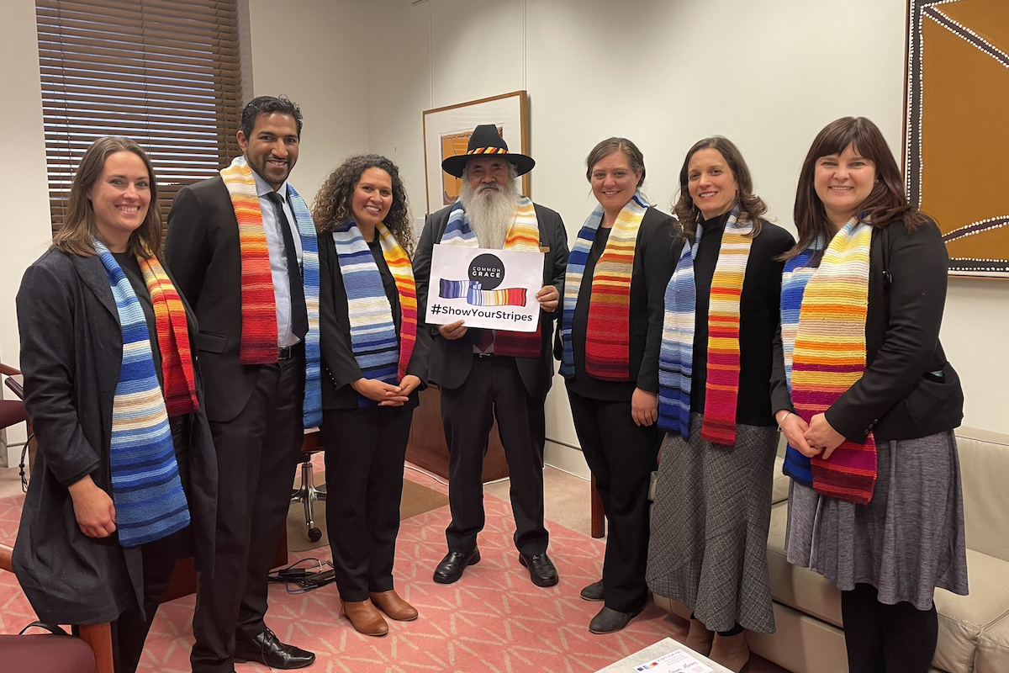
Australian Senator Patrick Dobson is presented with a knitted warming stripes scarf by the Common Grace group.
Sourced from University of Reading,
Institute for Environmental Analytics
EXPLORE
Notes:
Non-persuasive messages provide evidenced-based information in easily understood formats, while avoiding advocacy. This style of messaging minimises ideological pushback, reduces the possibility of alienating people, and allows for delivery to large, diverse, public audiences. Our intention here is to increase literacy and get people thinking about things, which can in turn facilitate behaviour change.

Slide 12
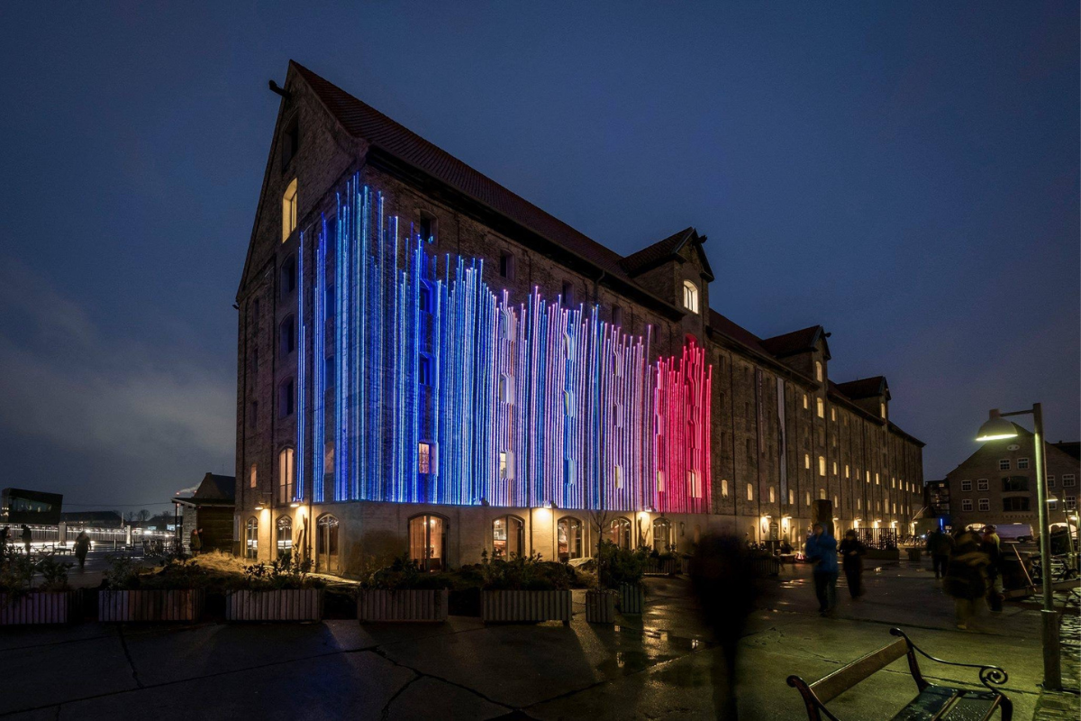
In 2021, the climate stripes were used for interactive light shows in Copenhagen (pictured) and Berlin.
Sourced from University of Reading,
Institute for Environmental Analytics
EXPLORE
Notes:
Non-persuasive messages provide evidenced-based information in easily understood formats, while avoiding advocacy. This style of messaging minimises ideological pushback, reduces the possibility of alienating people, and allows for delivery to large, diverse, public audiences. Our intention here is to increase literacy and get people thinking about things, which can in turn facilitate behaviour change.

Slide 13

In 2022, sustainable couture designer, Tammam, turned the iconic stripes into an eco-friendly clothing range for display at London Fashion Week.
Sourced from University of Reading,
Institute for Environmental Analytics
EXPLORE
Notes:
Non-persuasive messages provide evidenced-based information in easily understood formats, while avoiding advocacy. This style of messaging minimises ideological pushback, reduces the possibility of alienating people, and allows for delivery to large, diverse, public audiences. Our intention here is to increase literacy and get people thinking about things, which can in turn facilitate behaviour change.

Slide 14



Think
Pair
Share
1 minute to think about how you could use the climate stripes in your preferred creative medium
30 seconds each to share with your shoulder buddy
2 minute discussion in class to share your partner's ideas
EXPLORE
Notes:
Outlets
Distribution channels: how and why people source the media they do
Journalistic norms: norms that dictate the way journalists communicate like novelty, personalisation and dramatisation
Discourses: the language used to talk about a particular topic
These of course influence the diversity and quality of climate change information coming out through the media. The great thing is you have the potential to influence two of those drivers:

Slide 15
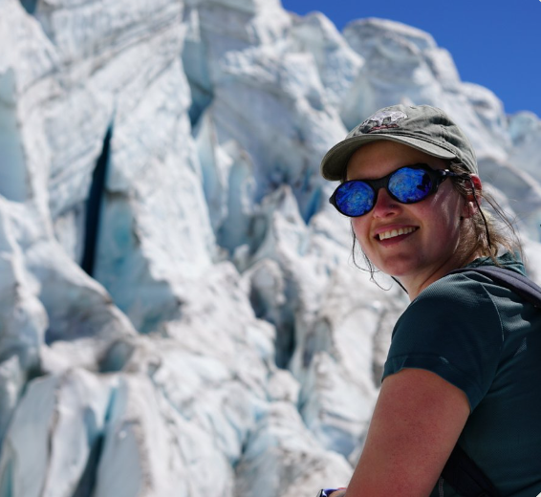
Artist Profile- Jill Pelto
Born 1994, USA
Masters of Science Graduate – study focus on Antarctic ice sheet changes.
Bachelor degree in Studio Art and Earth Science.
Given this limited information, how do you think Jill might represent climate data?
EXPLAIN

Slide 16
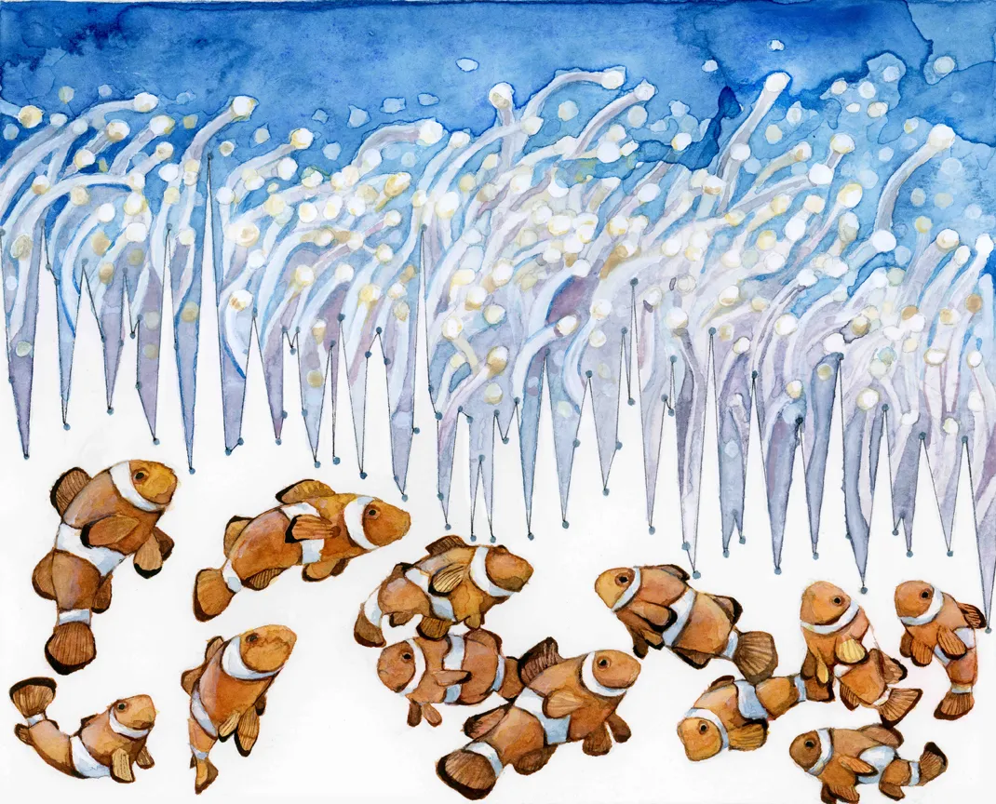
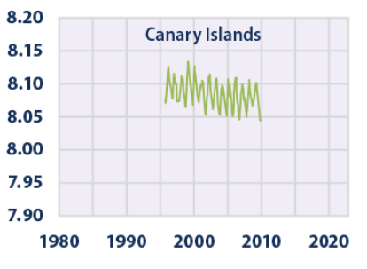
Watercolor and Colored Pencil, 2015
Graph form United States Environmental Protection Agency
Jill Pelto
Habitat Degradation: Ocean Acidification
Ocean Acidity 1996-2010
EXPLAIN

Slide 17
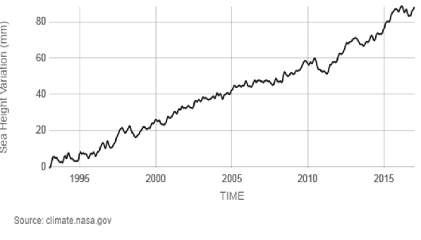
Elements of
Jill Pelto’s Approach
1- Original Graph
Real scientific data
Integrated into the illustrated graph
Example: Sea Height Variation Graph
EXPLAIN

Slide 18
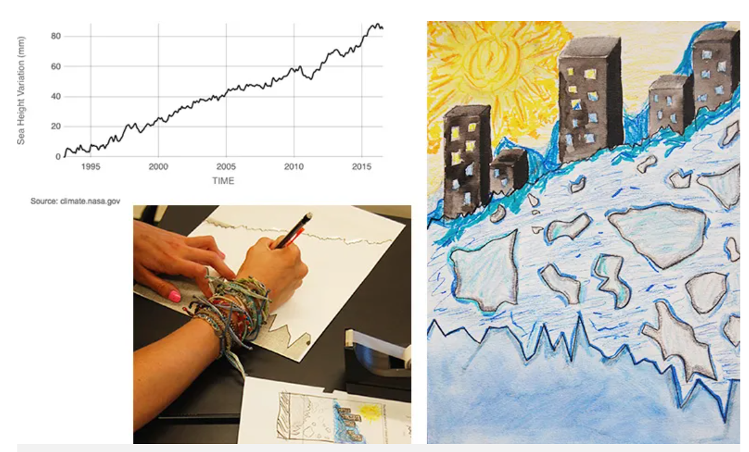
Elements of
Jill Pelto’s Approach
2- Illustrated Graph
Melding original graph and art to tell a visual story.
May communicate causes, impacts, implications, etc.
Visual details always connect to scientific data.
Student Artwork by Maddie R
Sourced: Jill Pelto & Science Friday 2016
EXPLAIN

Slide 19
Elements of
Jill Pelto’s Approach
3 - Artist’s Statement
Description of the illustrated graph.
Explains the link between visual choices and scientific data
Example: Structure of artist’s statement
Title
Mediums used
Explanation of the visuals used and how they connect to the data piece. (approx 100 words)
Explanation of the scientific data and how it was integrated into the work.
References
EXPLAIN

Slide 20
Elements of
Jill Pelto’s Approach
1- Original Graph
2- Illustrated Graph
3 - Artist’s Statement
Student Artwork by Maddie R
Sourced: Jill Pelto & Science Friday 2016
EXPLAIN

Slide 21
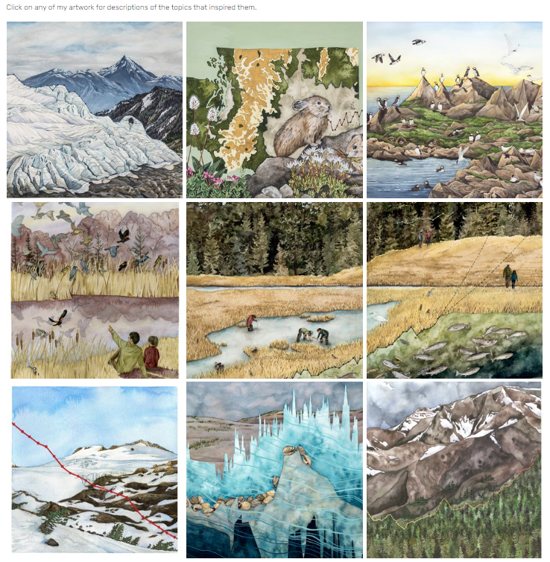

Access her website using the link or QR code.
Find at least two pieces that resonate with you and read their artist’s statements.
https://www.jillpelto.com/gallery-1
Explore Jill Pelto’s works
EXPLAIN

Slide 22



Create your own climate data art
Your finished work should include:
A title for the piece
Scientific data incorporated into the piece
Artist Statement
  Title
  150-250 word description
  Detail the mediums used in the work
  Discusses how the work is connected to the climate data
  Explains how the work is inspired by Jill Pelton or Ed Hawkins
CHOOSE FROM…
Sea surface temperature data
Renewable
energy data
Fashion
consumption data
ELABORATE

Slide 23
Climate data is integrated within the artwork and referenced extensively in the artist's statement. Artist statement explains how inspiring artists influenced the piece in multiple ways. | Well Above Standard
 | Above Standard
Generate an artwork inclusive of climate data and referenced in the artist's statement. Artist statement references inspiring artists. | At Standard
Generate an artwork with some elements of climate data. | Approaching Standard
AS.4.Students draw on inspiration from multiple sources to generate and develop ideas for artworks.
EVALUATE

Slide 24
The Open Road
Acrylic and Fineliner
The empty road towards the mountains symbolise what will happen to roads once climate change has led to the downfall of civilisation. There are no humans to drive the cars that emitted the greenhouse gases that caused the climate change in the first place.
Traditional cars burn fossil fuels as an energy source, which emit high levels of greenhouse gases. The mountains in the back are the line graph for number of cars in the world, similar to a Jill Pelto work.
Think, Pair, Share
How would you mark this student’s artist's statement?
EVALUATE

