Slide 1

The Effect of Institutional Ownership on Corporate Governance Quality in Financial Institutions
2022 ICVG Conference: Governance in its institutional context
Noora Aljalahma
Rasol Eskandari
Hassan Yazdifar

Slide 2
Overview
The green report of the European Commission.
Existing studies have examined the effect of institutional ownership on firm performance, or the effect of CG on institutional shareholders’ preferences.
This study examines the effect of institutional ownership on the quality of CG in financial institutions.
In this study:
  System Generalized Methods of Moments.
  Governance score developed by Institutional Shareholder Services as a proxy for quality of CG.

Slide 3
Literature Review
Institutional ownership leads to strong CG in non-financial firms.
The importance of studying CG and institutional ownership (Monitoring role).
Institutional shareholders (as large shareholders) might exercise their power at the expense of minority shareholders.
Principal-Principal Agency Conflict.
Institutional ownership of financial institutions.
Institutional investors prefer an alternative approach which is to invest in firms with existing good governance mechanisms.

Slide 4
Data and Methodology
Variables
Sample
Publicly traded Financial Institutions
Period 2013-2018
2103 number of observations
Unbalanced panel data
Corporate Governance:
  Governance main score developed by ISS.
  ISS sub-scores (Board, shareholders, Auditing, Compensation)
Institutional ownership:
  Institutional ownership dummy variable.
  Percentage change of ownership.
  Percentage ratio of float shares held by institutions to the number of float shares outstanding.
Methodology
  Two Steps System Generalized Methods of Moments.

Slide 5
System Generalized Methods of Moments
 | Dependent Variable: Institutional Ownership
 | Main Score | Shareholders Score | Board Score | Audit Score | Compensation Score
Ownership | -2.809*** (7.050) | -2.389** (3.128) | -0.680 (6.238) | -1.573 (10.120) | -1.483* (6.183)
Ownership Change | 0.543*** (0.204) | 0.288** (0.161) | 0.196 (0.162) | 0.095 (0.210) | 0.316** (0.161)
Float Shares | 0.519* (0.317) | 0.032 (0.099) | 0.006 (0.283) | -0.229 (0.330) | 0.334** (0.176)
Leverage | -0.017 (0.146) | 0.084 (0.068) | -0.056 (0.175) | 0.003 (0.269) | 0.023 (0.172)
Sales Growth | 0.055 (0.164) | 0.014 (0.059) | 0.059 (0.073) | 0.039 (0.064) | 0.020 (0.070)
M-to-B | 0.984 (2.194) | 2.066 (1.682) | -1.472 (1.00) | 0.202 (1.453) | 1.547 (1.919)
Wald Test (P-value) | 245.24 (0.000) | 357.01 (0.000) | 505.59 (0.000) | 32.06 (0.000) | 226.29 (0.000)
AR (2) Test (P-value) | 0.144 | 0.270 | 0.584 | 0.278 | 0.206
Hansen Test (P-value) | 0.886 | 0.138 | 0.102 | 0.121 | 0.512
Number of Instruments | 15 | 15 | 15 | 15 | 15
Observations | 2103 | 2103 | 2103 | 2103 | 2103

Slide 6
Findings
Institutional ownership has a negative and significant effect on the main ISS score which represents the quality of CG.
When categorizing the governance score into four sub-scores it becomes obvious that the significant negative coefficient of the main score is due to the significantly negative effect that institutional investors have on shareholders rights.
The coefficients of the institutional ownership on the board and audit scores are not significant, while the compensation score is significant at 10%.
Ownership change and float shares have significant and positive effect on CG. These results contradict the previous finding.
The results are robust to two rubbishness tests (using alternative measurements of institutional shareholders, and using a linear regression)

Slide 7
Implications
The negative effect of Institutional on the main ISS score implies that institutional investors of financial institutions do not play their monitoring role effectively.
This also implies that institutions use their power as large and controlling shareholders to benefit at the expense of minority shareholders, which eventually leads to reducing the quality of CG.
The negative effect of institutional ownership on shareholders rights confirm that institutional shareholders exercising their power as large shareholders at the expense of minority shareholders.

Slide 8
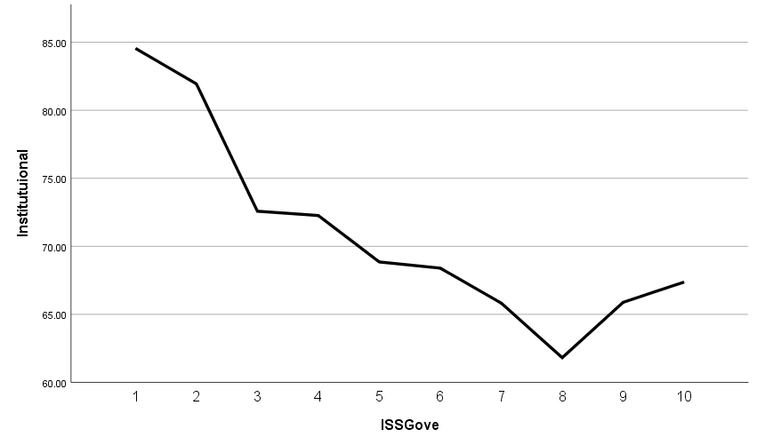
Regression plot

Slide 9
GMM: High and Low scores of ISS Main Governance score
 | Dependent Variable: Institutional Ownership
 | Low Main Score (<8) | High Main Score (=/>8)
Ownership | -0.389** (0.203) | 0.174* (0.135)
Ownership Change | 0.004 (0.003) | 0.006 (0.001)
Float Shares | 0.032*** (0.011) | -0.003 (0.009)
Leverage | 0.032** (0.017) | 0.017*** (0.006)
Sales Growth | -0.002 (0.001) | 0.001 (0.002)
M-to-B | -0.217** (0.093) | -0.028 (0.171)
Wald Test (P-value) | 32.66 (0.000) | 36.99 (0.000)
AR (2) Test (P-value) | 0.185 | 0.114
Hansen Test (P-value) | 0.299 | 0.087
Number of Instruments | 21 | 21
Observations | 1,060 | 264

Slide 10
Findings and Implications
The findings of this analysis along with the previous graphs confirm the proposition that while institutional shareholders cause the institutions with low scores to further decline in the quality of governance, they have a counter effect on institutions with good quality of governance.
These results imply that while institutional ownership has a negative effect on institutions with poor governance structure, it has a positive effect on institutions with high governance quality. This implies that it is of benefit for institutional shareholders to invest in institutions with a good governance quality (a score of 8 and above).
This finding supports and encourages the preference of institutional investors to invest in firms with good CG framework.

Slide 11
Implications
The presence of institutional investors may enhance CG quality especially for non-financial firms. However, very high ownership may worsen the quality of governance and increase agency issues for financial institutions, especially ones with less developed governance frameworks.
Thus, regulators should be alert to the potential adverse effects of institutional ownership on different sectors
These results imply that while institutional ownership has a negative effect on institutions with poor governance structure, it has a positive effect on institutions with high governance quality. This implies that it is of benefit for institutional shareholders to invest in institutions with a good governance quality (a score of 8 and above)
The finding supports and encourages the preference of institutional investors to invest in firms with good CG framework.

Slide 12
Thank You

