Slide 1
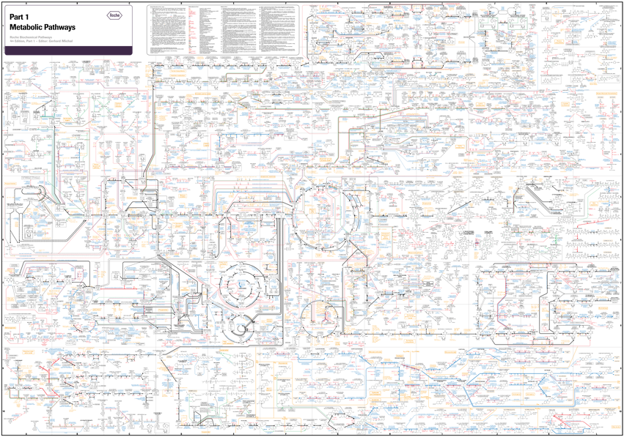

Why Software Architecture is of Critical Significance
– Now More Than Ever
20th IEEE International Conference on Software Architecture
Faculty of Information Technology
Research
Bran Selić
Malina Software Corp. (CANADA)
Monash University (AUSTRALIA)

Slide 2
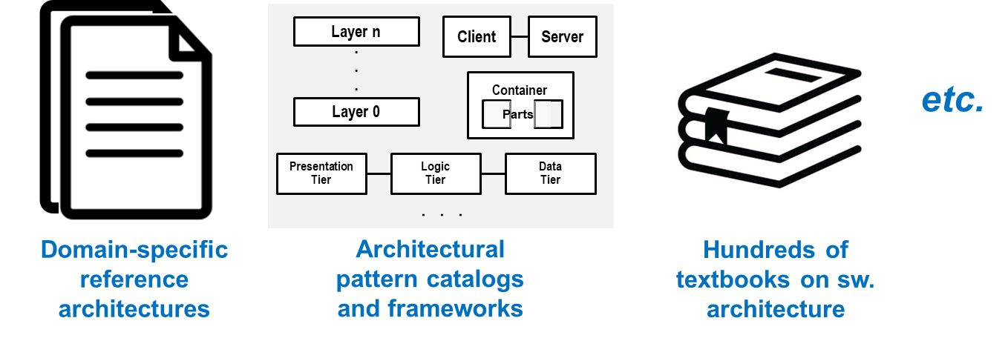
An Old Problem Solved?
Nowadays, we have at our disposal…
Q1: Are there any significant research questions still left in the domain of software architecture?
Q2: If so, what are they and why have they not been addressed?

Slide 3
An Old Problem Solved?
Nowadays, we have at our disposal…
Has anything changed that introduces new requirements?
Q1: Are there any significant research questions still left in the domain of software architecture?
Q2: If so, what are they and why have they not been addressed?

Slide 4
Sidebar:
A Cautionary Tale

Slide 5

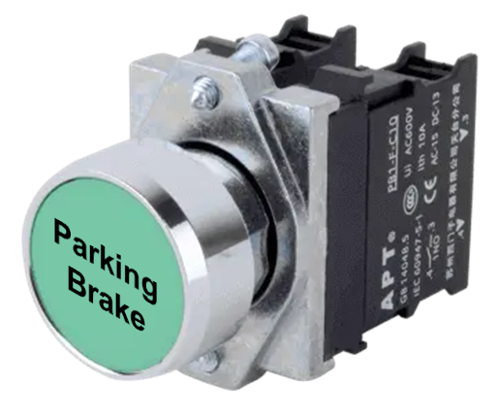


The Case of the Hi-Tech Parking Brake (1)
Traditional parking brake ($$$)
Pushbutton (₵)
Brake
replaced by
Brake
control
SW
But, how should we release the brake?

Slide 6
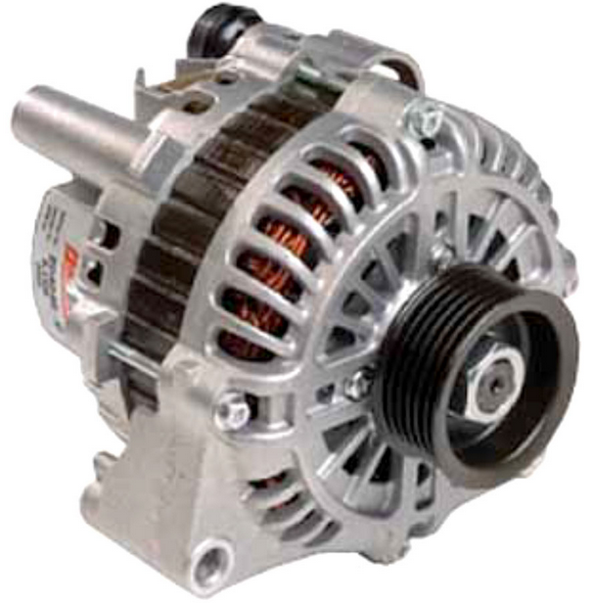


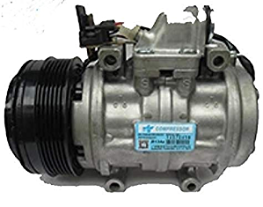
The Case of the Hi-Tech Parking Brake (2)
Solution:
Release brake when accelerator pressed
Dynamo
Brake
Brake
control
SW
RPM
sensor
AC System
On a hot day, the driver enabled the parking brake and exited the vehicle temporarily – leaving the door open
High external temperature quickly raised cabin temperature
AC control software activated AC compressor
This activation created additional demand for electrical power
Dynamo suddenly increased its RPM rate
Brake released; car started moving with no driver present!
AC control SW
Cabin temperature
sensor
AC compressor

Slide 7
The Case of the Hi-Tech Parking Brake (2)
Solution:
Release brake when accelerator pressed
Dynamo
Brake
Brake
control
SW
RPM
sensor
AC System
On a hot day, the driver enabled the parking brake and exited the vehicle temporarily – leaving the door open
High external temperature quickly raised cabin temperature
AC control software activated AC compressor
This activation created additional demand for electrical power
Dynamo suddenly increased its RPM rate
Brake released; car started moving with no driver present!
AC control SW
What does this have to do with software architecture?
Cabin temperature
sensor
AC compressor

Slide 8
Part 1:
Some Challenges Facing 21st Century Software Architects

Slide 9
Back to Our Question…
Nowadays, we have at our disposal…
Has anything changed that introduces new requirements?
Q1: Are there any significant research questions still left in the domain of software architecture?
Q2: If so, what are they and why have they not been addressed?

Slide 10

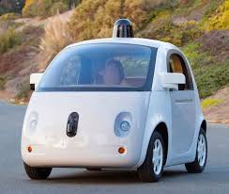
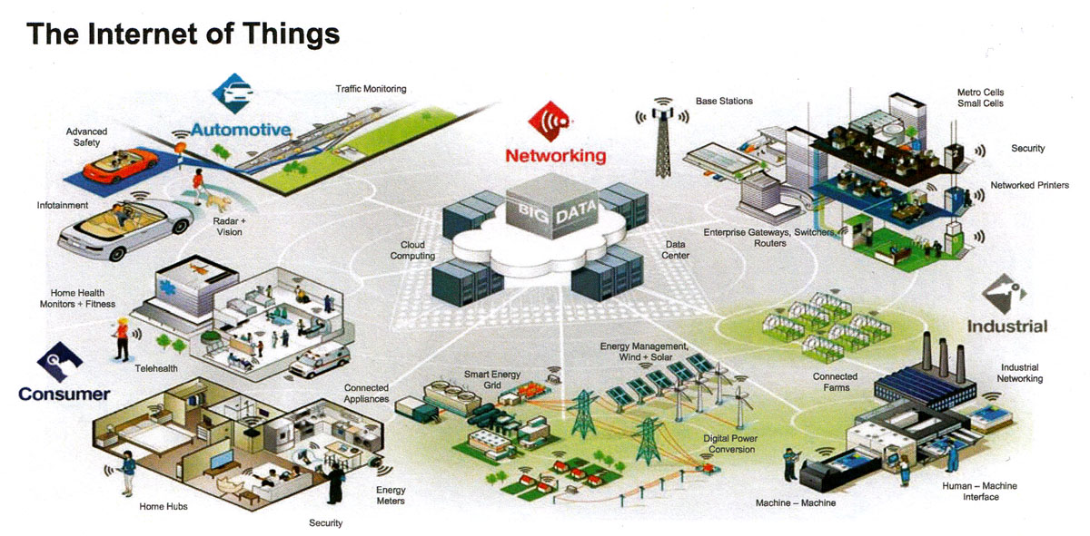

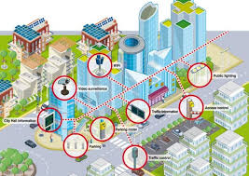
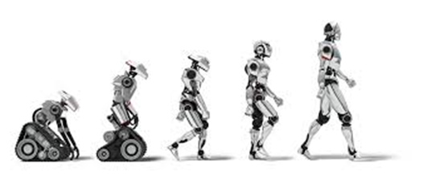
The Trend of 21st Century Software…
Self-driving Smart Cars
Smart Homes
“Smart Anything Everywhere”
-- Official slogan of EU’s H2020 research initiative
(https://smartanythingeverywhere.eu/)
Smart Robots
Smart Cities

Slide 11
The Trend of 21st Century Software…
Self-driving Smart Cars
Smart Homes
“Smart Anything Everywhere”
-- Official slogan of EU’s H2020 research initiative
(https://smartanythingeverywhere.eu/)
What exactly do we mean by “smart”?
Smart Robots
Smart Cities

Slide 12

“Smart” System Definition
A system with the following capabilities (NB: my definition):
  It can sense its context and detect relevant changes in that context or in its own internal state – in real time
  It can respond appropriately in a timely manner in a way that is consistent with its intended purpose (i.e., its specification)
  [optional] It can autonomously adjust its behavior to new situations based on available data and/or its history
  [optional] It may be networked with other systems in its context to enable their synchronized (“smart”) operation
⇨ We would like the system to respond in the same way that a knowledgeable (i.e., “smart”) human expert would respond

Slide 13
“Smart” System Definition
A system with the following capabilities (NB: my definition):
  It can sense its context and detect relevant changes in that context or in its own internal state – in real time
  It can respond appropriately in a timely manner in a way that is consistent with its intended purpose (i.e., its specification)
  [optional] It can autonomously adjust its behavior to new situations based on available data and/or its history
  [optional] It may be networked with other systems in its context to enable their synchronized (“smart”) operation
What stands in our way?
⇨ We would like the system to respond in the same way that a knowledgeable (i.e., “smart”) human expert would respond

Slide 14
In Essence…
What stands in our way?
⇨ We still lack a systematic and readily reproducible way of designing and building systems of this degree of sophistication
…Because it is a fundamentally hard (“wicked”?) problem

Slide 15







What Stands in Our Way…
All these “smart” systems involve some type of timely interaction with the concrete “natural” world
  We well know that this world is extremely complex (and often unfriendly)
To deal with that complexity, we interpret that world through a set of abstract representations
  Abstraction is one of our most powerful weapons for managing complexity
  Could it also be our biggest impediment in designing complex systems?

Slide 16


“Divide and Conquer”?
Electrical System
Braking System
Brake
Dynamo
Brake
control
SW
RPM
sensor
AC System
AC control SW
A Software Architecture View
Interacting
Features!!
AC control SW
Interacting
Features
Brake control SW
Cabin temperature
sensor
Automotive Application Framework
(e.g., AUTOSAR)
Hardware Virtualization Layer
(e.g., device drivers)
AC compressor

Slide 17
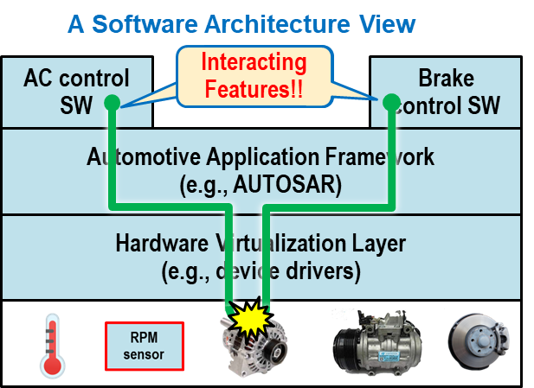
The Feature Interactions Problem
Feature: an ordered set of action steps designed to produce a desired system outcome
Feature interactions can occur when two or more feature executions (inadvertently) interfere with each other, resulting in an undesirable outcome
Necessary conditions:
  A hazardous precondition (initial state): combination of system and environment states that has the potential to cause feature interactions
  Shared resources: One or more system or environment resources that are shared by interacting feature executions
  Temporal overlap: A particular interleaving of action steps belonging to different feature executions leading to at least one of them producing an undesirable outcome
    But, only some interleavings can cause feature interaction (time dependent, state dependent)

Slide 18
The Feature Interactions Problem (cont.)
What makes feature interactions highly problematic:
  The source and cause of the conflict are not always obvious (i.e., difficult to anticipate)
  The interacting features are often specified independently of each other
  In feature rich systems, this can result in an unmanageable combinatorial explosion of possible feature interaction scenarios
    E.g.: In classical telephony, these were in the order of 10⁴
    How many can we expect to find in something as complex as a “Smart City”?
⇨ It is safe to conclude that in these kinds of complex systems it will never be practically feasible to identify, in advance, all possible feature interactions that can (and, invariably, will) occur

Slide 19
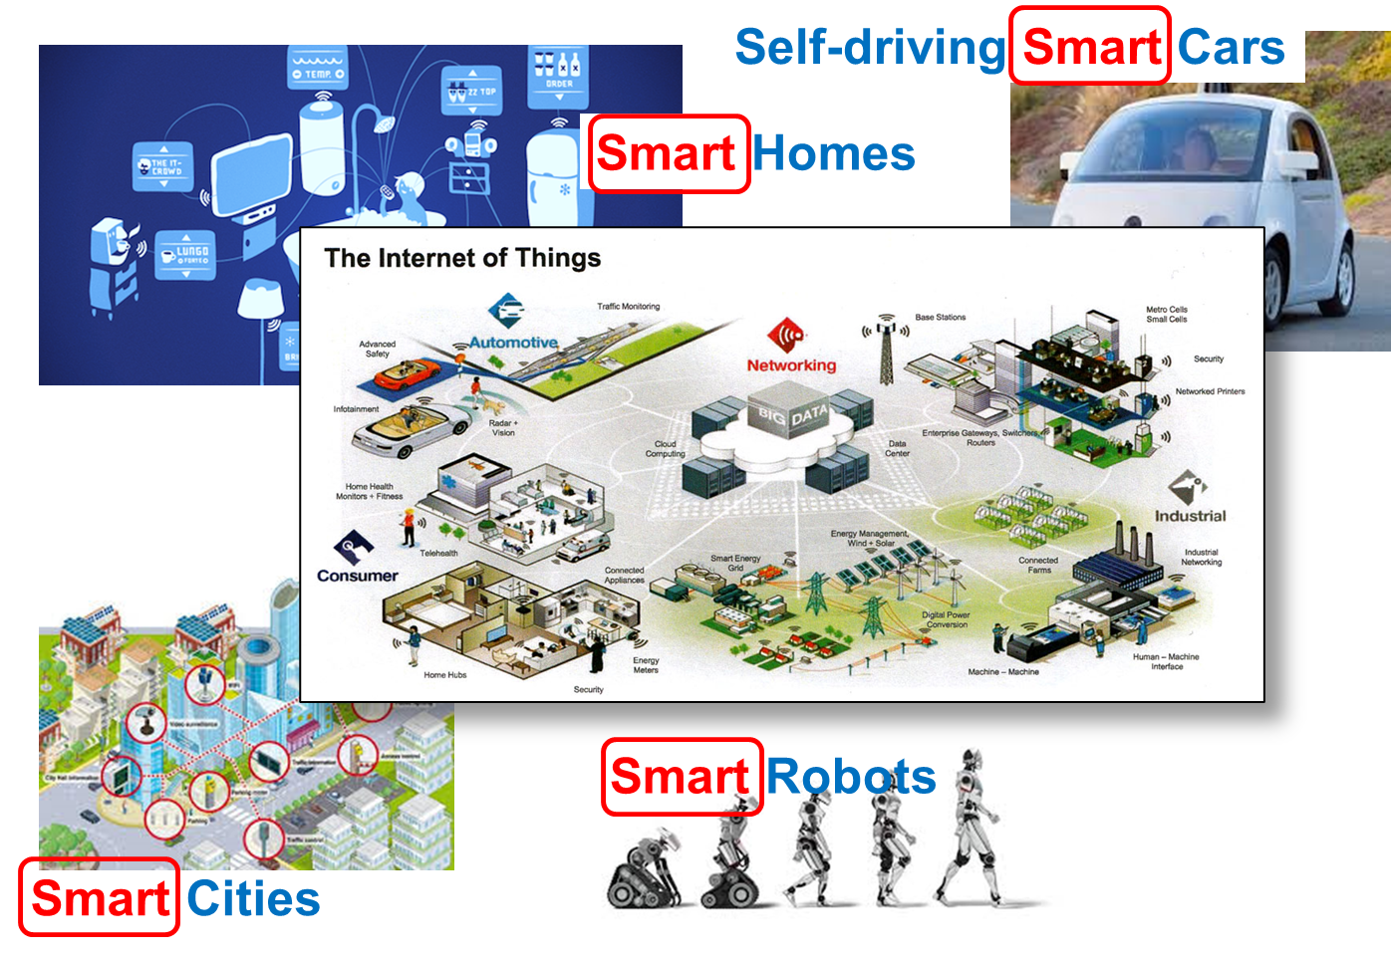




More “Smart” Trouble Brewing…
It’s not limited just to cyber-physical systems!
Human Users
Diversity
Distribution
“Smart”
SW
System
Concurrency
Physicality
Ambiguity
Unpredictability
This brave new world of “smart” things fundamentally involves interactions between software and the physical, non-computational (Gödel’s theorem), non-digital, unpredictable, ambivalent, diverse, and complex entities and dynamic phenomena, which characterize the natural world

Slide 20
More “Smart” Trouble Brewing…
For software to interact appropriately with these “dragons” it must incorporate some kind of internal models of such phenomena (e.g., “digital twins”)
Unfortunately, none of them are fully compatible with our current computing technologies: hardware, software, languages, formal mathematical logic, etc.
Human Users
Diversity
Distribution
“Smart”
SW
System
Concurrency
Physicality
Ambiguity
Unpredictability
This brave new world of “smart” things fundamentally involves interactions between software and the physical, non-computational (Gödel’s theorem), non-digital, unpredictable, ambivalent, diverse, and complex entities and dynamic phenomena, which characterize the natural world

Slide 21

Example: Modeling the Lifecycle of a Frog
We should be able to model the following phenomenon:
Instance A:
age 7 weeks
Instance B:
age 7 weeks
MEZOMORPH
FROG
Classification scheme is a discretionary matter
TADPOLE
Class of an instance changes dynamically
Lifecycle of an individual frog

Slide 22
Example: Modeling the Lifecycle of a Frog
We should be able to model the following phenomenon:
Overlapping Classification
MEZOMORPH
FROG
TADPOLE
Class of an instance changes dynamically
Lifecycle of an individual frog
But, not directly supported by any conventional OO language
Requires a different approach to classification
B. Selic and A. Pierantonio: “Fixing Classification: A Viewpoint-based Approach, ISOLA 2021

Slide 23
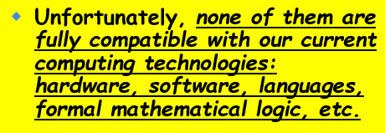
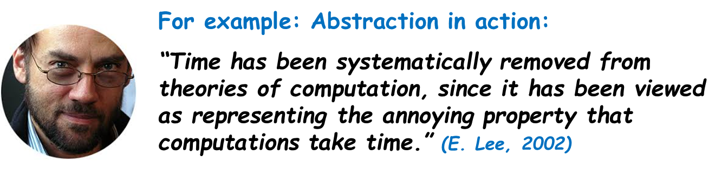
Why Are We So Unprepared for Reality?
Much of current computing theory can be traced to the mathematical origins of computing:
  Initial applications (code breaking, numerical analysis, artillery tables…)
  Hardware based on formal mathematical logic (AND, NAND, OR, NOR gates)
  Historically, theory of computing developed primarily by mathematicians
This culture was then assimilated by early software pioneers…
  Who instilled it in software technologies (computer languages, formal models, etc.)
  E.g., majority of computer languages only support abstract numerical types

Slide 24
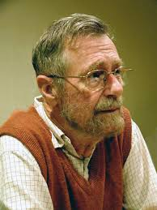
Dijkstra’s Dream and Lament
Edsgar W. Dijkstra’s hope for software design:
“I see no meaningful difference between programming methodology and mathematical methodology.” (EWD 1209)
However:
“[The interrupt] was a great invention, but also a Pandora’s Box.…essentially, for the sake of efficiency, concurrency [became] visible… and then, all Hell broke loose” (EWD 1303)
Actually, the real justification for interrupts was to provide a means computers to detect and respond to changes in their environment

Slide 25

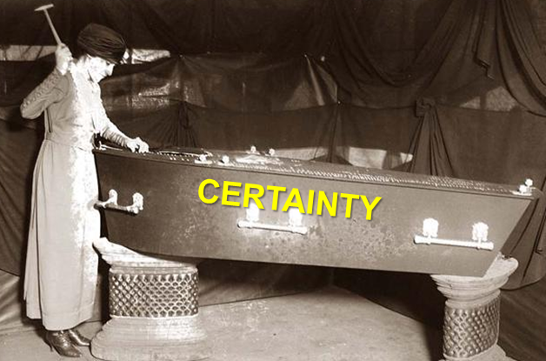
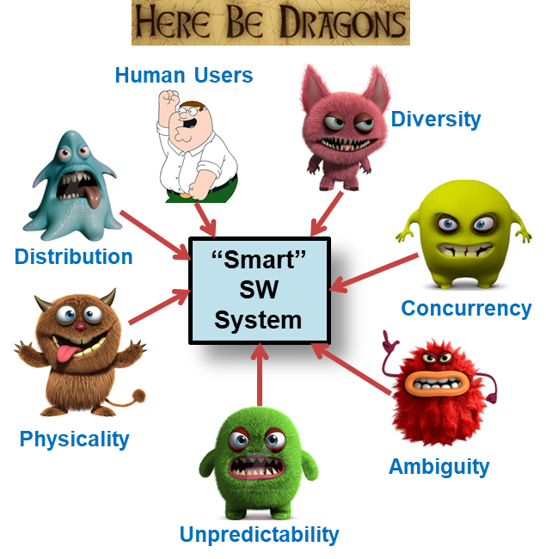
The Loss of Certainty!!
implies

Slide 26

How Should SE Deal with Uncertainty?
D. Garlan, “Software Engineering in an Uncertain World”, Proc. FSE/SDP Workshop on Future Software Engineering Research, (125-128) 2010.
David Garlan
Utility instead of correctness
Bounded approximation instead of precision [certainty?]
Closed-loop (control) systems
Incorporate uncertainty as a first-class design concern
Resiliency/adaptation in the presence of unpredictable/unexpected events
New formal methods and tools for reasoning in the presence of uncertainty
New methods of machine learning that ensure “reasonable” behavior

Slide 27
A Partial Research Program
D. Garlan, “Software Engineering in an Uncertain World”, Proc. FSE/SDP Workshop on Future Software Engineering Research, (125-128) 2010.
David Garlan
Utility instead of correctness
Bounded approximation instead of precision [certainty?]
Closed-loop (control) systems
Incorporate uncertainty as a first-class design concern
Resiliency/adaptation in the presence of unpredictable/unexpected events
New formal methods and tools for reasoning in the presence of uncertainty
New methods of machine learning that ensure “reasonable” behavior
Utility instead of correctness
Bounded approximation instead of precision [certainty?]
Closed-loop (control) systems
Incorporate uncertainty as a first-class design concern
Resiliency/adaptation in the presence of unpredictable/unexpected events
New formal methods and tools for reasoning in the presence of uncertainty
New methods of machine learning that ensure “reasonable” behavior

Slide 28
Part 2:
A Challenge for Software Architecture Researchers

Slide 29


Current “Good” Architectural Design Approach
Good design
Bad design!
A
B
AB
CDE
C
D
FGH
IJ
Each module performs a single
well-defined function/feature
(“Divide-and-Conquer” approach)
Inter-module couplings are minimized
Modules combine multiple related functions/features
Large number of inter-module couplings

Slide 30
How Nature Does “Smart”
Metabolic processes
http://biochemical-pathways.com/#/map/1
Metabolism [dictionary.com]: the sum of the physical and chemical processes in an organism by which its material substance is produced, maintained, and destroyed…

Slide 31
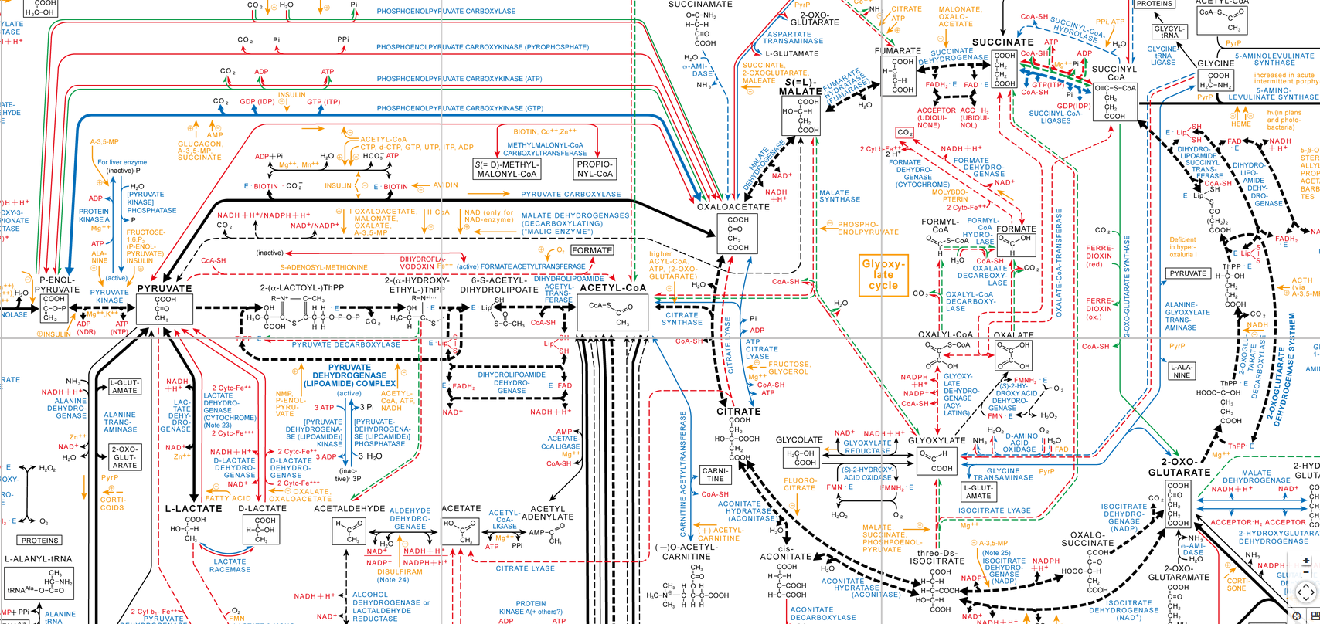
How Nature Does “Smart”
Metabolic processes
http://biochemical-pathways.com/#/map/1

Slide 32

Some Key Observations
A bewildering forest of connections!
No crisp modularity
??

Slide 33
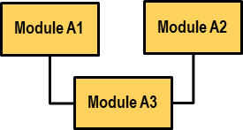
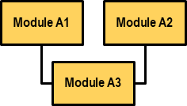

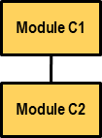
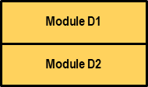
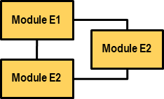


Traditional Design Based on Abstraction
Sub-
problem
B
Subproblem
A
Sub-
problem
C
Subproblem D
Sub-problem F
Subproblem E
Step 0: Complex Problem
Step 1: Divide and reduce (abstraction)
Subproblem
A
Solution to A
.
.
.
.
.
.
Sub-problem F
Solution to F
Step 2: Conquer
Step 3: Integrate

Slide 34
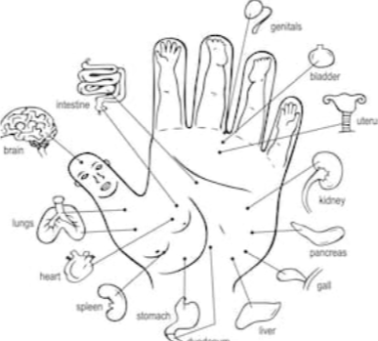
On Interconnectedness in Natural Systems
The clean maximal de-coupling approach that we prefer in traditional engineering does not occur in natural systems
Everything is ultimately connected to everything else either directly or indirectly
Thumb-Brain connection!!?
ACUPUNCTURE POINTS
Product of a systemic (vs. analytical) approach

Slide 35
On Interconnectedness in Natural Systems
The clean maximal de-coupling approach that we prefer in traditional engineering does not occur in natural systems
Everything is ultimately connected to everything else either directly or indirectly
Much greater utilization of relationships than we are used to
Thumb-Brain connection!!?
ACUPUNCTURE POINTS
Product of a systemic (vs. analytical) approach

Slide 36
Time for a New Approach to Design?
Bad design!
Bad design!
Good design
Good design
A
B
AB
CDE
C
D
FGH
IJ
Each module performs a single
well-defined function/feature
(“Divide-and-Conquer” approach)
Inter-module couplings are minimized
Modules combine multiple related functions/features
Large number of inter-module couplings
Could it be that time has come to reconsider some of our core design paradigms?

Slide 37
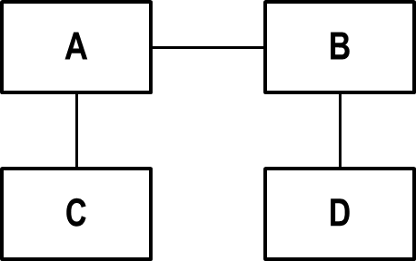
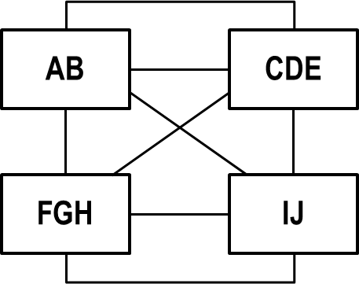
Thesis
Natural (bio) systems are much better at being “smart” than we can currently achieve with our traditional engineering approaches
But, we cannot hope to match the complexity of natural systems
However, perhaps we can move closer to them by devising a synergistic combination of traditional methods and new ways of dealing with complexity based on natural approaches
??
TRADITONAL
NATURAL
Example: Bio-inspired algorithms (genetic programming)

Slide 38

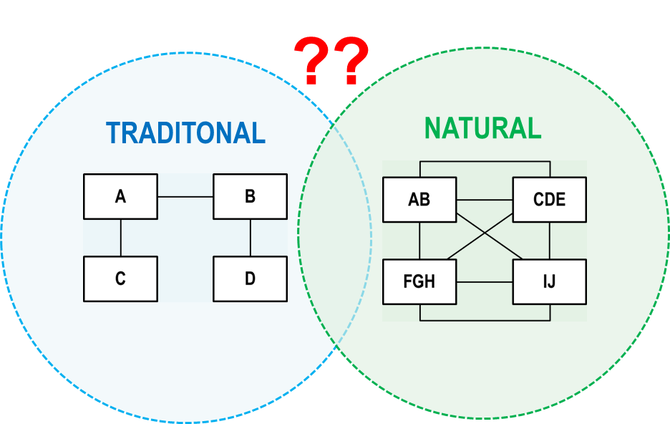
A Research Challenge
Is it feasible to come up with such an approach?
  Even if the answer is “no”, that would still be a very useful result
Study the “architecture” of natural organisms and the ways that they “emerge” and “self-organize”
  A multi-disciplinary effort!
  There is existing work: “science of complexity” (e.g., Santa Fe Institute)
    e.g., S. Kauffman, “At Home in the Universe”, Oxford University Press, 1995
Particular focus on relationships (the “lines” rather than the “boxes”)
  Identify different categories and patterns of relationships
  Map these to architectural design patterns

Slide 39
Building the Architectural Patterns Pyramid
“Smart” Objectives
Architectural Principles
Architectural Design Patterns
Realization Patterns

Slide 40
Part 3:
Summary

Slide 41
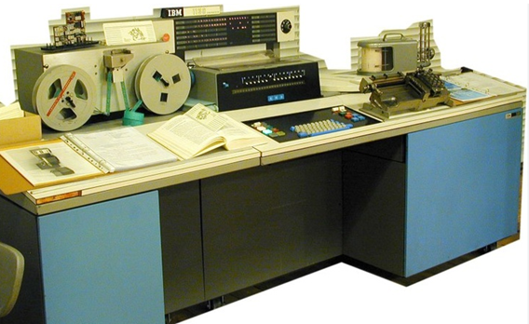
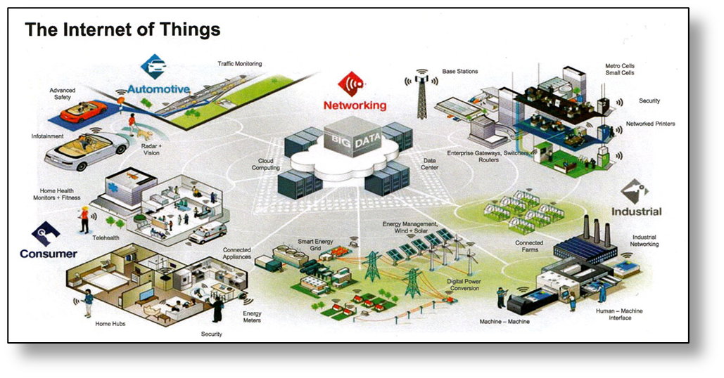
Summary (1): We’ve Come a Long Way
1960’s
21st Century
The scope (expectations) and complexity of software have expanded significantly, especially since the start of the 21st century
  Much greater degree of direct interaction with the vast and highly complex and often unpredictable “real” world (physical and social)
Relentless pressure to produce increasingly more sophisticated and more complex software systems (i.e., “intelligent”, “smart” systems, “systems of systems”, etc.)
  Vendors and researchers are rushed to satisfy this need
  But, with insufficient reflection on the qualitative discontinuity involved

Slide 42
Summary (2): Are We Aiming Too High?
1960’s
21st Century
Unfortunately, we do not (yet) have sufficient expertise and experience to design such systems in a systematic, and readily reproducible manner
  We cannot solve this problem with our existing methods and tools
  (Is it even feasible, given that the natural world is non-computational?)
How do we bridge the computational/non-computational divide?
New approaches and new knowledge are necessary

Slide 43
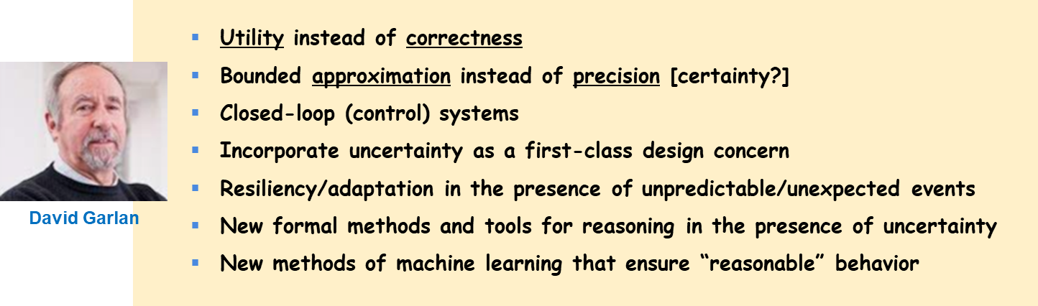
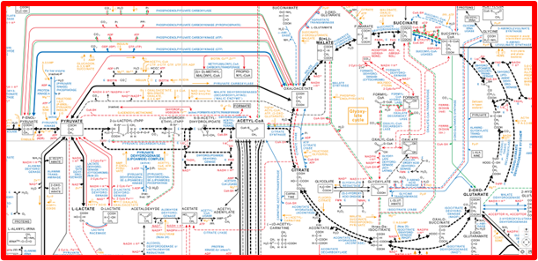

Summary (3): A Call to Action
All of the above have a major impact on software architecture design
Given that the types of systems we are seeking are approaching biological levels of complexity...
... can we perhaps learn from nature’s self-organizing systems?

Slide 44


Slide 45
Supplementary slides

Slide 46
Metamodel of Proposed Viewpoint-Based Classification
Using the concept of “viewpoint” from IEEE standard 42010*
e.g., using fuzzy logic to deal with overlapping classifications
*ISO/IEC/IEEE, Systems and software engineering – Architecture description, ISO/IEC/IEEE Standard 42010 (1st edition), 2011.

