Slide 1
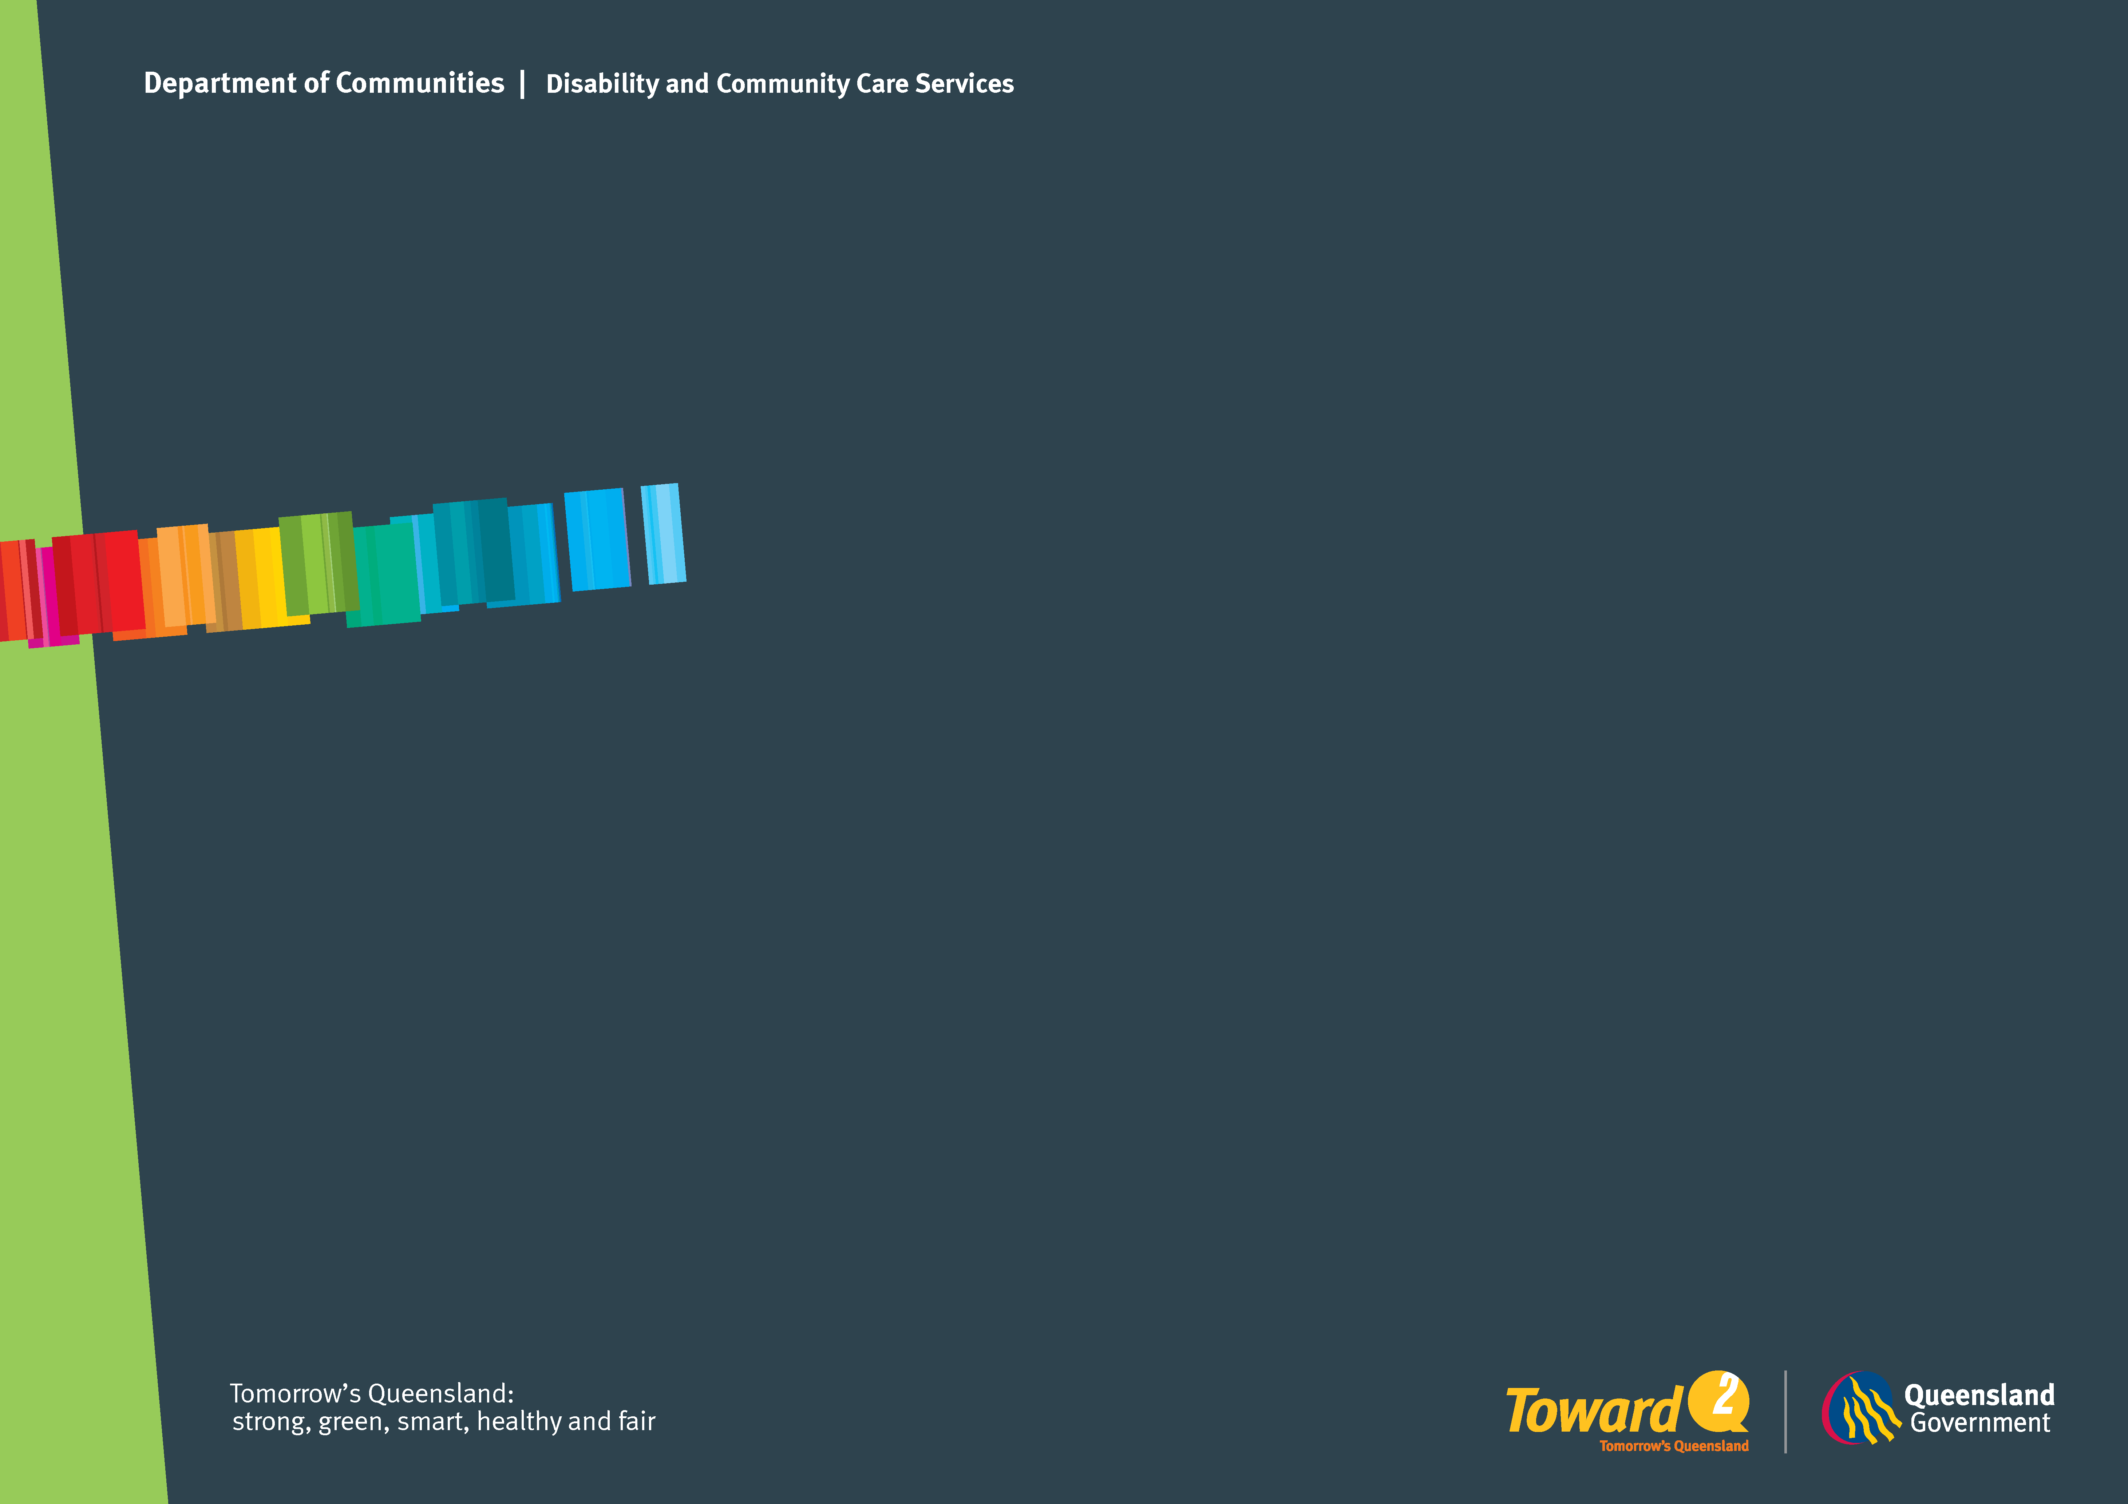
Challenges in implementing human rights in disability settings
Monash University, Faculty of Law 2012 Conference
Implementing Human Rights in Closed Environments,
20-21 February, Melbourne
Jeffrey Chan, PhD
Chief Practitioner Disability and Director of Forensic Disability

Slide 2
Cumulative risk factors in behaviours of concern and mental ill-health

Slide 3
Historical, Image and Language
Representations of Disability
Historical narrative, imagery and social-cultural discourse contribute to the negative representations of people with disabilities as “less than human”.
The role of clinical representations and clinical terminologies/descriptors contribute to the negative representations of people with disabilities.

Slide 4
Who are most vulnerable in disability closed environments?
Persons subject to restrictive interventions
      Younger people with more than one disability (autism)
      Persons with a psychiatric disability
Persons with complex communication needs
Persons exploring their sexuality
Aboriginal and Torres Strait Islander background

Slide 5
What areas human rights implementation need to consider?
The interface with occupational health and safety
Constructive dialogue with industrial unions
The revival of congregate care living arrangements segregated from the community
Engage with professional associations and peak bodies such as medical and health-care, education etc
Engage with NDIS – a big Australian social reform

Slide 6
Changing practice and organisational cultures
Secondary
Primary
Tertiary
RESEARCH
POLICY
PRACTICE

Slide 7
Primary level human rights intervention
Legislation
Leadership – embedding into organisational culture
Human rights training mandatory for all staff
Human rights training for people with disabilities

Slide 8
Secondary level of human rights intervention
Regulatory bodies “with teeth”
Human rights and promoting self-advocacy in closed environments
People with disabilities as community visitors to closed environments

Slide 9
Tertiary level of human rights intervention
Strong safe guarding processes with external participation and scrutiny where there are human rights abuse
Educating and working with police, courts, legal aid etc
Part of employment, contractual and key performance indicators requirements for service providers

