Slide 1
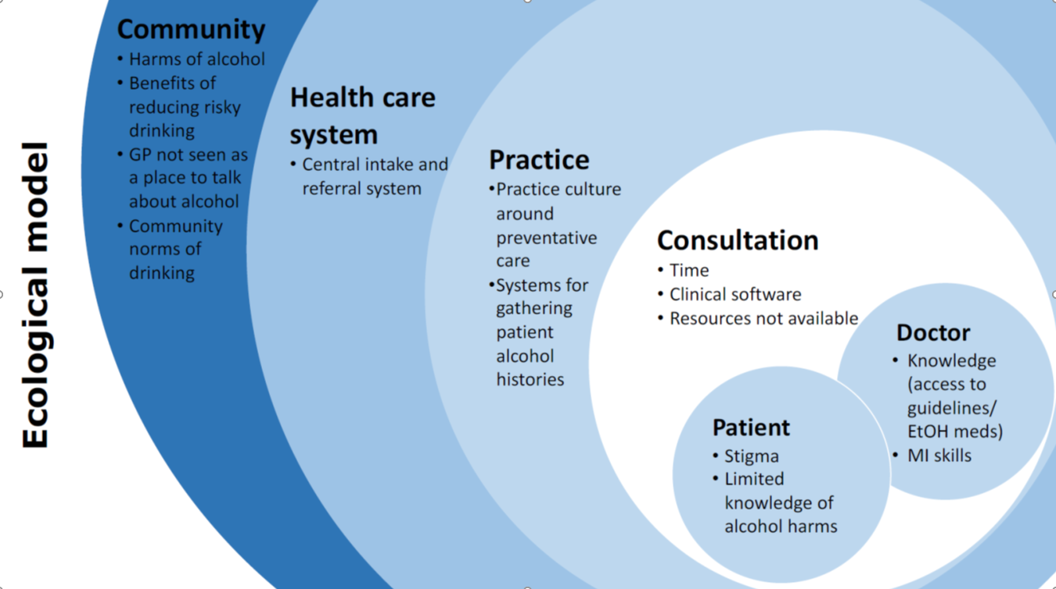







A qualitative study of clinicians and patients exploring how alcohol brief interventions can be better embedded in routine general practice
Nilakshi Gunatillaka¹, Grant Russell¹, Suzanne Nielsen², Renée O'Donnell³, Tina Lam², Helen Skouteris³, Lauren Ball⁴, Chris Barton¹, David Jacka⁵, Michael Tam⁶, Danielle Mazza¹, Catriona Rowe¹, Nathanael Wells¹ and Liz Sturgiss¹
¹Department of General Practice, School of Primary & Allied Health Care, Faculty of Medicine, Nursing and Health Sciences, Monash University, Australia, ² Monash Addiction Research Centre, Eastern Health Clinical School, Faculty of Medicine, Nursing and Health Sciences, Monash University, Australia, ³ Monash Centre for Health Research and Implementation, School of Public Health and Preventative Medicine, Faculty of Medicine, Nursing and Health Sciences, Monash University, Australia, ⁴ Healthy Primary Care Team, Menzies Health Institute Queensland, Griffith University, Australia, ⁵ Monash Health, Australia, ⁶ Academic Primary and Integrated Care Unit, Faculty of Medicine, University of New South Wales, Australia
BACKGROUND
Alcohol brief interventions (BIs) involve assessing a person’s alcohol use and offering individualised advice to reduce health risks. Despite their proven effectiveness, clinicians do not routinely offer brief interventions for alcohol use.
OBJECTIVE
To identify factors that influence whether alcohol BIs are used in consultations from the perspective of clinicians and patients.
FINDINGS
Barriers
Barriers were identified at multiple levels of the healthcare system and across the general community, including:
Australian drinking norms;
Inconsistent public health messaging;
Patients not identifying general practice as a place to go for help;
Community stigma;
General practice culture around preventative health;
Limitations of clinical software;
Current patient resources
Facilitators
Patients and clinicians identified factors that could support BIs in primary care:
Raising community awareness of the health harms of alcohol;
Building a practice culture around prevention;
Supportive resources to facilitate discussion about alcohol use and strategies to reduce intake
METHOD
Qualitative study using semi-structured interviews and focus groups (face-to-face and virtual) of primary care clinicians working in the greater Melbourne metropolitan region and patients from across Australia. Field notes were made from audio-recordings and themes were identified using a matrix based on the question structure.
IMPLICATIONS
We have identified factors at multiple levels of the healthcare system that influence the successful implementation of alcohol BIs in general practice. The data is being used to inform an intervention to increase clinician uptake of BIs in daily general practice.
39 GP participants
Participants
9 Nurse participants
6 Practice Visits
CONTACT DETAILS
Dr Liz Sturgiss
Building 1, 270 Ferntree Gully Road
Notting Hill, VIC 3168
0412 233 119
Liz.Sturgiss@monash.edu
https://research.monash.edu/en/persons/liz-sturgiss
3 Focus groups
16 patients interviewed

