Slide 1
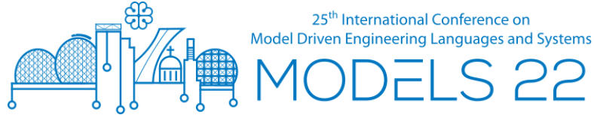
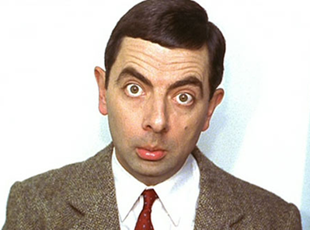

What’s Wrong with “Users”?
- An unflattering attack on our value system –
- and what can be done to fix it -
HuFaMo 2022 Workshop
“USER”
Bran Selić
Malina Software Corp. CANADA
Monash University, AUSTRALIA
selic@acm.org
bran.selic@monash.edu

Slide 2
CAVEAT: Based on Experience
Opinions expressed in this talk are not the result of systematic research but are drawn from 50 years of direct personal experience with the design and development of large-scale industrial software
My technical experience:
  1969: first computer program [Fortran]
  1972-1974: software for robotic manipulators [assembler, BASIC]
  1975-1976: financial applications software [COBOL, DSL]
  1977-1978: software for aerospace simulators [assembler, Fortran]
  1978-1982: software for telephony switching [microcode, DSL]
  1983-1987: packet switching, distributed operating systems [DSL]
  1988-2007: SW development tools, system architectures,
  high-level modeling languages [Smalltalk, C++, DSLs]
  2007- : consulting to industry (telecom, automotive,
  subsea oil and gas, smart grid, SW development tools),
  research (modeling languages, MBSE methods,
  human-centric SE) [UML, UML-RT, SysML ]

Slide 3
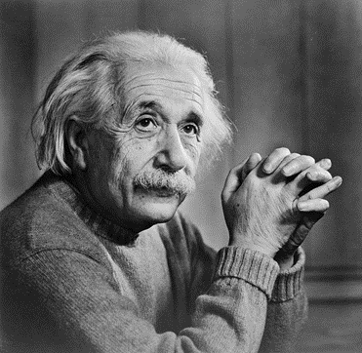
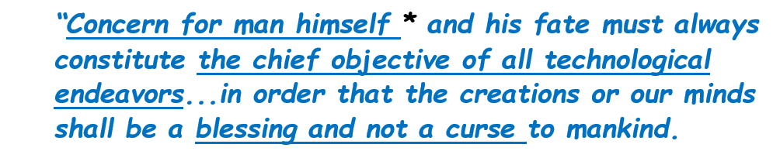
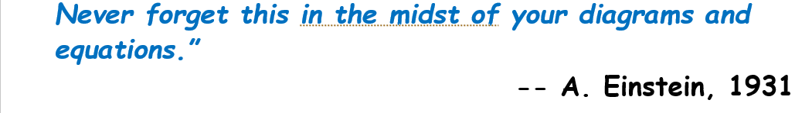
A Wise Man Once Noted:

Slide 4
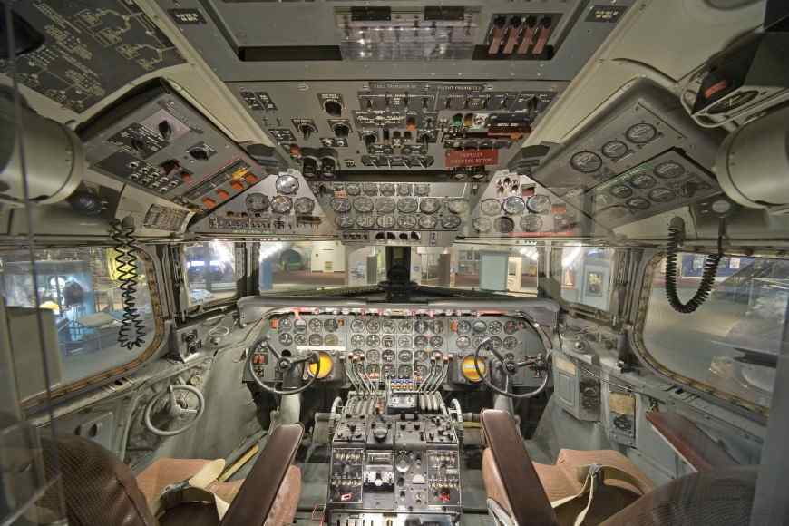
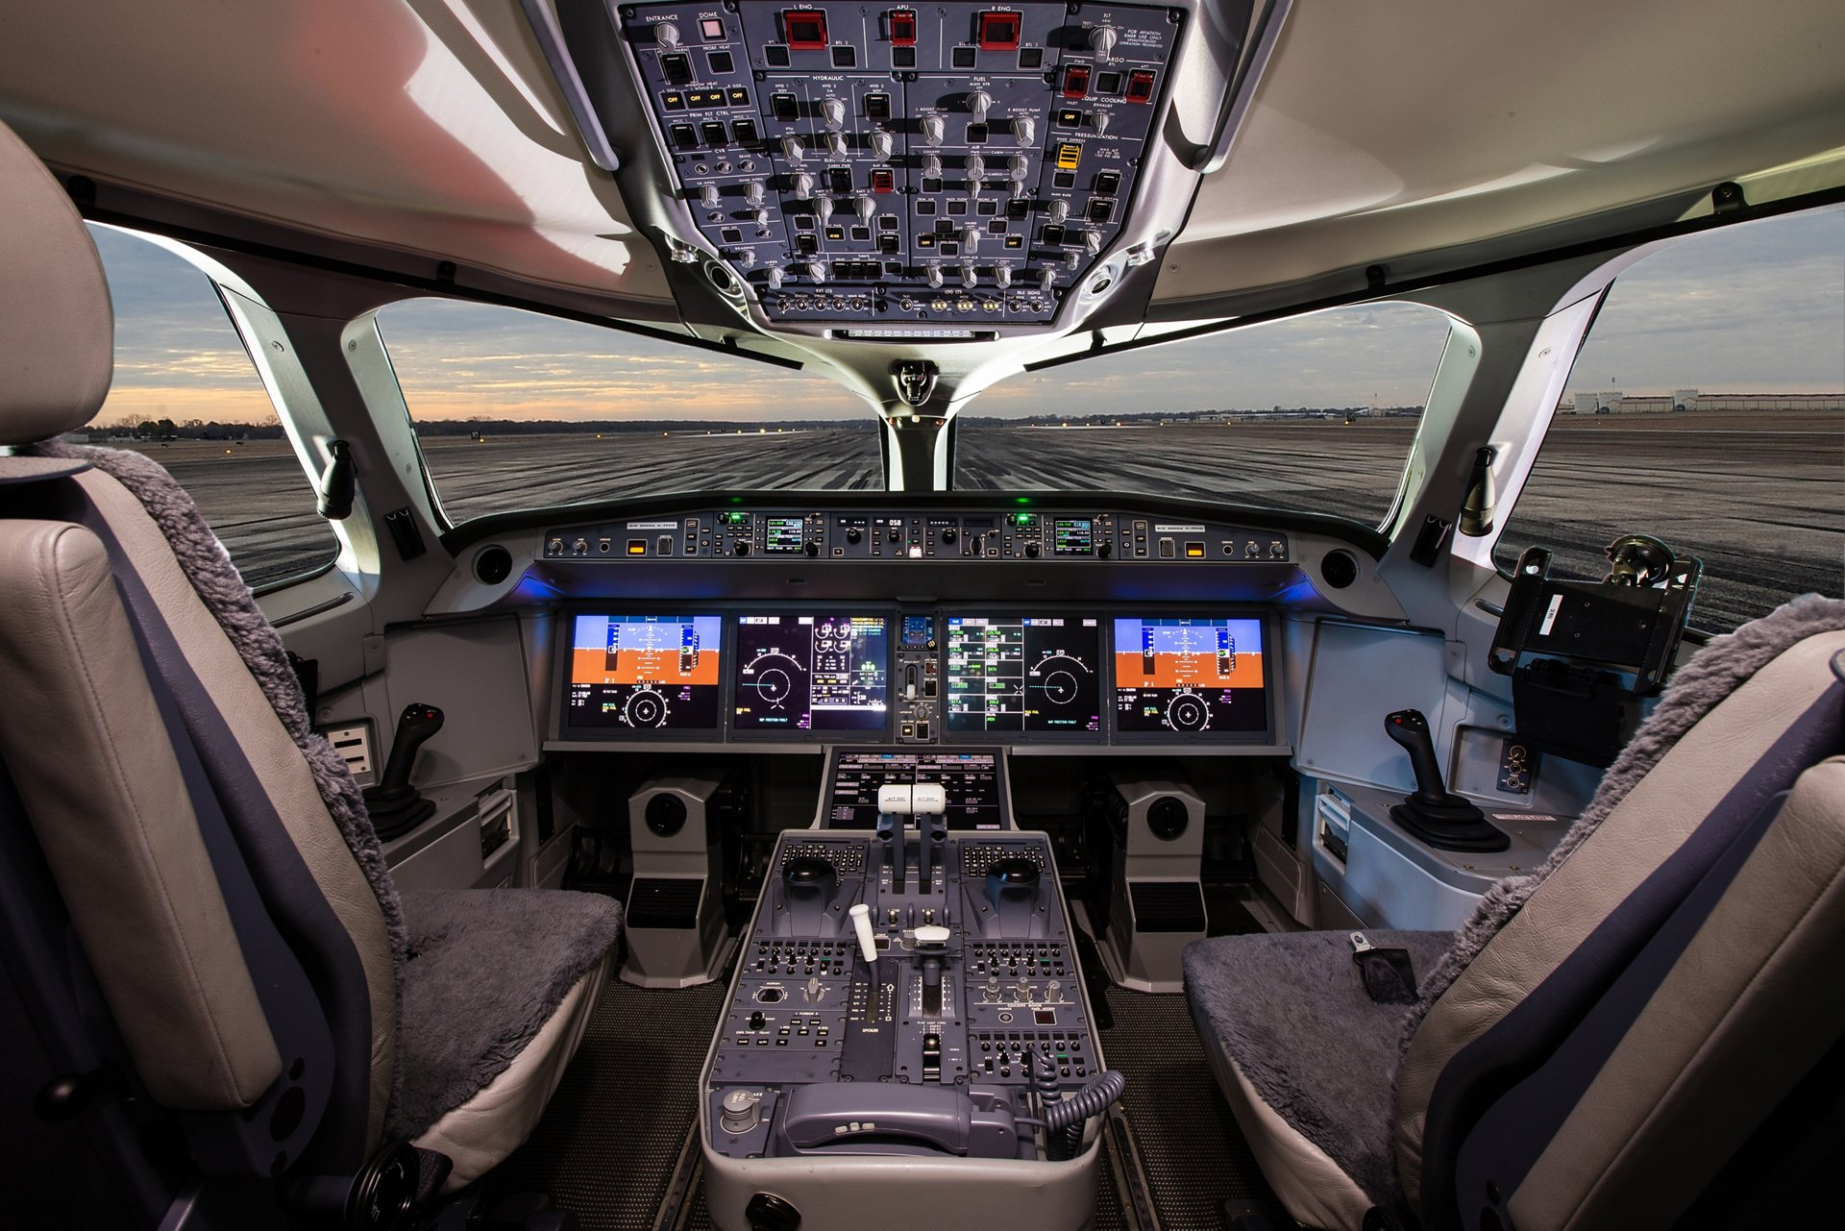
Classical Engineering: Human-Machine Interfaces
1950’s AIRLINER COCKPIT
MODERN AIRLINER COCKPIT
But, with the help of software…

Slide 5
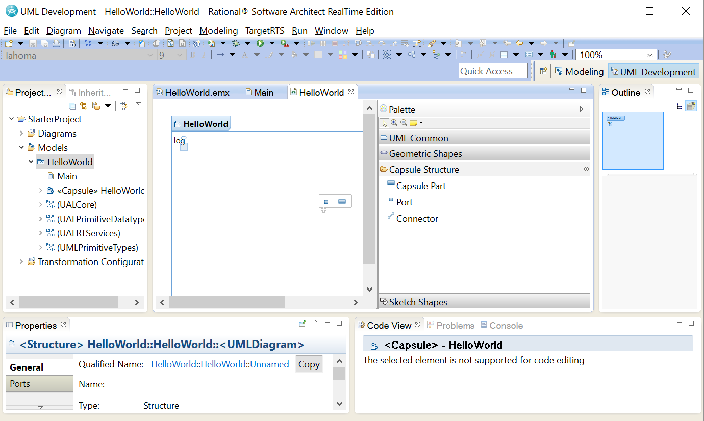
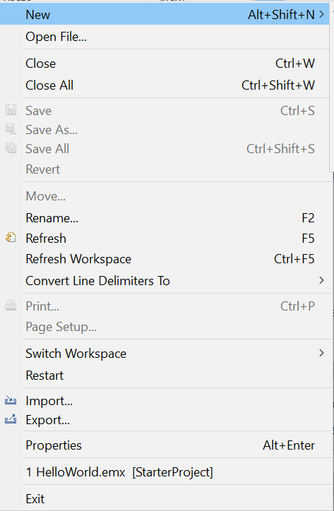
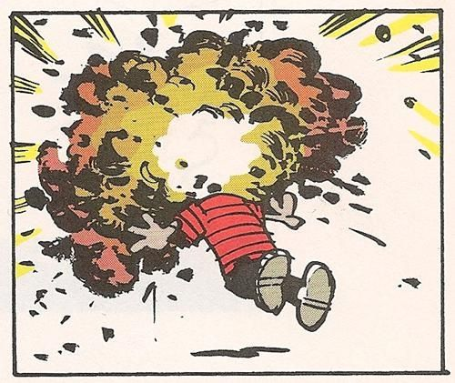
Contrast: “Modern” MBSE Tool
11 menu categories
Dozens of specialized controls represented by confusing and unintuitive icons
Close to 300 distinct menu items!
…which may need to be invoked in a specific order
TOOL USER
The complexity of many modern software development tools epitomizes the problem

Slide 6
A “Modern” IDE Tool Interface
11 menu categories
Dozens of specialized controls represented by confusing and unintuitive icons
Close to 300 distinct menu items!
…which may need to be invoked in a specific order
If you believe that this is how it has to be:
-- then, you are part of the problem
TOOL USER
The complexity of many modern software development tools epitomizes the problem

Slide 7
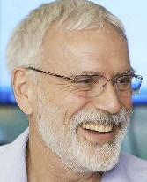
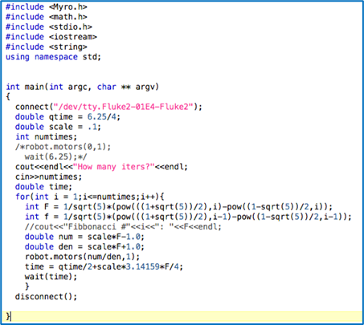

So, what exactly is the problem?
The “USER”
Primary focus ►
the CODE!
PROGRAMMER

Slide 8
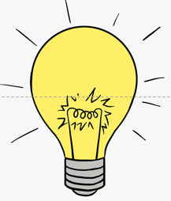




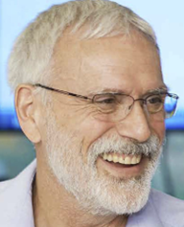
The “Existential Pleasure of Programming”
TRADITIONAL
ENGINEERING
Design
realization
Design
conceptualization
months to years
SOFTWARE
ENGINEERING
Working code
A highly seductive and rewarding experience!!
minutes
With minimal effort (typing)

Slide 9
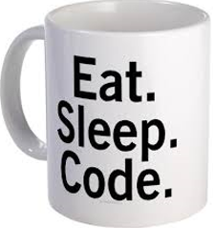
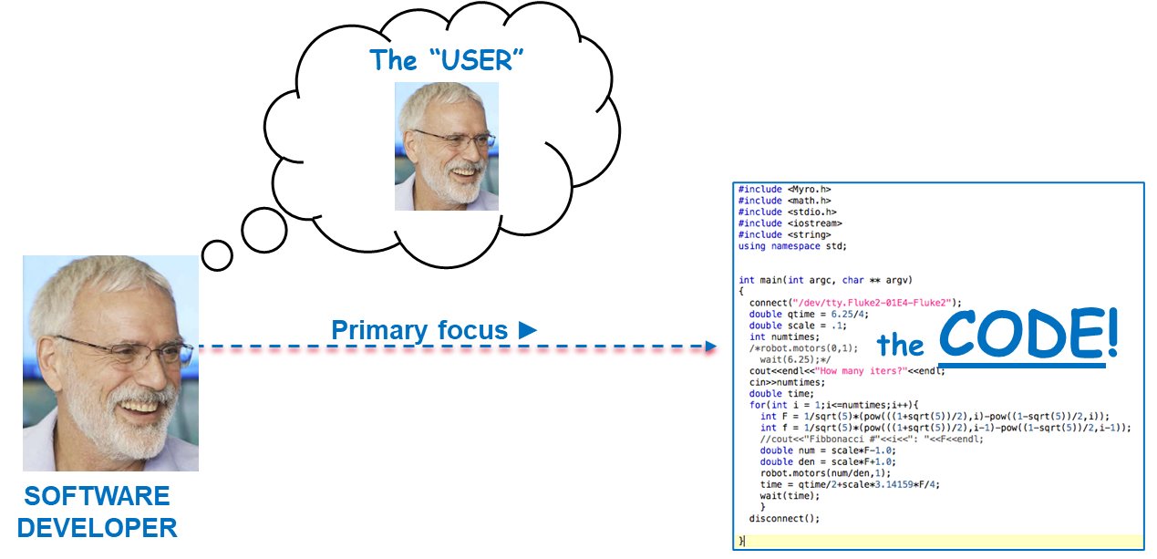


The “Medium is the Message” Syndrome
Programming is known to be addictive
The focus easily shifts from the product to
the craft of implementing the product
  Any detailed analysis of “users” and their needs gets in the way of the craft (i.e., “fun”) part

Slide 10
The “Medium is the Message” Syndrome
Programming is known to be addictive
The focus easily shifts from the product to
the craft of implementing the product
  Any detailed analysis of “users” and their needs gets in the way of the craft (i.e., “fun”) part
Encouraged by the “Agile Manifesto” (https://agilemanifesto.org/):
  “Develop only code and tests”
  “Working software over comprehensive documentation”

Slide 11
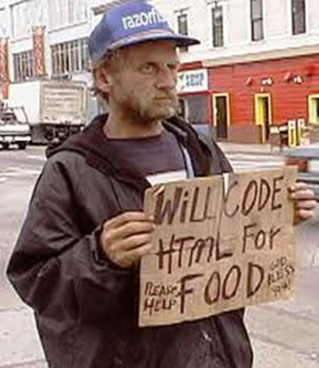
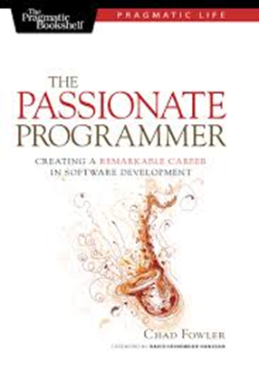
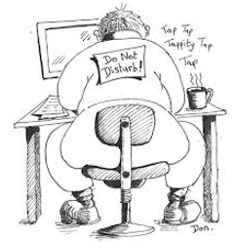
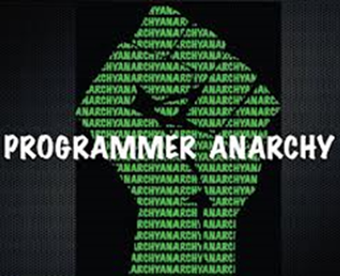
Programmer Culture
Primary expertise and focus: Implementation technology
  Versus problem-domain expertise
    E.g.: “I am a C++/Linux/Java/etc. expert”
    NB: In other engineering disciplines this is the job of technicians
  Constantly evolving software technologies require constant and extensive effort to maintain technical currency
Market demand encourages high degree of mobility
  Frequent employer and product domain switching is common ⇒ Insufficient time to gain deep problem domain expertise
Many programmers but very few system designers

Slide 12
Programmer Culture
Primary expertise and focus: Implementation technology
  Versus problem-domain expertise
    E.g.: “I am a C++/Linux/Java/etc. expert”
    NB: In other engineering disciplines this is the job of technicians
  Constantly evolving software technologies require constant and extensive effort to maintain technical currency
Market demand encourages high degree of mobility
  Frequent employer and product domain switching is common ⇒ Insufficient time to gain deep problem domain expertise
Many programmers but very few system designers
In fact, many software developers are not even trained as such => low entry barrier to software

Slide 13
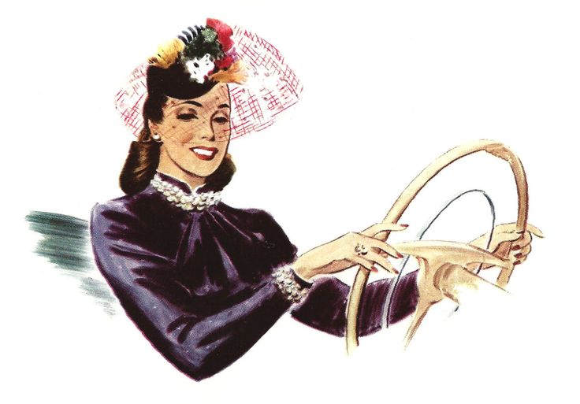




Example: Automotive Engineering
PASSENGER
DRIVER
ATTENDANT
USE
USE
USE
USE
PASSENGER VEHICLE
MECHANIC

Slide 14
Example: Automotive Engineering
PASSENGER
DRIVER
ATTENDANT
USE
USE
USE
USE
PASSENGER VEHICLE
Each category has idiosyncratic ways of “using” the product
MECHANIC

Slide 15

Viewed From a PROGRAMMER’S Perspective...
“USER”
PASSENGER
“USER”
“USER”
ATTENDANT
DRIVER
USE
USE
USE
USE
PASSENGER CAR
“USER”
“SYSTEM”
CAR MECHANIC

Slide 16

Viewed From a PROGRAMMER’S Perspective...
“Don’t know what they want”
“Don’t understand software”
“Don’t understand how to use my beautiful software”
“USER”
“USER”
PASSENGER
“USER”
“USER”
ATTENDANT
DRIVER
USE
USE
USE
USE
PASSENGER CAR
This “chauvinistic” view is symptomatic of a flawed and simplistic attitude that is endemic in software
“USER”
“SYSTEM”
CAR MECHANIC

Slide 17
Stakeholders: Looking Beyond Just “Users”
System clients/users/system operators
Customers/system owners/system admins
Government and industry regulators
Testers
Designers/architects
Developers (implementers)
Development managers
Product managers
Field support staff
Marketing staff
Sales staff
INTERNAL STAKEHOLDERS
Many of these categories are further sub-divided into finer sub-categories
Each of these categories has idiosyncratic and possibly even conflicting concerns
The generic term “user” obscures this critical diversity

Slide 18
Stakeholders: Looking Beyond Just “Users”
System clients/users/system operators
Customers/system owners/system admins
Government and industry regulators
Testers
Designers/architects
Developers (implementers)
Development managers
Product managers
Field support staff
Marketing staff
Sales staff
INTERNAL STAKEHOLDERS
Many of these categories are further sub-divided into finer sub-categories
⇒ The term “user” appearing in a requirement specification or design discussion should be a source of concern – a potential indication that the requirements are insufficiently refined or understood
Each of these categories has idiosyncratic and possibly even conflicting concerns
The generic term “user” obscures this critical diversity

Slide 19
Going Even Further: Beyond Stakeholders
Context
*
1..*
PartyWith
Interest
*
1..*
Value
motivation
1..*
1..*
*
*
Goal
1..*
*
RE FOCUS
No direct input to
system requirements
Affected
Party
Stakeholder
1..*
*
System
Requirement
Direct input on system requirements
Collateral
Party
Opponent
Prepared to actively interfere with system
May benefit from system operation
Beneficiary
Casualty
Potentially harmed by system operation

Slide 20

Context: The “Onion” Model
Wider
Environment
Containing
System
Regulator
Socio-Technical
System
System
System
owner
Investor
System
Integrator
System
operator
?
?
System
client
?
NB: The Agile Manifesto only refers to something called “customer” and “business people”
Hacker
Innocent
bystander
Based on I. Alexander: “Model-based Requirements Discovery” (http://www.scenarioplus.org.uk/papers/papers.htm)

Slide 21
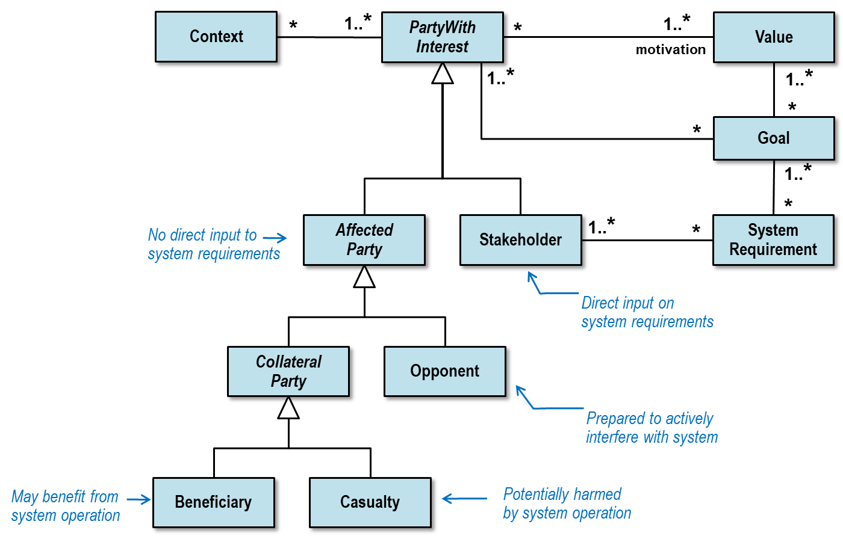
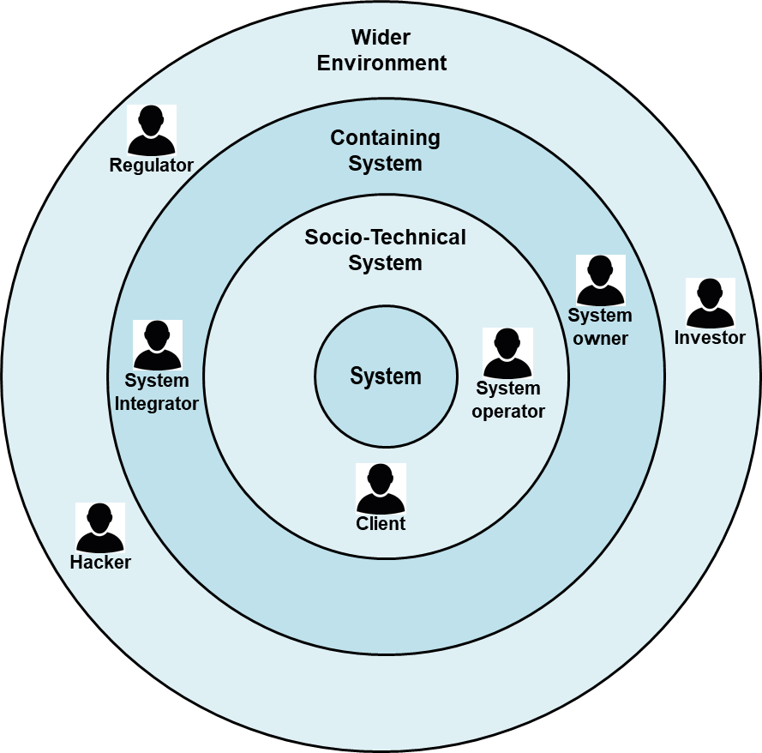
The Broader Perspective
Constructing this type of model does not involve any coding!
  Precedes even use-case definition (Agile Manifesto: “Produce only code and tests”?!?)
Requires expertise from multiple diverse disciplines:
  Problem domain
  Software engineering
  Sociology
  Ethics
  Psychology
  Human factors
  etc.

Slide 22
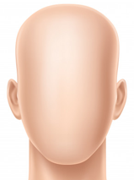
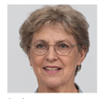
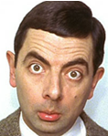
Personas: Transforming “Users” into Humans
“USER”
PERSONA
The traditional “user” concept tends to be abstract and reductionist
“Persona” concept:
  An imagined individual that typifies a category of system users with shared goals
    Conceived by Alan Cooper in 1980 as a refined human-centric requirements engineering method
  The clear “humanity” of personas tends to create a closer empathetic bond and a deeper appreciation of human factors

Slide 23
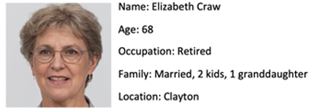

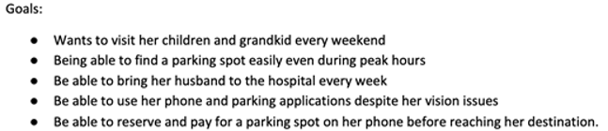
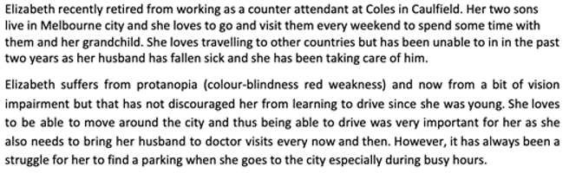
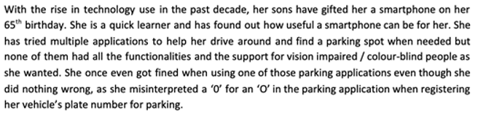
Example: Persona for a Parking App
Demographics
Goals
Key human aspect characteristics
Key Frustrations
Based on presentation by Prof. John Grundy, Monash University

Slide 24
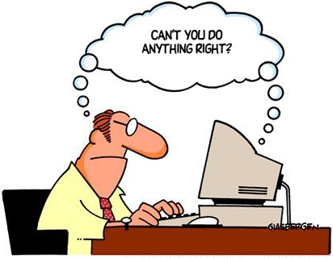
Human Factors and Software
Humanity is becoming increasingly dependent on software-based systems
  Smartphones, web-based services, cloud, etc.
  No longer just the domain of specialist users
The current models of human-computer interaction must now evolve to cope with the immense diversity of human needs and idiosyncrasies
How can software engineering methods and technologies be extended to address this issue?

Slide 25
Example: Implicit Bias in Software Apps
Implicit built-in assumptions in software that may unfairly discriminate:
  Age
  Gender
  Ethnicity
  Physical challenges
  Language
  Culture
  Socio-economic status
  Health
  Education
  etc.
How can we detect design flaws of this type?
How should we design software to avoid them?
How can we make designers aware of these?
What kinds of tools (if any) can help us with this?
Which human-aspects do we need to consider?
etc.
Based on presentation by Prof. John Grundy, Monash University

Slide 26

An Expanding Research Area:
Human-Centric Software Engineering –
The HumaniSE Research Program
at Monash University

Slide 27
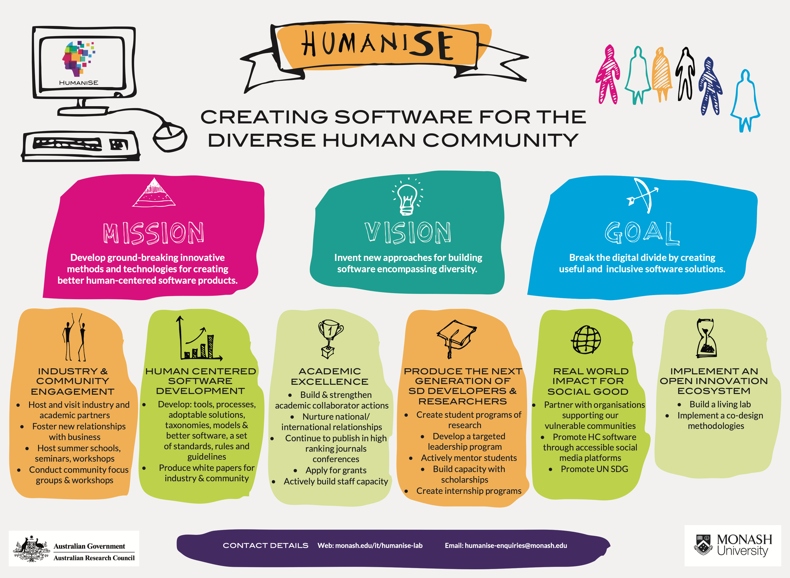
The HumaniSE Research Initiative

Slide 28
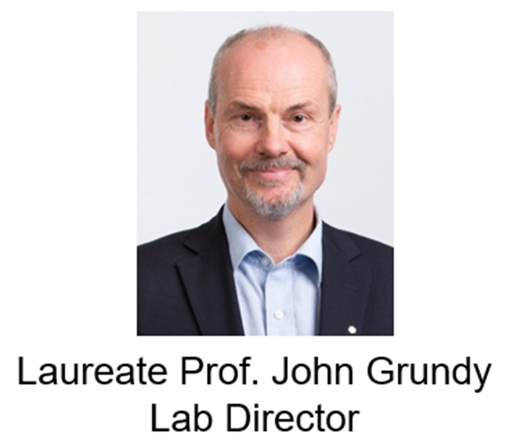
HumaniSE Research Program: Overview
Program lead:
  Prof. John Grundy, Monash U.
  Australian Research Council Laureate Fellow
Key issue addressed:
  Current SE approaches either ignore many human-centric issues or address them in ad hoc ways
Research directions:
  Human-centric Living Lab
  Develop more human-centric requirements engineering methods
  Incorporate human-centric issues into design methods
  Develop tools to support human-centric design
  Trials on “real world” examples with industry partners

Slide 29
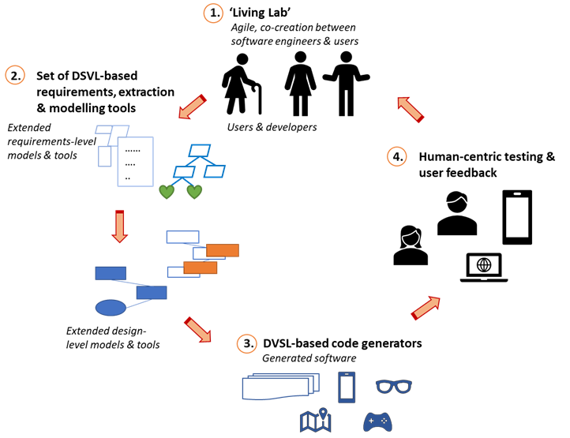
The HumaniSE Living Lab: Approach
A model-based approach:
DSVL = domain-specific visual language
Graphic courtesy of Prof. John Grundy, Monash University

Slide 30
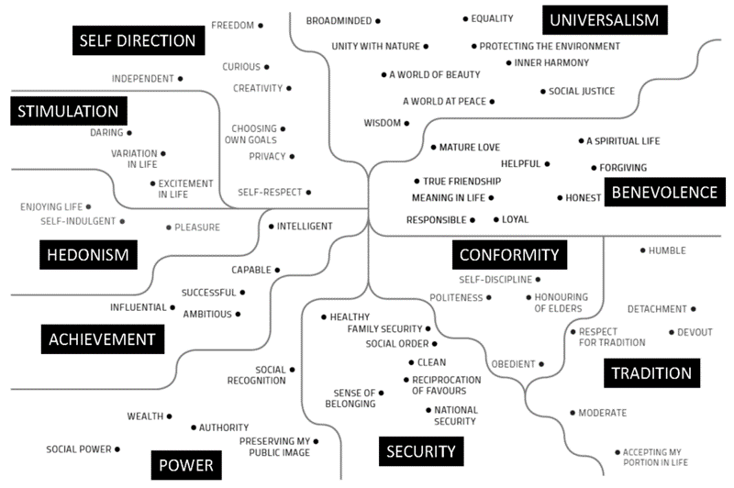
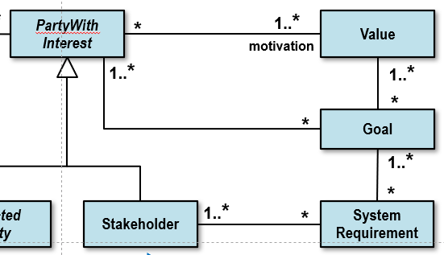
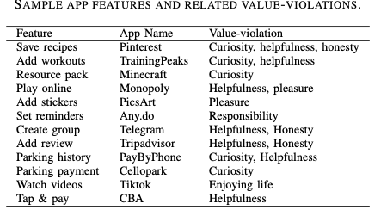
Example: Detecting Values Violations
Schwartz’s Theory of Basic Values*
Results of analyzing a number of apps
Develop analysis tools for detecting values violations
Based in part on input from Waqar Hussein and John Grundy, Monash University
* Schwartz, S.H., et al., Refining the theory of basic individual values. Journal of personality and social psychology, 2012. 103(4).

Slide 31
A Sampling of HumaniSE Projects
Survey & interviews of developers to determine which human aspects are most challenging
Human aspects impact on requirements engineering
Better supporting human values in software (e.g., detecting values violations)
Understanding and improving accessibility in software design
Capturing and modelling human aspects in requirements, design models (e.g., modeling and using personas)
Adding human aspects to software design tools
Automated detection and reporting of human-centric defects
Exploring application domains where human aspects are critical (e.g., health, smart cities, smart living, etc.)
Based on inputs from Waqar Hussein and John Grundy, Monash University

Slide 32
Summary
Traditional software engineering (SE) methods and technologies are failing to adequately address the human aspects associated with software and its use
This is due in great part to the unique and somewhat skewed psychology/culture prevalent among software practitioners
  Much more technology-facing than human-facing
Radical changes to SE and SE culture and education are needed to accommodate the fact that software has become much more pervasive in today’s society
  Used by the general population, which exhibits tremendous diversity
Human-centric software engineering is the emerging research field focused on addressing these issues
  New methods, new tools for human-centric software

Slide 33
Finally, a Reminder...
“Concern for man himself * and his fate must always
constitute the chief objective of all technological
endeavors...in order that the creations or our minds
shall be a blessing and not a curse to mankind.
Never forget this in the midst of your diagrams and
equations.”
-- A. Einstein, 1931

Slide 34



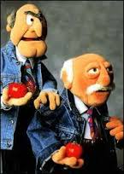


Opinions?
Questions?

