Slide 1
Appropriate use of antidepressant medications for changed behaviours in people living with dementia
Education Activity
Centre for Medicine Use and Safety (CMUS)

Slide 2





Introduction
Background
Dementia is associated with a deterioration in:^{1,2}
  Memory
  Thinking
  Behaviour
  Communication
  Ability to perform daily activities

Slide 3




Introduction
Dementia and changed behaviours
People living with dementia often experience changed behaviours. Changed behaviours are diverse and may include:
  Wandering e.g. walking aimlessly and/or excessively, attempting to exit a safe location³
  Anxiety e.g. thoughts of worry, fearfulness and behaviours such requests for reassurance^{2,3}
  Depressive symptoms e.g. hopelessness, tearfulness, loss of interest, withdrawal, changes in appetite, sleep disturbances and suicide ideation (e.g. a person is thinking or planning to take their own life)^{2,3}
  Sleep disturbances e.g. difficulty falling or staying asleep³

Slide 4
Introduction
Care for people living with dementia and changed behaviours
Care for people living with dementia and changed behaviours can be split into two broad strategies:
Non-pharmacological strategies
Definition: non-medication strategies
Examples: pet therapy, exercise therapy, art therapy^{2,3}
Pharmacological strategies
Definition: medication strategies
Example: psychotropic medications
Royal Commission into Aged Care Quality and Safety⁴ defines a psychotropic medication as:
“Any drug capable of affecting the mind, emotions, and behaviour”

Slide 5

Introduction
Use of Psychotropic Medications in People Living with Dementia and in Residential Aged Care
The Royal Commission into Aged Care Quality and Safety Interim Report: Neglect highlighted an overreliance on psychotropic medications⁵
Psychotropic medications such as antidepressants are associated with adverse outcomes for people living with dementia:
  Sedation e.g. drowsiness, sleepiness
  Falls
  Agitation

Slide 6

Introduction
Clinical Practice Guideline for Appropriate Use of Psychotropic Medications in People Living with Dementia and in Residential Aged Care
Three most common psychotropic medications implicated in restrictive practice in residential aged care are:
  Antipsychotics
  Benzodiazepines
  Antidepressants⁴
The new clinical practice guideline focuses on the appropriate medication use of antipsychotics, benzodiazepines and antidepressants

Slide 7
Group discussion - what is an antidepressant?

Slide 8

What is an antidepressant?
An antidepressant is a class of medication that can be used for:^{4,6}
  symptoms of depression
  anxiety disorders
  obsessive compulsive disorder
Some examples of antidepressants include citalopram, escitalopram, mirtazapine and sertraline
Sometimes antidepressants are prescribed to people living with dementia and changed behaviours
One Australian study⁷ reported 37% of residents are dispensed an antidepressant within three months of admission to residential aged care, with higher rates of antidepressant use among residents living with dementia

Slide 9



The place of antidepressants in the care of a person living with dementia
Antidepressants could be considered for people living with dementia who develop:
  Moderate major depressive disorder AND who have previously taken an antidepressant that worked, or
  Severe major depressive disorder, or
  Depressive disorder with suicidal ideation and/or risk of self-harm. Self-harm describes a person who is deliberately causing pain or damage to their own body
Antidepressants should NOT be routinely considered for people living with dementia who:
  Experience newly developed depressive symptoms or mild-to-moderate major depressive disorder
  Experience sleep disturbances
If the care team decide to initiate an antidepressant for a person living with dementia and changed behaviours, it is important the care team think about when they should stop the antidepressant

Slide 10
Learning Objectives
By the end of today’s session, you will be able to:
  Identify the prompts for discontinuation of an antidepressant for people living with dementia and changed behaviours
  Discuss the potential benefits and harms associated with the use of antidepressants for sleep disturbance in people living with dementia
  Specify the criteria for escalating care surrounding discontinuation of antidepressants
  Explain what should be documented surrounding discontinuation of antidepressants
  Be aware of supporting resources accompanying the Guideline to use in everyday practice

Slide 11

Discontinuation of antidepressants
Image from freepik

Slide 12

What is medication discontinuation?
Medication discontinuation is the planned and supervised process of stopping a medication
Medication discontinuation may also be known as:
  Deprescribing
  Medication cessation
  Medication withdrawal

Slide 13


When should we start thinking about discontinuation?
Antidepressants are associated with significant risk of unintended and sometimes harmful effects (adverse events)
  Is the person living with dementia experiencing an adverse event?
    e.g. the person had two falls since starting an antidepressant
Antidepressants may provide little benefit in relieving depressive symptoms
  Has the specific changed behaviour you want to improve (target symptom) improved?
  Has the target symptom remained unchanged?
  Has the target symptom worsened?
  Using antidepressants for changed behaviours may be considered restrictive practice
    Restrictive practice must only be used as a last resort and for the shortest time necessary
    Restrictive practice is “any practice or intervention that has the effect of restricting the rights or freedom of movement of the care recipient”⁸
  Antidepressants may provide little benefit in relieving other changed behaviours
    Antidepressants should not be used for sleep disturbances in people living with dementia
    The care team should consider discontinuation if antidepressant is used for a person living with dementia is experiencing agitation only

Slide 14
Group discussion – what are some prompts for antidepressant discontinuation?

Slide 15
Prompts for antidepressant discontinuation
Clinical steps
Person living with dementia:
  Has experienced an adverse event
    e.g. the person had a fall
  Is at risk for experiencing an adverse event
    e.g. the person is taking multiple medications that could increase their risk of having a fall
  No longer consents to take the an antidepressant
  Has requested a review
  Is having difficulty or refusing to swallow
  Has a change in goals of care
  Has mild to moderate major depressive disorder
  Has a first-time episode of severe major depressive disorder who respond to treatment, has been taking the antidepressant for six months after symptoms have resolved
Target symptoms:
  Have not improved
    e.g. a person’s depressive symptoms have NOT improved with the use of non-pharmacological strategies and an antidepressant
There is no known reason why the antidepressant is being used
  e.g. a person is new to your residential aged care and they are prescribed an antidepressant for an unknown reason
Antidepressant not used for an appropriate reason
  e.g. a person is prescribed an antidepressant for sleep disturbances
Please see the Guideline for additional prompts for antidepressant discontinuation

Slide 16
Prompts for antidepressant discontinuation
Communication and documentation steps
Contact the prescriber
Notify entire care team
Document the prompt for considering antidepressant discontinuation you have identified
Document conversation with prescriber and plan going forward
  e.g. contacted prescriber and will discuss the option of antidepressant discontinuation with entire care team at next case conference
Recommend a comprehensive medication management review

Slide 17
Harms vs Benefits of Discontinuation of Antidepressants
Improved quality of life
Reduced medication errors
Reduced risk of adverse events
Simpler medication regimens
Symptoms coming back
  This is known as reoccurrence of symptoms
Unpleasant reaction that may happen during the process of stopping a medication
  This is known as discontinuation symptoms
  May also be known as adverse withdrawal events, discontinuation effects, withdrawal effects and withdrawal symptoms
BENEFITS
HARMS

Slide 18
Group discussion - what should you monitor for during the discontinuation process?

Slide 19
What should you monitor for during the discontinuation process?
While an antidepressant is being tapered for a person living with dementia, all staff should monitor for:
  The effect on the person’s target symptom:
    Has the target symptom come back (recurrence of symptoms)?
    Has the target symptom stayed the same?
    Has the target symptom improved?
  Unpleasant reaction that may happen during the process of stopping a medication (discontinuation symptoms)
    Is the person more irritable?
    Is the person experiencing trouble falling or staying asleep?
  Benefits of discontinuation:
    Has the person had less falls?
    Is the person more alert?
All staff should notify the prescriber or clinical nurse as soon as possible once a symptom reoccurs or if there are discontinuation symptoms
Non-pharmacological strategies should continue throughout the discontinuation process and after the antidepressant is stopped

Slide 20

Case study
Jack Jones is a 77-year old man living with Alzheimer’s dementia
12 months after becoming a resident, Jack develops depressive symptoms. The local general practitioner (GP), Dr. Mary Song, contacts Jack’s older person’s psychiatrist, Dr. Geffrey Miles
Dr. Geffery Miles reviews Jack and concludes that Jack is experiencing severe major depressive disorder for the first time
Dr. Geffery obtains consent from Jack and initiates an antidepressant, citalopram. After Jack’s depressive symptoms resolve, he continues to take citalopram 20mg oral in the morning for seven months
Image from freepik

Slide 21
Case study
Small groups
Read the Case Study
Discuss questions 1 and 2 over the next 15 minutes
Prepare answers to share in group discussion

Slide 22
Review of case study questions
Group Discussion
Question 1. What are some prompts that would make you consider discussing discontinuation of Jack’s antidepressant with Dr. Mary Song? How would you communicate and document this?

Slide 23
Review of case study questions
Group Discussion
Question 1. What are some prompts that would make you consider discussing discontinuation of Jack’s antidepressant with Dr. Mary Song? How would you communicate and document this?
Clinical Steps
Jack has a first-time episode of severe major depressive disorder who responded to treatment, has been taking the antidepressant for more than six months after symptoms resolve
Jack has requested a review of his antidepressant
Communication and documentation steps
Contact the prescriber
Document prompts for discontinuation you have identified
Document conversation with prescriber and plan going forward
  e.g. contacted Dr. Mary Song. She is happy with Jack’s progress and will contact Dr. Geffrey Miles for advice on discontinuing citalopram. Dr. Mary will update care team at case conference next week
Notify entire care team
  e.g. after case conference, contacted local pharmacy. Spoke with pharmacist Richard and notified him of the plan to slowly taper and stop Jack’s citalopram. Richard to dispense lower strength of citalopram
Recommend a medication review
Non-pharmacological strategies should continue throughout the discontinuation process and after the antidepressant is stopped

Slide 24

Case study continued
During the tapering process, Jack experiences trouble falling asleep at night
During handover, your colleague Jenny says,
“Experiencing sleep disturbance is the last thing Jack needs. We should get on top of it straight away. You should contact Dr. Mary and request Jack to be commenced on mirtazapine. Mirtazapine makes people sleepy so it will help Jack get a good night sleep while they taper his other antidepressant, citalopram. And two antidepressants will help with his depression too- it’s a win-win situation!”
Image from freepik

Slide 25
Review of case study questions
Group Discussion
Question 2. Do you agree or disagree with Jenny’s sentiments? What would you communicate and document in this situation?

Slide 26
Review of case study questions
Group Discussion
Question 2. Do you agree or disagree with Jenny’s sentiments? What would you communicate and document in this situation?
Clinical Steps
Jack’s sleep disturbance may represent
a discontinuation symptom
  Discontinuation symptoms can be described as an unpleasant reaction that may happen when a medication is stopped too quickly
    e.g. insomnia
  In consultation with Jack’s older person’s psychiatrist, the tapering process could occur more slowly
Antidepressants should not be used for sleep disturbance
  there is a lack of evidence they are effective
  there is evidence of its risk of harm
    e.g. adverse events
Multiple antidepressants should not be used at the same time
  This can increase the risk of harm
    e.g. adverse events
The care team should investigate the possible underlying causes of sleep disturbance and trial non-pharmacological strategies first

Slide 27
Review of case study questions
Group Discussion
Question 2. Do you agree or disagree with Jenny’s sentiments? What would you communicate and document in this situation?
Communication and documentation steps
Contact the prescriber
  Contacted Dr. Mary. She will speak with Jack’s older person psychiatrist, Dr. Geffery Miles for advice
Document your observations
  The discontinuation symptom should be quantified and documented in the medical record, nursing progress notes and behaviour support plan where applicable
Document conversation with prescriber and plan going forward
  Dr. Mary contacted Dr. Geffery Miles. After discussion about Jack’s symptoms, Dr. Geffery feels Jack may be experiencing a discontinuation symptom. Dr. Geffery requested to increase citalopram back to previous dose with a plan to review Jack in four days
Notify entire care team
  Spoke with pharmacist Richard and notified him of the updated tapering plan. Richard to dispense new strength of citalopram for Jack
Recommend a medication review

Slide 28

Update on Jack
Dr. Geffery reviews Jack and decides to slow the tapering schedule further. The entire care team work together to implement non-pharmacological strategies throughout the discontinuation process
After a few months, Jack successfully discontinues his antidepressant. Jack’s son, David comments,
“Dad is doing great since stopping his antidepressant. It was a slow process, but it was worth it. It’s been 12 months since Dad stopped his citalopram. It is fantastic to see him chatting with other residents and dropping off newspapers to them in the morning. It reminds him of the good old days when he was a mailman!”
Image from freepik

Slide 29



Take home messages
Antidepressant discontinuation should be individualised to the person living with dementia
There are many prompts for antidepressant discontinuation including:
  The person living with dementia is experiencing an adverse event or at risk of experiencing an adverse event
  The target symptom has not improved
  The antidepressant is not used for an appropriate reason e.g. sleep disturbances
While an antidepressant is slowly stopped, all staff should monitor for:
  The effect on the person’s specific changed behaviour (target symptom)
  Unpleasant reaction that may happen during the process of stopping a medication (discontinuation symptoms)
  Benefits of discontinuation
Non-pharmacological strategies should continue throughout the discontinuation process and after the antidepressant is stopped

Slide 30
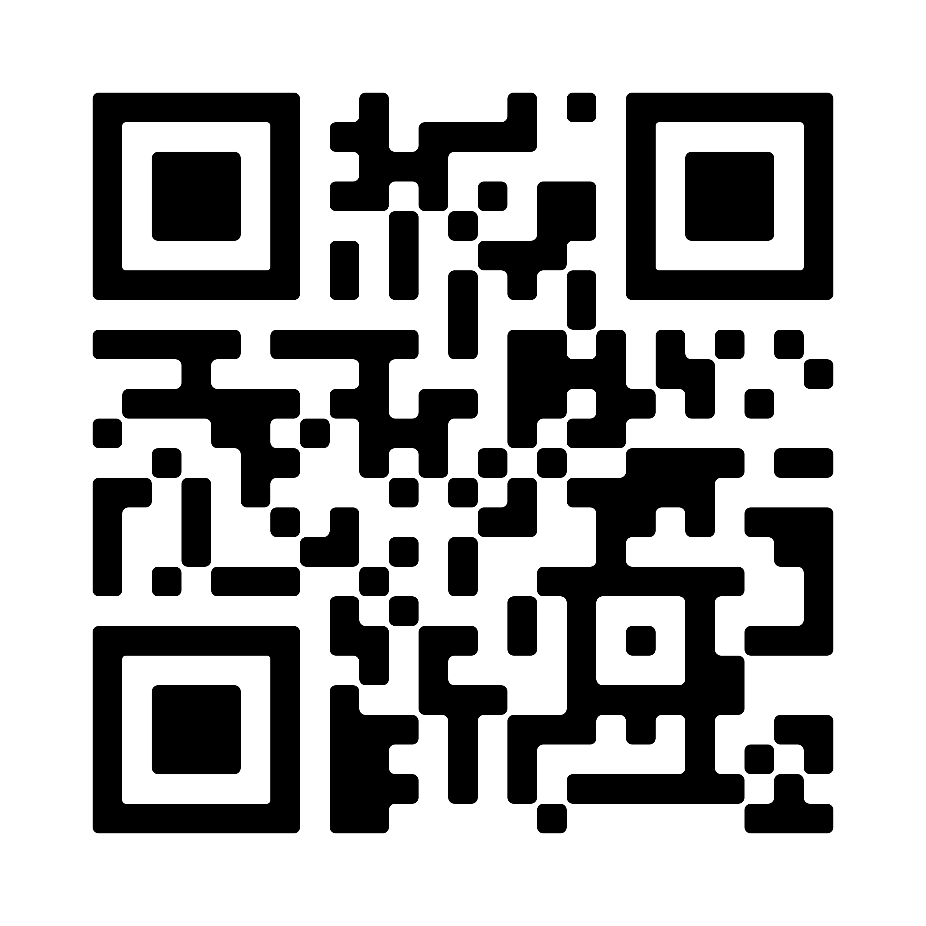
Supporting resources
Access to the Guideline

Slide 31
References
The Royal Commission into Aged Care Quality and Safety. Background Paper 3: Dementia in Australia: Nature, Prevalence and Care. Commonwealth of Australia; 2019. Accessed December 9, 2022. https://agedcare.royalcommission.gov.au/sites/default/files/2019-12/background-paper-3.pdf
New South Wales Ministry of Health. Assessment and Management of Behaviours and Psychological Symptoms associated with Dementia (BPSD). 2022. Accessed January 25, 2023. https://www.health.nsw.gov.au/mentalhealth/resources/Publications/assessment-mgmt-people-bpsd-2022.pdf.
Burns K, Jayasinha R, Tsang R, Brodaty H. Behaviour Management A Guide to Good Practice: Managing Behavioural and Psychological Symptoms of Dementia. Dementia Support Australia; 2012. Accessed September 19, 2022. https://www.dementia.com.au/resource-hub/behaviour-management-a-guide-to-good-practice
Aged Care Quality and Safety Commission. Psychotropic medications used in Australia: information for aged care. Australian Government; 2021. Accessed September 2, 2022. https://www.agedcarequality.gov.au/resources/psychotropic-medications-used-australia-information-aged-care
The Royal Commission into Aged Care Quality and Safety. Interim Report: Neglect. Commonwealth of Australia; 2019. Accessed September 19, 2022. https://agedcare.royalcommission.gov.au/publications/interim-report
National Health Service. Overview – Antidepressants. National Health Service; 2021. Accessed November 30, 2022. https://www.nhs.uk/mental-health/talking-therapies-medicine-treatments/medicines-and-psychiatry/antidepressants/overview/
Harrison, SL, Sluggett, JK, Lang, C, et al. The dispensing of psychotropic medicines to older people before and after they enter residential aged care. Med J Aust. 2020;212(7):309-313. doi: 10.5694/mja2.50501
Aged Care Quality and Safety Commission. Overview of restrictive practices. Australian Government; 2021. Accessed September 2, 2022. https://www.agedcarequality.gov.au/resources/overview-restrictive-practices
Unless specified, all icons included in this presentation are from Flaticon.com

