Slide 1
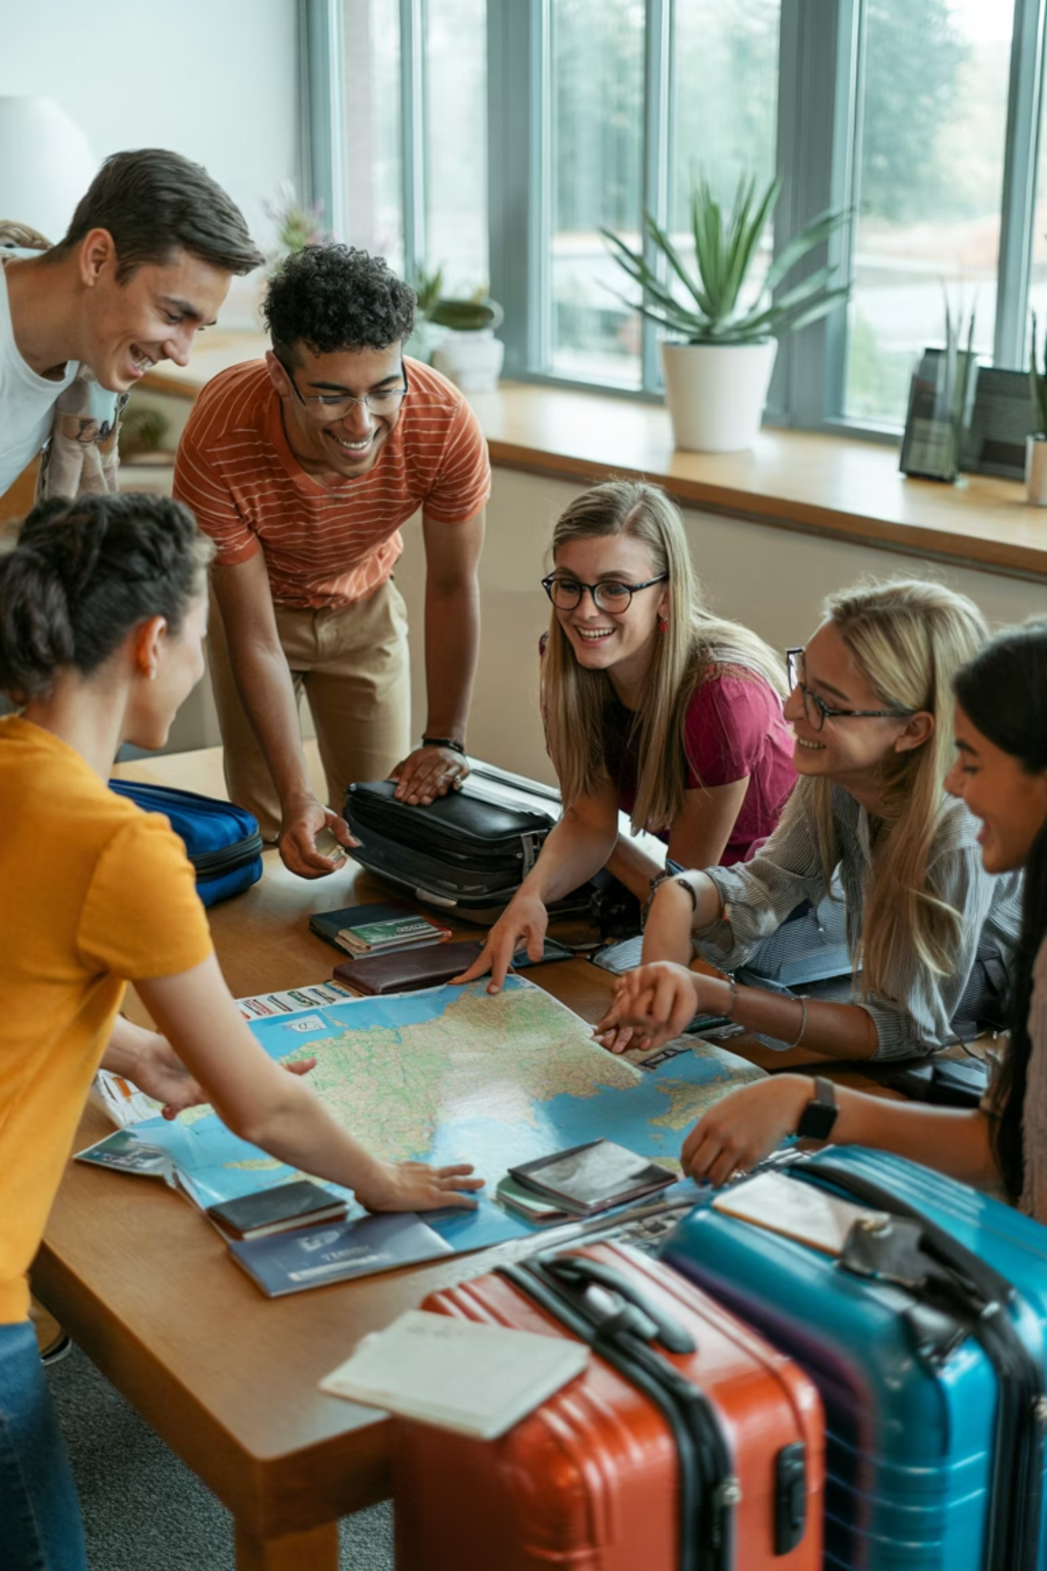
Pre-Departure Orientation
A comprehensive guide for international student travel
[Template for Program Leaders]
[Insert Date of Session]

Slide 2

Acknowledgment of Country
We acknowledge that our university campuses are located on the unceded lands of the Kulin nation, and we pay our respects to their Elders, past and present.
We also acknowledge the traditional custodians of the lands we will be visiting in [destination country] and pay our respects to their Elders and communities.

Slide 3


Country Profile
Key Cultural & Practical Insights
To help you prepare for your journey, here's an overview of key aspects of [Insert Destination]:
Language: [Insert Official Language(s)]. While English may be spoken in tourist areas, learning a few basic phrases in the local language can greatly enhance your experience.
Religion: [Insert Predominant Religion(s)]. Respect local religious customs and dress codes, especially when visiting sacred sites.
Customs & Etiquette: [Insert Key Customs, e.g., greetings, dining etiquette, tipping norms, conservative dress codes, respect for elders]. Observe local customs to ensure a respectful and positive interaction.
Time Zone: [Insert Time Zone Offset from UTC, e.g., UTC+X hours]
Weather: [Insert Typical Weather/Climate for travel period, e.g., "Expect warm and humid weather with average temperatures of X-Y degrees Celsius. Rainy season from Month to Month."]

Slide 4




Destination Risk Profile
Current DFAT Smartraveller level: [Insert Level]
Last updated: [Insert Date]
Security Concerns
Health Risks
An overview of current crime rates, political stability, terrorism risks, and general safety considerations specific to the destination country.
Information on prevalent diseases, necessary vaccinations, the quality of medical facilities, and key health precautions for the region.
Transportation Safety
Environmental Factors
An assessment of local transportation systems, road conditions, and recommended modes of travel for students.
Details on climate conditions, natural disaster risks, altitude considerations, and essential preparation for the local environment.

Slide 5



Smart Steps for a Safe Journey
Stay Alert, Not Anxious
Trust Your Instincts
Travel Smart
Regularly scan your surroundings without appearing fearful. Take your earbuds out, don't look at your phone when walking between locations.
Try to blend in. Avoid displaying valuable items and be cautious with unfamiliar people offering unexpected assistance. Observe how locals act, particularly in busy areas.
Research safe/unsafe areas before exploring. Use buddy system after dark. Keep phone charged with local emergency numbers programmed. Share itineraries with program leaders.
Practice these techniques before departure through role-playing scenarios during orientation sessions.

Slide 6



Behavioural Expectations & Code of Conduct
University Representation
Cultural Respect
Accountability
Remember you are ambassadors of our institution. Your actions reflect on the university and future international opportunities.
Research and observe local customs, dress codes, and social norms. Ask questions respectfully when unsure about appropriate behaviour.
Violations may result in early return at personal expense, academic penalties, or disciplinary action under the Student Code of Conduct. You are expected to attend all activities for the duration of the program.
Substance Policy: Understand local laws regarding alcohol consumption. Illegal drug use is strictly prohibited and may carry severe legal penalties abroad.
All participants must sign the Acknowledgement of Conditions form before departure.

Slide 7
Itinerary Overview
Date
Location
Key Activities
Oct 7
Berlin, Germany
Arrival in Berlin, Hotel Check-in, Welcome Dinner & Program Briefing
Oct 8
Central Berlin
Morning Lecture at Humboldt University on German Economy, Afternoon visit to Brandenburg Gate & Reichstag Building
Oct 9
Potsdam
Day trip to Potsdam: Company Visit to SAP Innovation Center, Sanssouci Palace tour
Oct 10
Berlin (Mitte)
Visit to a local tech Startup Accelerator, Networking session with German entrepreneurs, East Side Gallery tour
Oct 11
Berlin (Kreuzberg)
Workshop on European Business Practices, Cultural immersion at local markets, Farewell Dinner
Oct 12
Berlin, Germany
Check-out & Departure
Important Notes & Advice
Key Risks: Be aware of [specific risks, e.g., pickpocketing in crowded tourist areas, local transportation delays]. Always travel with a buddy, especially after dark.
What to Bring Daily: Comfortable walking shoes, a reusable water bottle, portable charger for devices, small backpack, and necessary medications. Check weather forecasts for appropriate clothing layers.

Slide 8

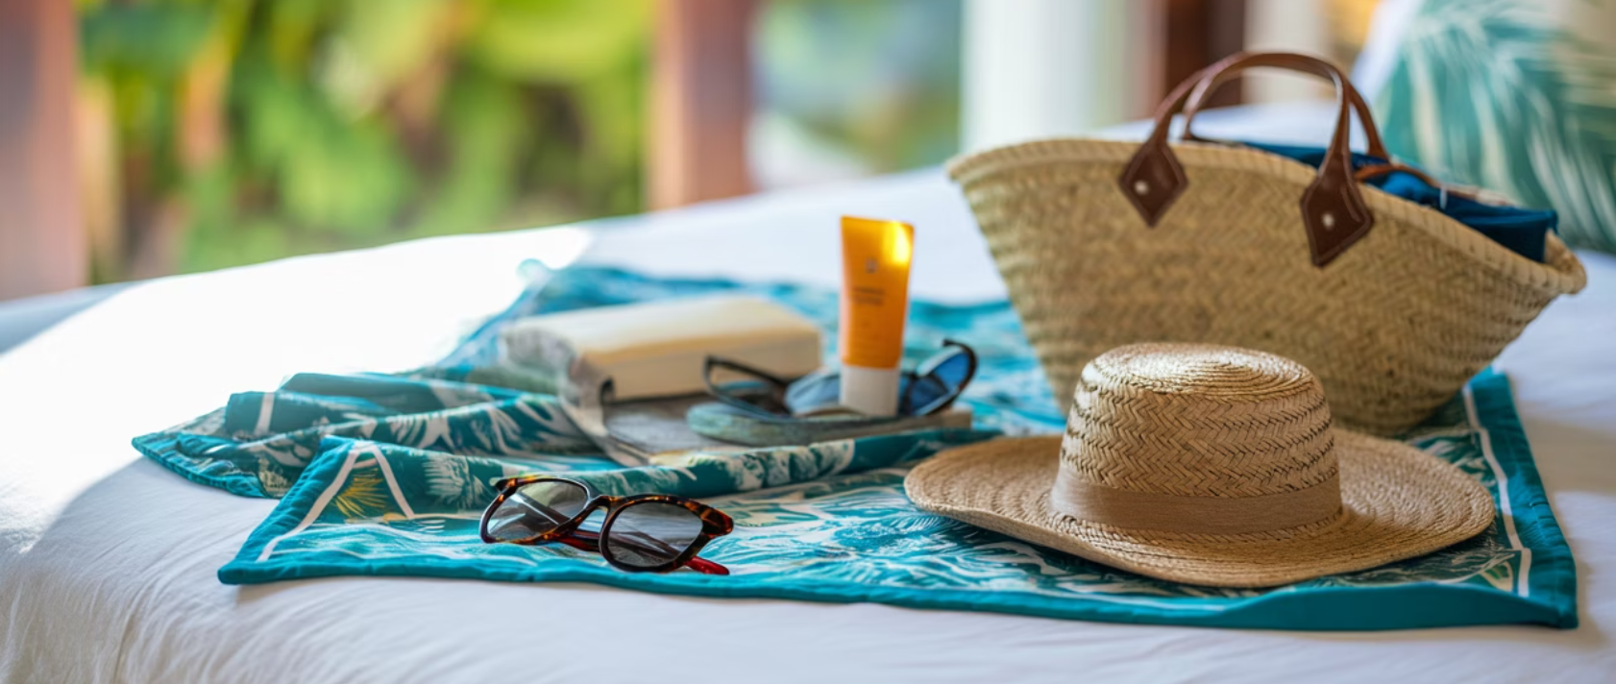




Packing List for a Tropical Climate
Essential Documents
Passport (valid 6+ months after return)
Student ID and university documentation
Travel insurance details
Photocopies of important documents (stored separately)
Clothing
Lightweight, breathable clothing
Rain jacket and scarf
Modest attire for cultural sites
Comfortable walking shoes and sandals
Technology & Adaptors
Hat and sunglasses
Phone and charger
Universal power adapter
Health & Safety
Portable battery pack
Prescription medications (in original packaging)
Waterproof phone case
High SPF sunscreen and insect repellent
Basic first aid kit
Practical Items
Hand sanitizer and disinfectant wipes
Reusable water bottle
Day backpack
Quick-dry towel
Combination locks for luggage
Remember: Pack light and leave space for souvenirs! Most toiletries can be purchased at your destination if needed.

Slide 9

Packing List for a Cold Winter Climate
Essential Documents
Passport (valid 6+ months after return)
Student ID and university documentation
Travel insurance details
Photocopies of important documents (stored separately)
Clothing
Thermal underwear and base layers
Waterproof winter coat and sweaters
Insulated boots with good traction
Warm hat, scarf, gloves, and thick socks
Indoor footwear for accommodations
Health & Safety
Prescription medications (in original packaging)
Lip balm and moisturiser for dry air
Basic first aid kit with cold remedies
Hand warmers and tissues
Technology & Practical Items
Universal power adapter
Insulated water bottle for hot drinks
Portable battery pack (cold drains batteries faster)
Umbrella and waterproof day pack
Remember: Dress in layers for varying indoor/outdoor temperatures! Consider purchasing winter items at your destination if luggage space is limited.

Slide 10
Essential Contact Information
Program Contacts
Emergency Services
Program Leader: [Name, Position]
University 24/7 Assistance: [Insert Number]
Mobile: [Insert Number]
Local Emergency Number: [Insert Number]
Email: [Insert Email]
Local Police: [Insert Number]
Nearest Hospital: [Insert Name and Address]
On-site Contact: [Name, Position]
Embassy/Consulate: [Insert Address and Number]
Mobile: [Insert Number]
Email: [Insert Email]
Group Communications Platform: [e.g., WhatsApp Group Name/Link]
Please check for updates frequently (e.g., daily at 9 AM and 5 PM).

Slide 11




University Travel Assistance Services
24/7 Support Line
Access to round-the-clock emergency assistance for medical emergencies, security threats, natural disasters, and other urgent situations. The assistance provider will also activate the university's travel insurance.
Medical Services
Coordination of medical care, hospital admissions, medication needs, and emergency medical evacuations when necessary.
Security Assistance
Expert advice during security incidents, arrangement of security escorts, and evacuation coordination during civil unrest or natural disasters.
Contact Global24 assist at: (+612) 9312 5191 or assistance@global24.com.au

Slide 12





Emergency Response Protocol
Identify Emergency
Assess situation severity: minor, moderate, or major incident requiring immediate response
Contact Assistance
Call university travel assistance or local emergency services depending on situation
Notify Program Leader
Update program leader about situation via designated communication channel
Follow Instructions
Comply with guidance from assistance providers, local authorities and the university

Slide 13
Safety Best Practices
Before Departure
While Abroad
Subscribe for DFAT Smartraveller updates
Maintain regular check-ins with program leaders
Complete university travel requirements
Monitor your Monash email
Obtain required visas and documentation
Stay aware of surroundings and avoid high-risk areas
Visit a travel doctor to get recommended vaccinations and medications
Use buddy system when traveling locally
Follow food and water safety guidelines
Print copies of important documents including bookings and visas
Secure valuables and maintain low profile
Respect local customs and dress codes
Research local laws and customs

Slide 14
Questions & Resources
Please direct any questions about this briefing to:
[Insert Program Leader Email]
Additional resources:
University travel policy
Travel insurance information
Destination country embassy website: [Insert Link]
Health authority travel recommendations: [Insert Link]
Safe travels!

