Slide 1


Welcome
2018 INDUSTRY SEMINAR SERIES

Slide 2

www.pwc.com.au/legal
PwC Legal Team
2018 Industry Seminar Series
April 2018

Slide 3
PwC Australia – Who we are
At PwC Australia our purpose is to build trust in society and solve important problems
Our business areas:
Assurance
Consulting
Deals
Technology
Legal
Tax
Private Clients
620+ Partners at PwC Australia | 8 offices Adelaide, Brisbane, Canberra, GWS, Melbourne, Newcastle, Perth & Sydney | $2.12bn FY Australian firm revenues rise to record high | Voted #1 workplace in Australia in 2017 and 2018 | 7,500+ employees across Australia

Slide 4
PwC Legal is part of a fast growing regional team...
Internationally, PwC has local legal practices in key regional locations across the Asia pacific, including Hong Kong, China and Japan …
Territory | Network firm(s) | Laws practised
Singapore | PwC Legal International Pte Ltd Camford Law | English, Australian Singapore
Hong Kong / PRC | Tiang & Co PwC Legal China | Hong Kong, English PRC
Japan | PwC Legal Japan | Japan
Taiwan | PricewaterhouseCoopers Legal | Taiwan
India | PwC India | India
Thailand, Cambodia, Laos | PwC Legal & Tax Consultants | Thailand, Cambodia, Lao
Philippines | Cabrera & Co | Philippines
Vietnam | PwC Legal Vietnam | Vietnam
Indonesia | Melli Darsa & Co | Indonesian
Australia | PwC Australia | Australian (NSW, Vic, Qld, WA, ACT)
New Zealand | PwC Legal New Zealand | New Zealand
Current
total of 29 partners and
120+ lawyers
in Australia
… as well as an office in the US which provides US based clients with local access to our non-US law network …
          https://www.ilclegal.com/

Slide 5
Now
And by 2020
… and part of a major global legal network.
We are now a major global law firm – the most geographically extensive in the world – with more than 3,200 lawyers across more than 90 countries.
Global legal services revenue
US$500m+
Total
Global legal services revenue
US$1bn
Total
In Australia...
29 120+
Legal partners Lawyers
Throughout the Asia Pacific region...
73 450+
Legal partners Lawyers
Globally... |  | Global top
3,200 in 90 |  | 20
Lawyers Countries |  | Law business by revenue
Our global vision for legal services is to build a market-leading global legal services network, operating in key business areas, as part of the PwC multi-disciplinary service offering.

Slide 6
Application process
Deadline driven recruitment
Assessment centre which includes:
- Group case study
- Group presentation
- Partner/ Director interview
Online assessment:
- Deductive reasoning
- Inductive reasoning
- Numerical
Online application
Online testing
Video interview
Assessment centre
Offer & on boarding
The video interview is a chance for us to learn about you and your story
No CVs
No transcripts
Be invited to join the Class of 2019 community. A platform to connect, sharing of content and connectivity events.
Notes:
Highlight the meaning for each stage.

Slide 7
Meet our legal team
Sarah Loke
Lawyer
Banking &
Finance
James Dickie
Lawyer
Projects & Infrastructure
Faiza Bukhary
Lawyer
Corporate
Advisory
Notes:
Hana please fix icons

Slide 8
Banking & Finance
Sarah Loke

Slide 9

What is Banking and Finance?
Me trying to figure out what is “Banking & Finance” as a law student:
Corporate
General working capital and refinancing of corporate facilities.
Projects
Peer-to-peer
Renewable energy projects (eg. solar and wind farms)
Legal complexities in relation to online platforms that match investors with borrowers
Finance areas & examples
Leveraging your own assets to obtain finance
Property
Start-ups
Development of new towers and buildings
Strategic acquisitions and asset sale transactions
Leveraging your own assets to obtain finance
We help clients with their finances because money underpins everything in business
M&A
Asset Finance
Notes:
Hana can you please insert appropriate icons for each finance area?

Slide 10


What are the perks of being a junior Banking and Finance lawyer?
01
Business Development skill sets
02
Not limited to legal banking & finance work
03
International exposure
Client interaction and engagement
04
Notes:
Hana can you please fix 01 02 and 04

Slide 11


How is the PwC Legal Banking and Finance team different to other firms?
The PwC model
Traditional
model
Legal
advisors
Borrowers are required to engage a number of international and local advisors to facilitate expansion and cross-border financing
Project
advisors
Investment Banks
Our fully integrated model allows Borrowers to deal with a single top tier provider across the entire financing
Financial
advisors
PwC Legal Team – Monash University Presentation

Slide 12
Projects and Infrastructure
James Dickie

Slide 13
What is Projects and Infrastructure?
The Projects and Infrastructure team is typically engaged on work
relating to physical assets at various stages of development,
construction and/or post-construction.
Work scopes may include:
Project structuring
Contract drafting and negotiation for land rights, procurement and provision of services and ancillary planning and regulatory requirements
Legal due diligence
Tender evaluation
Finance structuring and negotiation
Lead advisory and interface management (especially on integrated offers)

Slide 14
How we’re different: Bungala Solar Project
The Bungala Solar project:
“Our multi-disciplinary capability enabled us to provide integrated services across all stages of the project, providing Reach with a single end to end interface on a complex sale process”
860,000
solar panels
Employ
400
Australians
SOUTH
AUSTRALIA
Fully operational by
Sept 2018
Bungala
Solar
Farm
Port
Augusta
Largest
solar farm
in the Southern
Hemisphere
585 hectares in Port Augusta
Adelaide
Bungala 3 (B3)
(80 MW AC)
Project highlights
Bungala 2 (B2)
(110 MW AC)
Reach Solar Energy’s Bungala Solar Project will be the largest solar farm in Australia and the Southern Hemisphere. It will contain 860,000 panels over 585 hectares in Port Augusta, South Australia
The construction phase will create over 400 jobs for the Port Augusta region. Design and construction commenced in Q2 2017, with first electricity to be on the grid by Q2 2018 and the farm fully operational by Q3 2018.
Reach and PwC pioneered an innovative model of co-development and risk allocation that has disrupted industry best-practise and placed PwC at the forefront of Australia’s renewable energy transition.
Bungala 1 (B1)
(110 MW AC)
Transmission line
towards Port Augusta

Slide 15
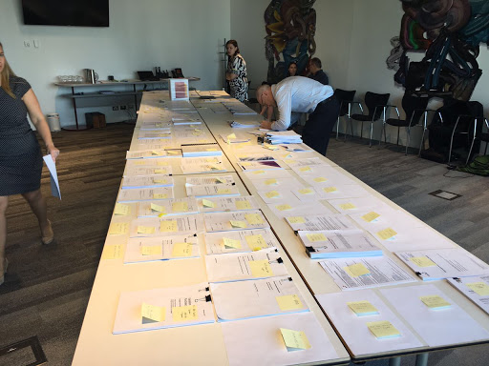
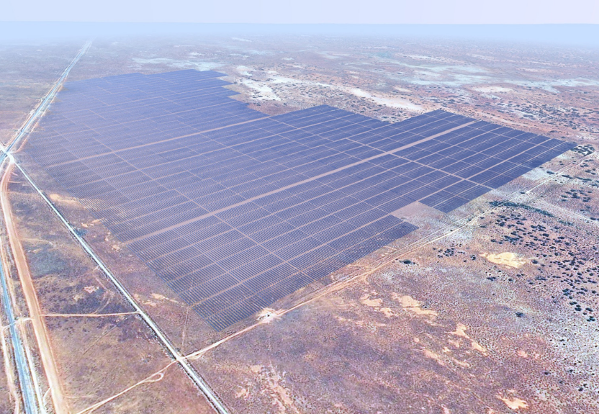
From paper to project
Access Licence and Lease – grants access to land for the term of the project, follows access licence and call option
Development Approval - grants statutory permission for the project to be developed
EPC Contract – contract to engineer, procure and construct the solar farm
O&M Agreement – agreement to operate and maintain the solar farm over a fixed term
Power Purchase Agreement (PPA) – offtake agreement for the supply of electricity over a fixed term
Transmission Connection Agreement – agreement to construct connection infrastructure and connect solar farm to grid
From this
To this

Slide 16
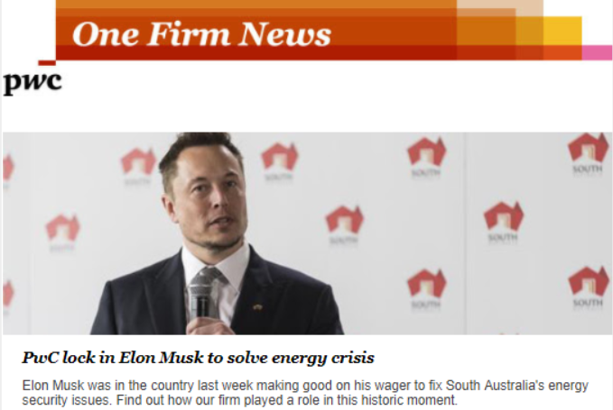
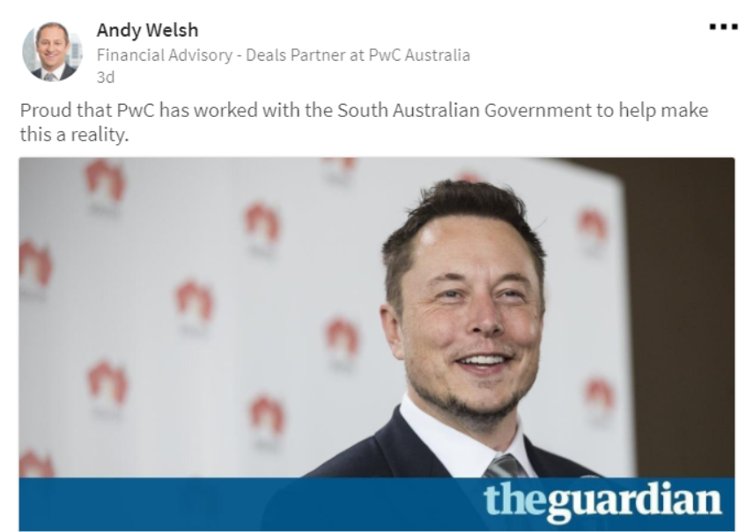

Our impact on the future
Energy
Battery technology applications to renewable projects – solving the reliability debate
Energy
Corporate Power Purchase Agreements – the rise of the corporate energy customer
Energy
Changes to government policy (State & Federal)
Construction
Innovative project delivery structures / risk allocations
Construction
Current infrastructure boom – Governments stepping up / unsolicited proposals accommodated
Transport
Regulation of driverless cars

Slide 17
Corporate Advisory
Faiza Bukhary

Slide 18
Corporate Advisory – what is it really about?
M&A
Technology
General Advisory
Buying and selling companies
Establishing joint venture arrangements
Initial Public Offerings
Capital raisings
Corporate restructuring
The integration of our legal practice with the other deal related disciplines of PwC (particularly our accounting, tax and assurance colleagues) allows us to provide premium legal advice in the context of the broader transaction.
Technology transformation and outsourcing
Cloud contracting and the internet of things
Cyber security
Commercialisation of data
Data analytics and privacy
Telecommunications services and technology infrastructure
Transactional support
Blockchain development
Protection and risk analysis through data lifecycle
Foreign investment advice
Shareholder arrangements
Employee equity arrangements
Corporate trust deeds
Internal financing documents
Establishing partnerships
Ad-hoc advice
Basically, everything else that might involve a corporate entity!

Slide 19
So what do I get to do?
Drafting Attend negotiations of key transaction documents, prepare ‘completion deliverables’, prepare due diligence reports, draft or review prospectus disclosures. |  |  | Research Researching case law and commentary to provide ad hoc advice to clients or to feed into structuring discussions.
Attending meetings See negotiations of key transaction documents in action or attend and minute due diligence committee meetings for an IPO. |  |  | Project Support Help the team keep track of the project, ensure filing is in order, maintain key issues / document checklists etc.
Data collation Preparing requests for information, doing the first review of documents we receive from clients, ensuring all queries have been addressed, doing third party searches etc. |  |  | Pitches and proposals Assist with drafting proposals for new clients and new deals. This includes, liaising with other PwC teams- whether within Melbourne, Australia or even around the globe!

Slide 20
But what if I don’t know what I don’t know?
01
Partner Coach
Your ‘big picture’ advisor
03
Your coaching team
02
Buddy
Manager Coach
Your ‘go to’ person
Your technical advisor

Slide 21
Any questions?
© 2018 PricewaterhouseCoopers. All rights reserved.
PwC refers to the Australian member firm, and may sometimes refer to the PwC network.
Each member firm is a separate legal entity. Please see www.pwc.com/structure for further details.
Liability limited by a scheme approved under Professional Standards Legislation

