Slide 1
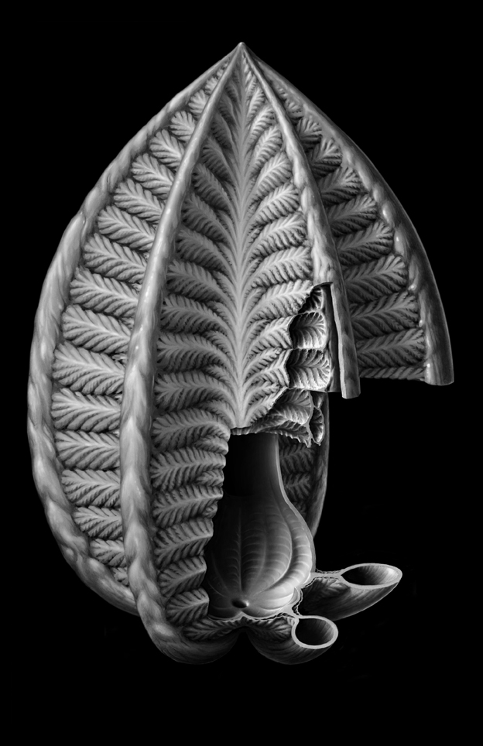
Reconstructing Rangea:
New discoveries from the Ediacaran of southern Namibia
Patricia Vickers-Rich¹, Andrey Yu. Ivantsov ², Peter W. Trusler¹, Guy M. Narbonne³, Mike Hall ¹, Mikhail A. Fedonkin², David A. Elliot ¹, and K.H. Hoffmann⁴
¹ Monash University, Melbourne, Australia
² Paleontological Institute, Moscow, Russia
³ Queen’s University, Kingston, Canada
⁴ Namibian Geological Survey, Windhoek, Namibia

Slide 2
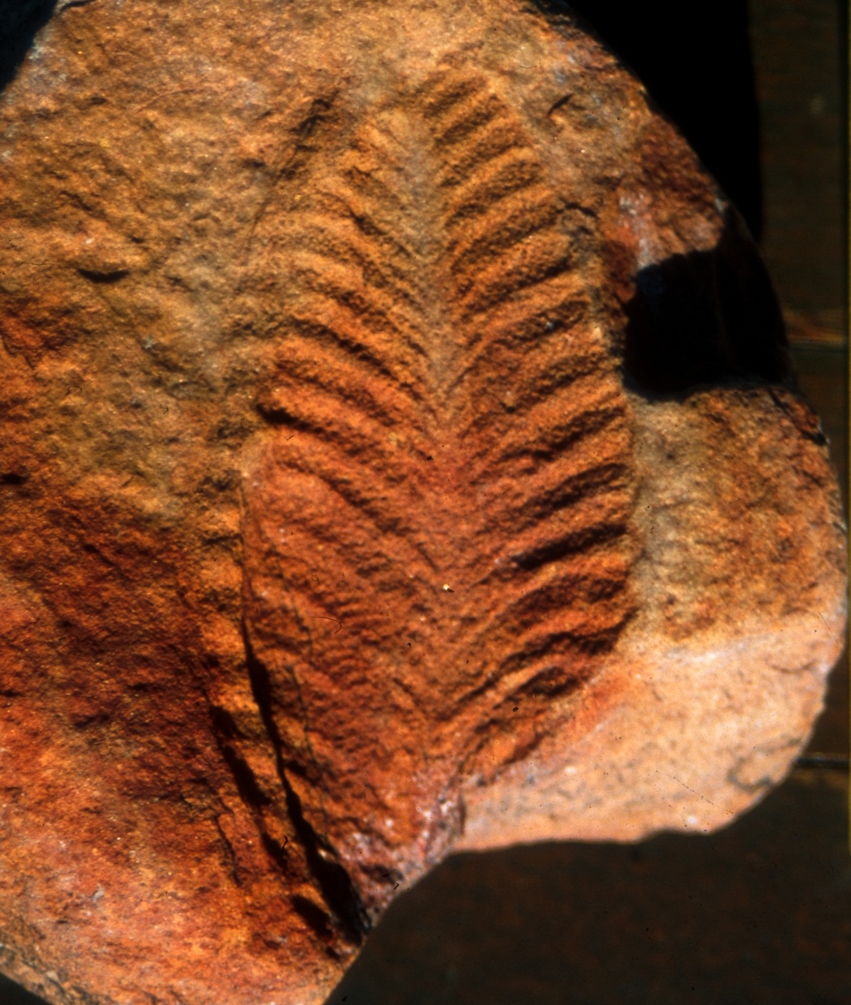
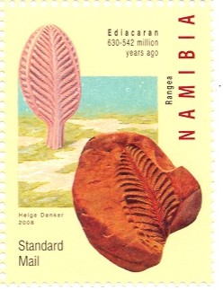
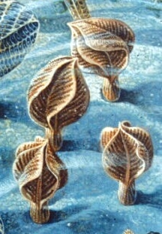
Namibia Post stamp, 2008
Rangea schneiderhoehni Gürich, 1930
National Geographic, 1997
Rangea: The first-described complex Ediacaran taxon

Slide 3
Interpretations:
simple leaf or complex frond?
2, 3, 4, 5, or 6 vanes?
epifaunal or infaunal?
primitive radial animal or extinct group?
Namibia Post stamp, 2008
Rangea schneiderhoehni Gürich, 1930
National Geographic, 1997
Previous global database for Rangea <30 specimens

Slide 4
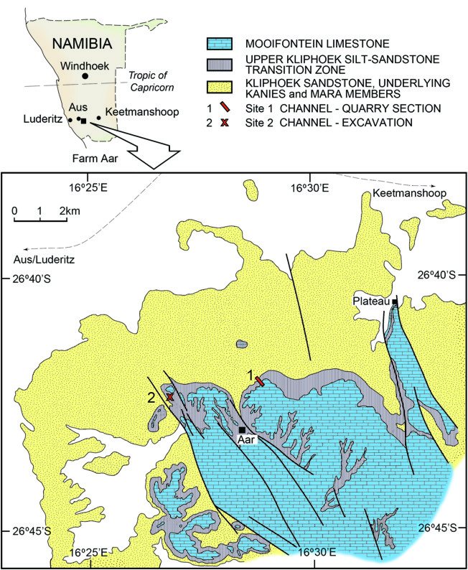
Location of the new Rangea discoveries on Aar Farm, Namibia

Slide 5
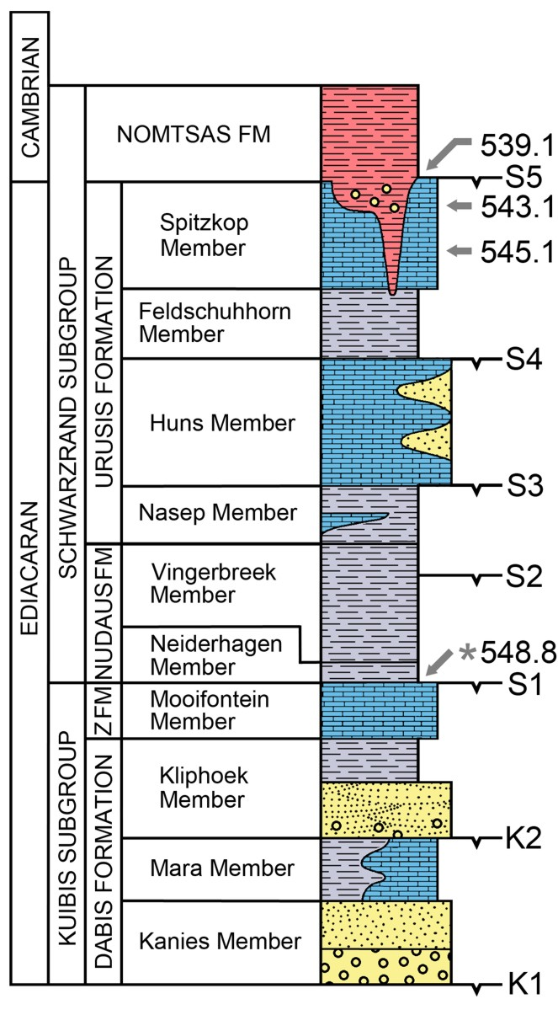
Nama Group stratigraphy, southern Namibia
Swartpuntia, Pteridinium
Cloudina
Cloudina
Pteridinium, Nasepia
Pteridinium
Pteridinium, Rangea
Cloudina
Pteridinium, Ernietta, Ausia, Namalia, Rangea
*
Cloudina
Pteridinium, Rangea
After Saylor et al., PC Research, 1995

Slide 6
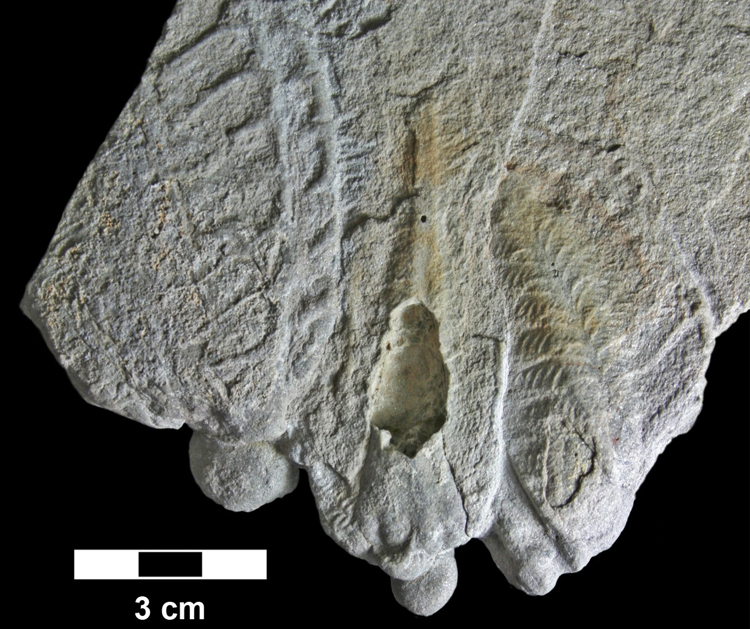
New Rangea discovery, Farm Aar, Namibia
1. Significantly expands the global Rangea dataset
2. Exhibit 3-D structures previously unknown from Rangea
Discovery Slab, Farm Aar, 2004

Slide 7
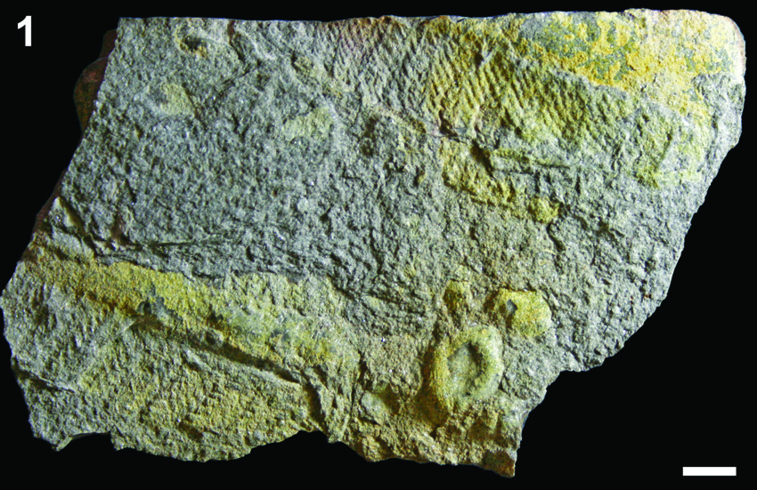
New Rangea discovery, Farm Aar, Namibia
3. Organic tissues were replaced by pyrite/jarosite which permits tracing of Rangea morphology through the rock

Slide 8
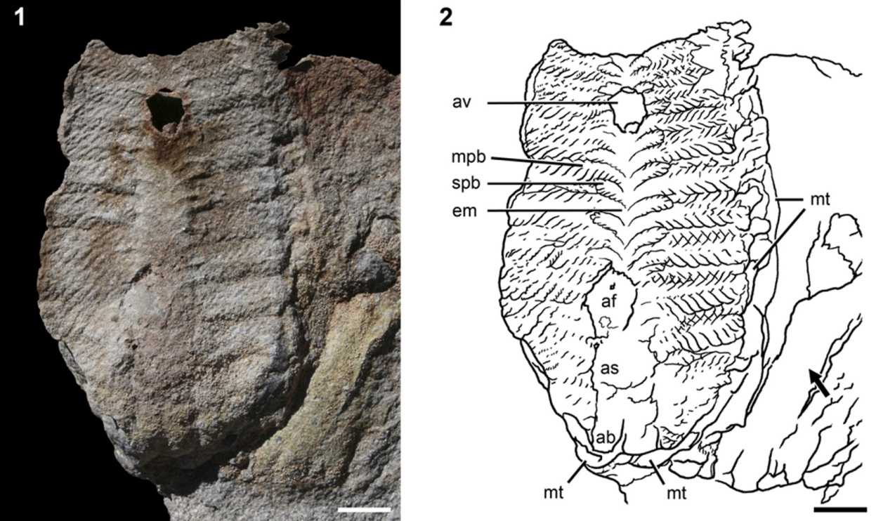
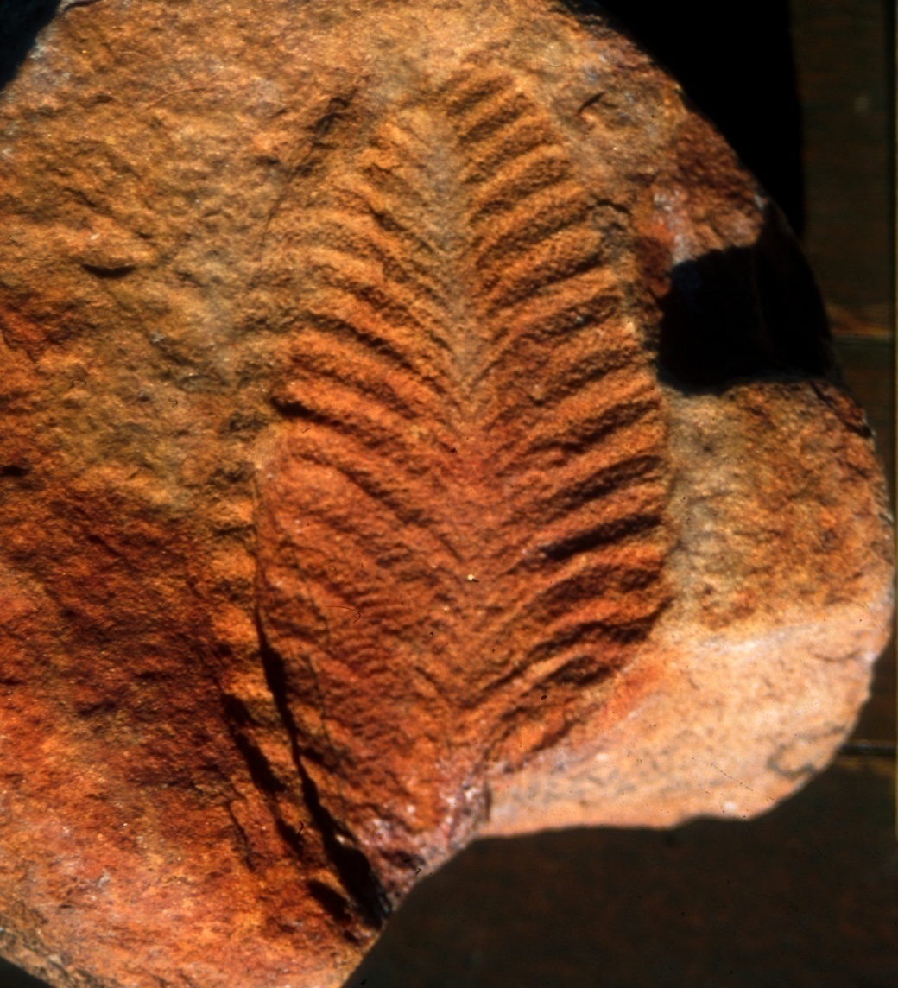
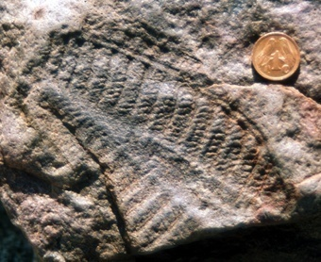
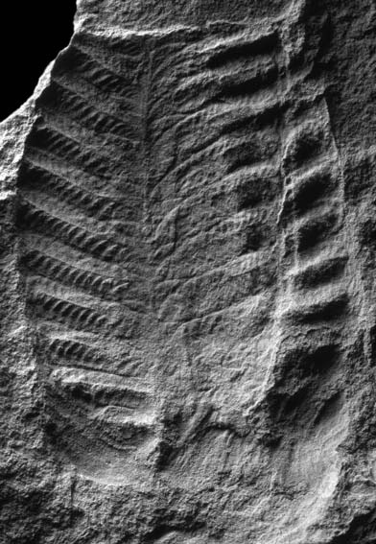
New Rangea discovery, Farm Aar, Namibia
External morphology is similar to that of previously reported specimens of Rangea from Namibia and Russia

Slide 9
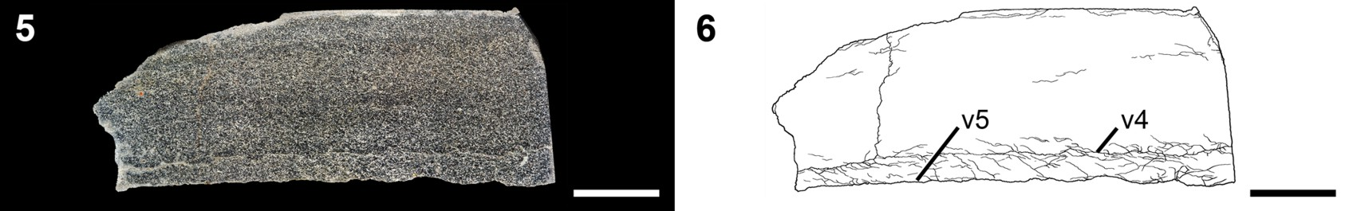
C
A
E
F
D
B
Rangea: Slicing Through an Enigma
C
D
A longitudinal cut through the vanes reveals two, parallel vanes (replaced by pyrite/jarosite), consistent with the surface view of the specimen

Slide 10
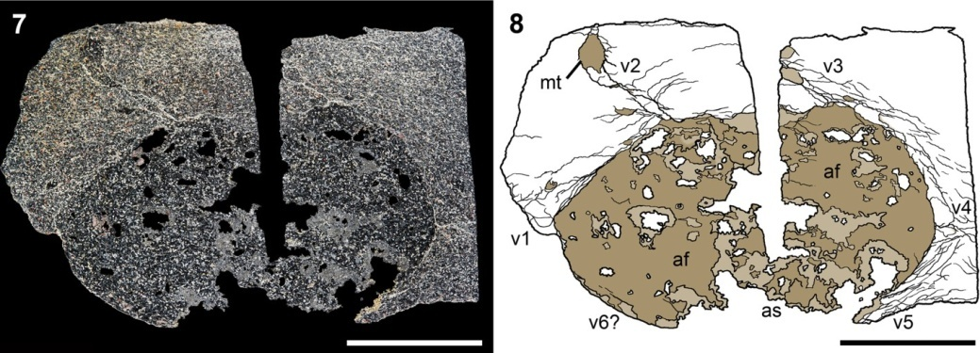
E
F
E
F
A transverse cut across the axis reveals a sandstone-filled axial bulb flanked by 6 radiating vanes replaced by pyrite/jarosite.

Slide 11
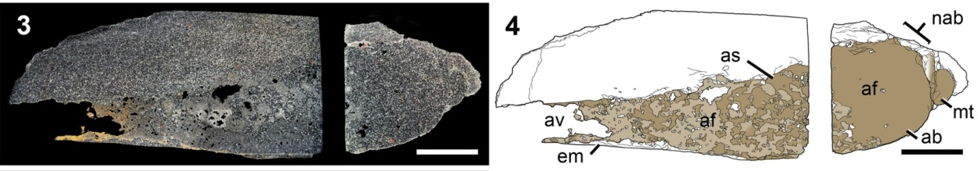
A
B
A
B
A longitudinal cut along the axis reveals that this sandstone-filled axial bulb passes distally into an empty stalk (axial void)

Slide 12
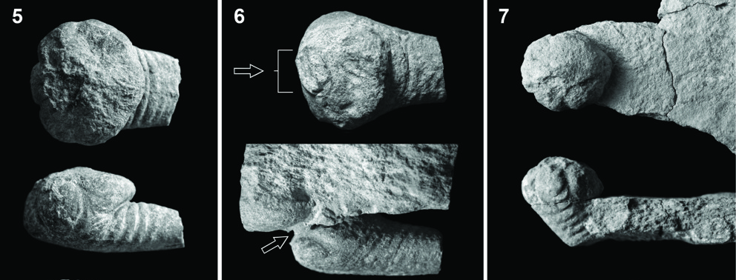
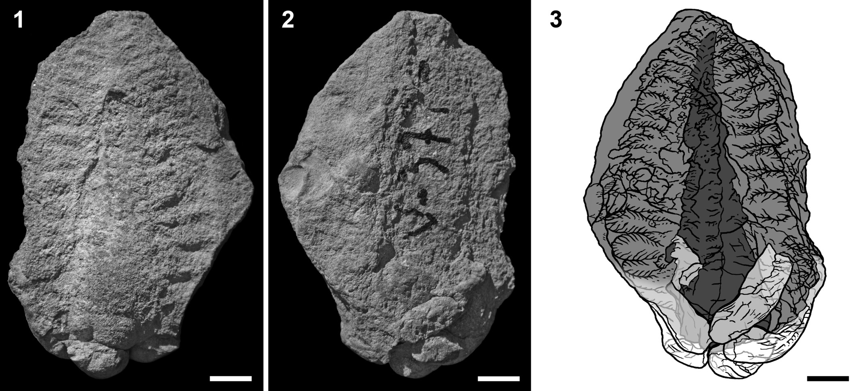
Top View
Side View
Sandstone-filled axial bulbs exhibit six-fold radial symmetry.
1
6
2
3
5
4
Axial bulbs and stalks are surrounded by 6 vanes that correspond to this symmetry

Slide 13
Reconstructing Rangea

Slide 14
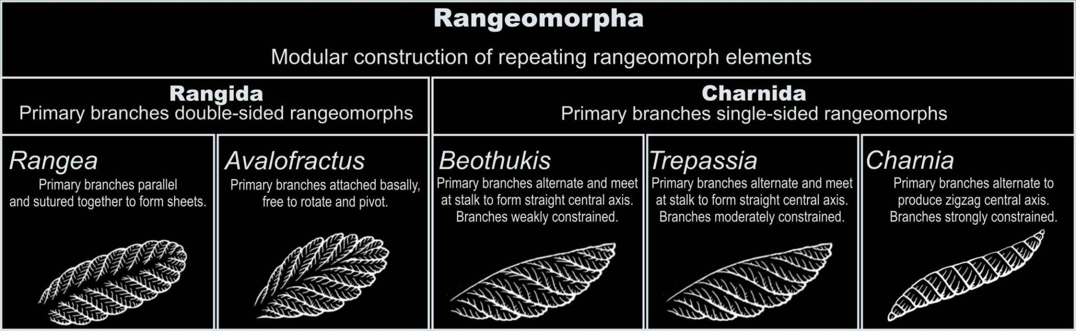
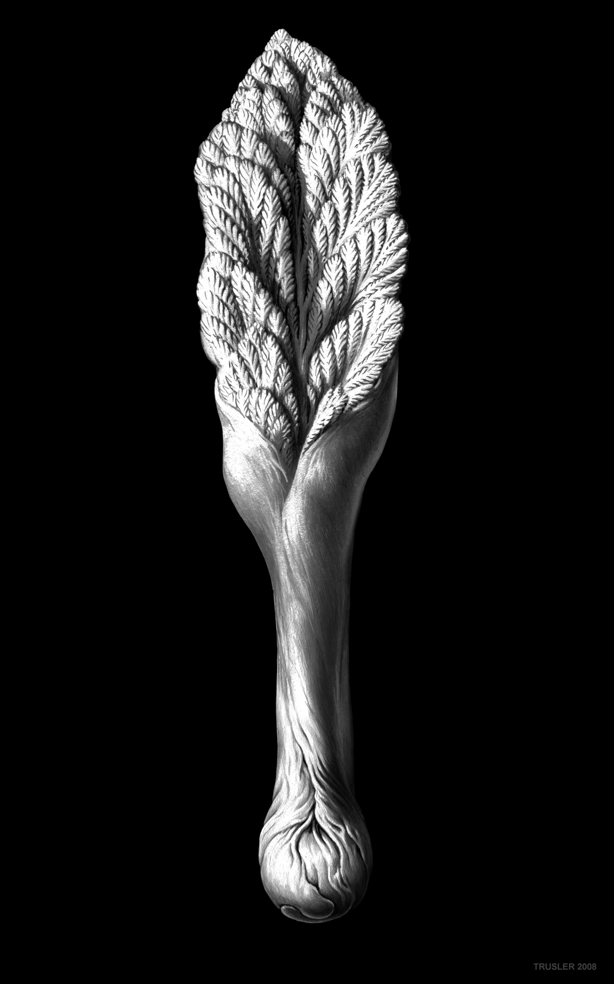
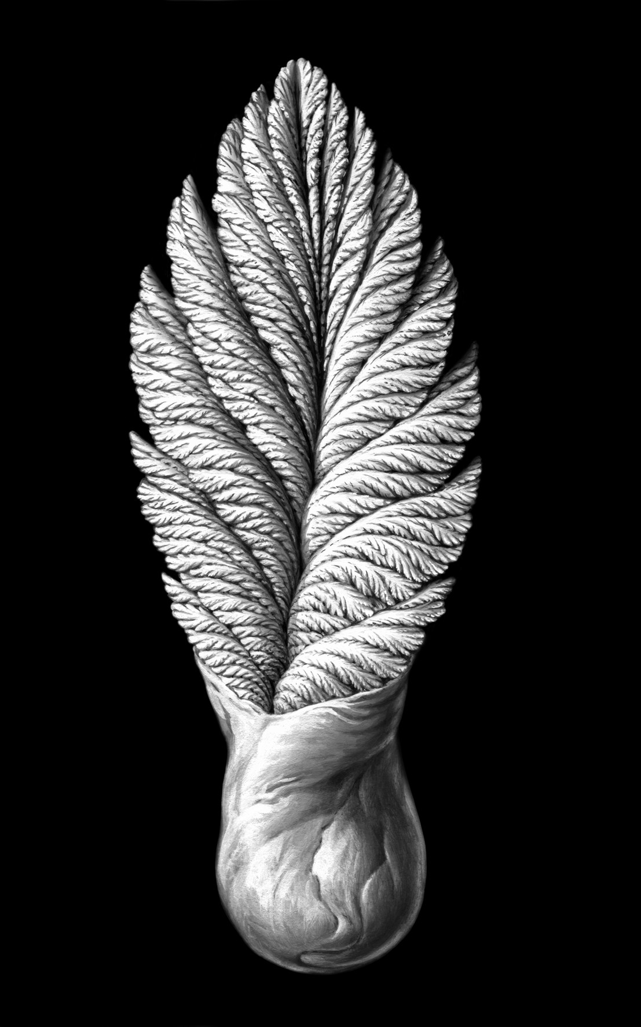
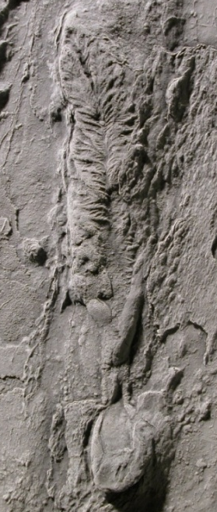
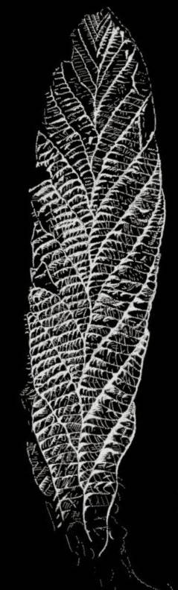
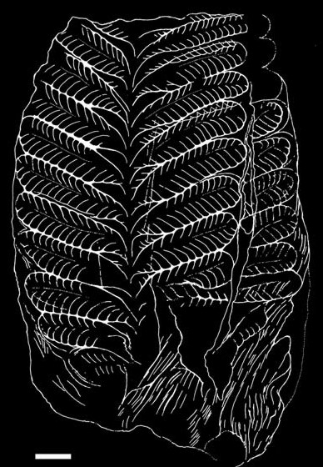
Avalofractus
Trepassia
Charnia
Secondary and tertiary branches double-sided
Secondary and tertiary branches single-sided
Secondary and tertiary branches single-sided
Rangea architecture is similar to that of the simplest rangeomorphs from Avalon, but its construction is much more complex and three-dimensional
After Narbonne et al., Journal of Paleontology, 2009

Slide 15
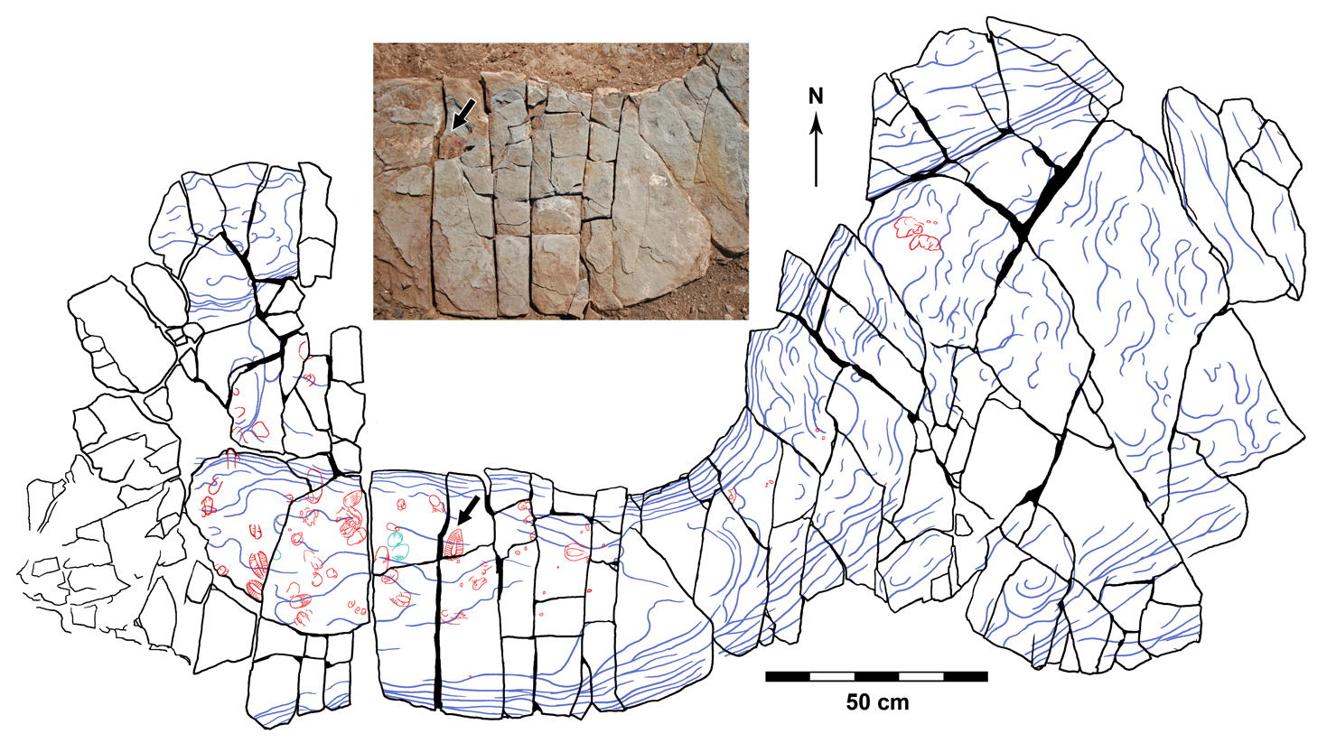
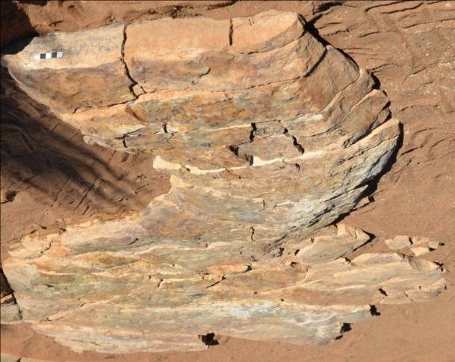
The new Rangea discoveries occur in shallow-water gutter casts.
There is no alignment of fossils, implying transport of untethered individuals

Slide 16
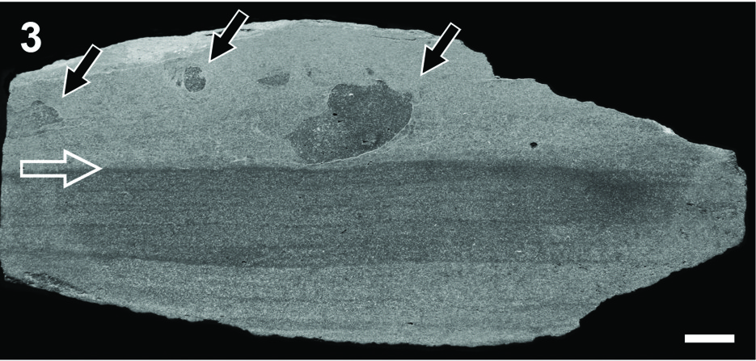
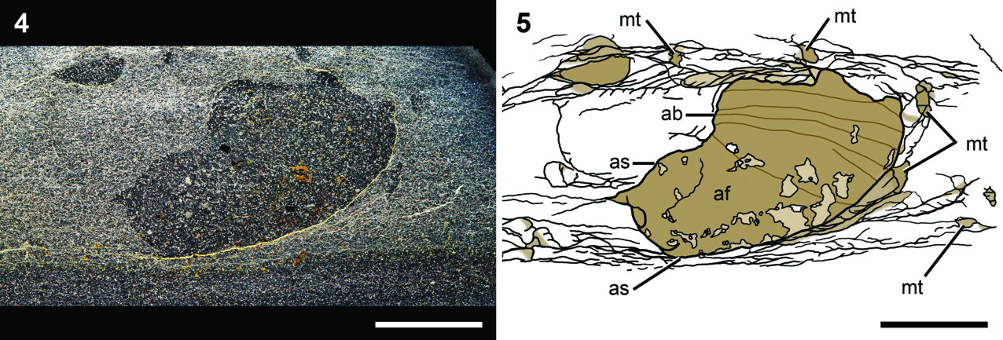
Axial bulbs are filled with sandstone that precisely matches strata lower in the gutter cast and does not match the sediment in which they were entombed.
This implies that sand fill preceded final deposition

Slide 17
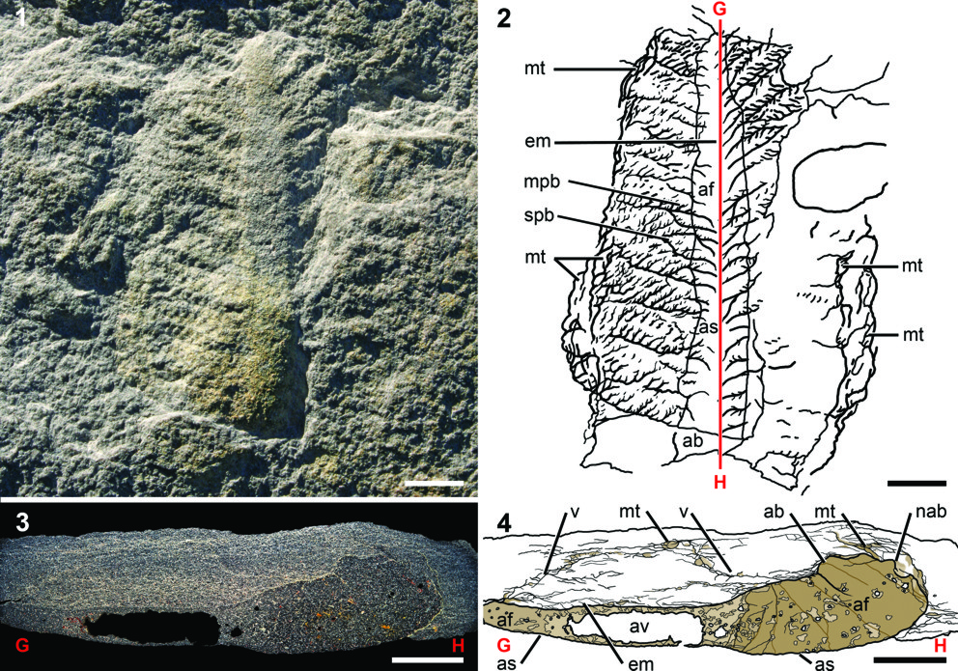
Sandstone fill was layered perpendicular to the axis in the proximal bulb and distally lines the stalk around an axial void
This implies active sand fill of the bulb while the Rangea was upright

Slide 18
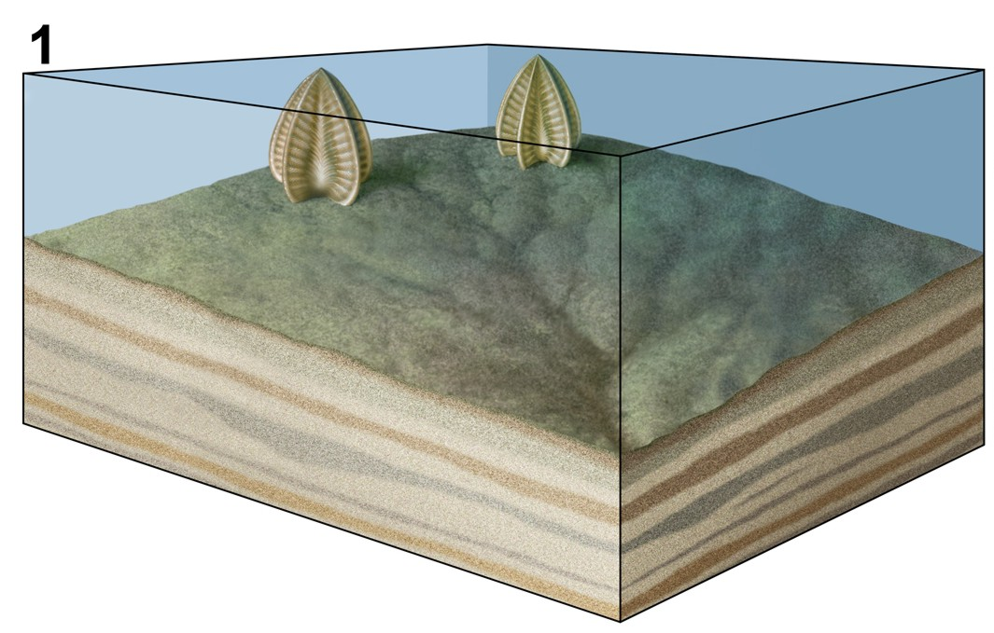
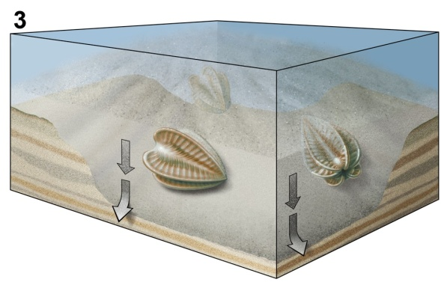
Reconstructing Rangea

Slide 19




Vote for Canada to host IGC 2020
A World of Geology - La géologie, tout un monde
www.IGC2020.ca

Slide 20
Reconstructing Rangea

Slide 22

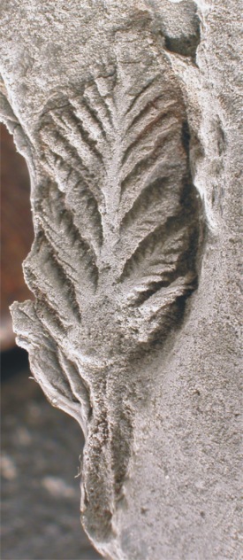
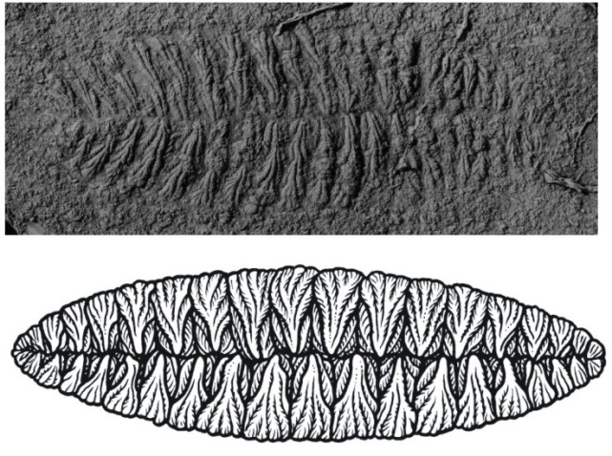
555-550 Ma
570-560 Ma
Architecture is similar to that of the simplest rangeomorphs from Avalon, but the construction is much more complex and three-dimensional

Slide 23

Reconstructing Rangea

Slide 24
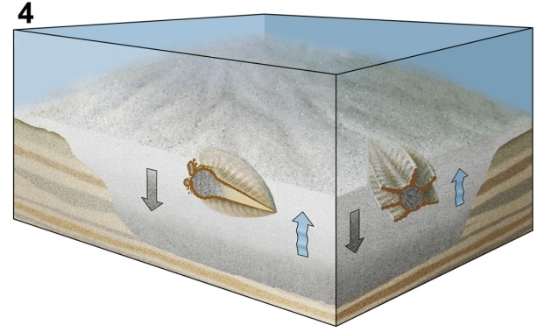
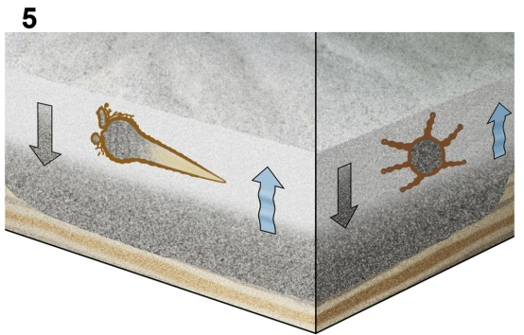
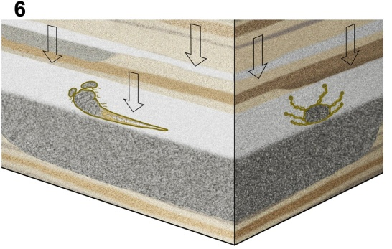
External view
Rangea transported in a gutter
Internal view
Fossil deposition and replacement of organics by pyrite
Stratal accumulation, compaction, and late alteration of pyrite to jarosite

Slide 25
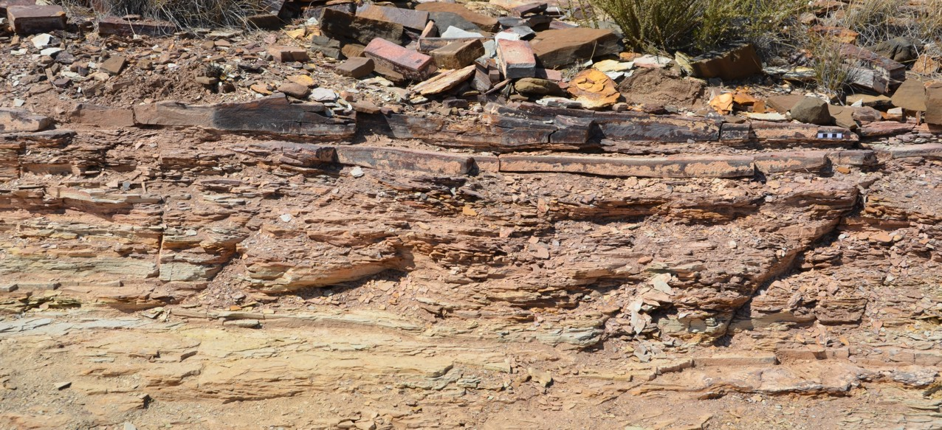
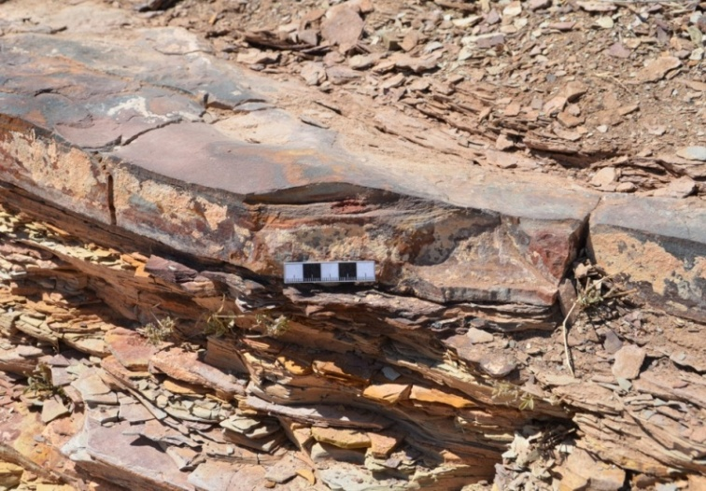
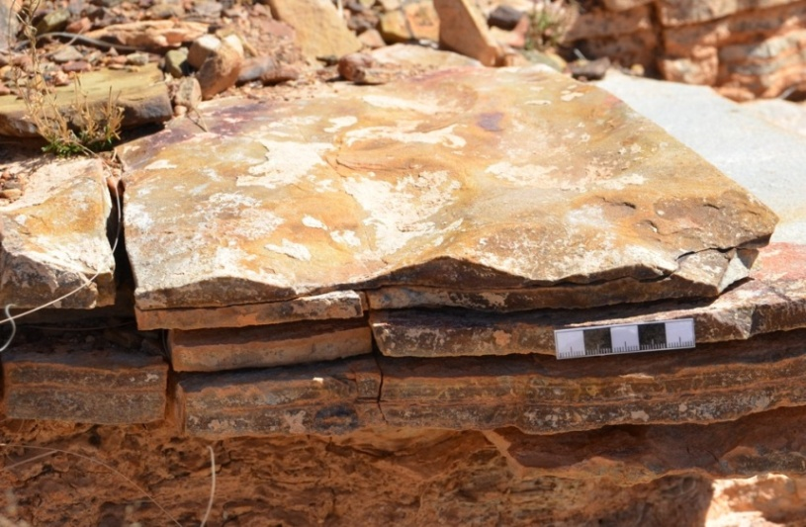
Event beds in Kliphoek Formation at Farm Aar
Reconstructing Rangea: Taphonomy and Ecology

