Slide 1



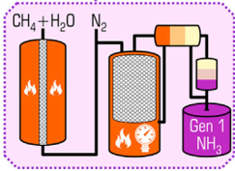



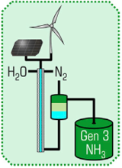
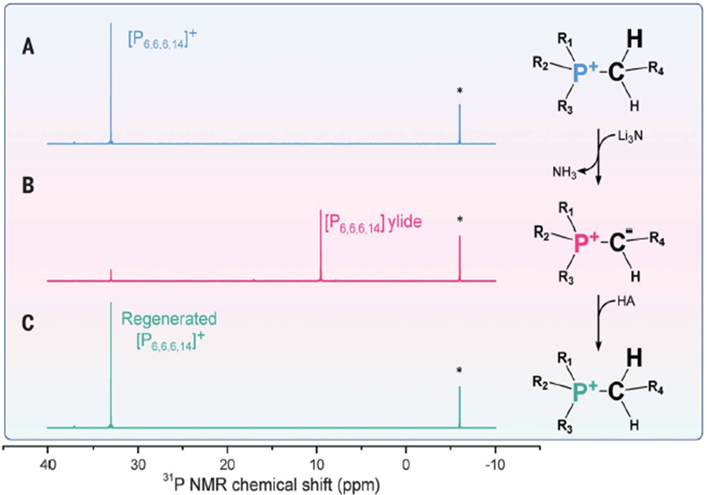
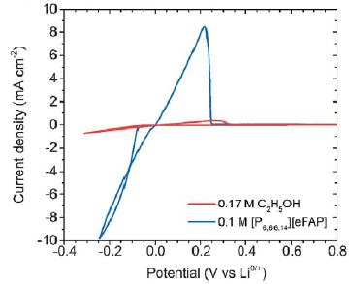
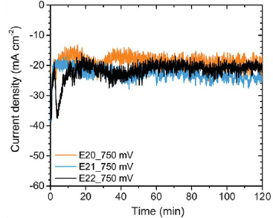
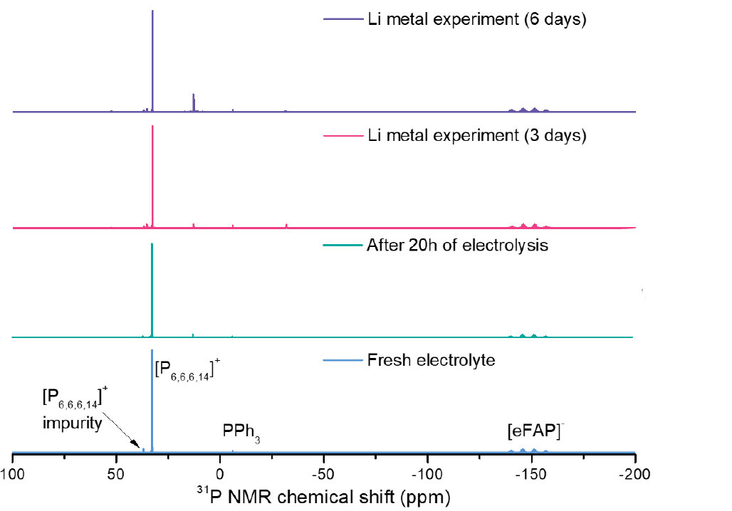
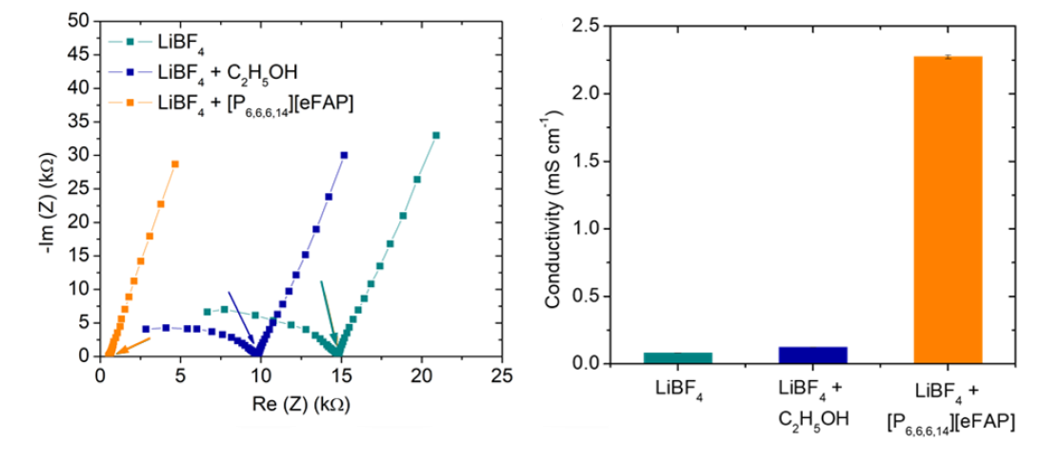
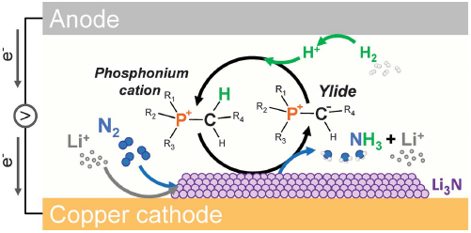
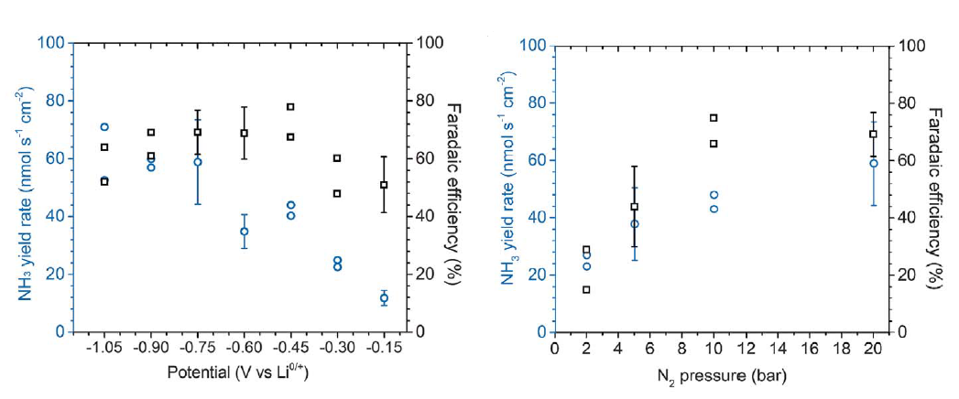
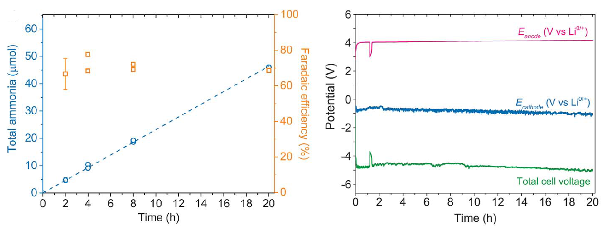

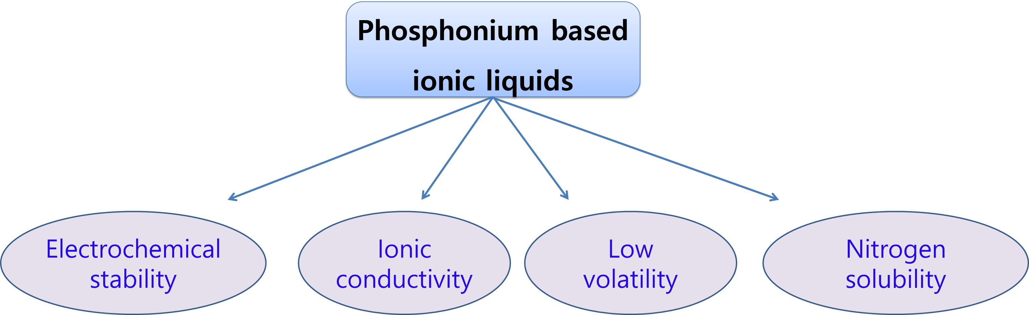
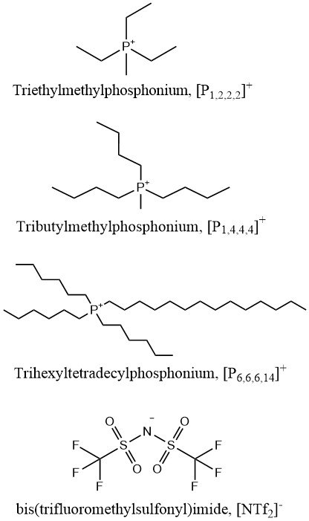
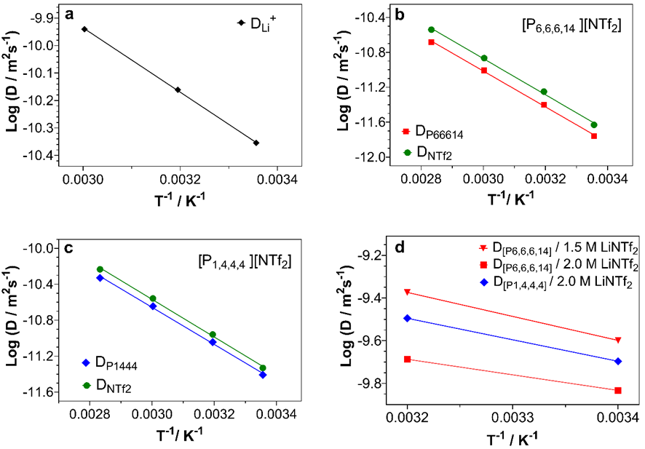
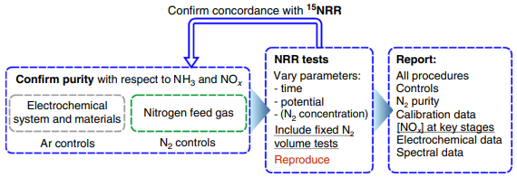
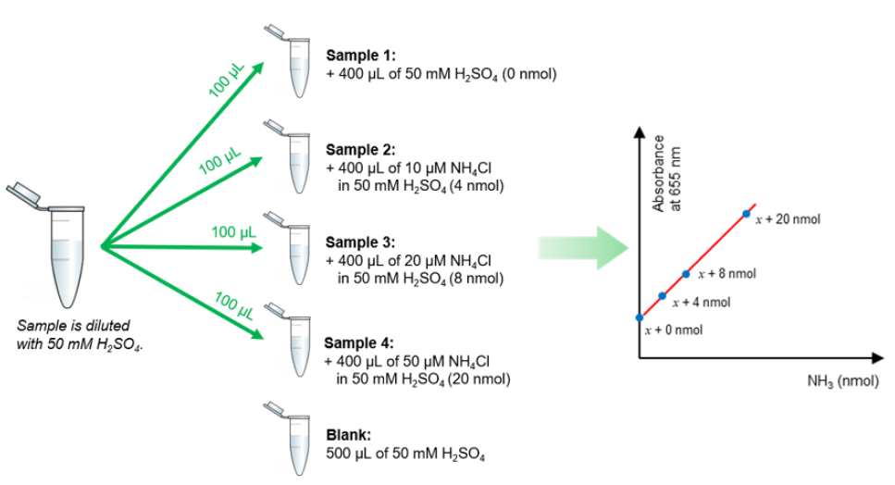
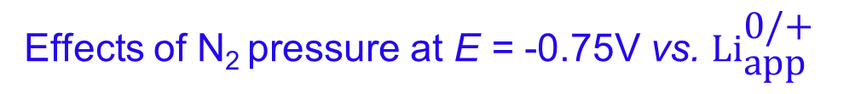
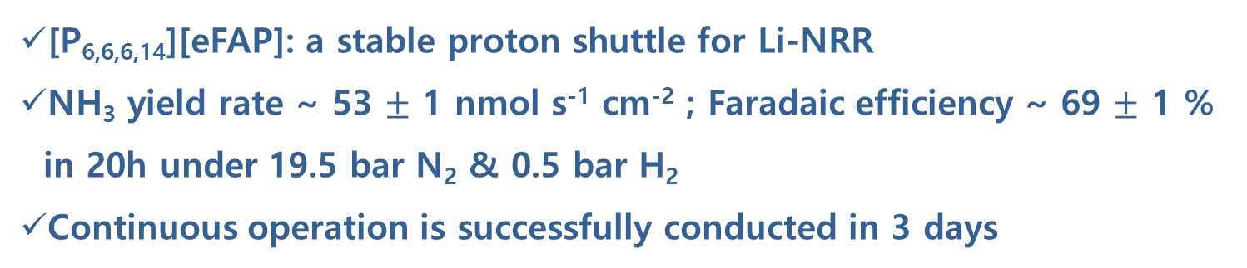


High Efficiency Ammonia Electrosynthesis via Understanding
the Mass-transport Effects of Phosphonium Ionic Liquids
Trung Nguyen ª, Hoang-Long Du ª, Luke A. O’Dell ^{b}, Alexandr N. Simonov ^{a ,}*, Douglas R. MacFarlane ^{a ,}*
ª ARC Center of Excellence for Electromaterials Science, School of Chemistry, Monash University, Clayton, Victoria 3800, Australia
^{b} Institute for Frontier Materials, Deakin University, Geelong, Victoria 3216, Australia
Email: trung.nguyen3@monash.edu
Introduction
Phosphonium Proton Shuttle for the NRR
Conventional Haber-Bosch process
Intensive resource and energy consumption
Contribute ~2% of global CO₂ emissions
[P_{6,6,6,14}][eFAP]: a stable proton shuttle for Li-NRR
NH₃ yield rate ~ 53 $±$ 1 nmol s⁻¹ cm⁻² ; Faradaic efficiency ~ 69 $±$ 1 % in 20h under 19.5 bar N₂ & 0.5 bar H₂
Continuous operation is successfully conducted in 3 days
DOI: 10.1016/j.joule.2020.04.004
Cyclic transformation of phosphonium IL (³¹P NMR)
Electrochemical analysis
NH₃ electrosynthesis
Allow to occur under mild ambient conditions
Green & zero emission
Powered by renewable energy
Current density (mA cm⁻²)
Current density (mA cm⁻²)
DOI: 10.1016/j.joule.2020.04.004
E_{WE} ( V vs. ${Li}_{app}^{0/+}$)
Time (min)
N₂ and H₂O can be converted into NH₃ via
electrochemical process enabled by renewable electricity
Reduction rate increased 10 times
-Im (Z) (kΩ)
Conductivity (mS cm⁻¹)
DOI: 10.1126/science.abg2371
Re (Z) (kΩ)
Li-mediated nitrogen reduction (Li-NRR): the most promising way to synthesize NH₃ with high faradaic efficiency and prospective rates.
Common proton carrier: Ethanol
Alternative: Phosphonium-based ionic liquids with unique properties
E_{WE} ( V vs. ${Li}_{app}^{0/+}$)
N₂ pressure
Effects of potential at 20 bar N₂
Effects of N₂ pressure at E = -0.75V vs. ${\text{Li}}_{\text{app}}^{\text{0/+}}$
Long-term operation
Improved Phosphonium Proton Shuttle
Objectives
New phosphonium-based ionic liquids as proton shuttles for the NRR
Diffusion coefficients of Li⁺ and phosphonium cations
in the electrolyte solution
Investigation of the mass-transport effects of phosphonium-based
ionic liquids
Designing an effective continuous flow cell to study mass-transport
in the Li-NRR system
Kinetic modelling and simulation for discovering mechanistic insight for the Li-NRR
Experimental
2.5 M LiNTf₂ in THF solvent
Neat [P_{6,6,6,14}] [NTf₂]
Electrochemical and control procedure
Neat [P_{1,4,4,4}] [NTf₂]
0.1 M ILs in LiNTf₂ / THF electrolyte
DOI: 10.1038/s41467-020-19130-z
Lithium-mediated NRR performance
Ammonia quantification: Spectrophotometric Berthelot method
Standard addition method: eliminate matrix interferences
Ammonia concentrations correspond to absorbance of
indophenol chromophore
DOI: 10.1126/science.abg2371
References
1. MacFarlane, D. R.; Cherepanov, P. V.; Choi, J.; Suryanto, B. H. R.; Hodgetts, R. Y.; Bakker, J. M.; Ferrero Vallana, F. M.; Simonov, A. N., A Roadmap to the Ammonia Economy. Joule 2020, 4 (6), 1186-1205.
2. Suryanto, B. H. R.; Matuszek, K.; Choi, J.; Hodgetts, R. Y.; Du, H.-L.; Bakker, J. M.; Kang, C. S. M.; Cherepanov, P. V.; Simonov, A. N.; MacFarlane, D. R., Nitrogen reduction to ammonia at high efficiency and rates based on a phosphonium proton shuttle. Science 2021, 372 (6547), 1187-1191.
3. Choi, J.; Suryanto, B. H. R.; Wang, D.; Du, H.-L.; Hodgetts, R. Y.; Ferrero Vallana, F. M.; MacFarlane, D. R.; Simonov, A. N., Identification and elimination of false positives in electrochemical nitrogen reduction studies. Nature Communications 2020, 11 (1), 5546.
4. Lazouski, N.; Steinberg, K. J.; Gala, M. L.; Krishnamurthy, D.; Viswanathan, V.; Manthiram, K., Proton Donors Induce a Differential Transport Effect for Selectivity toward Ammonia in Lithium-Mediated Nitrogen Reduction. ACS Catalysis 2022, 5197-5208.

