Slide 1
Student and Education Business Services (SEBS)
Academic Programs and Governance (APG)
CourseLoop 2022 upversion

Slide 2
Summary
Changes to Dashboard view - Governance Meetings, Tasks and Notifications added to navigation and listed on the Dashboard
Governance Meetings - new format for viewing meetings from the Dashboard
Tasks (new feature) - create tasks for proposals and assign to users or groups of users for information or action
Notifications (new feature) - notifications emailed to users or groups of users to inform or request an action for a task

Slide 3
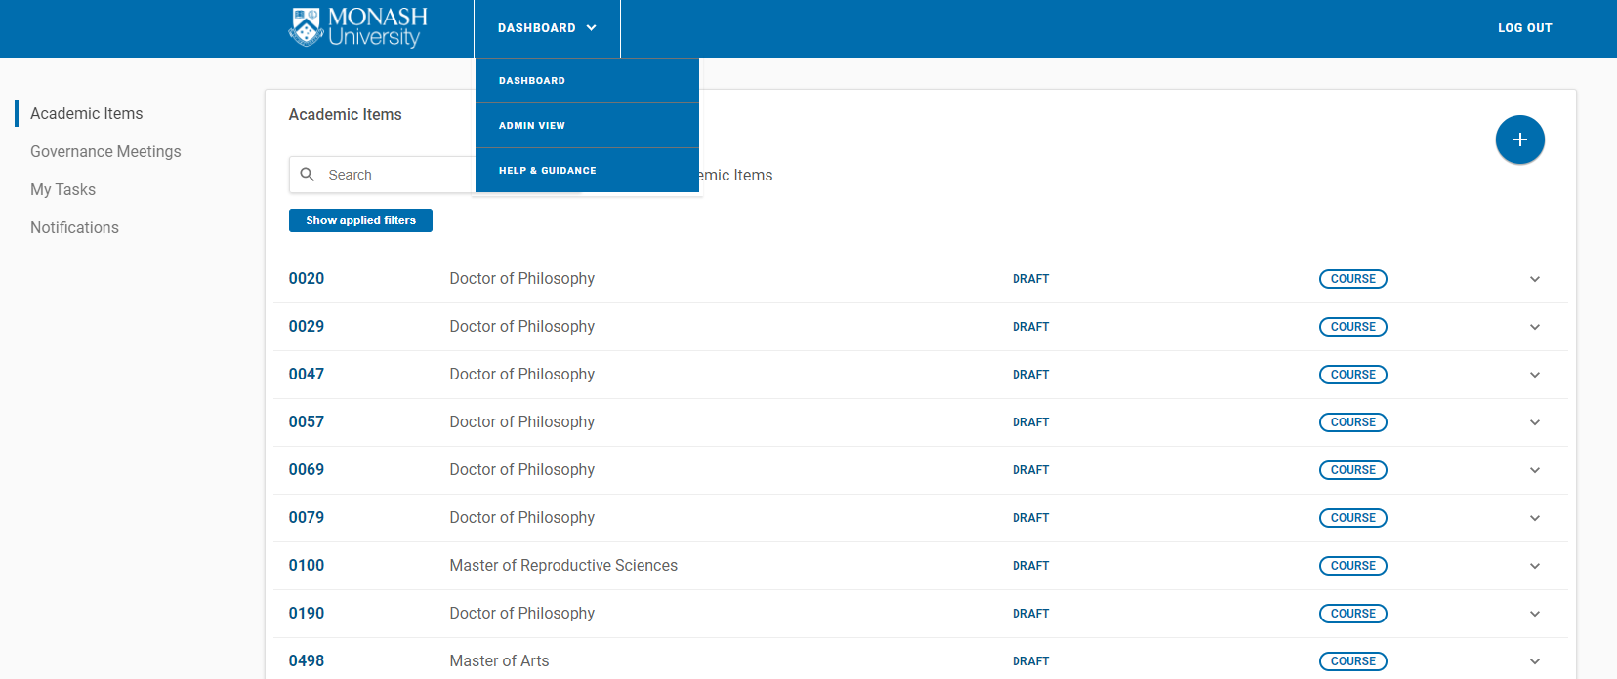
New Dashboard view
The Dashboard navigation now includes Governance Meetings, My Tasks and Notifications.
Note: Governance Meetings is no longer listed in the Dashboard menu.

Slide 4
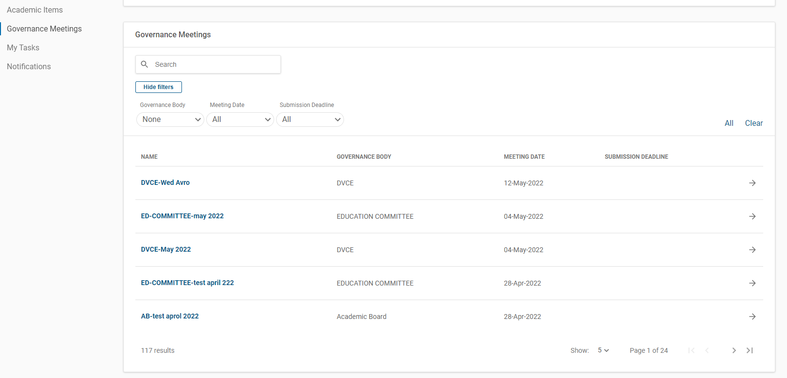
Governance Meetings
Governance Meetings are listed on the Dashboard.
Filters are available to search meetings
By clicking on each one of the heading you will be able to sort in ascending or descending order
Click on the arrow to view proposals assigned to a meeting.

Slide 5
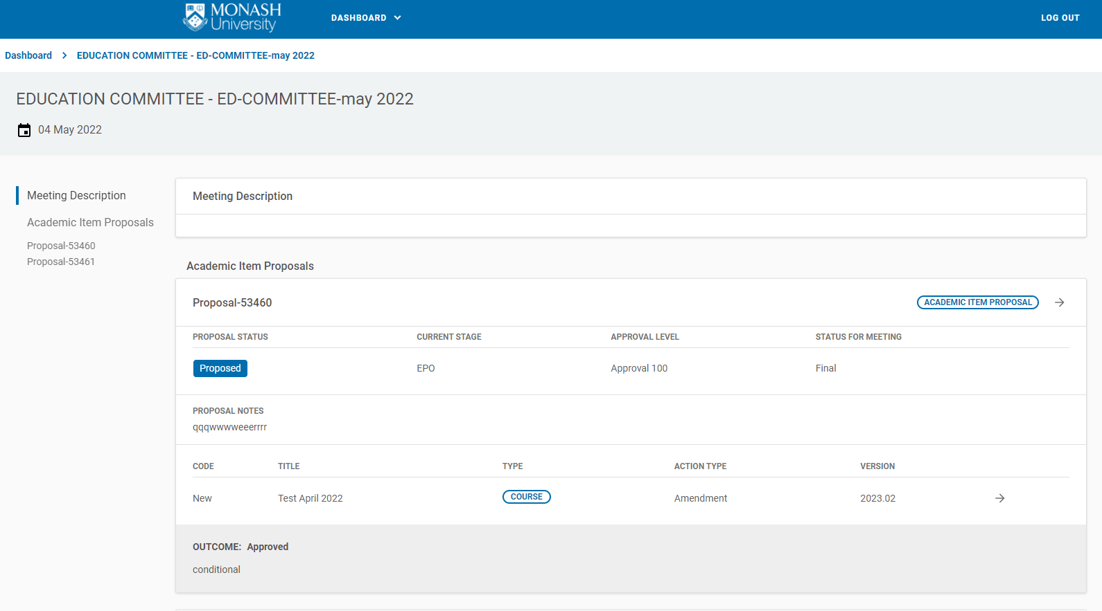
New Meeting view
See new format below listing academic item proposals for each meeting.
Click arrow to view proposal landing page.
The information in this column is not currently configured for Monash. This is temporary until new features are added in the system.
Proposals are now listed by proposal id number not course title
Click arrow to view the proposal academic course information tab

Slide 6
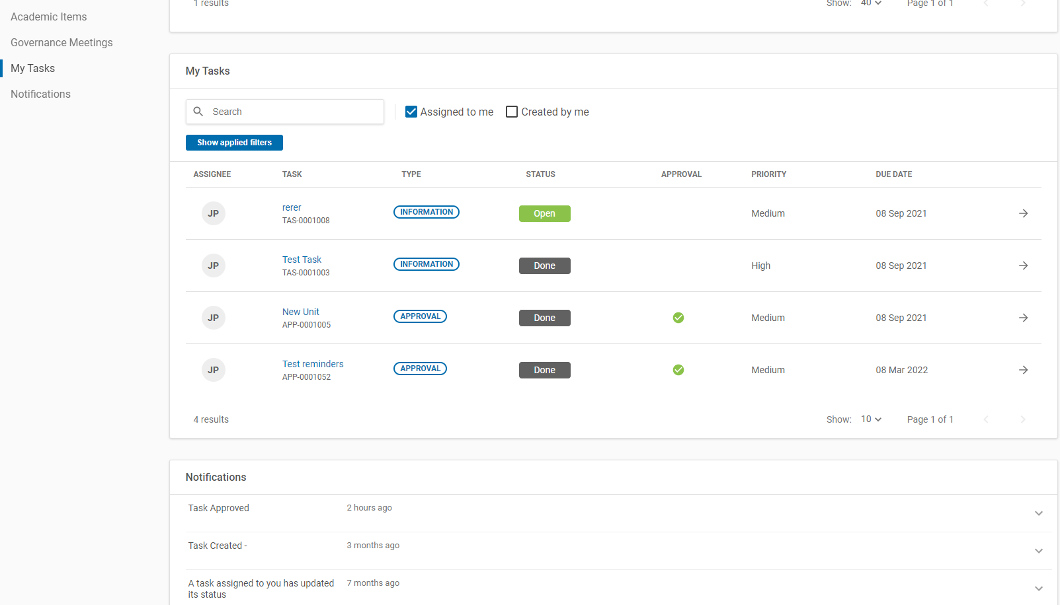
Tasks and Notifications
Tasks and Notifications are listed on the Dashboard. You will be able to view all tasks and notifications that are allocated to you or that you have allocated to another Courseloop user.

Slide 7
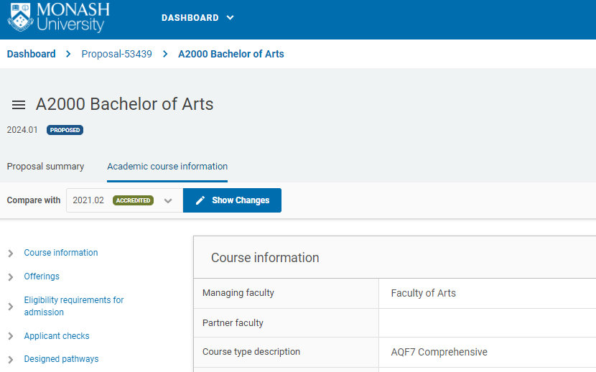
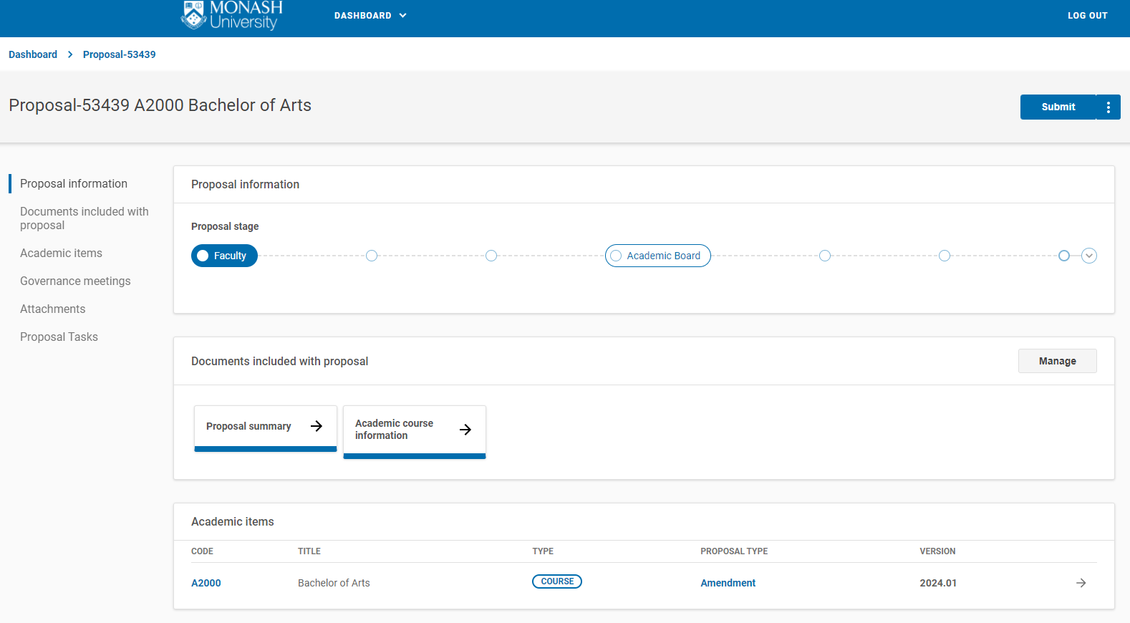
Tasks
There are 3 types of tasks: information, endorse or approve. Tasks can be assigned to a single user or a group of users. Note: Tasks can only be created from within a proposal and not from the Dashboard.
Click to go to the proposal landing page
Go to proposal task to create and assign new tasks

Slide 8
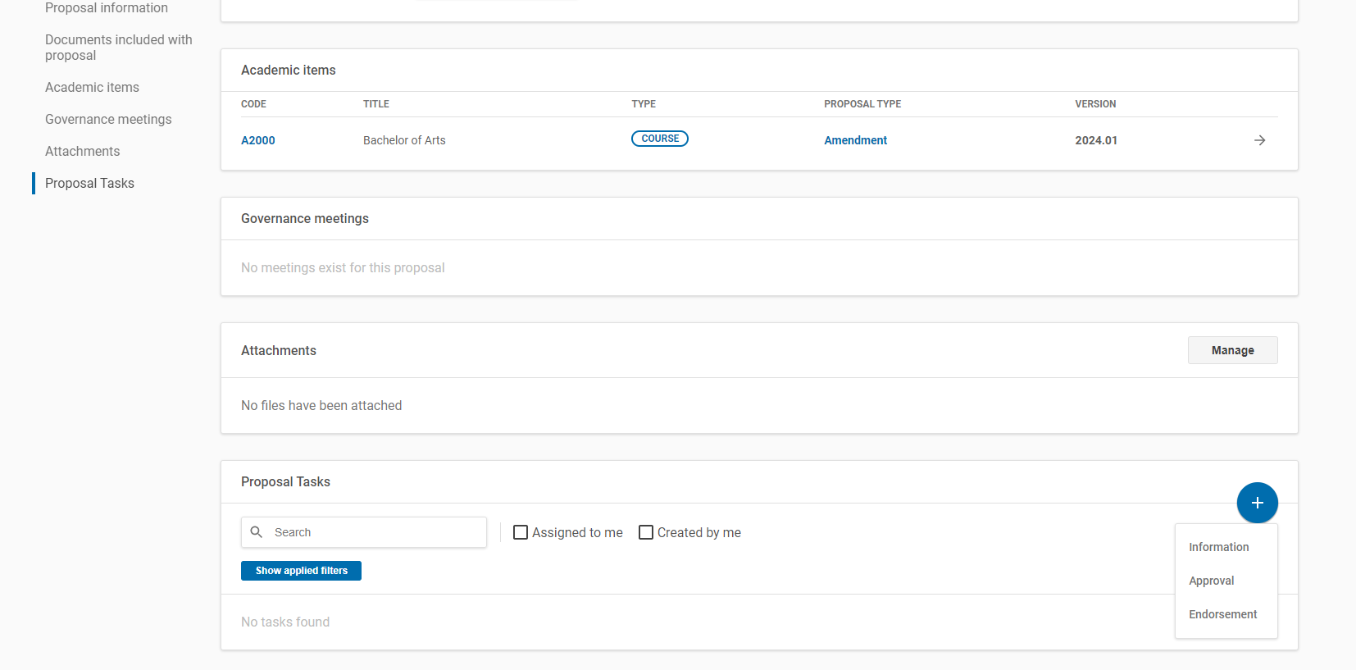
Create a task
Click on the plus sign to create a new task.

Slide 9
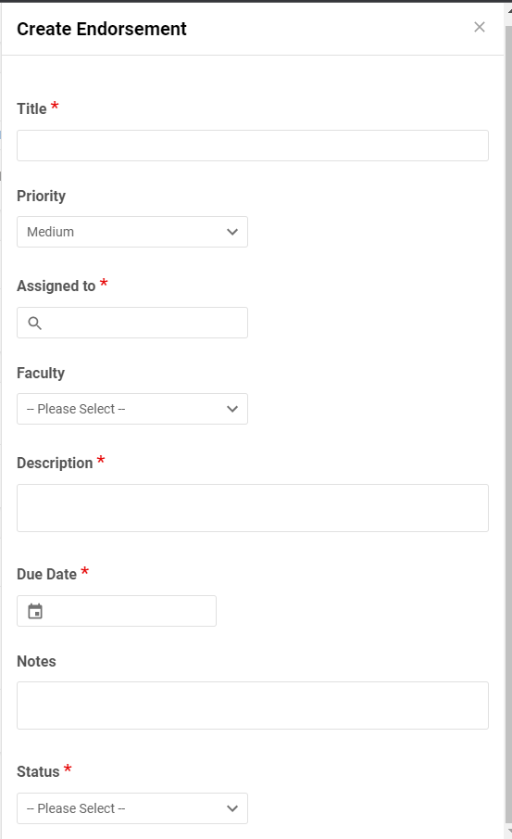
Create a task
Select one of the following types: Information | Approval | Endorse and complete all required sections.
Note: Information task should be used to create a bespoke request (e.g. seeking confirmation by another user that proposal content is accurate).

Slide 10
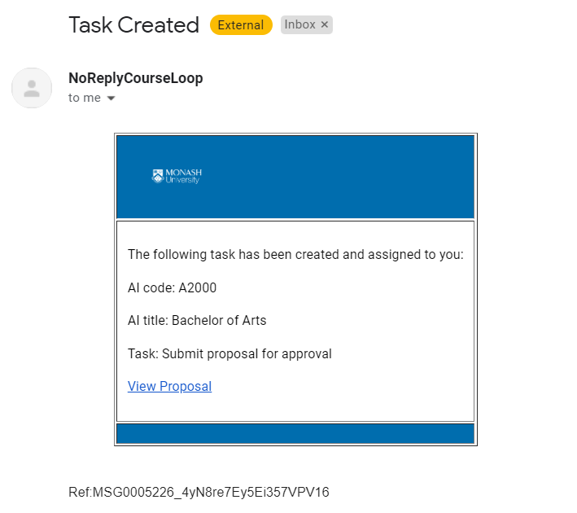
Notifications
You will receive an email notification when a task has been assigned to you or when a task you have created has been actioned.
Do not reply to the CourseLoop email address in notifications.
Click on link to view proposal landing page.

Slide 11
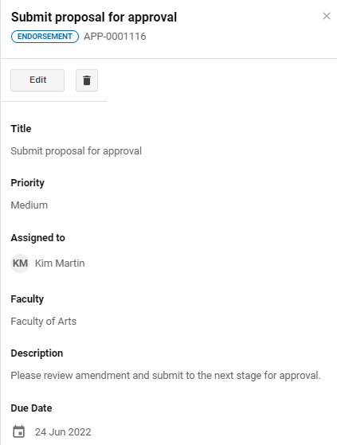
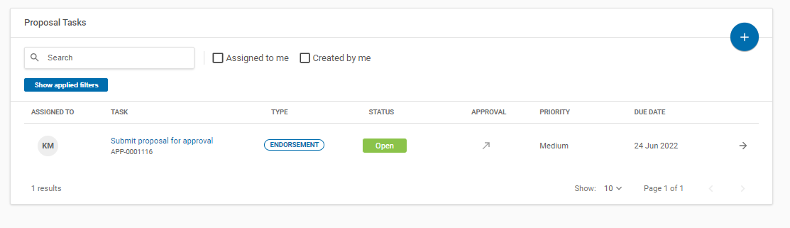
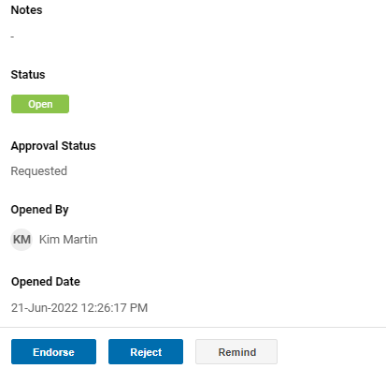
Open and action tasks
A task can be edited or deleted.
Click to open task.
Click to action task.

Slide 12
Additional information
For additional information or assistance, please contact us via email.
SEBS - Curriculum and Publications (units, tasks, notifications)
SEBS-Publications@monash.edu
Academic Programs and Governance (courses, AoS, governance meetings, tasks and notifications)
educationprogams@monash.edu

