Slide 1
ESG and Shareholder Value:
SC Johnson College of Business | Cornell
The Role of Board Facial Impressions and Perceived Trustworthiness
Aaron Yoon (Northwestern), Jiawen Yan (Cornell), Siew Hong Teoh (UCLA), Luo Zuo (Cornell)
2022 ICVG Conference: Governance in its institutional context
(Dec. 2022)
Notes:
First, I would like to thank the conference organizers for inviting me to present the paper titled
“ESG and shareholder value: the role of board facial impression and perceived trustworthiness”
I’m Jiawen Yan, currently a 3-rd year PhD candidate of accounting at Cornell. This is a joint with Aaron Yoon from Northwestern, Siew Hong Teoh from UCLA, and Luo Zuo from Cornell.

Slide 2
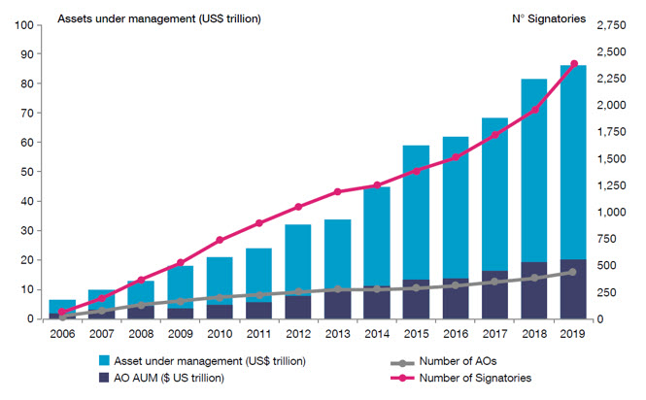
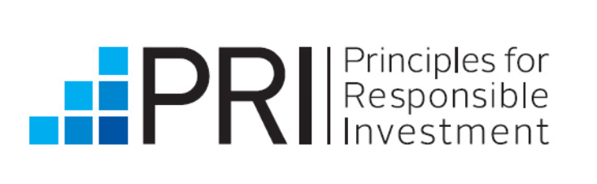
Growing interest in ESG
Key issue: understand whether ESG activity creates shareholder value and if so, how to identify that
Notes:
First, Let me talk about our motivations. ESG is becoming a very hot topic in recent days. If we look at the assets invested in ESG, they are becoming larger and larger.
The global ESG investments by asset managers increased from less than 10 trillion dollars in 2006 to almost 100 trillion dollars in 2019
So, the key issue is to understand whether ESG activities (or ESG investment) create shareholder value. If yes, how should we identify them?

Slide 3
The Debate- ESG & Shareholder Value
Negative/No relation ☹
  CSR & financial returns have tradeoffs (McWilliams and Siegel 1997)
    Managers do good with other people’s money (Cheng, Hong and Shue 2014)
    Benefit stakeholders, not the shareholders (Di Giuli and Kostovetsky 2014)
    At best does not help nor harm shareholder value (Bebchuk et al. 2022)
Positive relation ☺
  Shareholder value is generated through:
    Investments in material ESG issues (Khan et al. 2016)
    High ability CEOs engaging in ESG issues (Welch and Yoon 2022)
Notes:
If we search around the literature, we find that there are a lot debates about whether ESG activities increases shareholders value or not
Some existing studies find negative or no relation, and argue that there are tradeoffs between ESG and financial returns. If the managers are doing good with other people’s money, the final outcome benefits broad scope of stakeholders, not the shareholders.
Some other existing studies find positive relation. By investing material ESG issues, and selecting high ability CEOs, shareholder value is increased

Slide 4
Why is there a debate?
Lack of agreement about what constitutes ESG activities (Berg et al. 2022)
No mandated guidance on ESG related disclosures (Christensen et al. 2019)
Costs & benefits of ESG are hard to verify (Serafeim and Yoon 2022)
Murky and inconsistent ESG measurements (Chatterji et al. 2016)
Under what circumstances do ESG activities create shareholder value?
Notes:
Why is there a debate? There are three reasons explaining the mixed evidence:
The definition is not clear. We do not have an agreement on what ESG activities. Different dataset, different measurement of ESG
The ESG disclosure is voluntary. We do not have a mandated guidance on ESG related disclosures
The costs and benefits of ESG are hard to verify
In this paper, we try solve the puzzle. Our broad research question is when do ESG activities create shareholder value

Slide 5
Research Question
Do ESG activities increase firm value when managers & employees trust the board more?
Notes:
Specifically, we investigate: do ESG activities increase firm value when managers and employees trust the board of directors more?

Slide 6
Issues with ESG
ESG activities (Edmans 2011; Serafeim and Yoon 2022):
  Risky: hard to verify, involve multi-step effort, require additional effort
  Tradeoff: costly in short-term but may provide benefits in the future
Risk-averse agents
  Discouraged from taking innovation, even if it is value increasing (Jensen and Meckling 1976)
  Engage in myopic behavior, just to increase investor perceptions (taking ESG activities that have low immediate costs and low future returns) (Stein 1989)
Potentially positive NPV ESG projects that have delayed net benefits are risky for myopic agents
  How can we break this dilemma?

Slide 7
Role of Trust
Trust
  Reflects multiple traits related to the observer’s perceptions about whether the observed has the intention to help or hurt. (Peng et al. 2022)
Beneficial role of trust:
  Individual level: positive outcomes such as employee satisfaction (Edwards and Cable 2009), high effort and performance (Colquitt et al. 2007), and leadership effectiveness (Gillespie and Mann 2004)
  Firm level: organizational change and survival (Sonpar et al. 2009), strategic alliances (Ireland et al. 2002), mergers and acquisitions (Maguire and Phillips 2008), and Tobin’s Q (Xu et al. 2019).
Notes:
Introduce a conditioning factor of “trust”

Slide 8
Trust in the ESG setting
Trust can:
  Motivate agents risk taking
    ESG investments are long-term and risky; agents want a board they can trust to not punish them inferior short-term outcomes
  Reduce agency problems/free riding
    Different ways to control risk (e.g., contracts)
    A powerful alternative to formal governance mechanisms that align incentives and address agency problems (Puranam and Vanneste 2009)
  Encourage information flow (Sandvik et al. 2020)
    Better information flow to and from board and agents
    Board has useful information. If they are trusted, managers use that information for the benefit of the firm.

Slide 9
Key Result- Annualized Alpha
-0.2%
2.8%
Top
Quartile
ESG Score
-4.9%
0.6%
Bottom
Quartile
Bottom
Quartile
Top
Quartile
Board Trust

Slide 10
Methodology & Results

Slide 11
ESG Data
From MSCI ESG Ratings dataset
- One of the most widely used
- Most comprehensive

Slide 12
Operationalization of Trust
Perceived trustworthiness
  Trust is a trait that is rooted in the human evolutionary past and is associated with the observer’s perception of whether the observed has the intention to help or harm (Bowles and Gintis 2011)
  Facial trait perceptions have developed over the evolutionary history and serve as shortcuts to aid survival during threats and uncertainties (Oosterhof and Todorov 2008)
  Facial trait impressions impact compensation contracting (Li et al. 2020), financial reporting (Jia et al. 2014), audit pricing (Hsieh et al. 2020), and analyst behavior and performance (Peng et al. 2020)
Notes:
Trust is a trait that is rooted in the human evolutionary past, and is associated with the observer’s perception of whether the observed has the intention to help or harm
To operationalize the construct of trust, we use facial trustworthiness. In finance and accounting, facial traits have impacts on various outcomes such as compensation contracting, financial reporting, audit pricing, and analyst behavior and performance

Slide 13
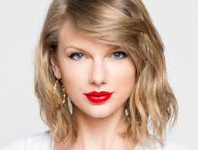
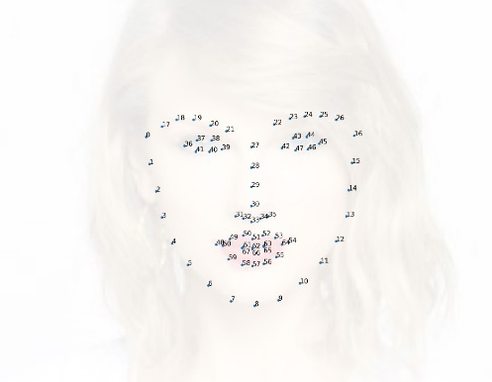
Operationalization of Trust
Following Peng et al. (2022):
Standardize photos
Locate 68 facial landmarks
Calculate the 65 facial attributes
Compute the raw scores for trustworthiness (Vernon et al. 2014)
Director Trustworthiness
IBUG (Imperial College tool) to obtain 68 fiducial landmark points
Vernon et al. (2014)’s Machine Learning algorithm
65 Physical Cues
Eye Width; Nose Height; Jaw Curve; Mouth gap; Cheekbone Position; etc.
Notes:
To measure directors’ facial trustworthiness, we download their profile images from proxy statements, and use machine learning algorithm following Peng et al. (2022) to measure the trust of each board member

Slide 14
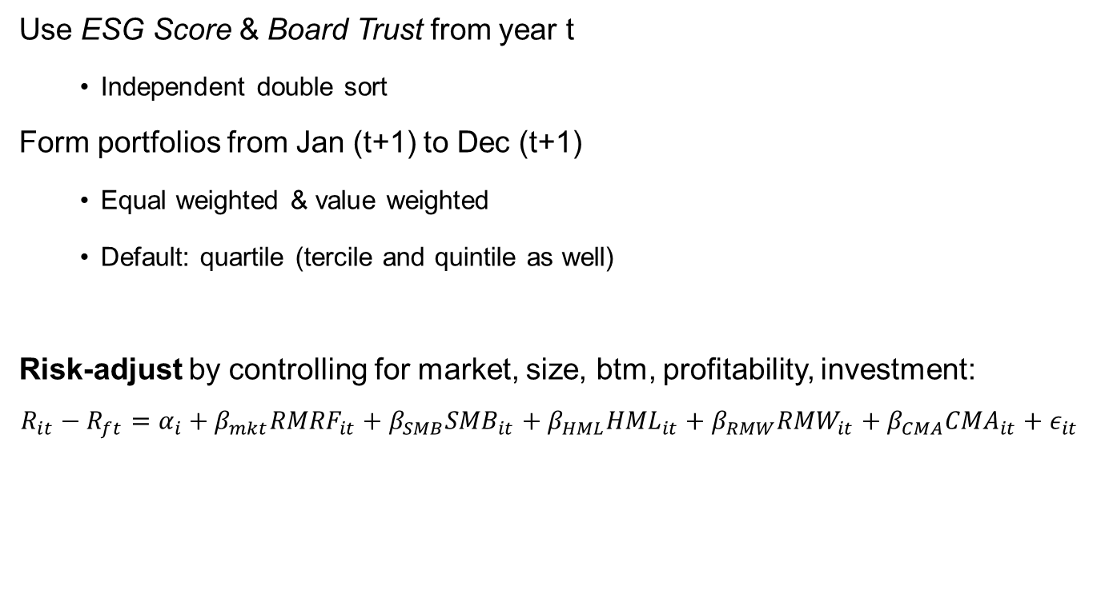
Portfolio Construction
Notes:
In order to evaluate the investment outcome/ESG value
We construct portfolios based on ESG score and Board Trust at time t, and examine investment outcomes in time t+1
When calculating risk-adjusted returns, we control for the five factors of market risk, size, book-to-market, profitability, and investment

Slide 15
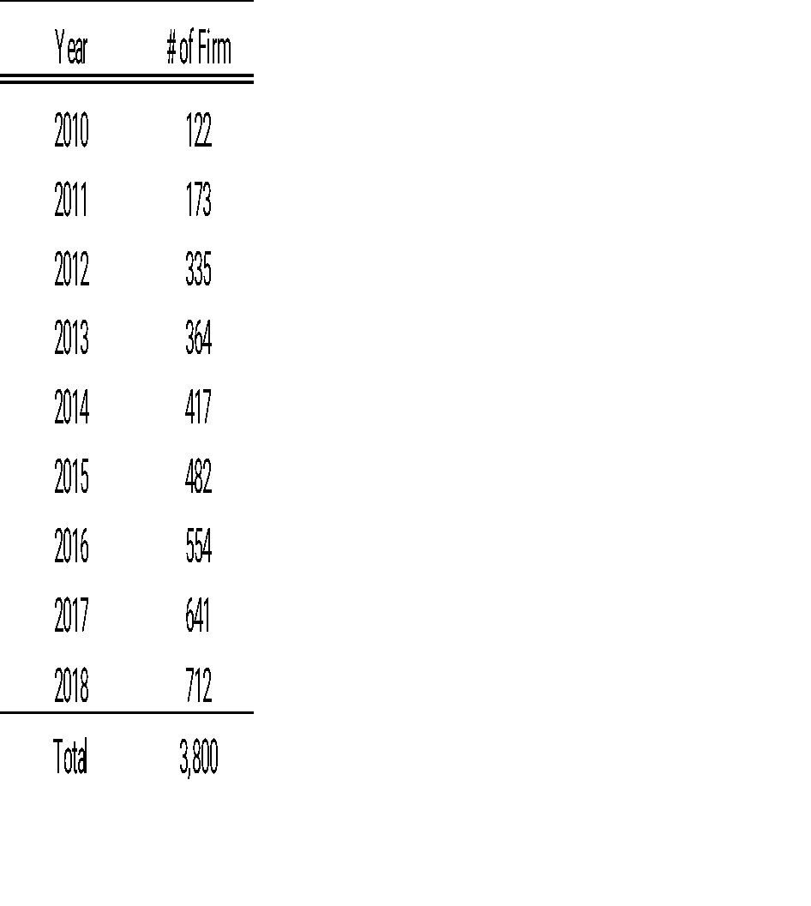
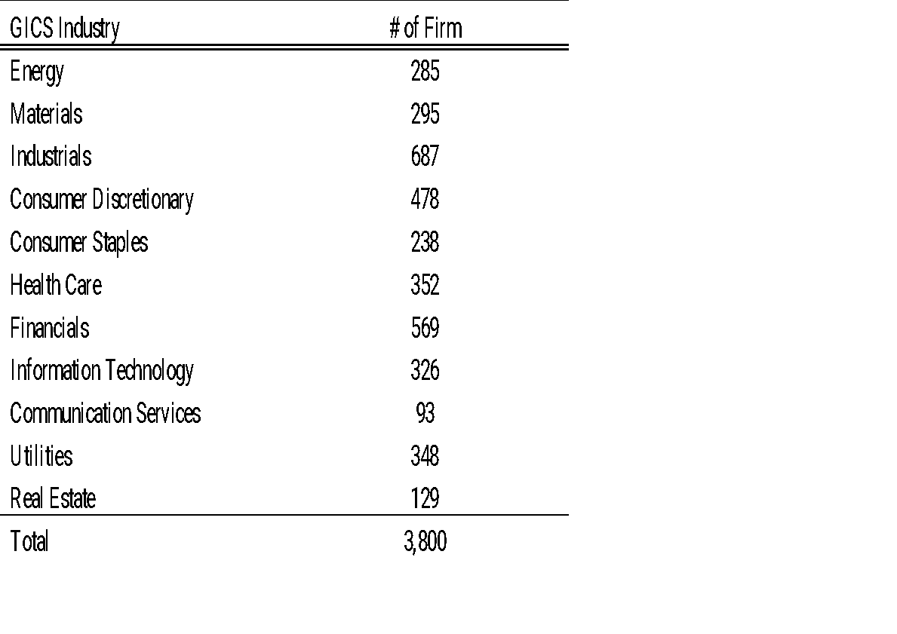
Sample Development
Roughly 4000 firm- years across 9 years

Slide 16
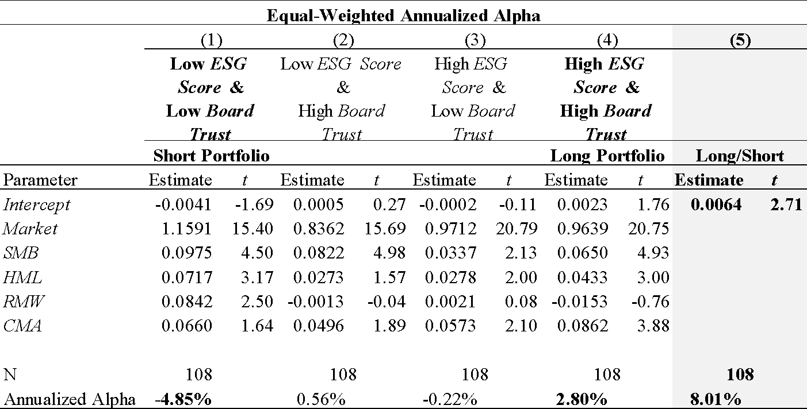
Role of Perceived Trust in ESG
Trust and ESG are both needed to generate the most shareholder value

Slide 17
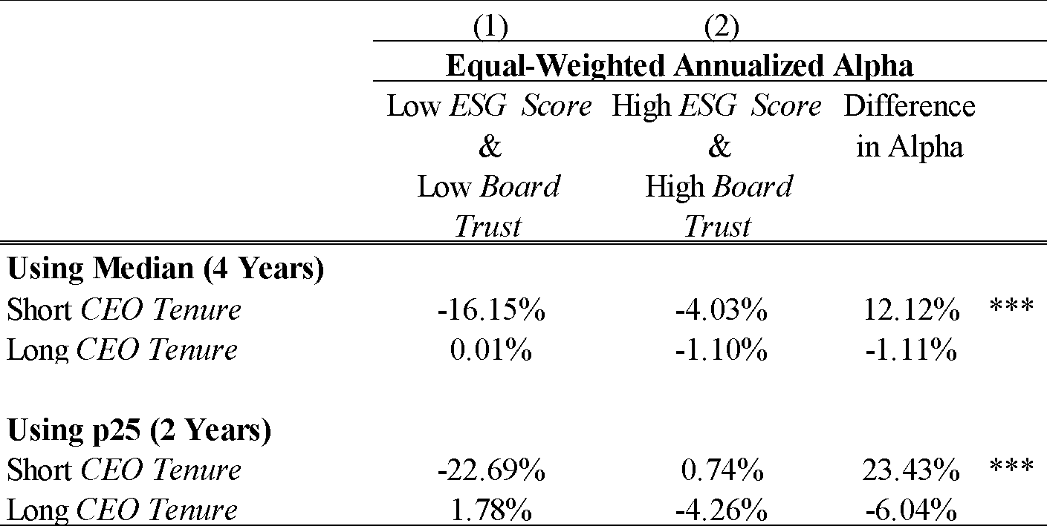
Cross Sectional Tests – By Tenure
Perception of trust forms rather quickly (Engell, Haxby, and Todorov 2007; Oosterhof and Todorov 2008) and the impact of this perception does decrease over time (Peng et al. 2022)

Slide 18
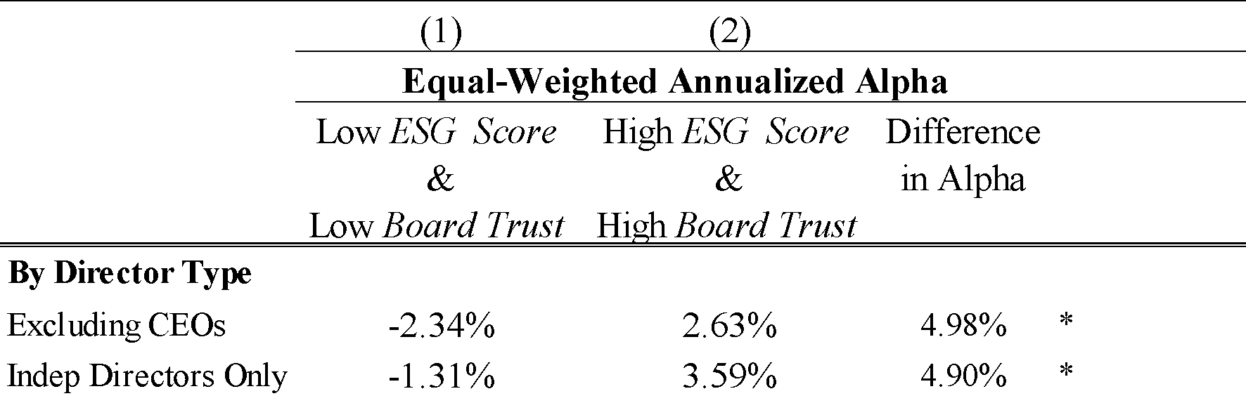
Cross Sectional Tests – By Director Type
Not driven by the CEO’s facial trustworthiness
Not driven by the Inside directors’ facial trustworthiness
  Inside directors are likely to already have a closer working relationship with the management, and the perception of trust may be less important.

Slide 19
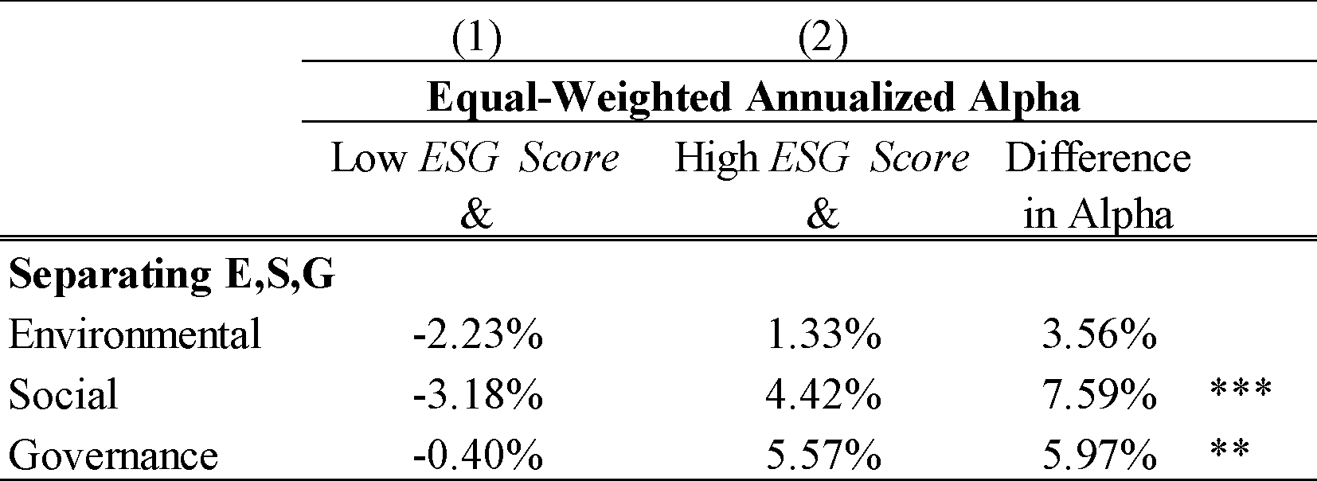
Cross Sectional Tests – By ESG
Good G and S are associated with better firm value
Role of directors are more crucial for those investments that are hard to quantify and nascent

Slide 20
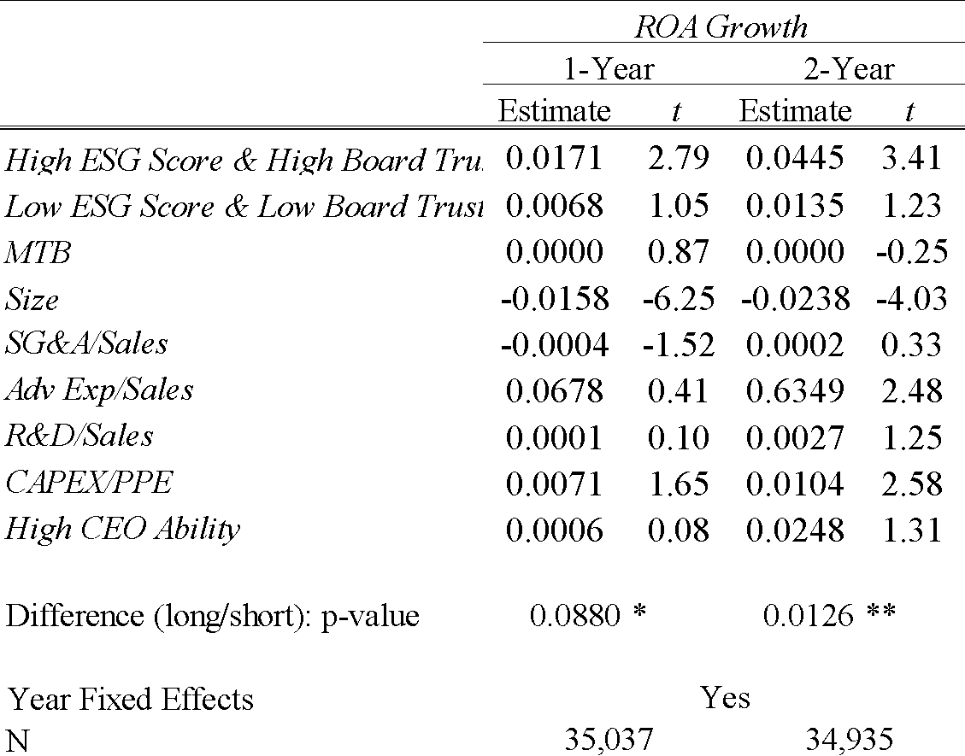
Accounting Performance- ROA Growth
Similar results using Sales Growth

Slide 21
Robustness
Alternative factor model benchmarks (ff 3-factor, 4-factor)
Value-weighted and equal weighted portfolios
Alternative portfolio breakpoints (terciles and quintiles)
Fama-MacBeth Regressions
…

Slide 22
Conclusion
ESG may create future shareholder value when managers and employees trust the board.
ESG investments are subject to high information asymmetry, harder to quantify, and often face much uncertainty. Trust motivates agents to take risks.
A more trusting environment can curb agency problems
Managers may be more open to sharing information and receiving guidance from trustworthy directors

Slide 23
Thanks

