Slide 1

Vertical pay disparity, cultural traditionality, and employee productivity: the China experience
Yu Flora Kuang
Bo Qin
Xing Yang
The University of Melbourne
Notes:
show the title

Slide 2
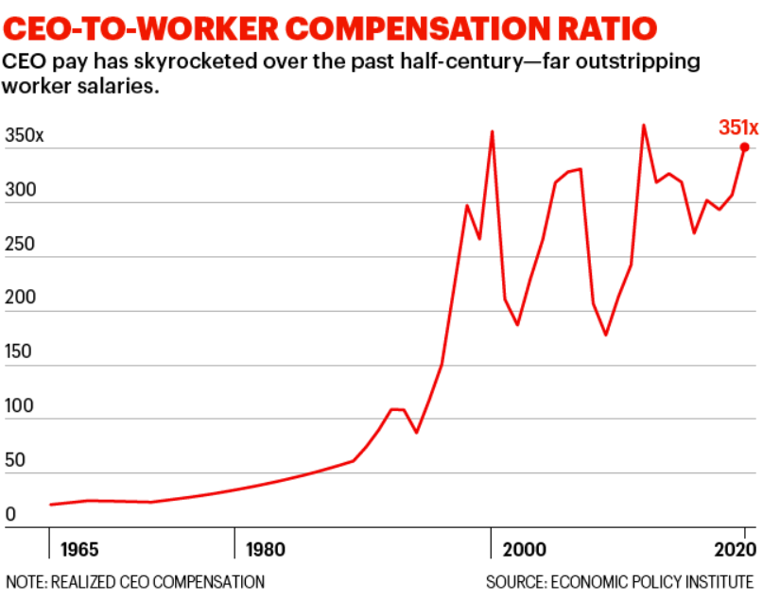
Research Motivation
Fortune 500 CEOs and their employees

Slide 3
Research Motivation
Executives and employees pay disparity
Firm performance
Employees’ perception of pay disparity
Equity theory
Large pay disparity may cause resentment, sabotage, and lack of team potency. It may also reflect agency problem.
Shaw (2015)
Akerlof and Yellen (1990)
Bebchuk et al. (2011)
Duffy et al. (2012)
Tournament theory
Large pay disparity can reward the talent of managers and thus inspire greater employee efforts for promotion.
Lawler (1971)
Lazear and Rosen (1981)
Rosen (1986)
Mueller et al. (2017)

Slide 4
Informal Institutions (Culture)
Employee perception is influenced by informal institutions (Hayes et al. 2018; Xie et al. 2015)
Culture defines what is right and wrong (Leventhal et al. 1980) and shape the general mindset (Lai et al. 2020)
Culture explains homogeneity among individuals in their beliefs and behaviors (Dequech 2003; Scott 2001)
Culture further affects economic activities, e.g. investors’ asset valuations (Chan et al. 2005), trading behavior (Chui et al. 2010), and managers’ decision making (Lai et al. 2020).

Slide 5
Informal Institutions (Culture)
Hofstede (1980) describes culture from four dimensions: power distance, uncertainty avoidance, individualism-collectivism, and masculinity-femininity.
Power distance reflects a society’s tolerance for unequal power distribution and shapes employees’ perceptions of pay fairness (Akerlof and Yellen 1990).
Masculinity emphasizes ambition and wealth acquisition, which is highly relevant to the promotion in workplace and the achievement of high compensation.

Slide 6

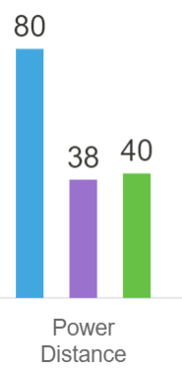
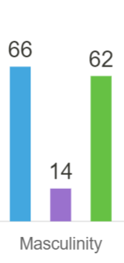
China vs. Other Countries
China: High power distance and masculinity
- Hierarchies and competitiveness are well-established norms. Pay disparity may maintain orders and promote effective competition and talent selection – greater employee efforts

Slide 7
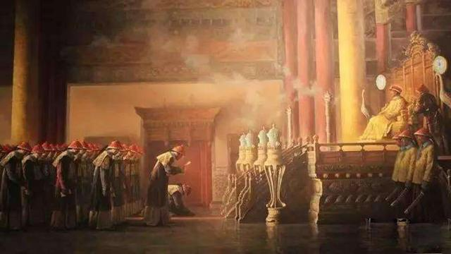
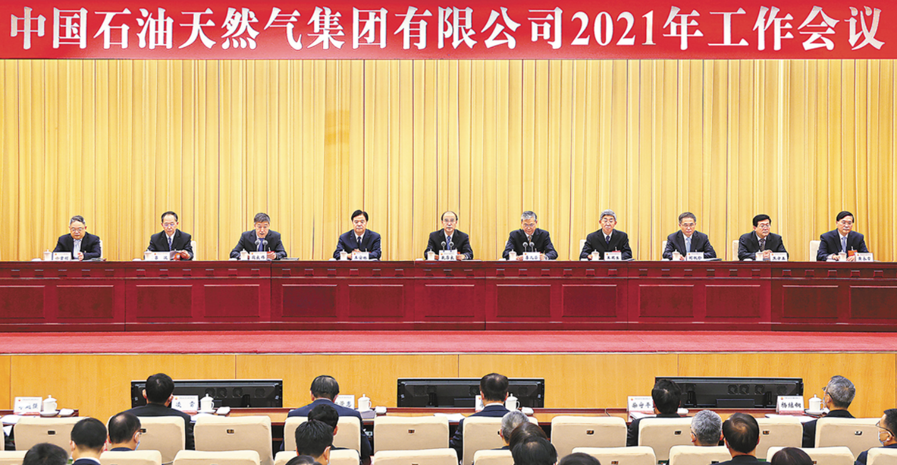
China: High Power Distance
300 years ago
The 21st century

Slide 8
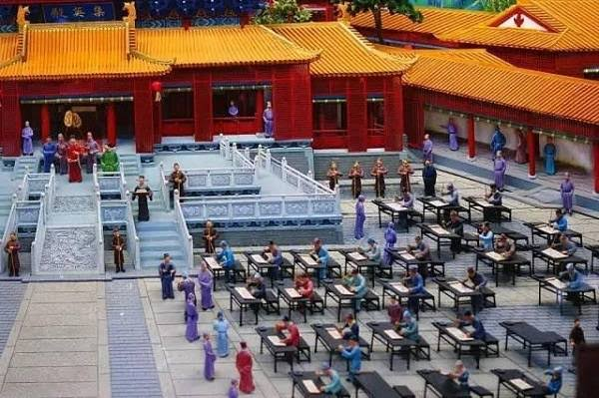
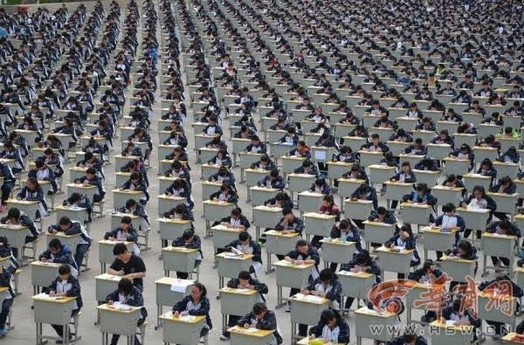
China: High Masculinity
1,000 years ago
The 21st century

Slide 9
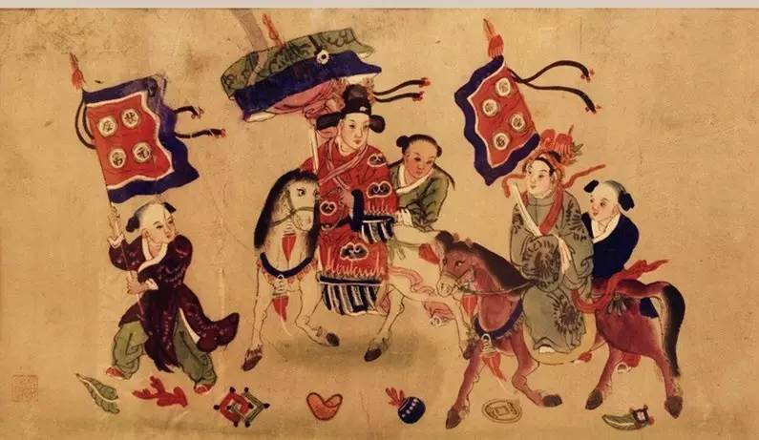
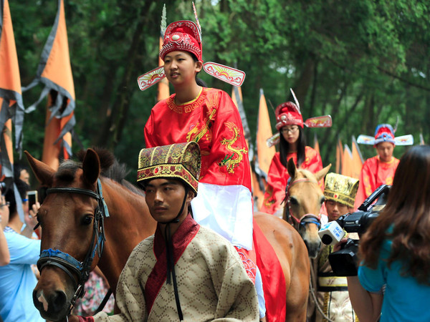
China: High Masculinity
1,000 years ago
The 21st century

Slide 10
China Setting
Inequality
Costs
Pay Disparity
Benefits
High Effort
High Effort
Costs
Pay Disparity
Benefits
Inequality
High power distance
High masculinity

Slide 11
Hypothesis
China: high power distance and high masculinity – competition, efforts, and high rewards
Chinese firms tend to provide more pay incentive than US firms, possibly due to the greater power distance in China (Merchant et al., 2011).
Chinese employees prefer more unequal distribution of rewards than US employees (Chen, 1995)
With a high degree of power distance and masculinity, employees in China may believe that pay disparity is essential for maintaining power distance and selecting talents.
H1: There is positive association between pay disparity and employee productivity in China
H2: The positive association between pay disparity and employee productivity is more pronounced when culture traditionality is stronger

Slide 12
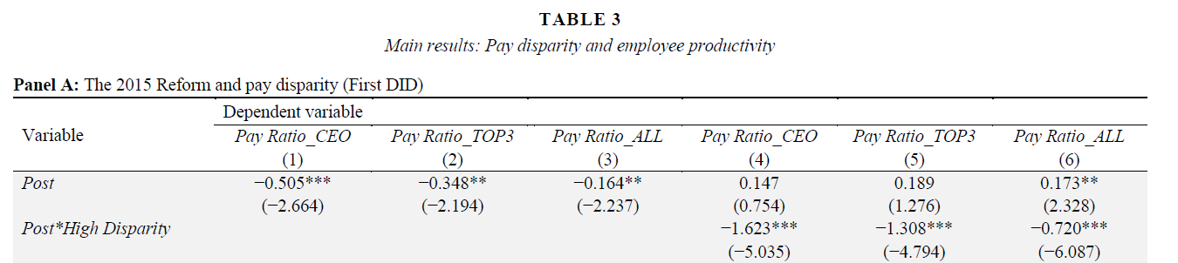
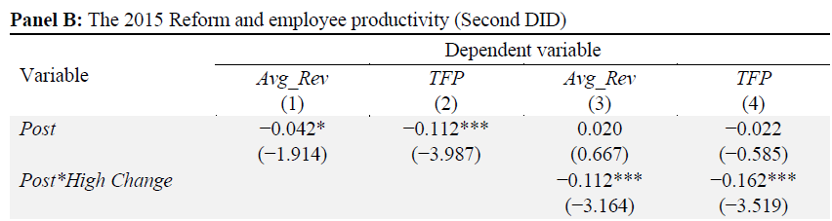
Main Results (H1)
H1: a two-step DID design following (Bakke et al. 2016), using the 2015 pay-cut policy as an event.

Slide 13
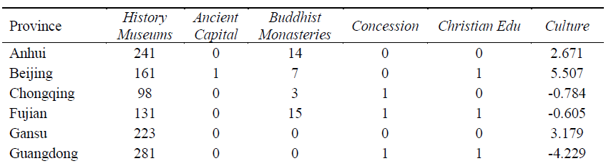
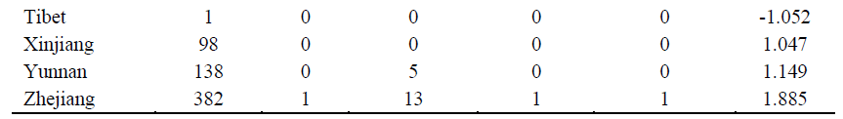
Degree of Culture Traditionality
Regional culture traditionality in China
…

Slide 14
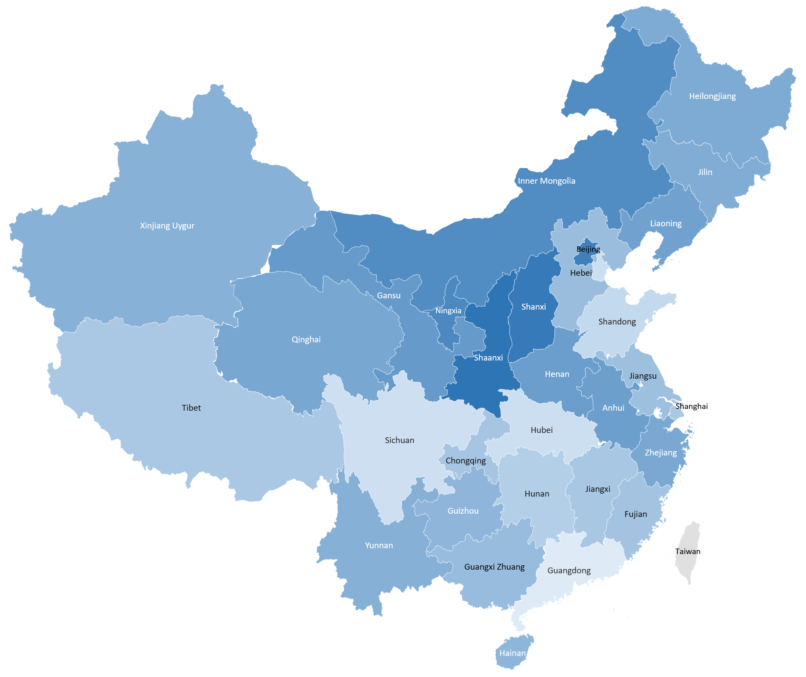
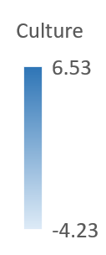
Degree of Culture Traditionality
Regional culture traditionality in China

Slide 15
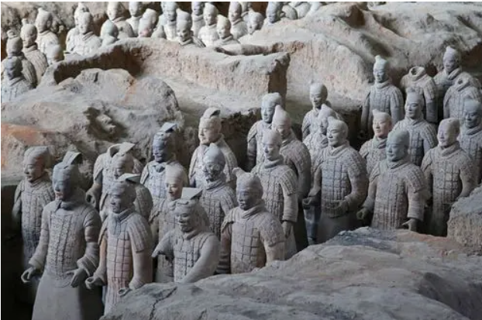
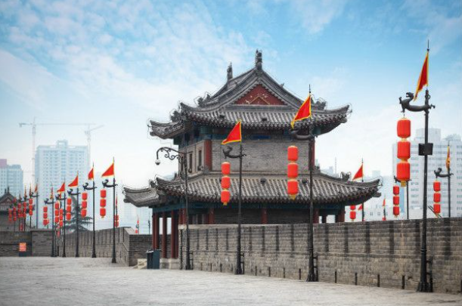
Degree of Culture Traditionality
Shaanxi province has the highest level of culture traditionality (6.533)

Slide 16
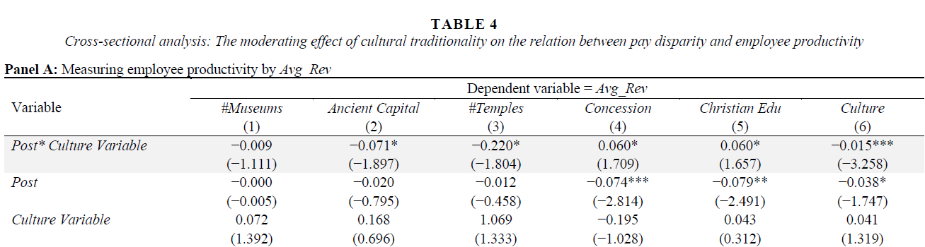
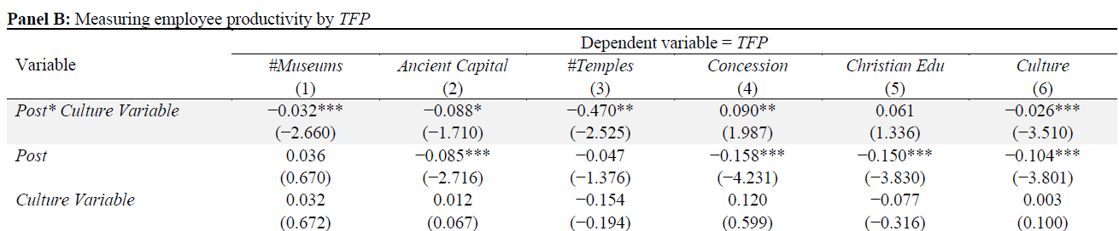
Main Results(H2)
H2: Moderating effect of culture traditionality

Slide 17
Key Takeaways
Main findings
a. Reduction in pay disparity is associated with reduced employee productivity
b. Employees’ productivity decreases more when cultural traditionality is higher
Contribution
a. To the studies on pay disparity and firm performance
b. To the literature of informal institution and corporate governance
Practical implication
Culture factors should be considered when restricting executives’ compensation

Slide 18
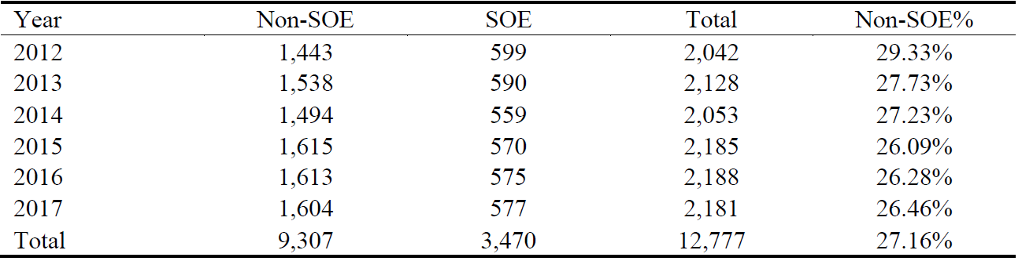
Sample Selection
A quasi-natural experiment – the 2015 pay-cut reform in China

Slide 19
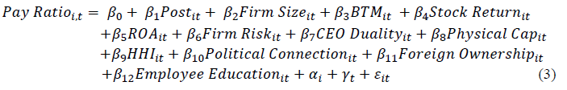
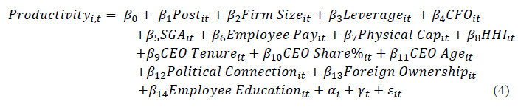
Research Design (H1)
A quasi-natural experiment – the 2015 pay-cut reform in China
H1: a two-step DID design following (Bakke et al. 2016)

Slide 20
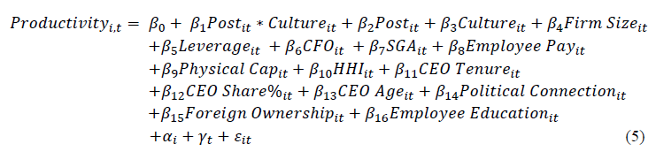
Research Design (H2)
A quasi-natural experiment – the 2015 pay-cut reform in China
“Downward adjust” executive compensation for State-owned firms to achieve a “reasonable” income distribution between firm managers and employees.
H2: Moderating effect of culture traditionality

Slide 21


