Slide 1



LEARNING OUTCOMES
Learning Intention
Students will investigate how the design of a wind turbine affects its ability to transform wind energy into motion and power.
They will explore how simple machines change the direction and magnitude of forces, and how these design choices influence efficiency and performance.
Success Criteria
Build and test a simple wind turbine model
Identify the energy transformations involved in generating power
Explain how blade design changes affect efficiency and power output
Describe how turbine design relates to sustainable energy solutions
Notes:
Optional to show to students

Slide 2
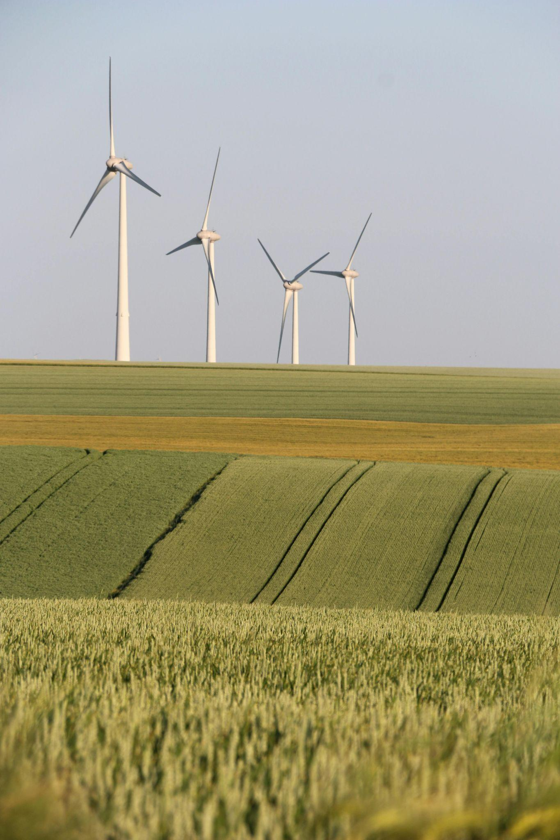

TURBINE TOURNAMENT:
Investigating energy transformations and efficiency with wind turbines
Year 7/8 Science
Notes:
USE THESE SLIDES ALONGSIDE THE LESSON PLAN

Slide 3



v
WHAT IS A
WIND TURBINE?
Learning introduction
Notes:
SPEAKER NOTES:
A wind turbine is a machine that captures energy from moving air and turns it into electricity
What they look like – Tall towers with large blades that spin when the wind blows – often found on hills, rural farmlands, coastlines, offshore, or wind farms.
Their purpose – To convert wind energy into electricity, providing a clean and renewable source of power.

Slide 4
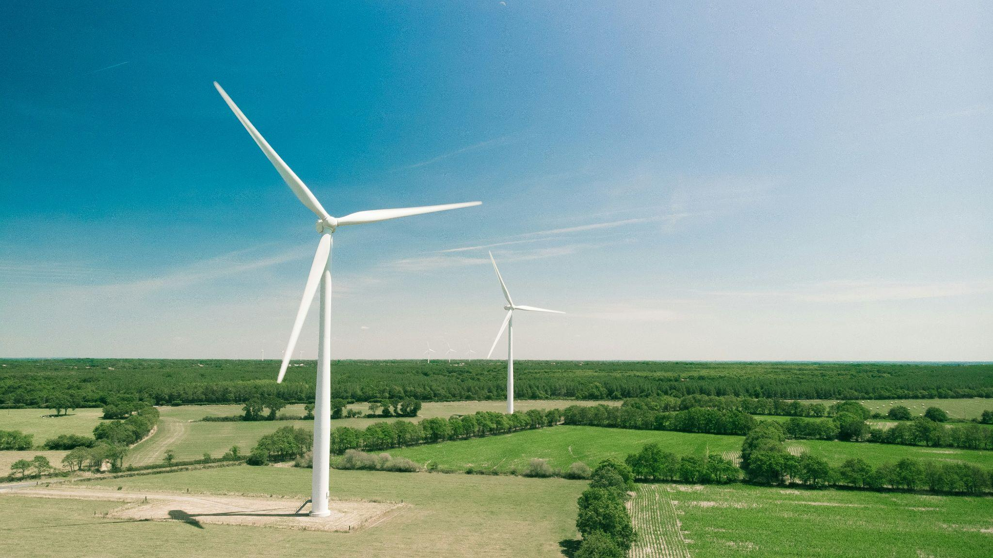
v
WHAT IS A
WIND TURBINE?
A machine that turns moving air (wind) into electricity
It works like a fan but in reverse – instead of using electricity to make wind, it uses wind to
make electricity
Learning introduction
Notes:
SPEAKER NOTES:
A wind turbine is a machine that captures energy from moving air and turns it into electricity
What they look like – Tall towers with large blades that spin when the wind blows – often found on hills, rural farmlands, coastlines, offshore, or wind farms.
Their purpose – To convert wind energy into electricity, providing a clean and renewable source of power.

Slide 5
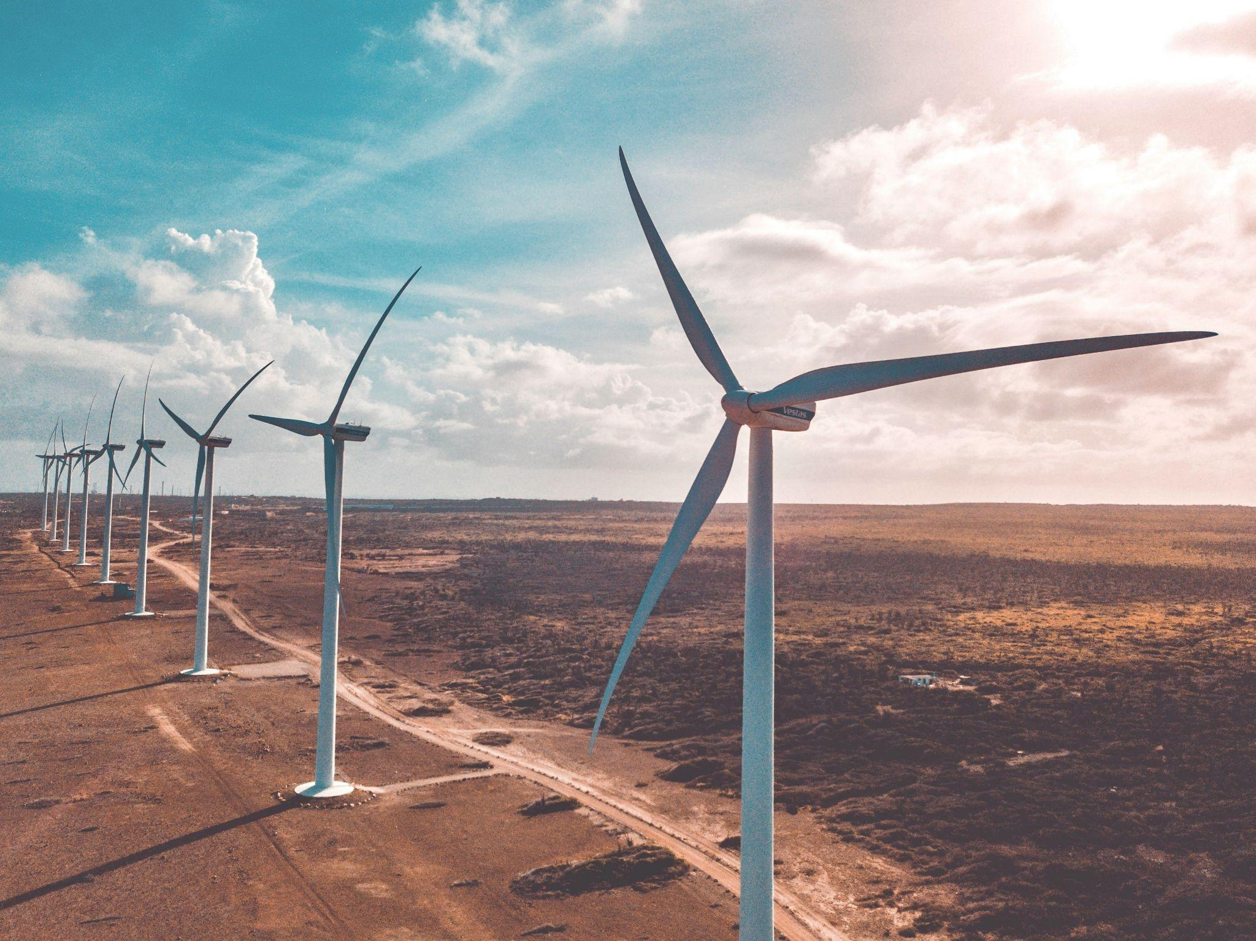
v
WHY ARE THEY CONSIDERED A RENEWABLE ENERGY SOURCE?
Learning introduction
Notes:
SPEAKER NOTES:
(Next slide answers)
Because wind…
Comes from the Sun
The sun heats the Earth unevenly, making air move – that movement is wind
Never runs out
As long as the sun shines, there will always be wind
Is clean and sustainable
Wind energy produces no pollution/CO2 emissions and helps limit climate change

Slide 6
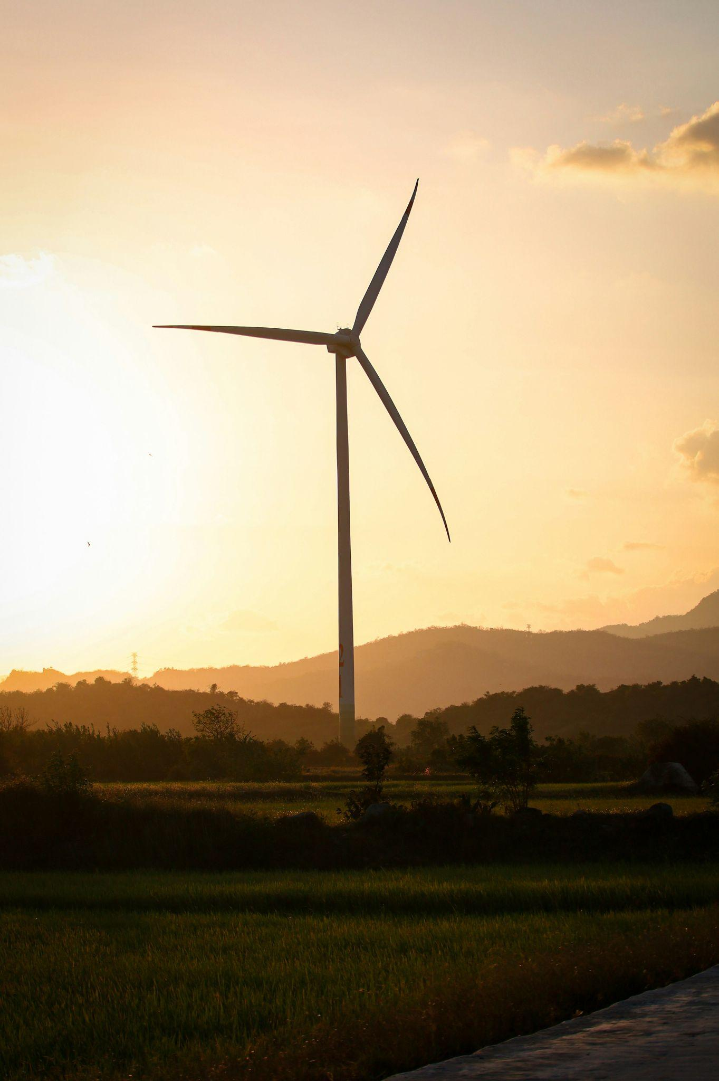
v
BECAUSE WIND:
Comes from the sun
The sun heats the Earth unevenly, making air move — that movement is wind
Never runs out
As long as the sun shines, there will always be wind
Is clean and sustainable
Wind energy produces no pollution and helps limit climate change
Learning introduction
Notes:
ALL CONTENT ON SLIDE

Slide 7
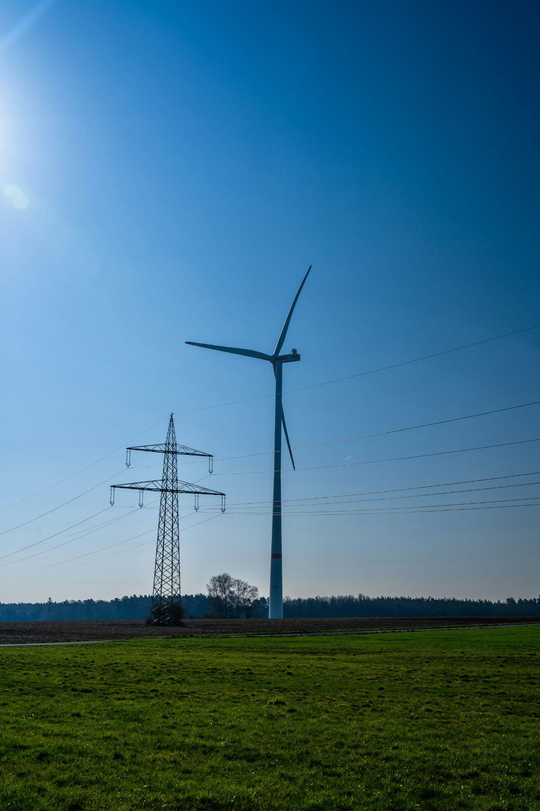
v
HOW DO THEY
GENERATE ELECTRICITY?
Learning introduction
Notes:
SPEAKER NOTES:
Class prompts to explore ideas before learning the answer
“What kind of energy does the wind have?” (Kinetic energy)
“What mechanics are inside the turbine to generate electrical energy?”
Answer
The wind blows and pushes the blades, causing them to spin.
This motion transfers kinetic energy to the shaft, turning it into rotational kinetic energy.
The shaft spins a magnet inside a coil of wire, which induces an electric current – transforming that movement into electrical energy.
The electricity then flows down the tower to a transformer, where the voltage is increased so it can travel efficiently through power lines to homes and businesses.

Slide 8
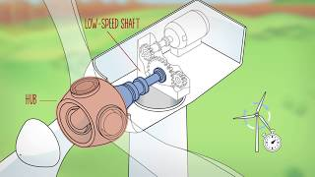
VIDEO: HOW DOES A WIND TURBINE WORK?
v
Notes:
VIDEO (2:46 mins) – How does a wind turbine work?
Answer
The wind blows and pushes the blades, causing them to spin.
This motion transfers kinetic energy to the shaft, turning it into rotational kinetic energy.
The shaft spins a magnet inside a coil of wire, which induces an electric current – transforming that movement into electrical energy.
The electricity then flows down the tower to a transformer, where the voltage is increased so it can travel efficiently through power lines to homes and businesses.

Slide 9

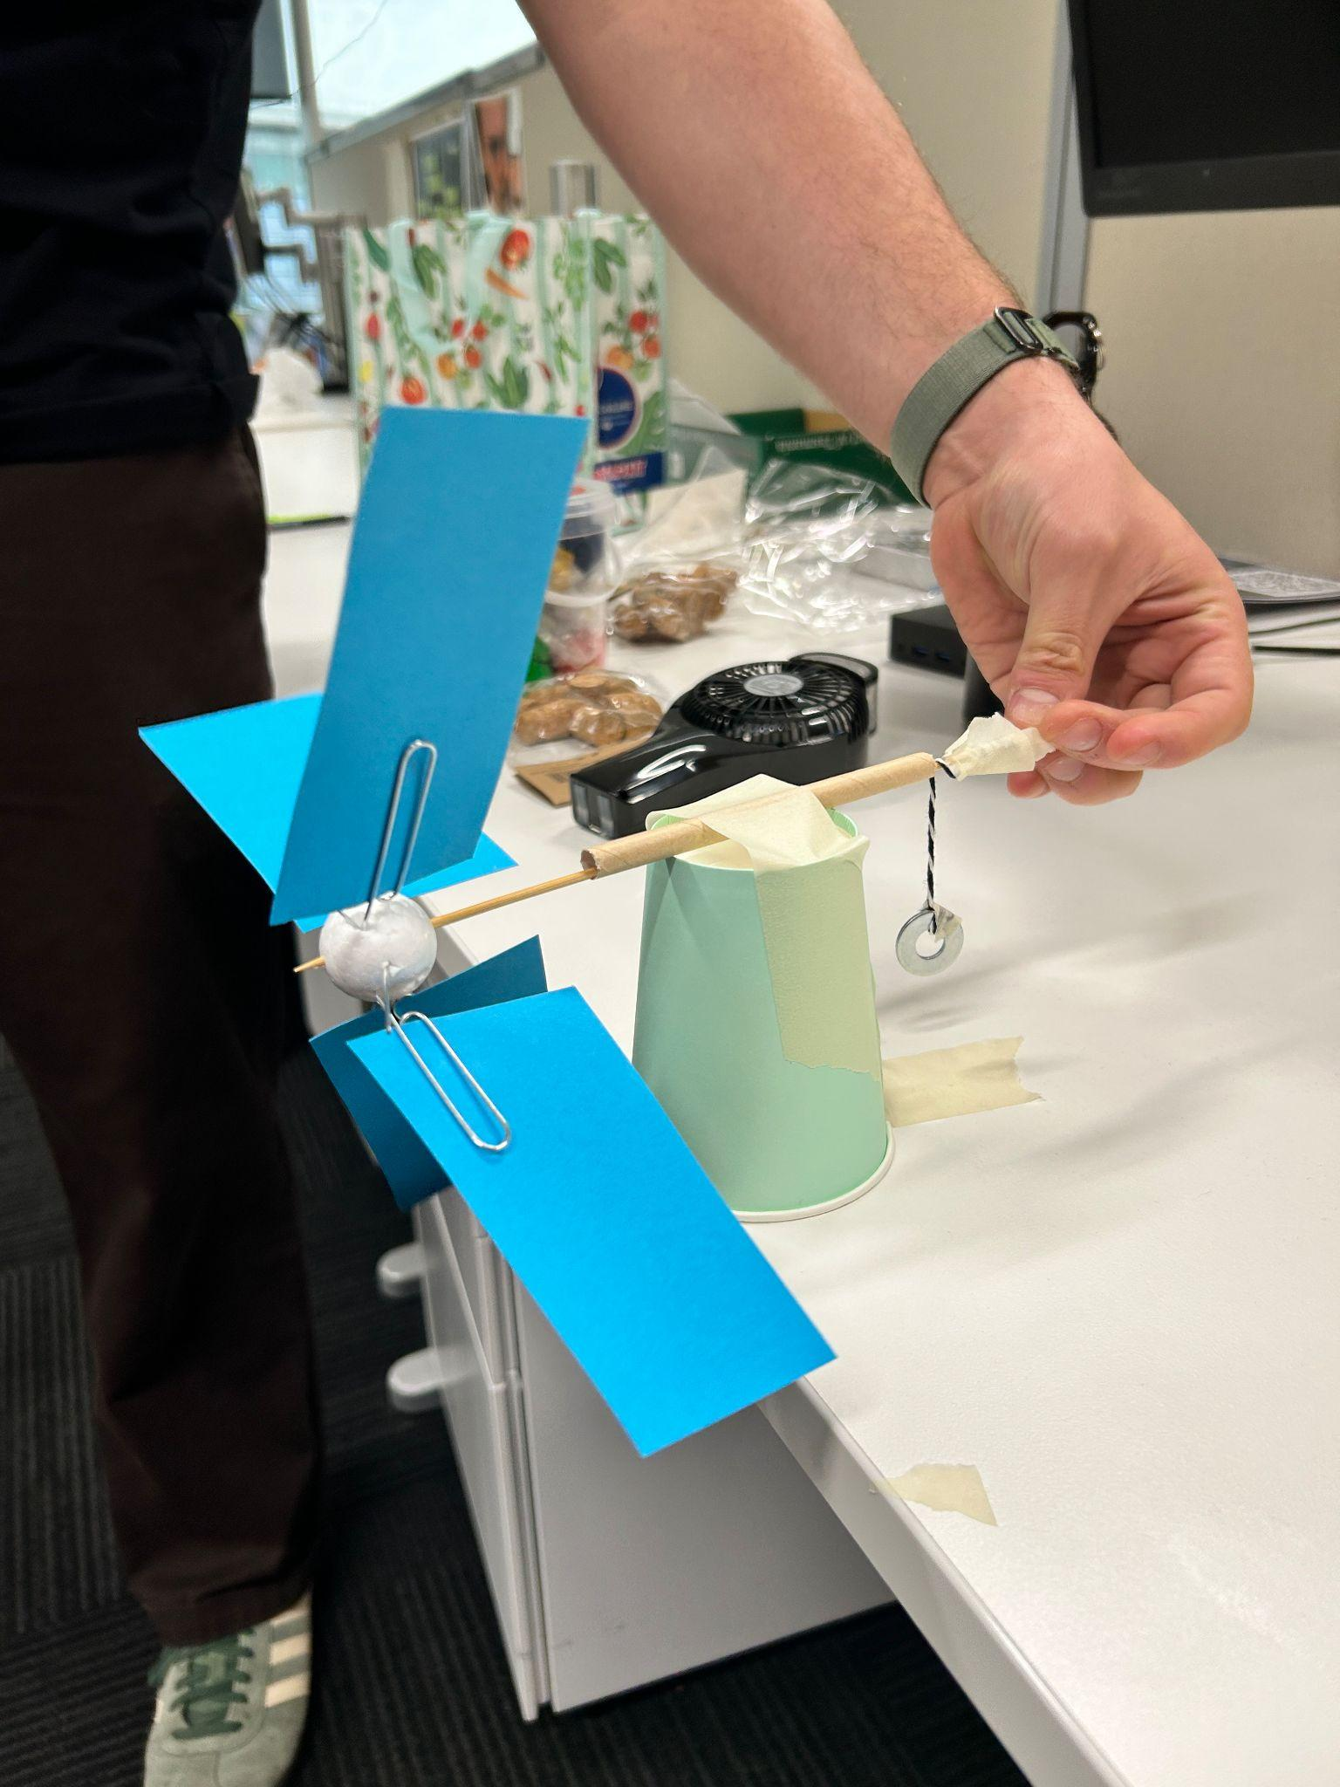
ACTIVITY:
TURBINE TOURNAMENT
From blade shape to spin speed –
design matters when it comes to power
In groups, you will:
Build a basic turbine model and test how fast it can lift a washer
Experiment with at least 2 different blade designs to see how they affect power and efficiency
v
Activity instructions
Notes:
REFER TO LESSON PLAN + ACCOMPANYING DIAGRAM SHEET FOR FULL INSTRUCTIONS

Slide 10
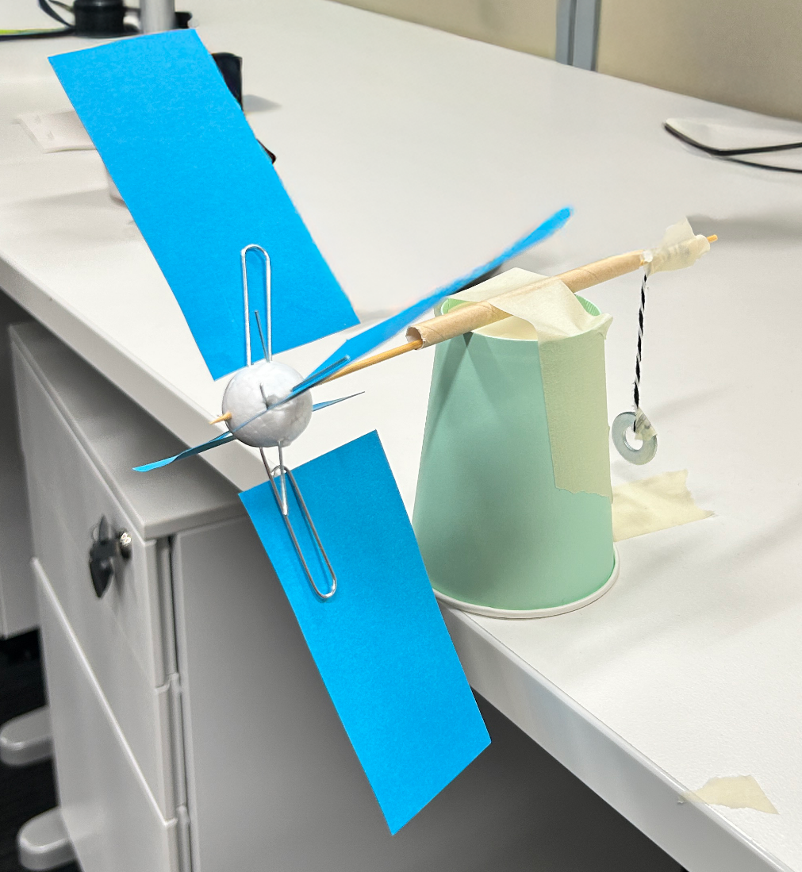
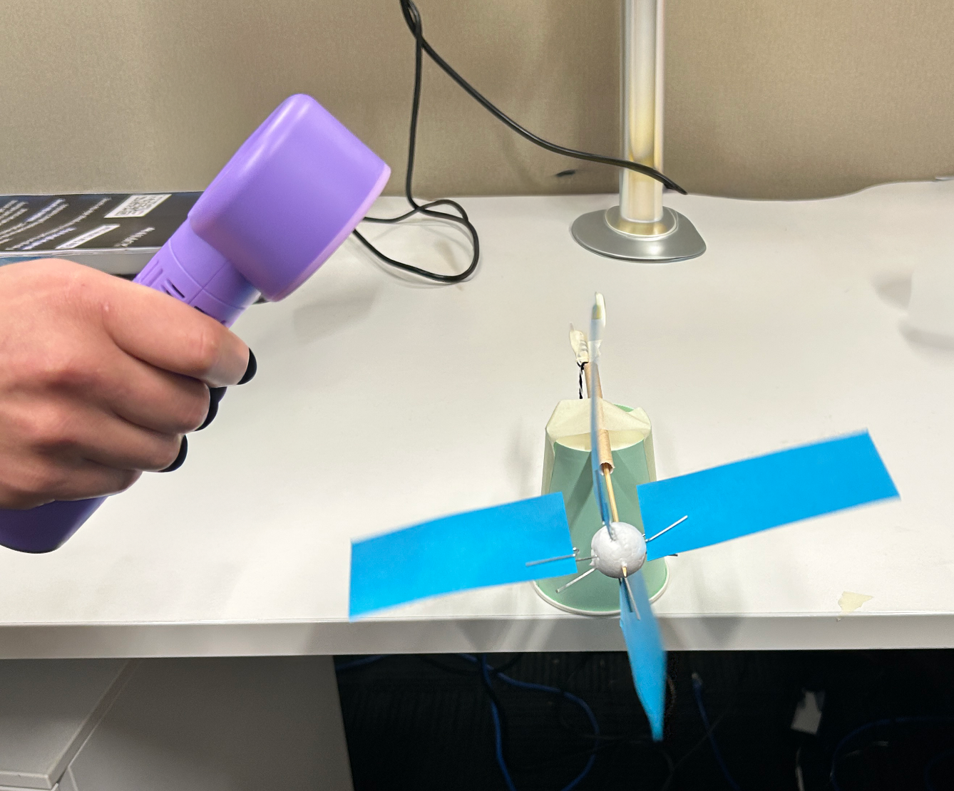
TEST MODEL SET-UP
v
Notes:
REFER TO LESSON PLAN + ACCOMPANYING DIAGRAM SHEET FOR FULL INSTRUCTIONS

Slide 11
v
EXPERIMENT INSTRUCTIONS:
Measure how far the washer hangs below the skewer
Turn on the fan to spin the turbine
Time how long it takes for the washer to wind up to the skewer
Record the results
Experiment with at least 2 other blade designs (size, angle, number) and re conduct the test (only alter one variable at a time so you know what made the change though!)
v
Activity instructions
Notes:
REFER TO LESSON PLAN + ACCOMPANYING DIAGRAM SHEET FOR FULL INSTRUCTIONS

Slide 12
POWER CALCULATION
v
To calculate power we need three things to plug into our equations
W = weight of the washer in grams (3g)
H = length of the string holding the washer in centimeters
S = time it take for the washer to reach the top in seconds
v
Activity
Notes:
REFER TO LESSON PLAN + ACCOMPANYING DIAGRAM SHEET FOR FULL INSTRUCTIONS

Slide 13
Step 1: Convert units
v
For our equations to work we need to have them in standard units:
Mass (M) = kilograms
Length (L) = meters
Time (T) = seconds
Converting from our original units:
M = w/1000
L = H/100
T = S
v
Activity
Notes:
REFER TO LESSON PLAN + ACCOMPANYING DIAGRAM SHEET FOR FULL INSTRUCTIONS

Slide 14
Step 2: Potential energy
v
After being raised, the washer has gained gravitational potential energy
We can calculate it using:
E_potential = M * g * L
Where g is the acceleration due to gravity (9.8 m/s/s)
v
Activity
Notes:
REFER TO LESSON PLAN + ACCOMPANYING DIAGRAM SHEET FOR FULL INSTRUCTIONS

Slide 15
Step 3: Power
v
Power is energy delivered over time
We can calculate the average power (in watts) by dividing the total energy by how long it took:
P = E_potential / T
v
Activity
Notes:
REFER TO LESSON PLAN + ACCOMPANYING DIAGRAM SHEET FOR FULL INSTRUCTIONS

Slide 16
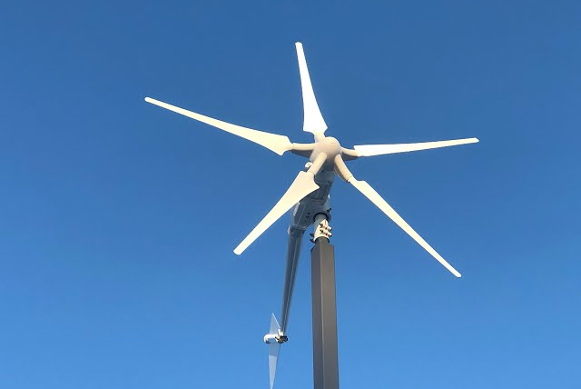
BLADE DESIGN
FINDINGS:
v
NUMBER
Learning discussion
Notes:
SPEAKER NOTES:
Ask class for their findings before moving to the next slide
Prompts –
Did more blades make it spin faster or slower?
How did blade number change the power or efficiency?
Was there an optimum number of blades?

Slide 17
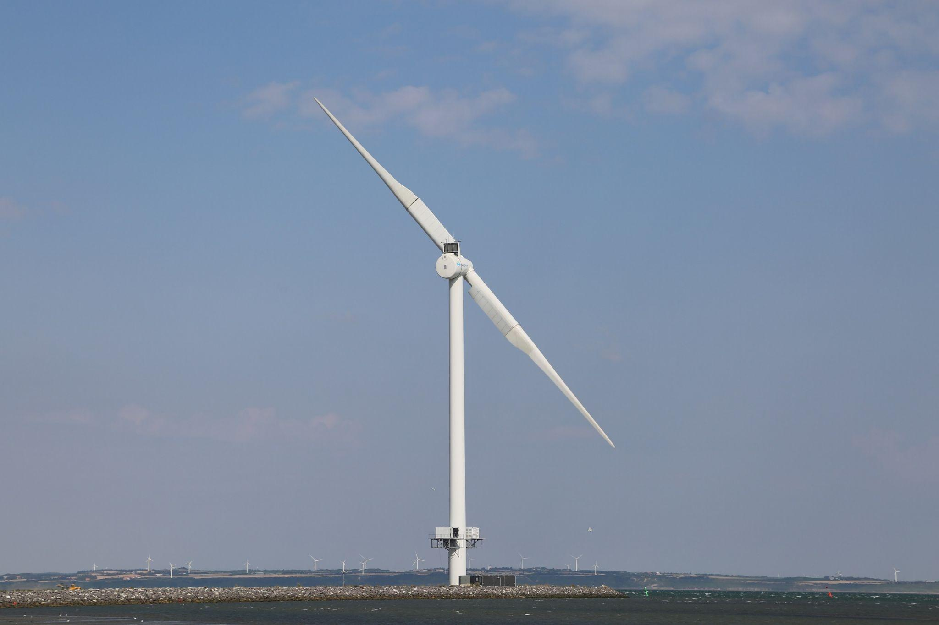
v
NUMBER
OF BLADES
Most turbines have three blades
This gives the best balance of efficiency, stability, and cost
Two blades spin faster but are noisier and wear out more quickly
Four to six blades are heavier, more expensive, and don’t produce much
more power
Learning discussion
Notes:
ALL CONTENT ON SLIDE

Slide 18
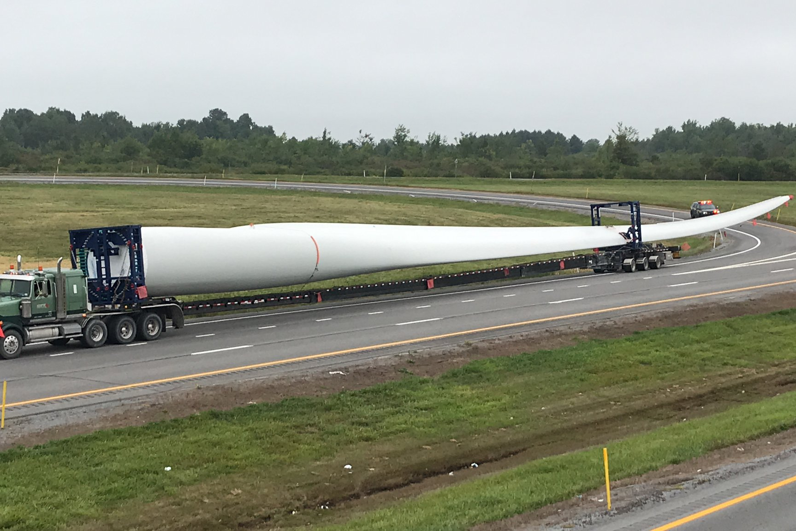
BLADE DESIGN
FINDINGS:
v
NUMBER
SIZE
Learning discussion
Notes:
SPEAKER NOTES:
Ask class for their findings before moving to the next slide
Prompts –
Did larger blades make it spin faster or slower?
How did blade size change the power or efficiency?
Was there an optimum blade size?

Slide 19
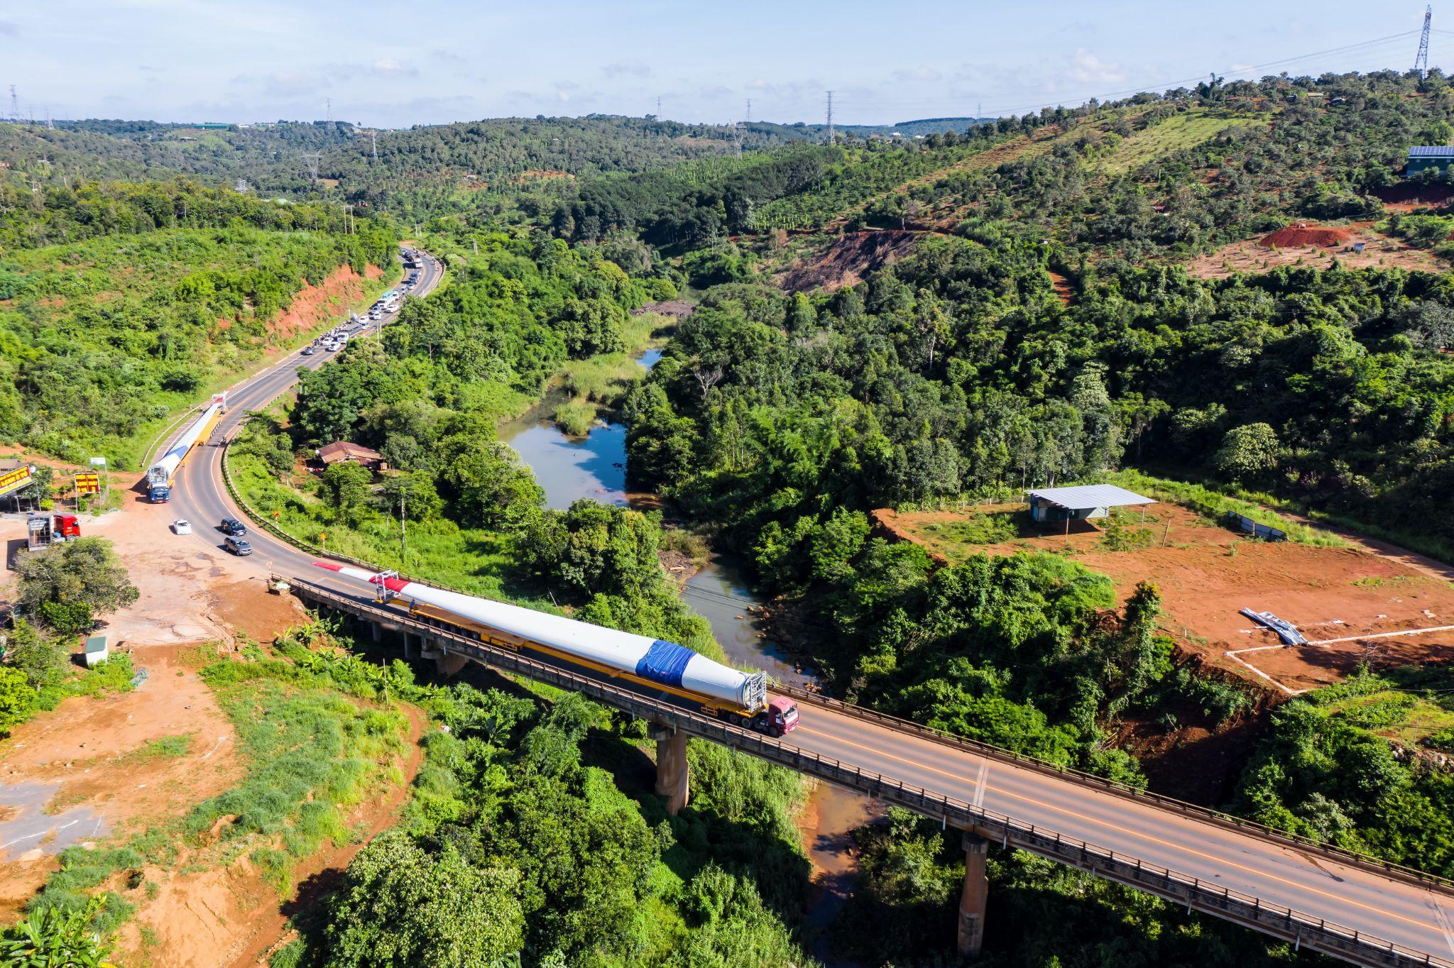
v
SIZE
OF BLADES
Bigger blades catch more wind and produce more power
However, bigger blades are heavier, need stronger towers, and cost more to build and transport
Wind farms choose the largest blades that are practical for their location
Learning discussion
Notes:
ALL CONTENT ON SLIDE

Slide 20
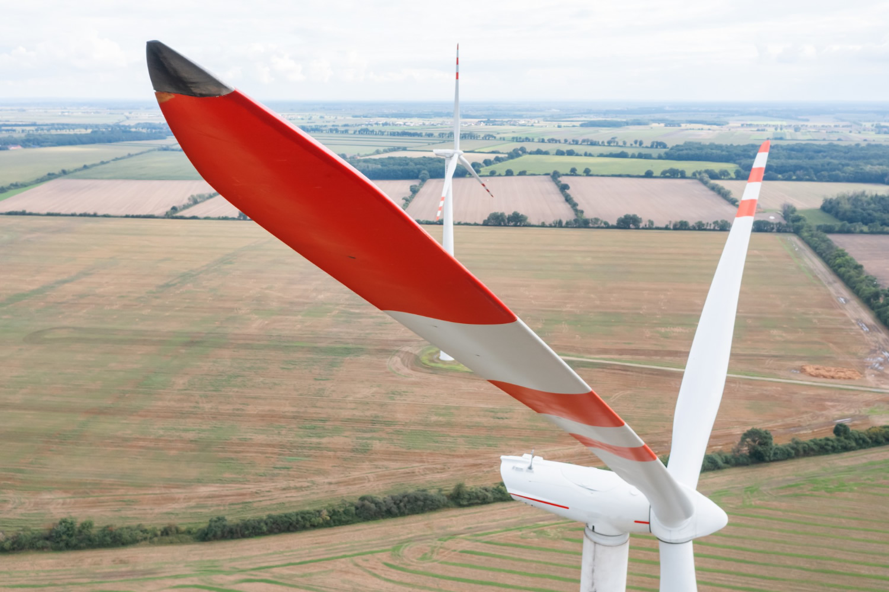
BLADE DESIGN
FINDINGS:
v
NUMBER
SIZE
ANGLE (PITCH)
Learning discussion
Notes:
SPEAKER NOTES:
Ask class for their findings before moving to the next slide
Prompts –
Did changing the blade angle make it spin faster or slower?
How did blade angle affect power or efficiency?
Was there an optimum blade angle?

Slide 21
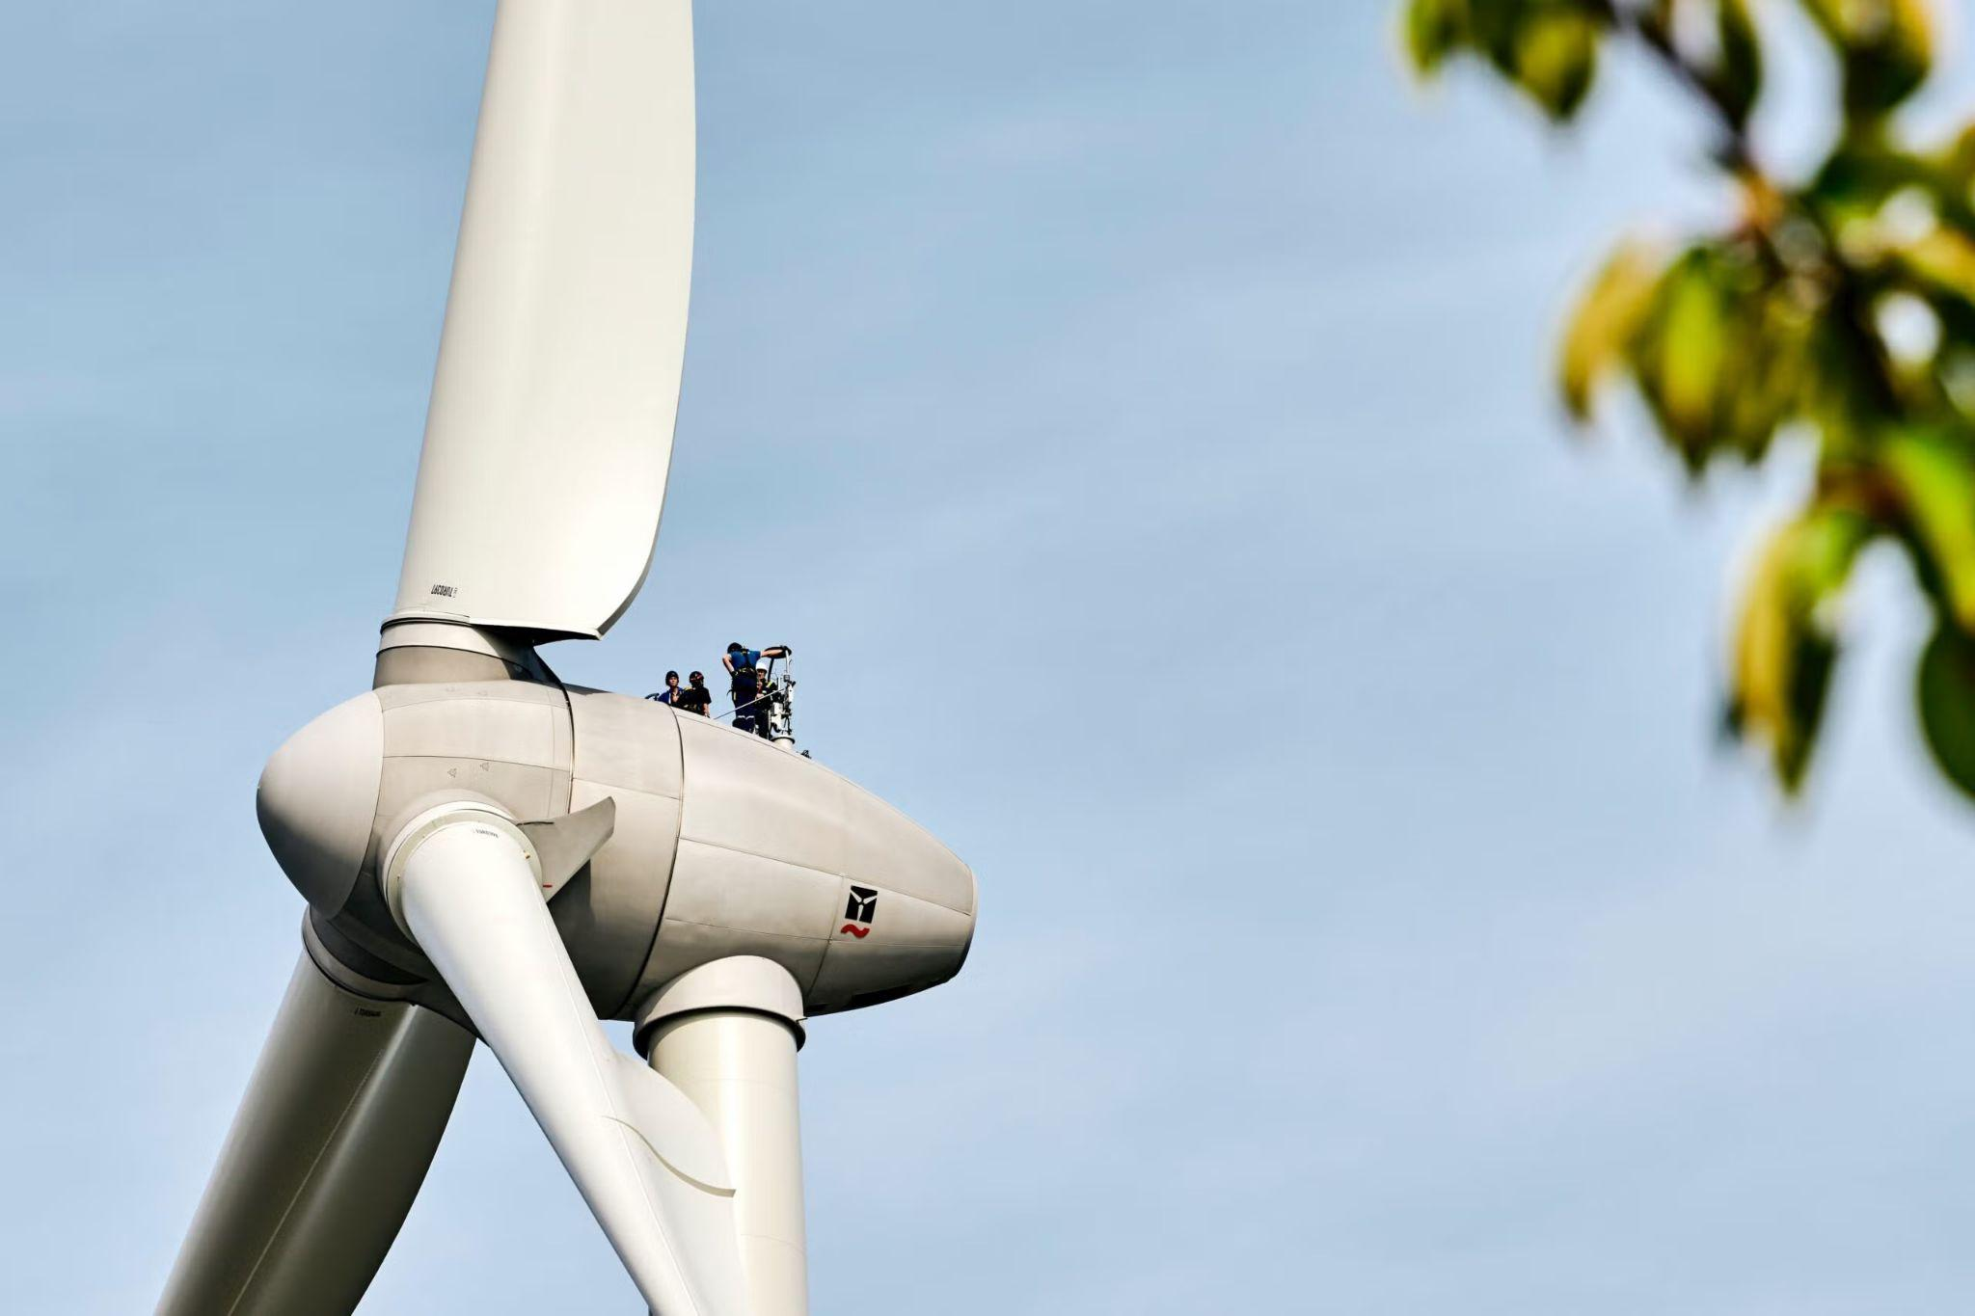
v
ANGLE (PITCH)
OF BLADES
The angle controls how much wind the blade catches
If the blades are too flat, they produce
less power
If they are too steep, there is too much
drag and the blades slow down
Modern turbines automatically adjust the blade angle to get the best power output
for different wind speeds
Learning discussion
Notes:
ALL CONTENT ON SLIDE
END OF LESSON

Slide 22

STUDENT FEEDBACK
LINK
http://bit.ly/4hV8Bka

