Slide 1



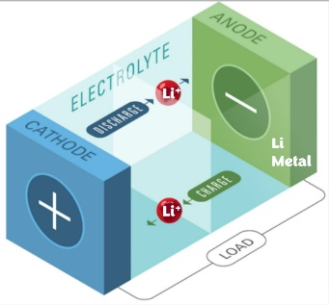

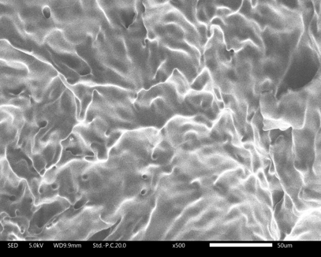
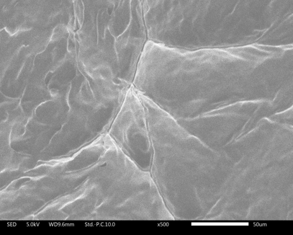
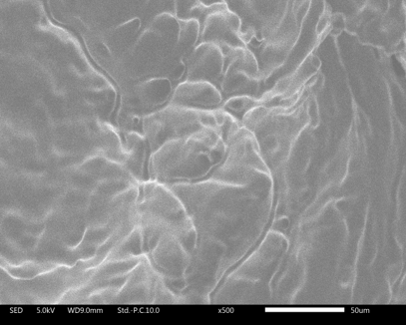
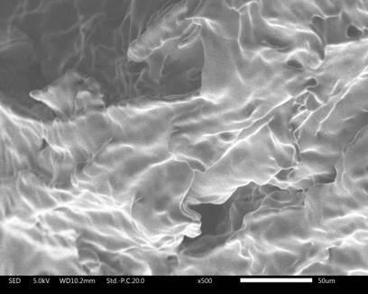
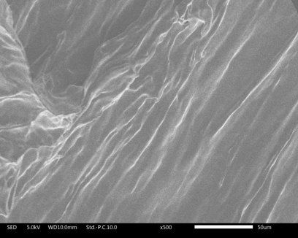
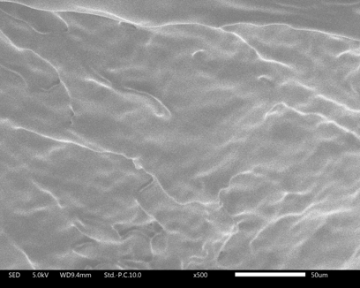

Development of Mixed Organic Ionic Plastic Crystal Electrolytes for Energy Storage
Shanika Abeysooriya,¹ Faezeh Makhlooghi Azad,¹ Luke A. O’Dell,² Jennifer M. Pringle,¹
¹Institute for Frontier Materials (IFM), Deakin University, Burwood Hwy, VIC 3125, Australia.
²Institute for Frontier Materials (IFM), Deakin University, Geelong, VIC 3220, Australia.
sabeysooriya@deakin.edu.au
Understanding the effect of combining OIPCs with two different cations has on the physicochemical and electrochemical properties and their potential use as solid-state electrolyte materials.
Research Aim
Synthetic Methodology
Introduction
OIPCs (Organic Ionic Plastic Crystals)
Consist completely of cations and anions with a long range ordered crystalline lattice with short range disorder that occurs through rotational motions of molecules.^{1,2}
Beneficial Features:
Good ionic conductivity
Negligible volatility
Goal:
Increase defects/ vacancies to tune physicochemical properties.
[C₂epyr][FSI]
N,N-diethylpyrrolidinium bis(fluorosulfonyl)imide
[C_{(i3)}mpyr][FSI]
N-isopropyl,N-methylpyrrolidinium
bis(fluorosulfonyl)imide
Negligible flammability
Thermally stable
Varying mol % of [C_{(i3)}mpyr][FSI] (5 – 90 mol %) were mixed with [C₂epyr][FSI] to produce OIPC mixtures.
Results
Neat [C₂epyr][FSI]
Neat [C_{(i3)}mpyr][FSI]
10 mol % OIPC mixture
When a small amount of slightly larger [C_{(i3)}mpyr]⁺ is introduced, ionic conductivity increased compared to neat [C₂epyr][FSI].
We assume this is due to increase in defects/ disorder in the OIPC mixture.
Neat [C₂epyr][FSI]
Neat [C_{(i3)}mpyr][FSI]
10 mol % OIPC mixture
Investigation of OIPC Mixtures as Potential Solid-state Electrolytes
Morphology of Neat OIPCs and 10 mol% OIPC mixture
Li-salt added mixtures were quasi-solids at room temperature.
With 10 mol % LiFSI, melting transition decreases and broadens.
Phase behaviour of OIPC mixtures
Transport properties of Li-salt added OIPC mixtures
Ionic conductivity properties of OIPC mixtures
With increasing [C_{(i3)}mpyr][FSI] mol %,
Melting transitions move to higher temperatures. Melting peaks remain sharp.
Solid-solid phase transitions move to lower temperatures.
Presence of solid solutions.
Conclusions
Li-salt added 10 mol % [C_{(i3)}mpyr][FSI] binary mixture displayed slightly higher ionic conductivity than other mixtures.
This correlates with the ionic conductivity trends of the binary OIPC mixtures.
10 mol % [C_{(i3)}mpyr][FSI] added [C₂epyr][FSI] mixture, showed high ionic conductivity compared to neat [C₂epyr][FSI]. This hints to the increase in defects/ disorder when introducing a small of slightly larger cation ([C_{(i3)}mpyr]⁺) to [C₂epyr][FSI] OIPC system.
Li-salt added OIPC mixtures show promising results for potential use as solid-state electrolyte materials.
Phase behaviour of Li-salt added OIPC mixtures
References
R. Yunis, T. W. Newbegin, A. F. Hollenkamp and J. M. Pringle, Mater. Chem. Front., 2018, 2, 1207–1214.
D. Al-Masri, R. Yunis, A. F. Hollenkamp, C. M. Doherty and J. M. Pringle, Phys. Chem. Chem. Phys., 2020, 22, 18102–18113.
ifm.deakin.edu.au

