Slide 1

Jumping on the spectral bandwagon

Slide 2

A bright shiny new toy
At FlowCore we have a new spectral analyser
  – The Cytek Aurora
We want it to be used and pushed by you the FlowCore user group
  Strongly encourage all users to have a go on this instrument
  Not just for large panel users
FlowCore staff are here to help you jump on the spectral analysis bandwagon
Email us at flowcore.enquiries@monash.edu to express your interest or to ask any questions

Slide 3

What FlowCore users say about the Aurora
What’s great…
Easy to use
Software is very friendly for new users. Most options are logically organized and easy to find – even if you don’t use the manual.
Better separation of signal
Like that you can create a reference list for all your antibodies so that you don’t have to do this every time you use the machine
Tip – Take a session to create a reference list of your antibodies – makes subsequent bookings a lot easier and faster

Slide 4

What FlowCore users say about the Aurora
What’s not so great…
Need to have perfect reference controls for the spectral unmixing program to work
Aurora needed more in depth checking of compensation than BD/Beckman instruments
If you are the first user of the day you need to account for a 30-minute warm up period
When acquiring a sample and it reaches the “events to record” it will automatically go to the next sample. May need to go back manually if you haven’t acquired all your cells in a tube.

Slide 5
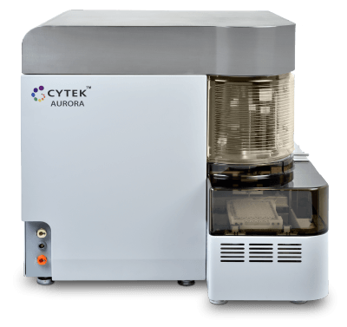
FlowCore Aurora
5 lasers (UV, Violet, Blue, Yellow/Green, Red)
64 detectors
UV | 16 Channels
Violet | 16 Channels
Blue | 14 Channels
Yellow-Green | 10 Channels
Red | 8 Channels
The Fortessa X20b/c have 5 lasers but only 18 detectors
Do not need to change filters in the Aurora

Slide 6
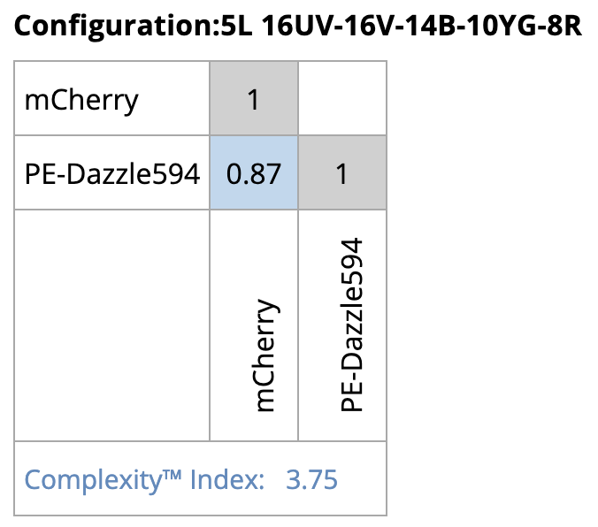
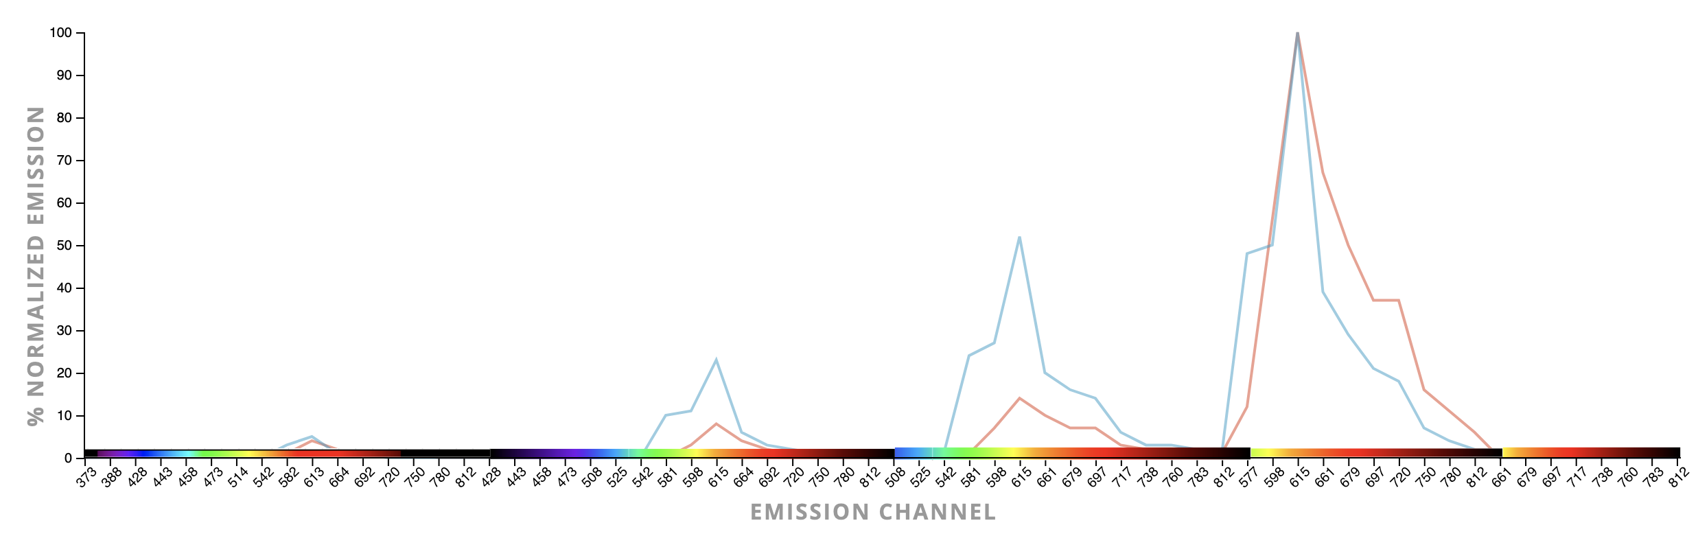
Full spectrum enables use of highly overlapping dyes
On a standard cytometer such as the Fortessa X20b you couldn’t run mCherry and PE-Dazzle 594 together – too much overlap in the 610/20 channel.
But with spectal analysis you can as the software accounts for differences between fluorophores across the entire spectrum (orange boxes).
mCherry PE-Dazzle 594
Run more fluorochromes together

Slide 7
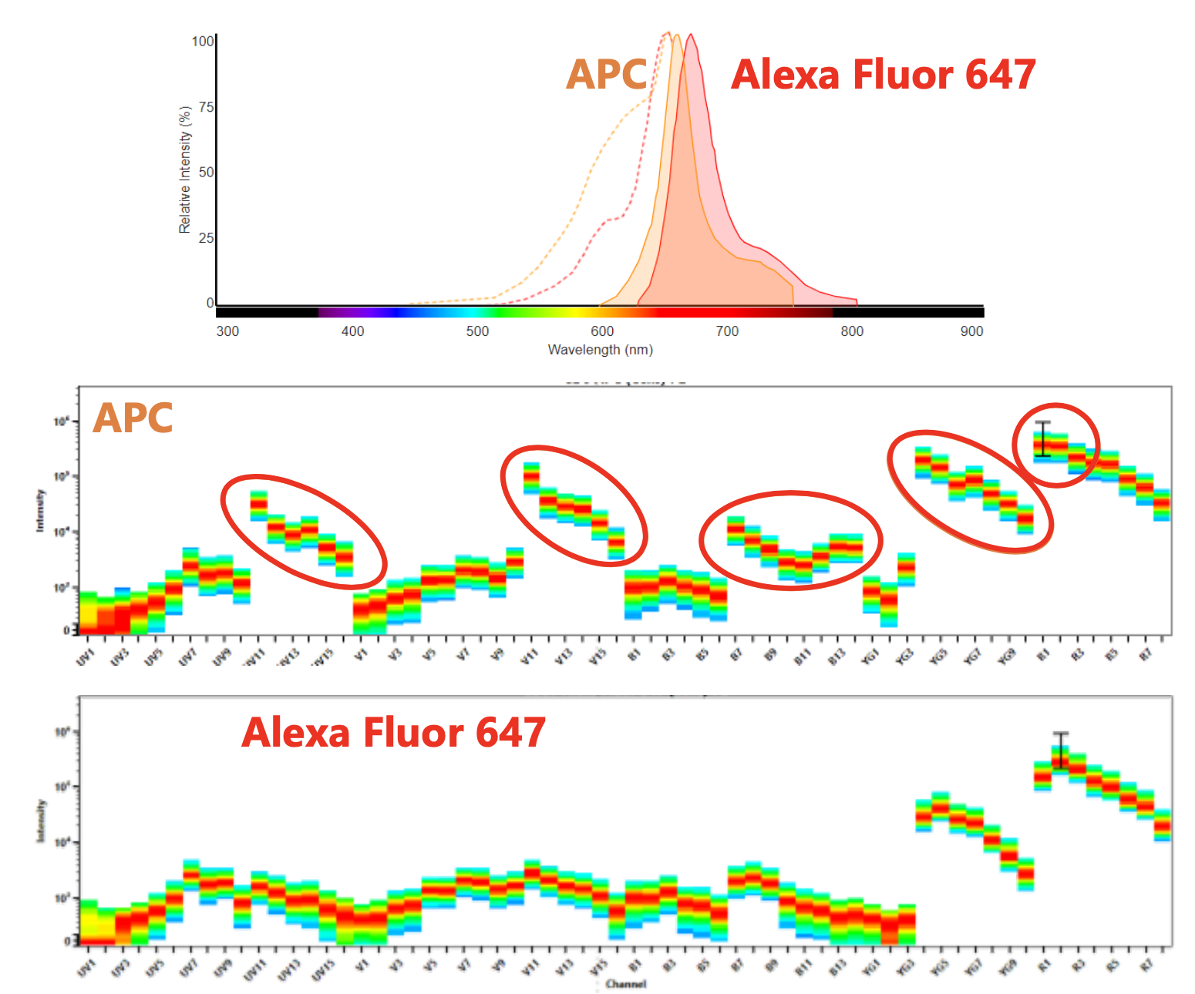
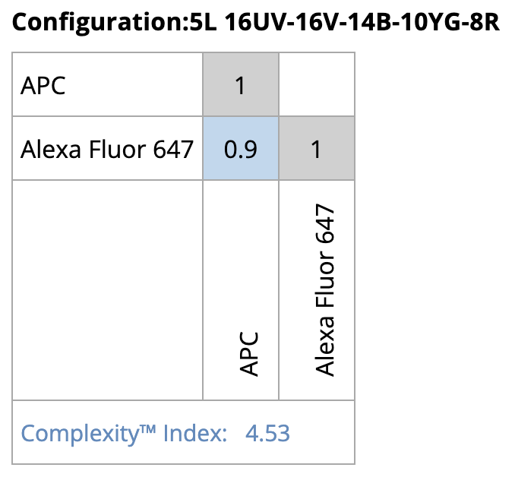
Full spectrum enables use of highly overlapping dyes
Example #2 - APC vs af647
Two very similar dyes
Aurora able to separate their signals based on differences across the spectrum

Slide 8
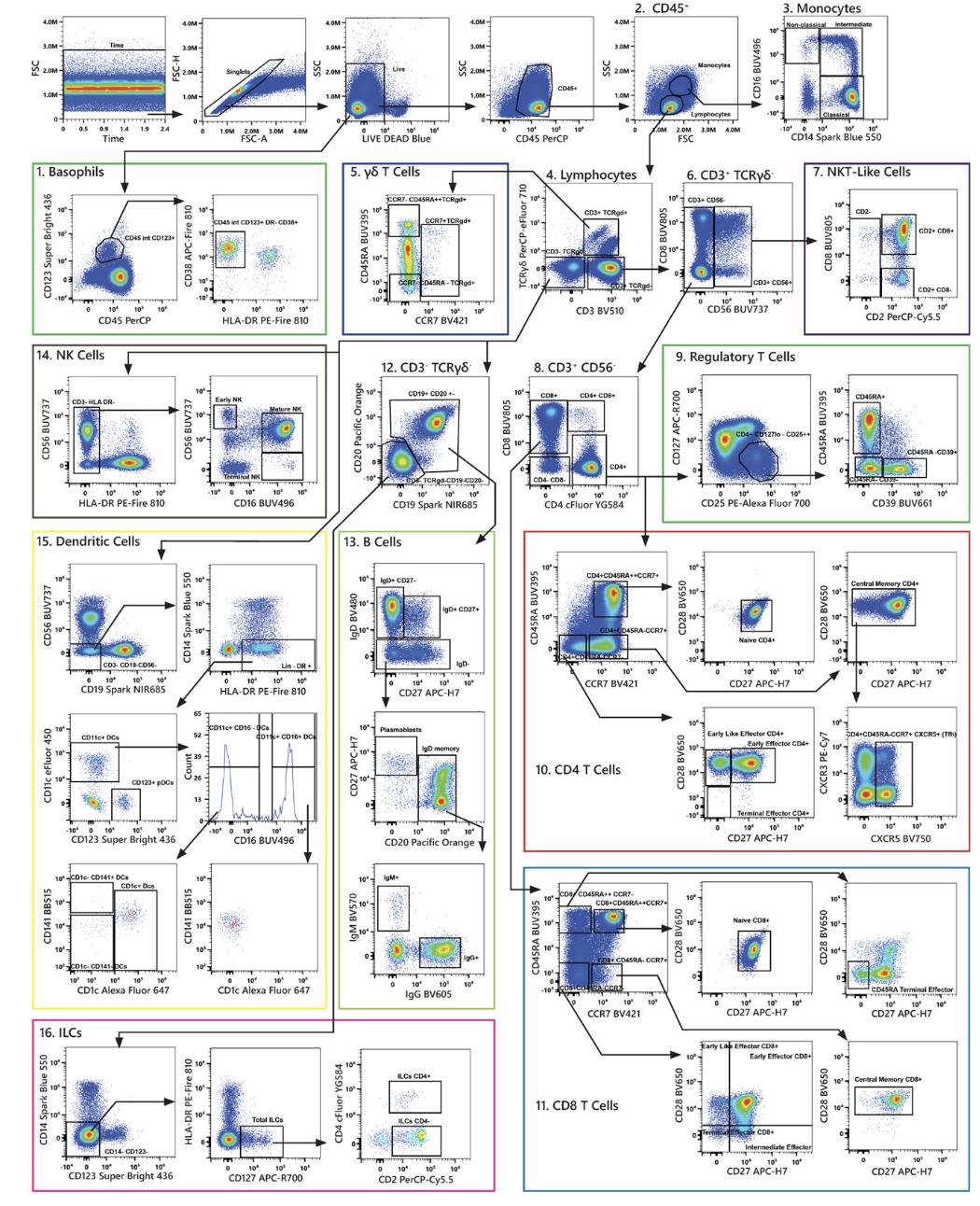
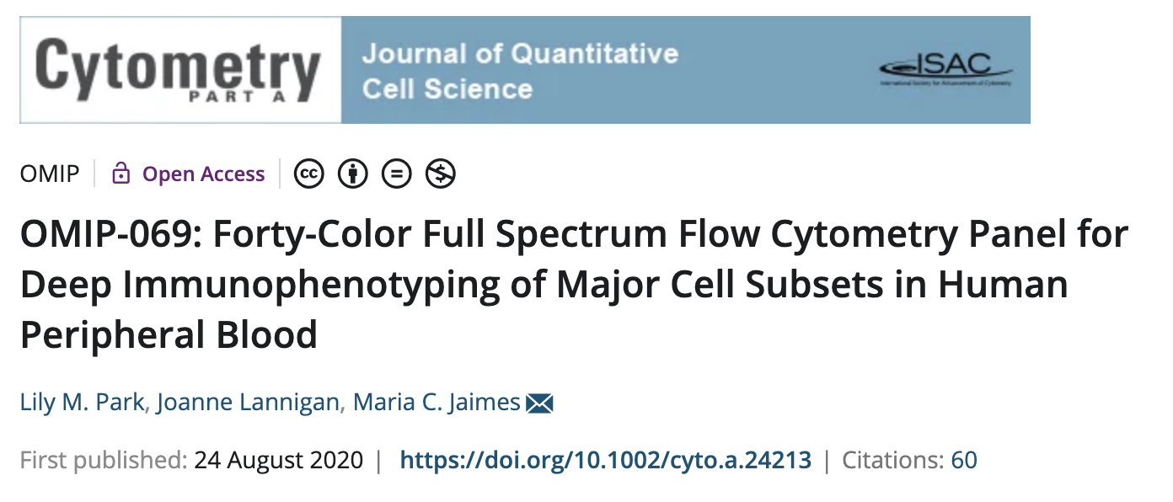
Allows for large scale panel designs

Slide 9
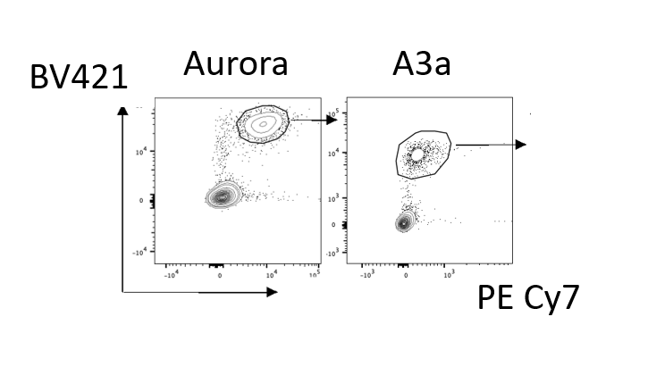
Superior separation of markers
The Aurora uses avalanche photo diodes (APDs) rather than PMTs
APDs are less noisy than PMTs – correlates to cleaner better resolved data
APDs are 10 – 100 times more efficient than PMTs at converting photons across wavelengths
The data on the right is from a FlowCore user comparing data taken on the Aurora vs the Symphony A3
We can see in the PECy7 channel much better population separation from the Aurora.

Slide 10
Superior separation of markers
Gated on Viable Cells
Gated on CD3+ Cells
BD Fortessa X20b
From another user we have a lymphocyte panel with data from both the Fortessa X20b vs the Aurora
Cytek Aurora
CD8 – BV785
αβTCR – VioBlue
CD3 - BUV395
γδTCR – APC-Vio770

Slide 11
Autofluorescence extraction
Autofluorescence treated as its own “fluorophore”
Autofluorescence signal is then subtracted from all other signals.
Better resolution for dyes emitting in high autofluorescent regions (UV and Violet)
May not always be beneficial

Slide 12
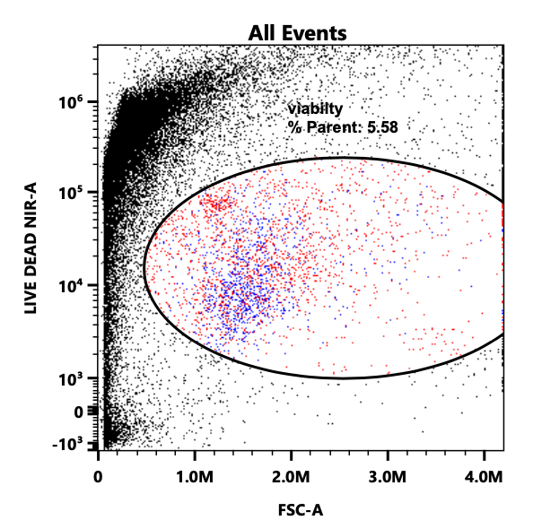
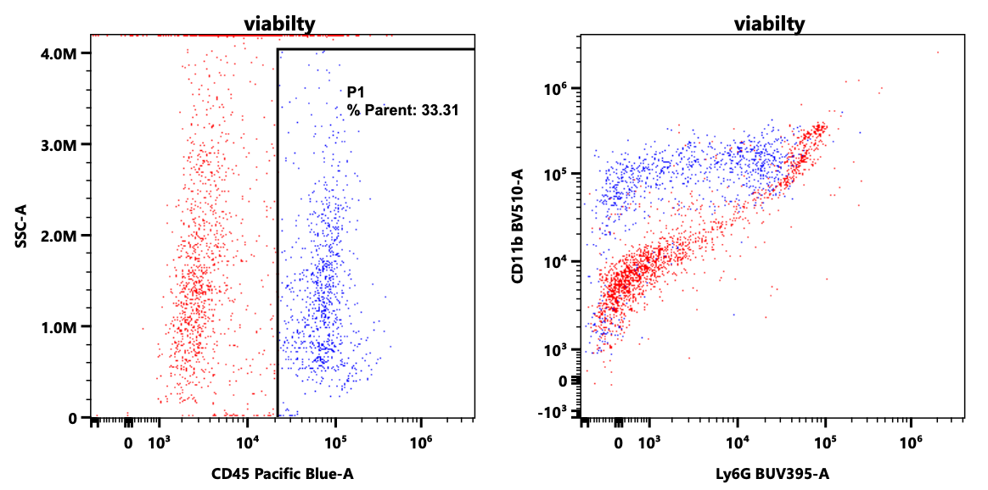
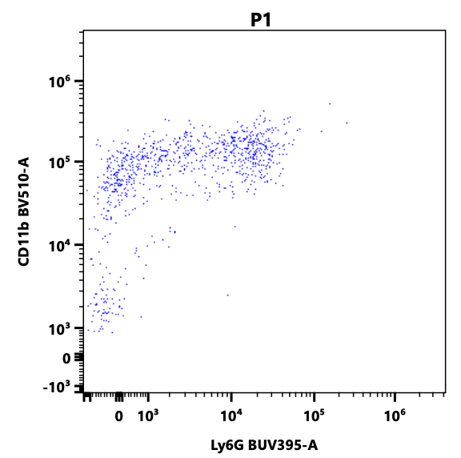
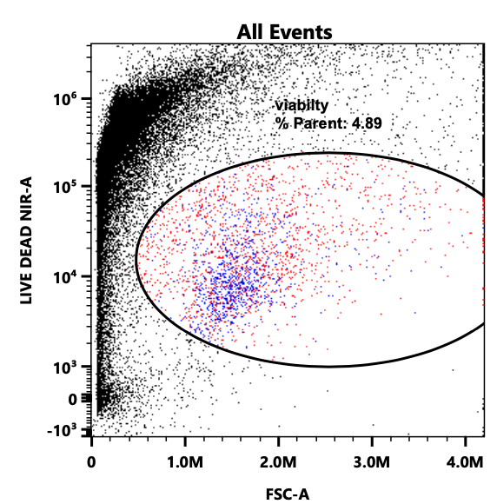
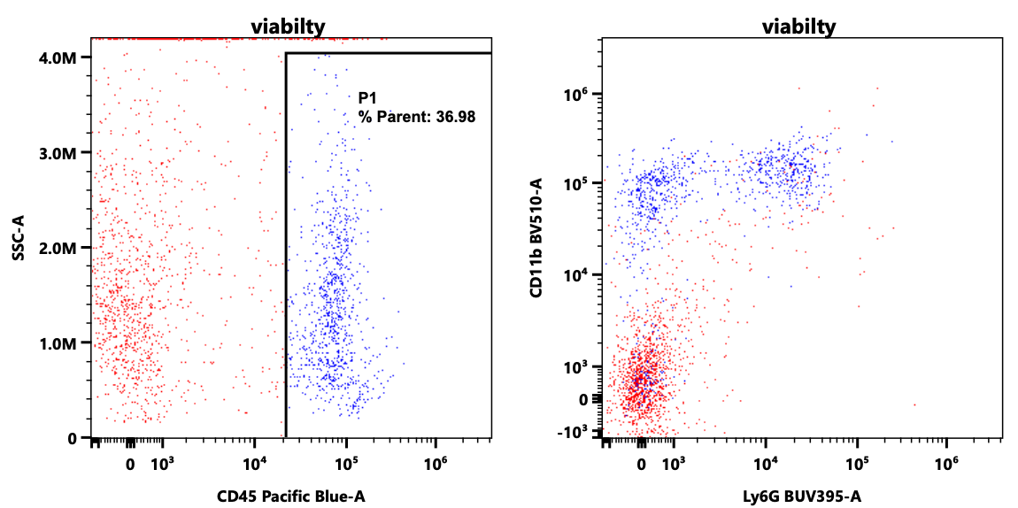
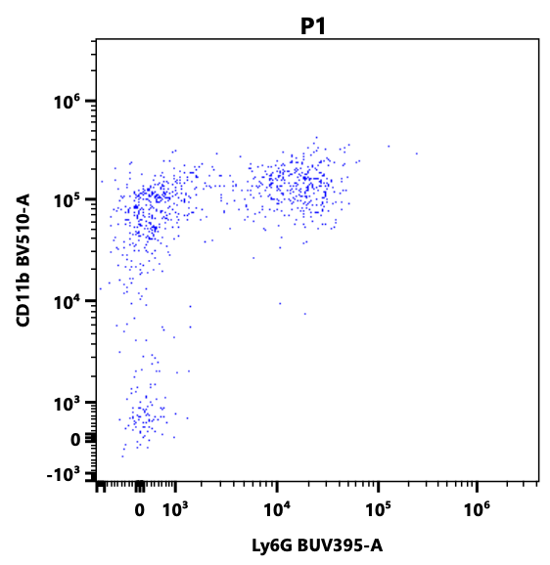
Autofluorescence extraction from skin samples
No AF
Extraction
With AF
Extraction

Slide 13

A range of Loading options
Single 5ml tube
  Can contain a bullet tube if desired
Multiple 5ml tubes – up to 40x 5ml tubes can be analysed using the rack provided
96 well plates
Further options may become available in the future

Slide 14

Automate your process
With the automated plate loader you can run 40x 5ml tubes or 96 well plates
Can preset acquisition so that you can set and forget
In-built clog and bubble detection which allows you to skip wells or stop acquiring samples as desired if you get an air bubble or blockage
  Not available on LSRII/Fortessa HTS units

Slide 15
Selecting Reference Controls as Benchmarks for Reference Control QC
Can save reference controls as benchmarks
  Allows you to check the quality of your reference controls over time
Excellent for long term experiments
Benchmarks can be updated as required
Can store reference controls in the library saving precious sample

Slide 16
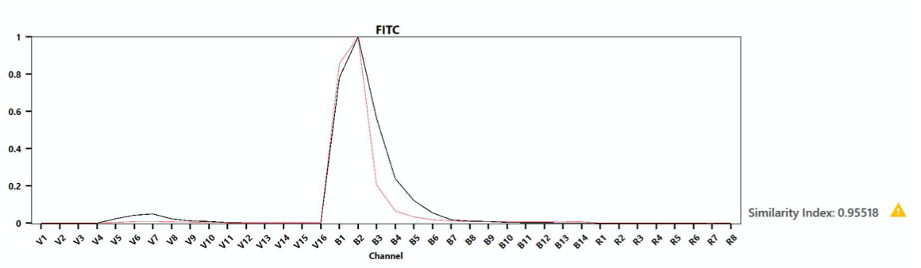
Similarity Index
Overlay spectra to determine degree of similarity
1 = spectra match perfectly
0 = spectra are completely different
Spectral profile check for antibody degradation over time
  Useful for tandem dyes
  Checking for contamination
Benchmark control in red
Reference control in black

Slide 17
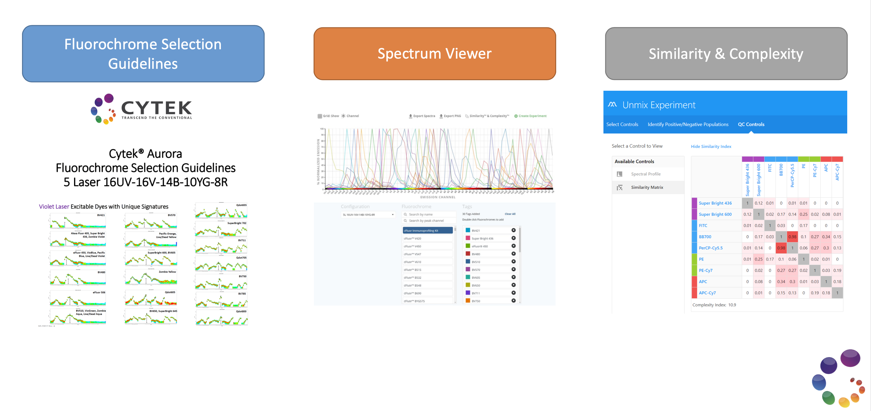
Cytek website has many tools to help with panel design
https://cytekbio.com

Slide 18

Thank you for your time
We hope to see you on the Aurora soon
If you have any questions or would like to book some time on the Aurora please contact FlowCore on the details below.
T: +61 3 9902 0271
E: flowcore.enquiries@monash.edu

