Slide 1

Thank You
This PowerPoint document contains the images that you requested.
Copyright Notice
All materials on this Site are protected by United States copyright law and may not be reproduced, distributed, transmitted, displayed, or otherwise published without the prior written permission of Wolters Kluwer. You may not alter or remove any trademark, copyright or other notice.
However, provided that you maintain all copyright, trademark and other notices contained therein, you may download material (one machine readable copy and one print copy per page) for your personal, non-commercial use only. Please refer to this link for further information on how to apply for permission for re-use
Any information posted to discussion forums (moderated and un-moderated) is for informational purposes only. We are not responsible for the information or the result of its practice.

Slide 2
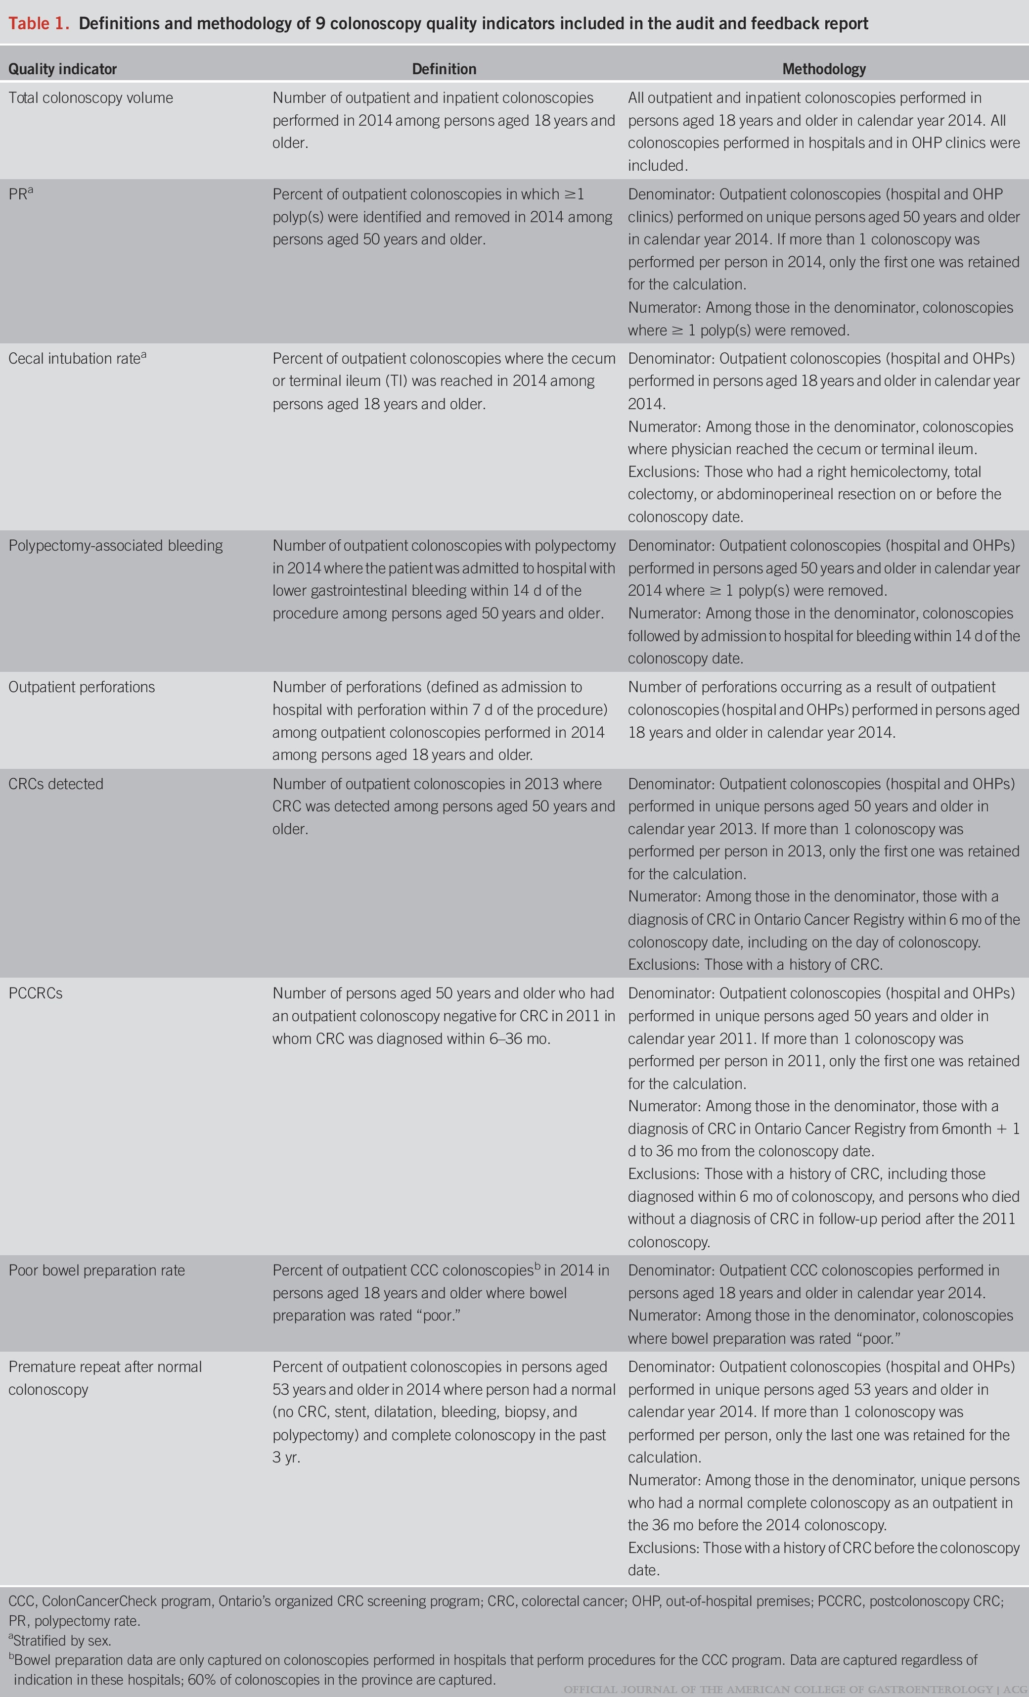
Table 1.
A Pragmatic Randomized Controlled Trial of an Endoscopist Audit and Feedback Report for Colonoscopy
Tinmouth, Jill; Sutradhar, Rinku; Li, Qing; Patel, Jigisha; Baxter, Nancy N.; Llovet, Diego; Paszat, Lawrence F.; Rabeneck, Linda
Official journal of the American College of Gastroenterology | ACG116(10):2042-2051, October 2021.
doi: 10.14309/ajg.0000000000001498
Definitions and methodology of 9 colonoscopy quality indicators included in the audit and feedback report

Slide 3
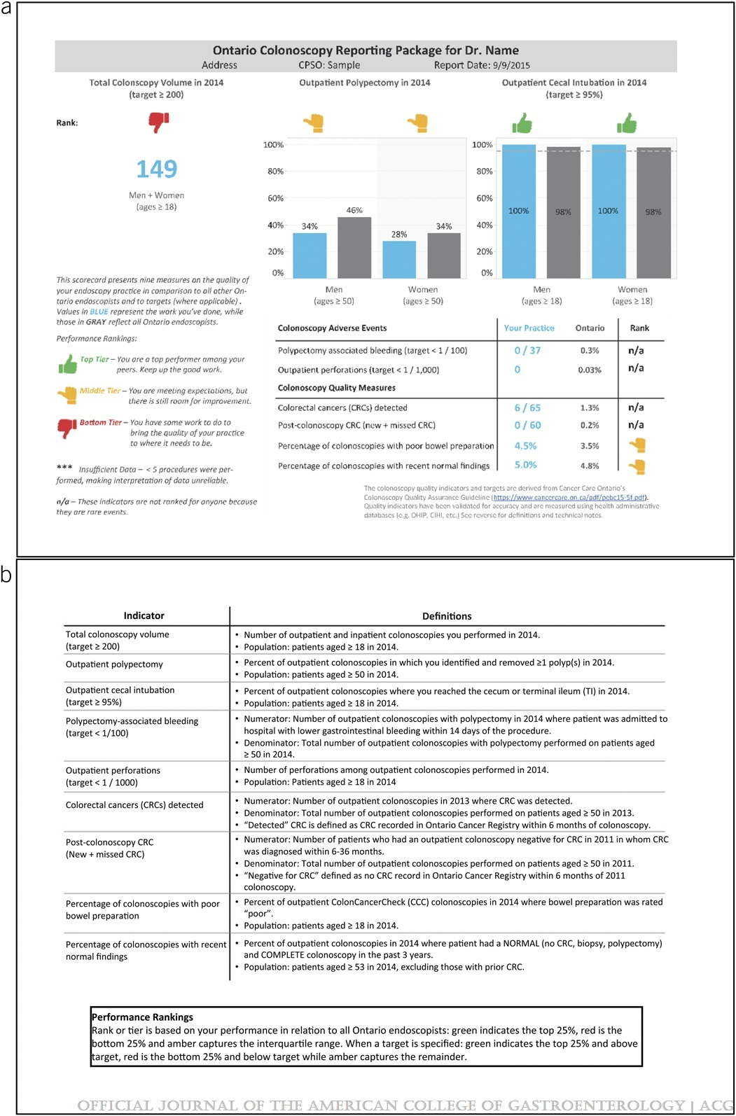
Figure 1.
A Pragmatic Randomized Controlled Trial of an Endoscopist Audit and Feedback Report for Colonoscopy
Tinmouth, Jill; Sutradhar, Rinku; Li, Qing; Patel, Jigisha; Baxter, Nancy N.; Llovet, Diego; Paszat, Lawrence F.; Rabeneck, Linda
Official journal of the American College of Gastroenterology | ACG116(10):2042-2051, October 2021.
doi: 10.14309/ajg.0000000000001498
Example of Ontario's audit and feedback 1-page report, using mock data (a. front side; b. back side).

Slide 4
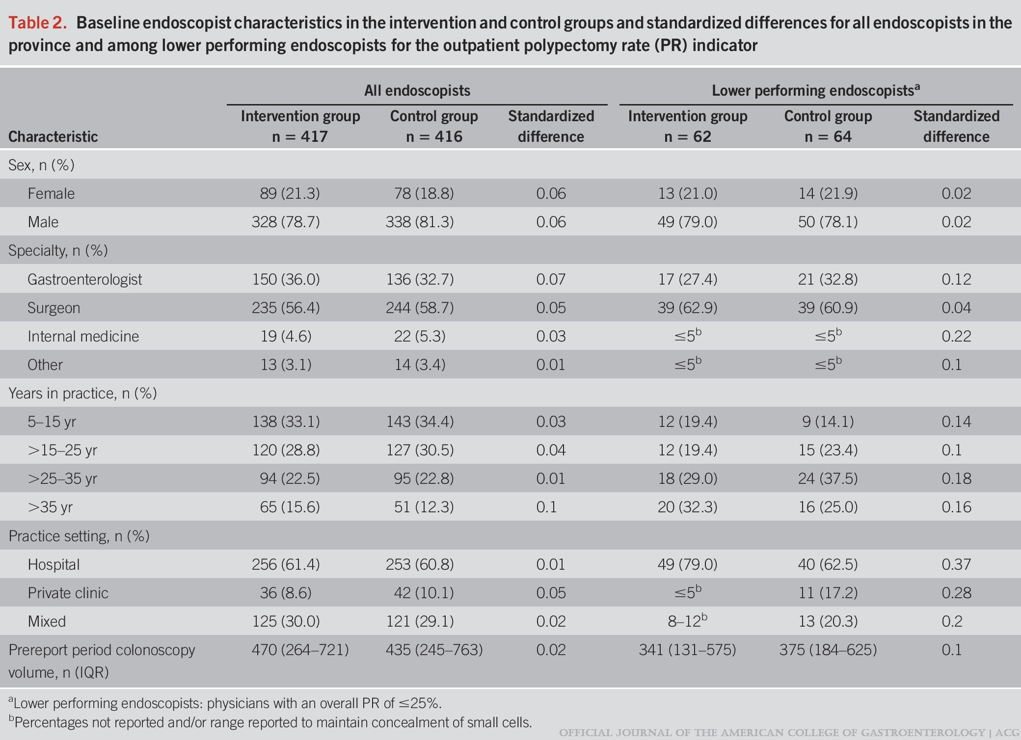
Table 2.
A Pragmatic Randomized Controlled Trial of an Endoscopist Audit and Feedback Report for Colonoscopy
Tinmouth, Jill; Sutradhar, Rinku; Li, Qing; Patel, Jigisha; Baxter, Nancy N.; Llovet, Diego; Paszat, Lawrence F.; Rabeneck, Linda
Official journal of the American College of Gastroenterology | ACG116(10):2042-2051, October 2021.
doi: 10.14309/ajg.0000000000001498
Baseline endoscopist characteristics in the intervention and control groups and standardized differences for all endoscopists in the province and among lower performing endoscopists for the outpatient polypectomy rate (PR) indicator

Slide 5
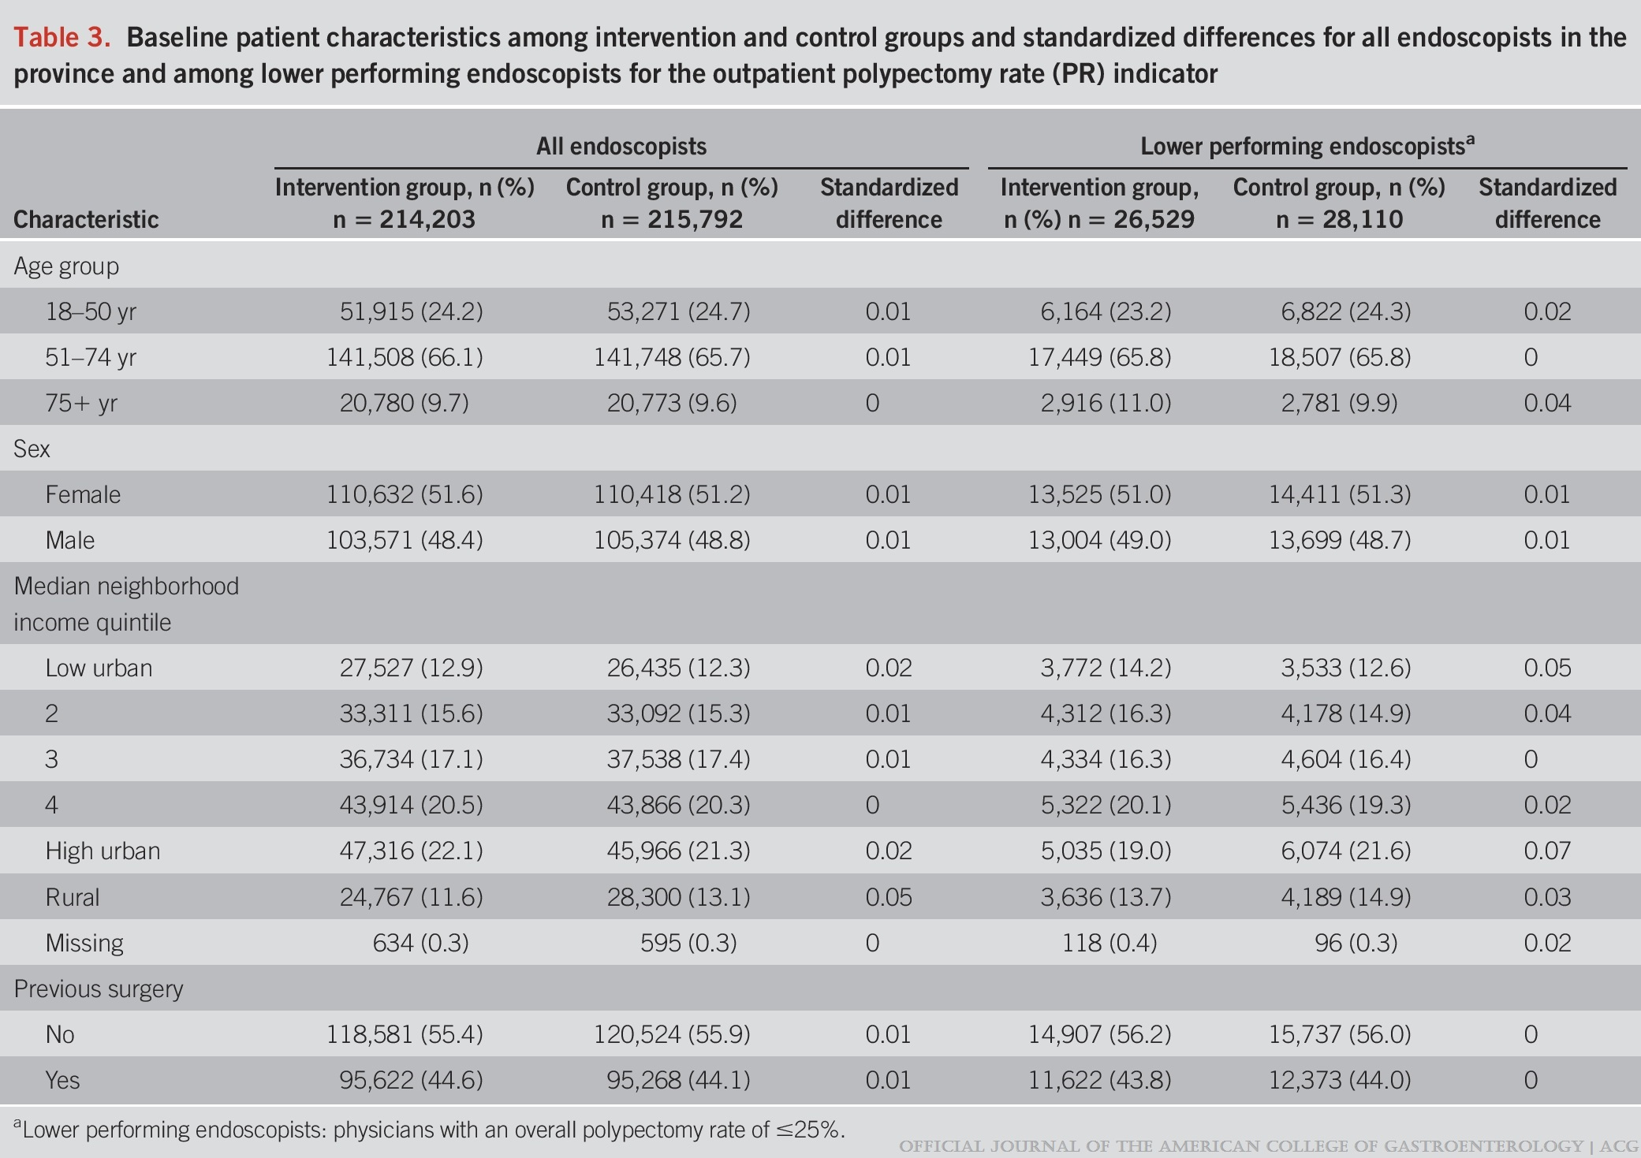
Table 3.
A Pragmatic Randomized Controlled Trial of an Endoscopist Audit and Feedback Report for Colonoscopy
Tinmouth, Jill; Sutradhar, Rinku; Li, Qing; Patel, Jigisha; Baxter, Nancy N.; Llovet, Diego; Paszat, Lawrence F.; Rabeneck, Linda
Official journal of the American College of Gastroenterology | ACG116(10):2042-2051, October 2021.
doi: 10.14309/ajg.0000000000001498
Baseline patient characteristics among intervention and control groups and standardized differences for all endoscopists in the province and among lower performing endoscopists for the outpatient polypectomy rate (PR) indicator

Slide 6
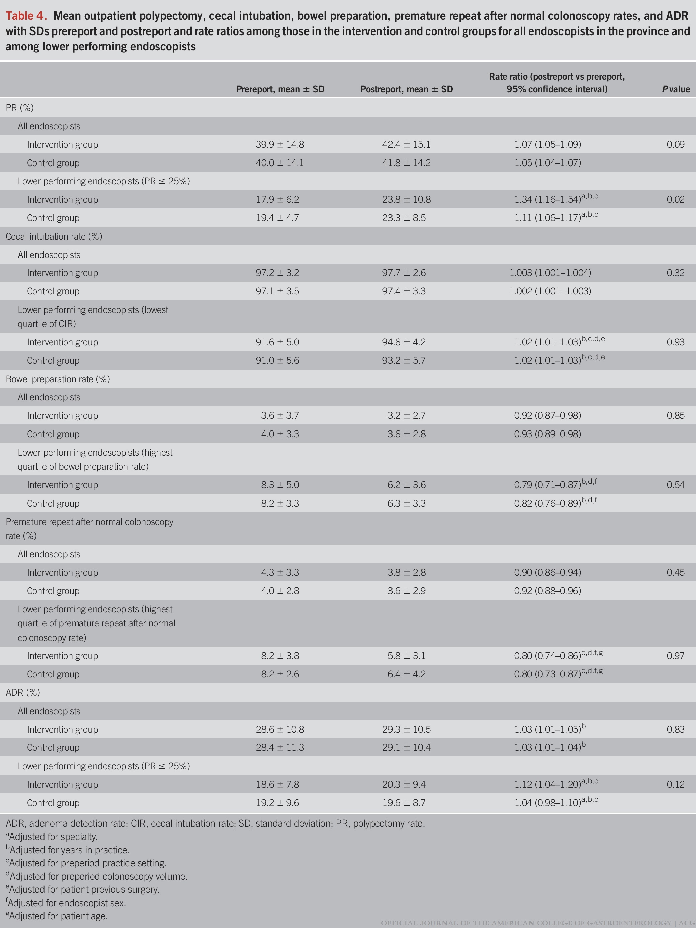
Table 4.
A Pragmatic Randomized Controlled Trial of an Endoscopist Audit and Feedback Report for Colonoscopy
Tinmouth, Jill; Sutradhar, Rinku; Li, Qing; Patel, Jigisha; Baxter, Nancy N.; Llovet, Diego; Paszat, Lawrence F.; Rabeneck, Linda
Official journal of the American College of Gastroenterology | ACG116(10):2042-2051, October 2021.
doi: 10.14309/ajg.0000000000001498
Mean outpatient polypectomy, cecal intubation, bowel preparation, premature repeat after normal colonoscopy rates, and ADR with SDs prereport and postreport and rate ratios among those in the intervention and control groups for all endoscopists in the province and among lower performing endoscopists

