Slide 1



LEARNING OUTCOMES
Learning Intention
Students will investigate how communities can prepare for and reduce the impacts of flooding through the design and testing of different mitigation strategies.
Success Criteria
Explain how climate change impacts flooding events
Identify a range of flood mitigation strategies
Apply these strategies to an Australian context
Evaluate the effectiveness of different approaches to flood preparedness
Notes:
Optional to show to students

Slide 2
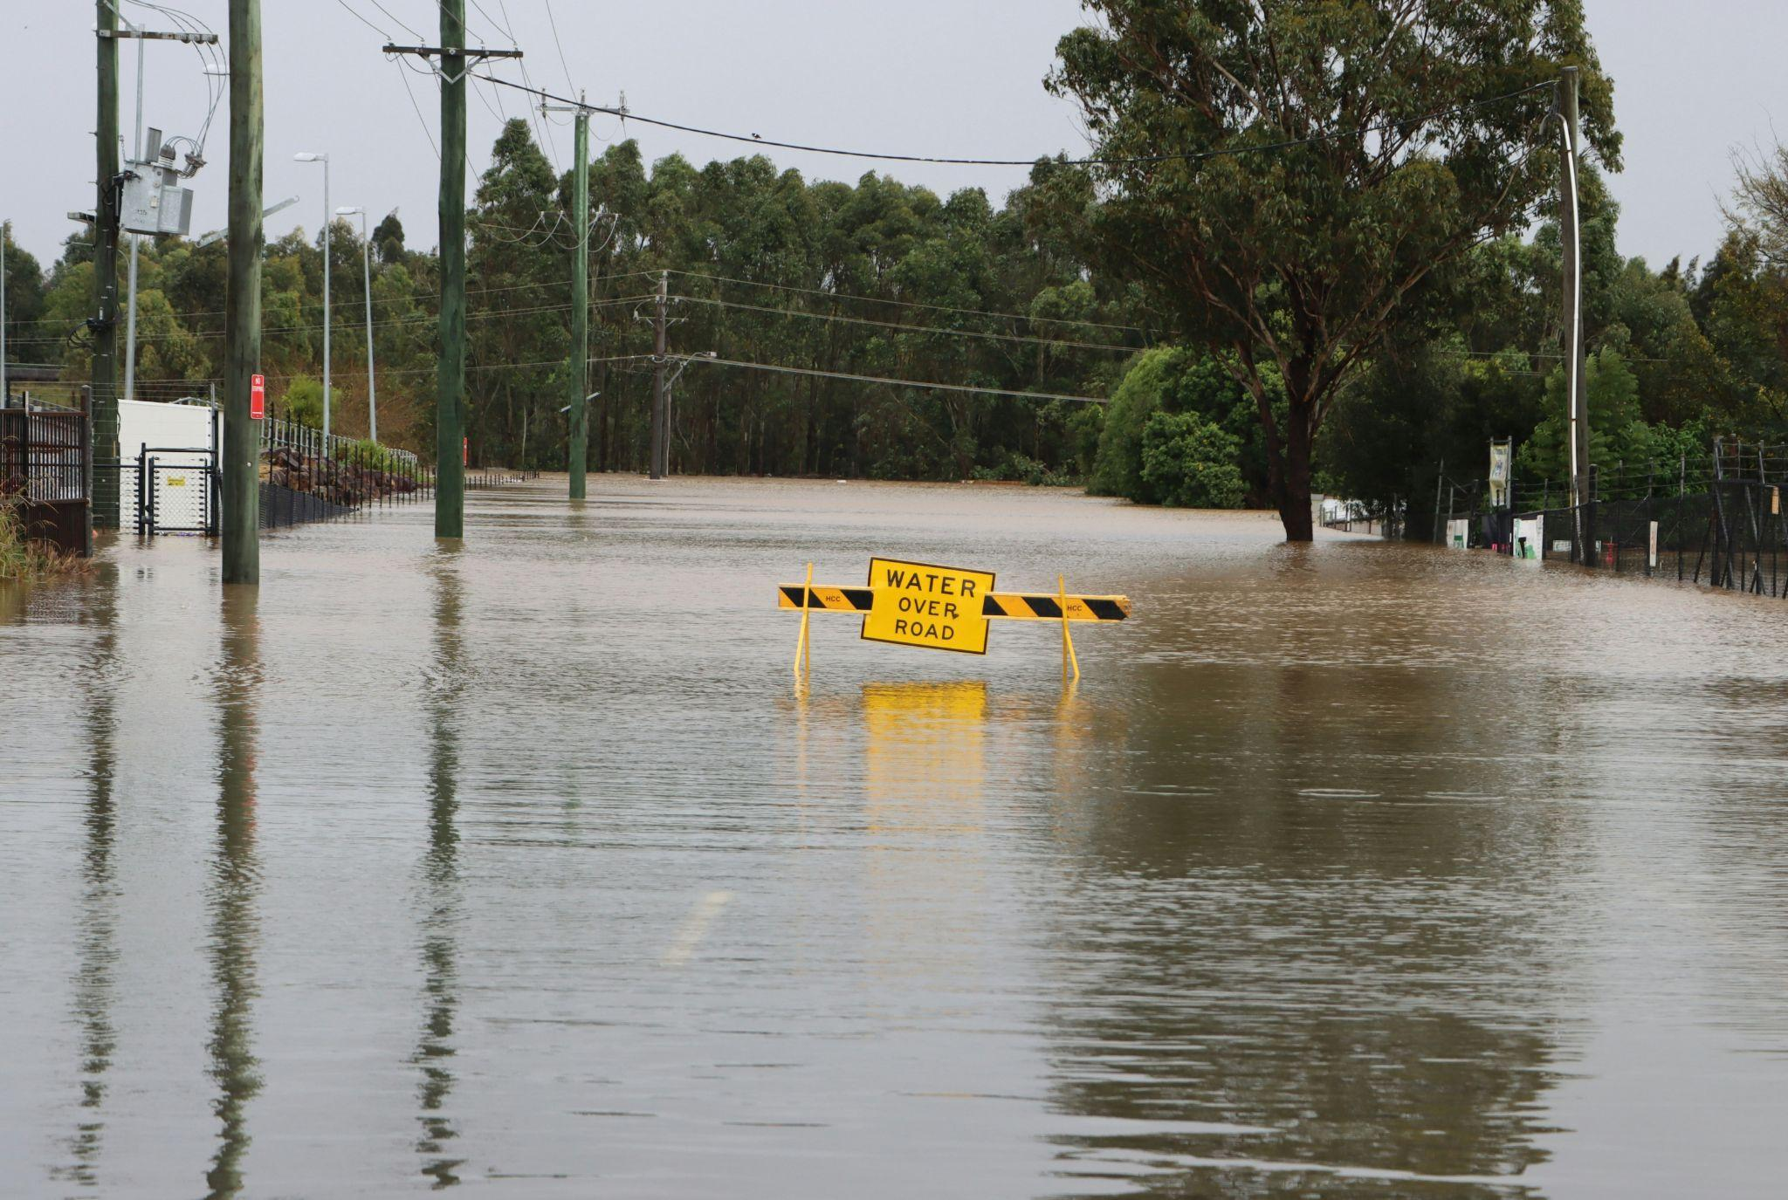

STAY AFLOAT:
Examining the effectiveness of flood mitigation infrastructure
Year 7/8 Geography
Notes:
USE THESE SLIDES ALONGSIDE THE LESSON PLAN

Slide 3


VIDEO: CLIMATE CHANGE AND FLOODING
v
Learning introduction

Slide 4
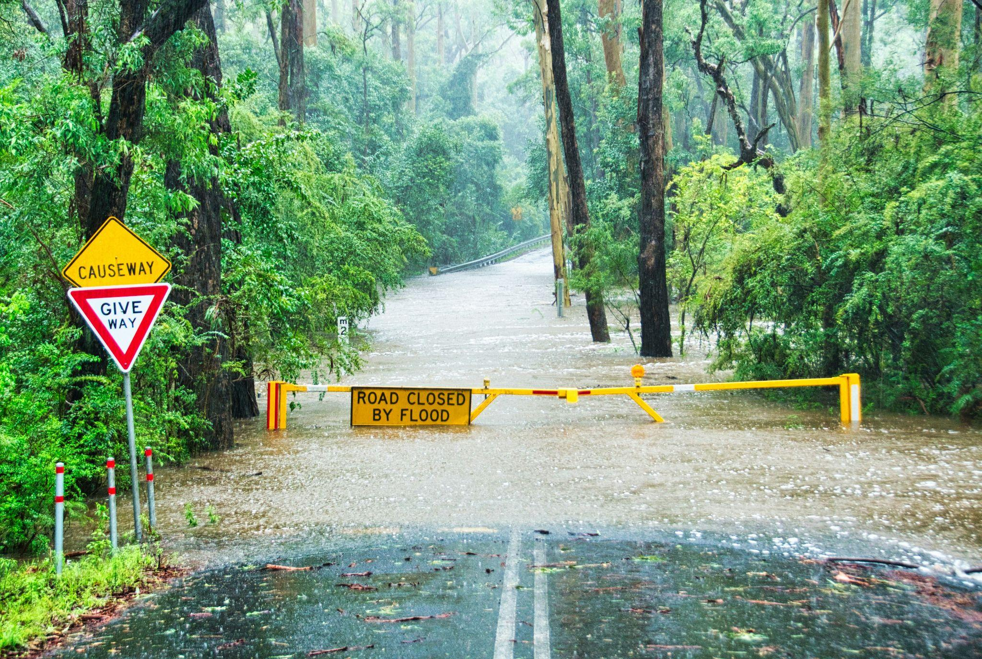

v
VIDEO RECAP
What are flood…
Drivers / Causes
(Why they’re getting worse)
Types
Impacts
Preventions
Learning introduction
Notes:
ANSWERS:
Drivers / Causes (Why they’re getting worse)
Climate factors -
Warmer air: Holds more moisture, leading to heavier rainfall
Rising sea levels: Mean storm surges can reach further inland
General factors -
Heavy rainfall: From storms, cyclones, or fronts
River capacity: When rivers can’t carry all the water, it overflows onto nearby land
Soil moisture: If the ground is already saturated, rain can’t soak in and floods form more easily
Water management: Releasing water from reservoirs can add to flooding.
Land use changes: More buildings, paving, and drains change how water flows and where it collects
Types
Riverine flooding: When rivers overflow their banks after heavy or prolonged rain, spreading water across nearby land.
Flash flooding: Happens quickly after intense rain, especially where the ground is already soaked or drains can’t keep up.
Coastal flooding: When storm surges or high tides push seawater onto the land.
Impacts
Environmental: Erodes soil, damages habitats, and spreads pollutants through waterways.
Economic: Destroys infrastructure, homes, and crops; costly to repair and recover.
Social: Causes injury, displacement, and loss of life; impacts mental health and community wellbeing.
Preventions
Awareness: Know if you live in a flood-risk area and stay alert to warnings.
Flood defences: Build barriers like levees and sea walls to block rising water.
Natural solutions: Restore trees, wetlands, and mangroves to slow water flow.
Water management: Control river flow and drainage to reduce overflow.
Climate action: Cut fossil fuel use to slow rising temperatures and sea-level rise.

Slide 5

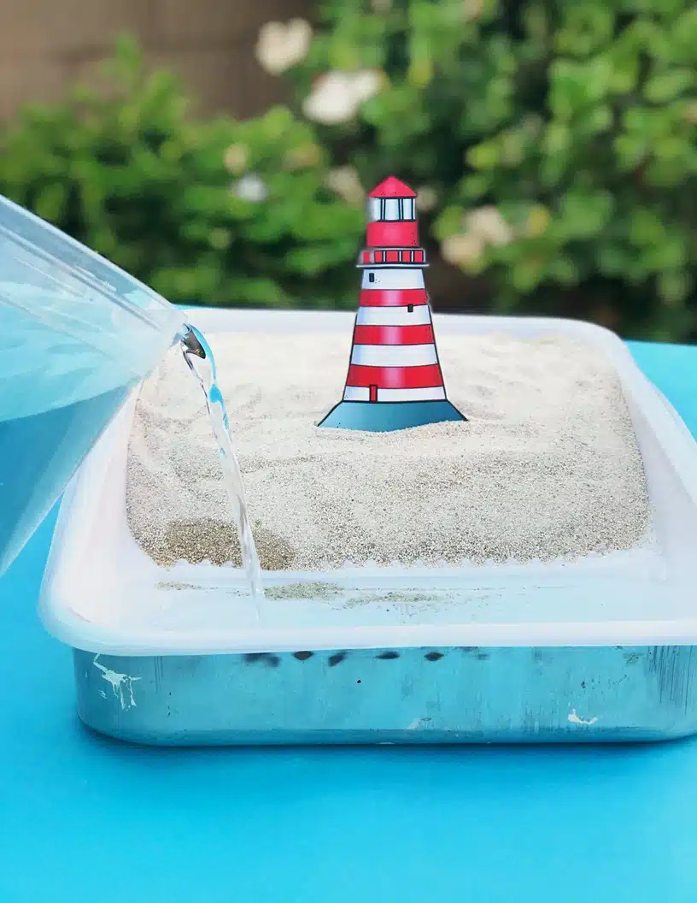
ACTIVITY:
STAY AFLOAT
In groups, you will be assigned a flood-mitigation method to model.
Models will be tested to assess how effectively they reduce the impacts of flooding.
v
Activity introduction
Notes:
REFER TO LESSON PLAN FOR FULL INSTRUCTIONS

Slide 6

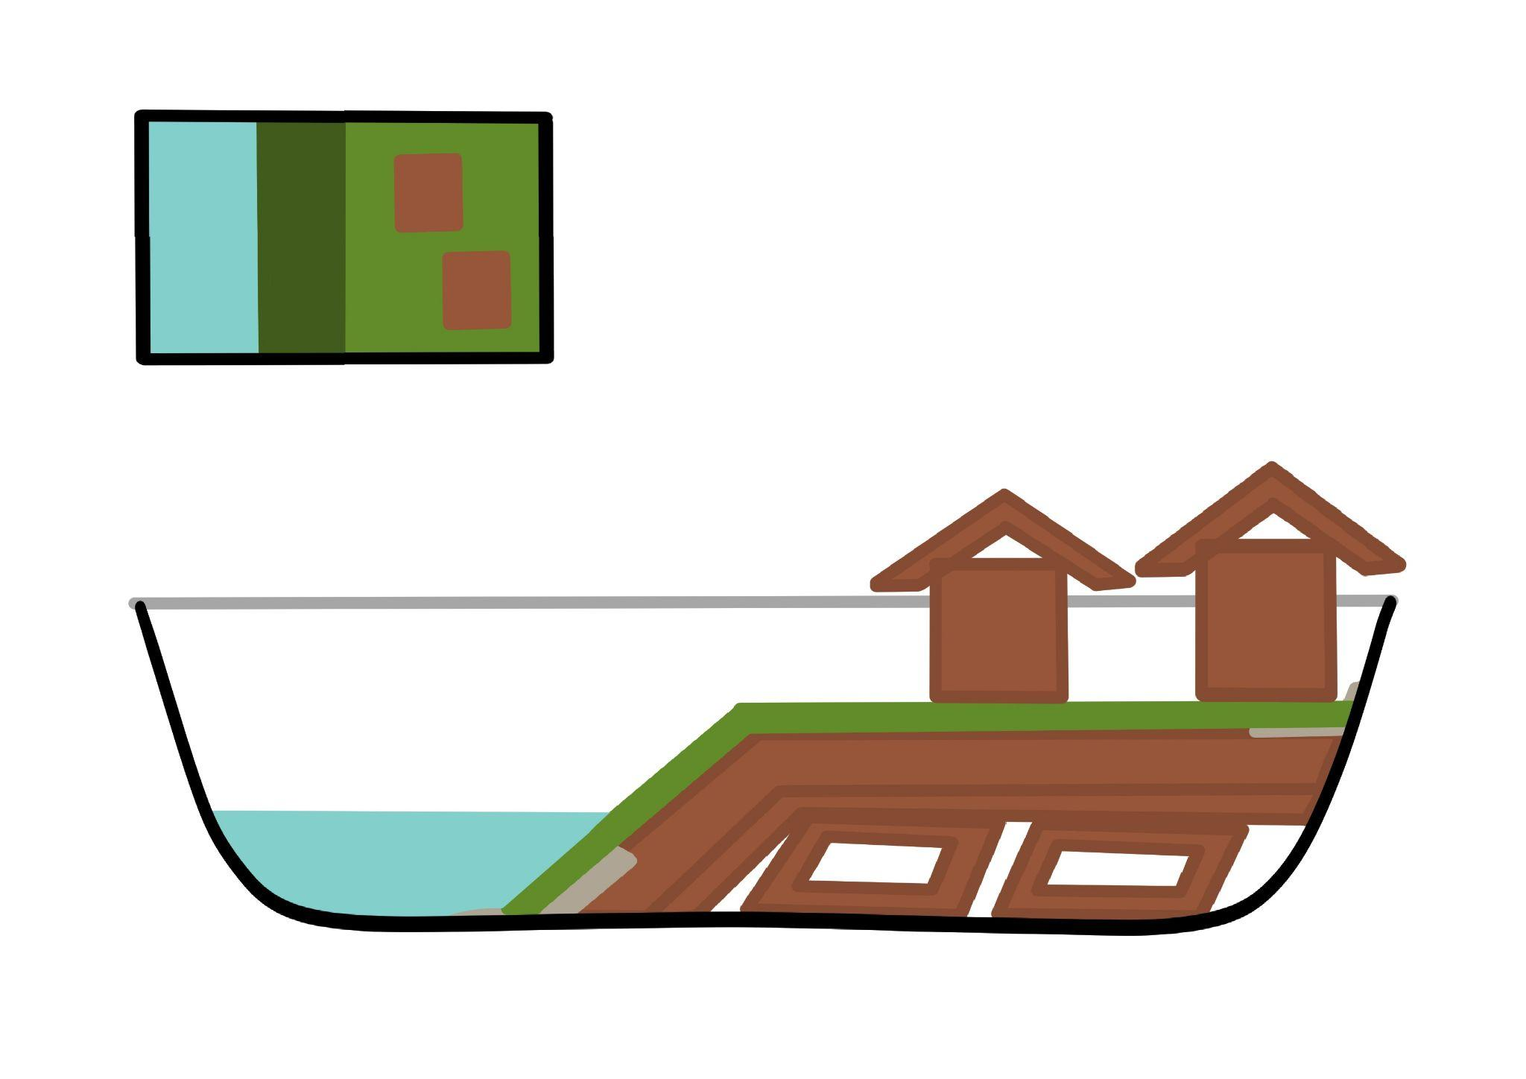
CONTROL
MODEL TEST
What do you
think will happen and why?
Activity introduction
Notes:
REFER TO LESSON PLAN FOR FULL INSTRUCTIONS

Slide 7
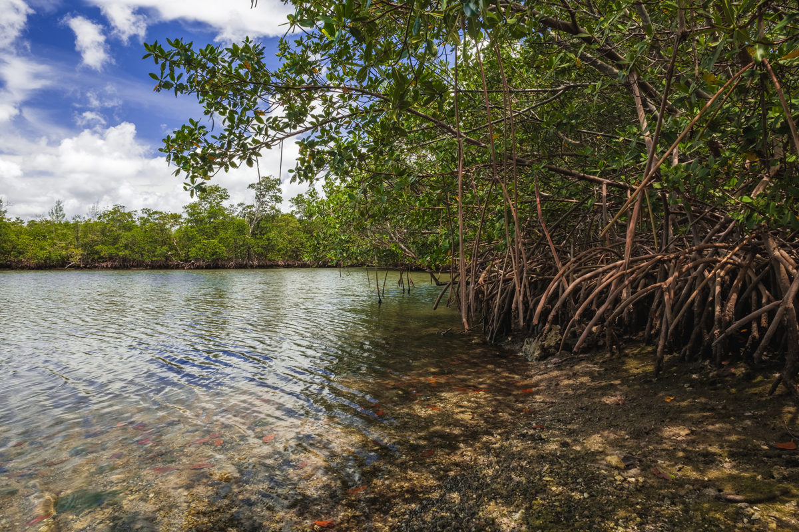
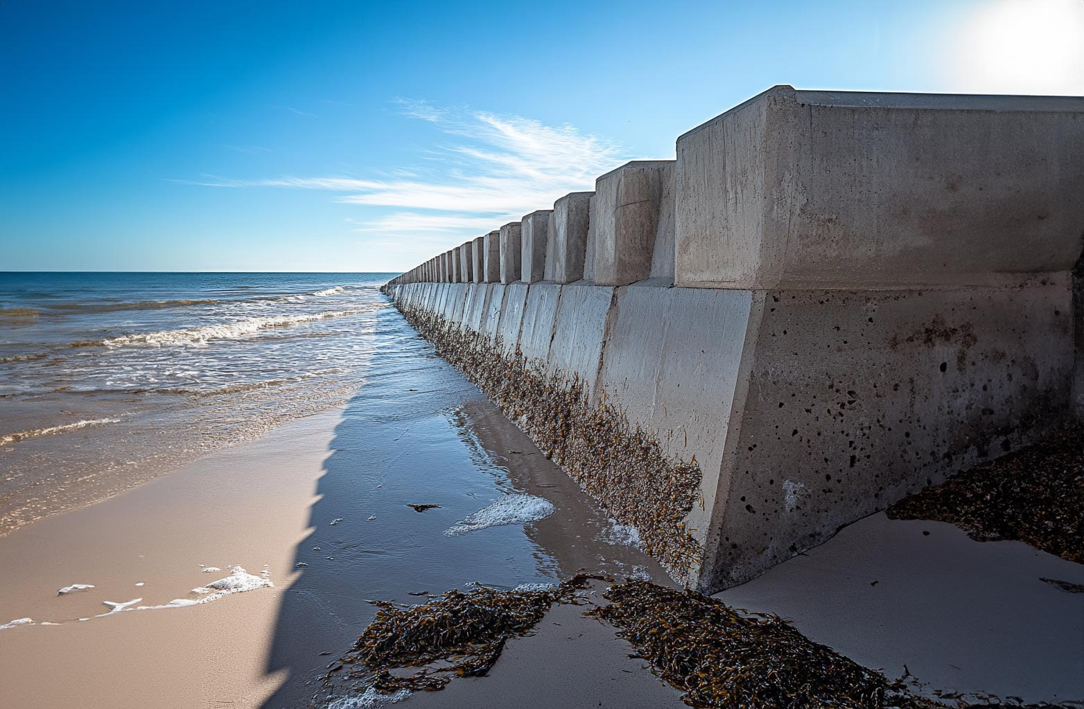
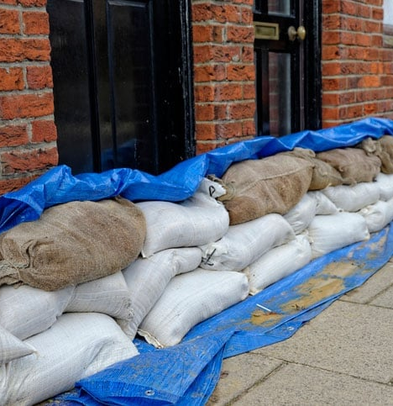
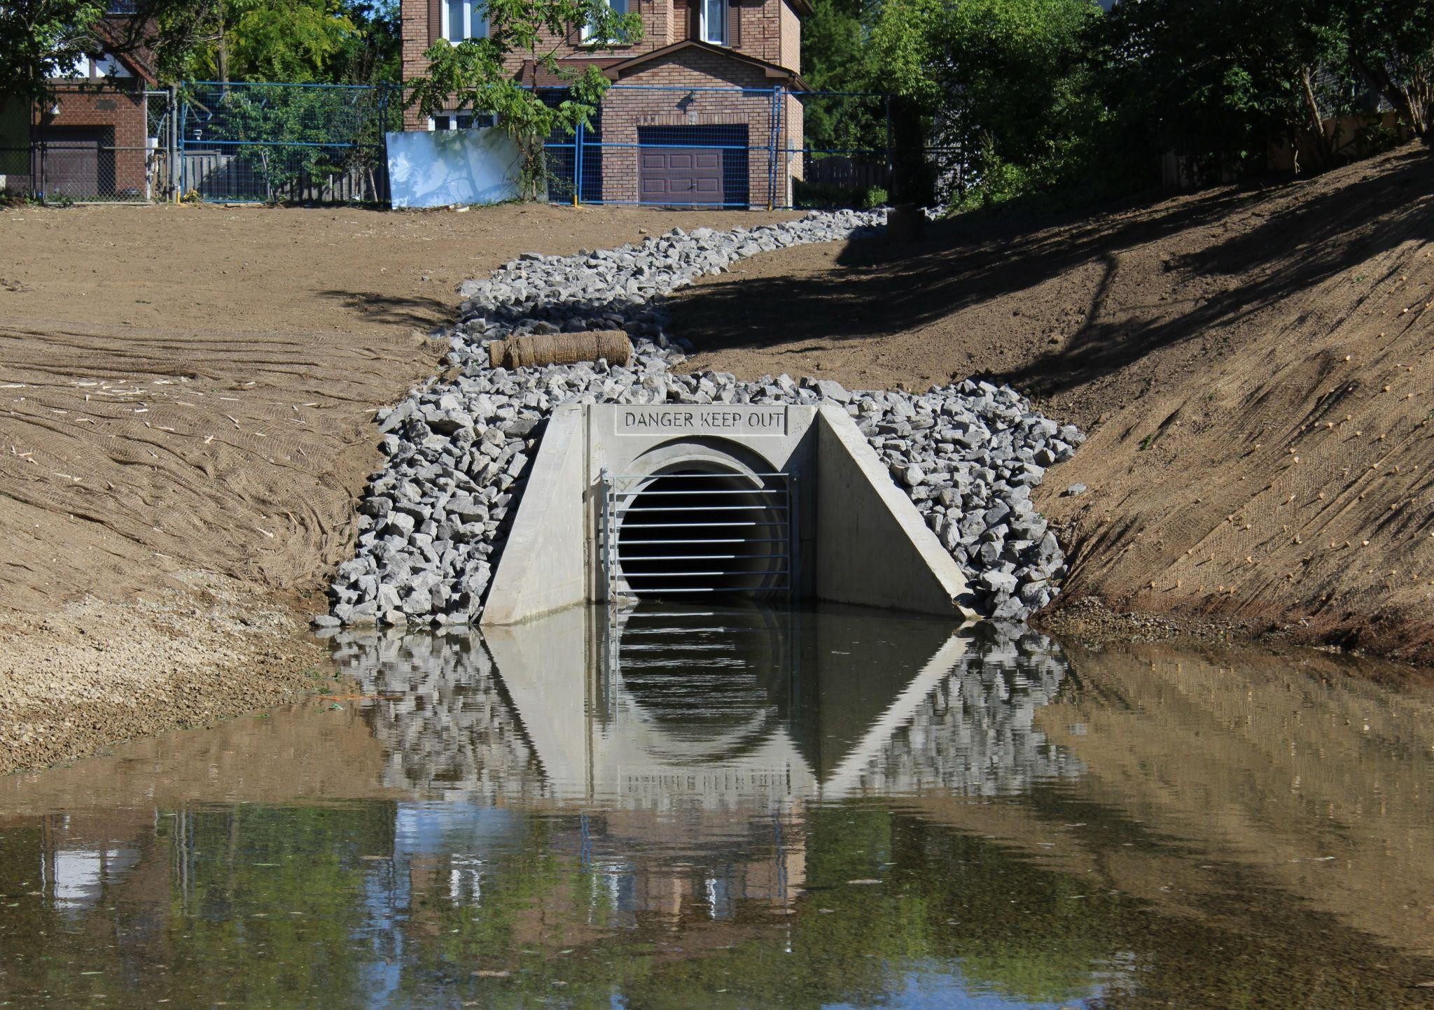
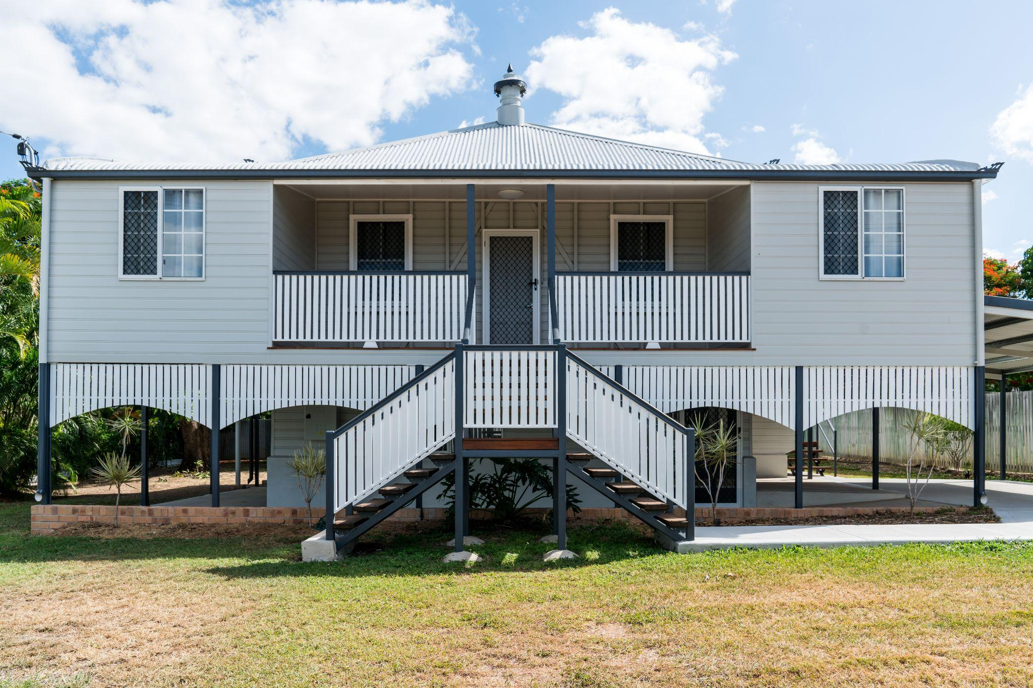
FLOOD MITIGATION STRATEGIES
v
Mangroves
Natural mitigation
Sea walls
Structural defence
Sandbags
Temporary barrier
Drainage
Water management
Stilts
Design adaptation
Activity introduction
Notes:
SPEAKER NOTES:
Flood mitigation refers to measures taken to reduce or manage the impacts of flooding, rather than to prevent flooding entirely.
Main concept of each method:
Mangroves (Natural mitigation) – slowing and absorbing water
Sea wall (Structural defence) – blocking and deflecting water
Sandbags (Temporary barrier) – redirecting water temporarily, quick community level response
Drainage (Water management) – moving and holding water safely
Stilts (Design adaptation) – avoiding floodwater altogether

Slide 8
MITIGATION
MODEL BUILDING
In your groups:
1. Research and draft your mitigation method
2. Build your model, adding your solution
to the control setup
Activity instructions
Notes:
REFER TO LESSON PLAN FOR FULL INSTRUCTIONS

Slide 9
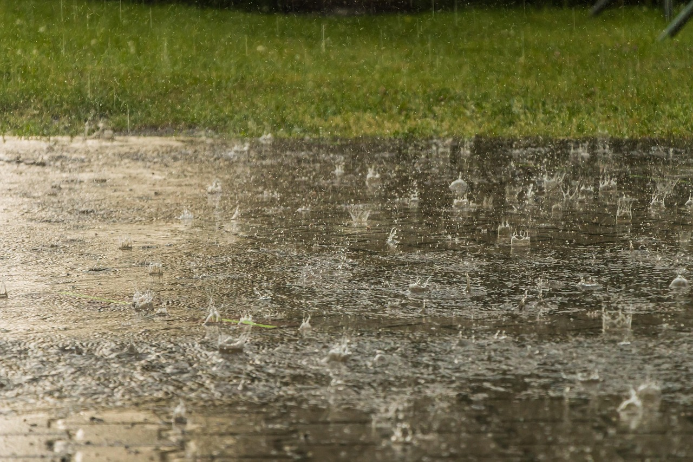
v
TIME TO PUT
THEM TO THE TEST
For each model:
What do you predict will happen?
What worked well?
What didn’t work?
Activity
Notes:
HOLDING SLIDE FOR TESTING MODELS

Slide 10
FLOOD MITIGATION STRATEGIES
v
Mangroves
Natural mitigation
Learning discussion
Notes:
BUILT SLIDE #1: MANGROVES
Ask class for their POSITIVE findings before moving to the next slide

Slide 11
v
MANGROVES
Pros:
Reduce wave energy and storm surge
Stabilise soil, prevent erosion
Low-cost, natural protection
Learning discussion
Notes:
Ask class for their NEGATIVE findings before moving to the next slide

Slide 12
v
MANGROVES
Pros:
Reduce wave energy and storm surges
Stabilise soil, prevent erosion
Low-cost, natural protection
Cons:
Take years to grow
Need coastal wetlands
Can be damaged by strong storms
Learning discussion

Slide 13
FLOOD MITIGATION STRATEGIES
v
Mangroves
Natural mitigation
Sea walls
Structural defence
Learning discussion
Notes:
BUILT SLIDE #2: SEA WALLS
Ask class for their POSITIVE findings before moving to the next slide

Slide 14
v
SEA WALLS
Pros:
Strong, durable flood barriers
Protect coasts and property from storm surges
Long-lasting once built
Learning discussion
Notes:
Ask class for their NEGATIVE findings before moving to the next slide

Slide 15
v
SEA WALLS
Pros:
Strong, durable flood barriers
Protect coasts and property from storm surges
Long-lasting, built once
Cons:
Expensive to build and maintain
Reflect waves, causing sand loss and erosion on beaches
Only suitable for coastal areas
Learning discussion

Slide 16
FLOOD MITIGATION STRATEGIES
v
Mangroves
Natural mitigation
Sea walls
Structural defence
Sandbags
Temporary barrier
Learning discussion
Notes:
BUILT SLIDE #3: SANDBAGS
Ask class for their POSITIVE findings before moving to the next slide

Slide 17
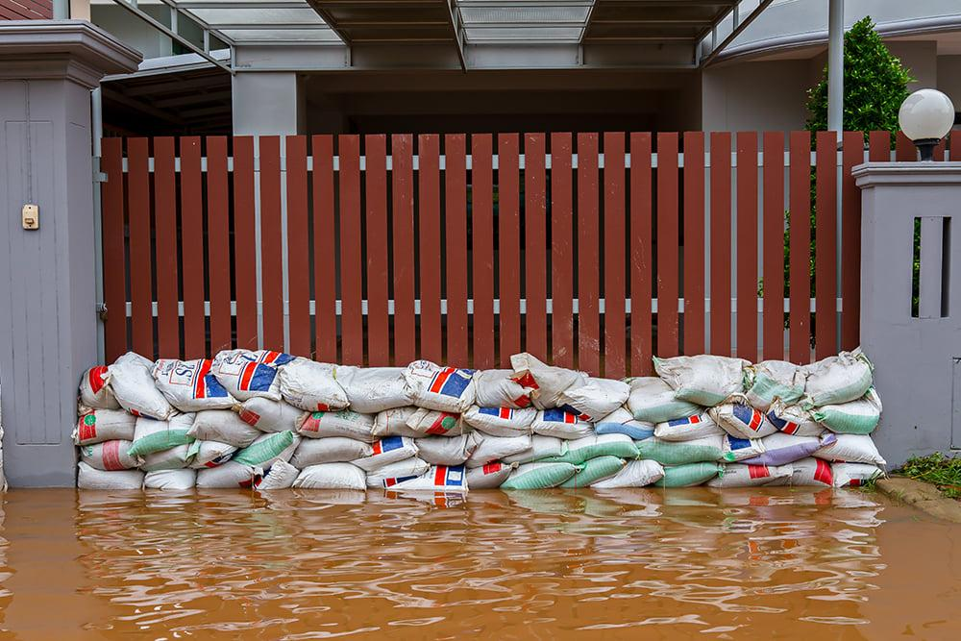
v
SANDBAGS
Pros:
Quick to set up in emergencies
Can be coordinated and deployed by the community/individuals
Effective for small-scale protection (e.g. homes or sections of road)
Learning discussion
Notes:
Ask class for their NEGATIVE findings before moving to the next slide

Slide 18
v
SANDBAGS
Pros:
Quick to set up in emergencies
Can be coordinated and deployed by the community/individuals
Effective for small-scale protection (e.g. homes or sections of road)
Cons:
Provide only temporary protection
Can collapse under pressure
Labour-intensive to fill, move
and dispose of
Learning discussion

Slide 19
FLOOD MITIGATION STRATEGIES
v
Mangroves
Natural mitigation
Sea walls
Structural defence
Sandbags
Temporary barrier
Drainage
Water management
Learning discussion
Notes:
BUILT SLIDE #4: DRAINAGE
Ask class for their POSITIVE findings before moving to the next slide

Slide 20
v
DRAINAGE
Pros:
Move large volumes of water quickly
Store and release stormwater in controlled areas
Protect larger urban areas
Learning discussion
Notes:
Ask class for their NEGATIVE findings before moving to the next slide

Slide 21
v
DRAINAGE
Pros:
Move large volumes of water quickly
Store and release stormwater in controlled areas
Protect larger urban areas
Cons:
Expensive and complex to build
Can overflow in extreme rain
May increase flooding elsewhere if poorly designed
Learning discussion

Slide 22
FLOOD MITIGATION STRATEGIES
v
Mangroves
Natural mitigation
Sea walls
Structural defence
Sandbags
Temporary barrier
Drainage
Water management
Stilts
Design adaptation
Learning discussion
Notes:
BUILT SLIDE #5: STILTS
Ask class for their POSITIVE findings before moving to the next slide

Slide 23
v
STILTS
Pros:
Raise buildings above floodwater
Limit damage to homes and contents
Provide long-term protection for flood-prone properties
Learning discussion
Notes:
Ask class for their NEGATIVE findings before moving to the next slide

Slide 24
v
STILTS
Pros:
Raise buildings above floodwater
Limit damage to homes and contents
Provide long-term protection for flood-prone properties
Cons:
Don’t stop surrounding flooding
Not suited to large or heavy buildings
Can isolate residents until
water clears
Learning discussion

Slide 25
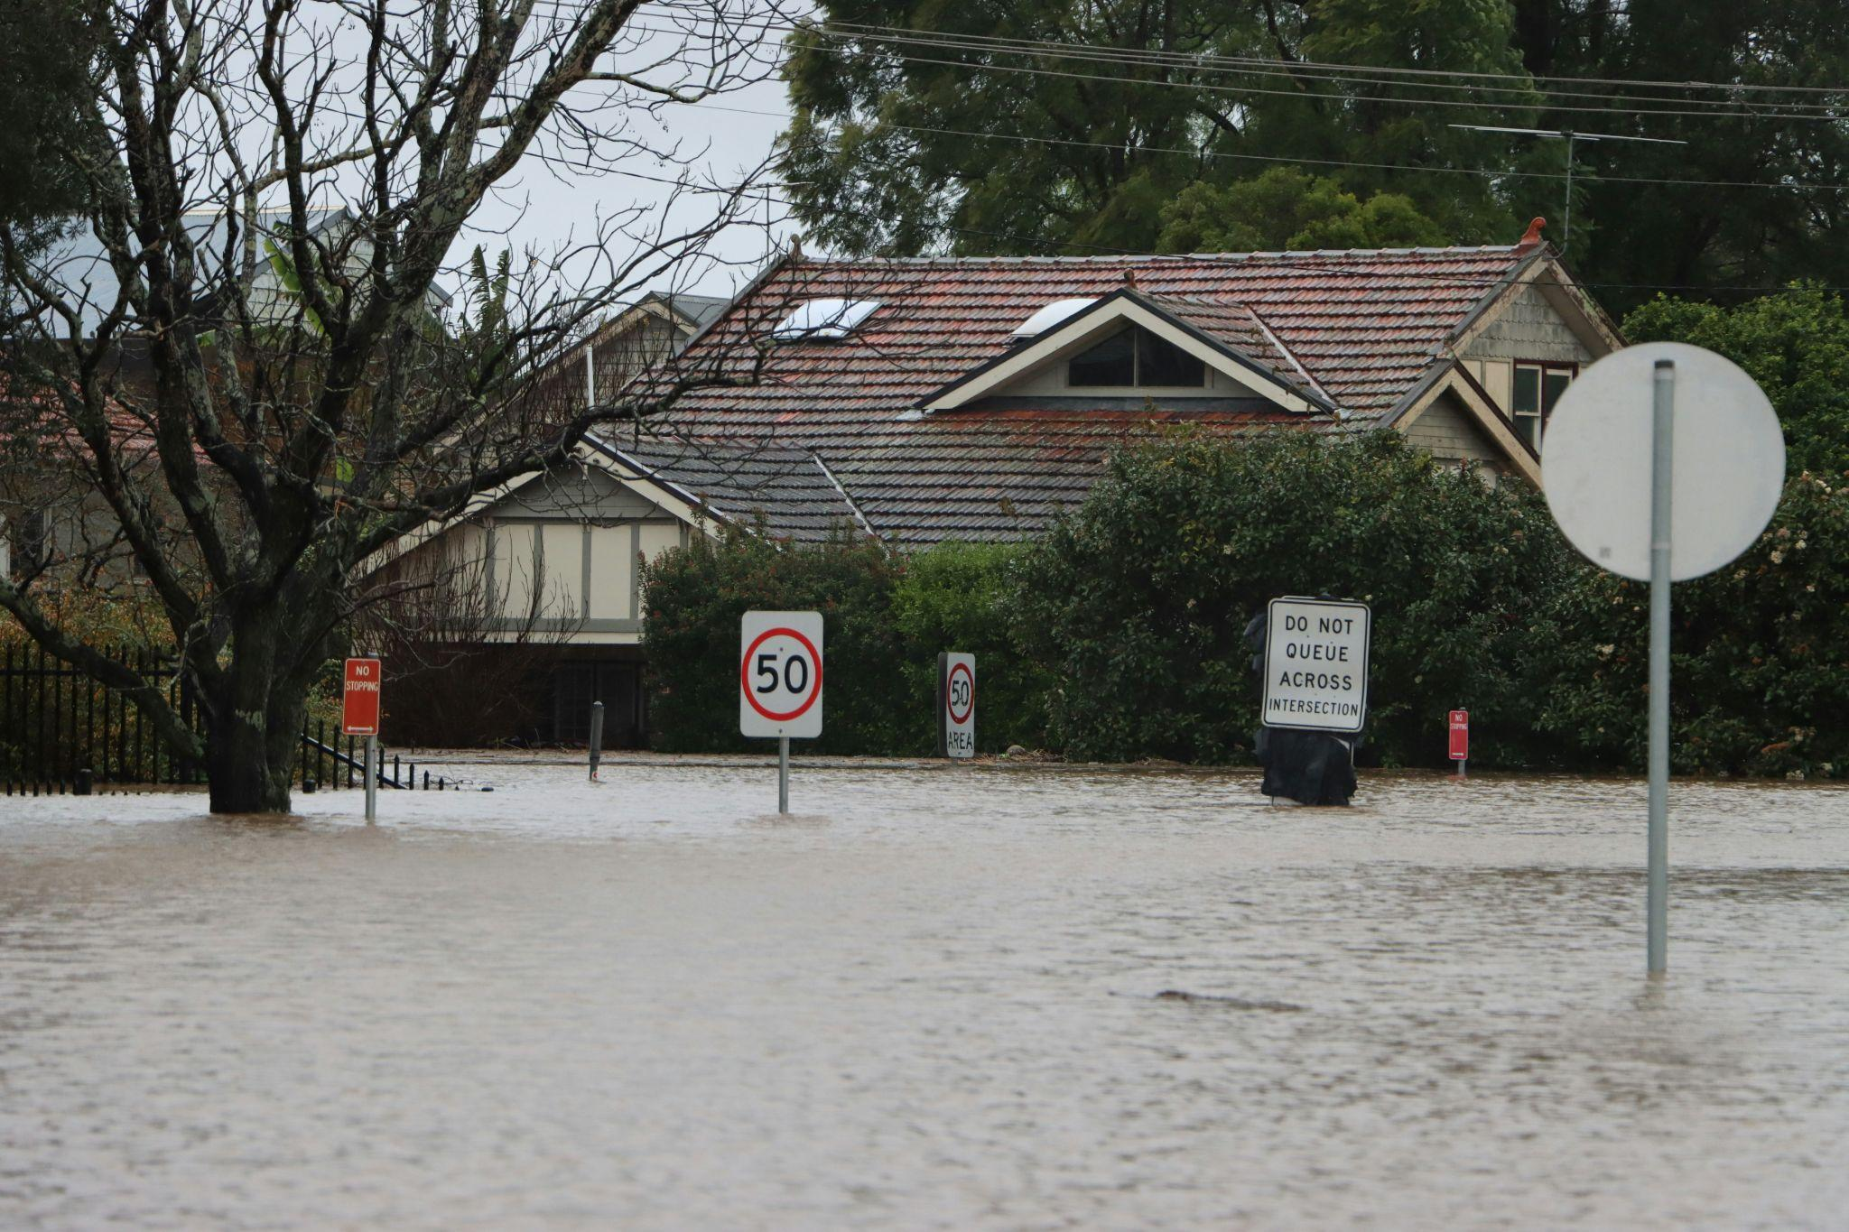
v
ARE THERE ANY OTHER STRATEGIES?
(both directly and bigger picture)
Learning discussion
Notes:
OTHER STRATEGY PROMPTS:
Renewable energy – reduce greenhouse gas emissions driving extreme weather.
Wetland and river restoration – restore natural systems to absorb and slow floodwater.
Improve emergency warning systems – give communities time to prepare or evacuate.
Land-use planning and hazard mapping – avoid building in flood-prone areas.
Community education and preparedness – improve awareness and response planning before floods hit.
END OF LESSON

Slide 26

STUDENT FEEDBACK
LINK
http://bit.ly/4hV8Bka

