Slide 1


Welcome
2018 INDUSTRY SEMINAR SERIES

Slide 2
10 Mistakes Law Graduates Make When Jobseeking
Anthony Lieu
Managing Director of Beyond Law
Head of Marketing and Lawyer at LegalVision

Slide 3

Rethink the design
of your CV
No more than two pages
Front load your experience
Remove old jobs (5+ years)
PDF your documents
Include two referees
Buy a domain name ($15 a year) and set up a professional email

Slide 4

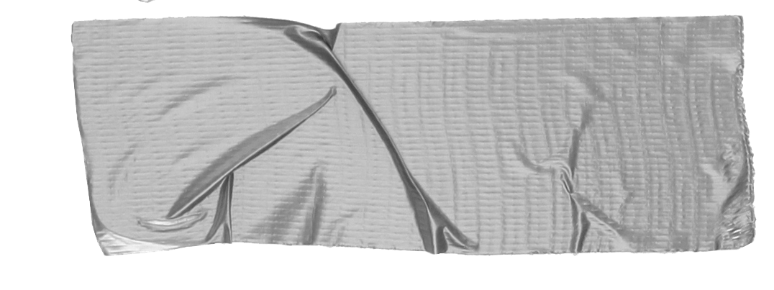

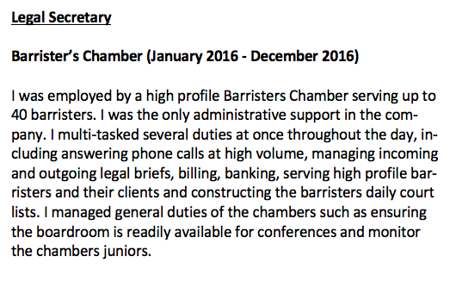
2. Highlight your impact
Avoid doing this:
Don’t just list what tasks you did at your previous job – highlight your impact
  What processes did you improve?
  Did you exceed your targets?
  Did you go beyond your job description?

Slide 5

3. Tie experience in your cover letter
Avoid repeating what was in your CV in your cover letter
Your first two paragraphs are the most important – tie your experience specifically to the job and organisation you are applying for

Slide 6
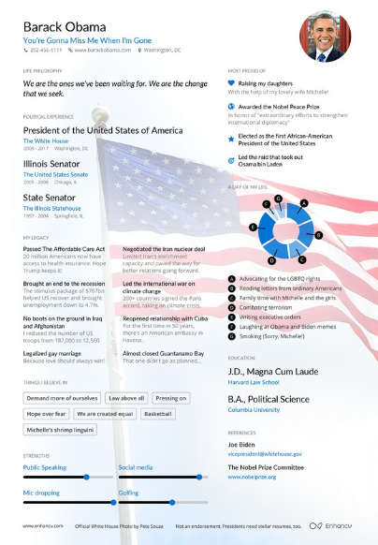
4. Give examples of value-add
Situation
Task
Action
Result

Slide 7
5. Be clear and concise
Keep a cover letter to one page
Use Grammarly or Hemingway

Slide 8

6. Research your employer
Demonstrate the valuable contribution you will make to your future employer
What are their goals? What are their recent achievements?
What is their vision and mission and how do you align to it?

Slide 9

7. Polish up your LinkedIn profile
Get a custom URL and add to CV
Get a professional photo taken
Highlight your accomplishments
Connect with likeminded individuals
Have a clear headline
Law Graduate | Legal Aid Intern | Interested in Fintech and Cryptocurrency

Slide 10
Most jobs getting filled these days aren’t even advertised
8. Be proactive in your
job search
Talk to everyone
Do your research
Sign up to Google News Alerts
Leverage social media

Slide 11
9. Get a third opinion
and read your cover letter aloud!

Slide 12

10. Discover emerging roles in NewLaw

Slide 13
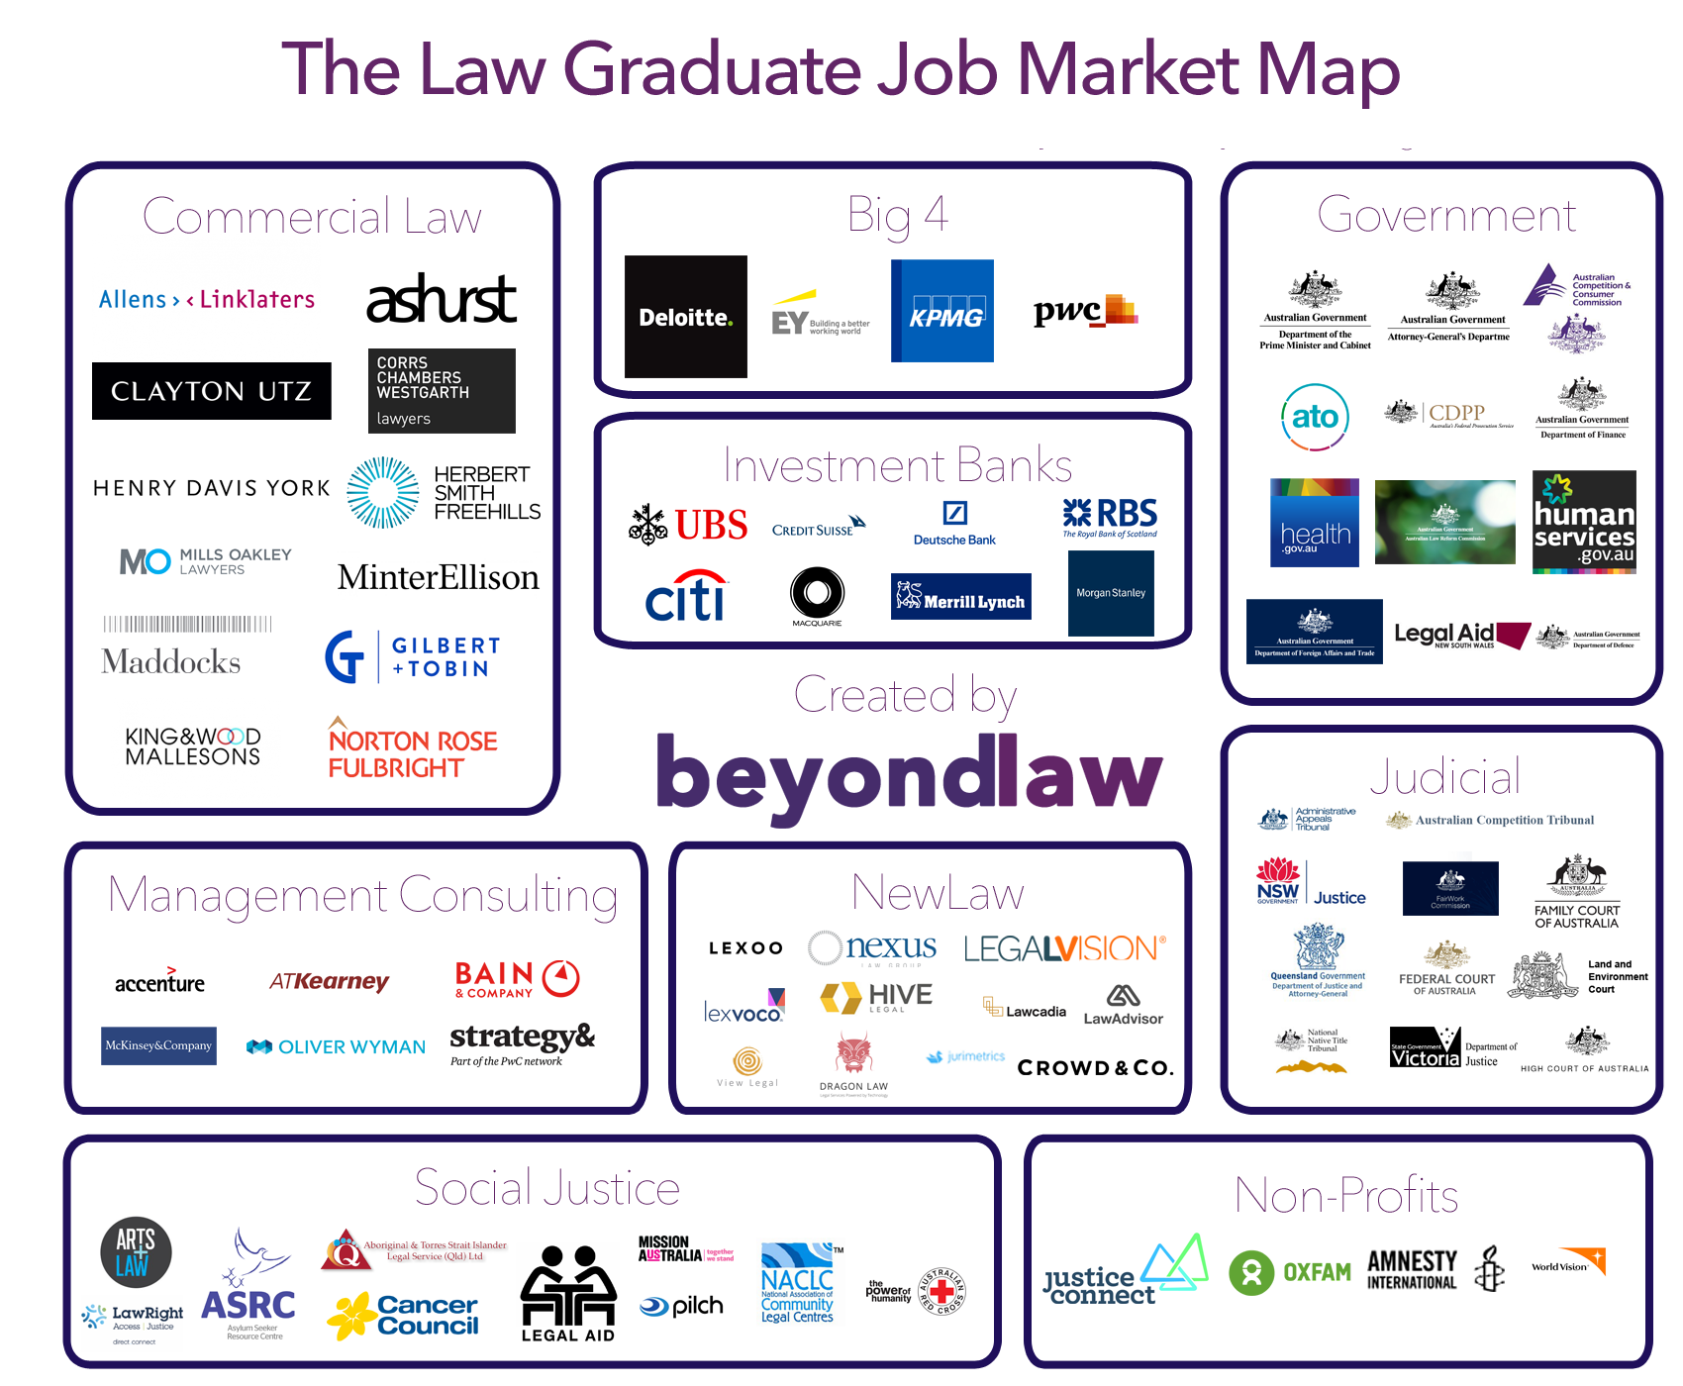
Broaden your horizons

Slide 14
Three things you can do now
1) Review your CV, sharpen the language and only keep what’s relevant
2) Research organisations you want to work for and send an extraordinary cover letter
3) Read someone else’s cover letter and CV and give them feedback

Slide 15
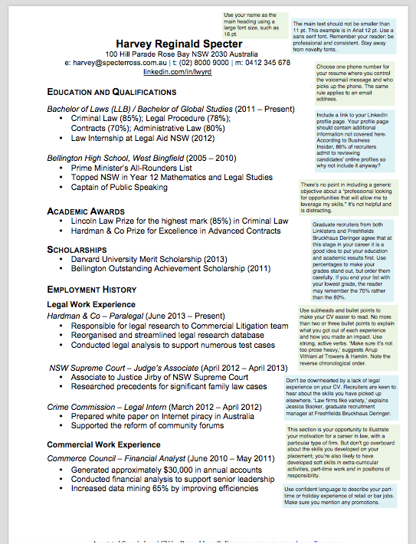
Download a free sample CV
Get your CV and
cover letter
reviewed on
Beyond Law

Slide 16

Good luck!

