Slide 1
Providing an ethical framework to guide prison staff: Laws, procedures and roles
(or chasing rabbits)
HR in Secure Settings
Dr Astrid Birgden
Consultant Forensic Psychologist
Deakin University/Just-Forensic

Slide 2
UN Convention against Torture and Other Cruel, Inhuman or Degrading Treatment or Punishment (1987)
Torture during interrogation is a human rights violation.
Notes:
2

Slide 4
American Ψ Association Presidential Task Force on Psychological Ethics and National Security (PENS) 2005
OK for Ψ to consult or advise (but not assist) in interrogations because:
1. Ψ “have a long-standing tradition of doing in other law enforcement contexts” (p. 1).
2. Ψ are “in a unique position to ensure that these processes are safe and ethical for all participants” (p. 1).
* But, torture in interrogation was outside international human rights law.
Notes:
While the PENS Report recommended that “psychs do not engage in, direct, support, facilitate, or offer training in torture or other cruel, inhuman, or degrading treatment” (p. 1) and “psychologists are alert to acts of torture and other cruel, inhuman, or degrading treatment and have an ethical responsibility to report these acts to the appropriate authorities” (p. 4), the report was ambiguous about the role of psychologists in interrogation, in that it accepted that they may act as consultants and proposed that: …consistent with the APA Ethics Code for psychologists to serve in consultative roles to interrogation and information-gathering processes for national security-related purposes, as psychologists have a long-standing tradition of doing in other law enforcement contexts. Acknowledging that engaging in such consultative and advisory roles entails a delicate balance of ethical considerations, the Task Force stated that psychologists are in a unique position to assist in ensuring that these processes are safe and ethical for all participants. (PENS Report, 2005, italics added, p. 1).
The argument may be that psychologists engaged in interrogation, not torture, But the APA website in 2008 was compelled to say "The effect of (a) new policy is to prohibit psychologists from any involvement in interrogations or any other operational procedures at detention sites that are in violation of the U.S. Constitution or international law (e.g., the Geneva Conventions and the U.N. Convention Against Torture)," says the letter, from APA President Alan E. Kazdin, PhD. "In such unlawful detention settings, persons are deprived of basic human rights and legal protections, including the right to independent judicial review of their detention” and “in this context, international law is given precedence over domestic law”.
If there wasn’t a risk, why was this stated?

Slide 5
AΨA Policy Position
The American Ψ Association:
Weighed “organisational consultant” role against “treatment provider” role.
Weighed “community protection” policy
against “do no harm” ethic principles.
That is, detainee rights were trumped
by community protection and so Ψ
treated detainees as objects or a
means to an ends.
Unethical Ψ Practice
Notes:
The PENS Report (2005) recommended that psychologists were to
demarcate their role of treatment providers (considered inappropriate)
from organizational consultants to interrogators (considered
appropriate).
and
While the PENS Report (2005) had recommended that
psychologists were to reject their treatment provider role in favor of
the organizational consultant role.....
And
“When such (ethical) conflicts arise, psychologists make known their commitment to the APA Ethics Code and attempt to resolve the conflict in a responsible manner. If the conflict cannot be resolved in this manner, psychologists may adhere to the requirements of the law (PENS, 2005, p.4).
The problem was, US law was outside international law.
Later, the APA website says in Feb 2010: “Previously, it appeared that if psychologists could not resolve such conflicts, they could adhere to the law or demands of an organization without further consideration. That language has been deleted and this new sentence added: “Under no circumstances may this standard be used to justify or defend violating human rights” and “the meaning of these two standards (1.02 and 1.03) was called into question during the last Bush administration when the Justice Department issued legal rulings authorizing so-called enhanced interrogation techniques”.
(This slide is my opinion after reading all the stuff)

Slide 6
Ethical Warning
“…unquestioned support for ideological banners of “national security,” or other high-sounding phrases (i.e., community protection/good order & security). In other nations, at other times, that same ideology was used to justify torture and suppression of human rights. Ψ seek objective truth behind slogans and euphemisms, and live by empirical evidence to guide their professional functions” (Zimbardo, 2007, p. 73)

Slide 7
What do various UN declarations have in common?
The right to self-determination or
autonomy and well-being.
Prison staff are ethically obliged to support offender autonomy and well-being.

Slide 8
So, how do prison staff balance offender rights and community rights?
A values-based question

Slide 9
Therapeutic jurisprudence: 3 areas of legal enquiry
The impact of the law can be therapeutic or anti-therapeutic.
Legal rules, procedures and roles have an impact on well-being.
Legal actors should harness the law to be therapeutic and increase offender well-being.
(Wexler, Winick)
Notes:
Three areas to consider are:
1. The law needs to balance individual needs or rights and community protection- it can be libertarian or paternalistic. At a policy level, this may mean changing statutes, court rules and procedures.
2. The legal system may need review and reform to maximise therapeutic effects. At an organisational level this means new procedures, sentencing options, and interagency cooperation.
3. Legal roles means the way legal practitioners behave can decrease or increase resistance to change in defendants.
These areas can contribute to psychological distress in individuals and so lead to law-related psychological dysfunction i.e., make people worse.

Slide 10
Evidence Ethics
Ethical Framework for Closed Environments
1. Does it work?
2. Is it the right thing to do?

Slide 11
Offender as….
Rights-Violator and
Rights-Holder

Slide 12
What are “offender rights”?
(Ward & Birgden, 2007)
1. Legal Right
Prescribed by particular laws (i.e. domestic & international laws)
2. Social Right
Guaranteed by a social institution (e.g. a prison)
3. Moral Right
Based on a moral theory or principle…..

Slide 13
(Ward & Birgden, 2007)
POLICIES
OBJECTS
Personal Freedom
Personal Security
v
Well-Being
Autonomy
Social Recognition
Material Subsistencee
Equality
Notes:
13

Slide 14
2 examples of (organic/soft criteria) culture change strategies

Slide 15
Aim: Motivation + Capacity
 | Offender
The Will
The Way

Slide 16
Aim: Motivation + Capacity
 | Offender | Staff
The Will
The Way

Slide 17
Example 1: Macro
Reducing Reoffending
Framework
(Corrections Victoria)
(Birgden & McLachlan, 2002)
Notes:
17

Slide 18
Corrections Victoria Long-Term Management Strategy
Strengthen CCS
Community
Retention
Home detention
Reduce
Demand
(N=600 beds)
Bail advocacy
Court support
Offending
behaviour
programs
Reduce
Reoffending
(10% prisons,
15% CCS)
Manage
Prison Bed
Demand
Pre and post
release
support
New prisons
Minor works
Meet
Demand
Improve
Prisons
Permanent beds
Relocatable cellular
accommodation
Notes:
Corrections Long Term Management Strategy
In 2001, was tasked with developing a statewide offender rehabilitation framework.

Slide 19
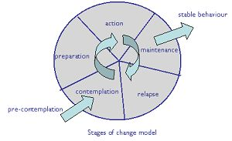
Stages of Change Model
Notes:
An organisational cultural change strategy relies on the staff.
Underpinning the reducing reoffending framework and the offender
management system was the risk-need model, good lives model and
therapeutic jurisprudence and we needed a method to kick start culture change
in Corrections Victoria toward rehabilitation.
The stages of change model is a general explanation of how individuals
change health-related behavior (which may or may not be applicable to
offending behaviour). (Diclement & Pochaska)
We designed 3 stages for staff based on the Stages of Change model:
Setting the scene for change through learning strategies (the will)
Providing staff skills to engage offenders in change (the way)
Maintaining organisational change through ongoing coaching and mentoring.

Slide 20
Culture Change Strategy cont
(Birgden, 2002)
Precontemplation
Contemplation
Preparation
Action
Maintenance
Values & Attitudes
Set the scene for
rehabilitation
Coaching & Mentoring
Case Managers
New Recruits
Skills
Motivational Interactions
+
=
Attitude Change
Behaviour Change
Culture Change
A cognitive-behavioural approach
to culture change
Notes:
3 steps to culture change using Stages of Change:
Step 1: Values and Attitudes
Like it or not, staff bring their personal values and attitudes about offenders to the
workplace.
"Setting the Scene" involved consciousness-raising about "what works" in offender
rehabilitation and tipping the argument toward rehabilitation rather than punishment.
The aim was to create a belief that rehabilitation can work, offenders can change, and a
change in the style of offender management assists.
Step 2: Skills Training
Provided competency-based training in motivational interviewing techniques to staff so
they could case manage offenders with dignity and respect.
For frontline staff to apply as "motivational microbursts" in their day-to-day interactions
with offenders whenever a teachable moment arises.
Step 3: Coaching and mentoring – Case Management System
Senior staff to coach junior staff and an organisational culture of support.
That was initially a pilot as prisons weren’t convinced, but it has since continued.
* The case management system is the engine room for change which is why we knew
we would have to rejig it in Corrections Victoria before we rolled out rehabilitation
programs.

Slide 21
Example 2: Micro
Compulsory Drug
Treatment Correctional
Centre
(Corrective Services
NSW)
(Birgden, 2008, Birgden & Grant, 2010)
Notes:
21

Slide 22
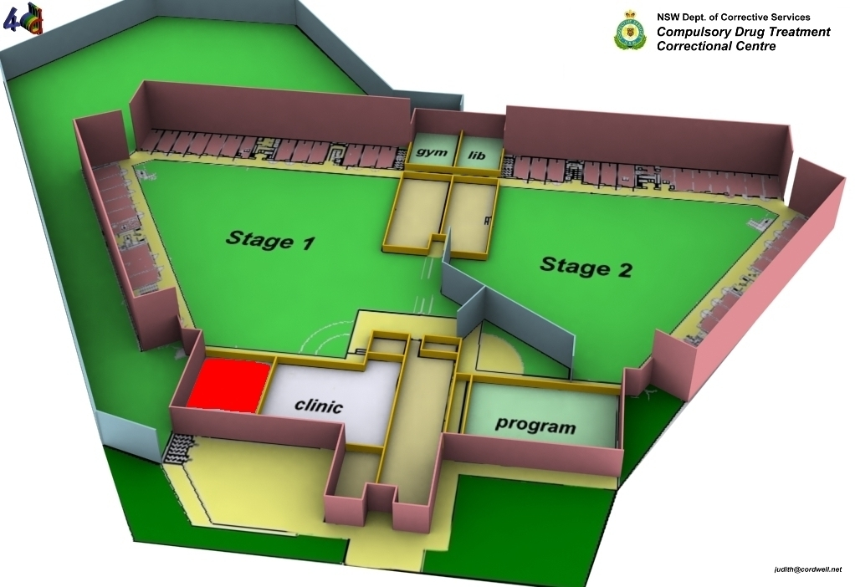
Notes:
22

Slide 23
Compulsory Drug Treatment Correctional Centre Act (2004)
4 Objectives
1. Treat drug dependency, eliminate drug use while in the program, and reduce likelihood of relapse on release.
2. Prevent and reduce crime in relation to drug dependency.
Promote reintegration into the community.
4. Provide a comprehensive program of compulsory treatment & rehabilitation under judicial supervision.
Notes:
The program is designed for repeat drug-related male offenders who commit crime to support drug dependence.
Stage 1- secure detention for about 8 months
Stage 2- semi-secure detention for at least 6 months
Stage 3- community custody until eligible for parole

Slide 24
Social Needs
Family & social
supports
Meaningful work & education
Leisure activities
Healthy functioning
Being safe
Choices
Intimate r’ships
Competence & mastery
Psychological Needs
Notes:
24

Slide 25

In changing organisational
culture, senior managers need
to respond every time
staff digress from the
agreed ethics & values of
the program. I call this
“chasing rabbits down holes”,
and, as one of my staff said-
you may even need to get right in
the hole!

Slide 26
NSW BOCSAR EVALUATION
(July 2010, N=95)
4% in Stage 1 (secure) and 0% in Stage 2 (semi-open) felt that they would prefer mainstream gaol.
100% in Stage 3 (community) said Program had changed their life- drug-free + improved problem-solving skills/self-awareness/ decision-making + sorting out finances/ housing/social supports (N = 13).
Improved scores on mental/physical health.
Low perceived coercion scores and high therapeutic alliance scores.
84% perceived their admission as voluntary!
(Dekker, O’Brien & Smith, 2010)

Slide 27
Correctional Services should be…
A human service system
Not a paramilitary organisation!

Slide 28
Ethical Practice
Don’t treat offenders as a means to an end for “community protection”.
Do support offender autonomy and well-being to meet needs (for the offender) and manage risk (for the community).

Slide 29
The best argument for observing human rights standards is not merely that they are required by international or domestic law but that they actually work better than any known alternative- for offenders, for correctional staff, and for society at large. Compliance with human rights obligations increases, though it does not guarantee, the odds of releasing a more responsible citizen. In essence, a prison environment respectful of human rights is conducive to positive change, whereas an environment of abuse, disrespect, and discrimination has the opposite effect: Treating prisoners with humanity actually enhances public safety. Moreover, through respecting the human rights of prisoners, society conveys a strong message that everyone, regardless of their circumstance, race, social status, gender, religion, and so on, is to be treated with inherent respect and dignity (Zinger, 2006, p. 127).
Notes:
29

Slide 30
References
Birgden, A. (2004). Therapeutic jurisprudence and responsivity: Finding the will and the way in offender rehabilitation. Crime, Psychology & Law, 10(3), 283-296.
Ward, T., & Birgden, A. (2007). Human rights and clinical correctional practice. Aggression and Violent Behaviour, 12(6), 628-643.
Birgden, A. (2008a). A compulsory drug treatment program for offenders in Australia: Therapeutic jurisprudence implications. Thomas Jefferson Law Review, 30, 367-389.
Reprinted:www.bfcsa.nsw.gov.au/__ data/assets/pdf_file/0007/196423/A_compulsory_drug_treatment_program.pdf
Birgden, A., & Grant, L. (2010). Establishing a compulsory drug treatment prison: Therapeutic policy, principles, and practices in addressing offender rights and rehabilitation. International Journal of Psychiatry and Law, 33, 341-349
astrid99@hotmail.com
Notes:
30

