Slide 1
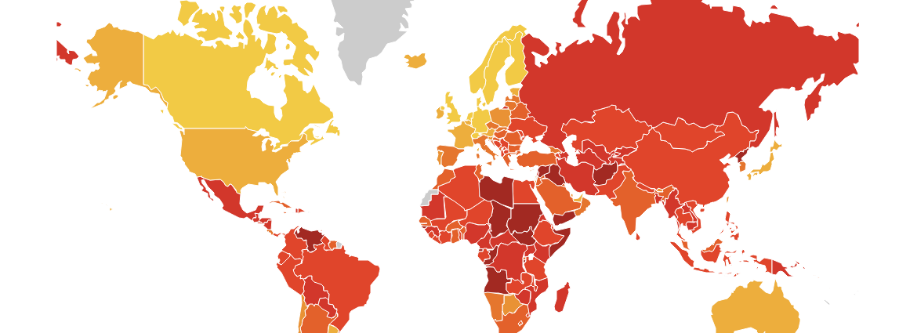
The role of contextual norms on managers’ corrupt behavior
Kiky Srirejeki, Vincent Chong, Stijn Masschelein
University of Western Australia

Slide 2

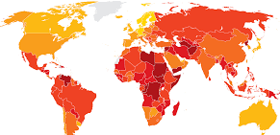
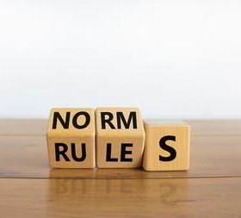
Background & Motivation
The quantitative scale
The geographic reach
Contextual norms
US$ 1 trillion bribes paid each year (World Economic Forum, 2019).
57% of public procurement involves bribery (OECD, 2014)
Global corporations engage in corrupt practices in countries where most of its government officials are corrupt: e.g: Siemens, British Aerospace company, etc.
Different bureaucracy and how the business works.
Dynamic interaction between parties (i.e., managers & officials).

Slide 3

Study 1:
Corrupt behavior as a strategic choice (other-group norms)

Slide 4

Rational Choice Theory
Parametric choice
Strategic choice
The decision made by an individual is independent of other individuals’ decisions.
Choosing parametrically: maximize the utilitiies relative to parameters that are set by the environment. 🡪 game against “nature”.
Individuals’ corrupt behavior is based on the individuals’ calculation of risk and return of corrupt behavior.
Eg: studies that emphasize individuals’ cultural attitude (e.g.,: Fisman & Miguel, 2007; Cameron et al., 2009); the role of partisan preferences (e.g., Anderson & Tverdova, 2003; Anduiza et al., 2013), the effect of risk tolerance (e.g., Becker, 1968; Lee & Guven, 2013).
The decision made by an individual is dependent of other individuals’ decisions.
The calculation of the cost and benefit of corrupt behavior becomes fundamentally interdependent with the corrupt behavior of others 🡪 game against “minds”.
Corrupt behavior can be strategic complementarity 🡪 the expected return of engaging in corrupt behavior increases the more other individuals do so and vice versa.
E.g., Corrupt behavior as the results of social norms (Bicchieri & Xiao, 2009, Abbink et al., 2018; Köbis et al., 2015).

Slide 5




Calculation of cost & benefit of corrupt behavior is fundamentally interdependent with the corrupt behavior of others.
Other-group norm
Bribe
Honest
Bribe-Bribe Bribe wins | Bribe-Honest
Honest-Bribe | Honest-Honest Honest wins
Bribe
H: The managers are more likely to offer (not offer) the bribe when officials are more likely to accept (reject) the bribe.
Honest

Slide 6
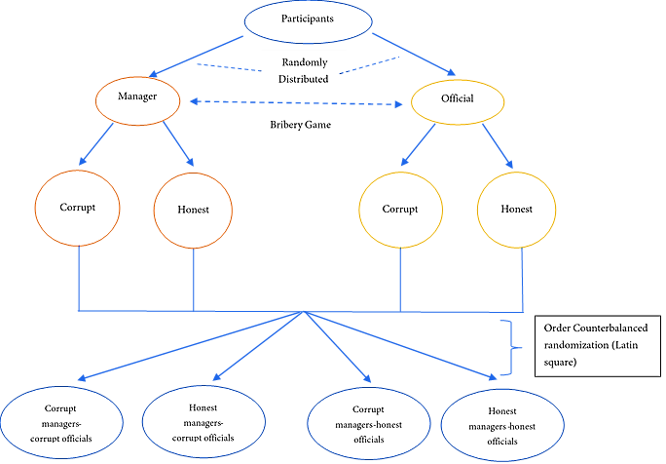
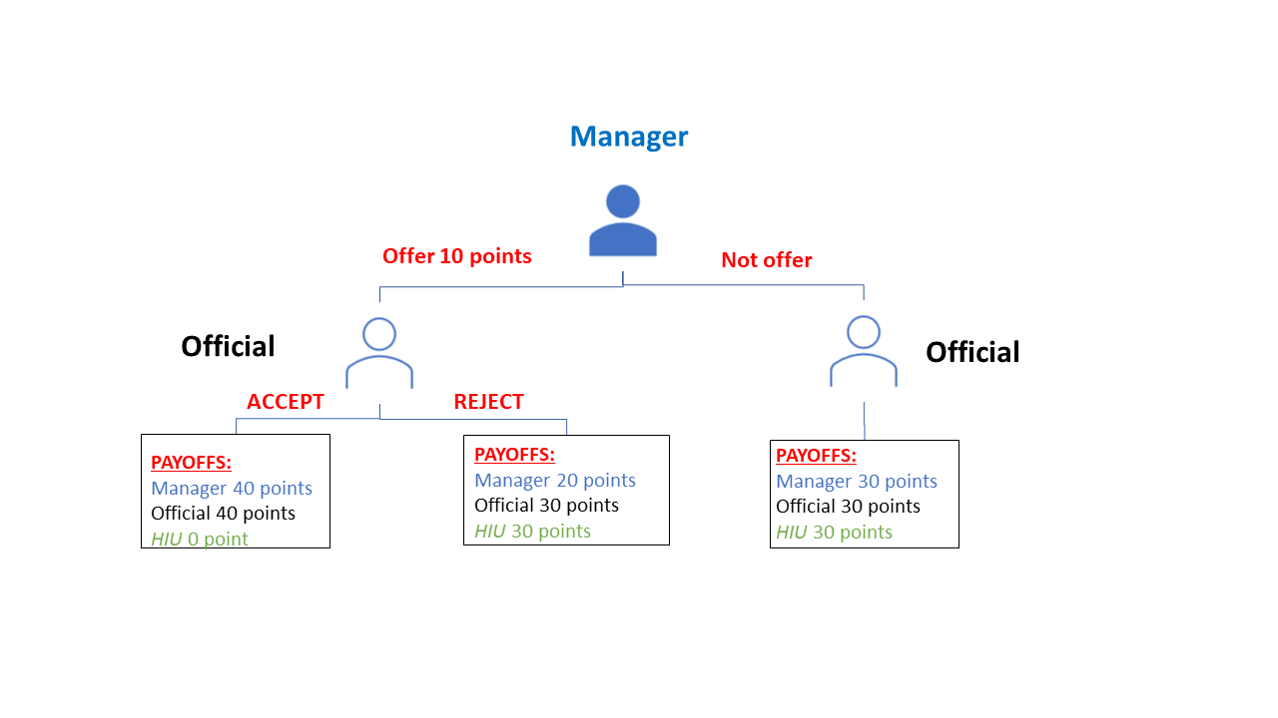
Research Method
Bribery Game
Initial stage
(5 rounds)
Main stage

Slide 7

Research Method
Experimental Bribery Game
Participants
110 participants from Prolific.
4.5 years work experience.
14 different nationalities.
Decision : binary
Programmed in O-tree.

Slide 8
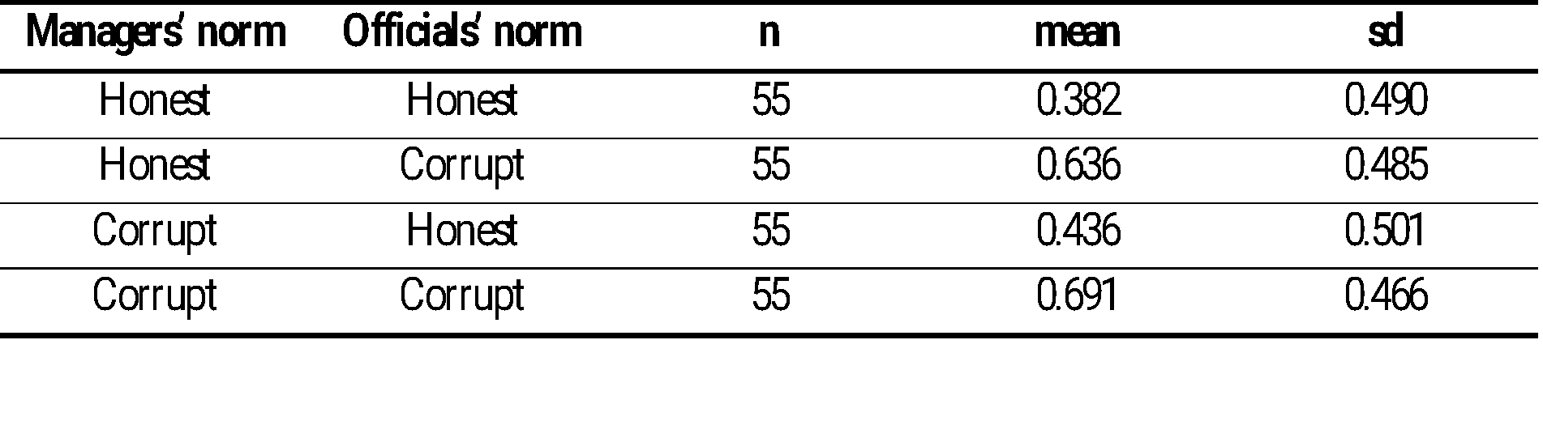
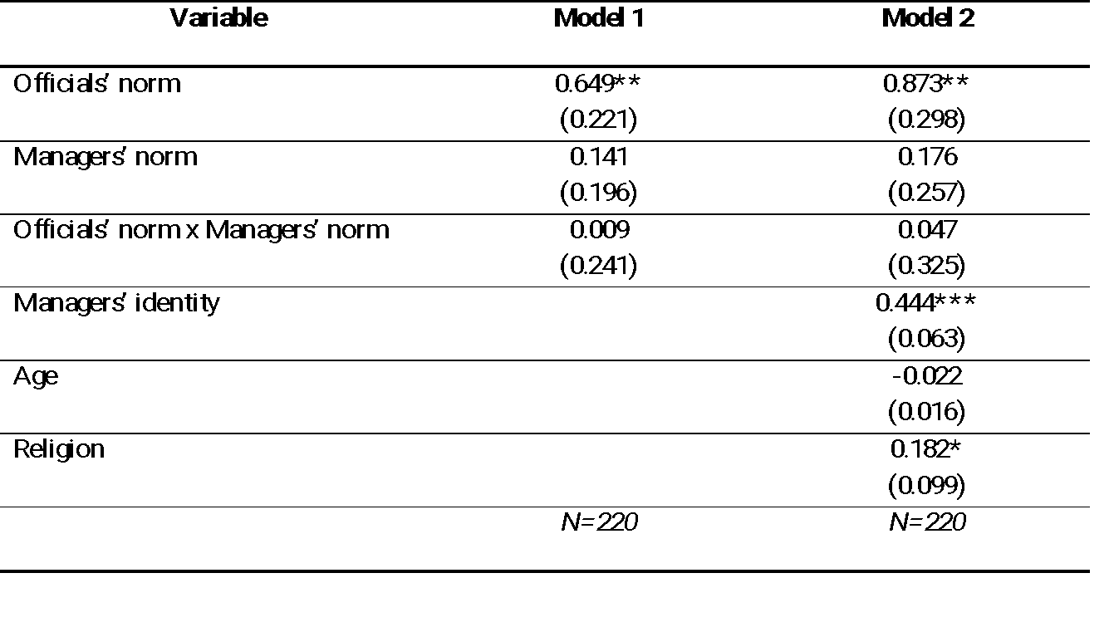
Results
Descriptive statistics of managers’ bribe offers
Probit regression analysis
The behavioral norm of other-group (i.e. official) affect managers’ corrupt behavior (the effect of other-group norms).
Managers’ corrupt behavior is driven by strategic complementarity
Managers consider the behavioral norm of the group that is relevant to their payoffs (i.e., officials’ norm).
*** p < 0.001; ** p < 0.01; * p < 0.1

Slide 9
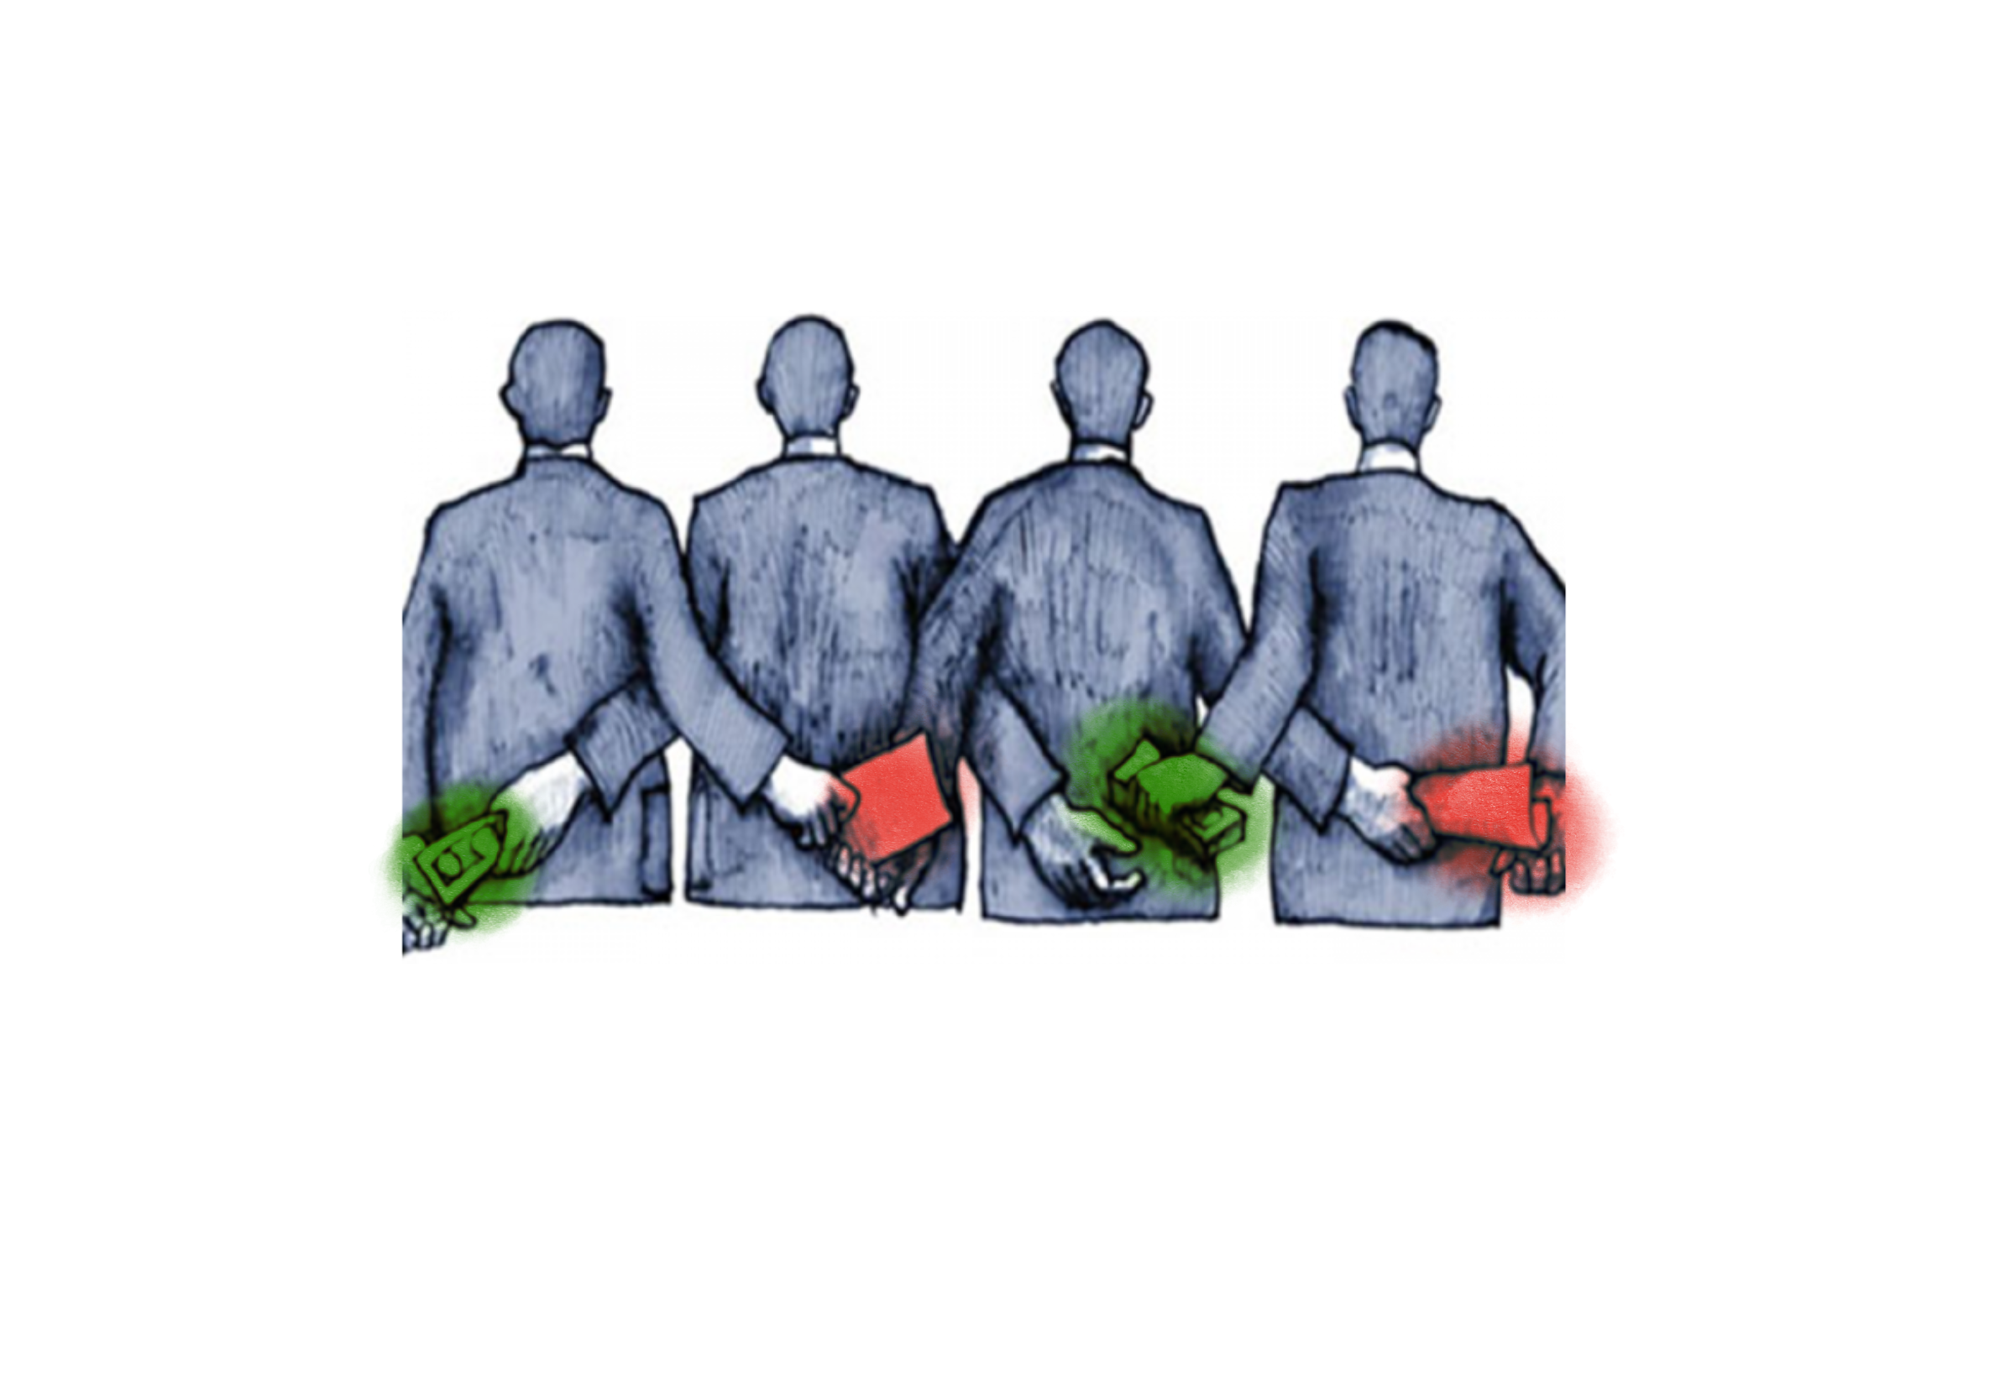
Study 2:
Corrupt behavior as a collective reputation (in-group norms)

Slide 10






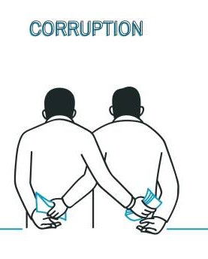
Social Norm Theory
Behavior of others 🡪 situational cues
Information
Social Norm Theory
Affiliation
Cheap shortcut to make decision
Individuals behaviors depend on their perception of their relation to the group
Probability of detection diminish
In a corrupt environment, bribery is better off.
Plenty of potential accomplice
Complicity diminish
In-group norm
H: The managers are more likely to offer (not offer) the bribe when other managers are more likely to offer (not offer) the bribe

Slide 11
Research Method
Experimental Bribery Game
Participants
81 participants from Prolific.
Average managerial experience : 10.8 years.
9 different nationalities.
Context-rich vignette.
Decisions: Scale (0-10).
Programmed in O-tree.

Slide 12
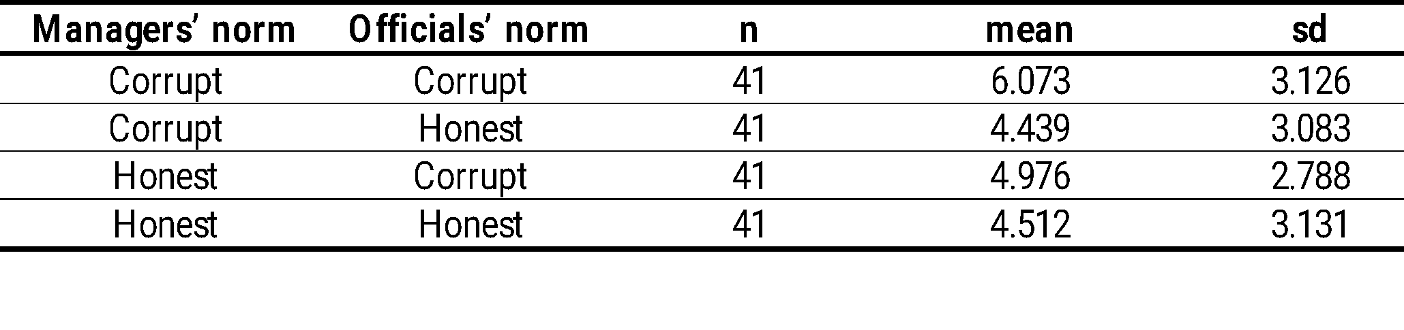
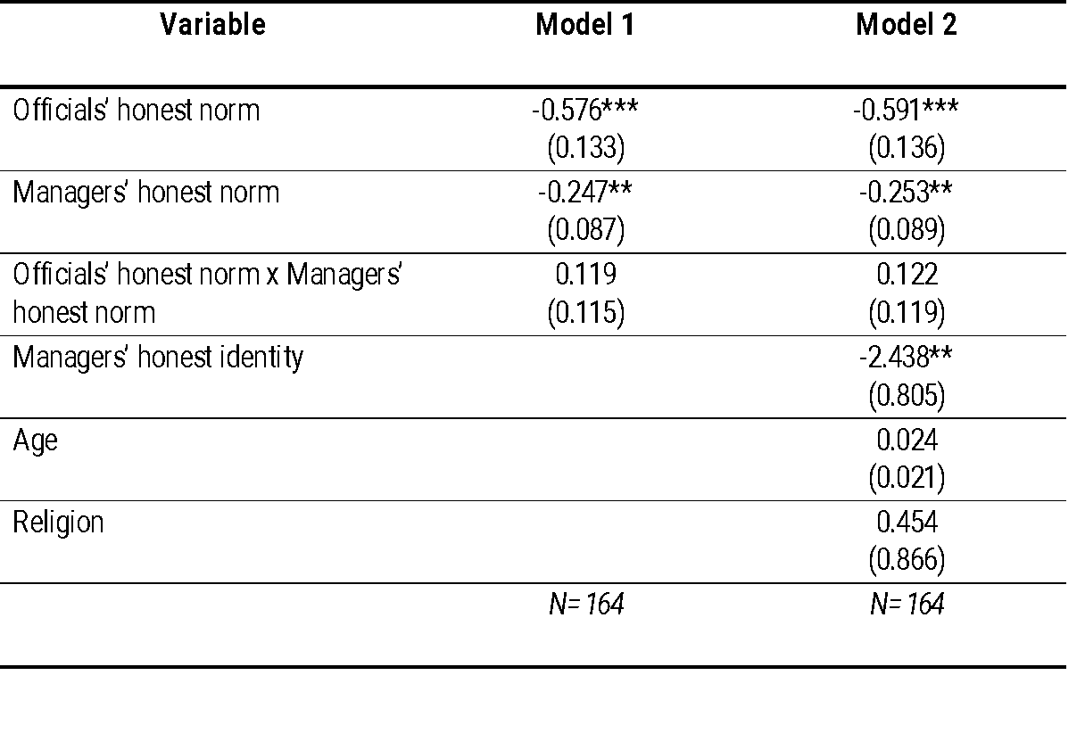
Results
Descriptive statistics of managers’ bribe offers
Regression analysis
The behavioral norm of other-group (i.e. official) affect managers’ corrupt behavior (the effect of other-group norms; confirm Study 1).
Observation of other managers’ norms also influence managers’ corrupt decision (the effect of in-group norms).
Managers value their affiliation to their group 🡪 collective reputation matters in an individual’s corrupt behavior.
*** p < 0.001; ** p < 0.01; * p < 0.1

Slide 13


Discussion & Conclusion
Managers’ corrupt behavior 🡪 strategic consideration.
For managers to get the best outcome, it is strategic to offer bribes when their associated partners are corrupt, because the chance that their bribe offer being accepted is very likely.
  The chance to get corrupt partners is higher, the risks of rejection is lower.
Managers’ corrupt behavior 🡪 observation of dynamic relationship among actors.
Individuals follow group norm (Bicchieri, 2016) 🡪 social cues, when everybody else does it, it means okay to do it.
  Provide information on what to do in a certain situation (Tayler & Bloomfield, 2011; O’Fallon & Butterfield, 2012).
Group reputation matters in individual’s decision to corrupt -> in a group with corrupt reputation, the incentive to corrupt is higher than in a group with honest reputation (Tirole, 1996).
  The sense of guilt to corrupt is less.

Slide 14


Discussion & Conclusion
In a corrupt environment, transparency can bring painful repercussion
Reveal corrupt norm 🡪 Potentially corrupt managers are more confident in the complicity of associated corrupt partners.
  Recent studies show that organizational transparency allows ill-intended employees to find accomplices and initiate collusion (Evans et al., 2016; Maas & Yin, 2022).
  When there are strong norms of corruption, increasing transparency might be less beneficial to curb corrupt behavior.
  Anti-corruption policymakers should be responsive to the situation, common practice and context of those they seek to regulate 🡪 anti-corruption policy should require a diversity of regulatory strategies to be more context-appropriate.
Group composition matters in influencing individual’s corrupt behavior
Through our unique set of studies, we can provide evidence that individuals adapt to group dynamics: when their group is corrupt, they are more likely to corrupt and vice versa.

Slide 15
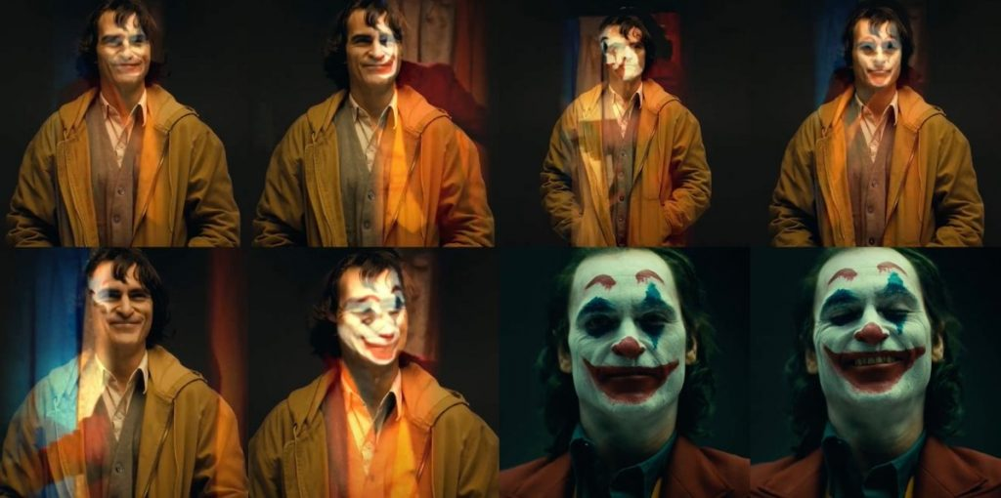

Slide 16
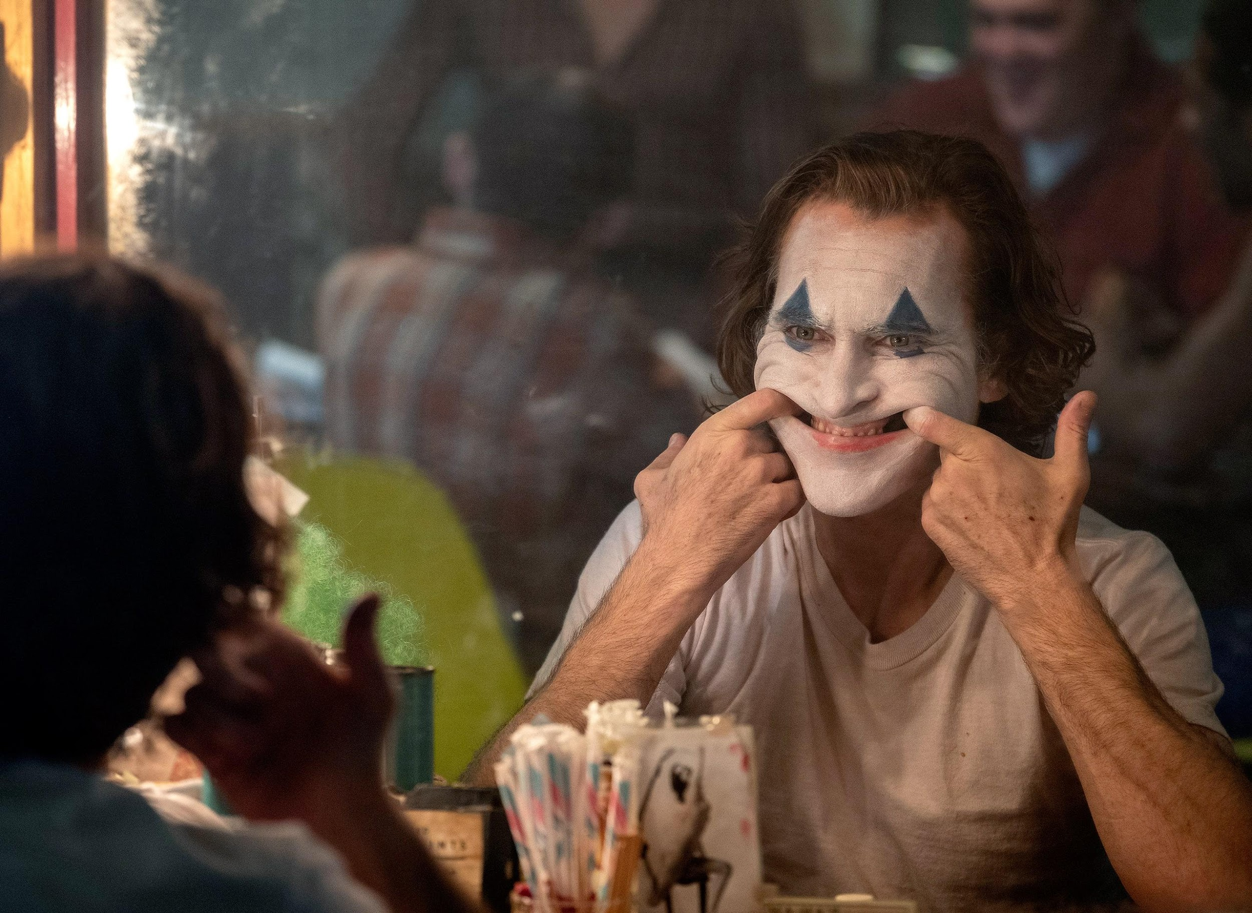
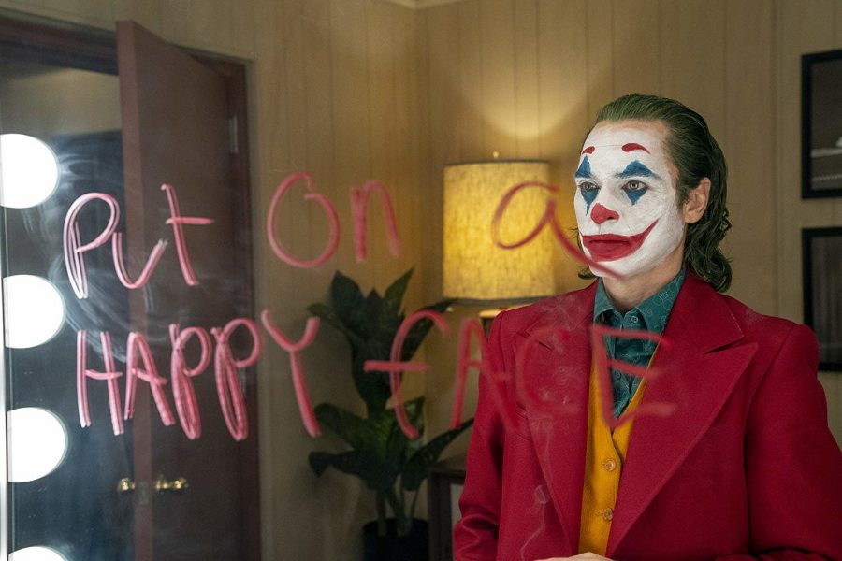
Thank you

