Slide 1
Appropriate use of antidepressant medications for changed behaviours in people living with dementia
Education Activity
Centre for Medicine Use and Safety (CMUS)

Slide 2





Introduction
Background
Dementia is associated with a deterioration in:^{1,2}
  Memory
  Thinking
  Behaviour
  Communication
  Ability to perform daily activities

Slide 3




Introduction
Dementia and changed behaviours
People living with dementia often experience changed behaviours. Changed behaviours are diverse and may include:
  Wandering e.g. walking aimlessly and/or excessively, attempting to exit a safe location³
  Anxiety e.g. thoughts of worry, fearfulness and behaviours such requests for reassurance^{2,3}
  Depressive symptoms e.g. hopelessness, tearfulness, loss of interest, withdrawal, changes in appetite, sleep disturbances and suicide ideation (e.g. a person is thinking or planning to take their own life)^{2,3}
  Sleep disturbances e.g. difficulty falling or staying asleep³

Slide 4
Introduction
Care for people living with dementia and changed behaviours
Care for people living with dementia and changed behaviours can be split into two broad strategies:
Non-pharmacological strategies
Definition: non-medication strategies
Examples: pet therapy, exercise therapy, art therapy^{2,3}
Pharmacological strategies
Definition: medication strategies
Example: psychotropic medications
Royal Commission into Aged Care Quality and Safety⁴ defines a psychotropic medication as:
“Any drug capable of affecting the mind, emotions, and behaviour”

Slide 5

Introduction
Use of Psychotropic Medications in People Living with Dementia and in Residential Aged Care
The Royal Commission into Aged Care Quality and Safety Interim Report: Neglect highlighted an overreliance on psychotropic medications⁵
Psychotropic medications such as antidepressants are associated with adverse outcomes for people living with dementia:
  Sedation e.g. drowsiness, sleepiness
  Falls
  Agitation

Slide 6

Introduction
Clinical Practice Guideline for Appropriate Use of Psychotropic Medications in People Living with Dementia and in Residential Aged Care
Three most common psychotropic medications implicated in restrictive practice in residential aged care are:
  Antipsychotics
  Benzodiazepines
  Antidepressants⁴
The new clinical practice guideline focuses on the appropriate medication use of antipsychotics, benzodiazepines and antidepressants

Slide 7
Group discussion - what is an antidepressant?

Slide 8

What is an antidepressant?
An antidepressant is a class of medication that can be used for:^{4,6}
  symptoms of depression
  anxiety disorders
  obsessive compulsive disorder
Some examples of antidepressants include citalopram, escitalopram, mirtazapine and sertraline
Sometimes antidepressants are prescribed to people living with dementia and changed behaviours
One Australian study⁷ reported 37% of residents are dispensed an antidepressant within three months of admission to residential aged care, with higher rates of antidepressant use among residents living with dementia

Slide 9
Group discussion - When could antidepressants be considered for people living with dementia and changed behaviours?

Slide 10

The place of antidepressants in the care of a person living with dementia
Antidepressants could be considered for if a person living with dementia develops:
  Moderate major depressive disorder AND who have previously taken an antidepressant that worked, or
  Severe major depressive disorder, or
  Depressive disorder with suicidal ideation and/or risk of self-harm (e.g. a person who is deliberately causing pain or damage to their own body)

Slide 11
Learning Objectives
By the end of this session, you should be able to:
  Describe the potential adverse events of an antidepressant for people living with dementia and changed behaviours
  Specify the criteria for escalating care surrounding adverse events and monitoring of antidepressant
  Explain what should be documented surrounding adverse events and monitoring of antidepressant
  Be aware of supporting resources accompanying the Guideline to use in everyday practice

Slide 12
Adverse events and monitoring of antidepressants
Image from freepik

Slide 13
Prescribers' responsibilities surrounding antidepressant initiation
What steps should prescribers complete and document before initiating an antidepressant?
Clinical Steps
Identify the specific changed behaviour you want to improve (target symptom)
  e.g. sadness, loss of interest
Identify the anticipated treatment outcome
  e.g. more interest in usual activities and hobbies they enjoy
Complete an individual harm-benefit analysis
Communication and documentation steps
Comprehensive discussion with the person living with dementia, support person and/or their substitute decision maker
Obtain informed consent
Document date to review the antidepressant
  e.g. review antidepressant in two weeks

Slide 14
Group discussion - what is an adverse event?

Slide 15


What is an adverse event?
Therapeutic Goods Administration (TGA)* defines as:
“Unintended and sometimes harmful occurrences associated with the use of a medicine, vaccine or medical device (collectively known as therapeutic goods). Adverse events include side effects to medicines and vaccines, and problems or incidents involving medical devices”.⁸
*The TGA is part of the Department of Health and Aged Care, Commonwealth of Australia. The TGA is responsible for ensuring that therapeutic goods (including medicines) available in Australia are safe

Slide 16
Group discussion - what are some adverse events of antidepressants?

Slide 17







What are some adverse events of antidepressants?
Insomnia;
  Difficulty getting to sleep
  Difficulty staying asleep
Fatigue
Falls
Serotonin syndrome
  When the body has too much serotonin
  Some symptoms are confusion, sweating, diarrhoea and muscle twitches
  It can be life threatening
Nausea
Agitation
  excessive fidgeting, pacing, irritability
Hyponatraemia;
  Low sodium levels in the blood
QT prolongation
  Abnormal heart rhythms
Bleeding risk
Anticholinergic symptoms
  Dry mouth
  Difficulty emptying your bladder
Diarrhea or constipation
Please refer to the Guideline for more information on antidepressant adverse events

Slide 18
Monitoring of antidepressants
What do we monitor when a person living with dementia is initiated an antidepressant for changed behaviours?
Clinical steps
Effect of the antidepressant on the target symptom
  Has the target symptom improved?
  Has the target symptom remained unchanged?
  Has the target symptom worsened?
3. Adverse events
  Is the person experiencing an adverse event?
  Is the person not experiencing an adverse event?
5. Consent
  Has the person who initially gave consent withdrawn consent?
2. Effect of antidepressant on day to day activities
  Is the person maintaining the same level of independence?
  Is the person still able to engage in activities that maintain quality of life?
  Is the person still able to maintain activities of daily living?
4. Adherence
  Is the person taking citalopram as prescribed?
  Is the person not taking citalopram as prescribed?
You have a crucial role during the monitoring process
Antidepressants should NOT be considered as an alternative to non-pharmacological strategies

Slide 19
Monitoring of antidepressants
What do we monitor when a person living with dementia is initiated an antidepressant for changed behaviours?
Communication and documentation steps
Document your observations
Contact the prescriber
Notify the care team
Document conversation with the prescriber and the plan going forward
Recommend an assessment by a psychiatrist, geriatrician and/or older person’s mental health team
You have a crucial role during the monitoring process
Antidepressants should NOT be considered as an alternative to non-pharmacological strategies

Slide 20

Case study
Jack Jones is a person living with Alzheimer’s dementia at Sunnyside residential aged care facility
12 months after becoming a resident, Jack develops depressive symptoms. Jack’s older person’s psychiatrist, Dr. Geffrey Miles, reviews him and concludes that Jack is experiencing severe major depressive disorder for the first time
Dr. Geffrey obtains consent from Jack and initiates an antidepressant, citalopram 10mg oral in the morning
Image from freepik

Slide 21
Case study
Small groups
Read the Case study
Discuss questions 1 and 2 over the next 15 minutes
Prepare answers to share in group discussion

Slide 22
Review of case study questions
Group discussion
Question 1a. Since Jack is initiated an antidepressant for severe major depressive disorder, what five points should you monitor?

Slide 23
Review of case study questions
Group discussion
Question 1a. Since Jack is initiated an antidepressant for severe major depressive disorder, what five points should you monitor?
Clinical steps
Effect of the antidepressant on the target symptom(s)
  Has Jack’s depressive symptoms improved?
  Has Jack’s depressive symptoms stayed the same?
  Has Jack’s depressive symptoms worsened?
3. Adverse events
  Is Jack experiencing an adverse event?
    e.g. Jack is experiencing diarrhoea
  Is Jack not experiencing an adverse event?
5. Consent
  Has Jack who initially gave consent withdrawn consent?
2. Effect of antidepressant on day to day activities
  Is Jack maintaining the same level of independence?
  Is Jack still able to engage in activities that maintain quality of life?
    e.g. Jack was too nauseous to play cards
  Is Jack still able to maintain activities of daily living?
    e.g. Jack was too dizzy to have a shower alone
4. Adherence
  Is Jack taking citalopram as prescribed?
  Is Jack not taking citalopram as prescribed?
    e.g. Jack refuses to take citalopram most days
You have a crucial role during the monitoring process!

Slide 24
Review of case study questions
Group discussion
Question 1b. Since Jack is initiated an antidepressant for severe major depressive disorder, what should you communicate and document during the monitoring process?
Communication and documentation steps
Document your observations
  e.g. Jack delivered the newspapers to three residents this morning and had a brief chat with them. Jack did not want to play his usual card game with other residents this afternoon
Contact the prescriber
Notify the care team
Document conversation with prescriber and plan going forward
  e.g. Dr Mary reviewed Jack today and we discussed his progress. The plan going forward for Jack is xxxx
Recommend an assessment by a psychiatrist, geriatrician and/or older person’s mental health team
You have a crucial role during the monitoring process!
Antidepressants should NOT be considered as an alternative to non-pharmacological strategies

Slide 25

Case study
Five days after commencing citalopram, Jack approaches you and reports he is feeling nauseous
Jack explains, “My stomach is feeling real crook. I won’t be able to deliver the newspapers this morning”
Jack continues to experience nausea over the next two days
Image from freepik

Slide 26
Review of case study questions
Group Discussion
Question 2. What practical steps do you take when Jack experiences nausea?

Slide 27
Review of case study questions
Group Discussion
Question 2. What practical steps do you take when Jack experiences nausea?
Clinical steps
Assess Jack’s symptoms
Start a food and fluid chart
Implement strategies to assist Jack with nausea
Communication and documentation steps
Contact the prescriber
Document incident in notes
Document conversation with prescriber and plan going forward
  Contacted Dr. Mary about Jack’s nausea. She said she will contact the pharmacist, Richard, for advice and call back this afternoon
  Dr. Mary called back at 1400. Richard advised that nausea is a potential adverse event of citalopram. Richard recommends citalopram should be taken with or soon after food. Dr. Mary advises to give citalopram with Jack’s breakfast and continue to monitor for nausea
Ask for medication review
Regardless of the adverse event, all staff should implement clinical steps and communication and documentation steps when a person living with dementia experiences an adverse event

Slide 28


Take home messages
If an antidepressant is initiated, all staff are responsible for monitoring:
  Any effect on target symptoms
  Adverse events
  Adherence
All monitoring points should be documented and communicated to the entire care team, including the prescriber
Staff should recommend an assessment by a psychiatrist, geriatrician and/or older person’s mental health team
  Any effect on day-to-day activities
  Consent
You have a crucial role during the monitoring process

Slide 29
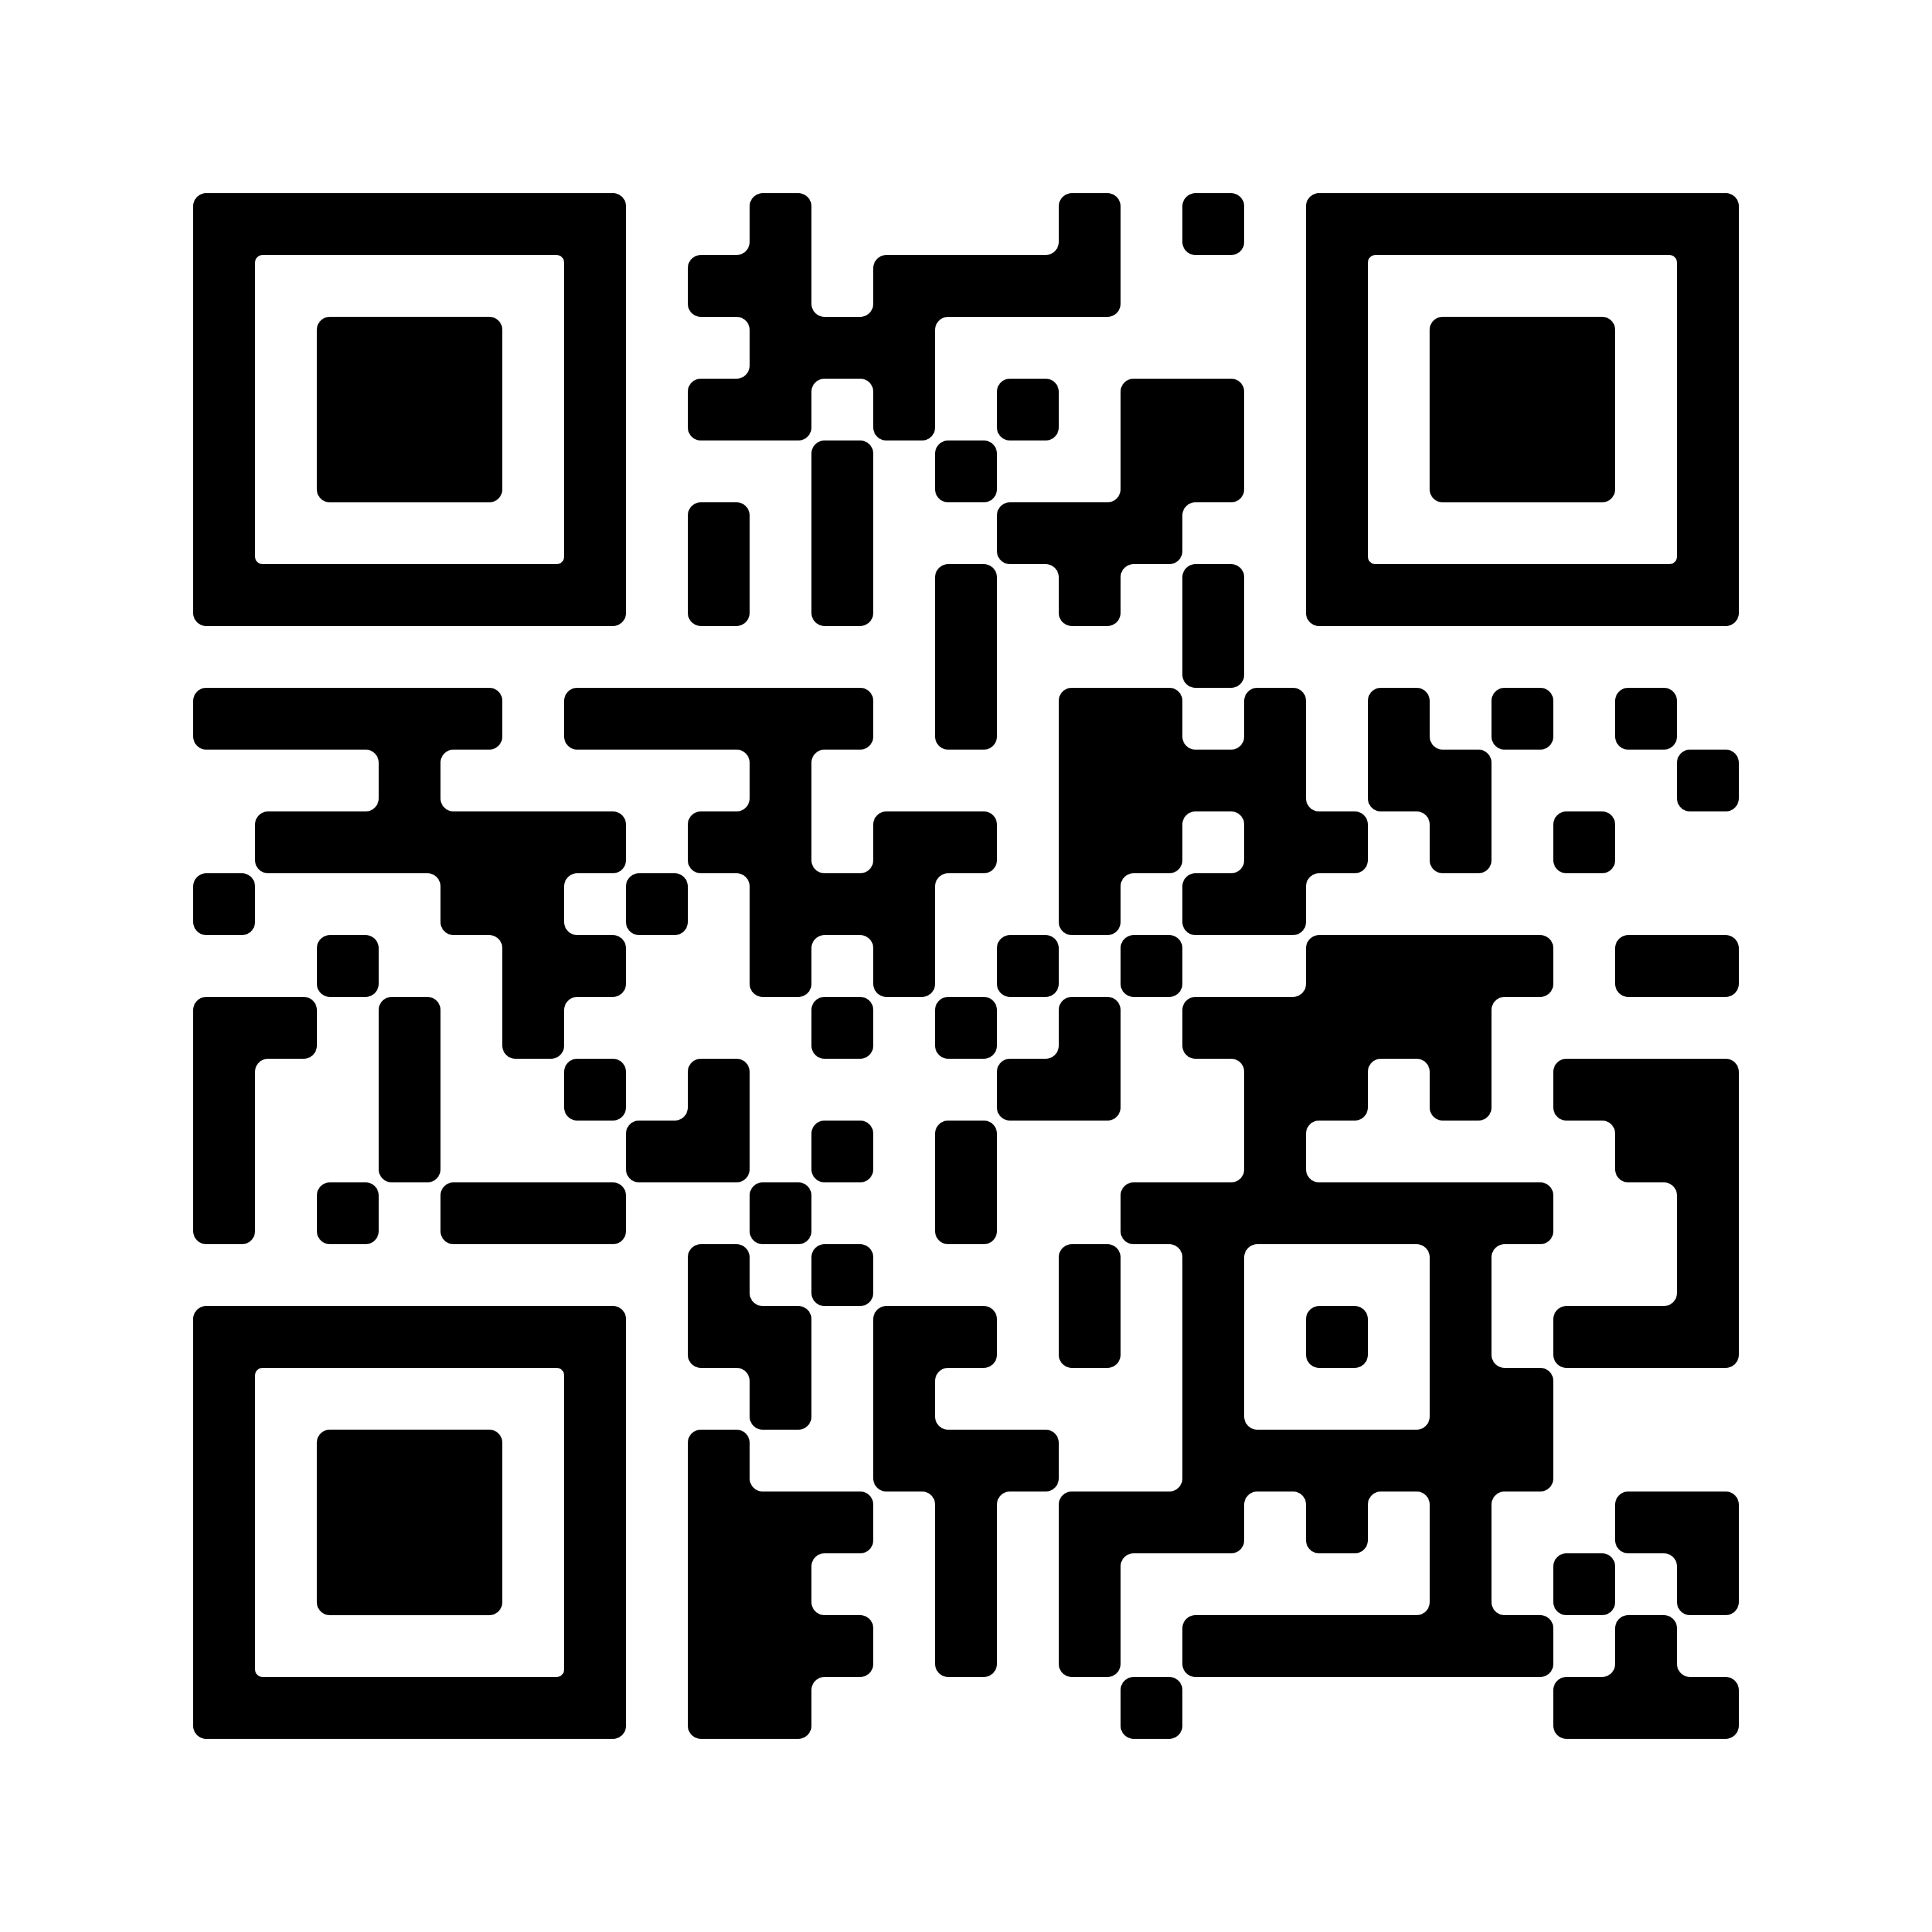
Supporting resources
Access to the Guideline

Slide 30
References
The Royal Commission into Aged Care Quality and Safety. Background Paper 3: Dementia in Australia: Nature, Prevalence and Care. Commonwealth of Australia; 2019. Accessed December 9, 2022. https://agedcare.royalcommission.gov.au/sites/default/files/2019-12/background-paper-3.pdf
New South Wales Ministry of Health. Assessment and Management of Behaviours and Psychological Symptoms associated with Dementia (BPSD). 2022. Accessed January 25, 2023. https://www.health.nsw.gov.au/mentalhealth/resources/Publications/assessment-mgmt-people-bpsd-2022.pdf.
Burns K, Jayasinha R, Tsang R, Brodaty H. Behaviour Management A Guide to Good Practice: Managing Behavioural and Psychological Symptoms of Dementia. Dementia Support Australia; 2012. Accessed September 19, 2022. https://www.dementia.com.au/resource-hub/behaviour-management-a-guide-to-good-practice
Aged Care Quality and Safety Commission. Psychotropic medications used in Australia: information for aged care. Australian Government; 2021. Accessed September 2, 2022. https://www.agedcarequality.gov.au/resources/psychotropic-medications-used-australia-information-aged-care
The Royal Commission into Aged Care Quality and Safety. Interim Report: Neglect. Commonwealth of Australia; 2019. Accessed September 19, 2022. https://agedcare.royalcommission.gov.au/publications/interim-report
National Health Service. Overview – Antidepressants. National Health Service; 2021. Accessed November 30, 2022. https://www.nhs.uk/mental-health/talking-therapies-medicine-treatments/medicines-and-psychiatry/antidepressants/overview/
Harrison, SL, Sluggett, JK, Lang, C, et al. The dispensing of psychotropic medicines to older people before and after they enter residential aged care. Med J Aust. 2020;212(7):309-313. doi: 10.5694/mja2.50501
Therapeutic Good Administration. Reporting adverse events. Dept of Health and Aged Care; 2021. Accessed December 9, 2022. https://www.tga.gov.au/resources/resource/guidance/reporting-adverse-events
Unless specified, all icons included in this presentation are from Flaticon.com

