Slide 1
Providing feedback with SETU
MONASH
Student Evaluation of Teaching and Units (SETU)

Slide 2
What is SETU?
SETU is simple. It’s an online survey enabling you to provide feedback on unit experiences and educators.
SETU assists with enhancing the design and delivery of your units, as well as resources and other aspects that impact on the student experience of a unit.
SETU works to improve learning outcomes for all Monash University students.

Slide 3

What impact does your feedback have?
Student feedback allows educators to make changes or improvements.
For example, if students request:
assignment details
lab and peer activity times
direction for their final exam
Educators may respond by:
providing more examples
updating clinical lab sessions
developing a practice exam

Slide 4

How SETU data is used?
At the University level:
monitoring quality
informing strategic planning
At the Faculty/Department level:
address common areas of concern
sharing good practice
At Unit Coordinator/Educator level:
monitoring student experience
implementing relevant change

Slide 5
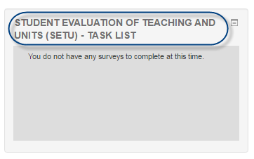
How to participate in SETU?
Access SETU via the Moodle block under your units.
OR
If you have units to survey you will receive an email with a link to the survey.
Access SETU survey landing page directly via: https://monash.bluera.com/monash
Both access points will request you to log in with your Monash username and password.
Choose which units and staff to evaluate.
Select your response.
Provide your comments.

Slide 6
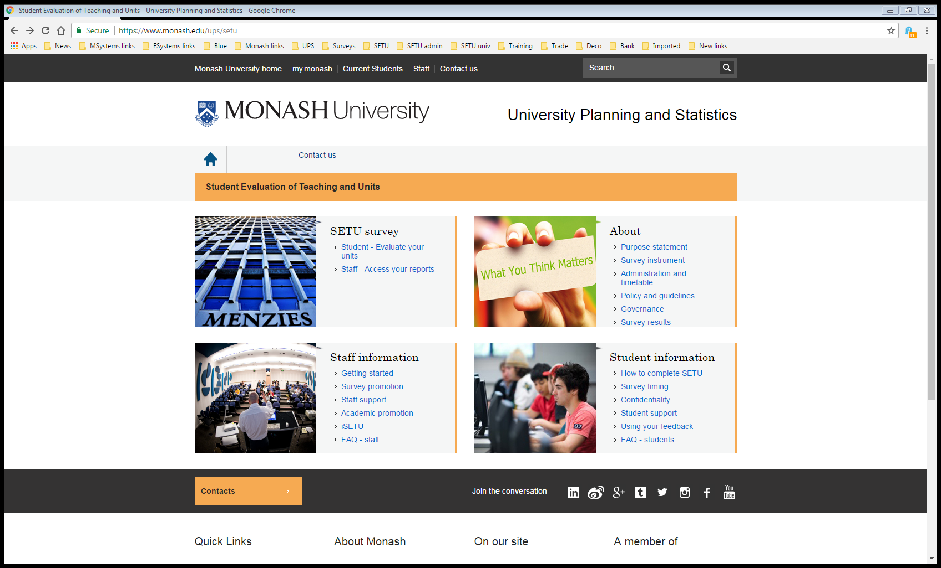
Confidentiality and SETU results
Don’t worry!
Your name and student ID are not included in any SETU report. Be careful not to identify yourself within the comments.
Find survey results online:
Survey results are available on the SETU website.
Click on the Survey results link to access results.

Slide 7
What are you waiting for?
Provide your feedback today!
https://monash.bluera.com/monash

