Slide 1

The Journey to Reinvent
Indonesian Rural Cooperatives
Novita Puspasari
Monash University/
Universitas Jenderal Soedirman

Slide 2
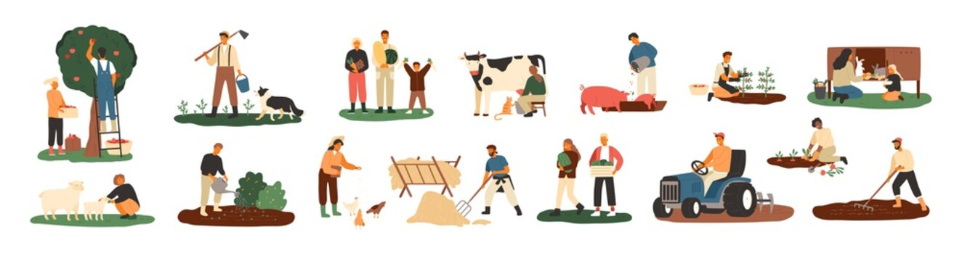
INTRODUCTION

Slide 3

Indonesian rural cooperatives (Koperasi Unit Desa/KUD) located in subdistrict/villages in Indonesia
KUDs were formed from amalgamation of several small agricultural coops
KUDs were formed “top-down” in New Order regime
The members were farmers
Huge success in the 1980s and early 1990s

Slide 4
Role of KUDs
Providing saving and loan services for the farmers
Providing rice mill facilities
Marketing the rice

Slide 5
The fall of KUDs….
Regime changed
Trend of urbanization

Slide 6
Currently…
KUDs in agony
Most KUDs do not have a “real” business activities
KUDs cannot adapt to the dynamic business environment
In the past four years, the government has dissolved over 81.686 cooperatives, the majority of which are KUD

Slide 7
AIMS OF THE RESEARCH

Slide 8
To identify problems in existing KUDs
To design planned action to manage the problems
To implement the planned action
To evaluate the steps taken

Slide 9
RESEARCH METHODS

Slide 10
Action research
In action research, researcher does not solely describe, interpret, and explain a social situation, but also intervene to change the situation (Cherns et al., 1976)
Four stages in action research:
  Diagnosis
  Action planning
  Action taking
  Evaluation
3++ years to conduct the research

Slide 11
THEORY/FRAMEWORK

Slide 12
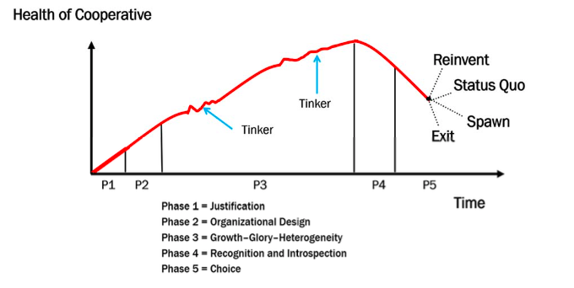
Cooperative life cycle (Cook, 2018)

Slide 13
RESULTS AND DISCUSSION

Slide 14
First year: diagnosis and action planning
Conducted 9 interviews (5 boards, 4 managements of KUDs)
Conducted 2 FGDs in local and national level (the participants were various cooperative stakeholders, such as cooperative boards, cooperative managers, cooperative activists, and representatives from local and national governments)
The first FGD (local) attended by 54 participants, the second FGD (national) attended by 23 participants

Slide 15
Findings:
  First: coops “lost their ground” when they mandated to be multi-purpose coops (not only serving farmers member) in the 1990s
  Second: KUDs were developed uniformly throughout Indonesia, they did not develop their businesses based on each village’s context
  Third: dependency problem. KUDs “seem” successful in the past, however, government intervention caused KUDs to rely more on government support
  Fourth: KUDs only addressed farming-related economic activities (on-farm agribusiness) with the lowest added value compared to other agribusiness subsystems
  Fifth: governance problems such as “one man show” from the board, double role “board-management”, coops often considered as part time job. These problems caused by lack of human resources in coops.

Slide 16
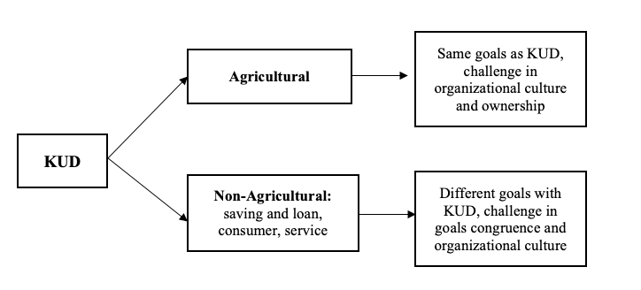
  The need to build “innovation ecosystem” for coops, yet without too much reliance on government
  Current KUDs classification based on interviews and FGDs:

Slide 17
Second year: action taking
Forming a consortium: Indonesian Consortium for Cooperative Innovation (ICCI)
22 organizations are involved in this consortium. The organizations consist of cooperatives, universities, incubators, startup/platforms, community hubs, and governments
The consortium orchestrated collaboration among each parties:
  For agricultural KUDs: linked them to TaniBox and Agriterra
  For non-agricultural KUDs: conducted series of workshops (Change Management workshops, Apps/Software workshops), linked them to Sakti Link

Slide 18
Third year-onwards: evaluation and learning
A very slow transformation due to an inertia?
Hogeland (2015) found a trend of inertia happened because the ideological lock
Ideological lock makes cooperatives resistant to change due to agrarianism beliefs that agricultural cooperatives should be operated "like a family", decentralized, autonomous, and typically on a small scale (Hogeland, 2015)
Trust issues between the KUDs and the outside parties (TaniBox, Sakti.Link)

Slide 19
CONCLUSION

Slide 20
KUDs experienced these phases in 1980s-1990s
KUDs hibernated, thousands were dissolved by the government. KUDs did introspection
KUDs had to choose to reinvent, status quo, spawn or exit.
KUDs chose to reinvent their business models: (modern) agricultural coop and multi-purpose coops

Slide 21
Implications:
Further research:
Since KUDs are divided into two classifications, future research can examine these two groups and answer the following RQs: How are the goals, organizational culture, and member-patron ownership different between the two? Which model is more sustainable?
Practical implications:
Regulations, incentives, trainings for both groups must also be different (i.e. agricultural KUDs that have to survive in the modern era, training and assistance related to good governance, management, technology, and current business processes can be provided. Non-agricultural KUDs shifting from the agricultural business model can be given training and assistance related to their new business model).

Slide 22

Thank you!

