Slide 1
The Remediation of Compensation Disclosure and 'Say-on-pay' Voting Outcomes
Wei Li & Yunyan Zhang
09/012/2022

Slide 2
Research Question
This study examines whether the remediation of compensation disclosure in the proxy statements affects the subsequent SOP voting results.

Slide 3
Motivation and Related Literature
High executive pay and a weak relationship between executive compensation and firm performance have received great public and academic scrutiny.
Since 2011 in the U.S, say-on-pay (SOP) empowers shareholders to vote for executive pay packages at the annual general meeting.
  Non-binding (i.e., advisory), but SOP voting dissent is a ‘simple, highly visible metric’ that is easily observable and can result in shareholder outrage once it is high enough to attract significant attention (Cuñat et al., 2016, p. 2).
  High voting dissent pressures firms to alter their pay package: a reduction in CEOs’ total compensation (Faghani, Monem, & Ng, 2015) and growth of CEO compensation (Kimbro & Xu, 2015).
  Firms have to discuss how they resolve shareholders’ vote dissent in the subsequent year’s proxy statement.
    Especially for companies that received a comment letter from the SEC in the prior year.
    Firms need majority of shareholders to approve the resolution plan.

Slide 4
Motivation and Related Literature Cont’d
To help investors better understand and monitor firms’ compensation practices, the SEC has mandated new detailed disclosure of executive compensation in the proxy statement since 2006.
    Precisely provide explanation and analysis of all material elements of the company’s compensation goals, practices and decisions for the executive officers.
    Disclose specific quantitative or qualitative performance targets used to determine bonus payouts, be precise to identify material differences in compensation policies and decisions.
The SEC reviews firms’ filings at least once every three years and issues comment letters (CLs) if identifying noncompliance.
  Most firms (80%) revised the disclosure in the proxy statement.
  The SEC published both comment letters and firms’ responses soon after the issues have been resolved.
Coupled with periodical review by the SEC, SOP provides a good setting
  To examine whether the remediation of disclosure defects identified via the SEC comment letter process influences shareholders' votes for management SOP.

Slide 5
Our main findings:
Investors are more likely to cast favorable votes on management SOP proposals if a firm resolves the deficiency in the proxy statement.
The impact is more pronounced when the resolution is related to critical disclosure elements.
Remediation firms’ subsequent executive compensation is linked more closely to firm performance after the remediation
  In further analysis

Slide 6
Contribution
First, our study contributes to the literature on the impact of SEC review by examining the consequences of the SEC review from the stewardship perspective.
  Most studies on the SEC comment letters focuses on the valuation perspective and documents an improvement in the recipient firms’ information environment (e.g. Bens et al., 2016; Dietrich and Johnston, 2017) and few studies examine the monitoring impact except for Wang et. al. (2022).
Second, we contribute to the growing research on the determinants and consequences of SOP voting outcomes.
  We document that the remediation in compensation disclosure affects the SOP votes, highlighting the importance of the information for regulators and investors.

Slide 7
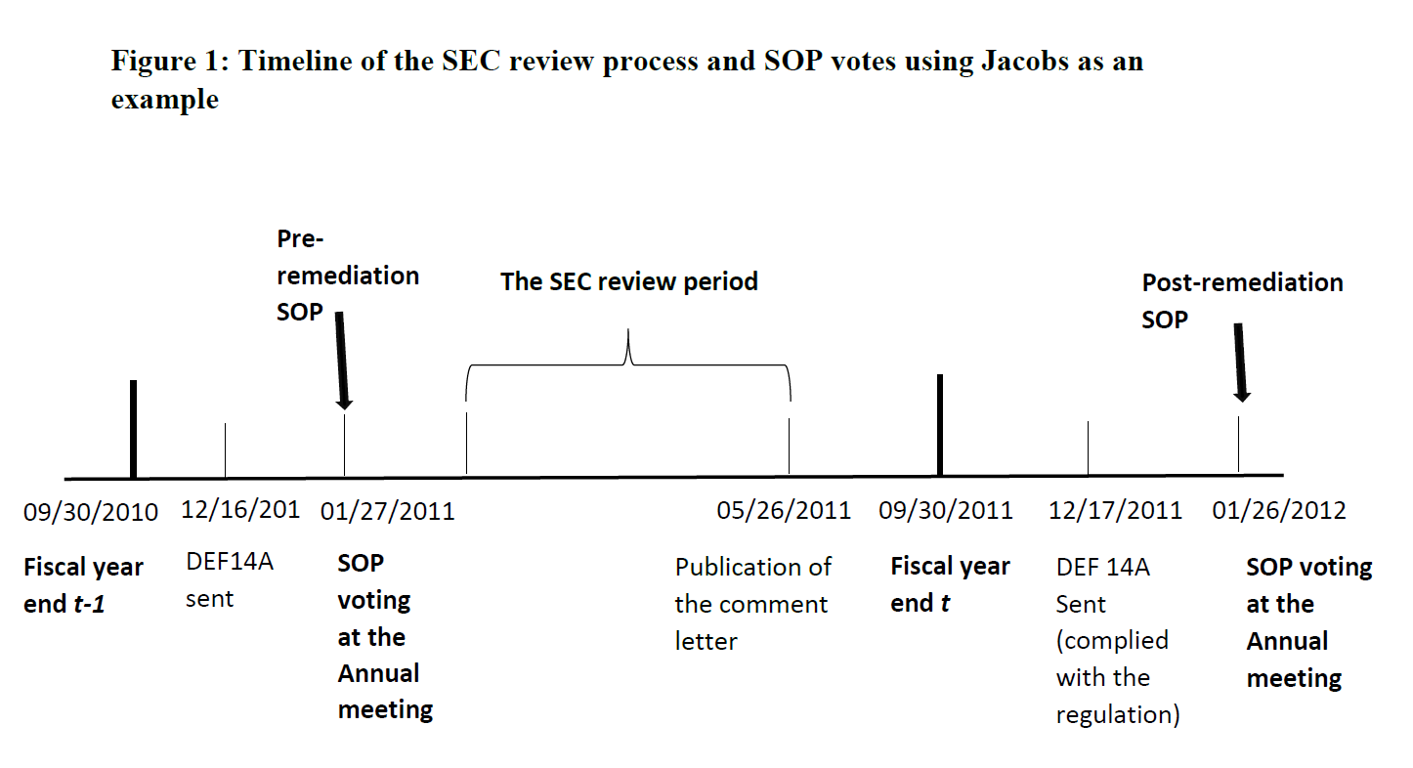
An exemplary case: Timeline of CL and SOPs
On February 2, 2011, the SEC reviewed its proxy statement and sent the initial comment letters, requesting firms to clearly identify all specific items of corporate performance in setting compensation policies and making compensation decisions, disclose all previously established goals, and discuss how the compensation awarded reflects those goals.
On March 3, 2011 Jacobs responded, promising to provide the requested information in future filings.

Slide 8
Jacob example cont’d
In January, 2011, only 45% of shareholders voted for the management proposals .
After the annual meeting, Jacobs revalued its pay program, involving compensation consultants and major institutional shareholders, and significantly changed the pay package.
The approval of an advisory resolution on the executive compensation requires the affirmative vote of a majority of shares of common stock.
  Jacob received at the annual meeting of 2012.
In January 2012, most shareholders (96%) agreed with SOP proposals.

Slide 9
Hypothesis 1
If the remediation results in substantive changes in compensation disclosure, we would expect it to enhance the credibility of management SOP proposals and hence attract more favorable votes.
In addition, more transparent disclosure and the public release of comment letters make it more costly for management to hide excess executive pay and hence may deter inadequate compensation practice.
Shareholders may also pay more attention to compensation practices upon the publication of comment letters.
  To avoid significant SOP voting dissent, firms may alter their compensation practices, reduce excess pay, or align executive payment more closely with firm performance.
H1: The remediation of the compensation disclosure is associated with more favorable SOP votes at the annual meeting.

Slide 10
Hypothesis 1 Cont’d
However, the receipt of SEC's comment letters may damage the firm's reputation and raise shareholders' concern about its disclosure quality, even after it remedies deficiencies in response to comment letters.
Shareholders may be more likely to disagree with management SOP proposals even after the remediation.
Hence we need to conduct empirical tests on whether and how the remediation in compensation disclosure affects SOP voting outcomes.

Slide 11
Hypothesis 2
Suppose the changes in disclosure quality in the remediation affect the SOP voting outcomes. Then we would expect the greater the improvement in compensation disclosure, the more impact on the SOP votes.
H2: The impact of remediation on the SOP voting is more pronounced if there are more substantial changes in compensation disclosure.

Slide 12
Sample Selection
SOP vote data from the Institutional Shareholder Services (ISS) for 2011-2018.
  The number of “for”, “against” and “abstain” votes during an annual shareholder meetings
SEC comment letters from Audit Analytics
  Identify executive compensation-related comment letters if the CLs contain disclosure key “907” in DEF 14A filings
Financial accounting data from COMPUSTAT, stock prices from the CRSP, board of directors from Institutional Shareholder Services (ISS), institutional holdings from Thomson Financial Institutional Holdings (13F), and CEOs' compensation from ExecuComp.

Slide 13
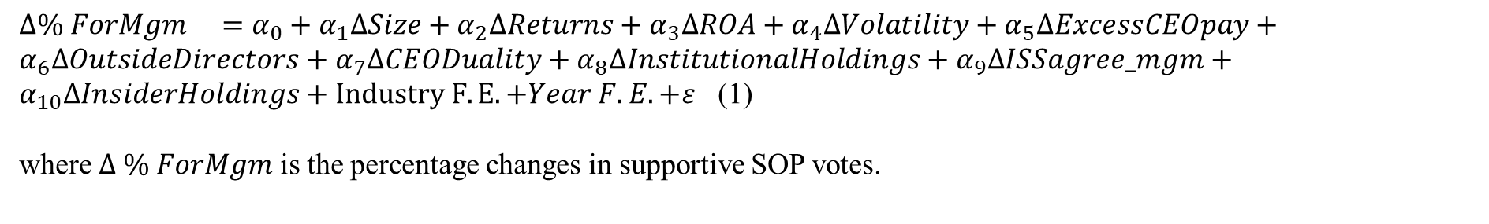

Research Design: Approach # 1
Following Bens et al. (2016), we employ a three-step process to estimate the effect of remediation.
Step 2: Then, we estimate the expected favourable votes for management SOP proposal
in the absence of the remediation.
Step 3: Estimate the remediation effect

Slide 14
Research Design: Approach # 2
Difference-in-Differences with a Matched Sample
To implement the above DID analysis, we construct the matched sample via a two-stage process, as follows.
Stage 1: Determinant model of receiving CL and remediating the disclosure
Stage 2: Find a matched control SOP without the remediation
We calculate the fitted value for each firm-year from Eq. (A1) and refer to it as a firm's propensity score that a firm will remediate its proxy statement upon receiving a comment letter. Then, we match a non-remediation firm (with replacement) against a remediation firm, based on the closest propensity score in the same industry-year.

Slide 15
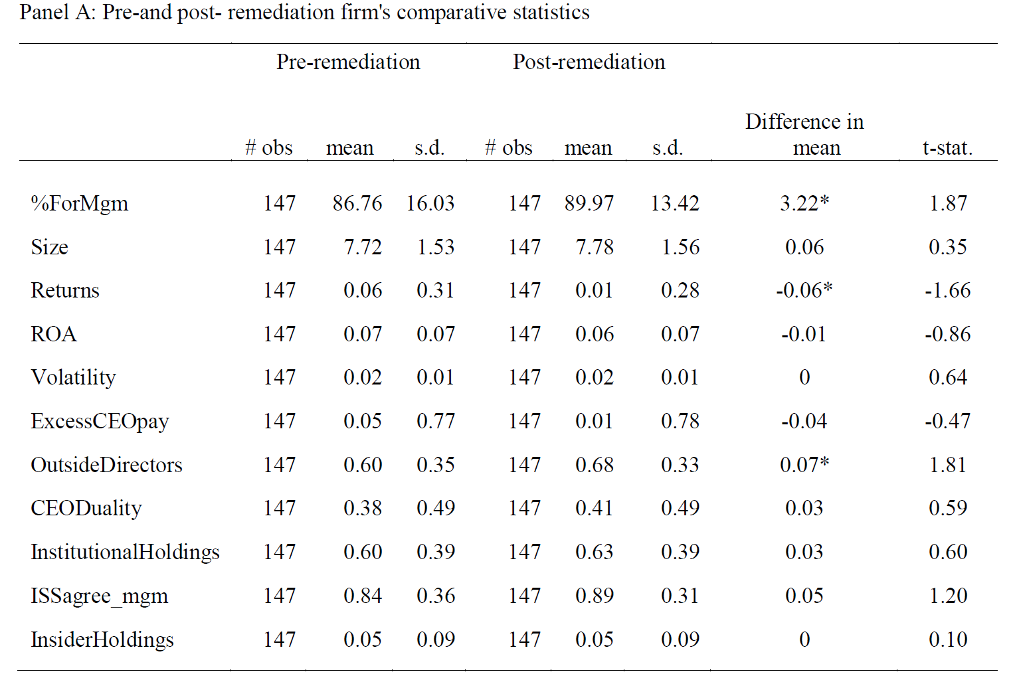
Summary Statistics

Slide 16
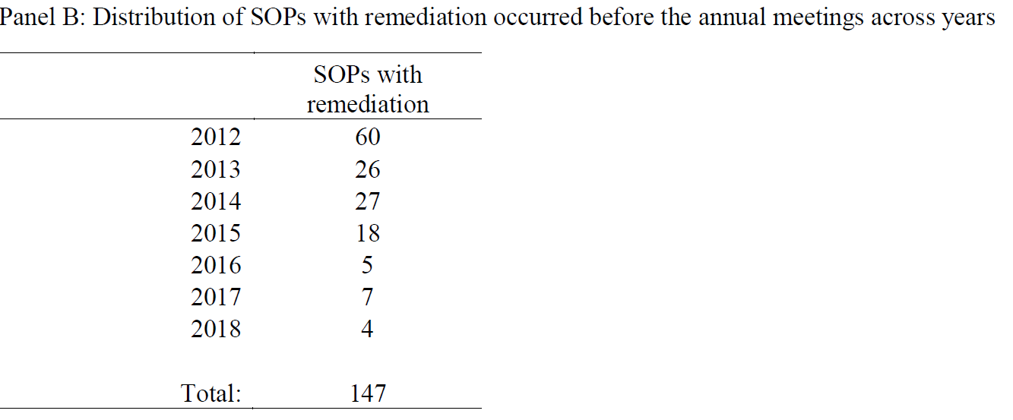
Summary Statistics Cont’d

Slide 17
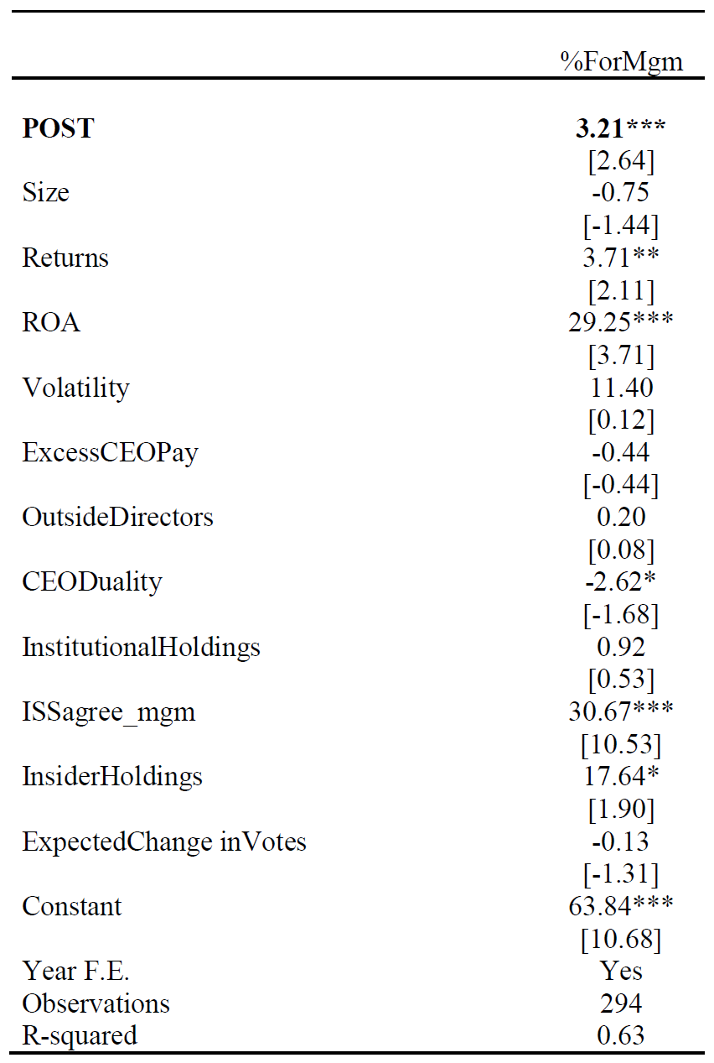
Results
Approach # 1
Shareholders increase favorable votes on management SOP proposals by 3.21% if a firm remediates its compensation-related disclosure before the meeting. (H1)

Slide 18
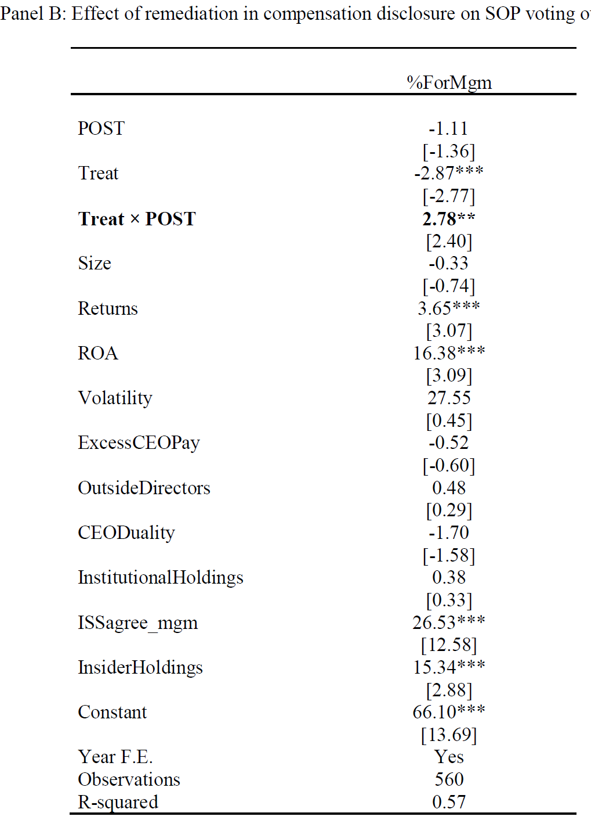
Results
Approach # 2
Shareholders increase favorable votes on management SOP proposals by 2.78% if a firm remediates its compensation-related disclosure before the meeting. (H1)

Slide 19
Major Disclosure Issues Related to Compensation
Top-5 key disclosure defects
1) Failed to disclose the performance targets in determining top executives' bonuses;
2) Failed to explain how individual performance is used to determine each officer's compensation;
3) Failed to identify and explain material differences in compensation between top executives;
4) Failed to explain how the payment benefit levels are determined/ negotiated for purposes of terminating top executives' employment;
5) Failed to explain all the functions played by the compensation consultants hired by the firm, including research, analysis, and recommendations. Also, failed to disclose the identity of the consultants;

Slide 20
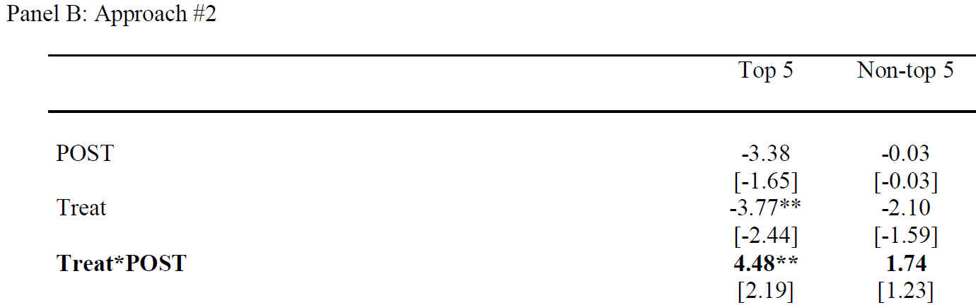
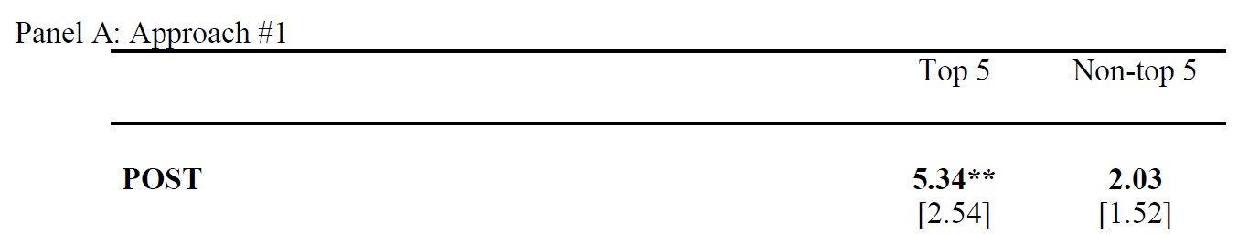
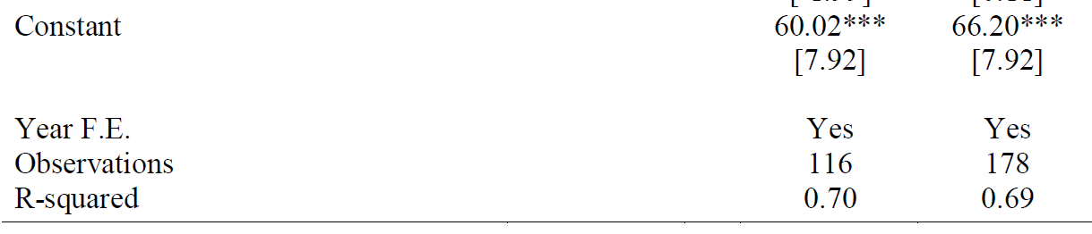
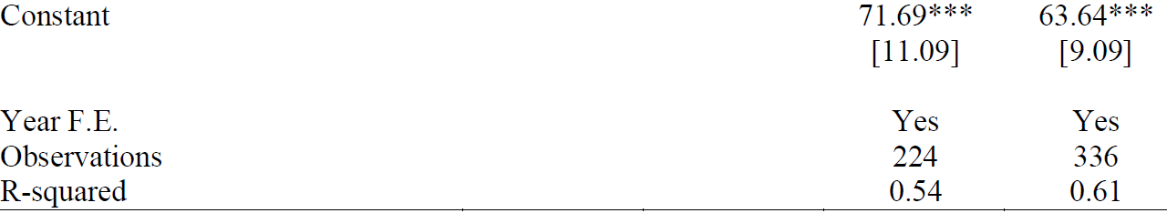
The Impact of Substantial Remediation on SOP outcomes (H2)
Controls Yes Yes
Controls Yes Yes

Slide 21
Further Analyses
The impact of remediation on the likelihood of significant SOP vote dissent
  If we apply 20% to define a significant SOP vote dissent, in approach one, the remediation in compensation disclosure reduces the probability of receiving a significant SOP vote dissent by 10%.
  In addition, the remediation of critical compensation issues (top-five) decreases this probability by 33%.
  Approach two shows similar results.
The impact on compensation practice
  The remediation firms are associated with a reduction in the total CEO compensation and an increase in CEO’s pay-for-performance sensitivity.
Relaxing Sample Restriction (including post-remediation SOPs in 2011)
  The results are consistent
The effect exists in the subsequent three years

Slide 22
Conclusion
Shareholders are more likely to agree with management SOP proposals if the firm remediates its compensation defects upon receiving a compensation-related comment from the SEC.
When the improvement in disclosure is more substantial, the remediation effect is more pronounced.

Slide 23
Questions and comments?
Thank you!

Slide 24
Appendix

Slide 25
Hypothesis Development
Divergent interests among stakeholders demand for monitoring and bonding mechanisms that help alleviate various agency conflicts (Jensen and Meckling 1976). e.g., executive compensation contract
Accounting information plays a central role, both in determining the extent of these conflicts and in designing mechanisms to mitigate them (Armstrong, Guay, and Weber 2010).
The SEC's comment letter
  Identifies the deficiencies in compensation disclosure.
  Followed by firms revision in the proxy statement
  Published by the SEC along with firms’ response soon after the issues have been resolved.
Before the annual meeting, shareholders can access the following information
  SEC's comment letters related to the previous year's proxy statement
  the revised proxy statement of the previous year including the resolution to the last SOP voting dissent
  the current year's proxy statement in compliance

Slide 26
The amended information may reveal inferior compensation scheme
Firms admitted that they only used online resources, such as salary.com, to set up the executive pay instead of the preciously stated peer groups.
When requested to describe the detailed role played by compensation consultants, some firms admitted that the consultant role is “very minimal, not as critical as” they previously claimed.

Slide 27
Firms’ Responses to CLs
Explain in detail and revise in the current and future filing
Explain in detail and revise only in the current filling
Request confidential treatment
Claim non-material information
Request for a reconsideration of the SEC comment (negotiation)
Note: type (1) & (2) comprise over 80% of firms’ responses in our final sample

Slide 28
An example of SEC’s CLs
We note your disclosure that bonus amounts are based on specific performance targets and that in 2007 these targets were met and bonuses paid. …….. however, please disclose all of your quantitative performance targets, the actual performance results and an analysis of how each target impacted the actual bonus amounts paid to each named executive officer. …… If you believe some or all of this disclosure would cause you competitive harm, please provide us with additional information specifically detailing your competitive harm analysis. Refer to Instruction 4 to Item 402(b) of Regulation S-K. Please advise us regarding how you intend to revise this disclosure in the future.

Slide 29
Response Letter from the Firm
In future Proxy Statements we will expand our disclosure of each named executive officers quantitative and qualitative performance objectives to be more specific as to each officers goals and the achievement of those goals. We will also add to our disclosure a discussion related to how qualitative performance is evaluated and how achievement of qualitative goals helps to achieve overall corporate goals. In future Proxy Statements we will also include a discussion as to how both quantitative and qualitative goals impact the actual bonus amounts paid.

Slide 30
Apple Ltd. 2020 Advisory vote to executive compensation
https://www.sec.gov/Archives/edgar/data/320193/000119312520001450/d799303ddef14a.htm#toc799303_22
23 pages of discussion on executive compensation (p. 29 to P.52)
Proposal No. 3 – Advisory Vote to Approve Executive Compensation
In accordance with the requirements of Section 14A of the Exchange Act and the related rules of the SEC, our shareholders have the opportunity to cast an annual advisory vote to approve the compensation of our named executive officers as disclosed pursuant to the SEC’s compensation disclosure rules, which includes the Compensation Discussion and Analysis, the compensation tables, and the narrative disclosures that accompany the compensation tables (a “say-on-pay” vote).
At the 2019 annual meeting of shareholders, 94% of votes cast supported our executive compensation program. We have discussions with many of our shareholders regarding various corporate governance topics, including executive compensation, and related trends, such as environmental, social, and governance considerations. The Compensation Committee will continue to consider shareholder feedback and the results of say-on-pay votes when making future compensation decisions.
RESOLVED

Slide 31
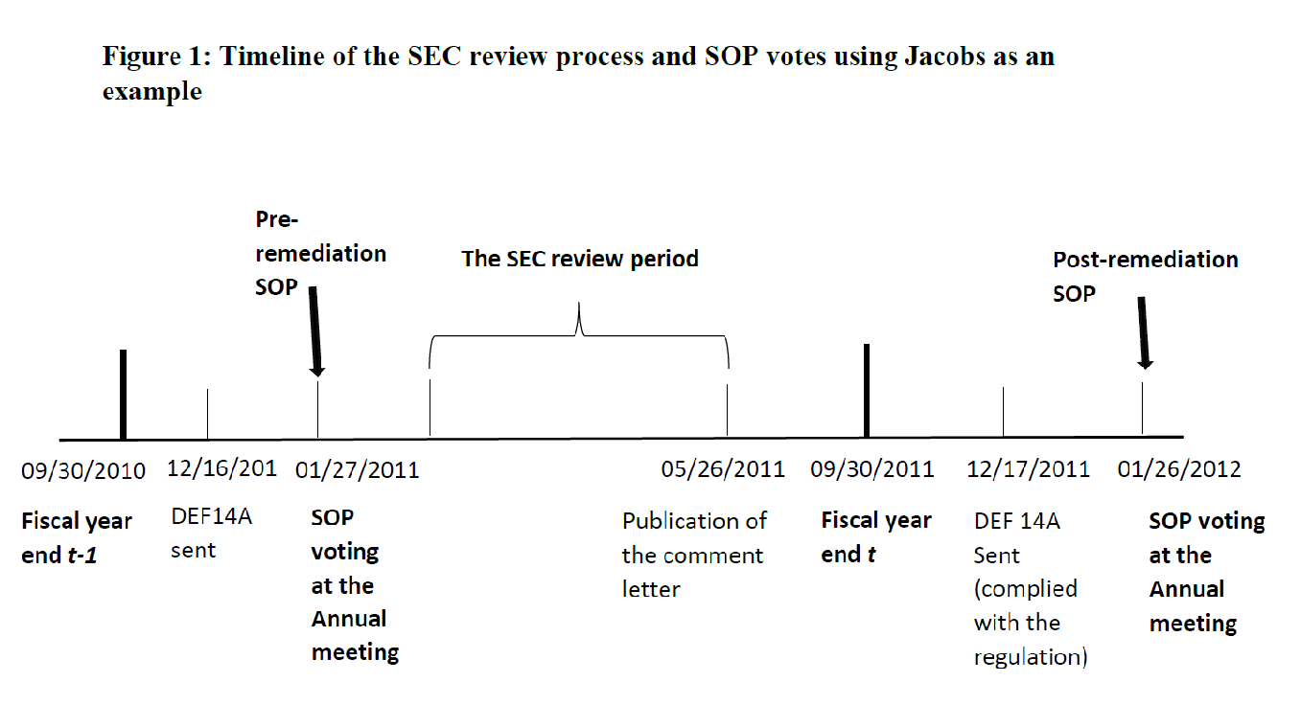
Pre- and post-remediation SOPs
Following Bens et al. (2016), we employ two alternative research designs in our main tests to identify the effects of the remediation effect on SOP voting results.

Slide 32
Relaxing the sample selection
Our main tests employ two primary research designs that strictly require a pair of pre-and post-remediation firms, which excludes the post-remediation firms in 2011 from the final sample.
Given that a significant number of SOPs occurred in 2011 and a tremendous number of SEC compensation-related letters were issued before and including 2010, we examine whether our results are robust after relaxing the restriction in Eq. (2) and Eq. (3) by including post-remediation SOPs in 2011 who received compensation-related comment letters in 2010.
Because the SOP starts from 2011, the post-remediation firms in 2011 have no pre-remediation SOP data and hence are not included in the previous sample for the main tests.

