Slide 1
Political connection and analyst research quality
Yangyang Chenª, Kaizhao Guo^{b}, Jingshu Wen^{c}
ª ByteDance Ltd
^{b} Adam Smith Business School-University of Glasgow
^{c} Said Business School-University of Oxford
December 2022

Slide 2
Research question
Do unqualified financial analysts exist?
If they do, why do investors pay for them in equilibrium?
  Information asymmetry
  Behavioral biases, eg., herding
  Conflicts of interests and rent seeking

Slide 3
Why rent seeking?
Politicians maximize their private benefits by protecting unqualified analysts from market competition.
Difficult to measure private benefits.
  Bribes are generally unobservable.
  Revolving door appointments may reflect experience and expertise.
China is a suitable setting.
  Allows for more direct measure of quid pro quo.

Slide 4
The economic channel for our setting
Decentralized government control
  53% of brokerages are state-owned enterprises (SOEs) in China;
  Brokerages’ average revenue: Central SOEs = 2 local SOEs = 8 private enterprises;
  The chairmen and CEOs of SOE brokerages are Communist party officials;
  Their salaries are government-controlled.
One-level up policy
  China Securities Regulatory Commission (CSRC) appoints SOE brokerage and securities exchange directors.
Exchange of favors
  Unqualified analysts likely to be connected to the CSRC officials obtain employment at brokerages.
  Brokerage directors receive promotions in return.

Slide 5
Hypothesis
Analysts with less expertise are more likely to have political connections.

Slide 6
How to measure analysts’ qualification?
Industry knowledge: the single most important quality of sell-side analysts
  Validation tests conducted.
Textual analysis of analyst reports on the healthcare industry
  We disentangle industry knowledge from professional connections and access to private information;
  Bradley et al. (2017) use pre-analyst work experience to proxy for industry knowledge.
Count the occurrences of industry-specific words
  Suitable when the variability in industry knowledge is large;
  Experts focus on key drivers of firms’ profits while charlatans don’t fully understand the business model or technology of firms.

Slide 7
Industry knowledge dictionary
Precompiled words
  The Global Industry Classification Standard (GICS) provides industry sectors.
  We gather the specialized words for each healthcare sector.
Scrape and hand-collect words
Then extract contextually similar words from firm disclosures

Slide 8
Data
Analyst and brokerage director data
  Employment history, age, education, gender
  Hand collected on China Securities Association, company websites, and Shanghai and Shenzhen Stock Exchanges
A-share healthcare industry reports issued during 2012-2019
  Scraped all available healthcare reports from Hexun.com
  Manually downloading additional reports from Huibo and Wind (work in progress)
  Current sample: 15,080 reports
Financials and stock price data
  Wind Financial Terminal

Slide 9
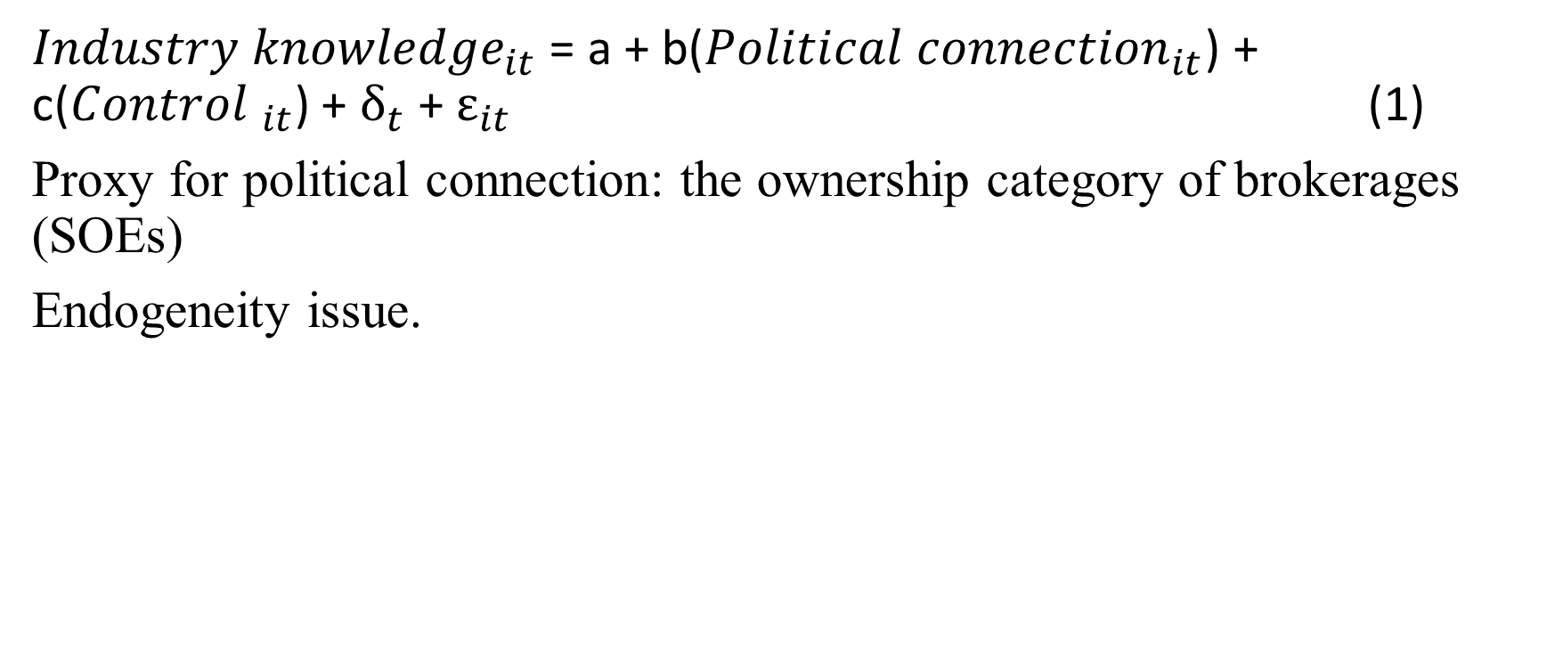
Empirical strategy
${Industry knowledge}_{it}$ = a + b(${Political connection}_{it}$) + c(${Control }_{it}$) + $δ_{t}$+ $ε_{it}$ (1)
Proxy for political connection: the ownership category of brokerages (SOEs)
Endogeneity issue.

Slide 10
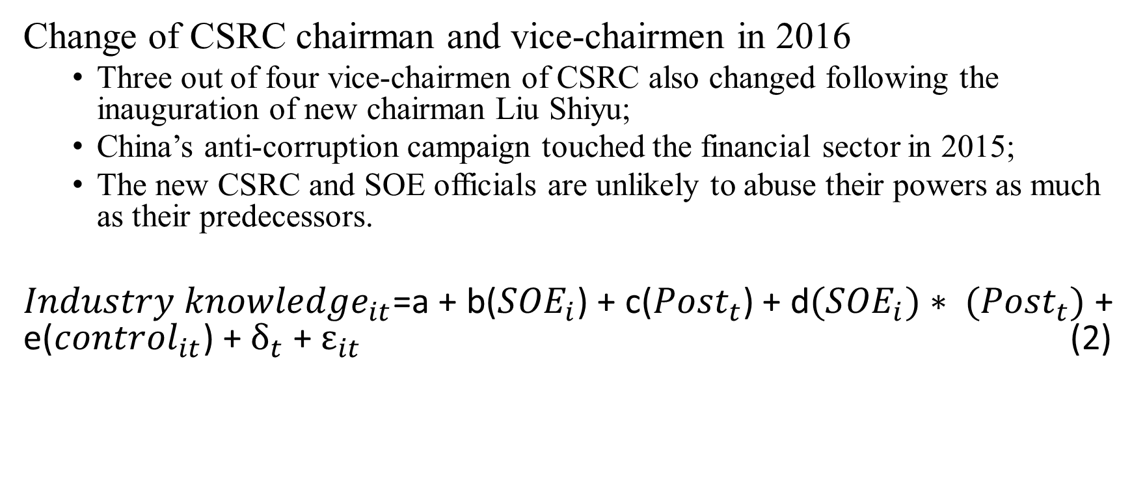
Exogenous shock and DID
Change of CSRC chairman and vice-chairmen in 2016
  Three out of four vice-chairmen of CSRC also changed following the inauguration of new chairman Liu Shiyu;
  China’s anti-corruption campaign touched the financial sector in 2015;
  The new CSRC and SOE officials are unlikely to abuse their powers as much as their predecessors.
${Industry knowledge}_{it}$=a + b(${SOE}_{i}$) + c(${Post}_{t}$) + d${(SOE}_{i})∗ {(Post}_{t})$ + e(${control}_{it}$) + $δ_{t}$+ $ε_{it}$ (2)

Slide 11
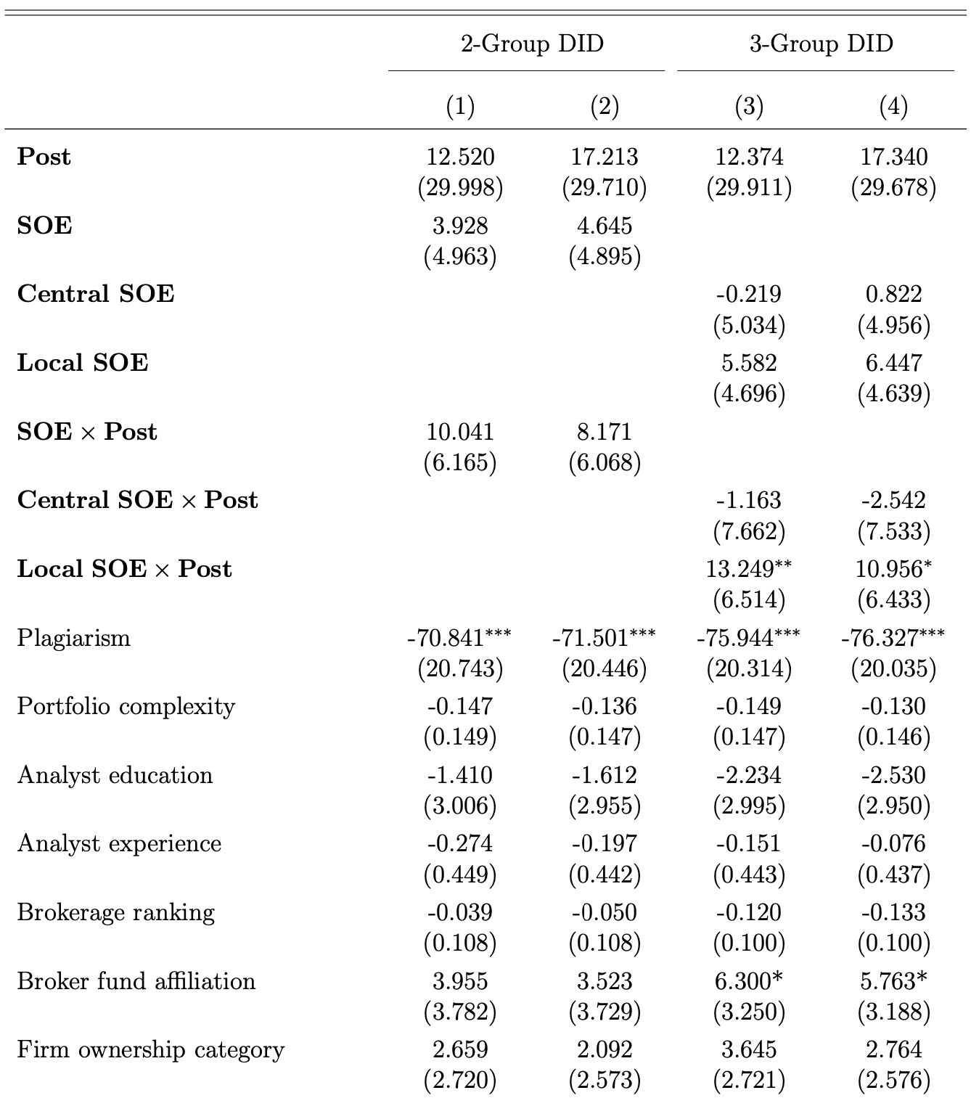
DID test on analysts’ political connection

Slide 12
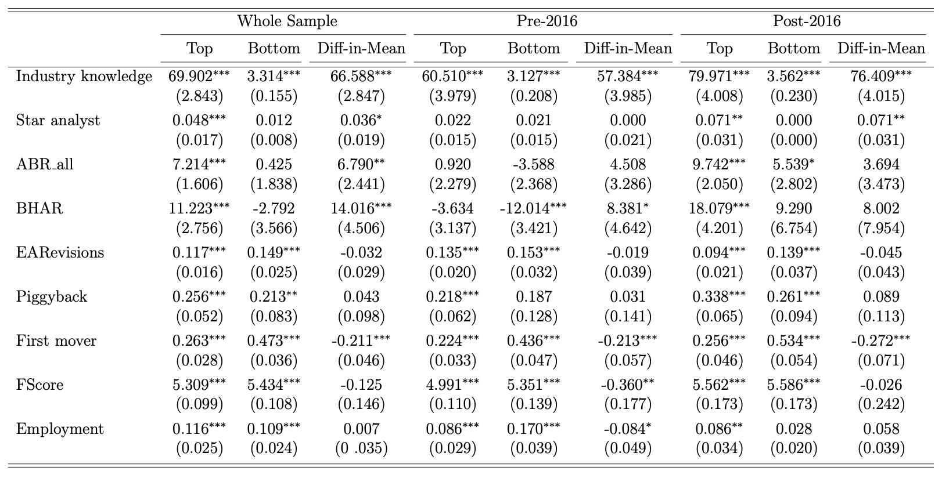
The existence of unqualified analysts

Slide 13
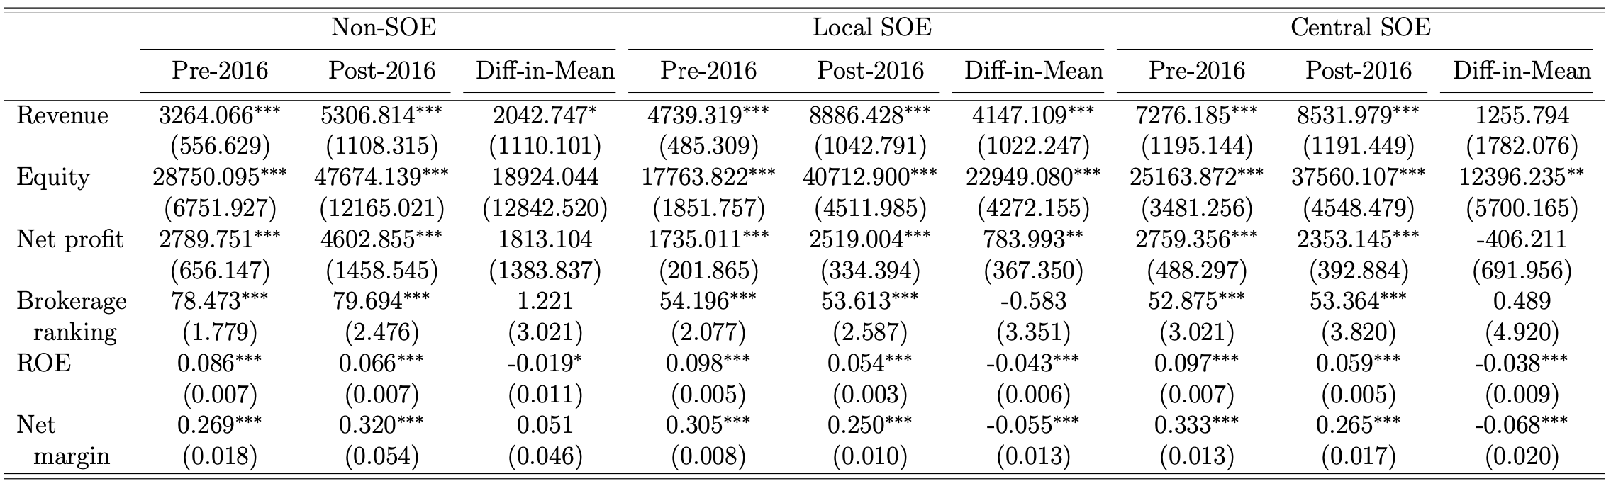
Subsample t tests on ownership category

Slide 14
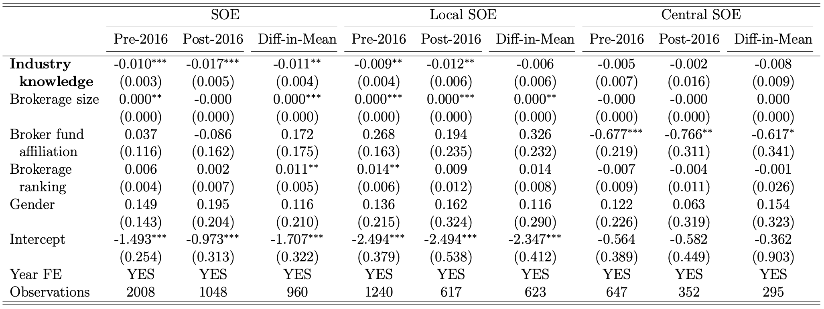
The quid pro quo: Brokerage directors’ promotion

Slide 15
Conclusions
Some unqualified financial analysts exist due to their political connection.
Previous papers show how politicians use their power for private interests in the context of regulatory policies, business deals, etc.
This paper examines how political exchange of favors affect sell-side research quality, which could affect market efficiency.

