Slide 1
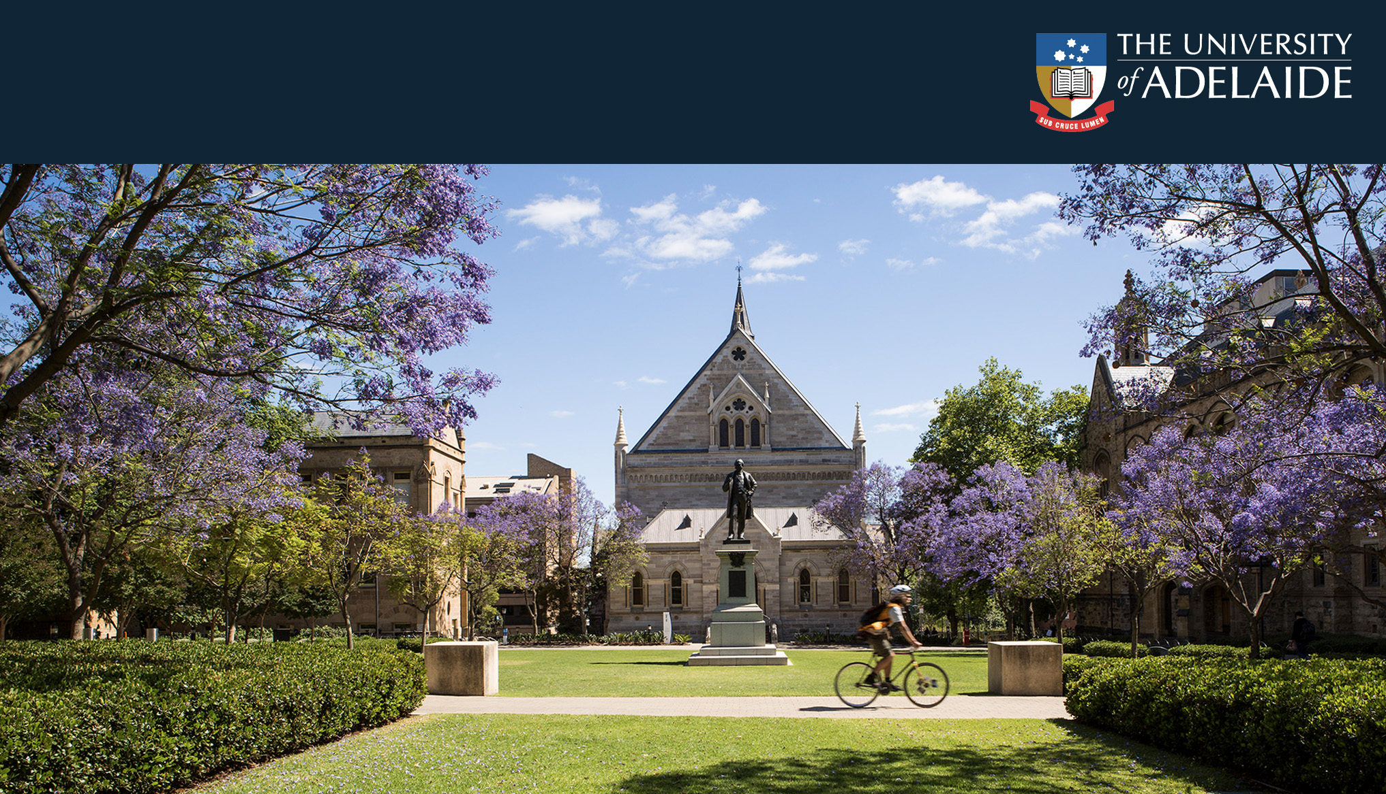
Firm-level governance and the tragedy of the commons: An expanded objects of control framework
2022 ICVG Conference: Governance in its institutional context
Dr Tracey Dodd
Prof Johannes Dumay
15 December 2022

Slide 2
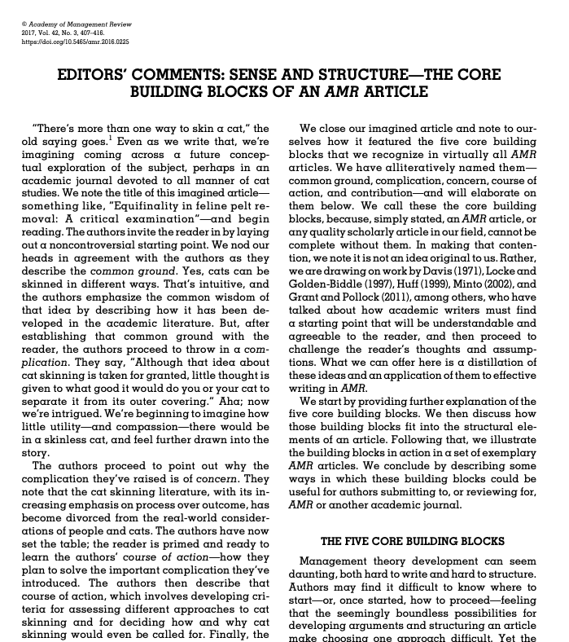
Overview
(1) The consensus
(2) The complication
(3) The concern
(4) Course of action
(5) The contribution
Lange and Pfarrer (2017)

Slide 3
Areas of consensus
From Van der Stede (2022) today we have heard that:
The role of management controls is to align the actions of internal stakeholders (e.g., staff, executives) with shared goals and values.
Management controls can thus be evaluated (e.g., deemed effective or ineffective) based on the degree of goal alignment among internal stakeholders, as well as the outcomes achieved.

Slide 4
Areas of consensus
From Van der Stede (2022):
If organisations adopt stakeholder capitalism (e.g., a vision of capitalism based on value creation for people who can impact or be impacted by the organisation), management control theory and practice must expand to reflect this aspiration.
Organisations who seek to embrace stakeholder capitalism but fail to re-orientate management controls risk a reputation of being apathetic (e.g., good intentions only, no action) or “purpose washing”.

Slide 5
Areas of consensus
Underpinned by stakeholder theory (Freeman et al., 2010), stakeholder capitalism embraces private ownership, coordination through markets, and decentralised decision-making by buyers and sellers rather than the state.
In place of individualism, competition, and a “winner-take-all” mentality, stakeholder capitalism calls for cooperative paradigms (Freeman et al., 2007, p. 303).
Essentially, stakeholder theory and stakeholder capitalism call for the integration of business and ethics.

Slide 6
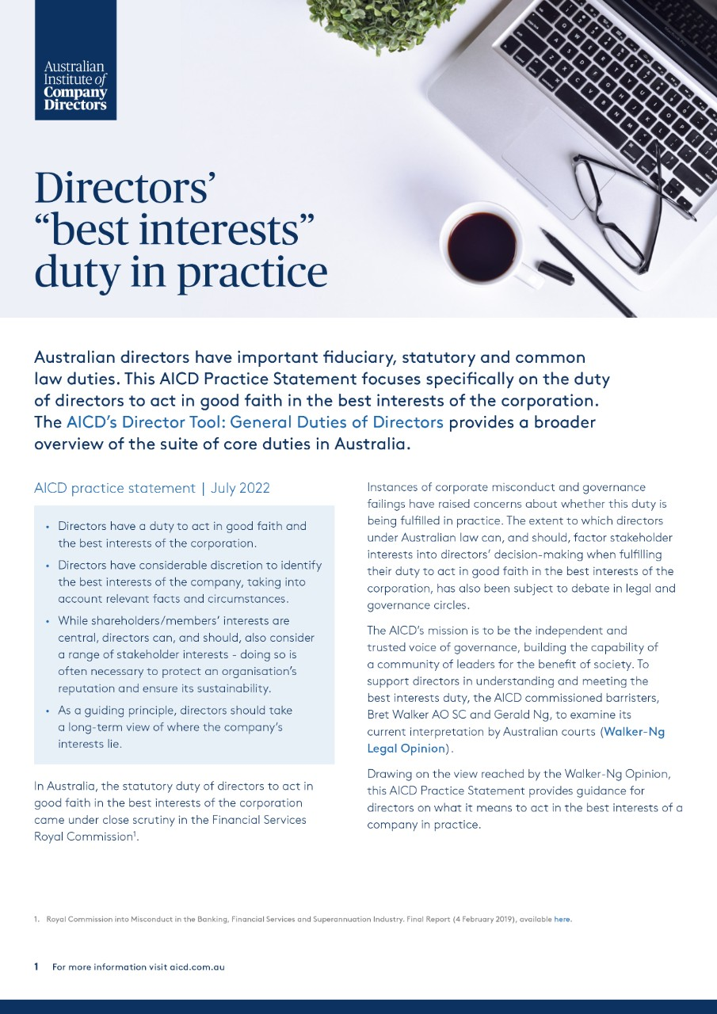
Areas of consensus
As Freeman et al. (2010, p. 280) argue, while “the principles of capitalism are worthy goals in and of themselves”, further refinement is required to consider the “jointness” of stakeholder interests.
Australian Institute of Company Directors. (2022)

Slide 7
Areas of consensus
The AICD (2022) practice statement follows moves by the Business Roundtable (2019, p. 1) to establish the “purpose of a corporation” as delivering “value” for a range of stakeholders, including customers, employees, suppliers, and the community.
Section 172 of the United Kingdom’s Companies Act 2006 also requires company directors to consider the long-term implications of “company operations on the community and environment” (Allens Linklaters, 2022, p. 3).

Slide 8
complications
However, further work is required.
First, stakeholder capitalism is a vision (Freeman et al., 2007), much remains unknown related to if and how stakeholder capitalism can be operationalised (Freeman et al., 2010).
Second, stakeholder interests do not always align (Lange et al., 2022).
Last, stakeholder capitalism is forward looking. Yet, many social and environmental issues have arisen due to the tragedy of the commons (Gills & Morgan, 2020).

Slide 9
complications
As argued by Bridoux and Stoelhorst (2022, p. 214) while “capitalism works when actors are motivated to engage in joint value creation” society faces “collective action problems”, namely “situations in which stakeholders may be tempted to pursue their own interest at the expense of maximizing joint value creation”.
Thus far society has “acted as though there were no material limits to growth….modern life has rapidly modified the planet”. This has occurred through deforestation, intensive agriculture, over-fishing, reliance on non-renewable energy and minerals sources and unsustainable disposal practices leading to waste issues.
Further, is stakeholder capitalism realistic or overly altruistic?
Can business and ethics be integrated and how could society approach this in a global setting where different value sets exist? (e.g., modern slavery)

Slide 10
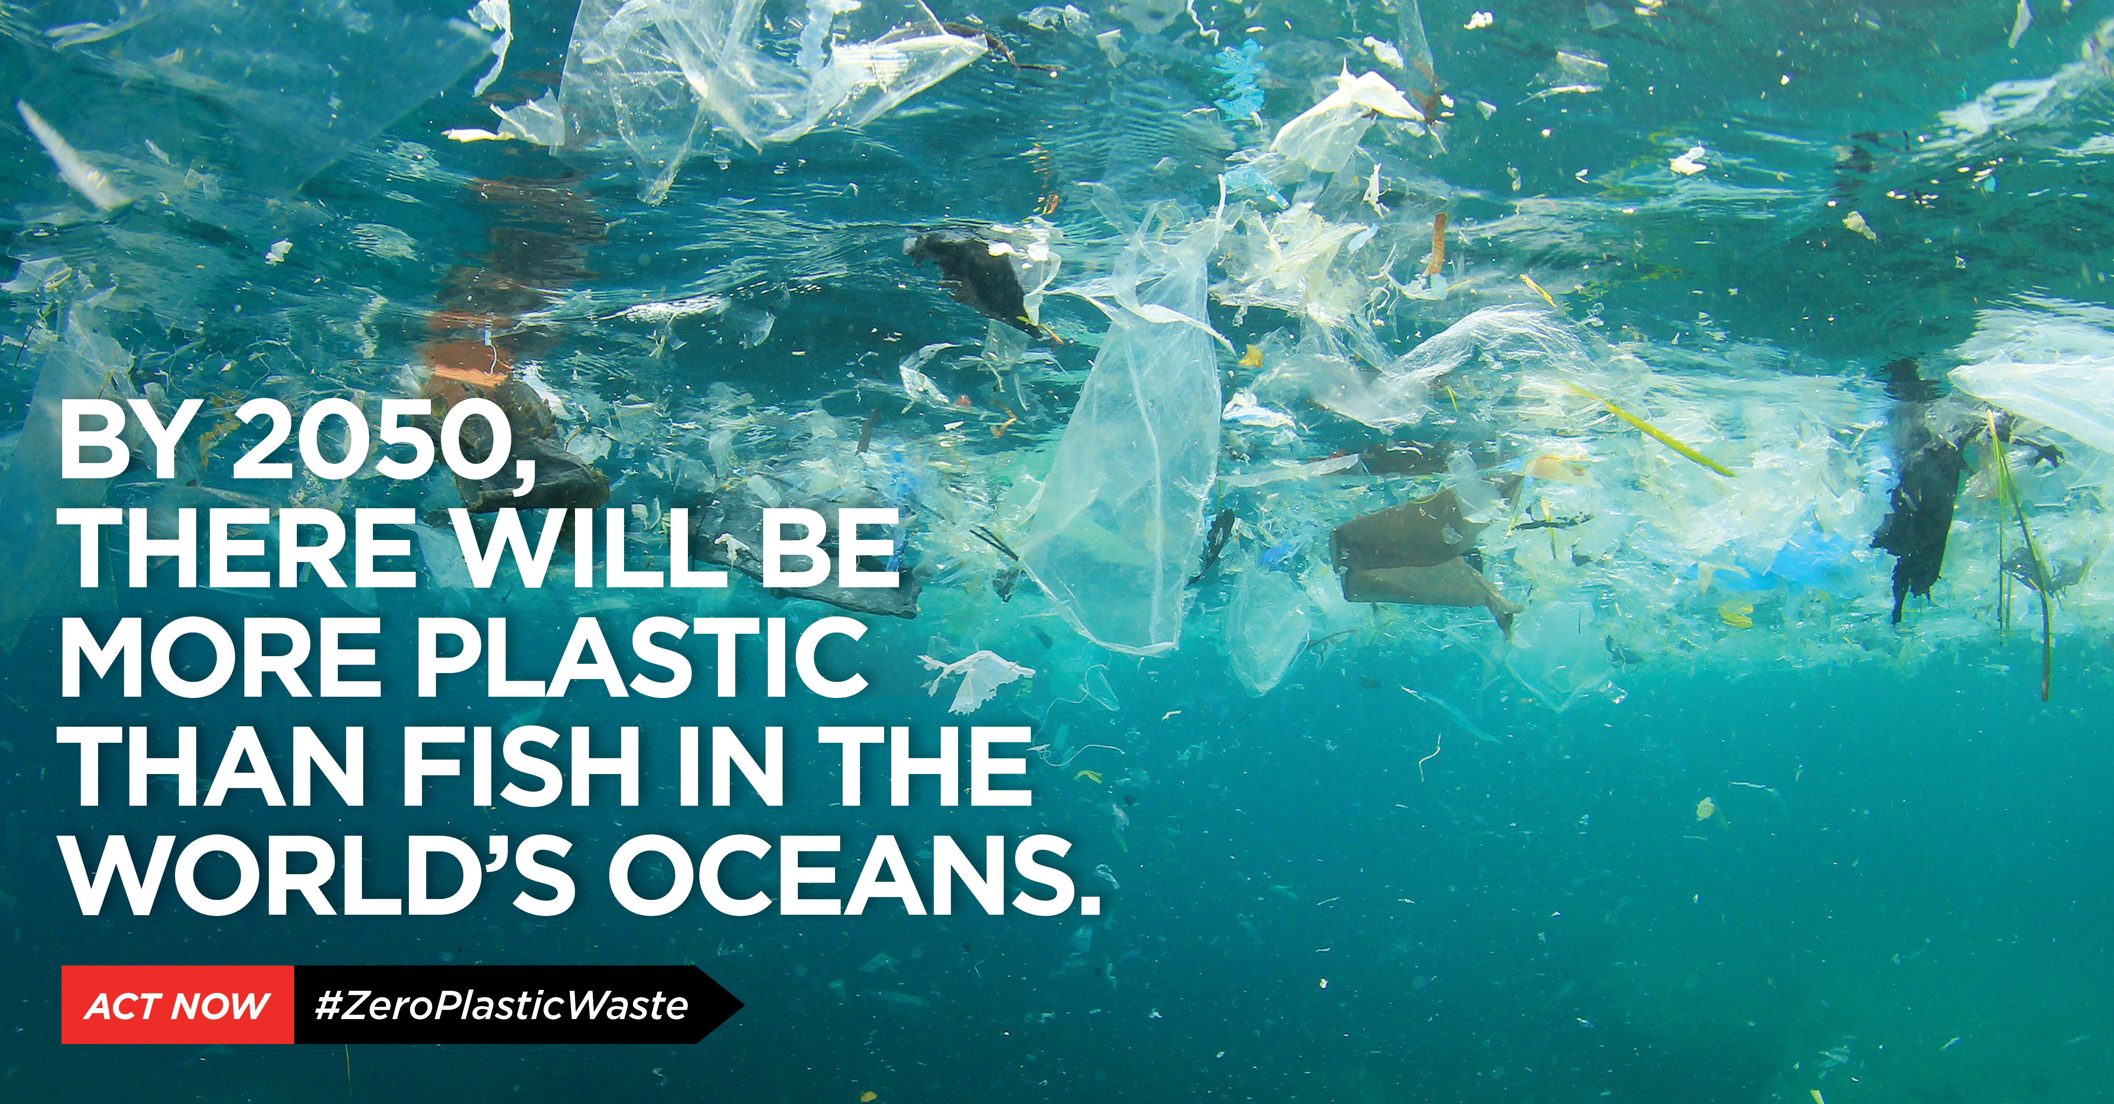
concerns
Institutional failure to protect shared resources

Slide 11
concerns
Climate change impacts:
A +2°C rise in temperatures, for example, would mean that 420 million people would have to face extreme and potentially lethal heatwaves.
Periods of drought would become more frequent, including in urban areas and 350 million people would face water shortages.
The loss of entire harvests could lead to famine, potentially resulting in 80 million deaths from starvation.
UNILAB (2022)

Slide 12
concerns
Consensus has not been reached on how:
a. the process of value creation should be conceptualised concerning public goods that suffer from the tragedy of the commons, and
b. stakeholder relations unfold in this context and how they could unfold better.
This is an issues as scholars and practitioners lack tools to operationalise and advance stakeholder theory and stakeholder relations.

Slide 13
Course of action
Merchant and Van der Stede (2017) reason that organisational action can be guided through cultural, personnel, action, and results controls.
This paper will explore how the objects of control framework (Merchant & Van der Stede, 2017) could assist organisations in establishing and maintaining stakeholder capitalism where institutions have failed to protect shared resources and now need to.

Slide 14
Management controls & Stakeholder capitalism
Designing and Evaluating Management Control Systems:
 |  | Lack of direction | Motivational problems | Personnel limitations
Cultural controls (Culture) | Behaviour-based organisational rules, encompassing but not limited to organisational culture and strategy | X | X
Personnel controls (Selection and placement) | Training, recruitment initiatives, informal coaching, and mentoring | X | X | X
Merchant and Van der Stede (2017)

Slide 15
Management controls & Stakeholder capitalism
Designing and Evaluating Management Control Systems:
 |  | Lack of direction | Motivational problems | Personnel limitations
Action controls (Behavioural constraints) | Frameworks designed to encourage or prohibit behaviour (including written organisational policies and procedures associated with rewards or sanctions) |  | X
Results controls (Results accountability) | Review and performance measurement | X | X
Merchant and Van der Stede (2017)

Slide 16
Course of action
Future
Within stakeholder networks:
Personnel controls
Action controls
Results controls
Current
Within a firm:
Personnel controls
Action controls
Results controls
Cultural controls
Cultural controls

Slide 17
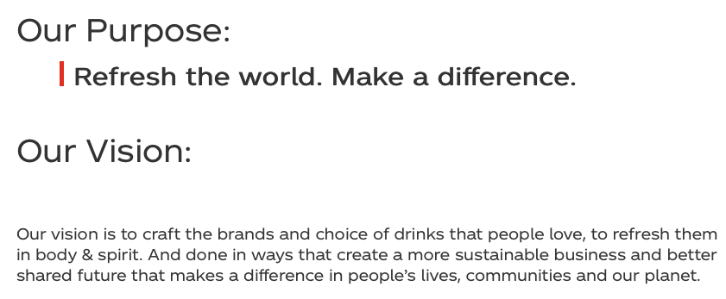

Course of action
Cultural controls: Behaviour-based organisational rules, encompassing but not limited to organisational culture and strategy. An example:
Current | Future
Organisational purpose/vision setting The Coca-Cola Company (2022) | Social purpose/vision setting The AFL (2022)

Slide 18

Course of action
Personnel controls: Training, recruitment initiatives, informal coaching, and mentoring. As an example:
Current | Future
Train and breed to win, competition-based activities and paradigms (e.g., consumer marketing expert - win at all social costs, scientist who can reduce costs) | Train and breed to better society, value-based activities and paradigms (e.g., consumer marketing expert – create value for society, scientist who can deliver products to better society)

Slide 19

Course of action
Action controls: Frameworks designed to encourage or prohibit behaviour (including written organisational policies and procedures associated with rewards or sanctions). As an example:
Current | Future
Profit orientated (e.g., all access office hours, access to emails at all times) | Harmony orientated (e.g., work/life harmony - reduced employee demands, remedy past harms and avoid future harm, see Schrempf-Stirling et al., 2016), Essentially, internalize externalities.

Slide 20
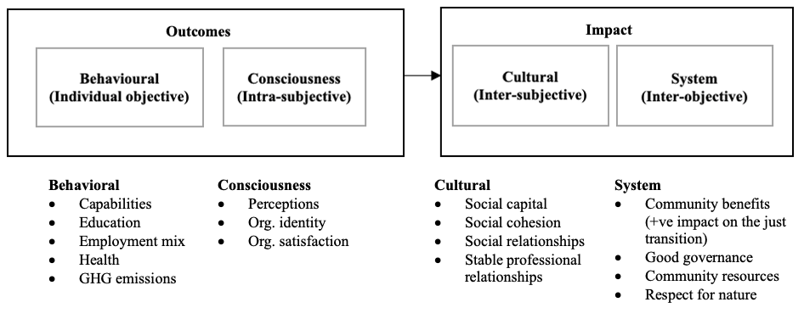
Course of action
Results controls: Review and performance measurement
Outcome v impact
Current | Future
Outcome focused/financial rewards | Impact orientated/mixed rewards

Slide 21
Outcome v impact

Slide 22
The contribution
Stakeholder theory
Management controls

Slide 23
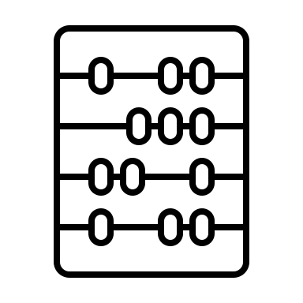
Thank you and questions

Slide 24
References
Allens Linklaters. (2022). Directors and Officers Duties: Evaluation of the ‘Best Interests’ Duty, https://www.aicd.com.au/content/dam/aicd/pdf/news-media/research/2022/Allens-research-the-best-interests-duty-26-05-2022.pdf. Accessed 6 September 2022.
Australian Institute of Company Directors. (2022). Directors’ “best interests” duty in practice. https://www.aicd.com.au/board-of-directors/duties/liabilities-of-directors/directors-best-interests-duty-in-practice.html. Accessed 27 August 2022.
Bridoux, F., & Stoelhorst, J. W. (2022). Stakeholder governance: Solving the collective action problems in joint value creation. Academy of Management Review, 47(2), 214–236.
Business Roundtable. (2019). Business Roundtable redefines the purpose of a corporation to promote “An economy that serves all Americans”. https://www.businessroundtable.org/business-roundtable-redefines-the-purpose-of-a-corporation-to-promote-an-economy-that-serves-all-americans. Accessed 27 August 2022.
Freeman, E. R., Harrison, J. S., Wicks, A. C., Parmar, B. L., & de Colle, S. (2010). Stakeholder Theory. The State of the Art. Cambridge University Press: Cambridge, UK.
Freeman, R. E., Martin, K., & Parmar, B. (2007). Stakeholder capitalism. Journal of Business Ethics, 74(4), 303–314.
Gills, B., & Morgan, J. (2020). Global climate emergency: After COP24, climate science, urgency, and the threat to humanity”. Globalizations, 17(8), 885–902.
Lange, D., Bundy, J., & Park, E. (2022). The social nature of stakeholder utility. Academy of Management Review, 47(1), 9–30.
Lange, D., & Pfarrer, M. D. (2017). Editors’ comments: Sense and structure—The core building blocks of an AMR article. Academy of Management Review, 42(3), 407-416.
Merchant, K., & Van der Stede, W. (2017). Management Control Systems, 4th Edition, Pearson: London UK.
Schrempf-Stirling, J., Palazzo, G., & Phillips, R. A. (2016). Historic corporate social responsibility. Academy of Management Review, 41(4), 700-719.
The ALF. (2022). Purpose and vision. https://www.afl.com.au/careers/our-organisation/our-purpose-and-values. Accessed 13 December 2022.
The Coca-Cola Company (2022). Purpose and vision. https://www.coca-colacompany.com/company/purpose-and-vision. Accessed 13 December 2022.
Van der Stede, W. (2022). Values Alignment: Management Control beyond “Purpose Washing”, 2022 ICVG Conference: Governance in its institutional context.
UNILAB. (2022). Climate change, the UN’s warning: a change of direction by 2050. https://www.unilab.eu/articles/coffee-break/climate-change-un/. Accessed 13 December 2022.

