Slide 1
Appropriate use of benzodiazepines for sleep disturbances in people living with dementia
Education Activity
Centre for Medicine Use and Safety (CMUS)

Slide 2





Introduction
Background
Dementia is associated with a deterioration in:^{1,2}
  Memory
  Thinking
  Behaviour
  Communication
  Ability to perform daily activities

Slide 3



Introduction
Dementia and changed behaviours
People living with dementia often experience changed behaviours. Changed behaviours are diverse and may include:
  Wandering e.g. walking aimlessly and/or excessively, attempting to exit a safe location³
  Sleep disturbances e.g. difficult falling or staying asleep³
  Agitation e.g. excessive fidgeting, pacing, irritability³
  Aggression e.g. verbal insults, swearing, punching, throwing objects^{2,3}

Slide 4
Introduction
Care for people living with dementia and changed behaviours
Care for people living with dementia and changed behaviours can be split into two broad strategies:
Non-pharmacological strategies
Definition: non-medication strategies
Examples: pet therapy, exercise therapy, art therapy^{2,3}
Pharmacological strategies
Definition: medication strategies
Example: psychotropic medications
Royal Commission into Aged Care Quality and Safety defines a psychotropic medication as:
“Any drug capable of affecting the mind, emotions, and behaviour”⁴

Slide 5
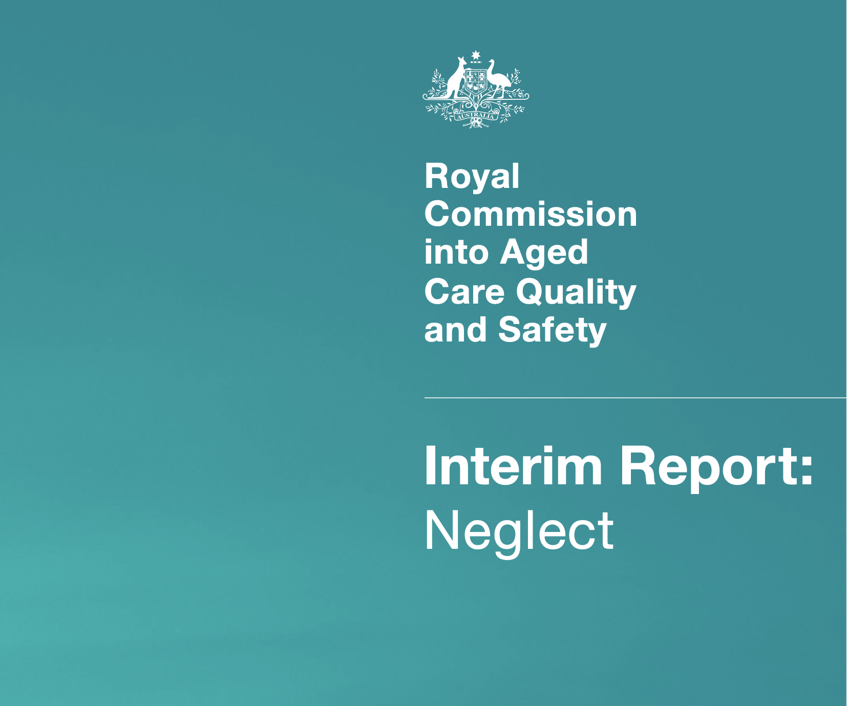
Introduction
Use of Psychotropic Medications in People Living with Dementia and in Residential Aged Care
The Royal Commission into Aged Care Quality and Safety Interim Report: Neglect⁵ highlighted an overreliance on psychotropic medications
Psychotropic medications such as benzodiazepines are associated with adverse outcomes for people living with dementia:
  Sedation e.g. drowsiness, sleepiness
  Falls
  Fractures

Slide 6

Introduction
Clinical Practice Guideline for Appropriate Use of Psychotropic Medications in People Living with Dementia and in Residential Aged Care
Three most common psychotropic medications implicated in restrictive practice in residential aged care are:
  Antipsychotics
  Benzodiazepines
  Antidepressants⁴
The new clinical practice guideline focuses on the appropriate medication use of antipsychotics, benzodiazepines and antidepressants

Slide 7
Learning Objectives
By the end of this session, you should be able to:
Explain the criteria that should be met before using a benzodiazepine for people living with dementia and sleep disturbances
Specify the criteria for escalating care surrounding initiation of a benzodiazepine
Explain what should be documented surrounding initiation of an benzodiazepine
Be aware of supporting resources accompanying the Guideline to use in everyday practice

Slide 8

Initiation of benzodiazepines
Image from freepik

Slide 9
Group discussion – what is a benzodiazepine?

Slide 10

What is a benzodiazepine?
A benzodiazepine is a class of medication that slows down the workings of the brain⁶
Benzodiazepines can cause:
  Excess sedation e.g. drowsiness, sleepiness
  Physical dependence⁷
  Tolerance⁷
Sometimes benzodiazepines are prescribed to people living with dementia and changed behaviours
One Australian study⁸ reports that 30% of residents are dispensed benzodiazepines within three months of admission to residential aged care
Some examples of benzodiazepines are temazepam, oxazepam, lorazepam and diazepam^{4,9}

Slide 11
Multiple choice question
When should benzodiazepines be considered for sleep disturbances in people living with dementia? Select the most correct option:
  When a person is first diagnosed with dementia as most people living with dementia eventually develop sleep disturbances
  When a person living with dementia and sleep disturbances starts to wander
  When a person living with dementia experiences sleep disturbances for the first time
  As a last resort when all other non-pharmacological strategies have been trialled for an adequate period of time
  B and D
Answer: D

Slide 12


Multiple choice question - answer
Why is option D correct?
Benzodiazepines should only be considered:
  As a last resort for people living with dementia who are experiencing sleep disturbances
Benzodiazepines should NOT be considered for people living with dementia who are:
  Initially diagnosed with dementia and not experiencing sleep disturbances
  Experiencing sleep disturbances and wander for the first time
  Experiencing sleep disturbances for the first time
If a decision is made to initiate a benzodiazepine for changed behaviours, the prescriber must clearly indicate the reason for prescribing the benzodiazepine

Slide 13
Harms vs Benefits of Benzodiazepines
May improve:
  Sleep disturbances¹⁰
  Agitation¹¹
Increase the risk of :
  Hip fracture¹²
  Falls¹³
  Excess sedation; drowsiness, sleepiness
  Daytime drowsiness
BENEFITS
HARMS

Slide 14
Steps before initiating a benzodiazepine
Clinical steps
When a person living with dementia is displaying sleep disturbances for the first time, contact the prescriber to rule out acute causes for the behaviour e.g. delirium, infection³
After these have been excluded, all staff should trial the following measures for an adequate and agreed period of time:
  Identify potential underlying causes;
    unmet needs
      e.g. loneliness, need for meaningful activity
    environmental factors
      e.g. noisy environment
    medical conditions
      e.g. pain, adverse events to medications
Non-pharmacological strategies;
  tailor non-pharmacological strategies to the person
    e.g. relaxation therapy, music therapy
  you may be able to refer to
    a dementia specialist within the residential aged care facility
    Dementia Support Australia (DSA)¹⁴
Get the entire care team involved!

Slide 15
Steps before initiating a benzodiazepine
Communication and documentation steps
Document clinical steps trialled and the sleep disturbance the person is experiencing in the (where applicable);
  medical record
  nursing progress notes
  behaviour support plan
Discuss the person’s sleep disturbance with the entire care team (including the prescriber)
Document conversations and the plan going forward
Get the entire care team involved!

Slide 16

Case study
Dimitri Popov is a person living with vascular dementia at Sunnyside residential aged care facility
Dimitri worked as a strawberry farmer and spent most of his working life getting up early in the morning
Dimitri enjoys drinking multiple cups of coffee throughout the day. Dimitri explains, “there’s not too much to do around here, so the coffee keeps me awake!”
Dimitri’s room is situated close to the nurses station. Often, Dimitri’s room door is left open during the night
Image from freepik

Slide 17
Case study
Small groups
Read the Case Study
Discuss questions 1 and 2 over the next 15 minutes
Prepare answers to share in group discussion

Slide 18
Review of case study questions
Group Discussion
Question 1. Should a benzodiazepine be prescribed for Dimitri’s sleep disturbance? What would you communicate and document?

Slide 19
Review of case study questions
Group Discussion
Question 1. Should a benzodiazepine be prescribed for Dimitri’s sleep disturbance? What would you communicate and document?
Clinical steps
No
Prescribing, dispensing or administering a benzodiazepine in this case should not be considered
Non-pharmacological strategies should be trialled for an adequate period of time first
Communication and documentation steps
Document Dimitri’s sleep disturbance in the medical record, nursing progress notes and behaviour support plan where applicable
  e.g. Dimitri was experiencing xxxxxx
Contact the prescriber
Notify the care team
Benzodiazepines should only be used as a last resort for people living with dementia who are experiencing sleep disturbances

Slide 20
Review of case study questions
Group Discussion
Question 2. List some management strategies you should try first before considering a benzodiazepine for Dimitri. How would you communicate and document this?

Slide 21
Review of case study questions
Group Discussion
Question 2. List some management strategies you should try first before considering a benzodiazepine for Dimitri. How would you communicate and document this?
Clinical steps
All staff should trial the following measures and for an adequate and agreed period of time:
  Investigate possible underlying causes of sleep disturbance such as;
    could Dimitri’s door be closed at night to reduce noise and light entering his room? Could a night light be used instead?
    could Dimitri’s coffees at night be swapped for a non-caffeinated drink?
    could staff encourage Dimitri to engage in group activities?
    could Dimitri be provided with his favourite newspaper each morning to read?
    what time would Dimitri usually wake up at home?
  Non-pharmacological strategies
    could staff encourage Dimitri to spend time in the garden?

Slide 22
Review of case study questions
Group Discussion
Question 2. List some management strategies you should try first before considering a benzodiazepine for Dimitri. How would you communicate and document this?
Communication and documentation steps
Document clinical steps trialled and the sleep disturbance Dimitri is experiencing in the (where applicable);
  medical record
  nursing progress notes
  behaviour support plan
Contact the prescriber
Notify the care team
Document conversations and plan going forward
  We spoke with Dimitri’s wife, Irene, about Dimitri’s morning routine at home. She explained Dimitri usually woke up at 5am and he enjoyed eating breakfast while reading the newspaper called ‘The Sunshine’ and overlooking the farm. Contacted newsagent and the newspaper will be delivered each morning from tomorrow. Please trial encouraging Dimitri to sit overlooking the garden on the mornings he wakes up early

Slide 23

Update on Dimitri
Dimitri was delighted when staff delivered his favourite newspaper to him the next morning. When Dimitri requested coffees later in the day, staff offered Dimitri an alternative non-caffeinated drink that Dimitri enjoyed growing up in his home country. Nurse Jenny observed,
“I thought Dimitri needed a benzodiazepine. I doubted non-pharmacological strategies would work for him. But they have been great. And even on the odd morning when Dimitri wakes up early, he responds well to sitting overlooking the garden. It’s great to see that all our detective work has paid off!”
Image from freepik

Slide 24
Prescribers' responsibilities surrounding benzodiazepine initiation
What steps should prescribers complete and document before initiating a benzodiazepine?
Clinical steps
Identify the specific changed behaviour they want to improve (target symptom)
  Does Dimitri have sleep disturbances? Have all other measures been trialled for an adequate and agreed period of time?
Identify the anticipated treatment outcome
  What benefit does Dr. Mary want to see as a result of Dimitri taking the benzodiazepine?
Complete an individual harm-benefit analysis
  What are Dimitri’s individual risks and benefits of taking the benzodiazepine?
  What other medications is Dimitri taking?
Communication and documentation steps
Have a comprehensive discussion with the person living with dementia, support person and/or their substitute decision maker
Obtain informed consent
Document treatment review date
Document treatment end date
  The prescriber, supply pharmacist and nurse should be document the treatment end date in the medical record, pharmacy dispensing history and nursing progress notes, respectively.
If the prescriber initiates a benzodiazepine, initial treatment duration for sleep disturbance should not exceed 2 weeks

Slide 25



Take home messages
There is a limited role for benzodiazepines for sleep disturbances
Before considering initiation of a benzodiazepine, all staff should trial for an adequate and agreed period of time:
  Identify and address possible underlying causes for sleep disturbance
  Implement non-pharmacological strategies
Benzodiazepines should only be considered as a last resort for people living with dementia who are experiencing sleep disturbances

Slide 26

Supporting resources
Access to the Guideline

Slide 27
References
The Royal Commission into Aged Care Quality and Safety. Background Paper 3: Dementia in Australia: Nature, Prevalence and Care. Commonwealth of Australia; 2019. Accessed December 9, 2022. https://agedcare.royalcommission.gov.au/sites/default/files/2019-12/background-paper-3.pdf
New South Wales Ministry of Health. Assessment and Management of Behaviours and Psychological Symptoms associated with Dementia (BPSD). New South Wales Government; 2022. Accessed January 25, 2023. https://www.health.nsw.gov.au/mentalhealth/resources/Publications/assessment-mgmt-people-bpsd-2022.pdf.
Burns K, Jayasinha R, Tsang R, Brodaty H. Behaviour Management A Guide to Good Practice: Managing Behavioural and Psychological Symptoms of Dementia. Dementia Support Australia; 2012. Accessed September 19, 2022. https://www.dementia.com.au/resource-hub/behaviour-management-a-guide-to-good-practice
Aged Care Quality and Safety Commission. Psychotropic medications used in Australia: information for aged care. Australian Government; 2021. Accessed September 2, 2022. https://www.agedcarequality.gov.au/resources/psychotropic-medications-used-australia-information-aged-care
The Royal Commission into Aged Care Quality and Safety. Interim Report: Neglect. Commonwealth of Australia; 2019. Accessed September 19, 2022. https://agedcare.royalcommission.gov.au/publications/interim-report
Department of Health, State Government of Victoria. Benzodiazepines. Better Health Channel. Updated October 26, 2020. Accessed October 27, 2022. https://www.betterhealth.vic.gov.au/health/healthyliving/tranquillisers#what-are-benzodiazepines
Depressants. Alcohol and Drug Foundation; 2022. Accessed January 13, 2023. https://adf.org.au/drug-facts/depressants/
Harrison, SL, Sluggett, JK, Lang, C, et al. The dispensing of psychotropic medicines to older people before and after they enter residential aged care. Med J Aust. 2020;212(7):309-313. doi: 10.5694/mja2.50501
Australian Medicines Handbook. Australian Medicines Handbook Pty Ltd. Updated January 2023. Accessed February 10, 2023. https://amhonline.amh.net.au.acs.hcn.com.au
Glass J, Lanctôt KL, Herrmann N, Sproule BA, Busto UE. Sedative hypnotics in older people with insomnia: meta-analysis of risks and benefits. BMJ. 2005; 331(7526):1169. doi: 10.1136/bmj.38623.768588.47
Meehan KM, Wang H, David SR, et al. Comparison of rapidly acting intramuscular olanzapine, lorazepam, and placebo: a double-blind, randomized study in acutely agitated patients with dementia. Neuropsychopharmacology. 2002;26(4):494-504. doi: 10.1016/S0893-133X(01)00365-7
Donnelly K, Bracchi R, Hewitt J, Routledge PA, Carter B. Benzodiazepines, Z-drugs and the risk of hip fracture: A systematic review and meta-analysis. PLoS One. 2017;12(4):e0174730. doi: 10.1371/journal.pone.0174730
Seppala LJ, Wermelink AMAT, de Vries M, et al. Fall-Risk-Increasing Drugs: A Systematic Review and Meta-Analysis: II. Psychotropics. J Am Med Dir Assoc. 2018;19(4):371.e11-371.e17. doi: 10.1016/j.jamda.2017.12.098
Dementia Support Australia. Helping you care for people with dementia. Dementia Support Australia. Accessed February 2, 2023. https://www.dementia.com.au/who-we-help/dementia-healthcare-professionals?hsCtaTracking=c0d1774a-0ac3-4c51-ade3-7370dee3ce26%7C5fd0cceb-a3e2-40d7-a516-d4845624ccef
Unless specified, all icons included in this presentation are from Flaticon.com

