Slide 1
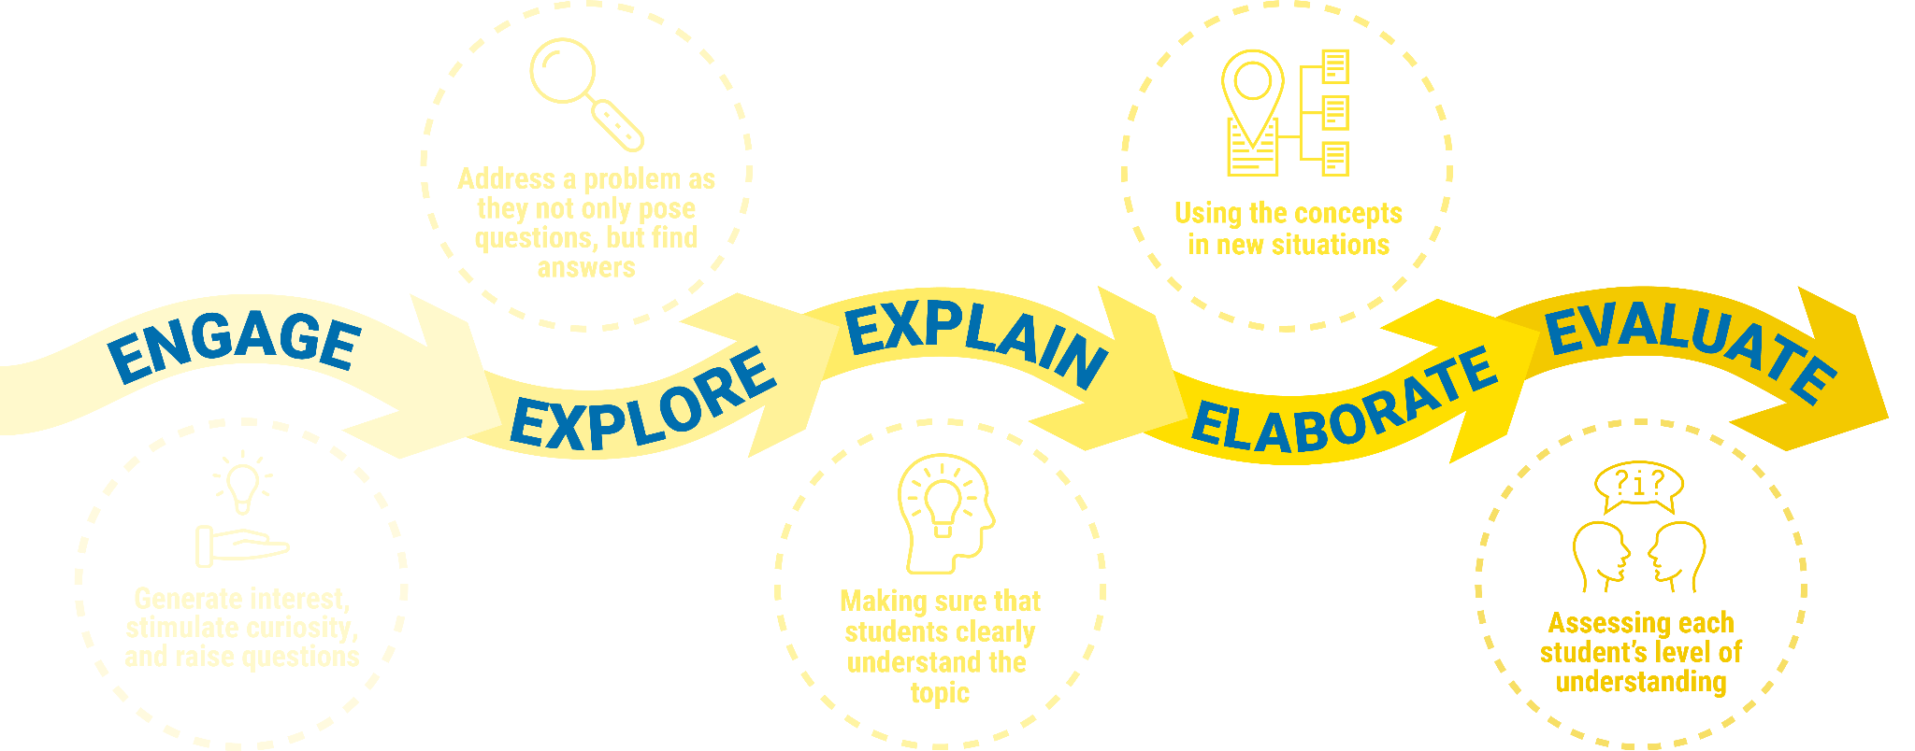
The 5E Pedagogical Model Overview
Notes:
Teacher Only Slide - Brief overview of the 5E Pedagogical Model for Inquiry Learning

Slide 2
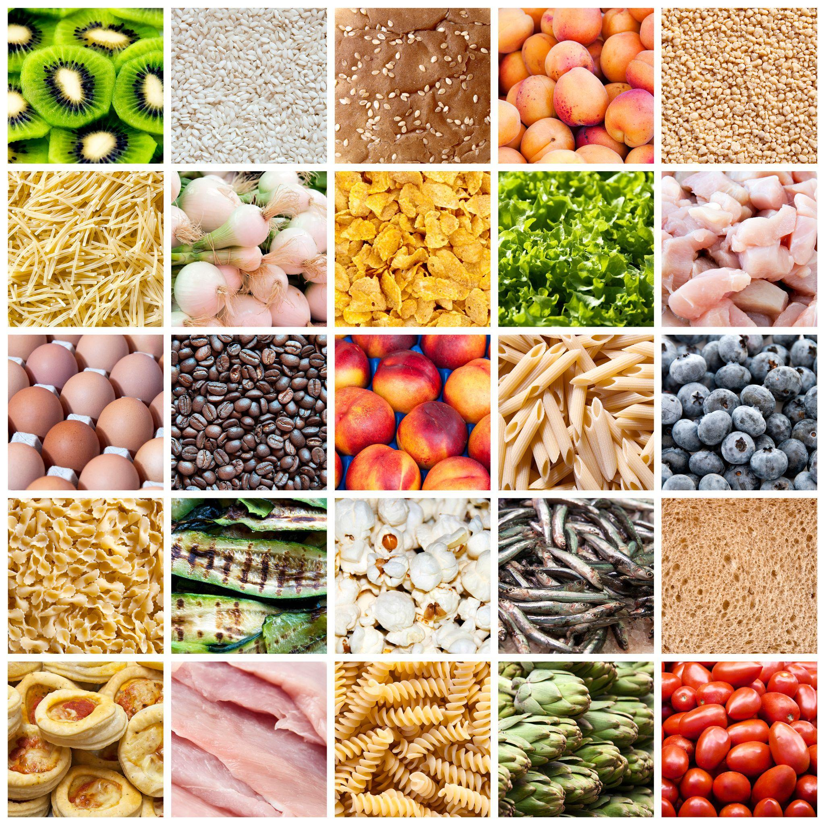
Exploring the impact of climate change on food security in Australia
LESSON PLAN

Slide 3
Learning Intention
Students will be able to identify the climate change risks and solutions to Australia's food security.
Success Criteria
Describe how climate change will impact extreme weather and resources
Apply these changes to the agriculture sector
Examine these impacts on a state scale
Identify potential solutions to climate risks

Slide 4
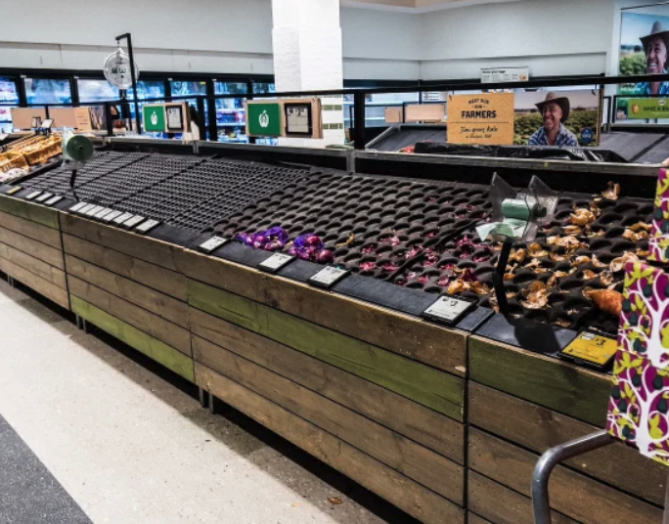
What do you see in this image?
What do you think this image means?
What does this image make you wonder?
ENGAGE

Slide 5
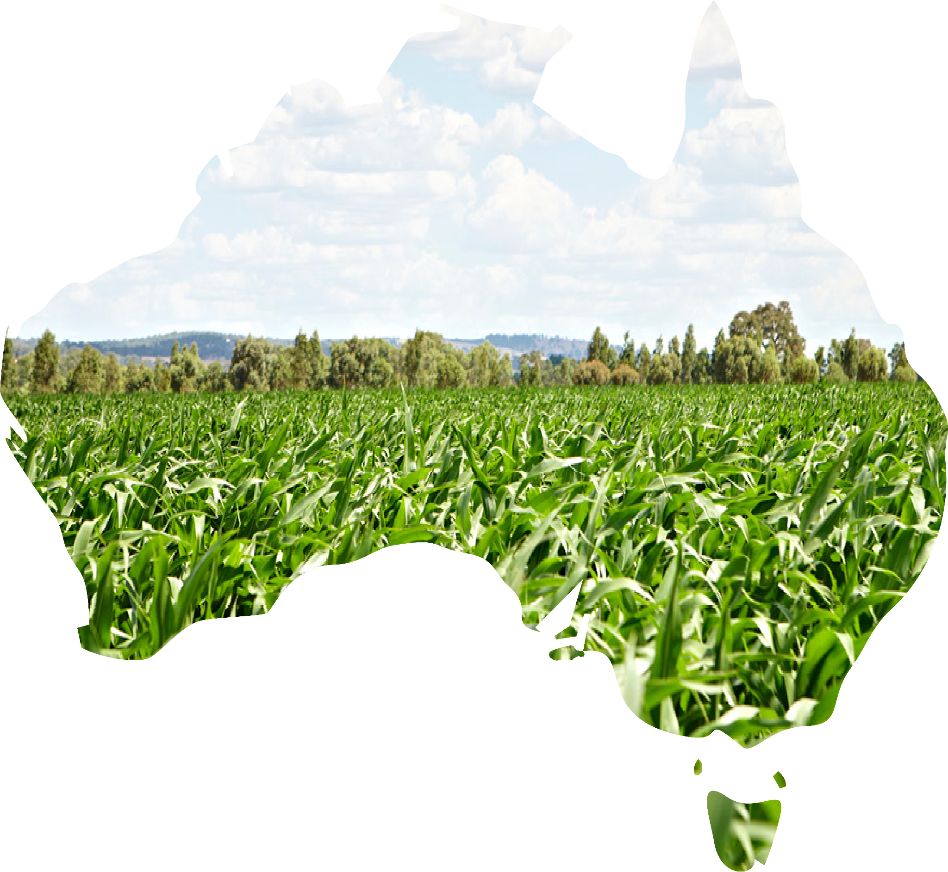
What crops are grown in Australia?
EXPLORE

Slide 6
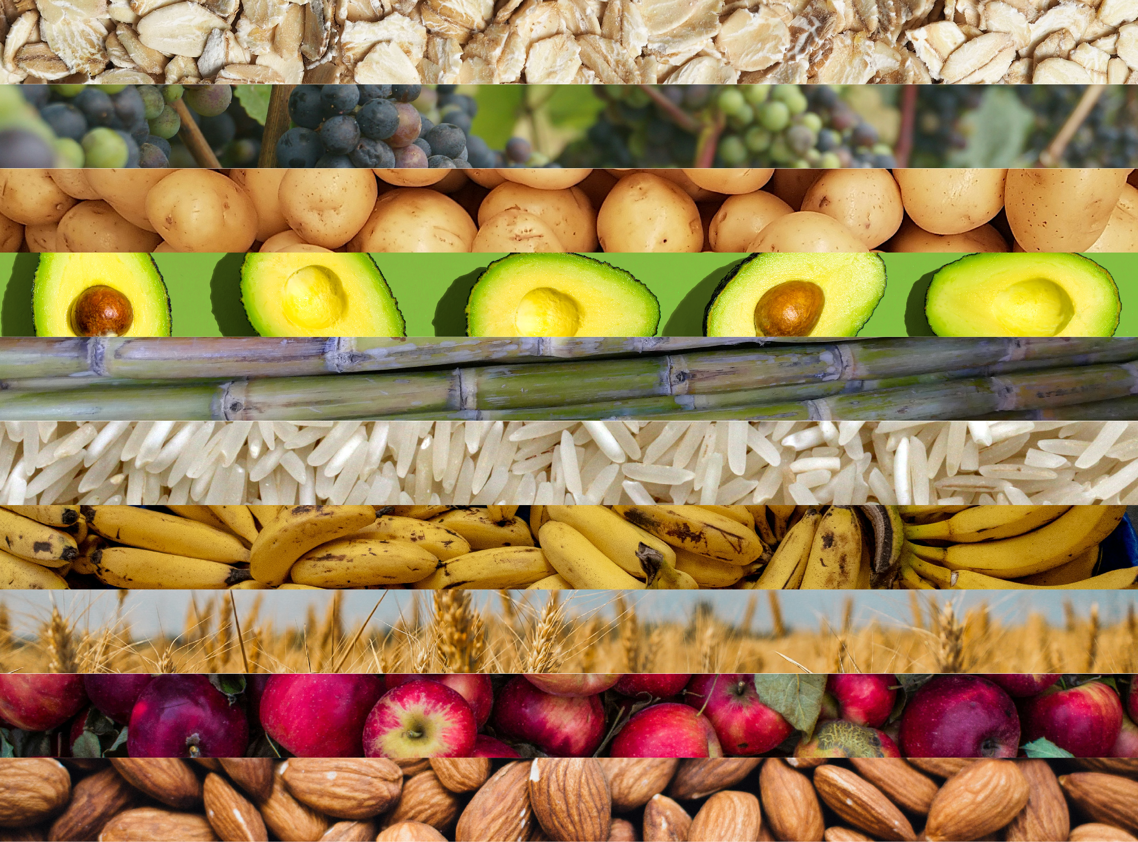
Oats
Grapes
Potatoes
Avocados
Sugar-cane
Rice
Bananas
Wheat
Apples
Almonds
10 Australian crops
Order them from 1 to 10 with 1 being the highest quantity produced to 10 being the lowest
EXPLORE

Slide 7
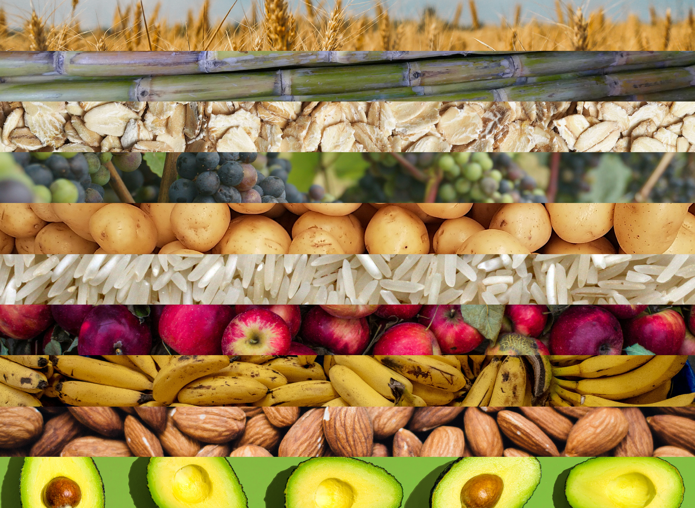
1. 36 million tonnes
Wheat
2. 28.7 million tonnes
Sugar-cane
3. 1.7 million tonnes
Oats
4. 1.2 million tonnes
Grapes
5. 1.1 million tonnes
Potatoes
6. 691,000 tonnes
Rice
7. 300,500 tonnes
Apples
8. 280,800 tonnes
Bananas
9. 136,800 tonnes
Almonds
10. 10,685 tonnes
Avocados
EXPLORE

Slide 8
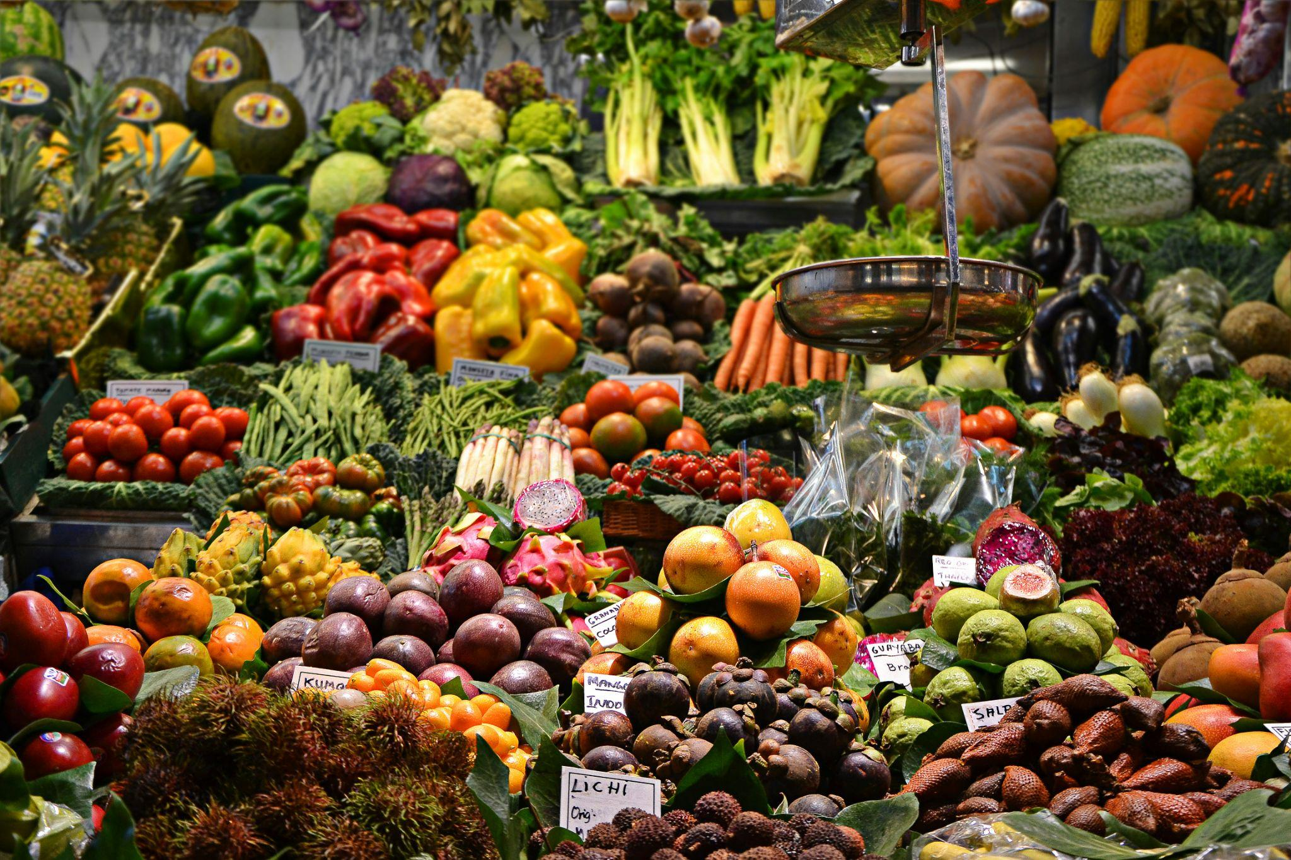
What is food security?
“When all people, at all times, have physical and economic access to sufficient safe and nutritious food that meets their dietary needs and food preferences for an active and healthy life.”
EXPLAIN
Notes:
What is Food Security?
Based on the 1996 World Food Summit, food security is defined when all people, at all times, have physical and economic access to sufficient safe and nutritious food that meets their dietary needs and food preferences for an active and healthy life.
Source: World Bank

Slide 9
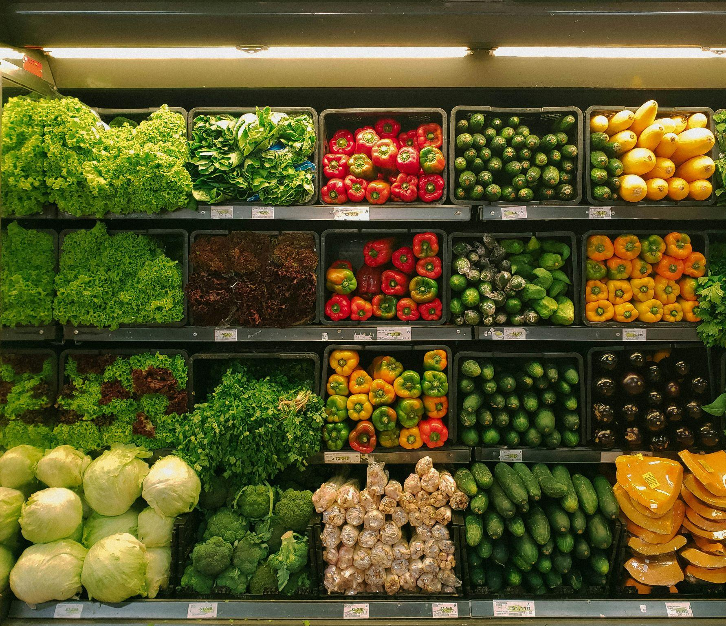

Key factors of food security
There are four key components of food security:
Food availability
Food access
Food use
Stability of the above
EXPLAIN
Notes:
The four main dimensions of food security:
Physical availability of food: Food availability addresses the “supply side” of food security and is determined by the level of food production, stock levels and net trade.
Economic and physical access to food: An adequate supply of food at the national or international level does not in itself guarantee household level food security. Concerns about insufficient food access have resulted in a greater policy focus on incomes, expenditure, markets and prices in achieving food security objectives.
Food utilisation: Utilisation is commonly understood as the way the body makes the most of various nutrients in the food. Sufficient energy and nutrient intake by individuals are the result of good care and feeding practices, food preparation, diversity of the diet and intra-household distribution of food. Combined with good biological utilization of food consumed, this determines the nutritional status of individuals.
Stability of the other three dimensions over time: Even if your food intake is adequate today, you are still considered to be food insecure if you have inadequate access to food on a periodic basis, risking a deterioration of your nutritional status. Adverse weather conditions, political instability, or economic factors (unemployment, rising food prices) may have an impact on your food security status.
For food security objectives to be realised, all four dimensions must be fulfilled simultaneously.

Slide 10
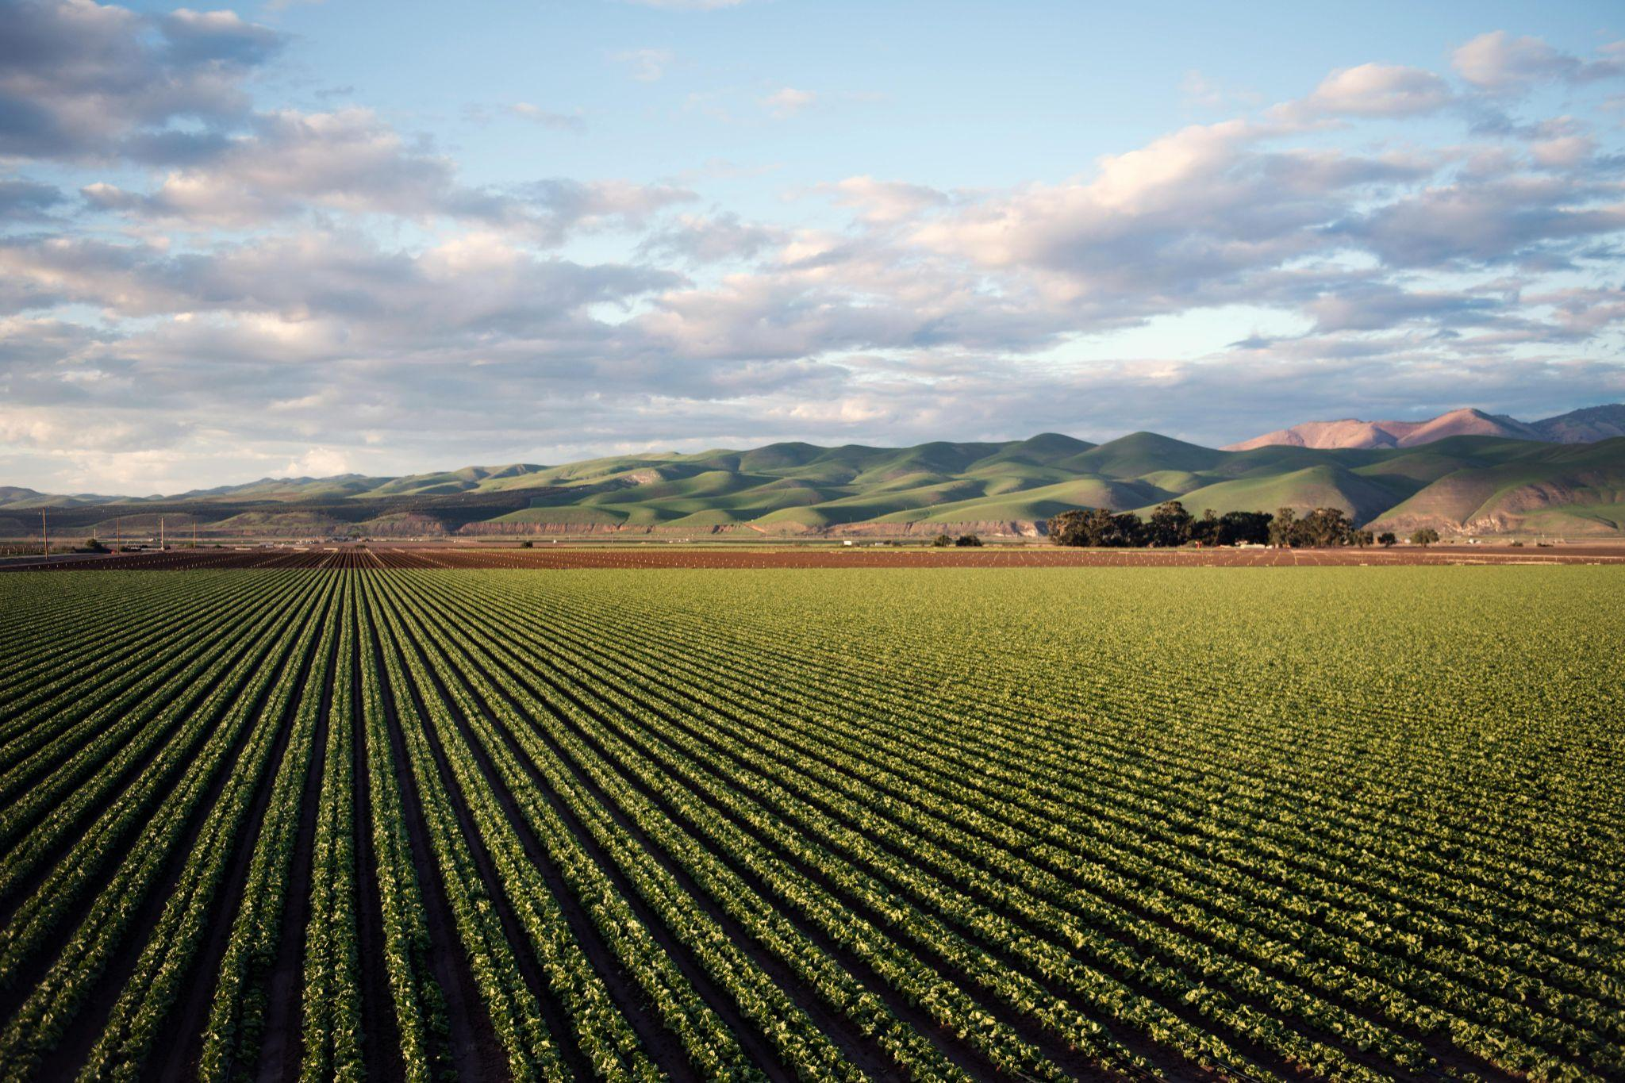
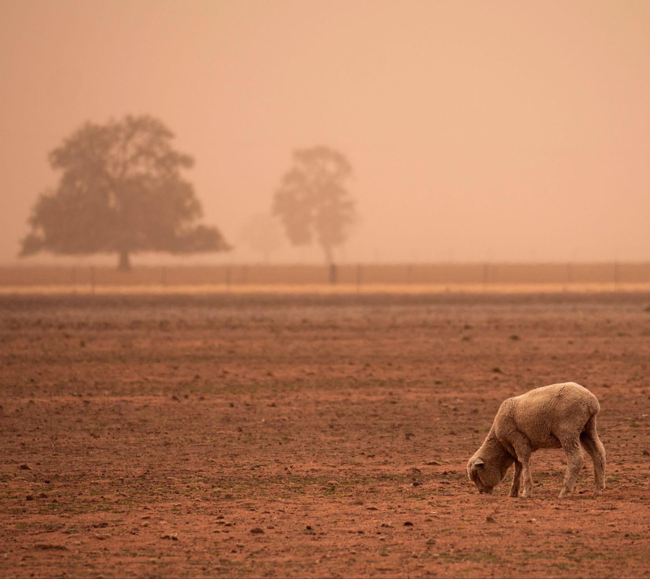
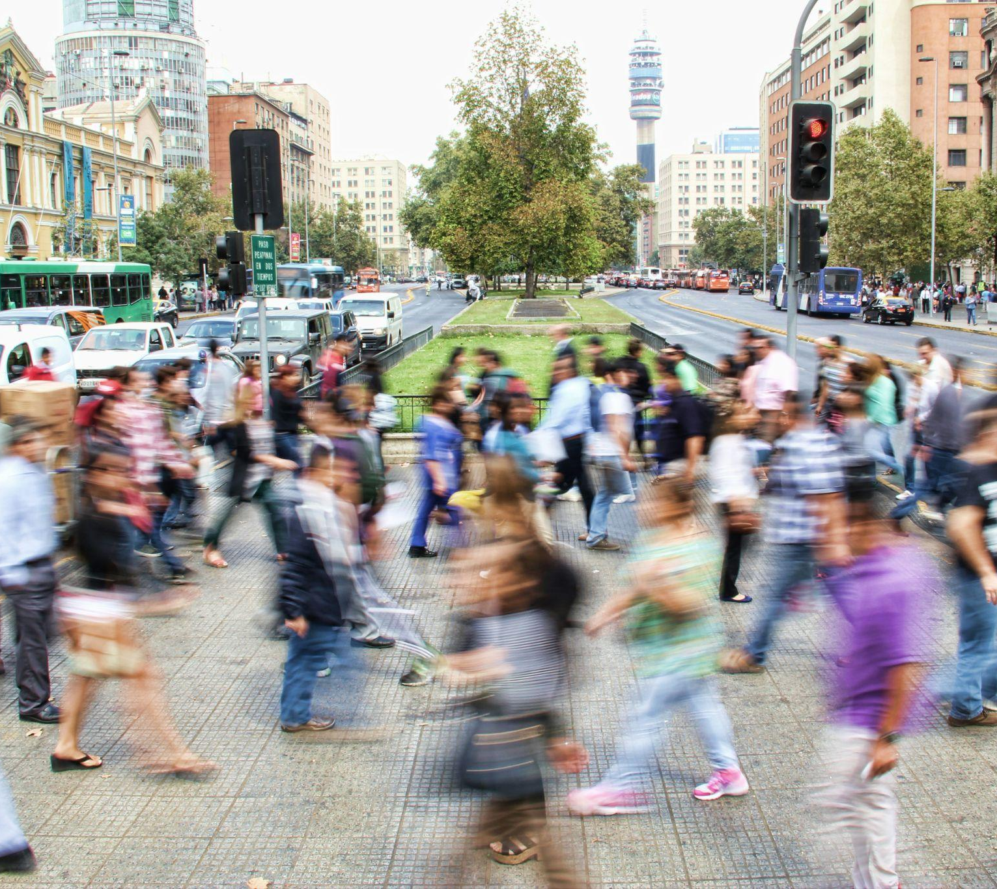

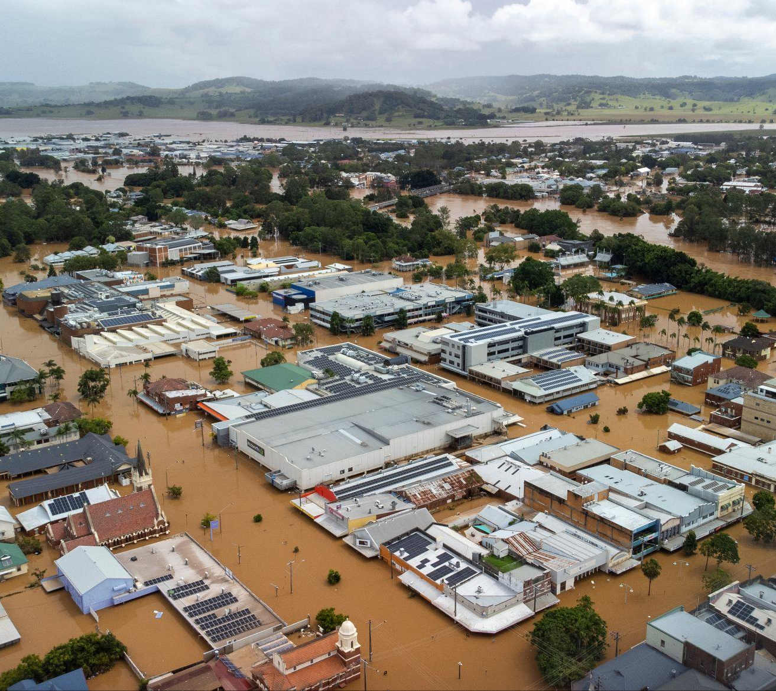
Main threats to food security
Climate change
Population growth
Rising food prices
Extreme
weather events
EXPLAIN
Notes:
1. Climate Change:
Rising temperatures are shifting agricultural seasons, altering growing conditions, and reducing crop yields, making farming increasingly unpredictable. It is also responsible for changing and polluting entire ecosystems, compromising biodiversity, and destroying harvests. All these events have a huge impact on food production, as they significantly limit the quality, availability, and accessibility of resources, and compromise the stability of food systems around the world.
2. Population growth:
By 2050, estimates predict that the total number of people living on Earth will reach nearly 10 billion. More people on the planet means more mouths to feed and this can put a strain on its resources as the modern agricultural system is already struggling to meet global needs. According to the 2020 IPCC Special Report on climate change, since 1961, food supply per capita has grown more than 30%.
3. Rising food prices:
Food insecurity among Australia’s lowest-income households (below $30,000) has risen to 48%, increasing by 5% since 2022 as the cost-of-living crisis deepens. Inflation-driven price hikes in food, housing, and utilities, combined with stagnant wages and inadequate income support, have widened the socioeconomic divide, forcing many to cut back on essentials. Global supply chain disruptions and climate change further exacerbate rising costs, disproportionately affecting low-income households, who remain trapped in a cycle of financial hardship
4. Extreme weather events:
The climate crisis is changing weather patterns and increasing the chances of extreme events such as hurricanes, floods, and droughts. Extreme weather events are increasingly disrupting food security by damaging crops, reducing yields, and destabilizing food supply chains. Prolonged droughts deplete water sources essential for irrigation, while intense storms and flooding destroy farmland and infrastructure, leading to food shortages and price spikes. These events also threaten livestock, degrade soil quality, and disrupt transportation networks, making it harder to distribute food where it is needed.

Slide 11





Climate change risks
Rising temperatures
Change in rainfall
Increasing extreme weather events
Rising sea levels & salinity
Resource degradation
Eg. Change in seasonal timings, more hot days
Eg. Reduced rainfall, more intense quick bursts
Eg. Bushfires, floods, droughts
Eg. Storm surges, salt water intrusion
Eg. Water, land
EXPLAIN
Notes:
Rising temperatures: Higher temperatures shorten growing seasons, reduce crop yields, and increase heat stress on livestock, leading to lower food production.
Change in rainfall: Unpredictable rainfall patterns cause droughts and floods, disrupting irrigation, damaging crops, and reducing water availability for agriculture.
Increasing extreme weather events: More frequent storms, droughts, and heatwaves destroy crops, livestock, and infrastructure, leading to food shortages and price instability.
Rising sea levels & salinity: Coastal flooding and saltwater intrusion degrade arable land, reducing crop productivity and threatening freshwater sources essential for farming.
Resource degradation: Soil erosion, desertification, and water scarcity deplete essential agricultural resources, making food production less sustainable and more vulnerable to climate shocks.

Slide 12
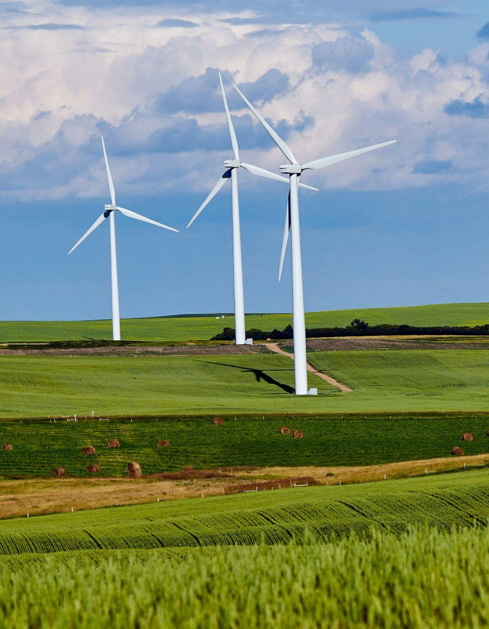
Time to become the experts
In your groups you will research your assigned topic in regards to food security on a state based scale:
Impact of climate change and extreme weather on food growth
Impact of climate change and extreme weather on the economy, producers and consumers
Impact of climate change and extreme weather on society/communities
Land and water focused solutions to maximise food security under climate change
ELABORATE

Slide 13

Information to find
Direct impacts on food security
Linking possible indirect impacts
Both positives / negatives
Who, what, when, where, why
ELABORATE

Slide 14






How far along are you?
Nothing
done
Only a
little
Some
done
About half way
Nearly
done
All
done
EVALUATE: LESSON 1
Notes:
End of lesson 1

Slide 15
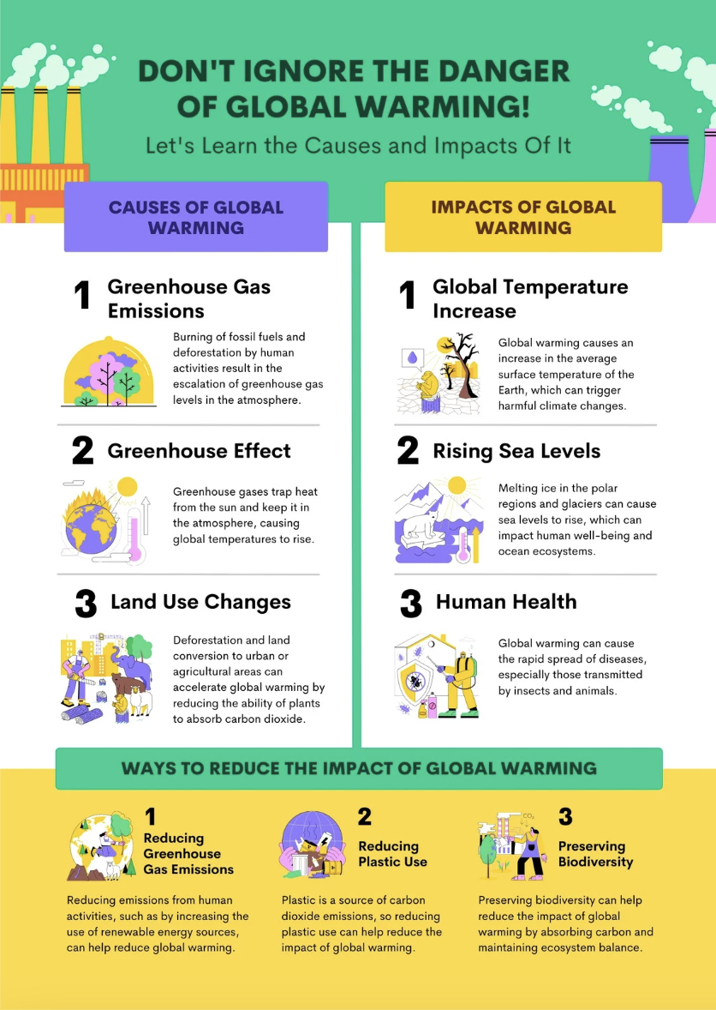
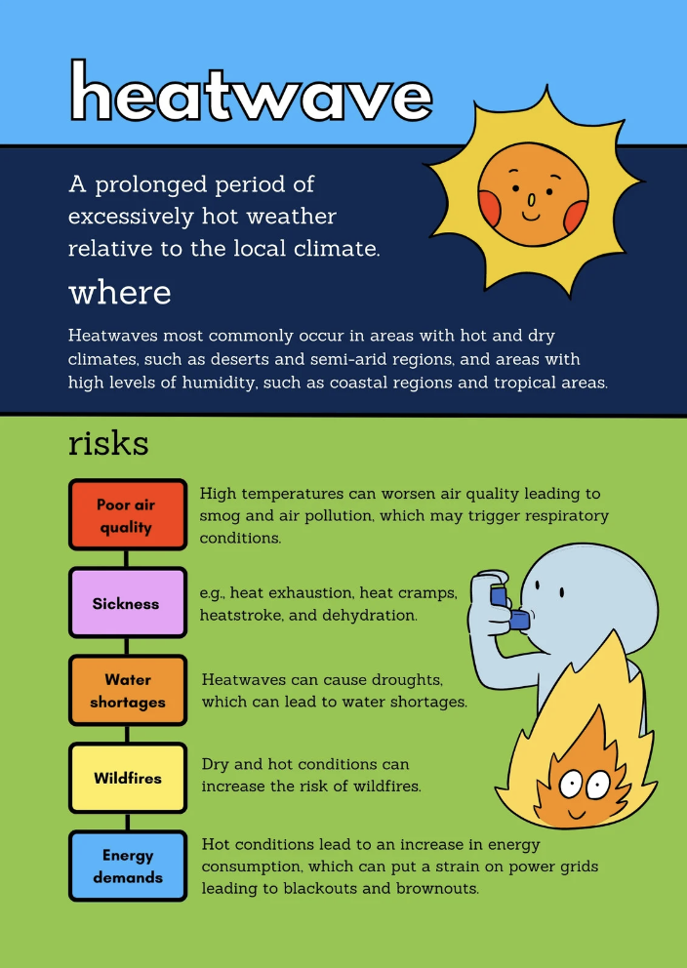
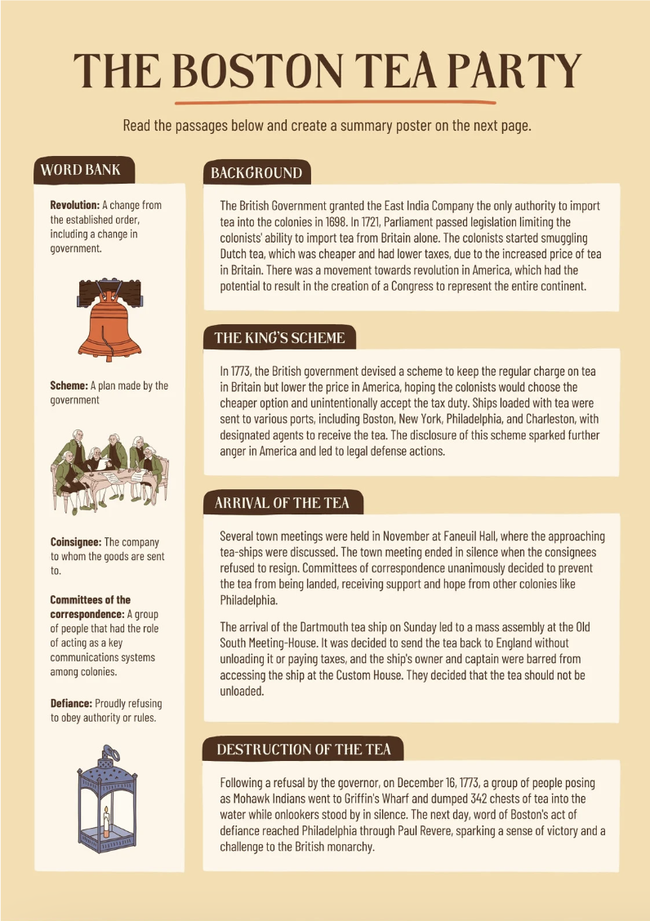
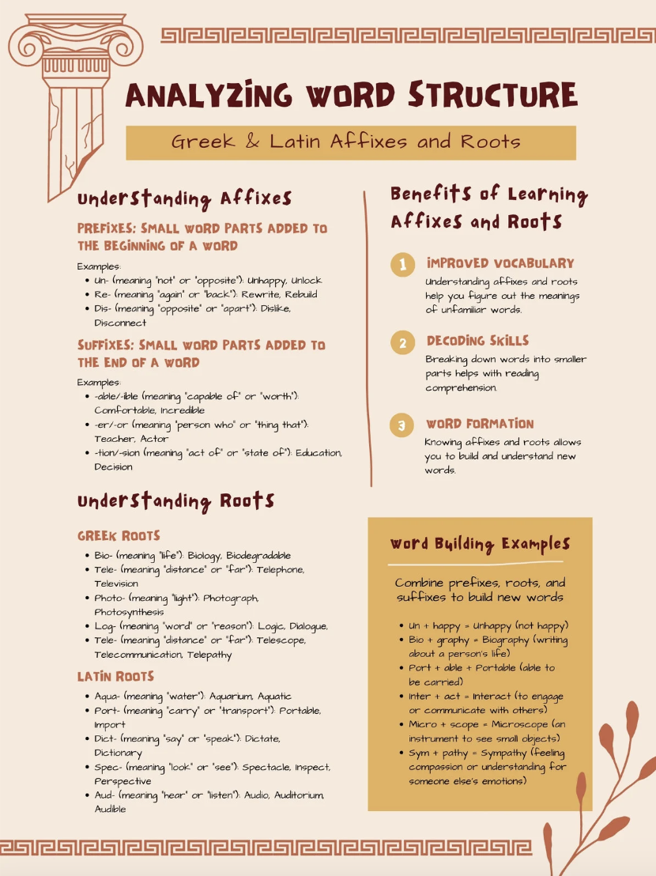
You can be creative with how you chose to structure and design you poster, but the key information needs to be showcased.
In your groups, you are to present a summary of the key points on a poster
EXPLAIN: LESSON 2
Notes:
Lesson 2

Slide 16
How far along are you?
Nothing
done
Only a
little
Some
done
About half way
Nearly
done
All
done
EVALUATE: LESSON 2
Notes:
End of lesson 2

Slide 17
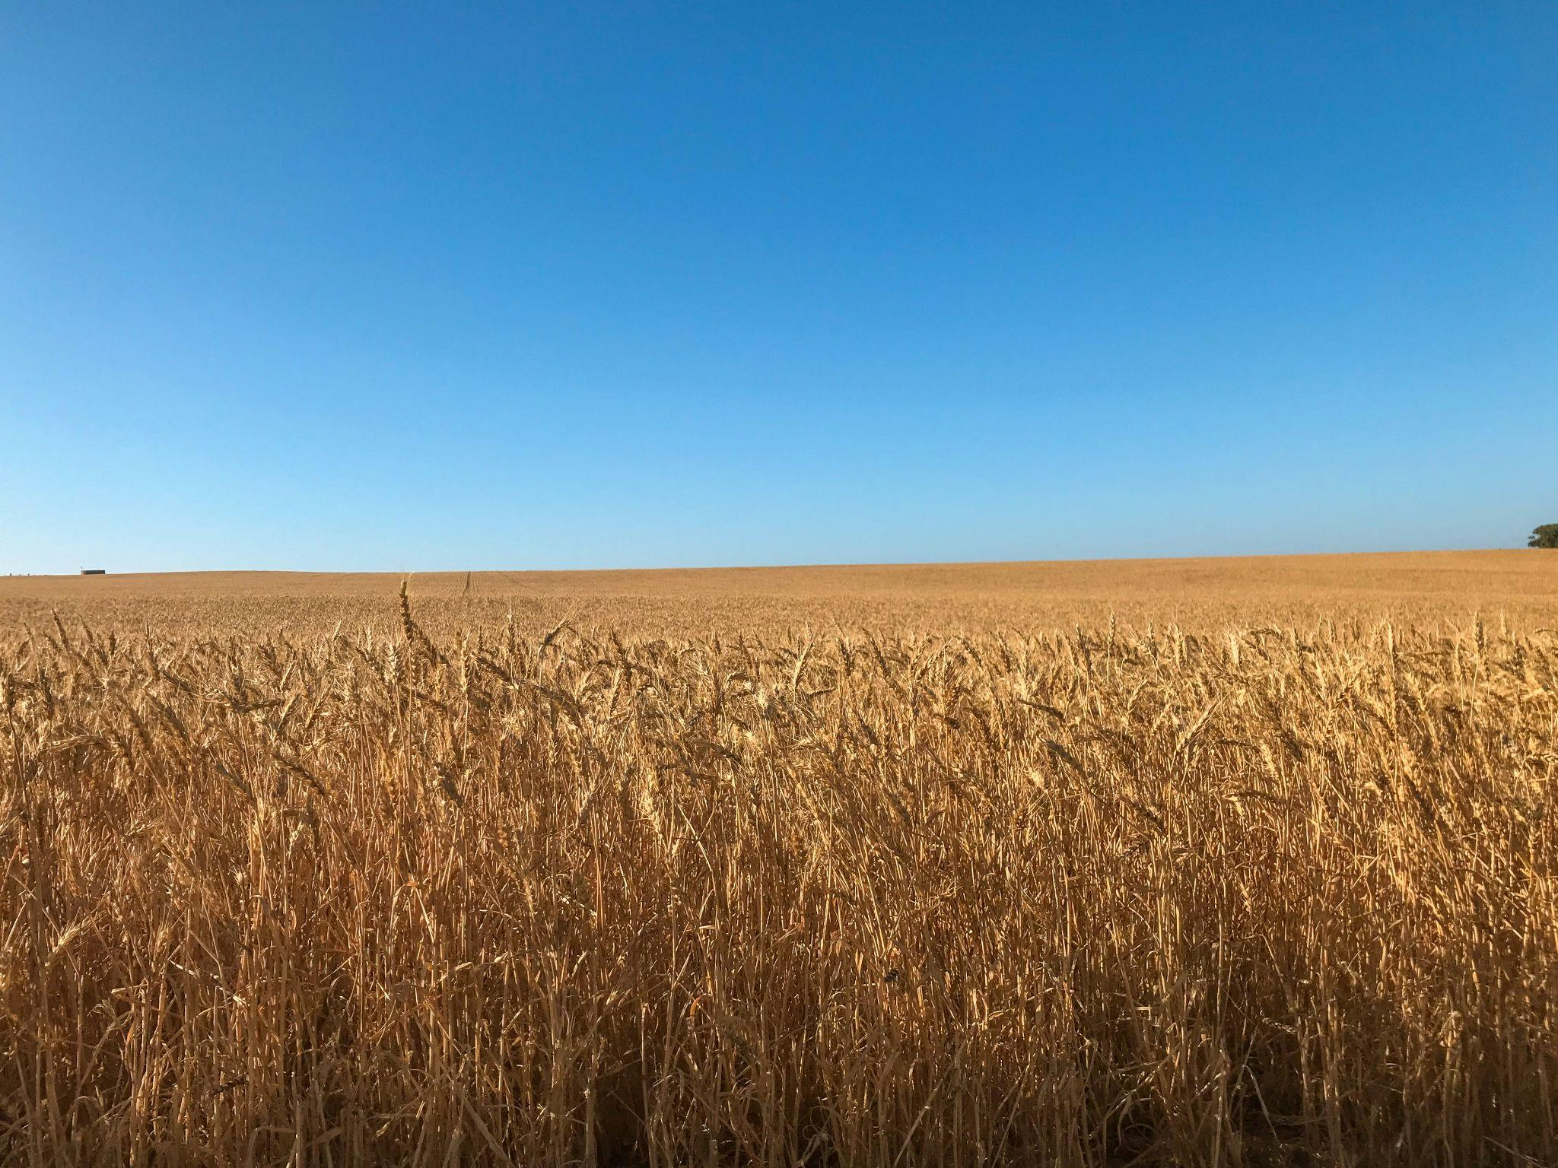
Group Presentations
EXPLAIN: LESSON 3

Slide 18
In your notes
Draw up a table as shown, and as each group presents take notes to fill it out.
Climate change topic | Direct impacts | Indirect impacts | Why it matters | Why is it happening / needs to happen
Impact on food growth
Impact on the economy, producers and consumers
Impact on society/ communities
Land focused solutions
Land and water focused solutions
EXPLAIN: LESSON 3

Slide 19

Write your name and one risk and one solution to food security on a Post it note and hand it to your teacher on the way out of class.
To leave…
Your name
1. Risk…
2. Solution…
:)
EVALUATE: LESSON 3
Notes:
End of lesson 3

