Slide 1



LEARNING OUTCOMES
Learning Intention
To create a town that meets people's needs while protecting the environment, ensuring sufficient goods and services are available, and balancing competing land uses, environmental impacts, and human wellbeing.
Success Criteria
Describe how human activities and land-use choices influence the sustainability and liveability of places.
Explain how environmental, economic and social factors shape how places are used and managed.
Evaluate the environmental impacts of human activity and suggest strategies to reduce them.

Slide 2
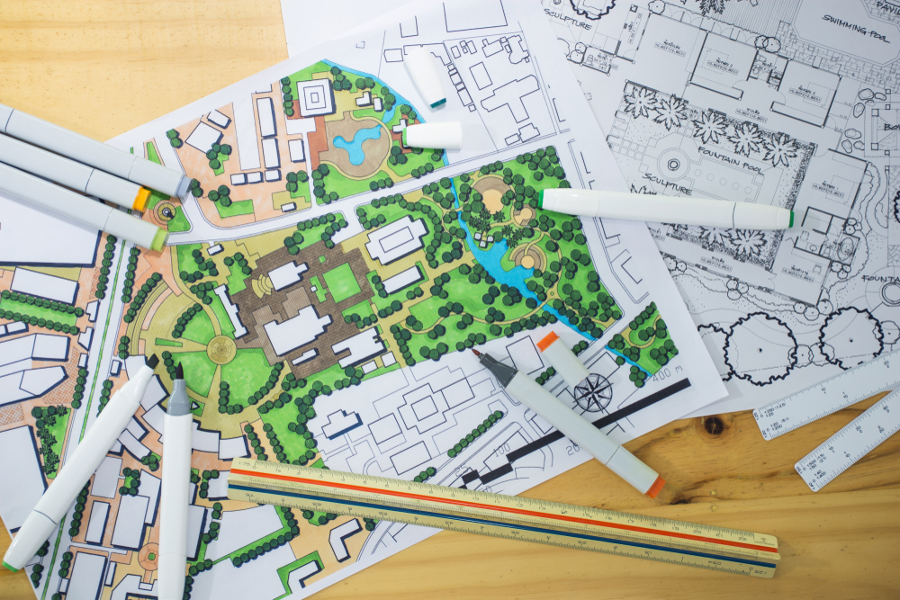

DESIGN A TOWN:
Planning for people, places
and the environment
Year 9/10 Geography

Slide 3

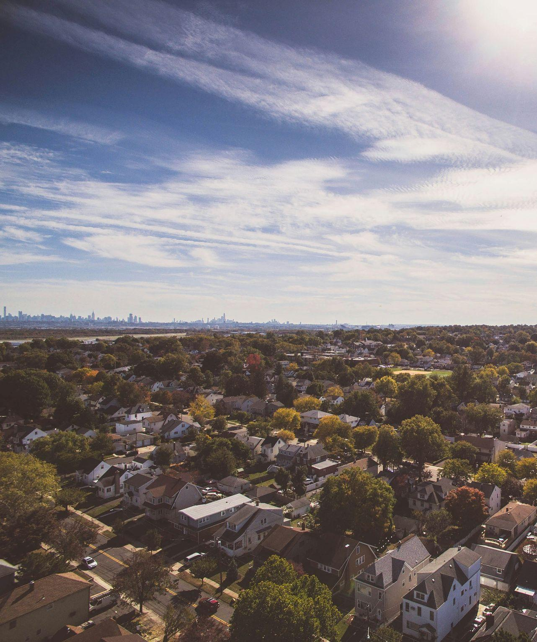
Congratulations!
You are now all urban planners!
You are tasked with designing a town.
On your piece of paper map and draw out your town.
You must consider:
Where you place each element
The amount of space you allocate to each
How these choices impact society, the economy, and the environment
v
Activity introduction
Notes:
REFER TO ACTIVITY PLAN FOR FULL INSTRUCTIONS

Slide 4
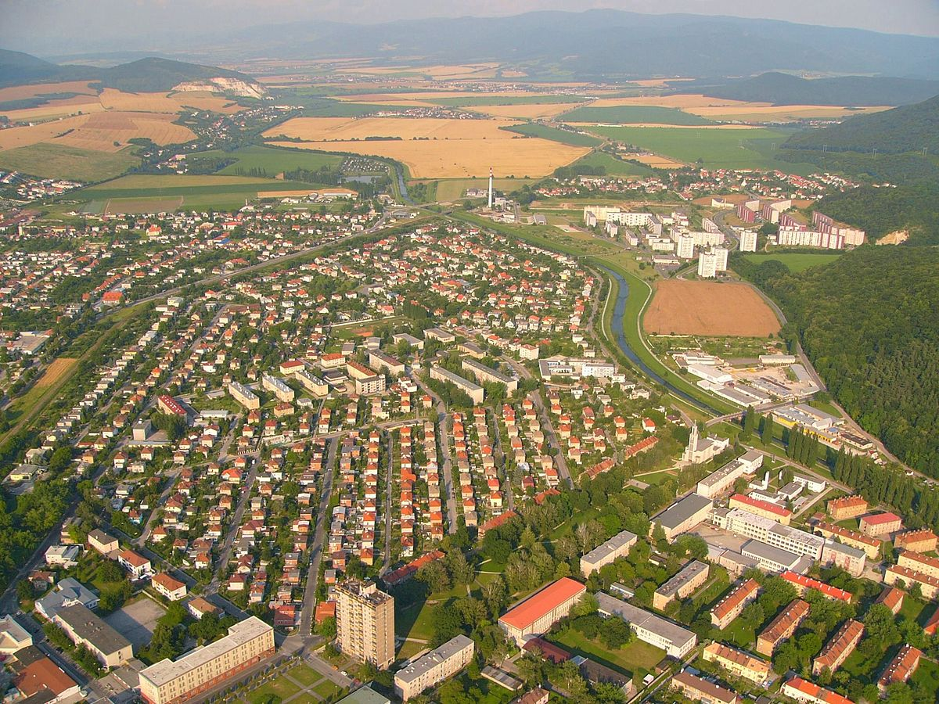

YOUR TOWN
MUST INCLUDE:
Food production fields (wheat and grain)
Food production farms (vegetables and fruits)
Livestock farming area
Industrial crops (sorghum and cotton)
Urban housing
Transport hubs (Buses and trains)
Industrial developments (factories)
A mine
Sacred sites
Recreational spaces:
  One park
  One sports ground
  One golf course
Each graph square = 250m
That makes an A3 graph paper town =15km x 21km
v
Activity instructions
Notes:
REFER TO ACTIVITY PLAN FOR FULL INSTRUCTIONS

Slide 5
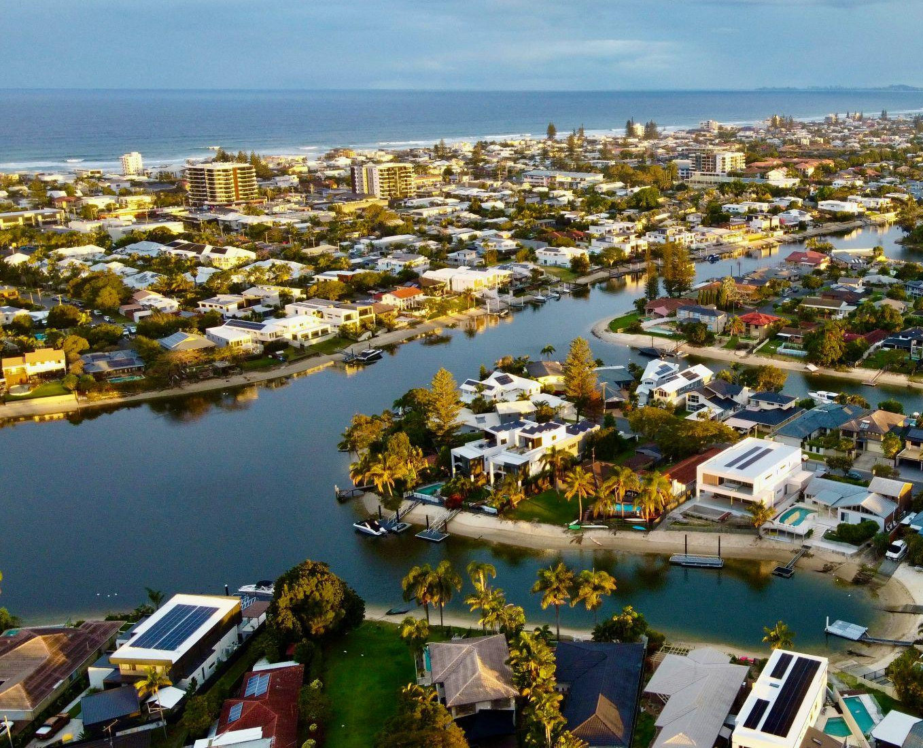

v
LAND AND
WATER FEATURES
You're free to add and shape water sources (such as lakes, rivers, and oceans) and land features (such as beaches, hills, and plains) however you wish.
Think carefully about where you place each element. Consider the implications of their placement, (e.g. placing water sources next to a mine might affect water quality).
Activity instructions
Notes:
REFER TO ACTIVITY PLAN FOR FULL INSTRUCTIONS

Slide 6
STAGE 2

Slide 7
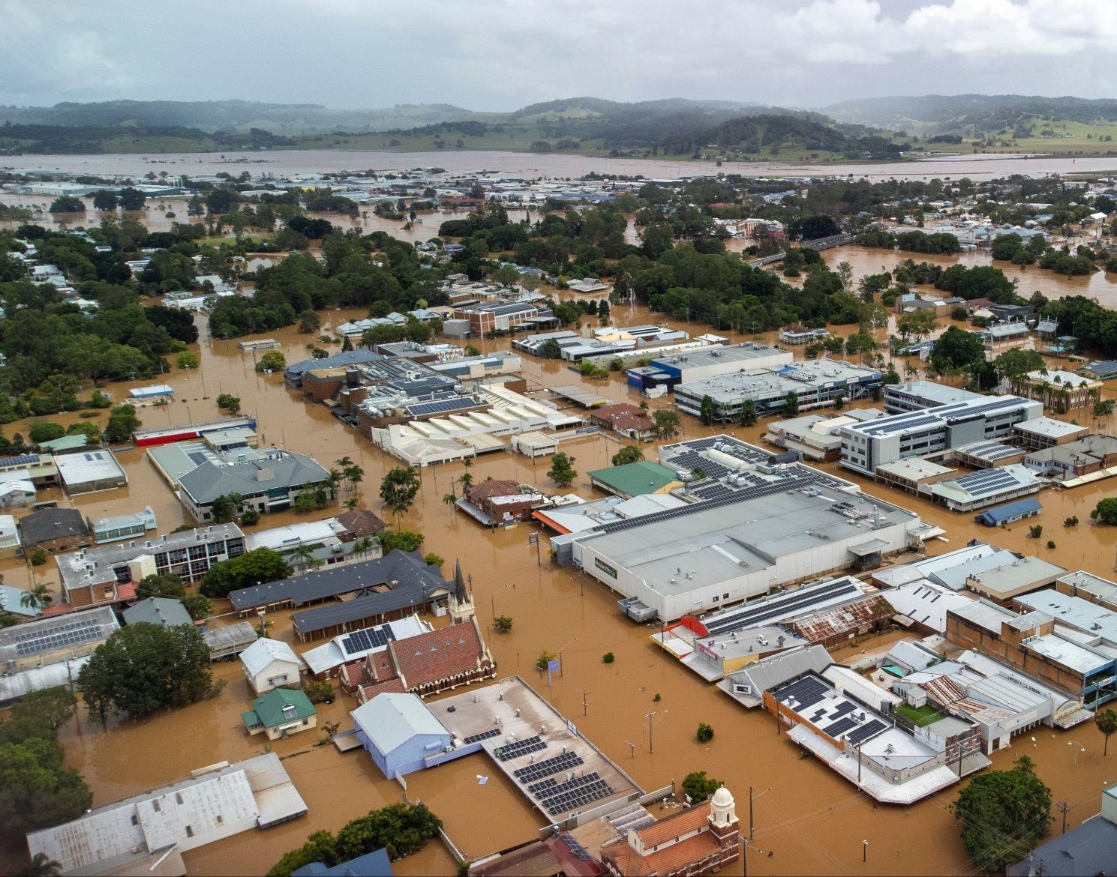
v
SUSTAINABILITY
AND ENVIRONMENTAL MANAGEMENT
Climate change and a growing population are two major threats to towns and cities.
Resilient designs, sustainable infrastructure, and proactive measures are needed to address these problems.
Next stage introduction

Slide 8

TO ADD
TO YOUR TOWN
Find where/how you can add in sustainable solutions to address these issues.
Some solutions might include:
Renewable energy sources
Urban greening
More bike lanes, fewer roads
You will also have to consider the environmental impacts solutions may pose and how to balance risk with reward.
v
Stage 2 instructions
Notes:
REFER TO ACTIVITY PLAN FOR FULL INSTRUCTION
Sustainable solutions prompts:
Renewable energy - Solar car parks, rooftop solar, wind turbines on farm land, biogas from livestock waste
Urban greening - Street trees, green roofs, shaded walkways, native gardens, green tram tracks, composting hubs, wetland restoration/rewilding
Active & shared transport - Bike lanes, e-scooter/bike charging hubs, electric bus network, car-free city zones, park-and-ride zones
Water management - Stormwater harvesting, greywater reuse, smart irrigation sensors
Waste Systems - Composting areas, recycling centres, bio fuels
Design & architecture - Recycled materials, 15-minute cities, mixed-use development (e.g. apartments with shops underneath), shade canopies, floodable parks, elevated pathways, reflective materials
Farming and agriculture - Crop rotation, drip irrigation, climate-resilient crop varieties, drought-tolerant crops, electric tractors, regenerative farming methods, vertical farms

Slide 9
STAGE 3

Slide 10

v
FEEDBACK
1. One positive comment about the town’s planning
2. One constructive suggestion for improvement
Walk around the room and look at other groups’ towns.
On a post-it note or piece of
paper write:
Peer feedback
Notes:
REFER TO ACTIVITY PLAN FOR FULL INSTRUCTION

Slide 11
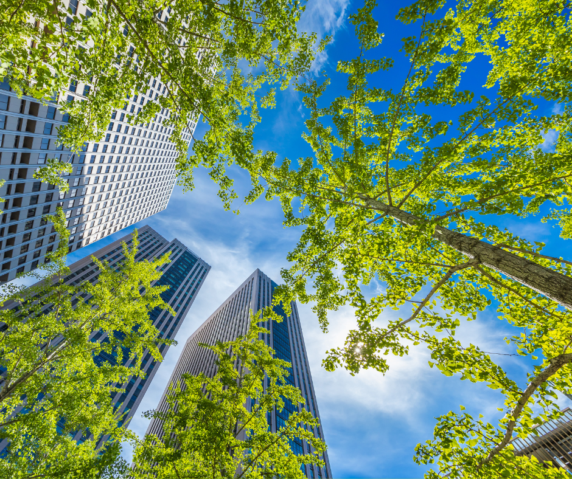
v
WHAT FEEDBACK
DID YOUR GROUP RECEIVE?
(What worked well? What didn’t?)
Learning discussion
Notes:
PROMPTS:
Sustainability - What sustainable solutions worked well, and what could be improved or added?
Layout and Accessibility - Is the town easy to navigate and live in? Are services, housing, and transport well connected?
Balance of Space - Did the group give too much or too little space to certain features (e.g. housing, farming, parks)?
Environmental Impact - How well does the town protect the environment and manage resources (energy, water, waste)?

Slide 12
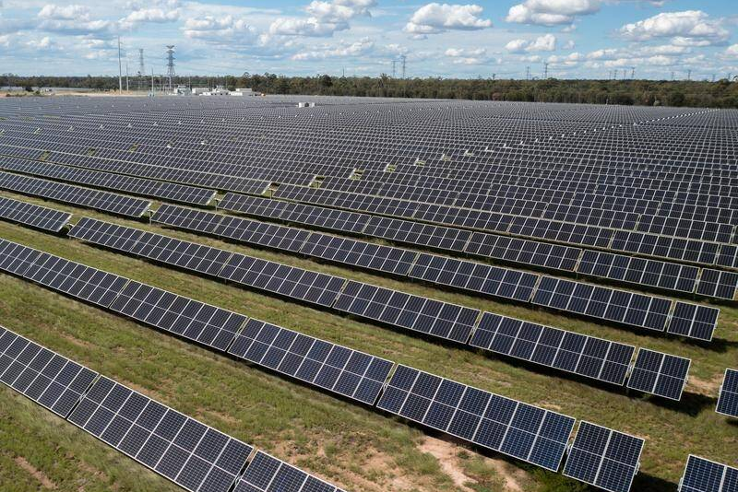
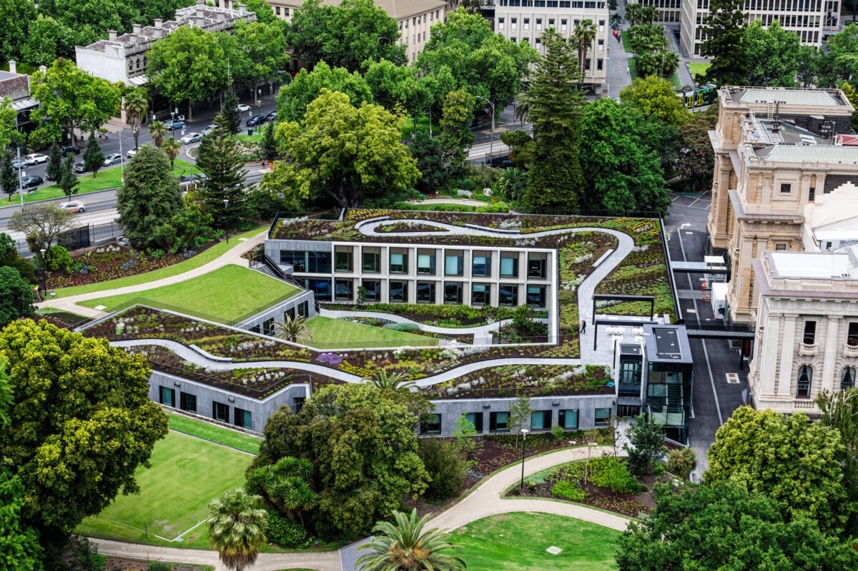
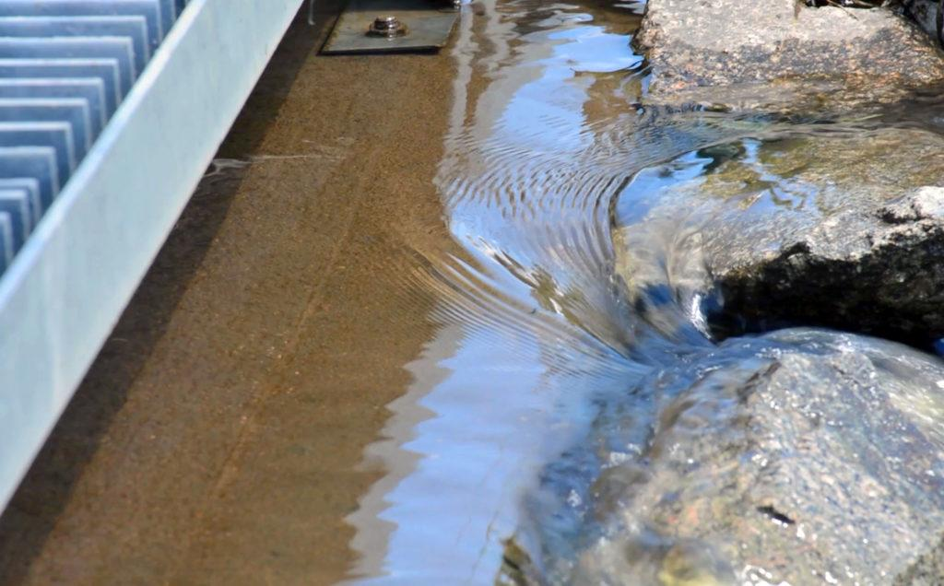
REAL-WORLD EXAMPLES
v
Renewable energy
Canberra's electricity is 100% renewable, sourced from large-scale solar
and wind projects.
Urban greening
Parliament of Victoria hosts one of the largest green roofs in Melbourne, with 300 Australian
native species.
Stormwater harvesting
Orange NSW collects rain runoff to help fill its dam, providing up to ~25%
of the city’s water
each year.
Learning discussion
Notes:
SPEAKER NOTES:
Renewable energy – Canberra, ACT
Canberra became the first Australian city to source 100% of its electricity from renewable energy in 2020. This is achieved through large-scale solar and wind farms located across the ACT and surrounding regions of New South Wales. The city uses long-term contracts with renewable energy providers to ensure steady supply, helping reduce its greenhouse gas emissions and making it a model for other cities.
Urban greening – Parliament of Victoria Green Roof, Melbourne
The Parliament of Victoria features one of Melbourne’s largest green roofs, covering around 2,000 square metres and supporting over 300 native Australian plant species. It provides insulation for the building, reduces the urban heat island effect, and supports local biodiversity in the city centre.
Stormwater harvesting – Orange, NSW
The city of Orange, New South Wales, captures and reuses stormwater runoff to supplement its water supply. The system collects rainwater from urban drains and streets, filters and stores it in wetlands, and then pumps it into Suma Park Dam. In an average year, this provides around 25% of the city’s water demand – a key strategy for a region prone to drought.
Other examples:
Solar car parks - Elizabeth City Centre, South Australia
Is the largest solar-shaded car park in Australia with 1,400 solar‐shaded car spaces, as part of a 5.9 MW car-park & rooftop solar installation. A good example of how existing commercial infrastructure (like a shopping centre car-park) can be adapted for renewable energy production and become dual-purpose.
Active transport – Hobart
The City of Hobart has been expanding its network of bike lanes and shared paths that links the city centre with southern suburbs. These upgrades aim to make cycling safer and more accessible, reducing car dependency and emissions.

Slide 13

STUDENT FEEDBACK
LINK
http://bit.ly/4hV8Bka

