Slide 1



LEARNING OUTCOMES
Learning Intention
Students will use algebraic formulas to calculate and represent energy use. They will learn how to express, substitute, and graph data to model changes in electricity demand.
Success Criteria
Formulate and simplify algebraic expressions using variables and operations
Substitute values and solve equations to model real-world situations
Represent relationships between variables on a graph and interpret the results
Explain how mathematical modelling can help analyse patterns and support
decision-making
Notes:
Optional to show to students

Slide 2
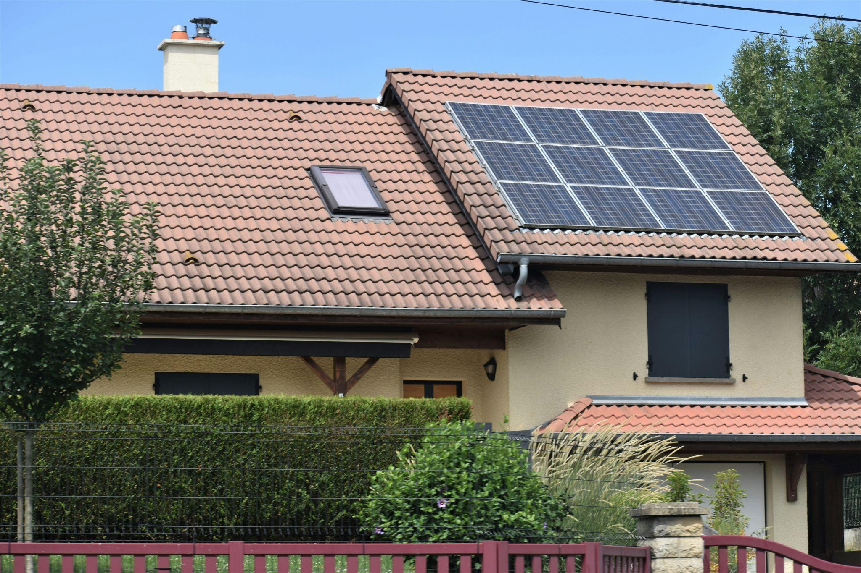

SOCKET VS. SOLAR:
Modelling solar energy supply and demand with Algebra
Year 7 Mathematics
Notes:
USE THESE SLIDES ALONGSIDE THE LESSON PLAN

Slide 3
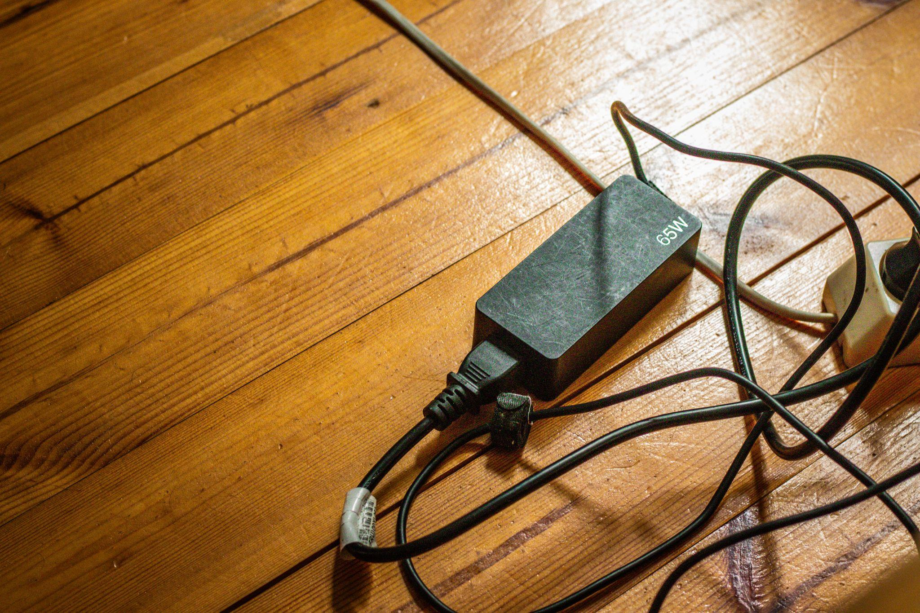


v
WHAT ARE
‘WATTS’
Learning introduction
Notes:
SPEAKER NOTES:
A watt (W) measures the rate at which something uses or produces energy

Slide 4
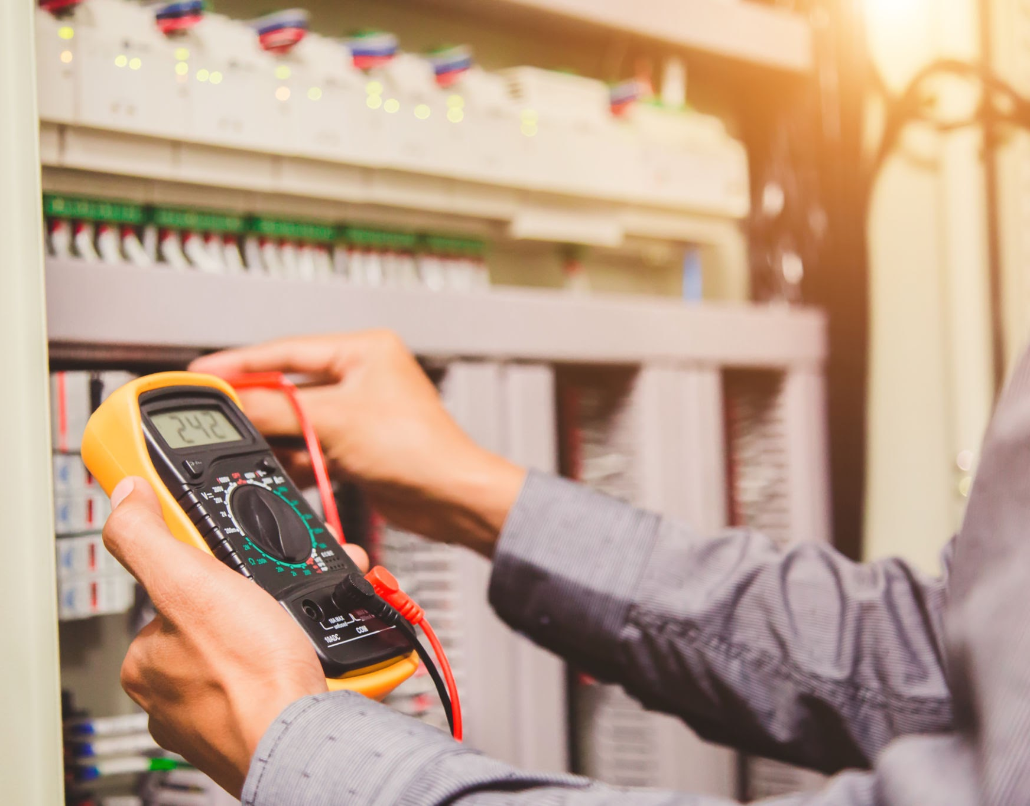
v
DEFINITION
A watt (W) measures the rate
at which something uses or produces energy
Think of electricity like water flowing through a hose – watts tell us how fast the water is flowing, or how quickly energy is being used
Learning introduction
Notes:
ALL CONTENT ON SLIDE

Slide 5
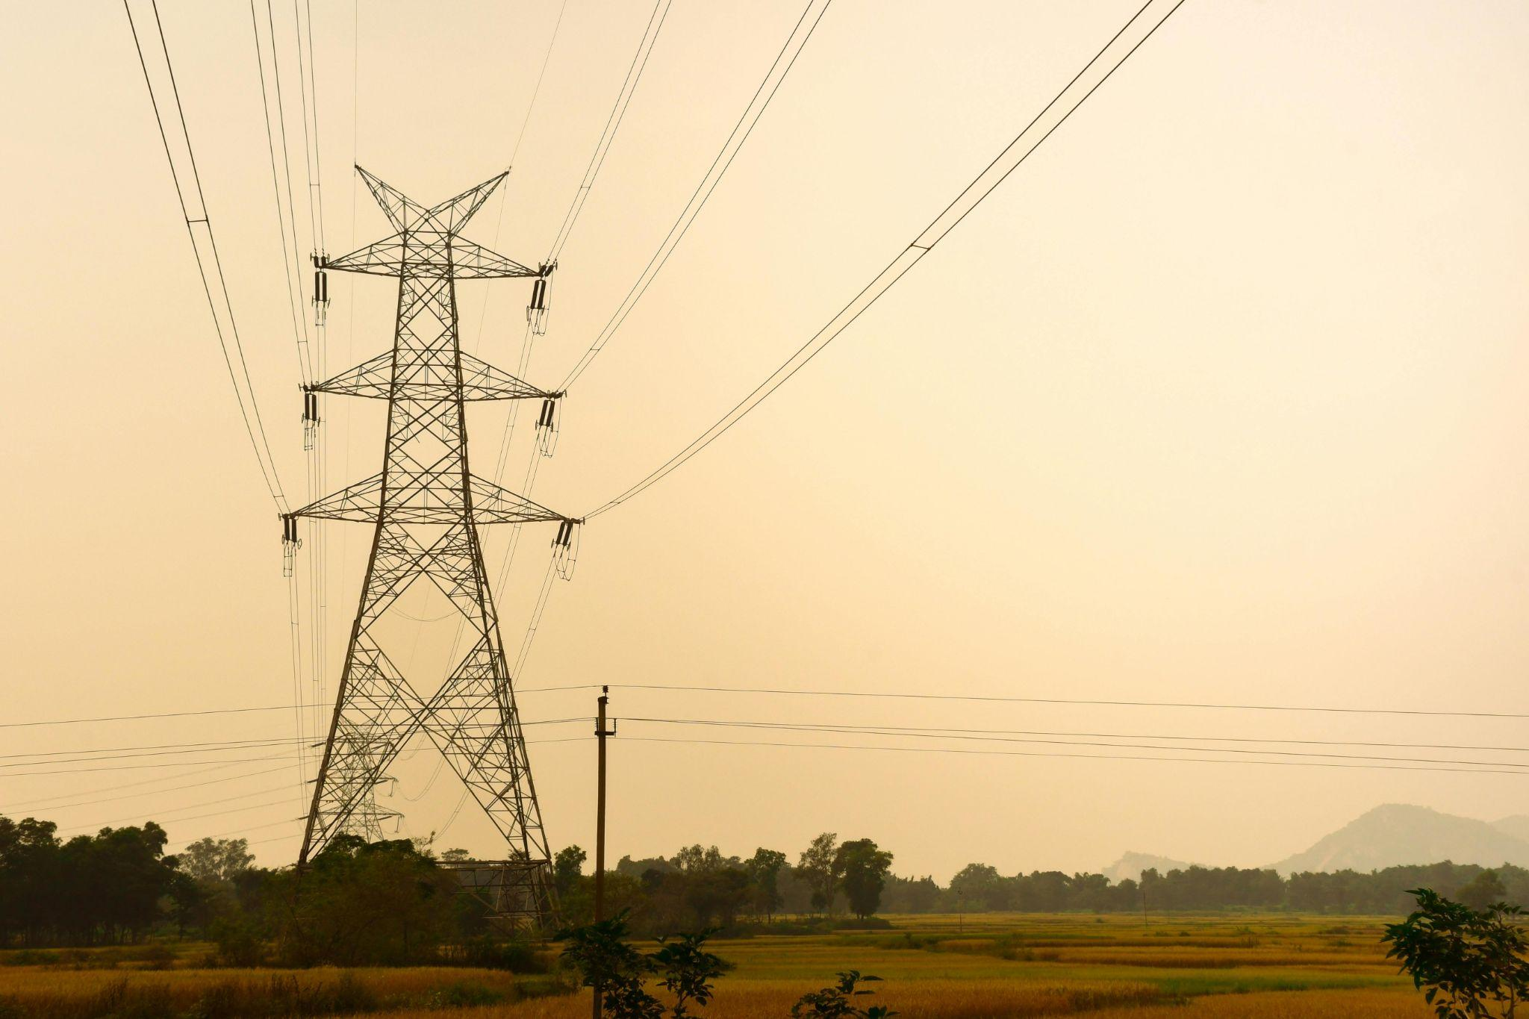
v
WHERE OUR
WATTS COME FROM
Some of our electricity comes from the sun, wind and water — but a lot still comes from coal and gas fueling
climate change
When households use energy efficiently, we save money and
reduce demand on fossil fuels
Learning introduction
Notes:
ALL CONTENT ON SLIDE

Slide 6
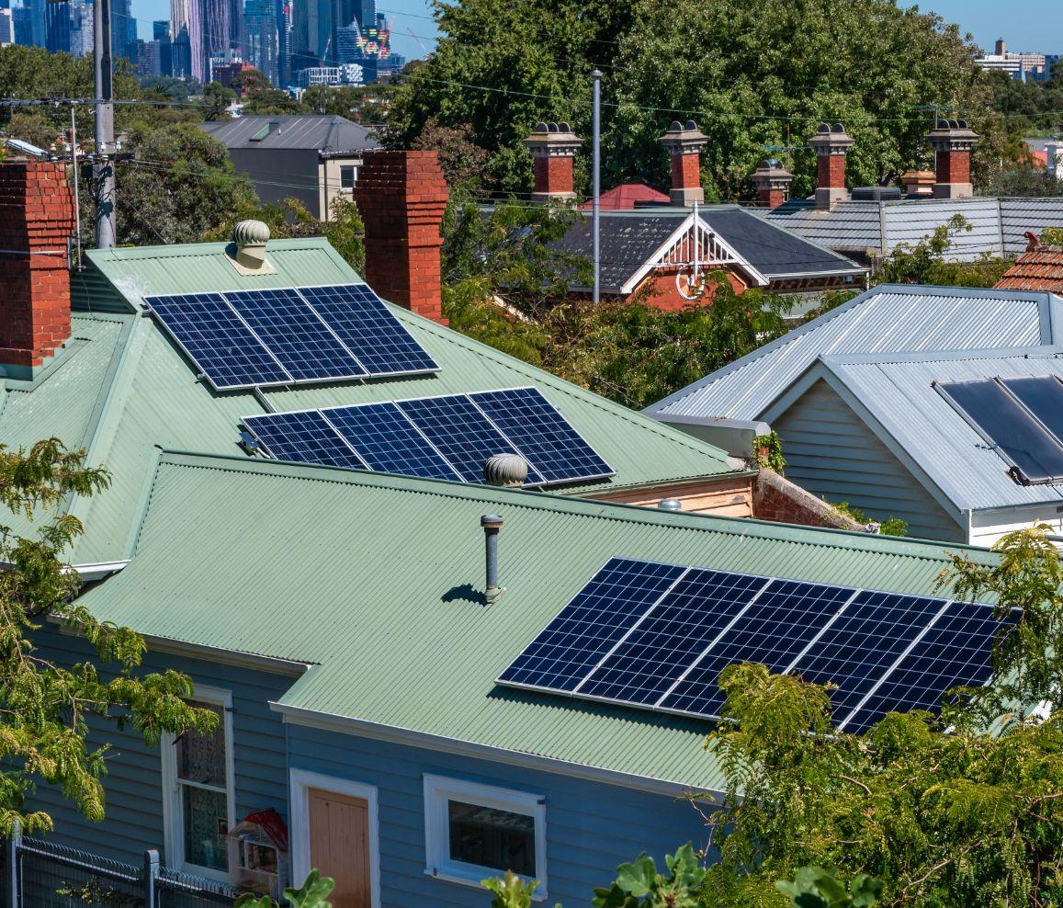

ACTIVITY:
SOCKET VS SOLAR
How does our energy use stack up against the sun’s supply?
Instructions:
In groups, measure and record a fan’s wattage on low and high settings using the smart plug
Use your values to complete
the worksheet
v
Activity instructions
Notes:
REFER TO LESSON PLAN FOR FULL INSTRUCTIONS + WORKSHEETS

Slide 7
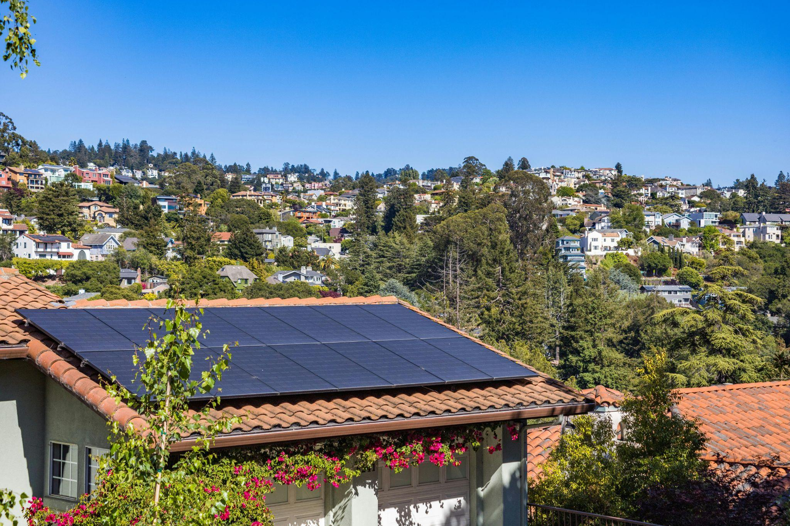
v
FINDINGS
Did the available solar energy cover the electricity demand
at any point?
How can renewables and households work together
to create a sustainable
energy future?
Learning reflection
Notes:
ANSWERS:
Solar vs electricity demand – Yes, but only once at midday for low speed (may have changes based on changed solar values)
Sustainable energy future:
Add other renewables to the grid (e.g. wind, hydro)
Increase renewable energy storage (batteries)
Switch off appliances not in use
Use energy-efficient appliances (fridges, heaters)
Shift usage to daytime (run dishwasher when solar is available)
Improve insulation to reduce heating/cooling load
END OF LESSON

Slide 8
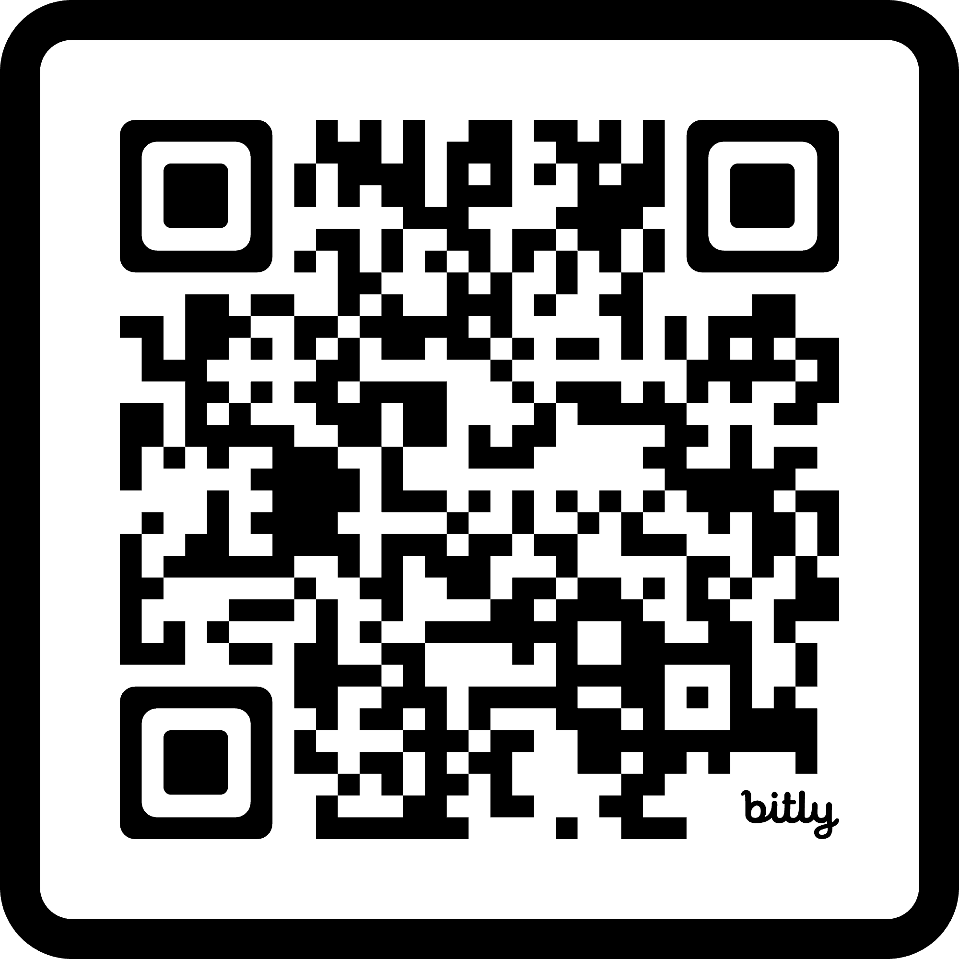
STUDENT FEEDBACK
LINK
http://bit.ly/4hV8Bka

