Slide 1

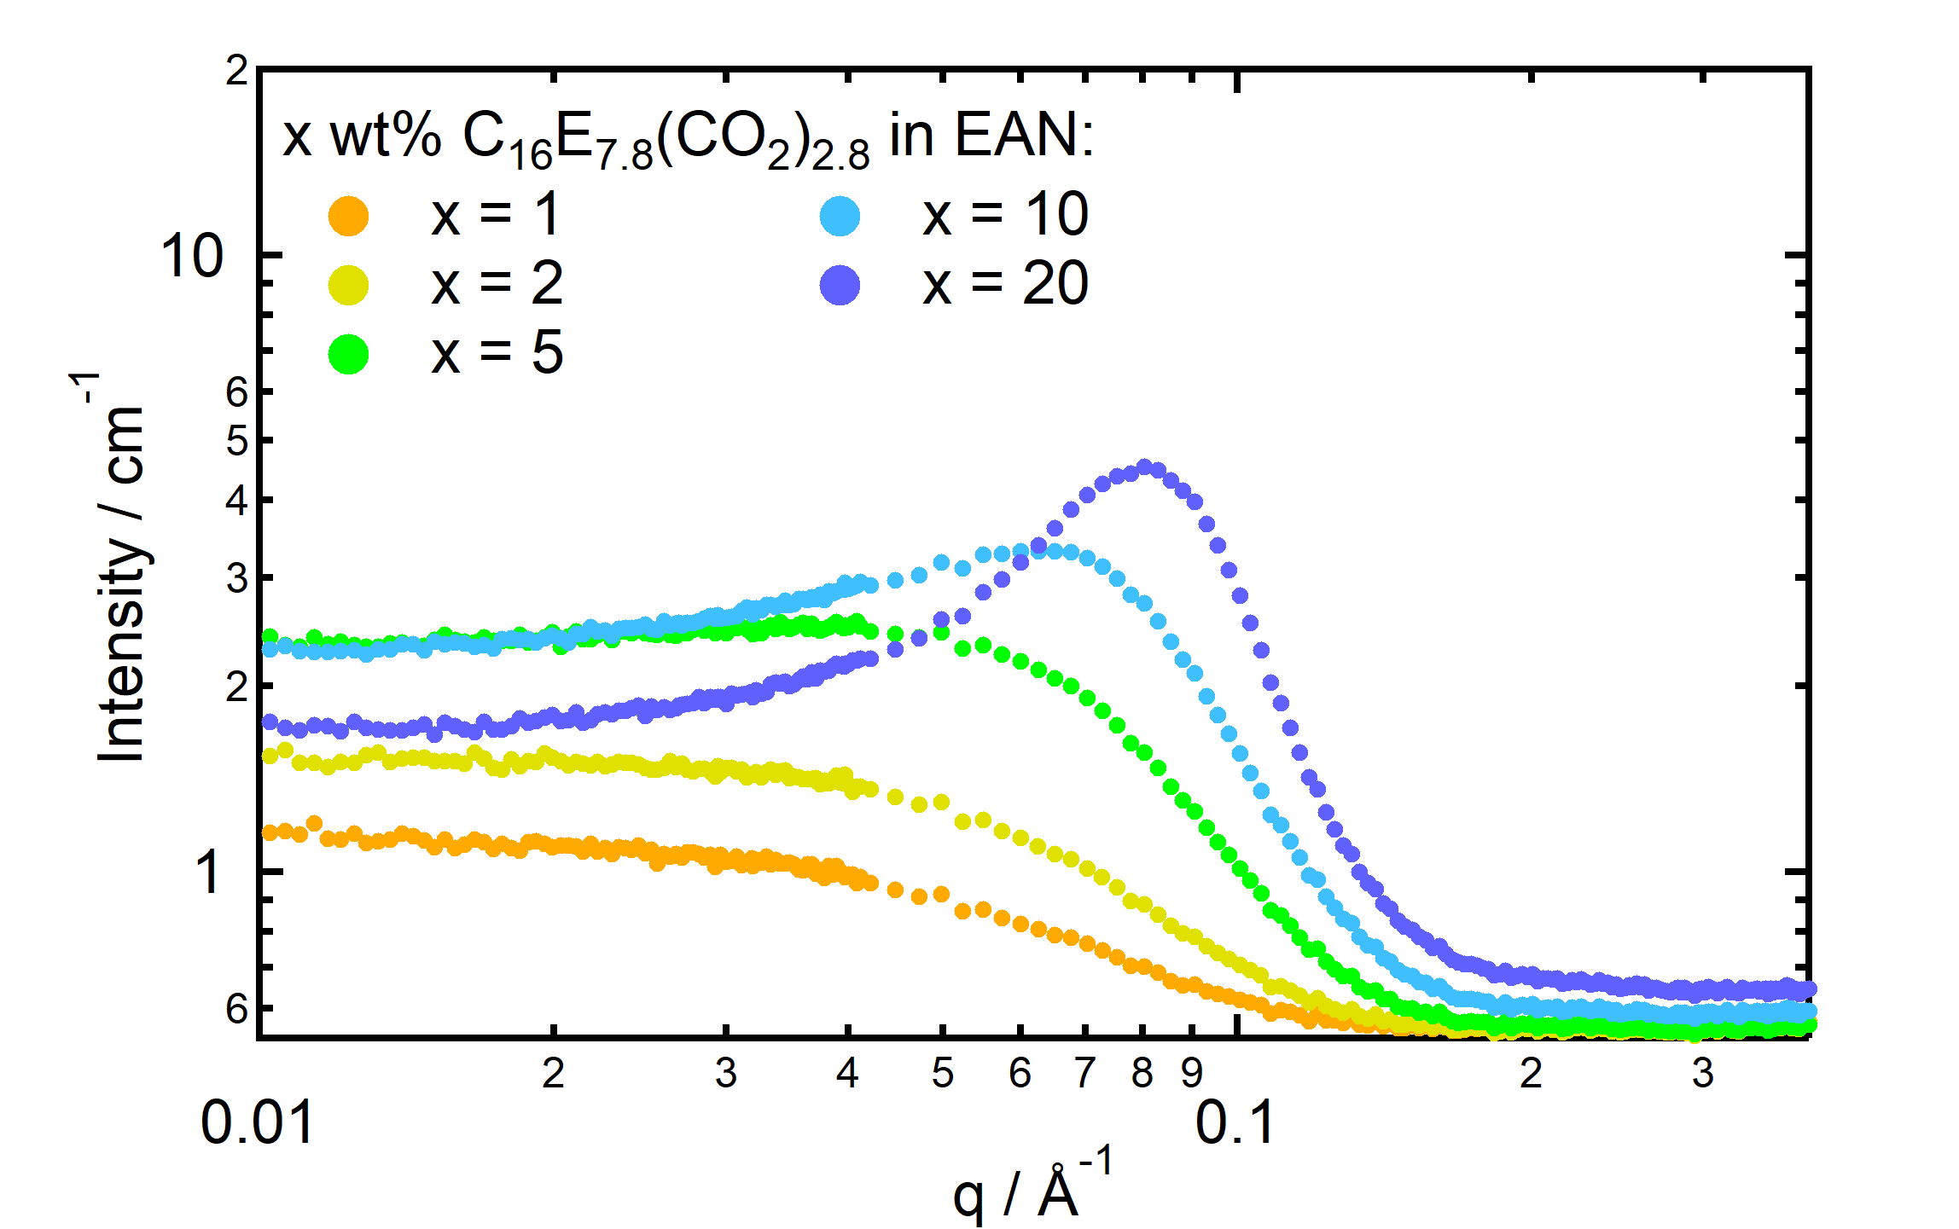
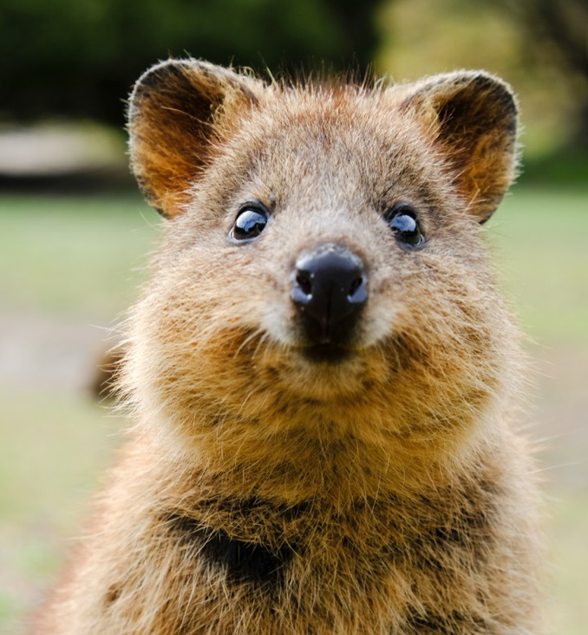
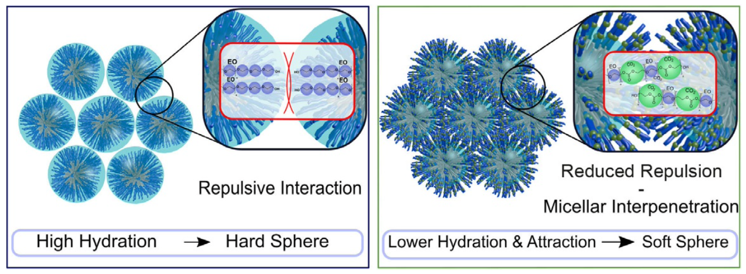
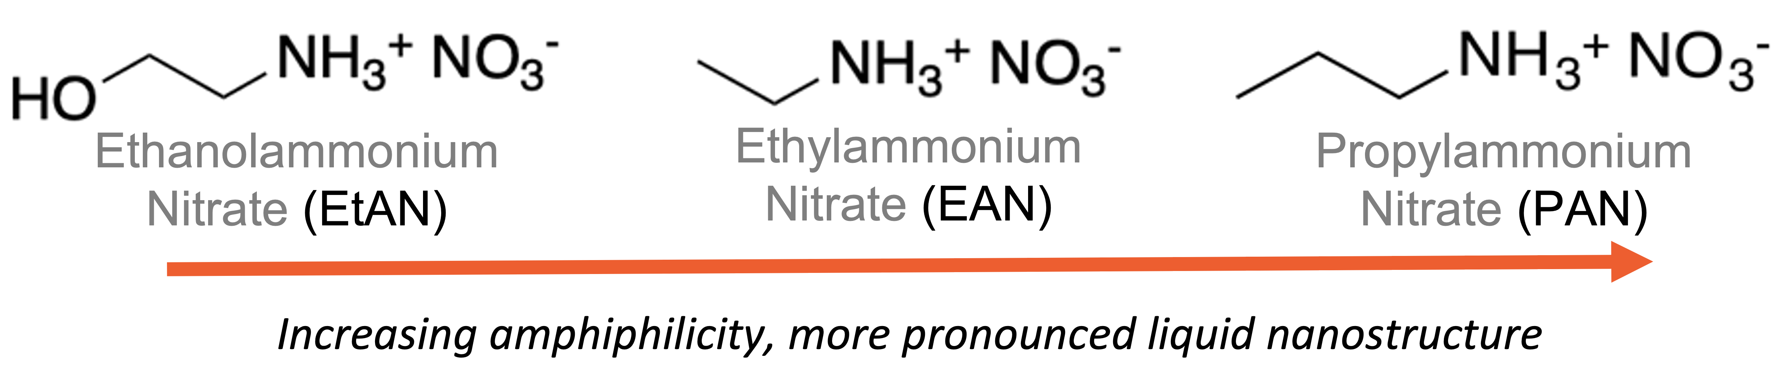
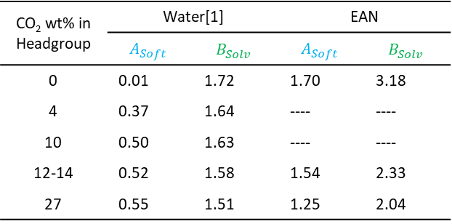



Self-Assembly of CO₂ Nonionic Surfactants in Ionic Liquids
Shurui Miao¹, Michael Gradzielski², Gregory Warr¹
1. School of Chemistry and University of Sydney Nano Institute, The University of Sydney, NSW 2006, Australia
2. Institut für Chemie, Technische Universität Berlin, D-10623 Berlin, Germany
Greener Surfactant
Model-Free Analysis
$$I\left(0\right)= φ∙{\left(∆SLD\right)}^{2}∙V∙S(0)$$
Water-hating
tail
Water-loving Headgroup
$$S{\left(0\right)}^{−1}= \frac{{\left(1+2φ_{hs}\right)}^{2}−4φ_{hs}^{3}+4φ_{hs}^{4}}{{\left(1−φ_{hs}\right)}^{4}}$$
QUOKKA @ ACNS
$$φ_{hs}=B_{Solv}φ(1−A_{Soft}φ)$$
By assuming hard sphere interaction between micelles, we can estimate the solvation and softness.
CO₂ wt% in Headgroup | Water[1] |  | EAN
 | $$A_{Soft}$$ | $$B_{Solv}$$ | $$A_{Soft}$$ | $$B_{Solv}$$
0 | 0.01 | 1.72 | 1.70 | 3.18
4 | 0.37 | 1.64 | ---- | ----
10 | 0.50 | 1.63 | ---- | ----
12-14 | 0.52 | 1.58 | 1.54 | 2.33
27 | 0.55 | 1.51 | 1.25 | 2.04
Designer Solvent
Ionic liquids (ILs) are an emerging class of liquids purely composed of ions. Among many other favourable liquid properties, a display of diverse intermolecular interactions is common to many ILs. This enable them to be excellent mediums for self-assembly and they are known to support structures ranging from micelles to liquid crystals. As the solvent, ILs offer a platform with tuneable amphiphilicity and solvation behaviours,[2] making them promising solvent for the rational design of new functional soft matters.
Micelles are wetter and softer in EAN than water.
Although the trend is reversed, micelles are significantly wetter and softer in EAN than in water even at the highest CO2 content, confirming liquid crystal phases are missing.
Solvent-Headgroup interaction can be engineered through solvent composition and CO₂:EO ratio!
References:
[1] V. J. Spiering, A. Ciapetti, M. T. Lima, D. W. Hayward, L. Noirez, M. S. Appavou, R. Schomacker, and M. Gradzielski, ChemSusChem 13, 601 (2020).
[2] R. Hayes, G. G. Warr, and R. Atkin, Chemical Reviews 115, 6357 (2015).

