Slide 1


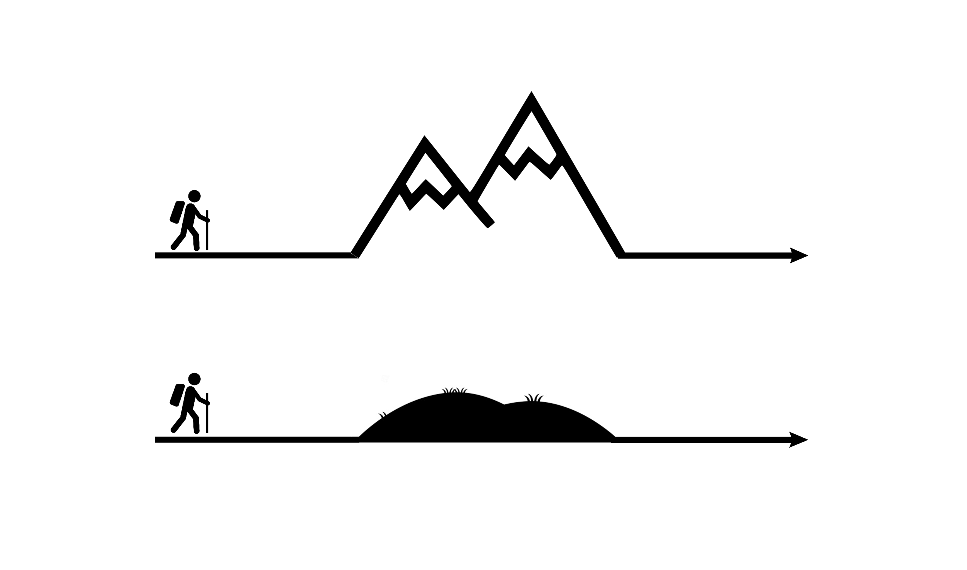
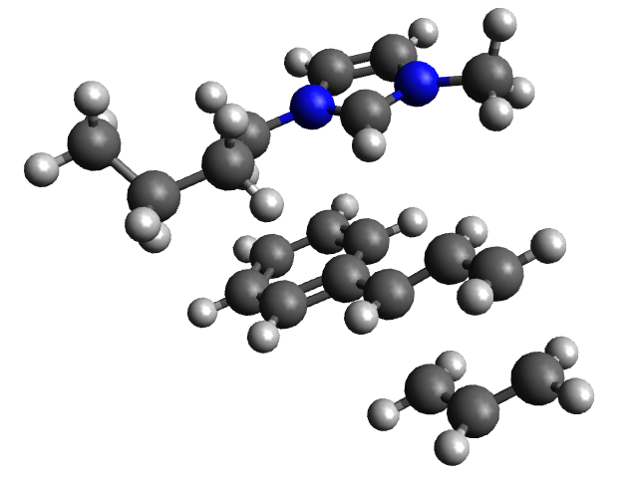
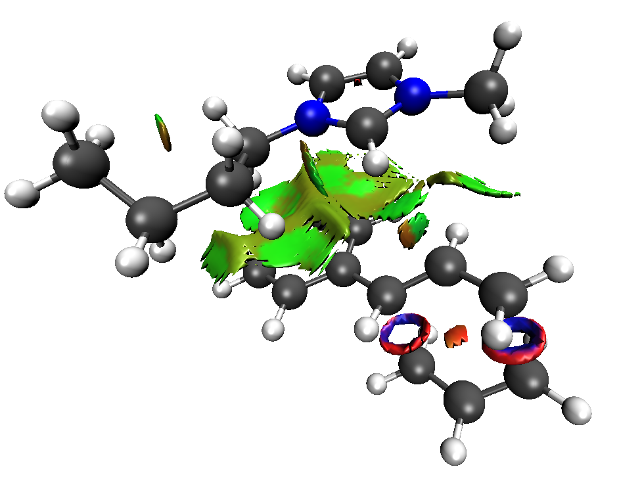



10th Australian Symposium on Ionic Liquids
Investigating the rate increase of Cope and Claisen rearrangements in [C₄C₁Im][NTf₂]
Gavin Smith¹ Supervisors: Dr. Charles Romain¹, Prof. Tom Welton¹, Prof. Patricia Hunt²
Contact: gjs21@ic.ac.uk
¹Imperial College London, London, UK; ² Victoria University of Wellington, Wellington, NZ
1. Literature Cope reaction
3. Is the ionic liquid lowering the transition state?
4. Are low-volume transition states favoured in high internal pressure ILs?
Reaction pathway
In molecular solvent
Calculation with a solvent environment (SMD)
No difference in activation energy between solvents
Volume [Bohr³/mol]
Accuracy of calculations do not allow for definitive predictions
No indication of lower volume TS
Starting
material
Product
Molecular solvent
Ionic liquid [C₄C₁Im][NTf₂]
In ionic liquid
 | Gas Phase | MeCN | Benzene | Ethanol | [C₄C₁Im] [NTf₂]
Act. E. [kJ/mol] | 108 | 105 | 106 | 105 | 105
Starting
Conformers
TS
Chair
TS
Boat
not the answer
not the answer
10x faster^{[1]}
Activation energy remains unchanged
6. Conclusions
7. Future Work
[1] S. T. Keaveney, R. S. Haines, and J. B. Harper, ChemPlusChem 2017, 82, 449-457
5. Are ion-π interactions stabilising transition states?
Experimental approach is needed
Is there an increased reaction rate in neutral mimics under high pressure?
Cope TS with [BMIM]⁺
Interactions
Energy calculations do not show a reduction in TS barrier for IL
Volume calculations do not show a smaller TS, but variation is large, may not be accurate
Specific solvent interactions do not change activation energy as starting materials and TS are equally affected
2. Our work
vs
Molecular
solvent
Ionic
liquid
VdW Interactions
But
Why?
Reacting ρ(r)
Maybe…
Activation energy
is unchanged
BOTH starting material and TS interact with [C₄C₁Im]⁺
not the answer

