Slide 1
Appropriate use of benzodiazepine medications for sleep disturbances in people living with dementia
Education Activity
Centre for Medicine Use and Safety (CMUS)

Slide 2





Introduction
Background
Dementia is associated with a deterioration in:^{1,2}
  Memory
  Thinking
  Behaviour
  Communication
  Ability to perform daily activities

Slide 3



Introduction
Dementia and changed behaviours
People living with dementia often experience changed behaviours. Changed behaviours are diverse and may include:
  Wandering e.g. walking aimlessly and/or excessively, attempting to exit a safe location³
  Sleep disturbances e.g. difficult falling or staying asleep³
  Agitation e.g. excessive fidgeting, pacing, irritability³
  Aggression e.g. verbal insults, swearing, punching, throwing objects^{2,3}

Slide 4
Introduction
Care for people living with dementia and changed behaviours
Care for people living with dementia and changed behaviours can be split into two broad strategies:
Non-pharmacological strategies
Definition: non-medication strategies
Examples: pet therapy, exercise therapy, art therapy^{2,3}
Pharmacological strategies
Definition: medication strategies
Example: psychotropic medications
Royal Commission into Aged Care Quality and Safety defines a psychotropic medication as:
“Any drug capable of affecting the mind, emotions, and behaviour”⁴

Slide 5
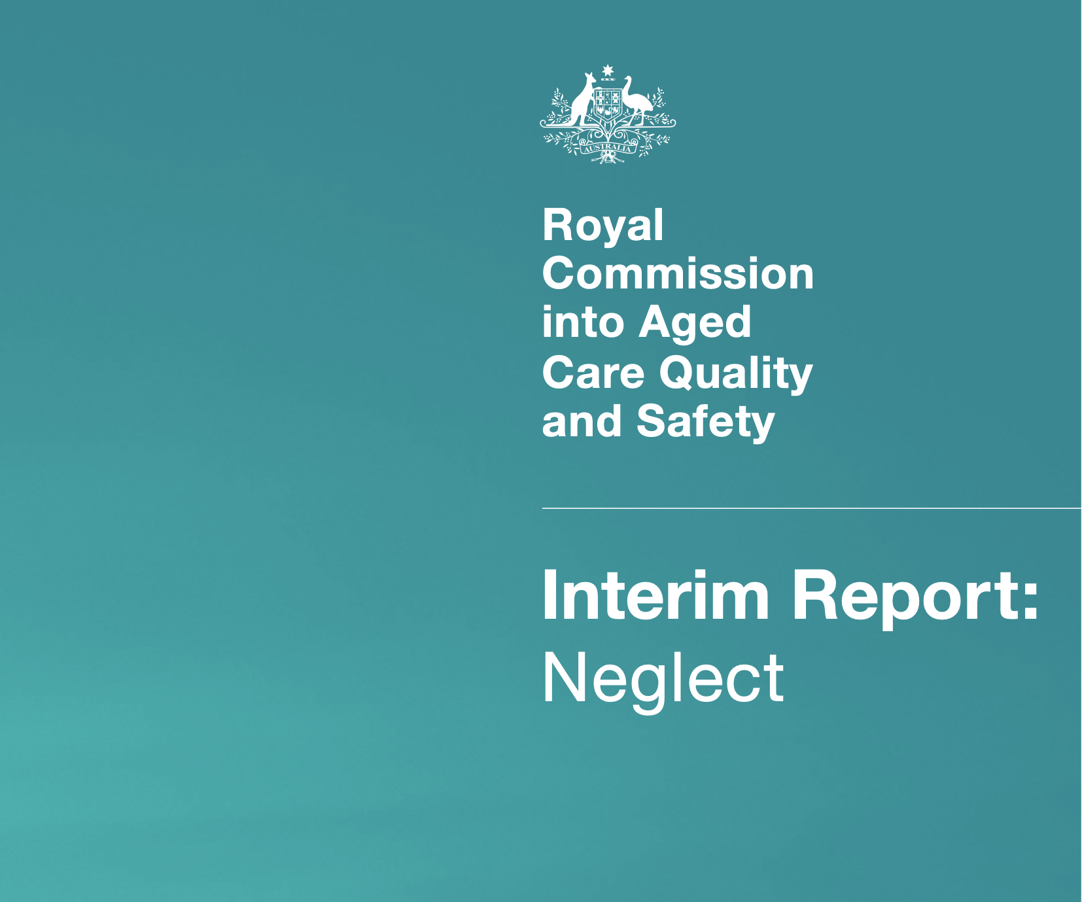
Introduction
Use of Psychotropic Medications in People Living with Dementia and in Residential Aged Care
The Royal Commission into Aged Care Quality and Safety Interim Report: Neglect⁵ highlighted an overreliance on psychotropic medications
Psychotropic medications such as benzodiazepines are associated with adverse outcomes for people living with dementia:
  Sedation e.g. drowsiness, sleepiness
  Falls
  Fractures

Slide 6

Introduction
Clinical Practice Guideline for Appropriate Use of Psychotropic Medications in People Living with Dementia and in Residential Aged Care
Three most common psychotropic medications implicated in restrictive practice in residential aged care are:
  Antipsychotics
  Benzodiazepines
  Antidepressants⁴
The new clinical practice guideline focuses on the appropriate medication use of antipsychotics, benzodiazepines and antidepressants

Slide 7
Group discussion – what is a benzodiazepine?

Slide 8

What is a benzodiazepine?
A benzodiazepine is a class of medication that slows down the workings of the brain⁶
Benzodiazepines can cause:
  Excess sedation e.g. drowsiness, sleepiness
  Physical dependence⁷
  Tolerance⁷
Sometimes benzodiazepines are prescribed to people living with dementia and changed behaviours
One Australian study⁸ reports that 30% of residents are dispensed benzodiazepines within three months of admission to residential aged care
Some examples of benzodiazepines are temazepam, oxazepam, lorazepam and diazepam^{4,9}

Slide 9
Group discussion - When should benzodiazepines be considered for people living with dementia and changed behaviours?

Slide 10


The place of benzodiazepines in the care of a person living with dementia
Benzodiazepines are associated with significant risks for people living with dementia and in changed behaviours;
  excess sedation
  falls and fractures
  daytime drowsiness
Benzodiazepines should only be used as a last resort for people living with dementia who are experiencing sleep disturbances

Slide 11
Learning Objectives
For people living with dementia and changed behaviours:
  Describe the potential adverse events of a benzodiazepine for people living with dementia and sleep disturbances
  Specify the criteria for escalating care surrounding adverse events and monitoring of a benzodiazepine
  Explain what should be documented surrounding adverse events and monitoring of a benzodiazepine
  Be aware of supporting resources accompanying the Guideline to use in everyday practice

Slide 12
Adverse events and monitoring of benzodiazepines
Image from freepik

Slide 13
Prescribers' responsibilities surrounding benzodiazepine initiation
What steps should prescribers complete and document before initiating a benzodiazepine?
Clinical steps
Identify the specific changed behaviour you want to improve (target symptom)
  e.g. person living with dementia waking up early at 2am six nights per week
Identify the anticipated treatment outcome
  e.g. over the next week, the number of times the person living with dementia wakes up early is reduced to three nights per week
Complete an individual harm-benefit analysis
Communication and documentation steps
Comprehensive discussion with the person living with dementia, support person and/or their substitute decision maker
Obtain informed consent
Document date to review the benzodiazepine
  e.g. review benzodiazepine in 4 days
Document the treatment end date
  e.g. stop benzodiazepine in 10 days. End date will be […]
If the prescriber initiates a benzodiazepine, they should clearly document the treatment end date
Initial treatment duration for sleep disturbances should not exceed two weeks

Slide 14
Group discussion - what is an adverse event?

Slide 15



What is an adverse event?
Therapeutic Goods Administration (TGA)* defines an adverse event as:
“Unintended and sometimes harmful occurrences associated with the use of a medicine, vaccine or medical device (collectively known as therapeutic goods). Adverse events include side effects to medicines and vaccines, and problems or incidents involving medical devices”. ¹⁰
*The TGA is part of the Department of Health and Aged Care, Commonwealth of Australia. The TGA is responsible for ensuring that therapeutic goods (including medicines) available in Australia are safe

Slide 16
Group discussion - what are some adverse events of benzodiazepines?

Slide 17




What are some adverse events of benzodiazepines?
Excess sedation
  drowsiness
  sleepiness
Daytime drowsiness
Falls
Tolerance
  when a person needs to take a larger dose to have the same effect
Worsened cognitive function
  problems with memory or concentration
Central nervous system depression
  slowed brain activity
Respiratory depression
  slowed breathing
Physical dependence
  a person may feel they need a benzodiazepine to go about their normal activities
Please refer to the Guideline for more information on benzodiazepine adverse events

Slide 18
Monitoring of benzodiazepines
What do we monitor when a person living with dementia is initiated a benzodiazepine for changed behaviours?
Clinical steps
1. Effect of the benzodiazepine on the target symptom
  Has the target symptom improved?
  Has the target symptom remained unchanged?
  Has the target symptom worsened?
3. Adverse events
  Is the person experiencing an adverse event?
  Is the person not experiencing an adverse event?
2. Effect of benzodiazepine on day to day activities
  Is the person still able to engage in activities that maintain quality of life?
    e.g. gardening, painting landscapes
  Is the person maintaining the same level of independence?
  Is the person still able to maintain activities of daily living?
    e.g. dressing, eating, toileting, bathing
4. Consent
  Has the person who initially gave consent withdrawn consent?
You have a crucial role during the monitoring process
Benzodiazepines should NOT be considered as an alternative to non-pharmacological strategies

Slide 19
Monitoring of benzodiazepines
What do we monitor when a person living with dementia is initiated a benzodiazepine for changed behaviours?
Communication and documentation steps
Document your observations in the (where applicable);
  medical record
  nursing progress notes
  behavioural support plan
Contact the prescriber
Notify the care team
Document conversation with prescriber and plan going forward
You have a crucial role during the monitoring process
Benzodiazepines should NOT be considered as an alternative to non-pharmacological strategies

Slide 20
Case study
Small groups
Staff Handout of Case Study
Read the Case Study on Topic: Adverse events and monitoring
Discuss questions 1 and 2 over the next 15 minutes
Prepare answers to share in group discussion

Slide 21

Case study
Mr. Dimitri Popov is an 84-year-old man living with vascular dementia at Sunnyside residential aged care
During your evening shift, you observe Dimitri waking up around 3am and not returning back to sleep. The care team works together to identify possible underlying causes for Dimitri’s sleep disturbance and trial non-pharmacological strategies
Despite implementing these strategies over the last few weeks, Dimitri continues to wake at 3am and not return to sleep
When discussing Dimitri at the case conference, the general practitioner (GP), Dr. Mary Song, feels that a trial of a benzodiazepine, temazepam, may be beneficial. After obtaining informed consent from Dimitri, Dr. Mary initiates temazepam 5mg oral at night
Image from freepik

Slide 22
Review of case study questions
Group discussion
Question 1a. Since Dimitri is initiated a benzodiazepine for sleep disturbance, what four points should you monitor?

Slide 23
Review of case study questions
Group discussion
Question 1a. Since Dimitri is initiated a benzodiazepine for sleep disturbance, what four points should you monitor?
Clinical steps
1. Effect of the benzodiazepine on the target symptom
  Has Dimitri’s early morning awakenings improved?
  Has Dimitri’s early morning awakenings remained unchanged?
  Has Dimitri’s early morning awakenings worsened?
3. Adverse events
  Is Dimitri’s experiencing an adverse event?
  Is Dimitri not experiencing an adverse event?
2. Effect of benzodiazepine on day to day activities
  Is Dimitri still able to enjoy gardening and painting landscapes?
  Is Dimitri maintaining the same level of independence?
    e.g. can Dimitri still engage in exercise therapy independently?
  Is Dimitri still able to maintain activities of daily living?
    e.g. is Dimitri still able to shower independently?
4. Consent
  Has Dimitri who initially gave consent withdrawn consent?
You have a crucial role during the monitoring process
Benzodiazepines should NOT be considered as an alternative to non-pharmacological strategies

Slide 24
Review of case study questions
Group discussion
Question 1b. Since Dimitri is initiated a benzodiazepine for sleep disturbance, what should you communicate and document during the monitoring process?
Communication and documentation steps
Document your observations
  Dimitri went for his daily walk today. Excess sedation was not observed. Dimitri also reports he was not feeling drowsy.
Notify the care team
Contact the prescriber
Document conversation with prescriber and plan going forward
  Dr Mary reviewed Dimitri today and we discussed his progress. The plan going forward for Dimitri is xxxx
Benzodiazepines should NOT be considered as an alternative to non-pharmacological strategies

Slide 25

Case study continued
Four days after starting temazepam, you observe Dimitri falling asleep while eating breakfast
When you attempt to wake Dimitri, he tells you “leave me alone. I just want to sleep”
Dimitri continues to sleep at the table
Image from freepik

Slide 26
Review of case study questions
Group discussion
Question 2. What practical steps do you take when Dimitri experiences daytime drowsiness?

Slide 27
Review of case study questions
Group discussion
Question 2. What practical steps do you take when Dimitri experiences daytime drowsiness?
Clinical steps
Complete vital signs such as;
  Heart rate
  Sitting and standing blood pressure
  Respiratory rate
Test blood glucose levels (if Dimitri has diabetes)
Communication and documentation steps
Contact the prescriber
Document incident in notes
Document conversation with prescriber and plan going forward
  e.g. called Dr. Mary Song. She advised to withhold temazepam tonight and she will review Dimitri tomorrow morning
Ask for reviews to reduce risk of drowsiness from:
  Pharmacist
Regardless of the adverse event, all staff should implement clinical steps and communication and documentation steps when a person living with dementia experiences an adverse event

Slide 28


Take home messages
If a benzodiazepine is initiated, all staff are responsible for monitoring:
  Any effect on target symptoms
  Adverse events
  Any effect on day to day activities
  Consent
This should be documented and communicated to the entire care team, including the prescriber
You have a crucial role during the monitoring process
Treatment duration for sleep disturbances should not exceed two weeks

Slide 29

Supporting resources
Access to the Guideline

Slide 30
References
The Royal Commission into Aged Care Quality and Safety. Background Paper 3: Dementia in Australia: Nature, Prevalence and Care. Commonwealth of Australia; 2019. Accessed December 9, 2022. https://agedcare.royalcommission.gov.au/sites/default/files/2019-12/background-paper-3.pdf
New South Wales Ministry of Health. Assessment and Management of Behaviours and Psychological Symptoms associated with Dementia (BPSD). New South Wales Government; 2022. Accessed January 25, 2023. https://www.health.nsw.gov.au/mentalhealth/resources/Publications/assessment-mgmt-people-bpsd-2022.pdf.
Burns K, Jayasinha R, Tsang R, Brodaty H. Behaviour Management A Guide to Good Practice: Managing Behavioural and Psychological Symptoms of Dementia. Dementia Support Australia; 2012. Accessed September 19, 2022. https://www.dementia.com.au/resource-hub/behaviour-management-a-guide-to-good-practice
Aged Care Quality and Safety Commission. Psychotropic medications used in Australia: information for aged care. Australian Government; 2021. Accessed September 2, 2022. https://www.agedcarequality.gov.au/resources/psychotropic-medications-used-australia-information-aged-care
The Royal Commission into Aged Care Quality and Safety. Interim Report: Neglect. Commonwealth of Australia; 2019. Accessed September 19, 2022. https://agedcare.royalcommission.gov.au/publications/interim-report
Department of Health, State Government of Victoria. Benzodiazepines. Better Health Channel. Updated October 26, 2020. Accessed October 27, 2022. https://www.betterhealth.vic.gov.au/health/healthyliving/tranquillisers#what-are-benzodiazepines
Depressants. Alcohol and Drug Foundation; 2022. Accessed January 13, 2023. https://adf.org.au/drug-facts/depressants/
Harrison, SL, Sluggett, JK, Lang, C, et al. The dispensing of psychotropic medicines to older people before and after they enter residential aged care. Med J Aust. 2020;212(7):309-313. doi: 10.5694/mja2.50501
Australian Medicines Handbook. Australian Medicines Handbook Pty Ltd. Updated January 2023. Accessed February 10, 2023. https://amhonline.amh.net.au.acs.hcn.com.au
Therapeutic Good Administration. Reporting adverse events. Dept of Health and Aged Care; 2021. Accessed December 9, 2022. https://www.tga.gov.au/resources/resource/guidance/reporting-adverse-events
Unless specified, all icons included in this presentation are from Flaticon.com

