Slide 1



LEARNING OUTCOMES
Learning Intention
Students create a creature with the aim of it surviving the effects of climate change to explore how animals adapt to their environment and how climatic shifts affect habitat, diet and survivability.
Success Criteria
Describe how climate change will impact species survival
Examine how different changes in environmental factors lead species to extinction
Identify potential adaptations to survive climate risks
Notes:
Optional to show to students

Slide 2
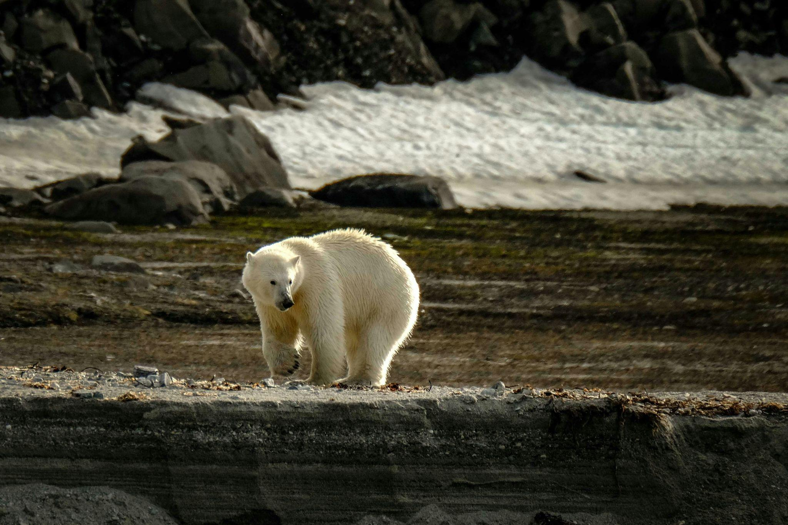

CREATURE FEATURE:
Exploring the impact of climate change on the ability of species to survive and thrive
Year 7/8 Science
Notes:
USE THESE SLIDES ALONGSIDE THE LESSON PLAN

Slide 3
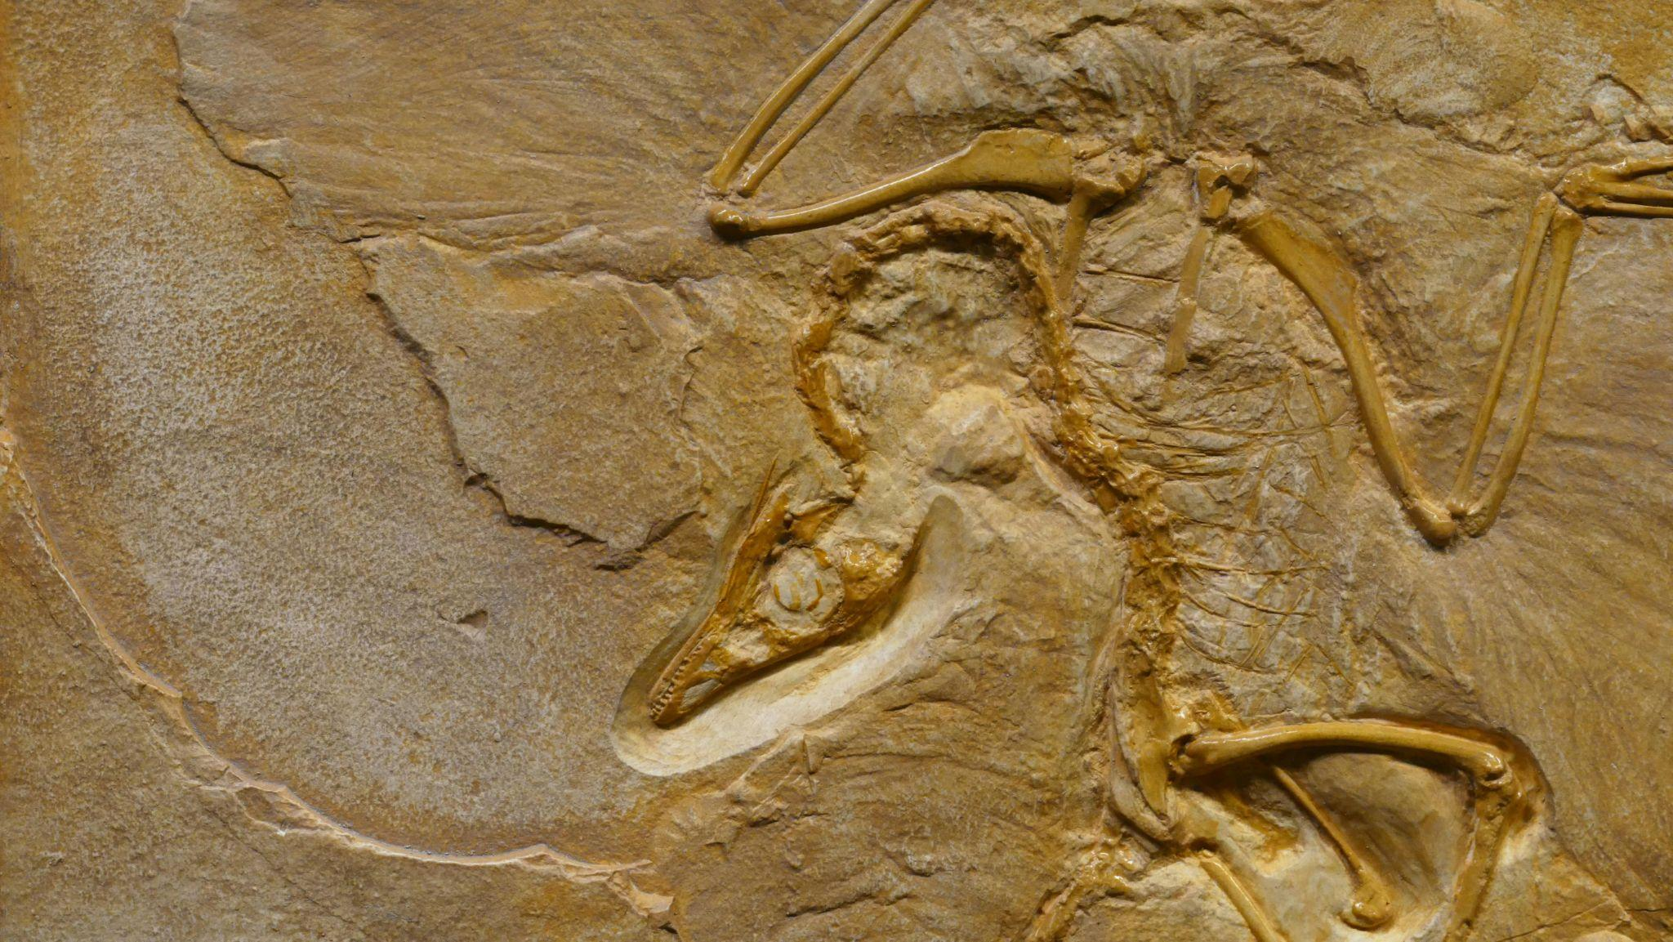


v
WHAT DOES THE WORD EXTINCTION MEAN TO YOU?
Learning introduction
Notes:
PROMPTS:
What words do you associate with extinct?
What does it mean when a species is classified as extinct?

Slide 4
DEFINITIONS
v
EXTINCT
(of a species, family, or other group of animals, plants, or organisms) having no living members; no longer in existence.
EXTINCTION
is the process or state of a species, family, or group becoming extinct.
Learning introduction
Notes:
SPEAKER NOTES:
Oxford Dictionary definition: ‘Extinction’ is the fact or process of a species, family, or other group of animals or plants becoming extinct.
Extinct means a species animals or plants that have no living members.
This means the species is no longer in existence - just like the dinosaurs; once roaming the earth are now extinct as they no longer exist.

Slide 5
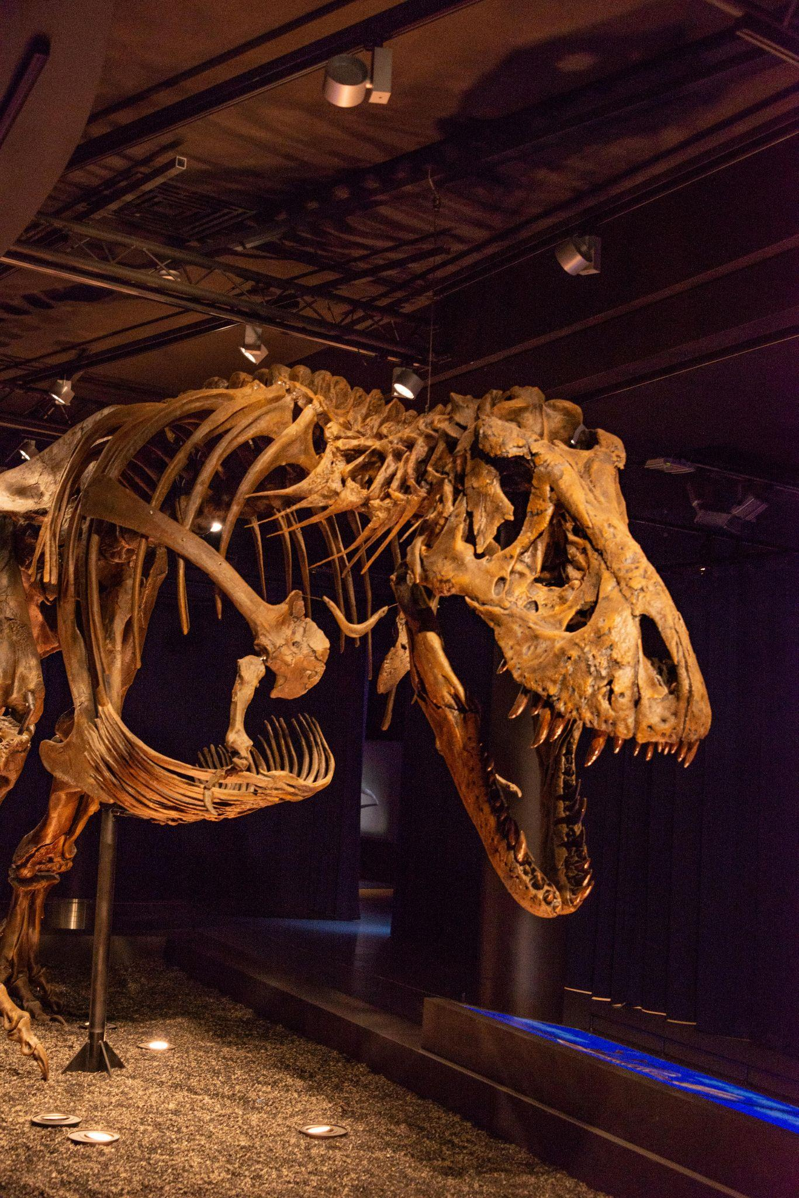
v
CAN YOU NAME ANY EXTINCT SPECIES?
(Other than the dinosaurs)
Learning introduction
Notes:
EXAMPLES:
Well-Known Extinct Species
Dodo
Woolly Mammoth
Saber-Toothed Cat (Smilodon)
Passenger Pigeon
Megalodon
Great Auk (Flightless penguin like bird)
Steller’s Sea Cow
Quagga (subspecies of Zebra)
Australian Examples
Tasmanian Tiger (Thylacine)
Pig-footed Bandicoot
Lesser Bilby

Slide 6

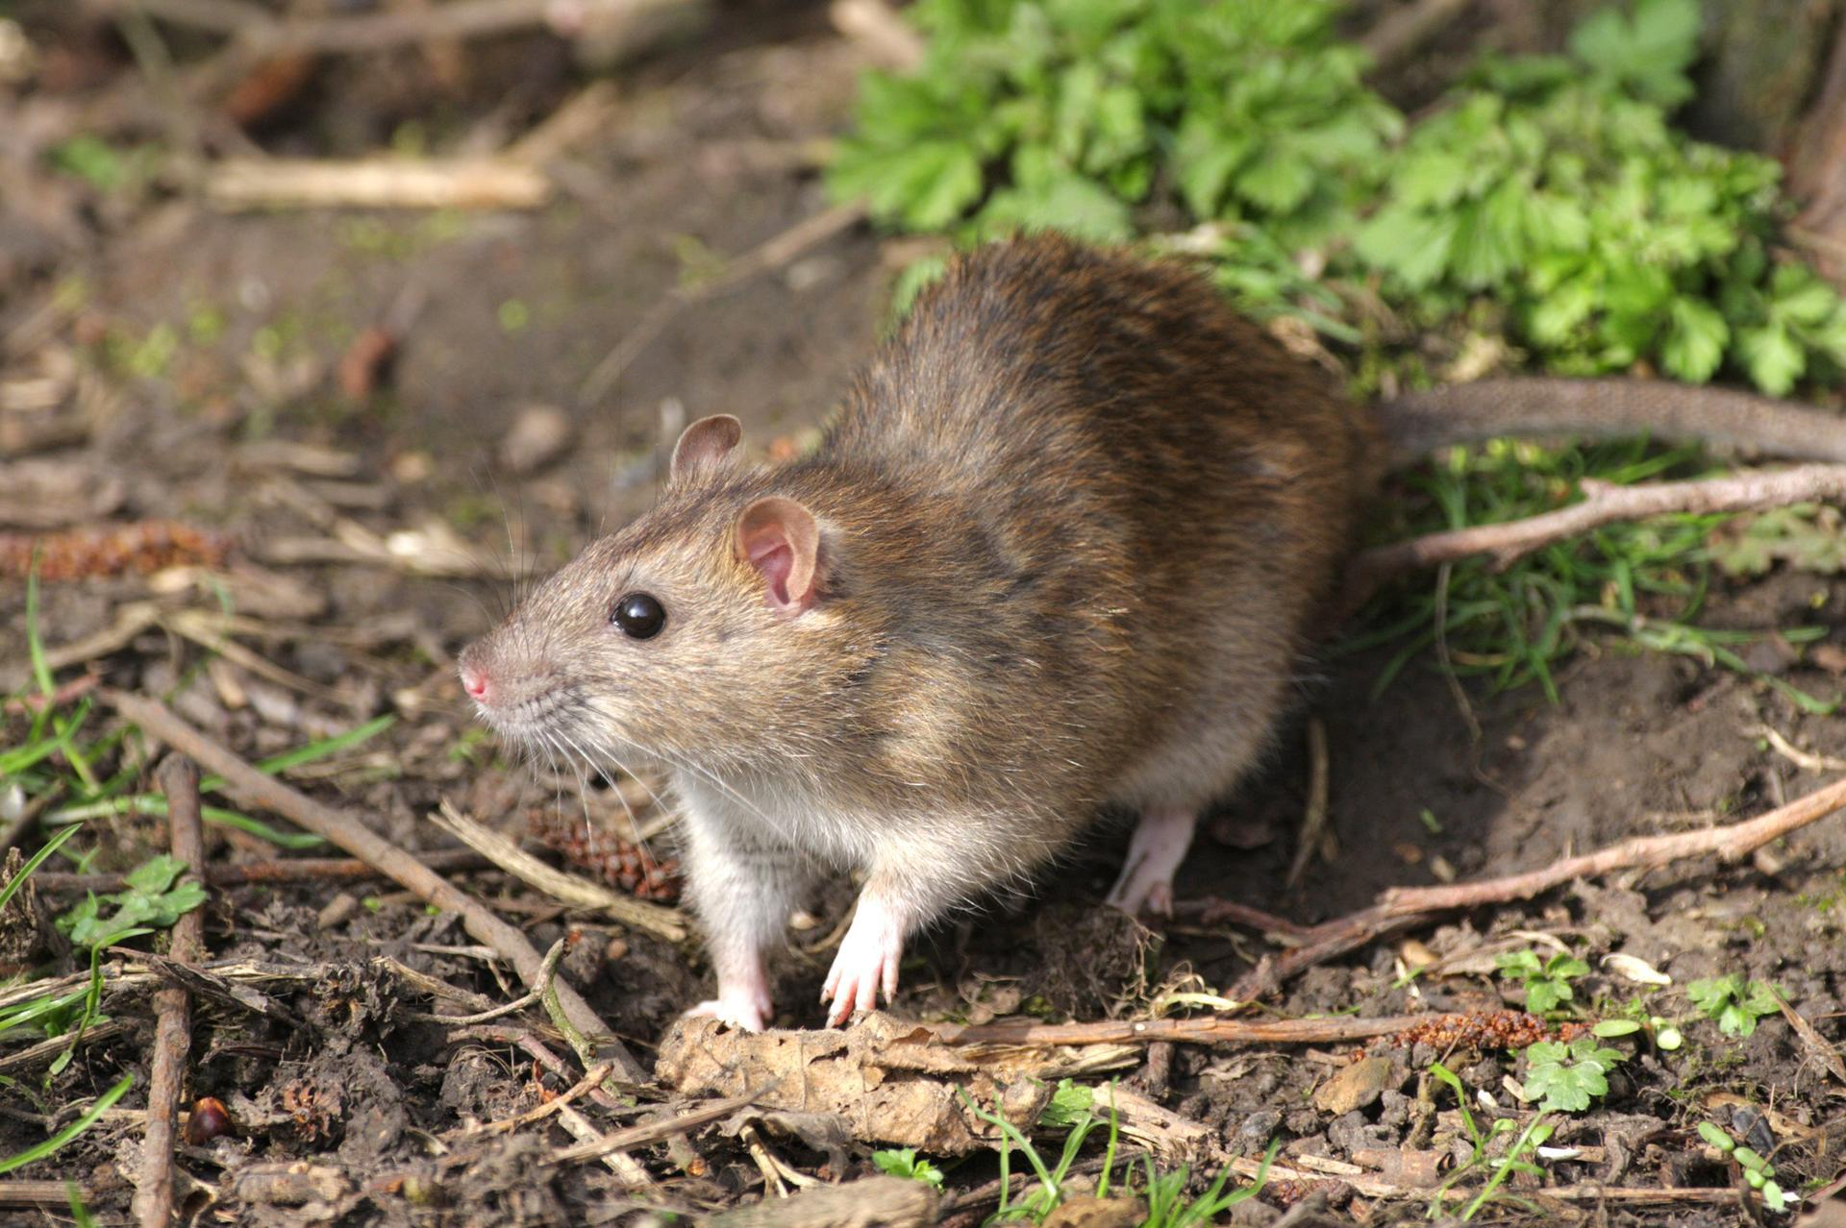
BRAMBLE CAY MELOMYS
EXTINCT
Location: Australia
The first mammal in the world to go extinct due
to climate change
Suffered habitat loss due
to rising sea levels and storm surges
v
Notes:
CLIMATE EXTINCTION EXAMPLE:
Bramble Cay Melomys
A small rodent from a tiny island in the Torres Strait (near the Great Barrier Reef), declared extinct in 2019.
Considered the first mammal extinction directly linked to human-induced climate change, after rising sea levels and storm surges destroyed its habitat and food sources.

Slide 7
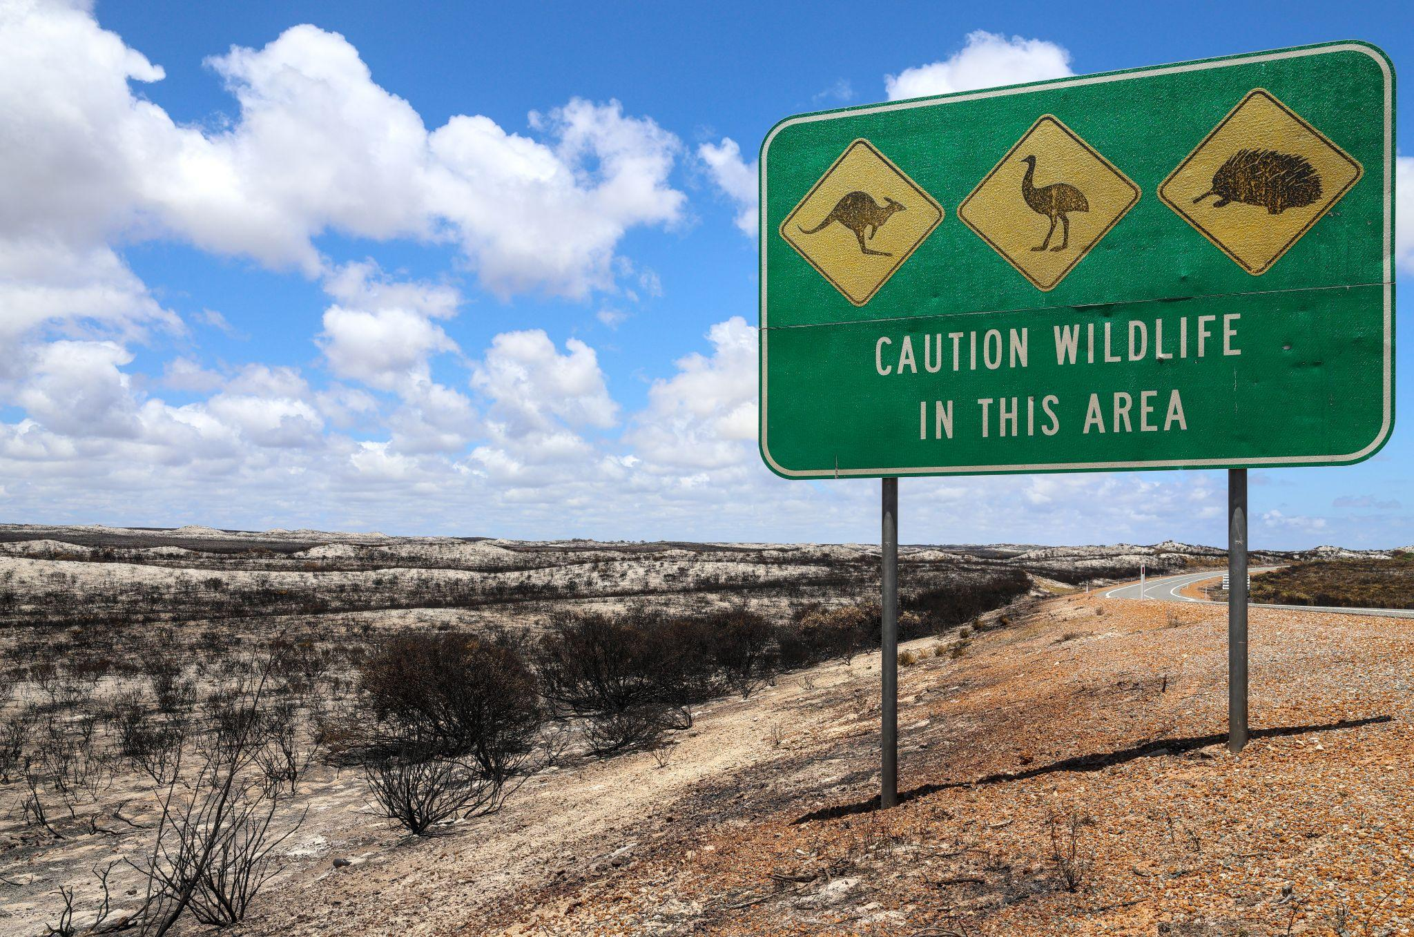
v
HOW COULD CLIMATE CHANGE AFFECT A SPECIES’ ABILITY
TO SURVIVE?
Learning theory
Notes:
TOPIC PROMPTS:
Habitat
Food and diet
Breeding and reproduction
Migration or movement patterns
Population numbers
Health and disease
Behaviour and activity levels
Lifespan and survival rates

Slide 8
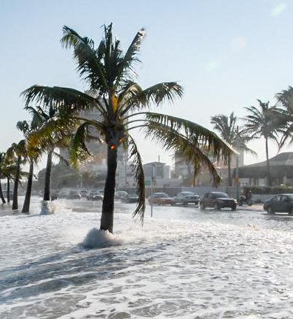
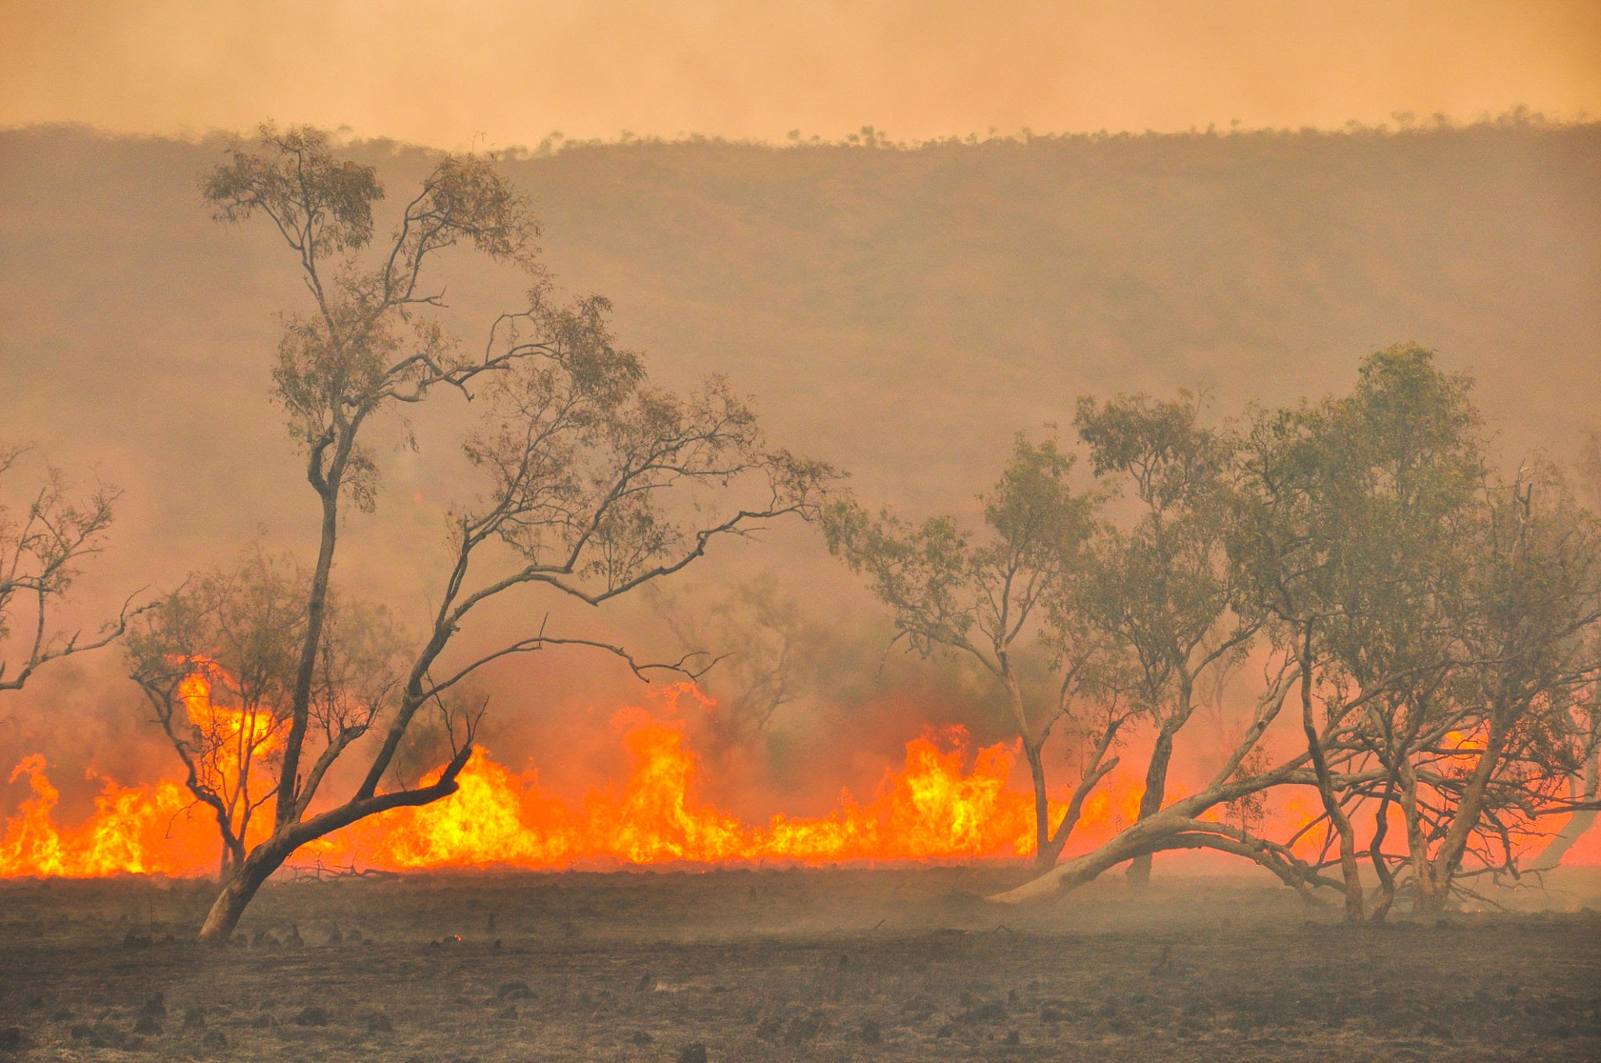
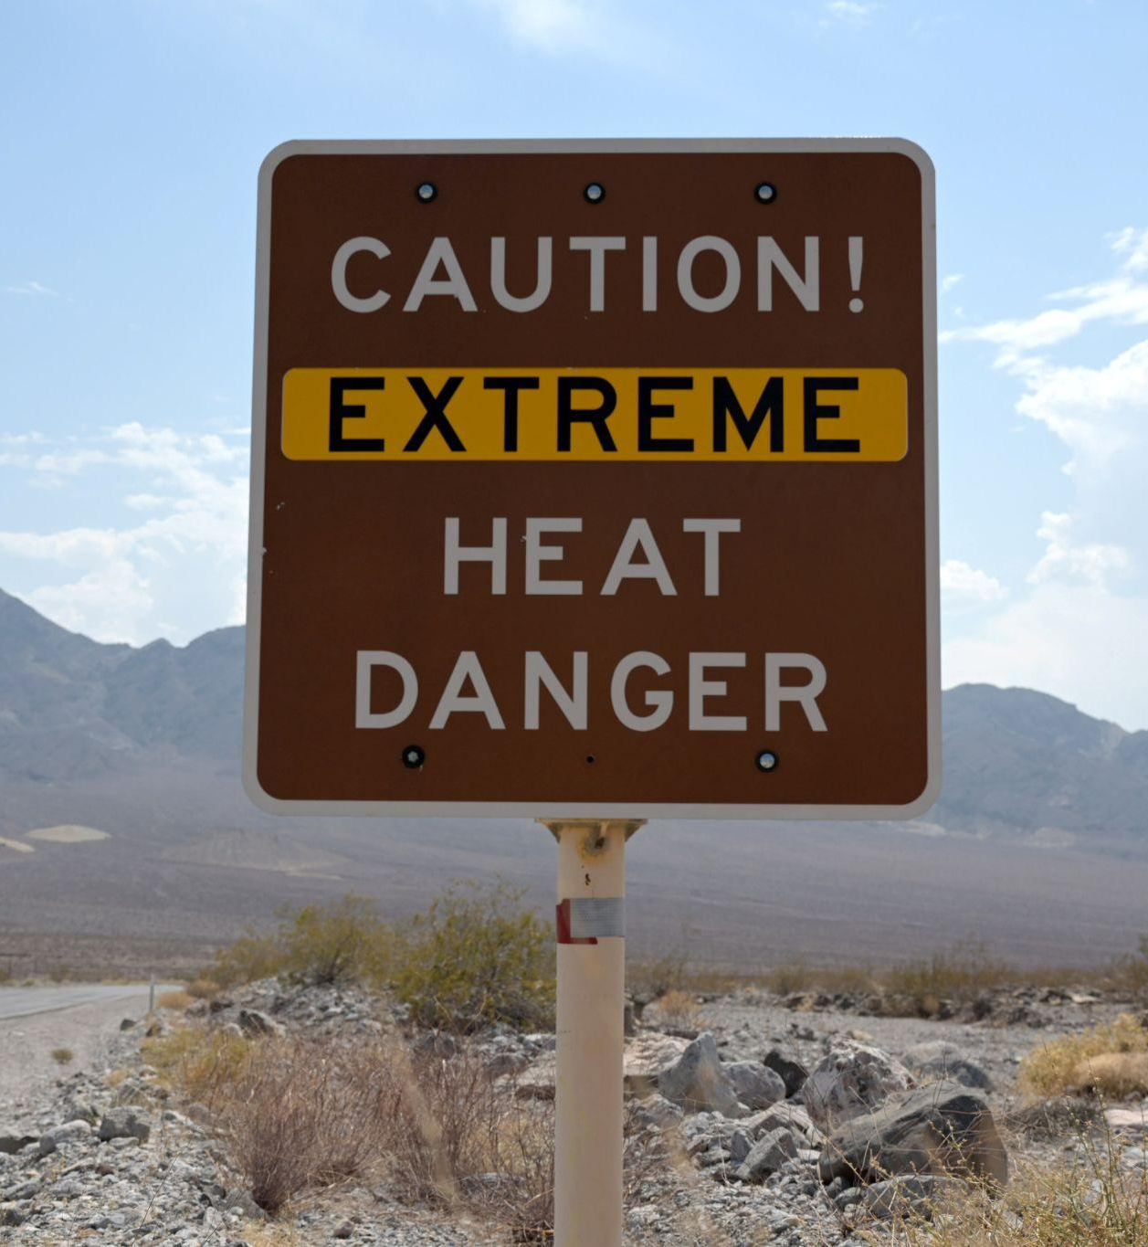
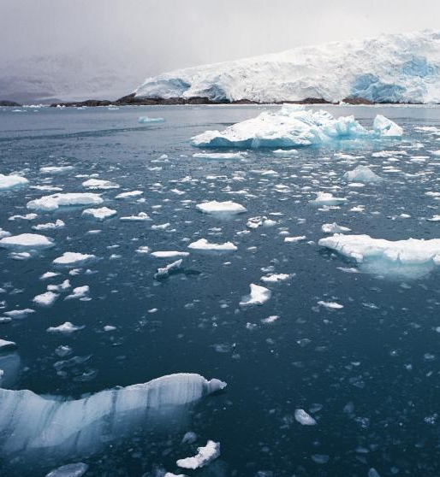
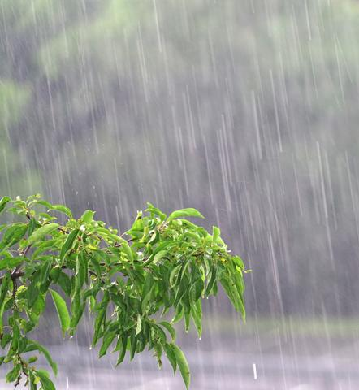
MAIN THREATS TO HABITAT
v
Rising sea levels
Extreme
weather
events
Rising
temperatures
Snow/ice
loss
Changing
rainfall
patterns
Learning theory
Notes:
SPEAKER NOTES:
Rising sea levels – flood coastal and island habitats, forcing animals to move or lose their homes.
More frequent and intense extreme weather events – fires, floods, and storms destroy habitats and make them unsafe or unstable.
Rising temperatures – make some habitats too hot or dry for species to survive, changing where they can live.
Snow and ice loss – removes critical habitats for polar and alpine animals that depend on frozen environments.
Changing rainfall patterns – alter ecosystems by causing droughts or floods, reducing water and plant life that animals rely on.
These impacts often occur at the same time – for example, rising temperatures can drive droughts while extreme weather destroys habitats – creating a chain reaction that puts even more pressure on species to survive.

Slide 9
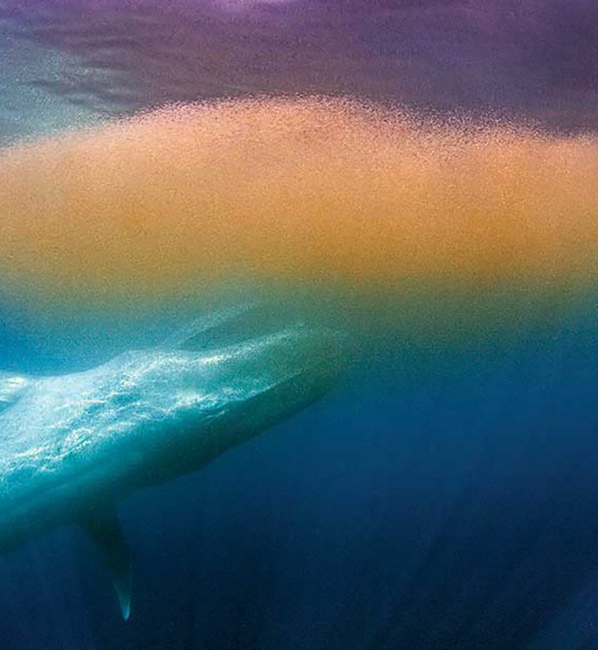
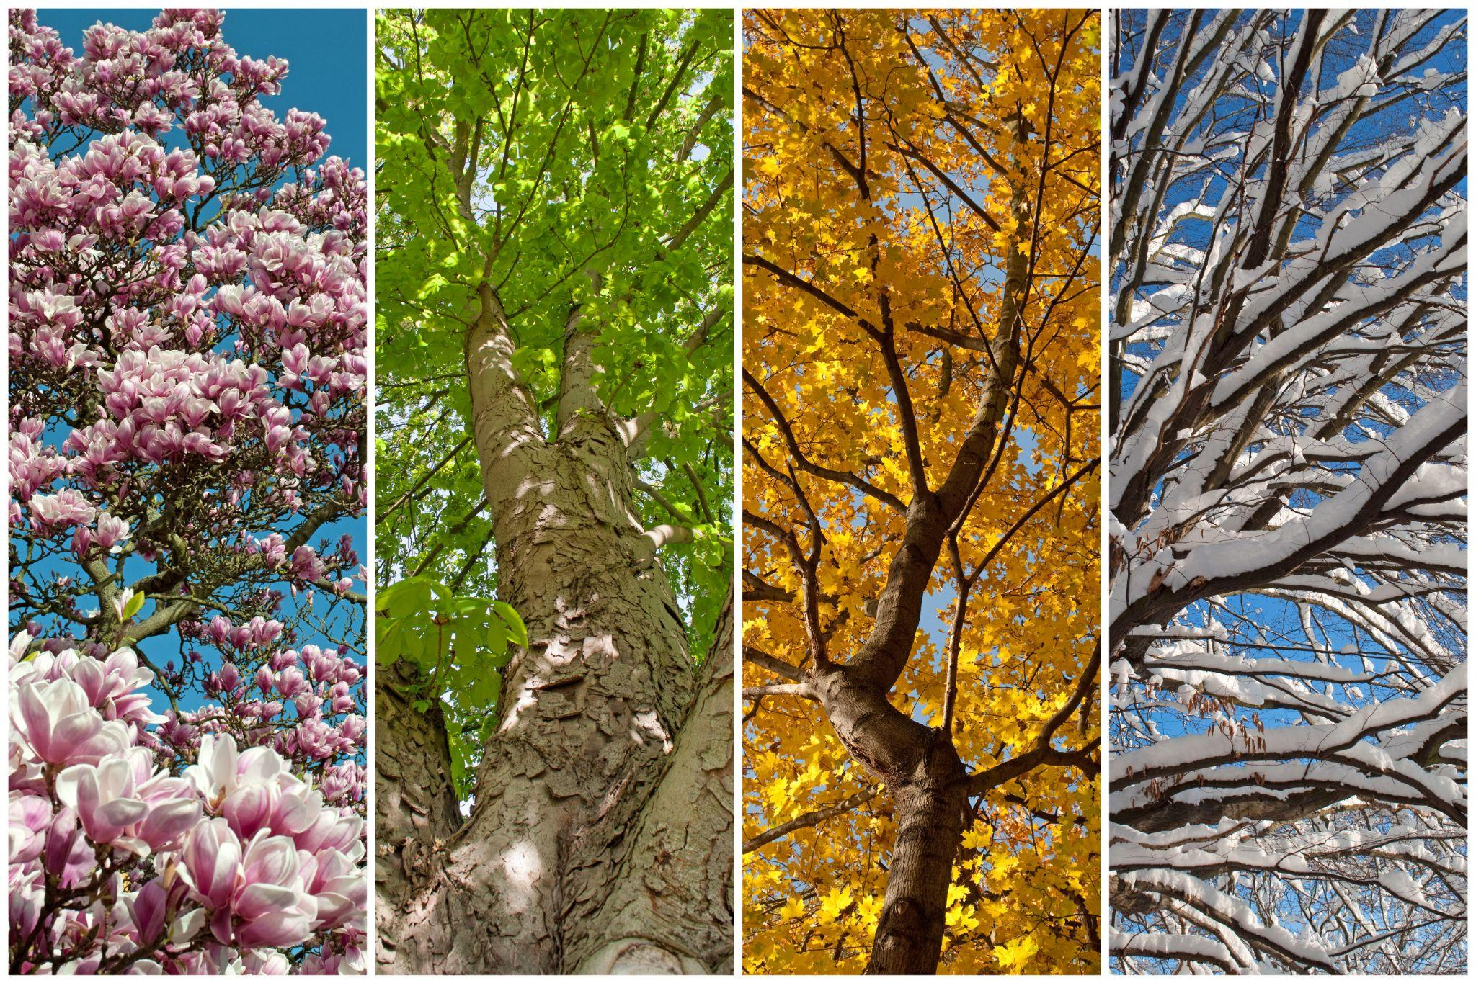
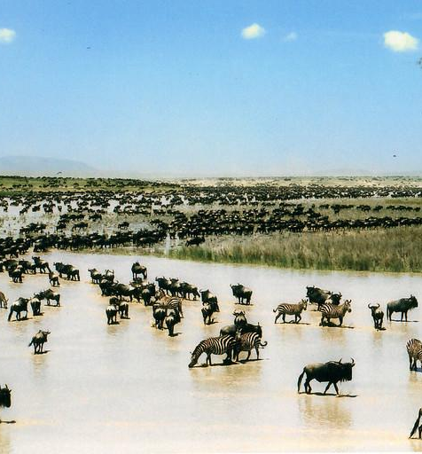
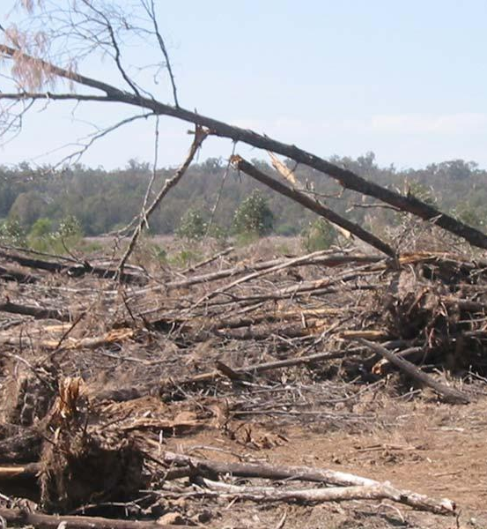
MAIN THREATS TO FOOD
v
Food chain disruption
Seasonal shifts
Forced migration
Habitat loss
Extreme
weather
events
Learning theory
Notes:
SPEAKER NOTES:
Food chain disruption – predator–prey relationships are disturbed, making it harder for animals to find or catch food.
Seasonal timings shifts/changes – alter when and where food is available, throwing off feeding and breeding cycles.
Forced migration – species may move away from their food sources, or their food sources may move away from them.
Habitat loss – reduces vegetation and prey, leaving animals with fewer reliable food options.
Extreme events – fires, floods, and droughts destroy plants, prey, and feeding grounds.
These impacts are often interconnected – for example, extreme events can damage habitats and destroy food sources, while also forcing prey species to migrate, disrupting food chains and creating a ripple effect that makes it even harder for animals to find enough to eat.

Slide 10
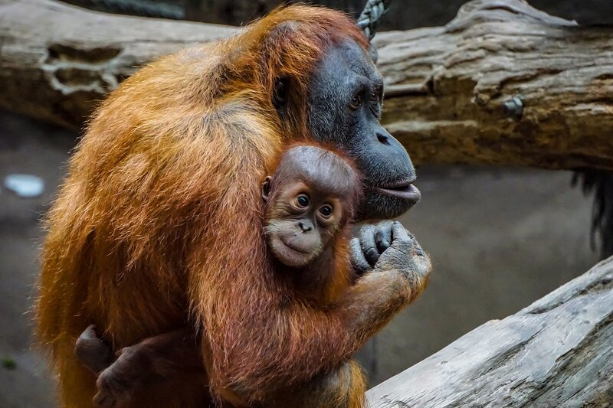
v
WHAT HAPPENS WHEN A SPECIES LOSES EITHER?
Do they:
Remain relatively unaffected
Adapt or evolve
Face extinction
Activity introduction
Notes:
EXAMPLES OF EACH:
Remain relatively unaffected – Rats and pigeons are examples of species that can live almost anywhere and eat a wide range of foods, so they cope well with environmental change.
Adapt or evolve – Red foxes have expanded their range and changed their hunting patterns as temperatures rise and prey species shift.
Some fish have adapted to warmer waters by breeding earlier in the season.
Face extinction – Bramble Cay Melomys (slide 6) became extinct after rising sea levels and storm surges destroyed its small island habitat and food supply – it’s considered the first mammal extinction linked directly to climate change.

Slide 11

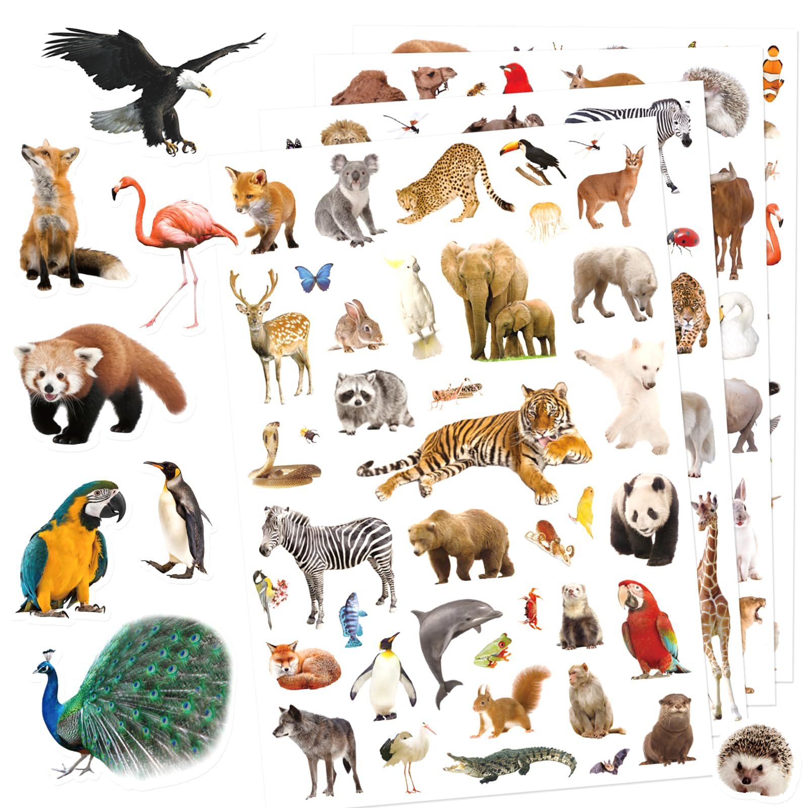
ACTIVITY:
CREATURE FEATURE
Create a creature using the materials which can survive the impacting factors of climate change (at least A4 size)
You must come up with:
Name
Habitat
Diet
Notable behaviours (e.g. can it migrate, can it camouflage, is it social)
v
Activity instructions
Notes:
REFER TO LESSON PLAN FOR FULL INSTRUCTIONS

Slide 12
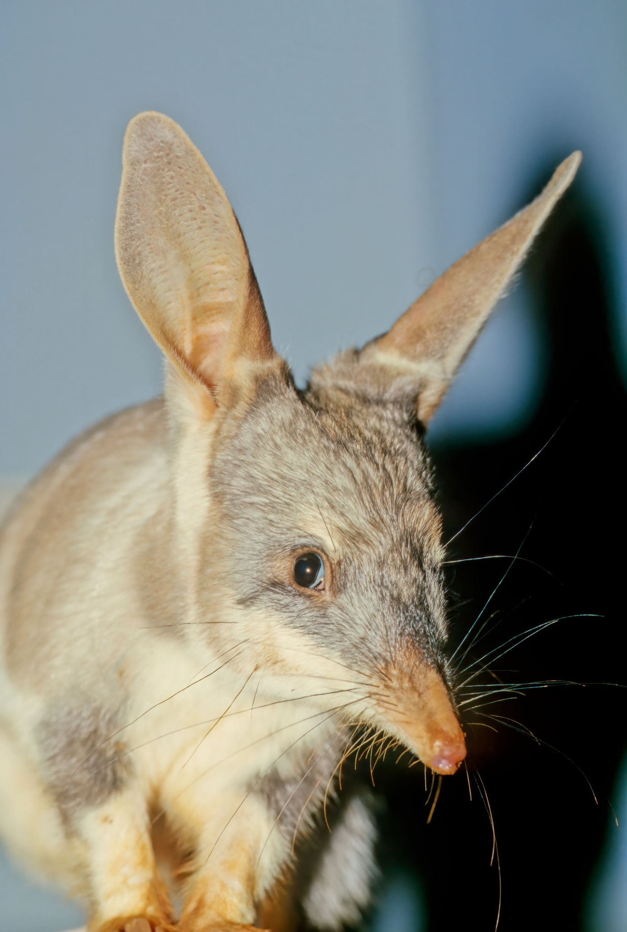
v
EXAMPLES OF ADAPTATIONS:
Hibernation
Nocturnal behaviour
Burrowing or sheltering
Body changes (e.g. thicker fur,
webbed feet, longer limbs)
Activity instructions
Notes:
ON SLIDE EXAMPLE:
Bilby
Habitat – desert/dry regions
Evolved – to conserve water
Adaptations – extracting moisture from its diet, producing concentrated urine, reducing evaporation loss through skin, living more underground
A full list of adaptation examples can be found in the ‘Teaching Materials and Resources’ table (R5) in the accompanying lesson plan.

Slide 13
ACTIVITY:
CREATURE FEATURE
Create a creature using the materials which can survive the impacting factors of climate change
You must come up with:
Name
Habitat
Diet
Notable behaviours (e.g. can it migrate, can it camouflage, is it social)
v
Activity instructions
Notes:
REFER TO LESSON PLAN FOR FULL INSTRUCTIONS

Slide 14
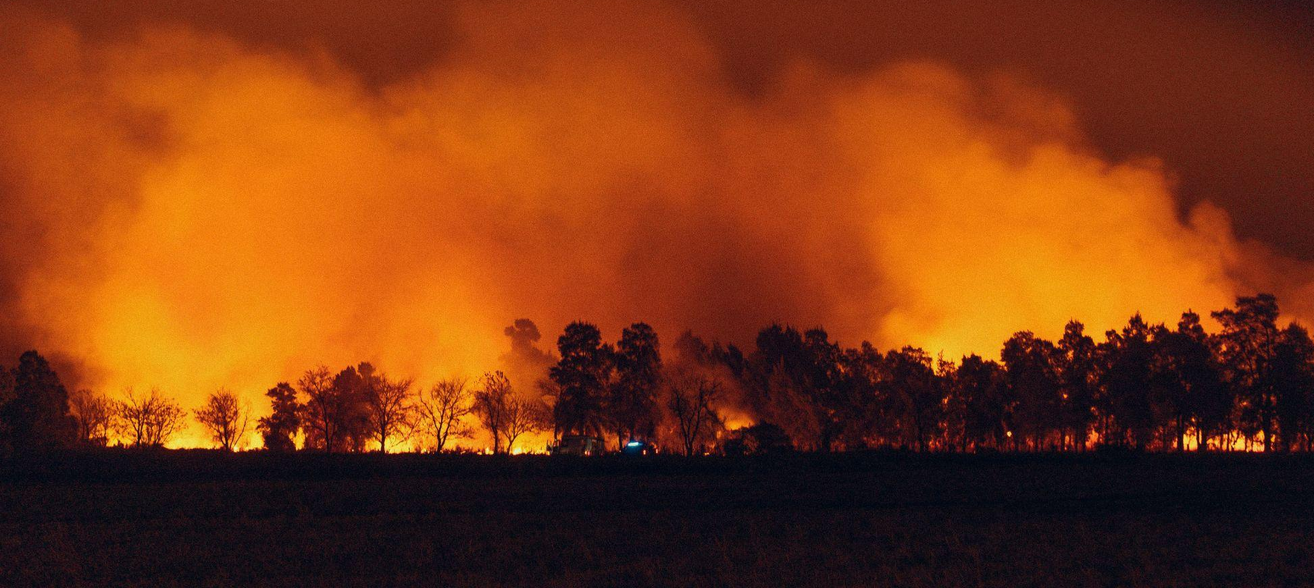
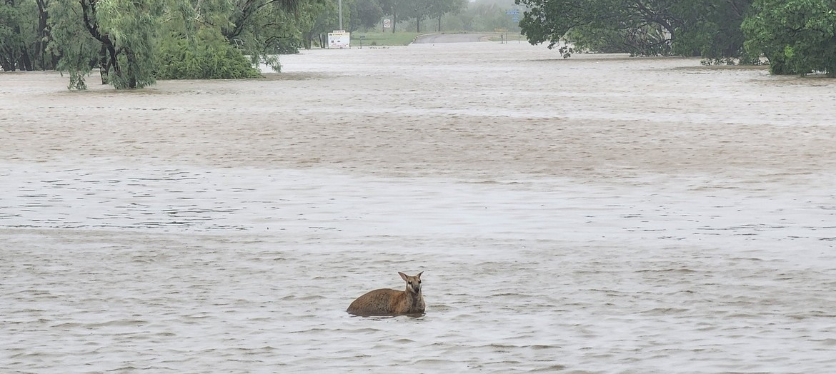
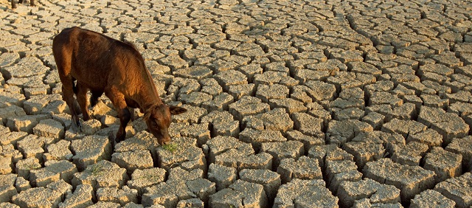
v
TIME TO PUT
THEM TO THE TEST
Do they:
Remain relatively unaffected
Adapt or evolve
Face extinction
Activity
Notes:
HOLDING SLIDE FOR SURVIVAL SCENARIOS PHASE OF THE ACTIVITY

Slide 15
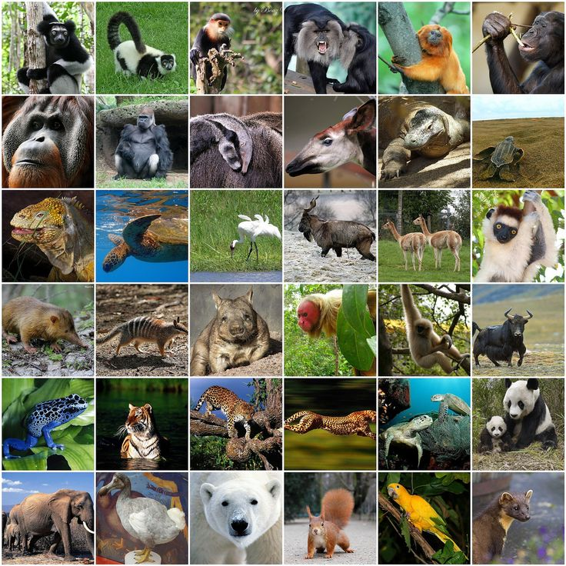
v
WHY CAN’T
ALL SPECIES
JUST ADAPT?
Learning discussion
Notes:
PROMPTS:
Timeframes (e.g. lifespans, rate of changes)
Location
Specific needs
Population size
What else is happening around them (e.g. human interference, other animals encroaching in their territory)

Slide 16
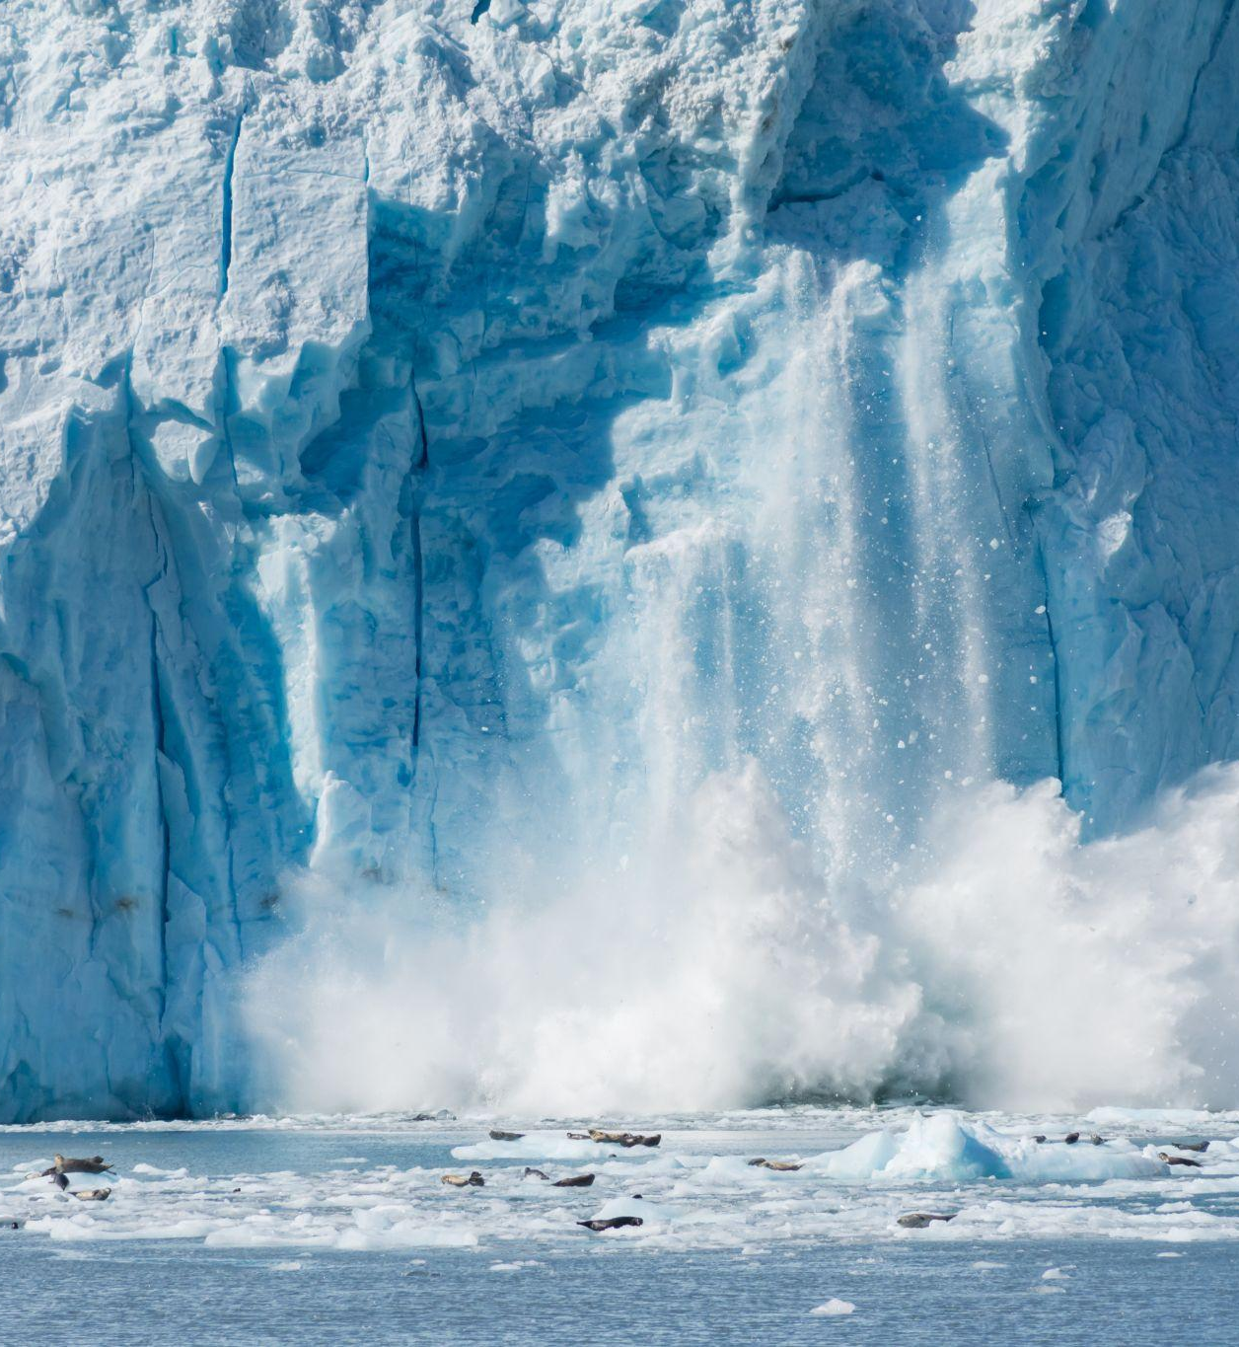
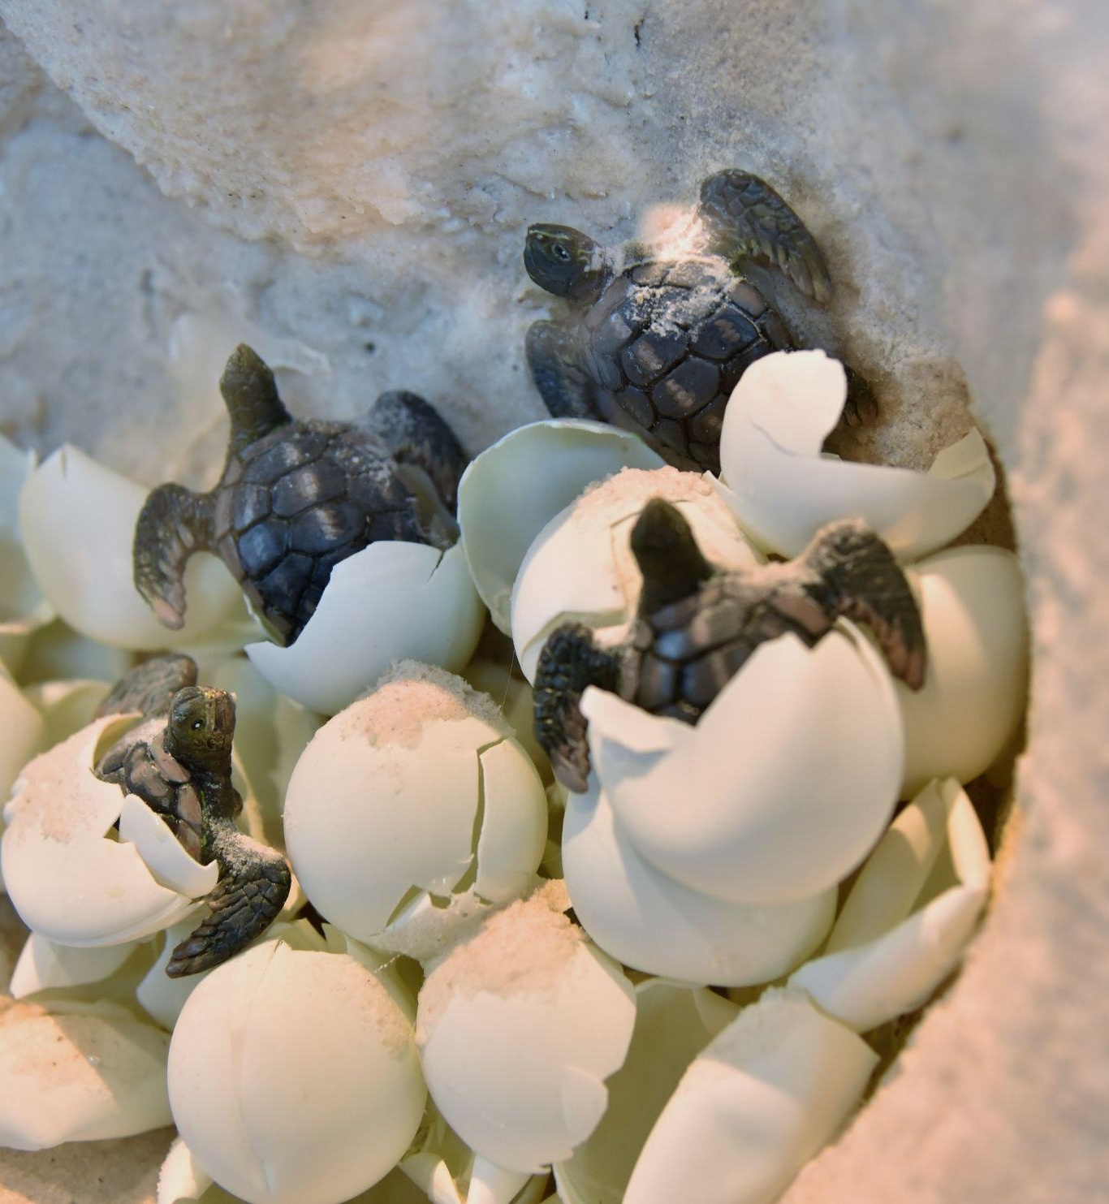
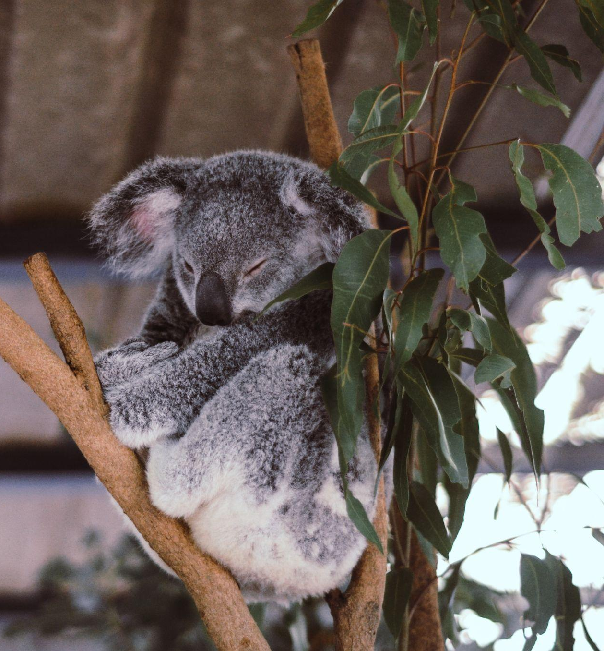
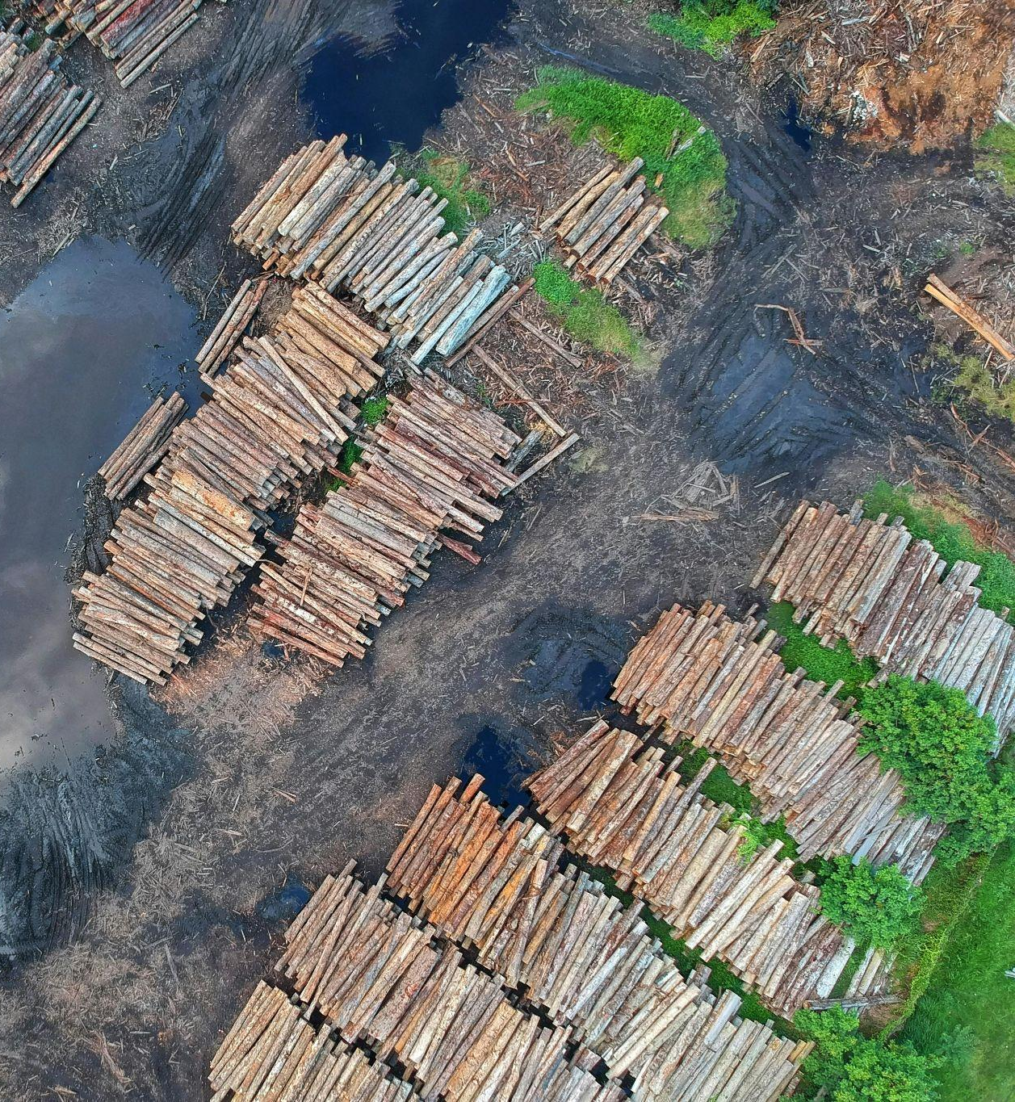
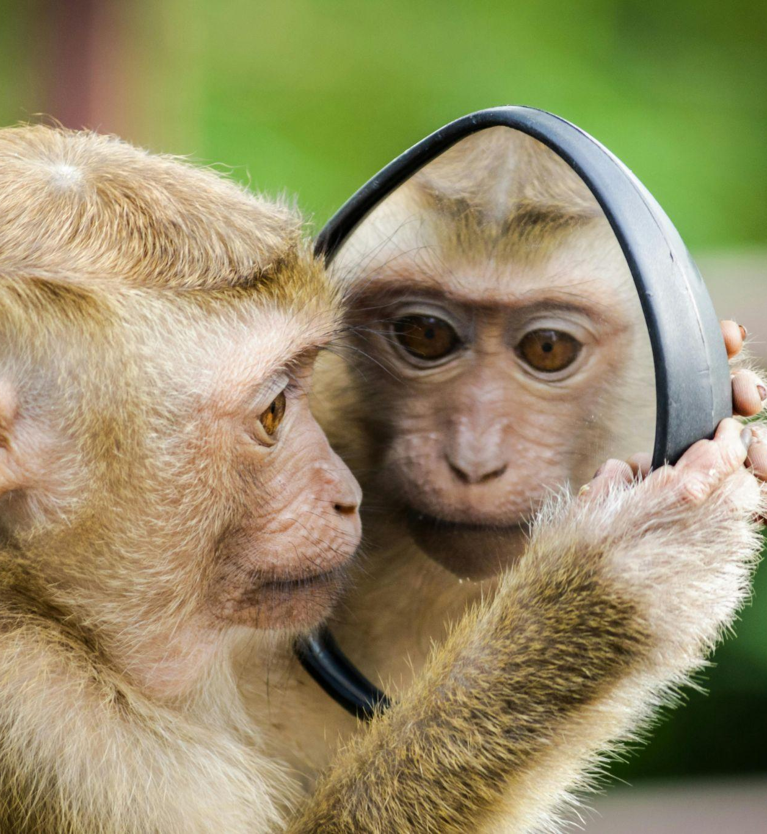
ADAPTATION CHALLENGES
v
Speed of climate change
Population limits
Specialised needs
Human pressures
Adaptation itself
Learning discussion
Notes:
SPEAKER NOTES:
Speed of change – Climate change is happening faster than species can evolve. Animals that normally adapt over hundreds or thousands of years now face major changes within just a few decades.
Population limits – When there are only small numbers of a species left, or little genetic diversity, it’s much harder for them to adapt to new conditions. For example, cheetahs have very low genetic diversity, which limits their ability to cope with new diseases or climate stress.
Specialised needs – Some animals depend on very specific foods or habitats. For example, koalas rely almost entirely on eucalyptus leaves and certain forest types, so when those trees die off or dry out, koalas struggle to survive.
Human pressures – Habitat destruction, pollution, and other human activities add even more stress, reducing the space and resources animals need to adjust or recover.
Adaptation itself – Even when a species manages to adapt in one way, that change can create new challenges. For example, shifting breeding times might disrupt migration patterns, or a new function could demand more energy - and therefore more food - which may no longer be available.

Slide 17
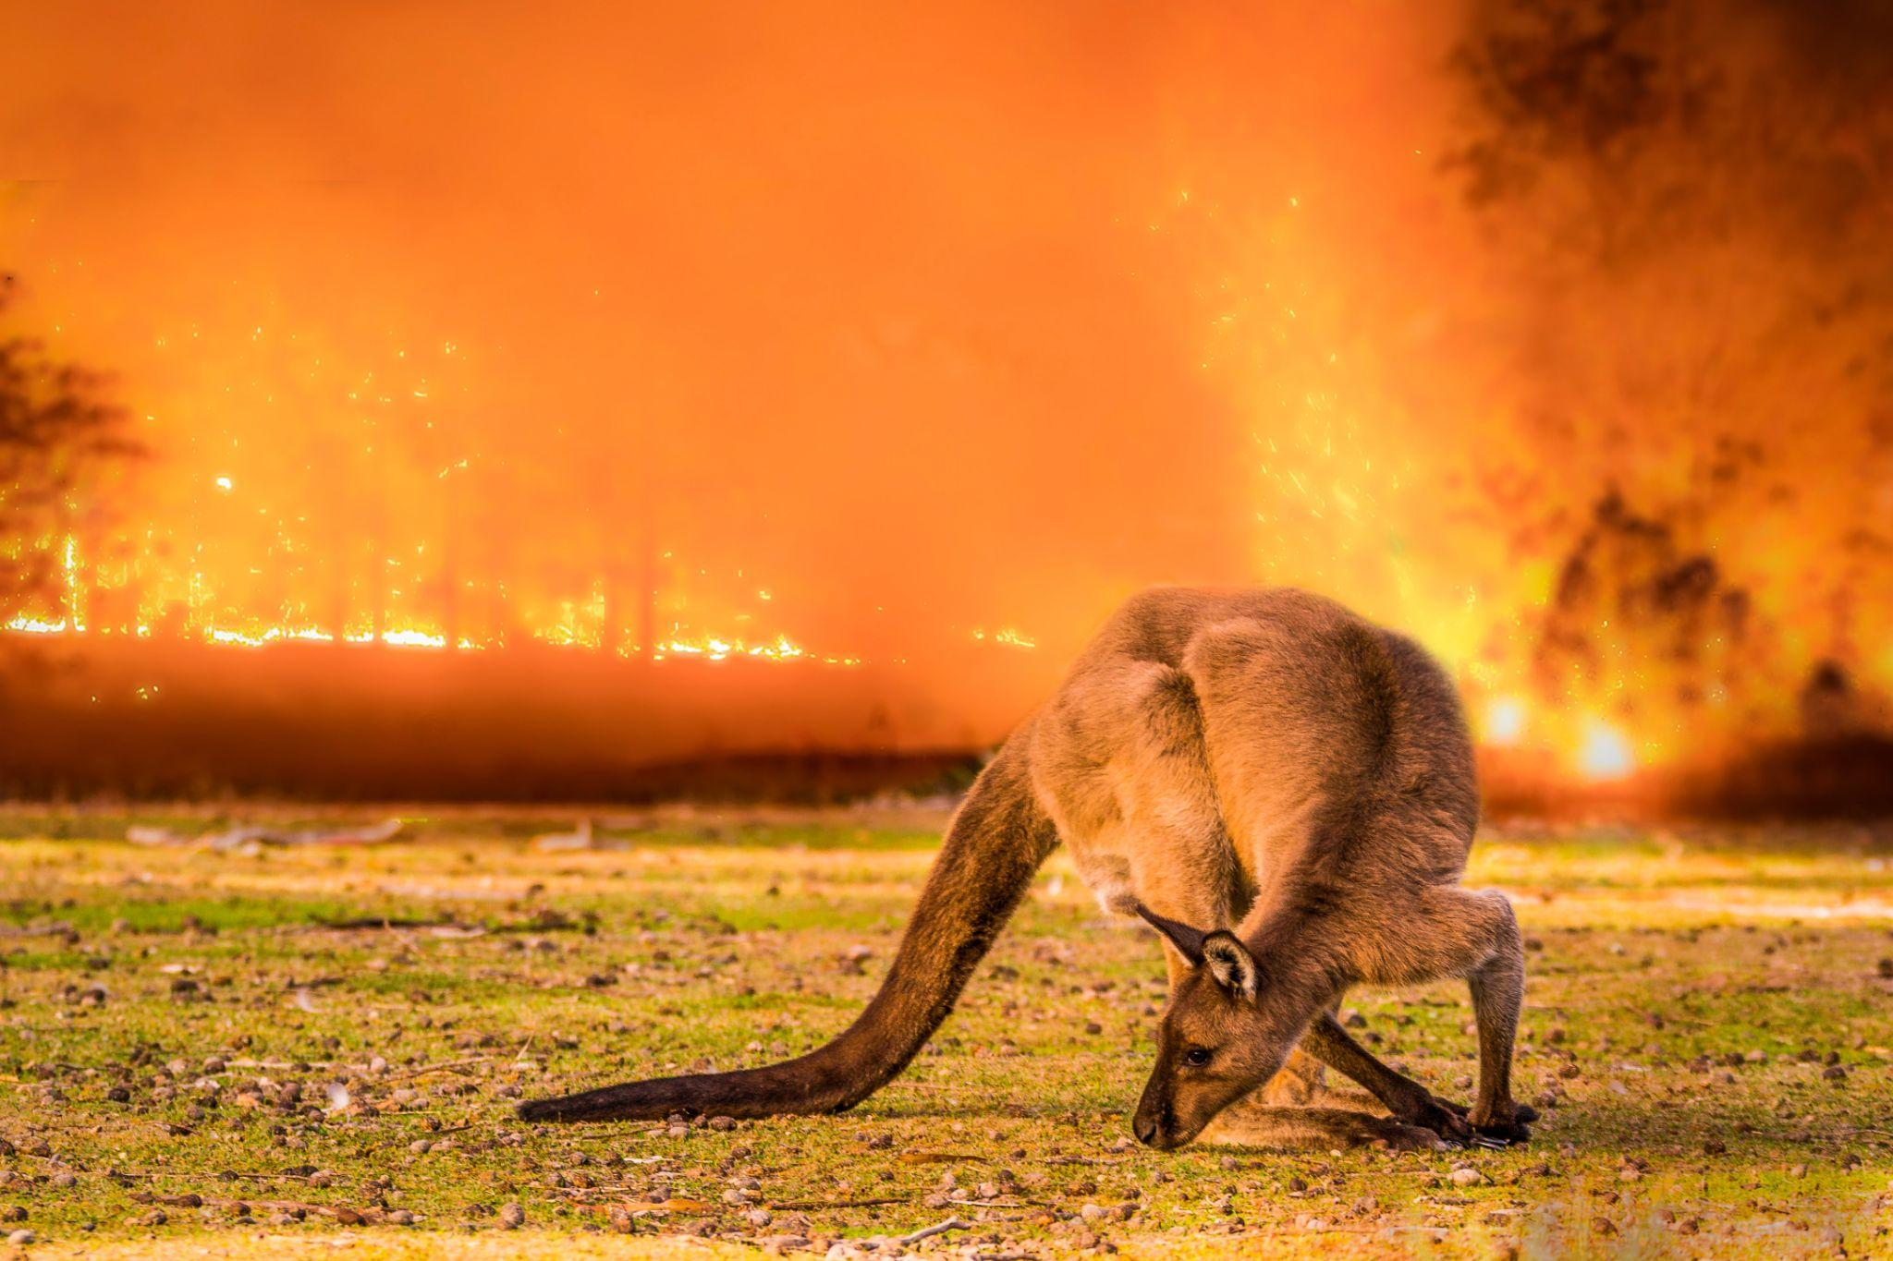
v
HOW CAN WE HELP OUR SPECIES?
(both directly and bigger picture)
Learning discussion
Notes:
PROMPTS:
Waste
Landcare
Emission reductions
Transport
Energy use
Agriculture
Urban planning

Slide 18
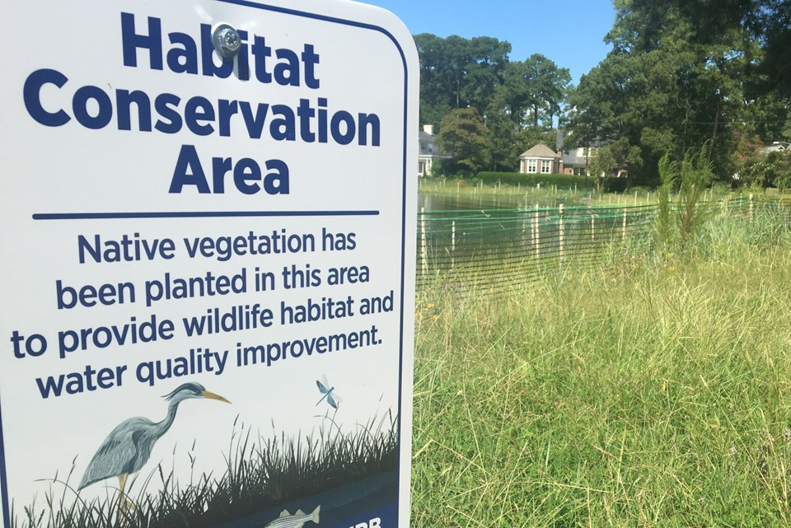
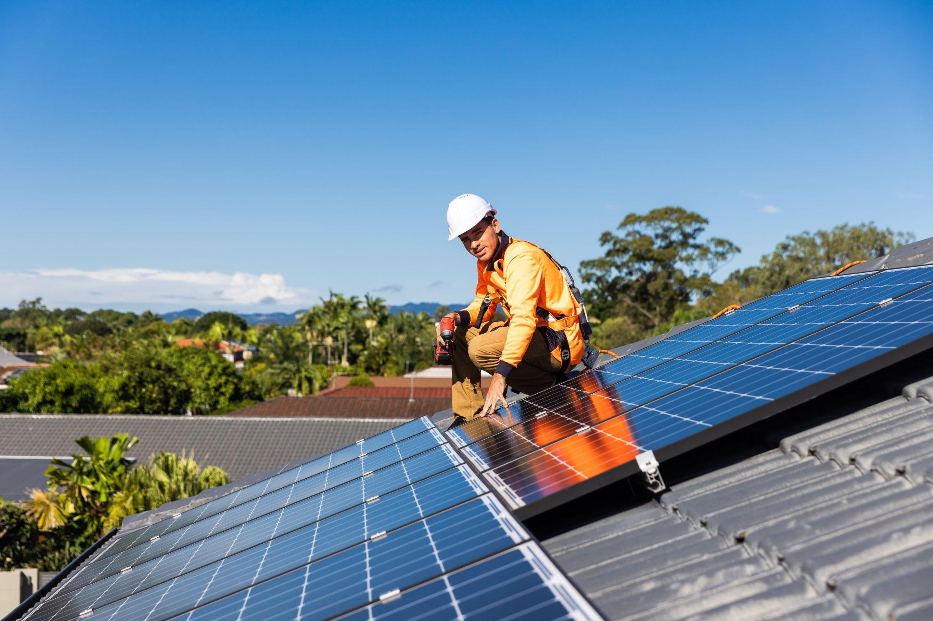
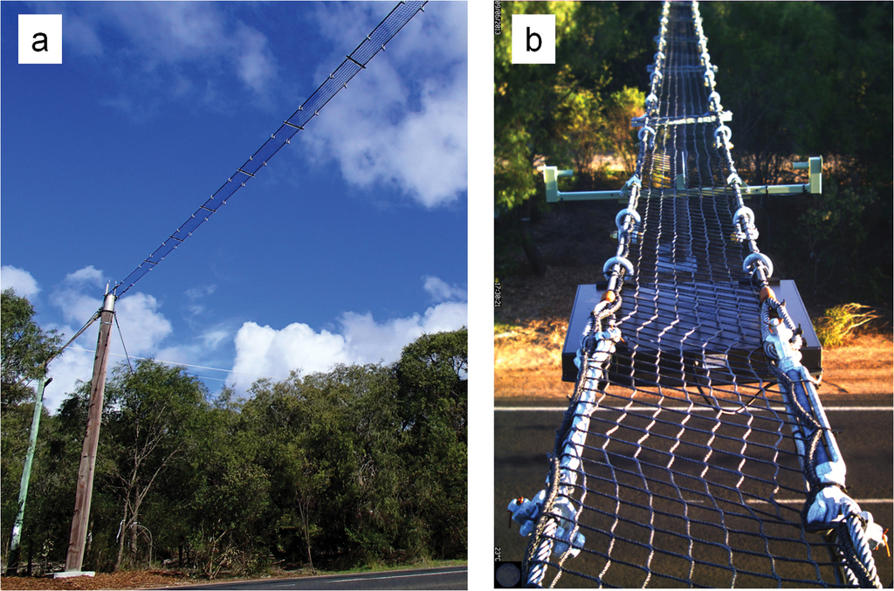
HUMAN DRIVEN SOLUTIONS
v
Conservation
(e.g. restoring habitats, safe breeding programs)
Reducing emissions
(e.g. renewable energy, using public transport)
Planning for coexistence
(e.g. wildlife crossings, native gardens)
Learning discussion
Notes:
SPEAKER NOTES:
Conservation – Protecting and restoring habitats, along with running safe breeding and recovery programs, helps species rebuild their populations and ensures they have places to live and find food.
Reducing emissions – Using renewable energy, public transport, and cutting pollution helps limit climate change, and protect the stable temperatures and ecosystems that species depend on.
Planning for coexistence – Designing spaces like wildlife crossings, native gardens, and protected corridors allows animals and humans to share environments safely, reducing collisions, habitat loss, and conflict.

Slide 19
OPTIONAL ACTIVITY
Informal proof of learning assessment

Slide 20


v
TO LEAVE
On a post-it note or piece of
paper write:
Your name
One climate change impact
One example of species adaptation
One solution or behaviour we as humans can do to help
Your name
1. Climate change impact
2. An adaptation
3. Human driven solution
Learning reflection
Notes:
END OF LESSON

Slide 21

STUDENT FEEDBACK
LINK
http://bit.ly/4hV8Bka

