Slide 1

Human Rights in Canadian Corrections: A Prison Ombudsman’s Perspective
Conference on Human Rights in Closed Environments
Monash University
Melbourne, Australia
February 20, 2012
Ivan Zinger J.D., Ph.D
Executive Director and General Counsel
Office of the Correctional Investigator

Slide 2
Outline of Presentation
Canadian Corrections by the Numbers
Role of the Office of the Correctional Investigator
A Human Rights Lens in Corrections
Key Challenges in Canadian Federal Corrections
  Mental Health
  Aboriginal Offenders
  Conditions of Confinement
  Access to Programs
  Preventing Deaths in Custody
  Federally Sentenced Women
Concluding Remarks

Slide 3
Canadian Corrections by the Numbers
Federal Adult Corrections
Offenders serving sentences of two years or more.
13,400 male and 580 women inmates.
8,600 offenders under community supervision.
Correctional Service Canada (CSC): 17,000 employees.
$3B budget in FY 2011-12 (a 40% increase from FY 2005-06)
Average annual cost of maintaining a federal inmate:
  $111,000 per male inmate.
  $211,000 per woman.
CSC adding 2,700 new cells in the next 2 years.
Provincial Adult Corrections (2008/2009)
Offenders serving sentences of less than two years.
23,700 incarcerated provincial inmates (including 13,600 remand).
109,400 provincial offenders on probation and parole.

Slide 4
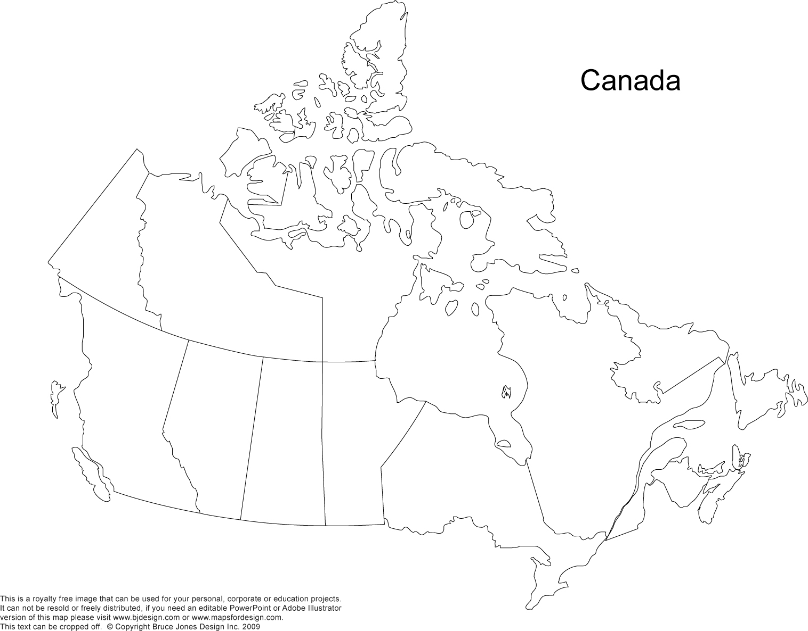
Incarceration Rate by Province and Territory
303
843
684
68
80
104
187
177
87
83
87
71
59
Rate per 100,000 adult population, 2010
*Numbers include federal, provincial and territorial incarceration rate
(Source: Statistics Canada)

Slide 5
Role and Mandate of the Office of the Correctional Investigator (OCI)
The Office of the Correctional Investigator (OCI) acts as an Ombudsman for offenders under Canadian federal jurisdiction (serving a sentence of two years or more):
  Independent monitoring and oversight of federal corrections.
  Accessible and timely investigation of offender complaints.
  Determines whether the Correctional Service of Canada (CSC) has acted fairly, reasonably and in compliance with law and policy.
  Makes recommendations to ensure accountability in corrections.
The Office was established in 1973 and formally entrenched in legislation in November 1992 with the enactment of the Corrections and Conditional Release Act (CCRA).

Slide 6
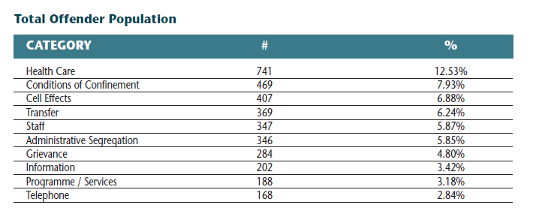
OCI By the Numbers
The Office has 36 staff, the majority of which are directly involved in the day-to-day addressing of inmate complaints.
2010-2011
  Investigators spent 375 days in federal penitentiaries.
  Responded to approximately 6,000 offender complaints
  Interviewed 2,100 offenders.
  Conducted over 1,200 use of force reviews and over 120 reviews of deaths in custody and serious bodily injury cases.
  Recorded over 20,000 toll-free contacts or spent 1400 hours on the phone.

Slide 7
Corrections and the Human Rights Business
The business of Corrections is all about promoting and monitoring respect for human rights; preventing human rights violations; and, detecting and remedying them.
Every aspect of a prisoner’s life is heavily regulated. The CSC makes thousands of decisions every day which impact on prisoners’ fundamental rights.
When government has exceptional authority over its citizens, the potential for abuse of powers is great and the protection of fundamental rights must be a core preoccupation of those empowered and trusted with those exceptional powers.

Slide 8
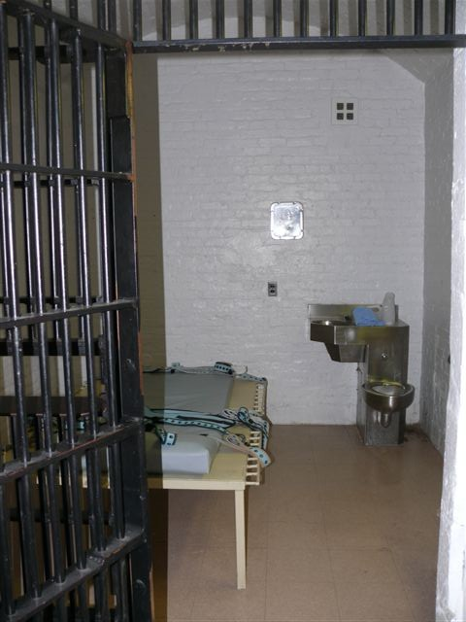
1. Mental Health

Slide 9
Mental Health: Prevalence and Concerns
Proportion of federal offenders with mental health needs has more than doubled between 1997 and 2008.
36% of offenders at admission are identified as requiring some level of psychological or psychiatric services. The prevalence rate of mental health problems for women offenders is estimated at 70%.
Incidents of serious self-harming behaviour in federal prisons have risen dramatically in the last 5 years. For FY 2010-11, there were 822 incidents of self-injury.
On average, 10 federal inmates commit suicide annually. The rate of suicide in federal custody is 7 times higher than the national average.
Offenders with mental health problems are more often:
  Victims of violence, intimidation and bullying.
  Placed in administrative segregation.
  Classified at higher security levels.
  Unable to complete correctional programs.
  Released later in their sentences.

Slide 10
2. Aboriginal Issues

Slide 11
The Proportion of Federally Incarcerated Aboriginal Offenders is Increasing
Source: CSC Corporate Reporting System, as of 2011-10-09

Slide 12
Aboriginal Offenders
Aboriginal offenders lag significantly behind non-Aboriginal offenders on nearly every indicator of correctional performance.
Compared to Non-Aboriginal offenders, Aboriginal offenders tend to be:
  Classified as higher risk and higher need in categories such as employment, community reintegration and family supports.
  Released later in their sentence (lower parole grant rates).
  Released at their Statutory Release (2/3) or Warrant Expiry dates.
  Classified as maximum security.
  Over-represented in segregation populations.
Lack of capacity to address the unique social, cultural and historical circumstances contributing to Aboriginal offending (Gladue factors).

Slide 13
3. Conditions of Confinement

Slide 14
Conditions of Confinement
In the last 2 years, the inmate population has increased by 1,500 or 11.2%.
Many institutions are already at or beyond their intended capacity, contributing to increased double-bunking. Currently 15.64% double-bunked – may reach 30% before new construction brings relief.
Overcrowding is linked to increased levels of violence and prison unrest and may contribute to higher incidences of disease transmission and infection rates.
In fiscal year 2009-10, CSC reported 9,129 security incidents and 2,258 physical injuries to inmates.
Use of force incidents increased from 998 in 2007-2008 to 1,372 in 2009-2010 (25%).
On any given day, about 800 federal inmates are housed in segregation units.

Slide 15
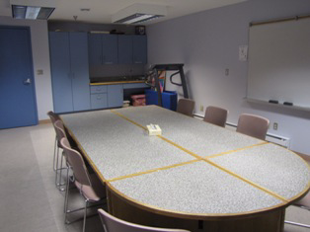
4. Access to Programs

Slide 16
Access to Programs
A sizeable number of inmates are on program “wait-lists”.
A 2009 CSC study indicated that 62% of all parole hearings are waived, postponed or revoked, often because programs and risk assessments are not completed in time.
In 2009-10, CSC spent $28.6M on core correctional programs targeting factors and needs associated with criminal behaviour. This spending represents less than 2% of CSC’s total $3B budget .
Access to program is prioritized on the basis of who are the closest to their Statutory Release (SR) date. Many offenders with long sentences are not offered programs until they are close to their SR date to accommodate offenders serving shorter sentences.

Slide 17
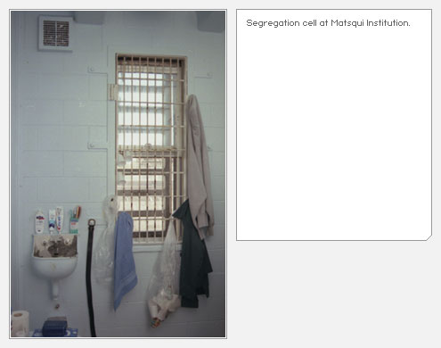
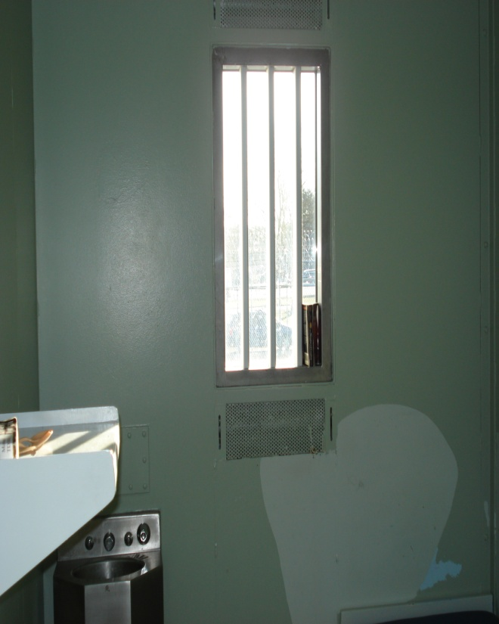
5. Preventing Deaths in Custody
Segregation Cell Retrofit
Before
After

Slide 18
51 Deaths Occurred in Federal Custody in Fiscal Year 2010 – 2011

Slide 19
Preventing Deaths in Custody
Between 1999 and 2009, 533 inmates died in federal custody (376 died in provincial custody).
The OCI identified a number of areas in which lessons learned from in-custody deaths continue to be a challenge for CSC:
  Response to medical emergency.
  Double-bunking assessments and suspension points.
  Monitoring of suicide pre-indicators.
  Management of mentally ill offenders.
  Quality/frequency of security counts and rounds.
  Balancing security requirements against preservation of life principles.
Most common causes of “natural” death in federal custody are heart disease, cardiovascular disease and cancer. Very few terminally ill offenders are released to die with dignity in the community.
Ongoing concerns with the quality of internal Mortality Review reports on natural cause deaths – lacking rigour, analysis and recommendation for improvement.

Slide 20

6. Federally Sentenced Women

Slide 21
The Number of Women Admitted From the Courts to Federal Jurisdiction Has Increased Over The Past Decade

Slide 22
Federally Sentenced Women
The number of women offenders has increased by 40% in last ten years, and 1 in 3 women are of Aboriginal descent.
CSC moving away from the progressive principles of women's Corrections – based on empowering women offenders through providing responsible and meaningful choices.
Areas of challenge:
  Governance structure remains inconsistent with "separate stream" for women's Corrections.
  Inadequate mental health services for women with acute psychological/psychiatric needs, particularly repeat self-harmers.
  Limited access to programming specifically designed to meet needs of women.
  Not enough meaningful employment and employability programming.
  Limited community reintegration options – inadequate accommodation and support for women upon release.
  Use of segregation to manage small number women high-need women – few alternatives available.

Slide 23
Concluding Remarks
The federal Canadian offender profile can be used as a barometer to gauge the successes and failures of key Canadian public policies (Zinger, CJCCJ, 2012), including:
  Access to community mental health services – 36% of male prisoners at intake are assessed as having serious mental health issues requiring psychological or psychiatric services (Wilton 2010).
  Aboriginal self-governance – 17.9% of prisoners are of Aboriginal ancestry but they comprise less than 4% in the Canadian general population (Public Safety Canada 2010; Statistics Canada 2008).
  Diversity in Canadian society – 7.9% of prisoners are black Canadians but they only represent 2.5% in the Canadian general population (Public Safety Canada 2010; Statistics Canada 2009).
  National drug strategy – 75% of prisoners have a history of substance abuse at admission, and substance abuse was directly linked with prisoners’ index offences in 66% of cases (Correctional Service Canada 2010; Weekes, Moser, Ternes and Kunic 2009).

Slide 24
Concluding Remarks (Con’t)
  Education – prisoners have on average a grade 8 education upon admission to penitentiaries (Correctional Service Canada, 2010);
  Harm reduction – 31% of prisoners have Hepatitis C and 4.6% have HIV/AIDS (Zakaria 2010).
  Women in Canadian society – the number of women prisoners have increased by 40% in the last 10 years, and the Aboriginal women offender population has increased by 90% (Correctional Service Canada 2010); and 68% of women offenders have been sexual abused and 86% have been physically abused (McConnell and Taylor 2010).

Slide 25
WWW.OCI-BEC.GC.CA

